Slide 1
Awake, My Soul, Stretch Every Nerve
CHRISTMAS
CM
Words: | Philip Doddridge (1755)
Music: | George F. Handel (1728), Arr. by Lowell Mason (1821)
4/4
D/F# - MI
Verses: 4
Lead - | MI
Alto - | DO
Tenor - | SOL
Bass - | DO
PDHymns.com

Slide 2
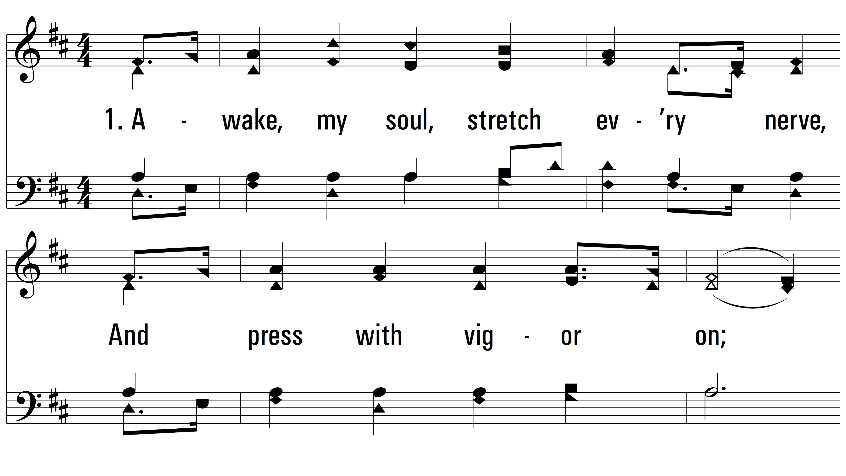
vs. 1 ~ Awake, My Soul, Stretch Every Nerve

Slide 3
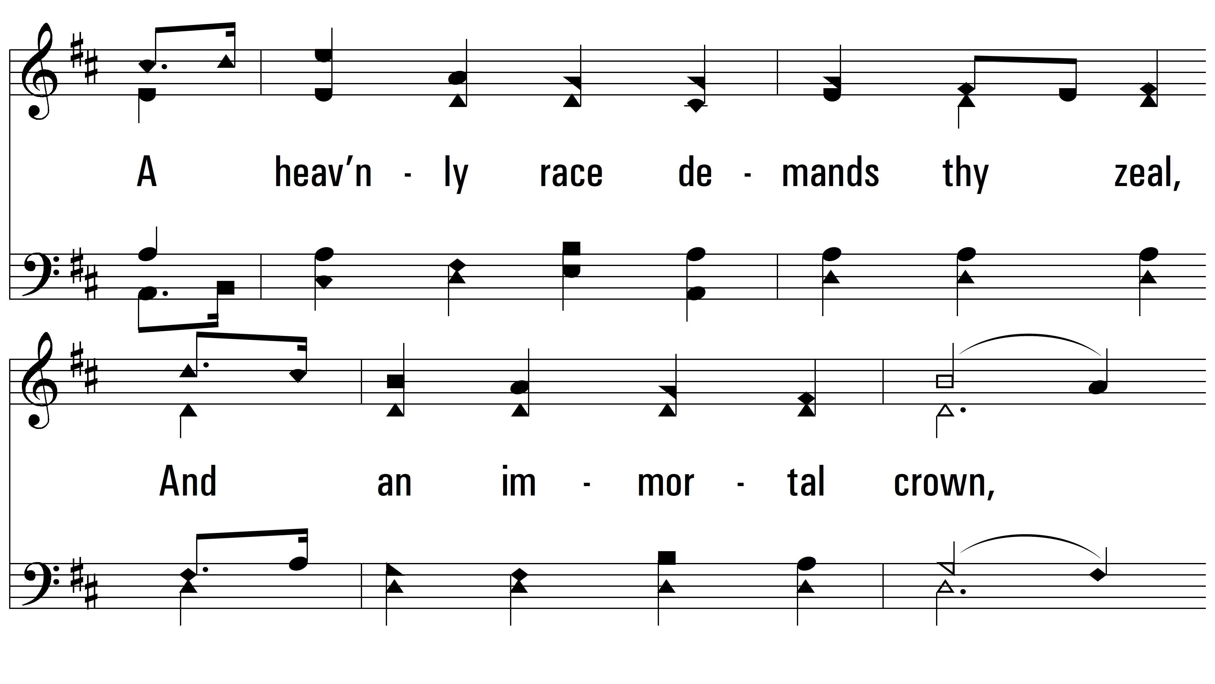
vs. 1

Slide 4
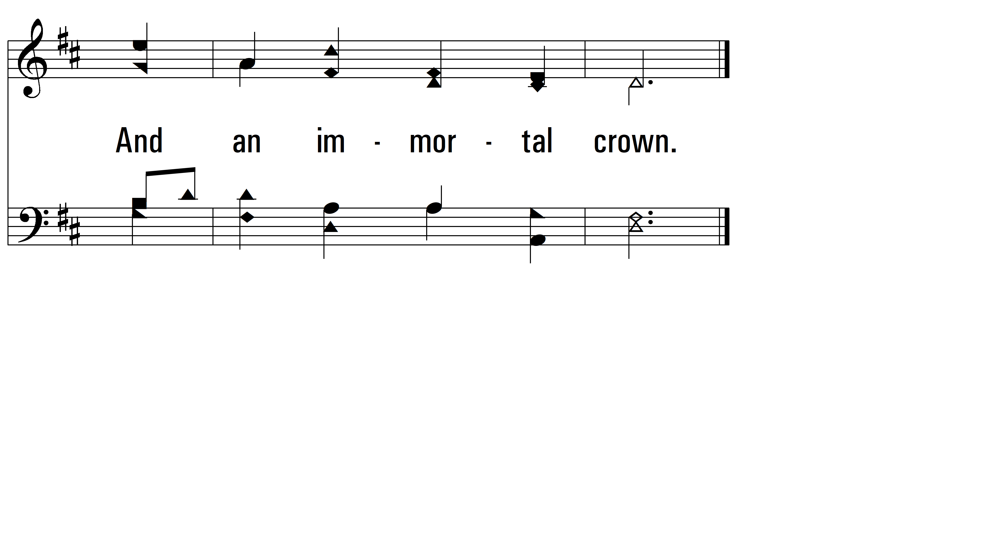
vs. 1

Slide 5
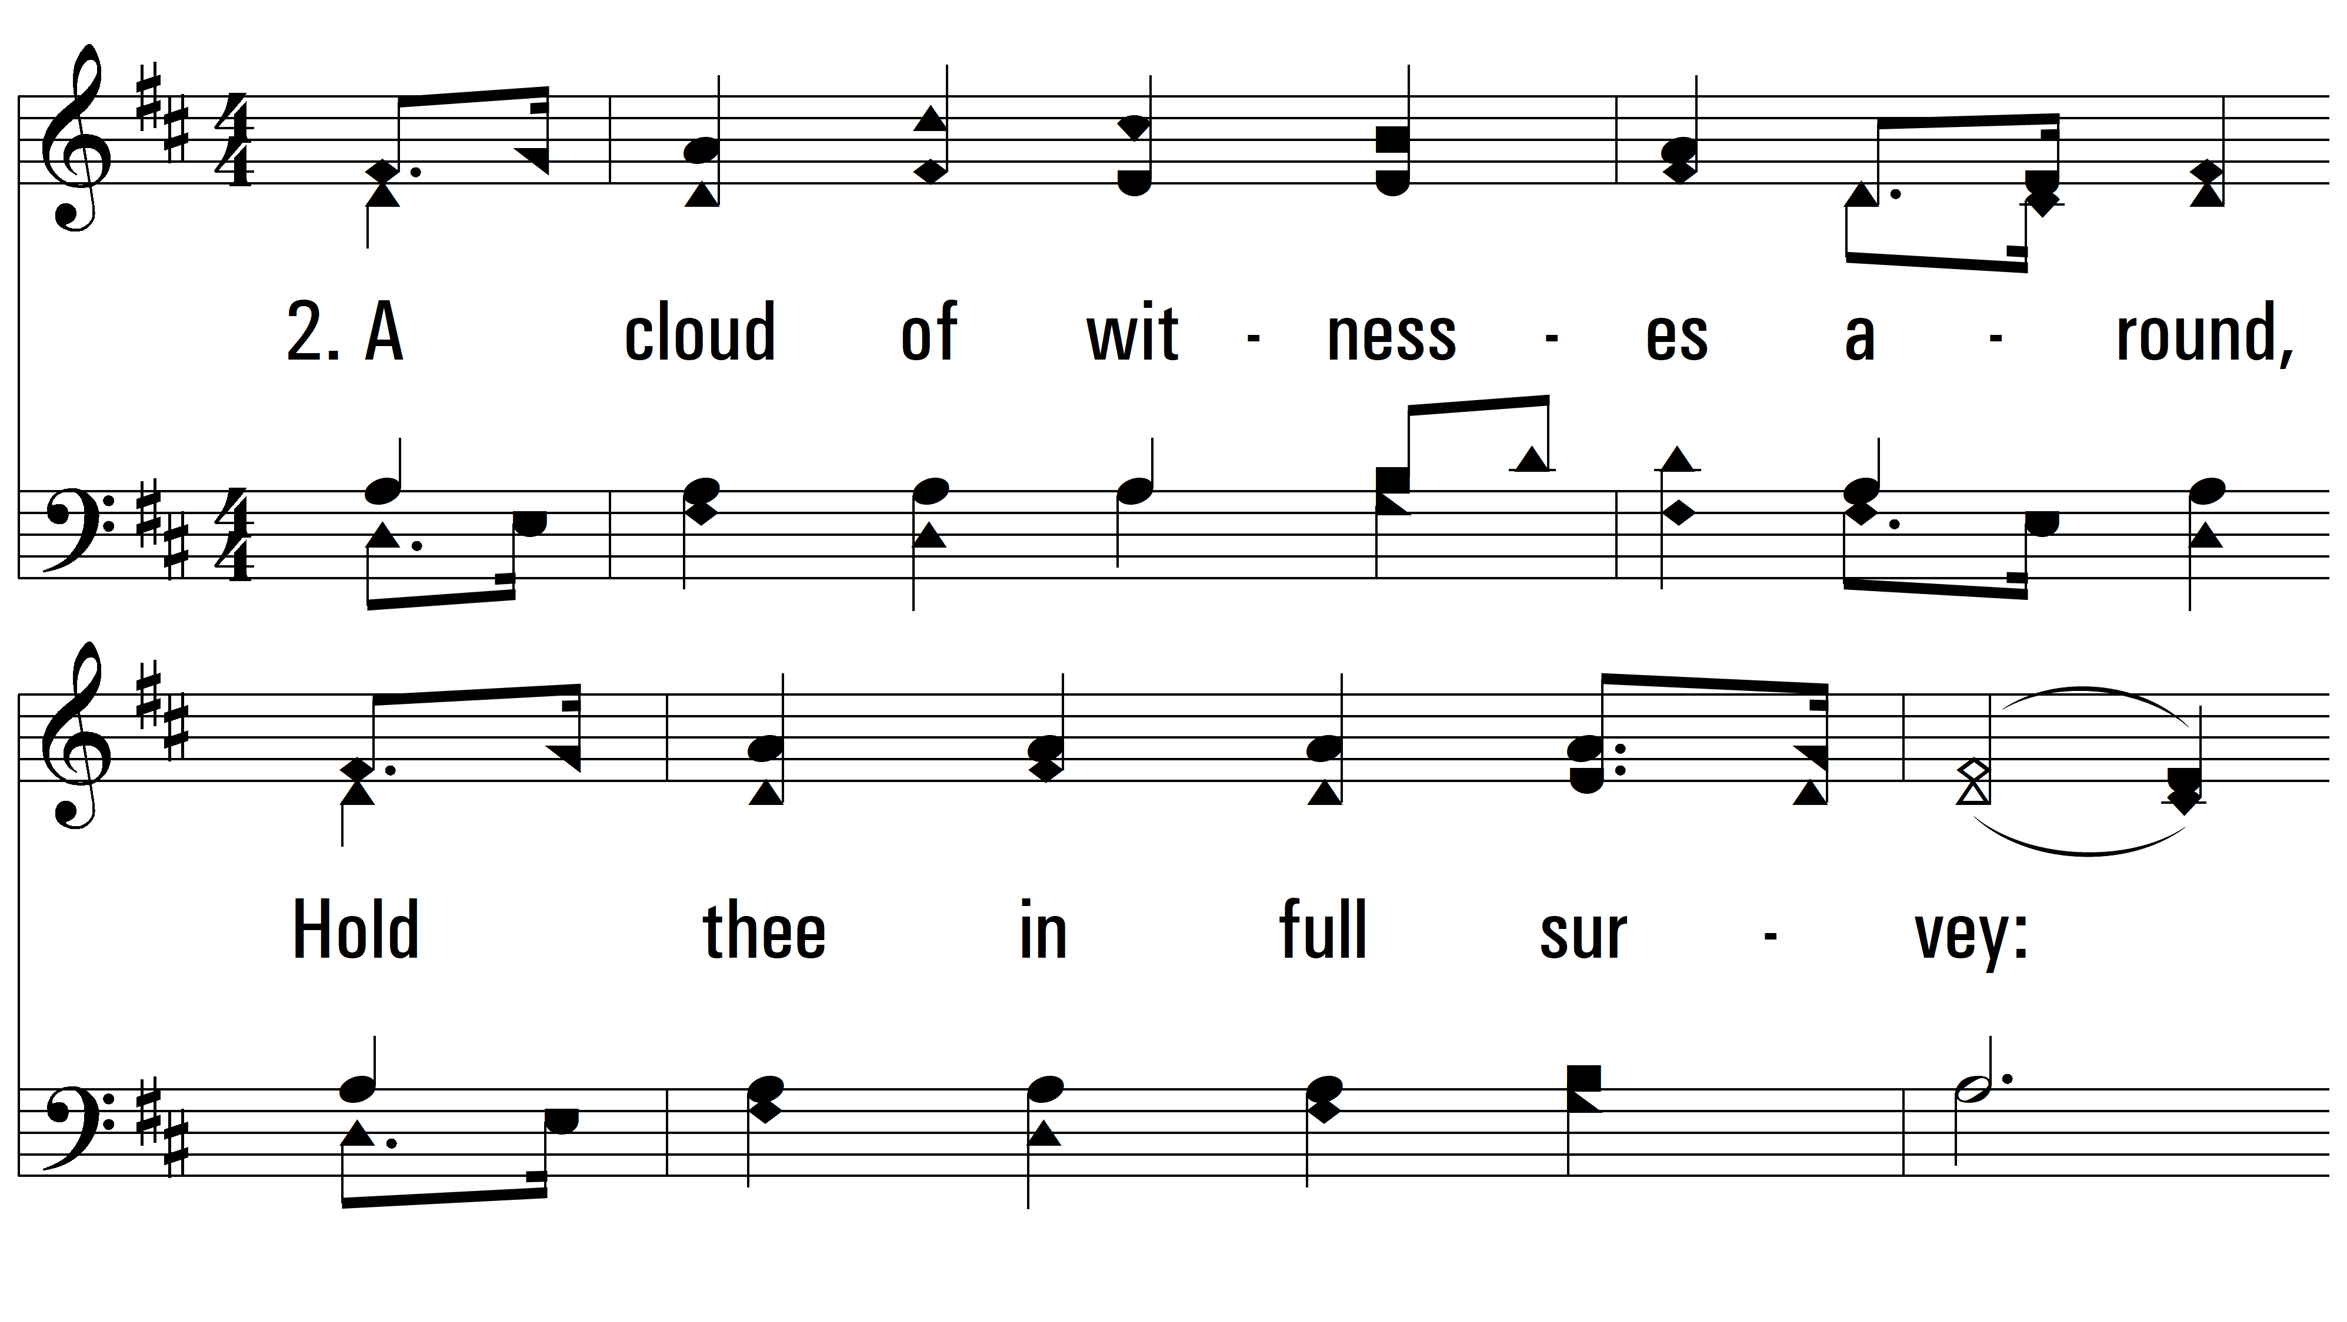
vs. 2 ~ Awake, My Soul, Stretch Every Nerve

Slide 6
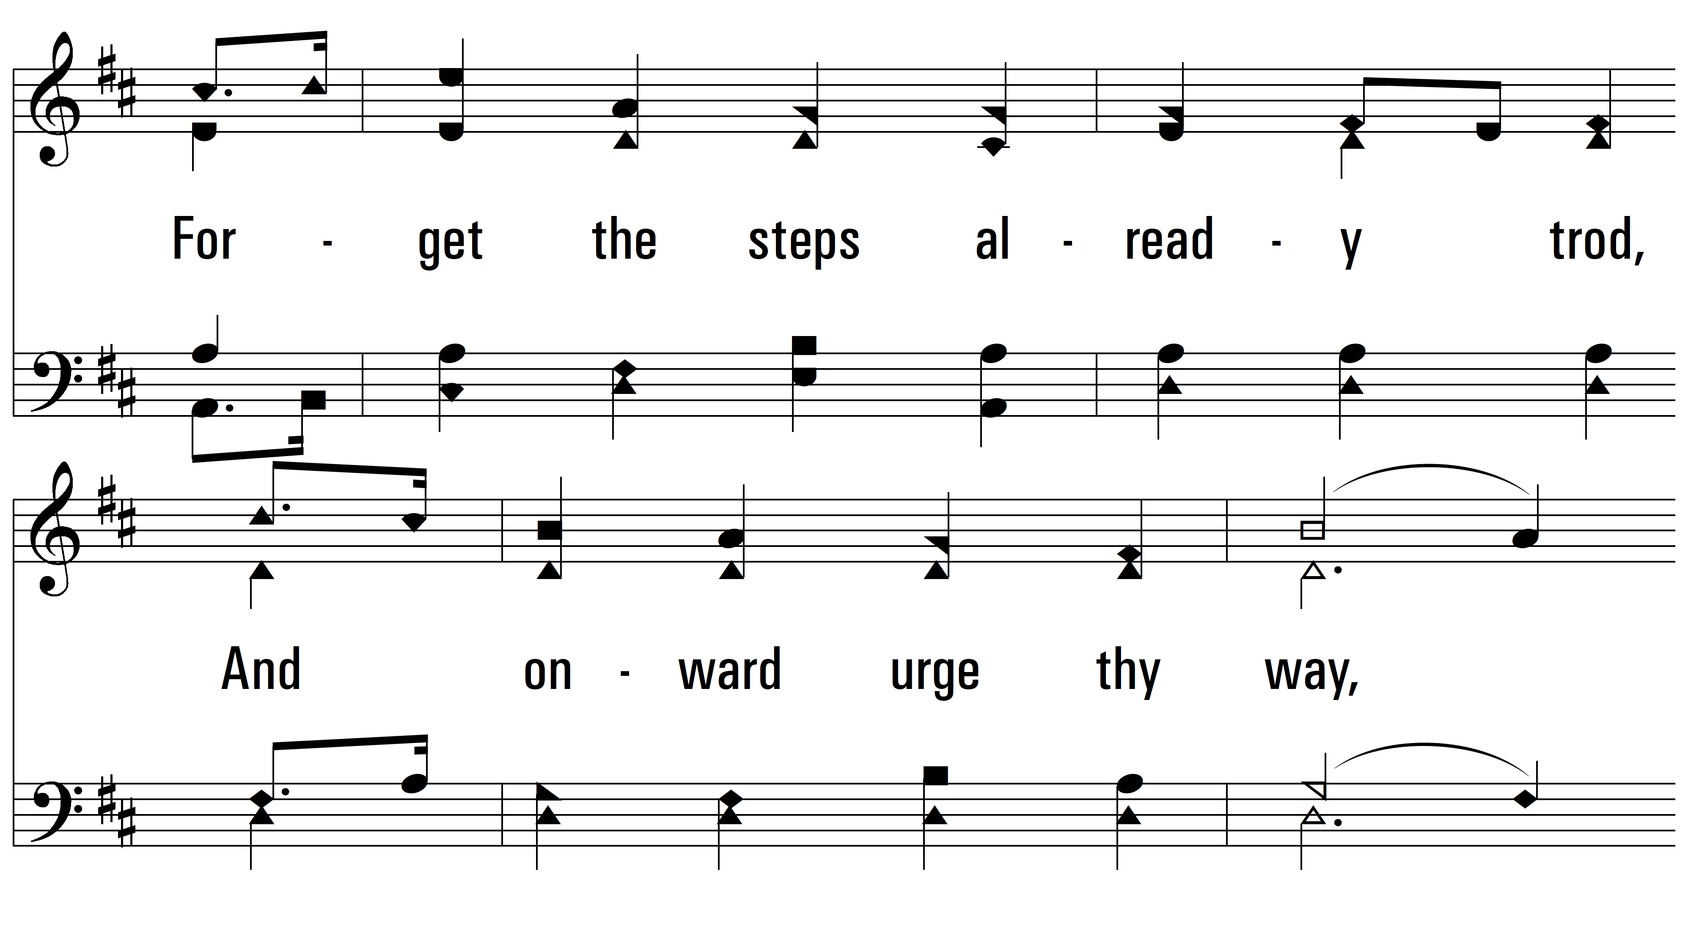
vs. 2

Slide 7
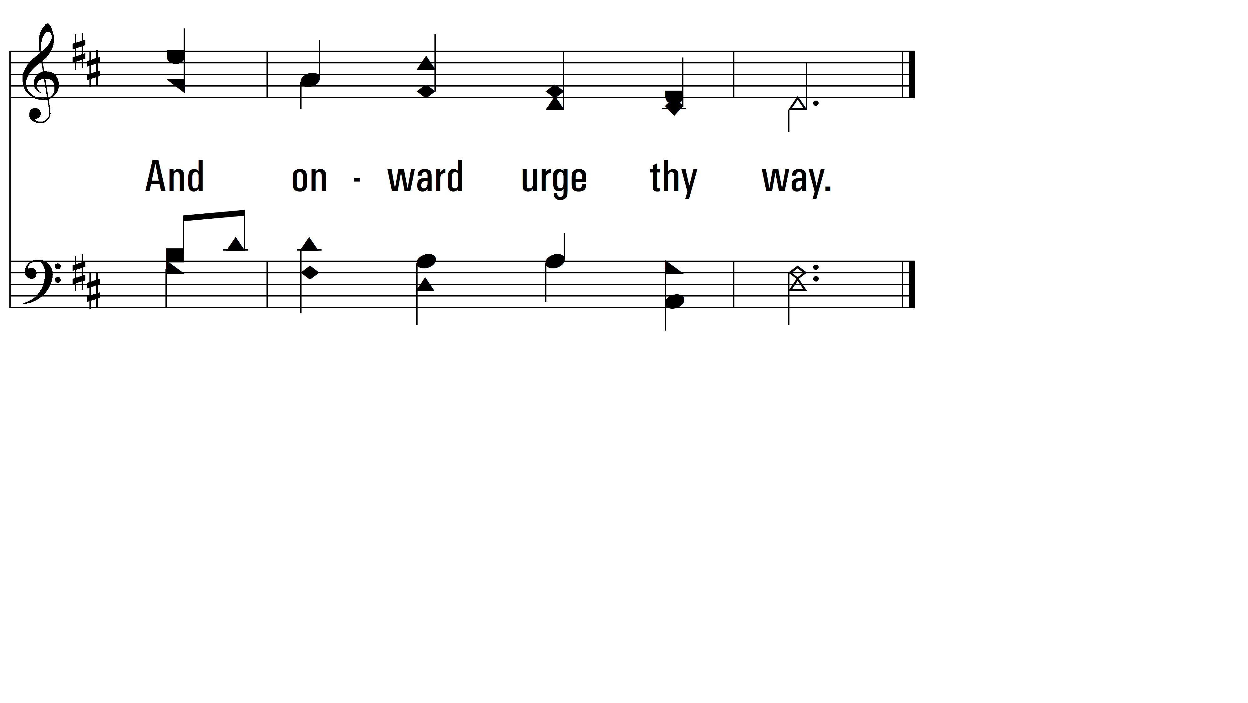
vs. 2

Slide 8
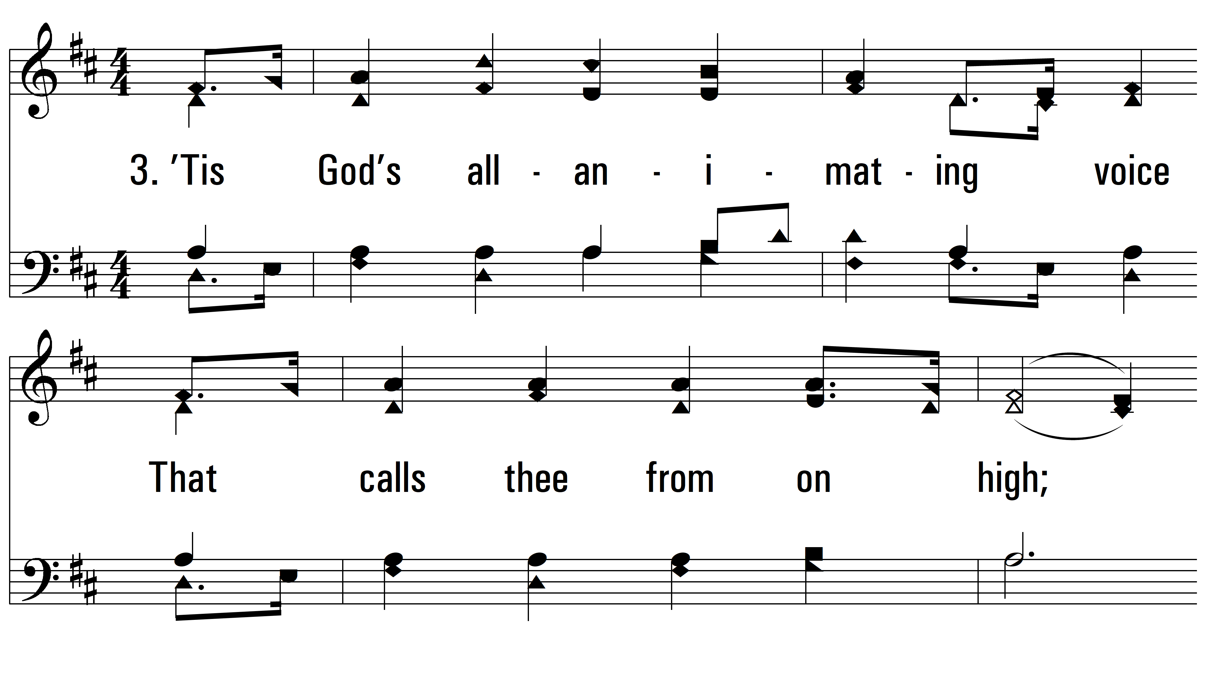
vs. 3 ~ Awake, My Soul, Stretch Every Nerve

Slide 9
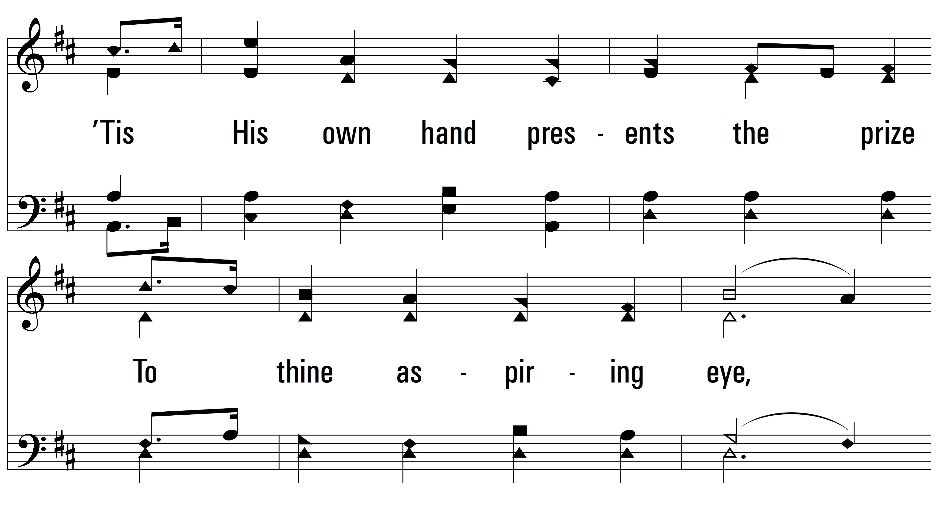
vs. 3

Slide 10
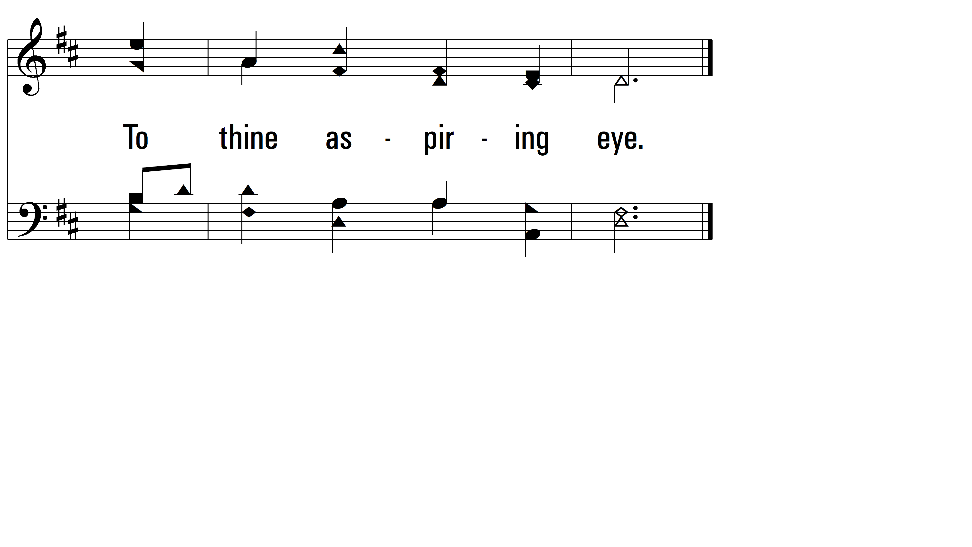
vs. 3

Slide 11
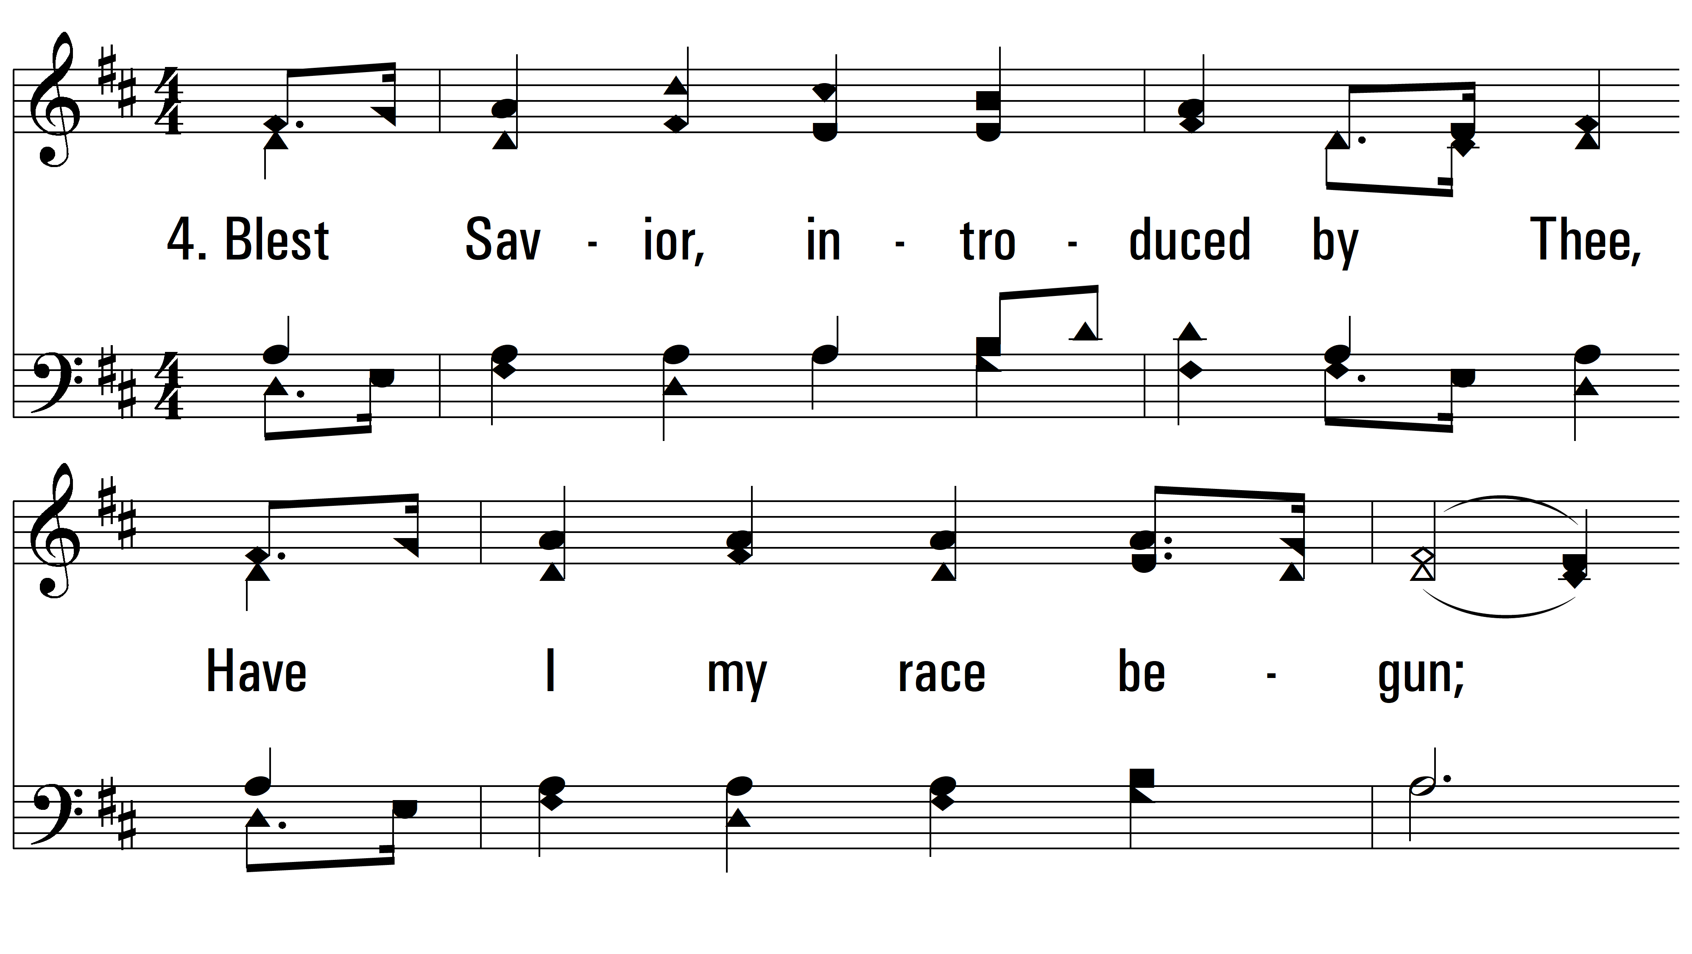
vs. 4 ~ Awake, My Soul, Stretch Every Nerve

Slide 12
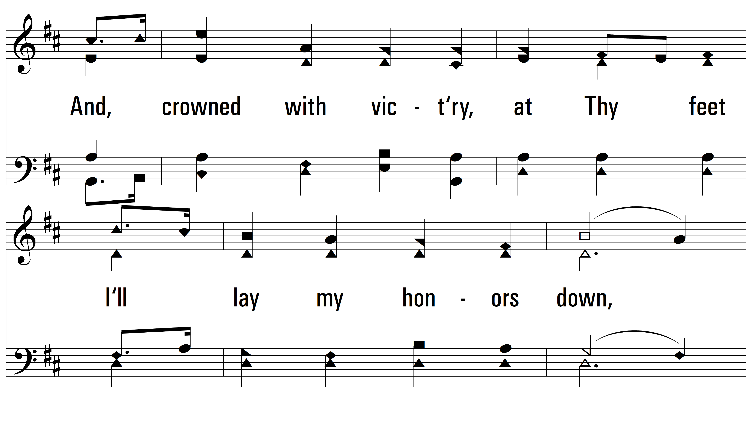
vs. 4

Slide 13
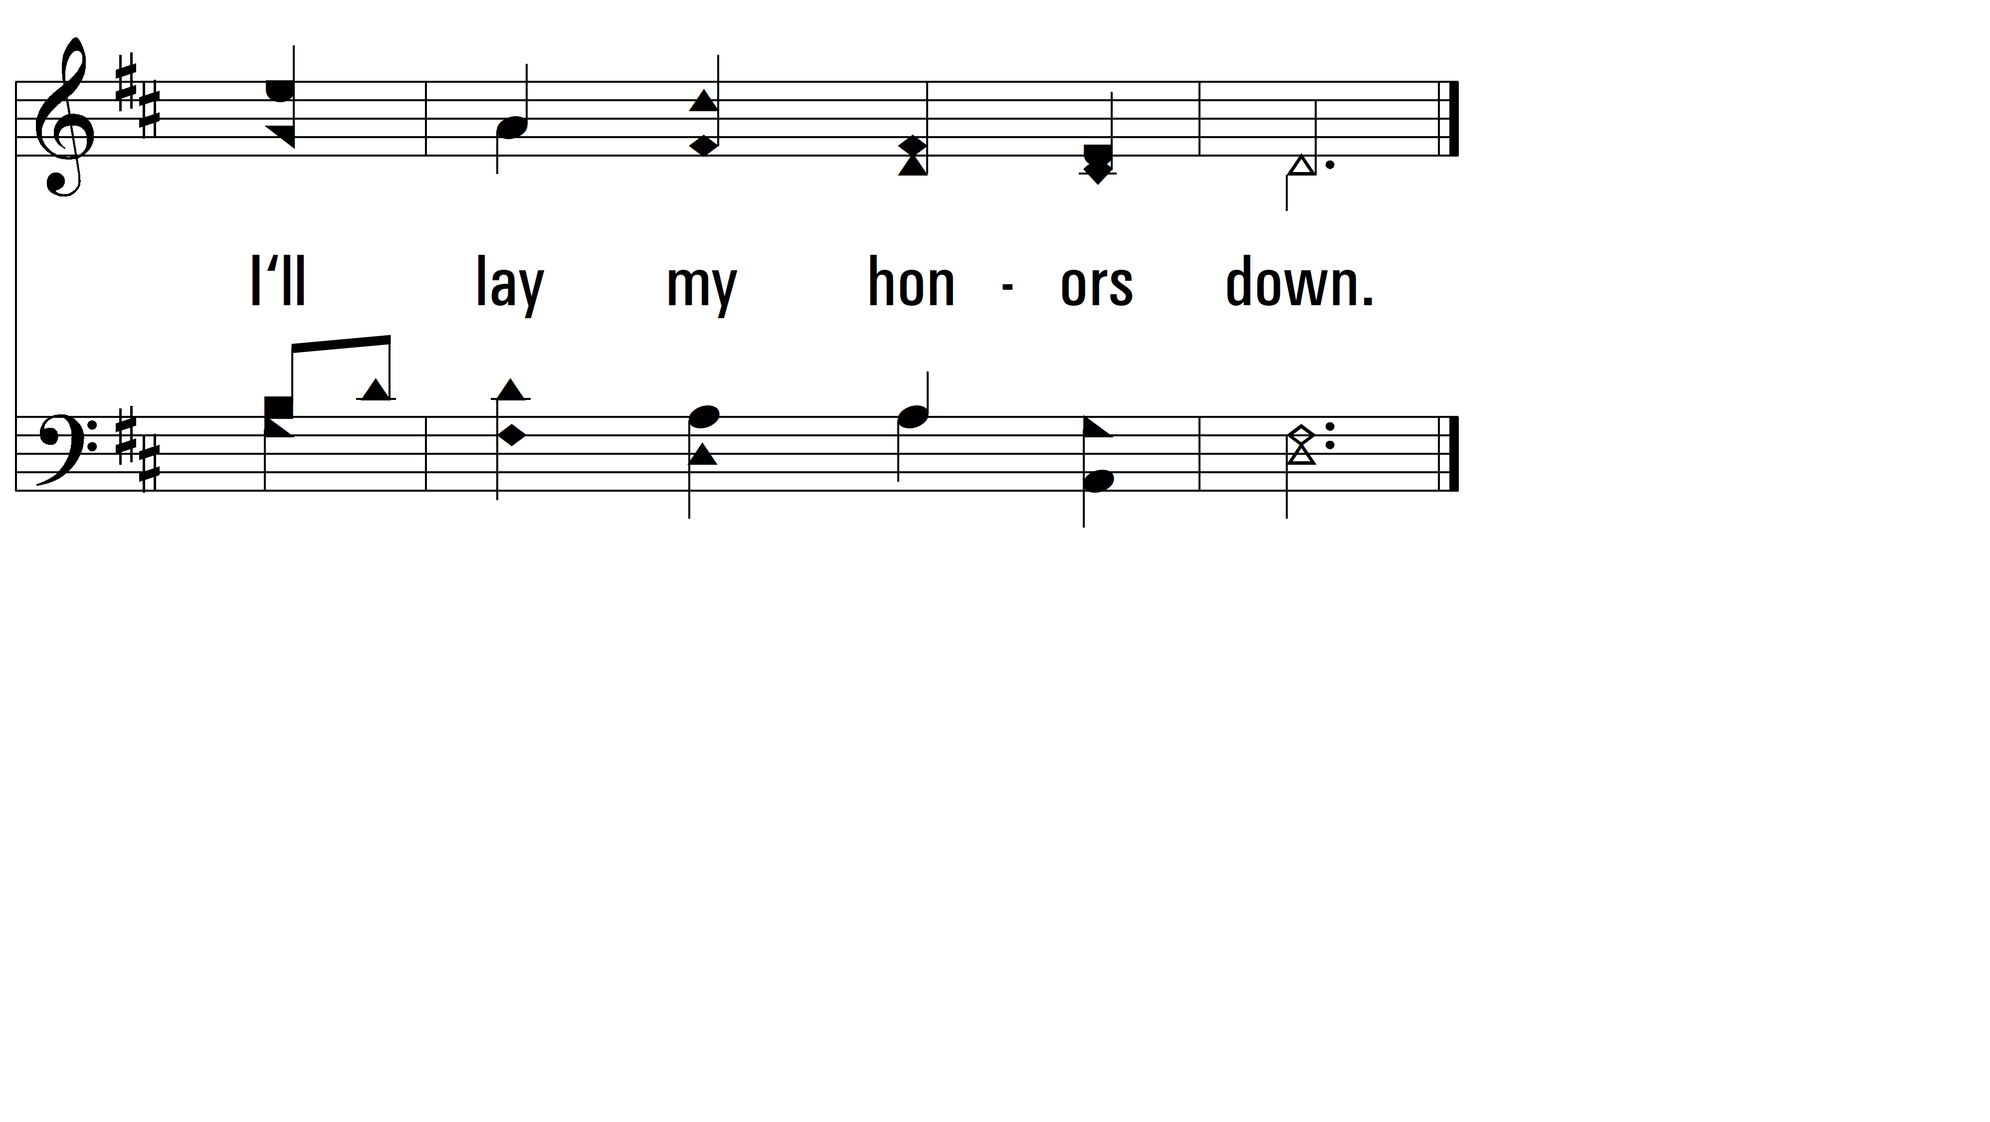
vs. 4
PDHymns.com
END

