Slide 1
Awake, And Sing The Song
ST. THOMAS
SM
Words: | William Hammond (1745)
Music: | Aaron Williams (1763)
4/4
G/D - SOL
Verses: 4
Lead - | SOL
Alto - | SOL
Tenor - | SOL
Bass - | SOL
PDHymns.com

Slide 2
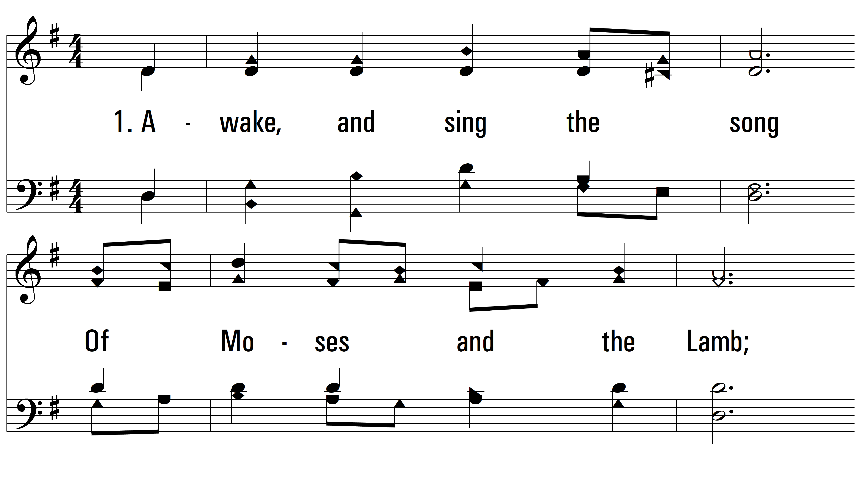
vs. 1 ~ Awake, And Sing The Song

Slide 3
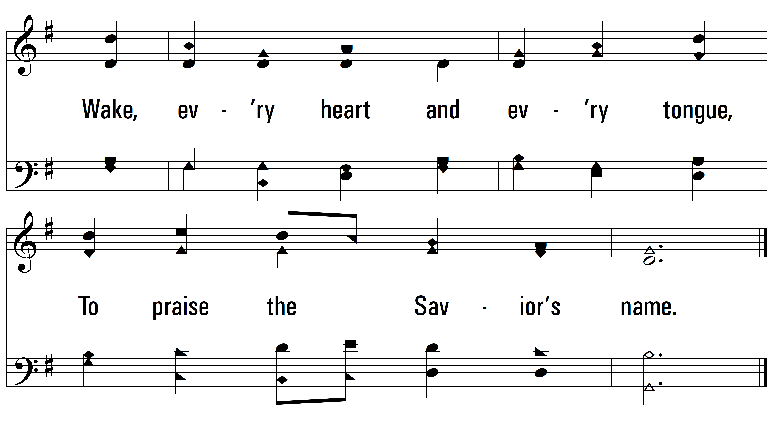
vs. 1

Slide 4
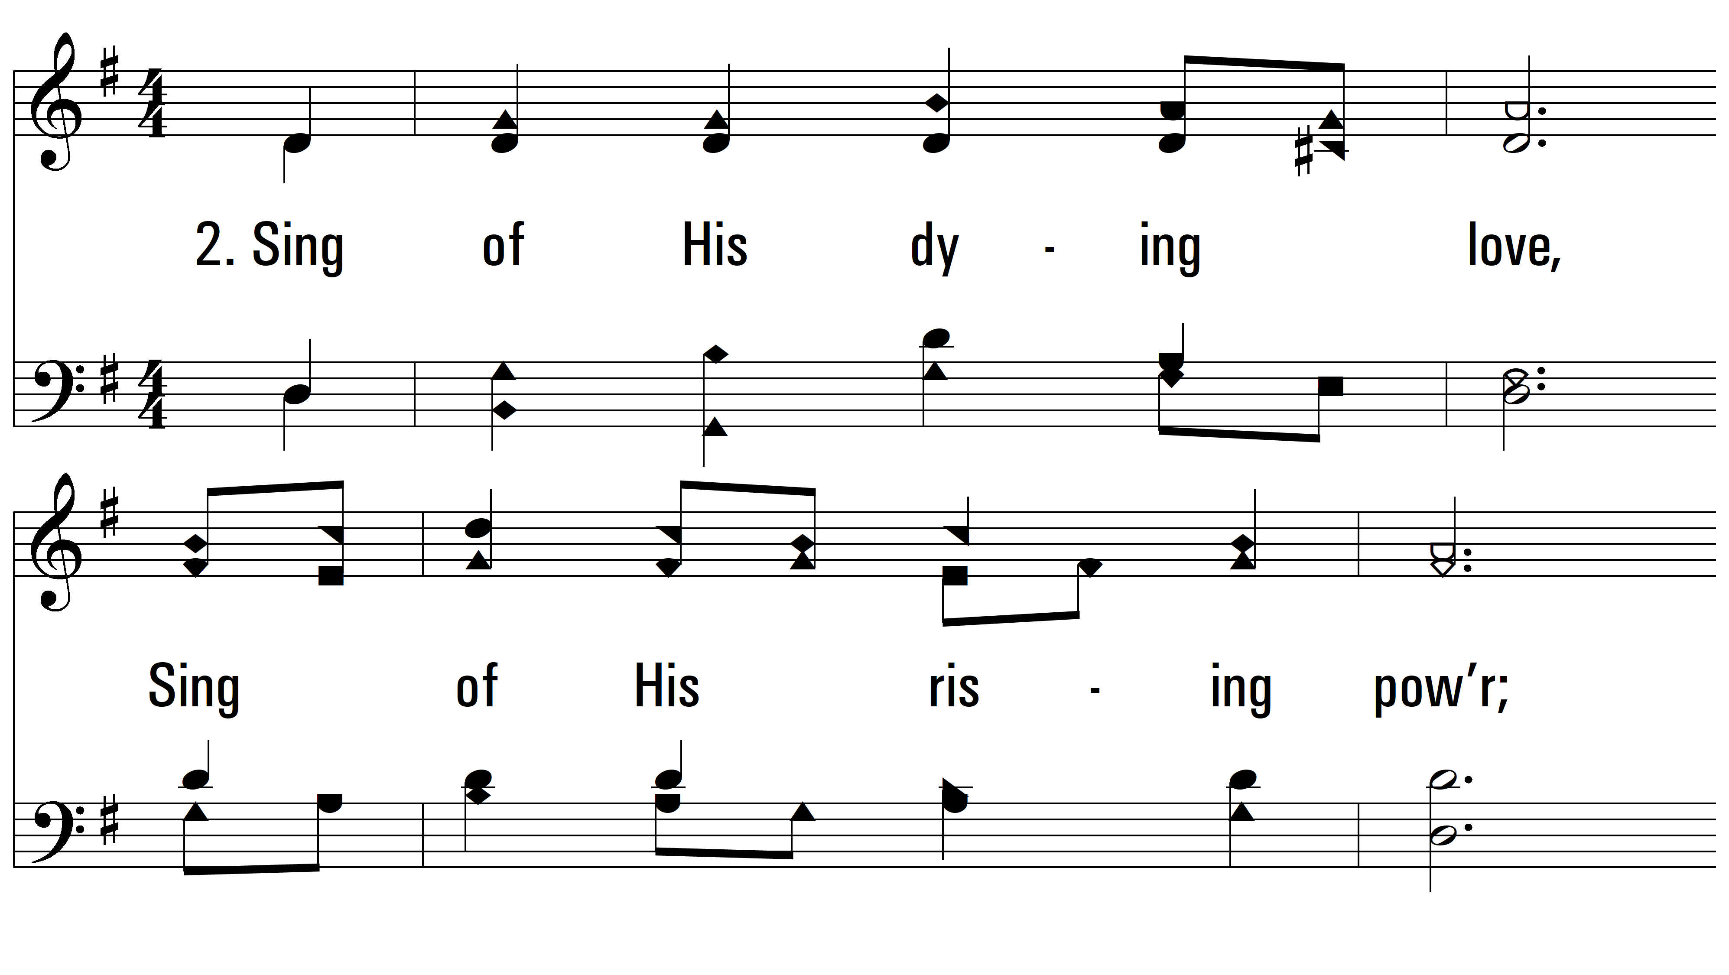
vs. 2 ~ Awake, And Sing The Song

Slide 5
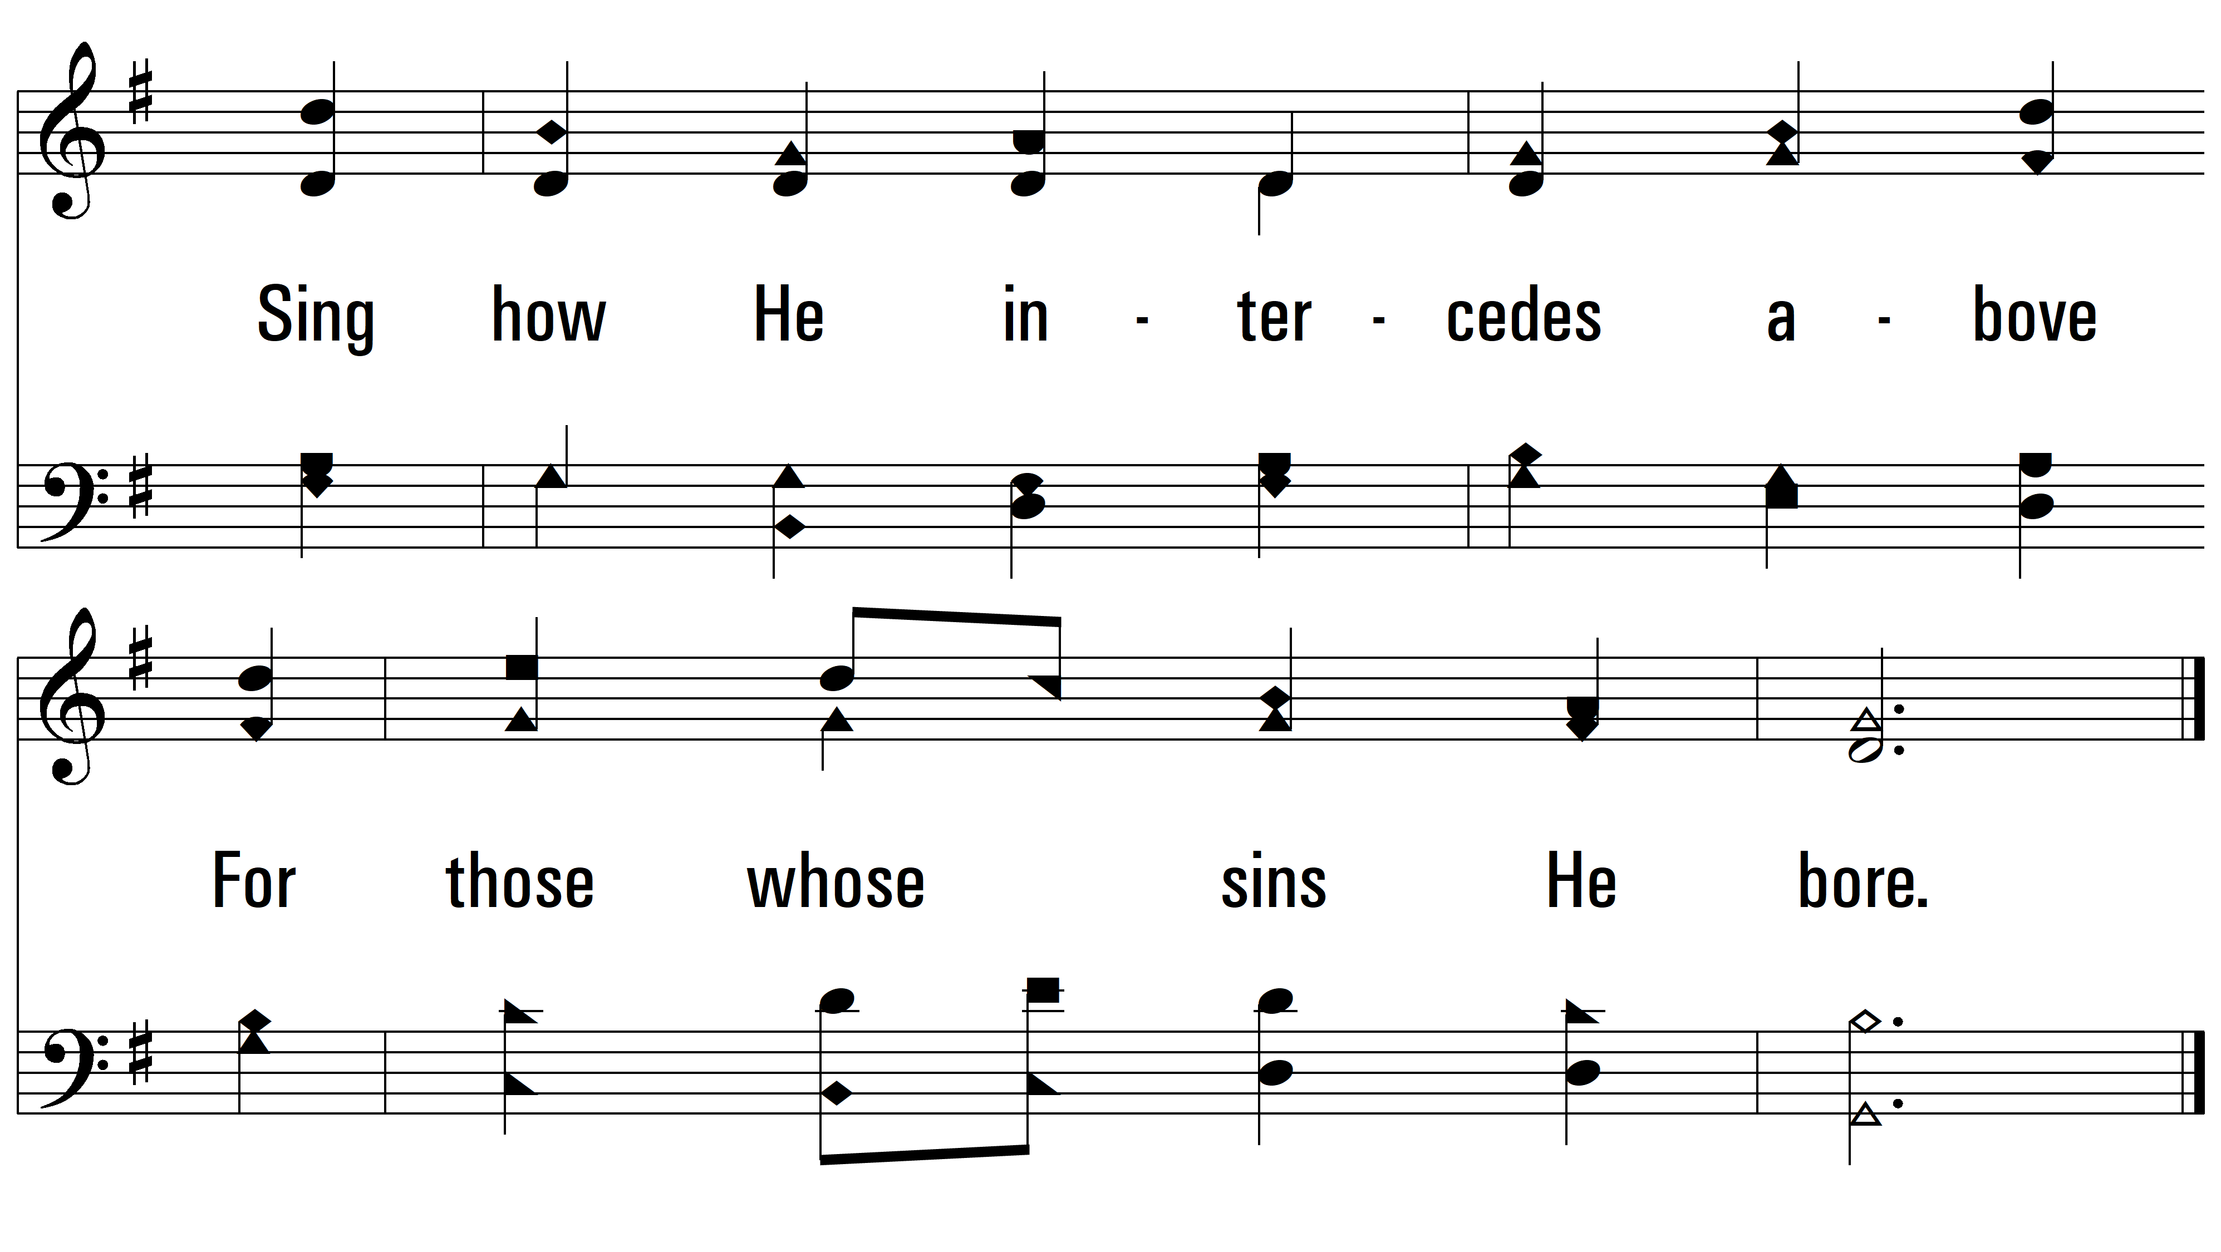
vs. 2

Slide 6
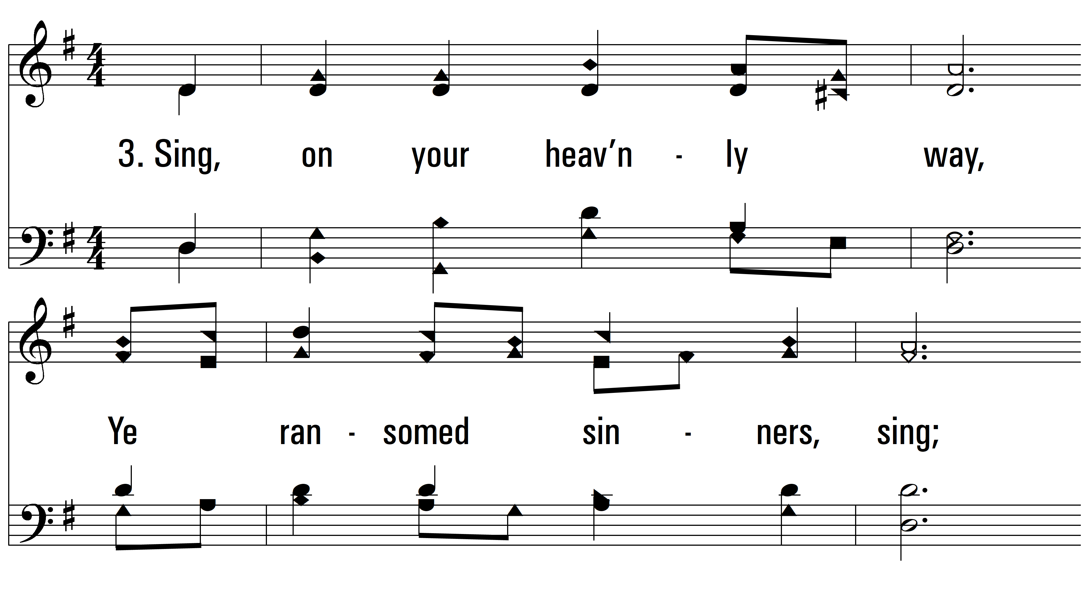
vs. 3 ~ Awake, And Sing The Song

Slide 7
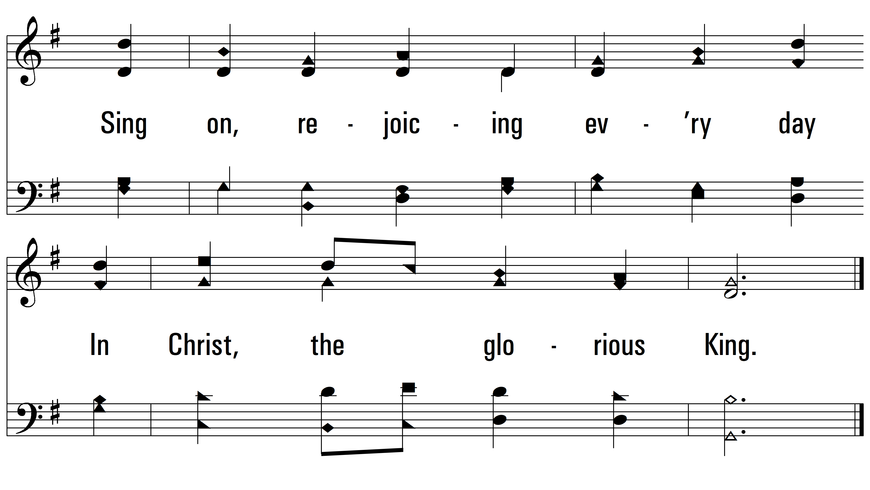
vs. 3

Slide 8
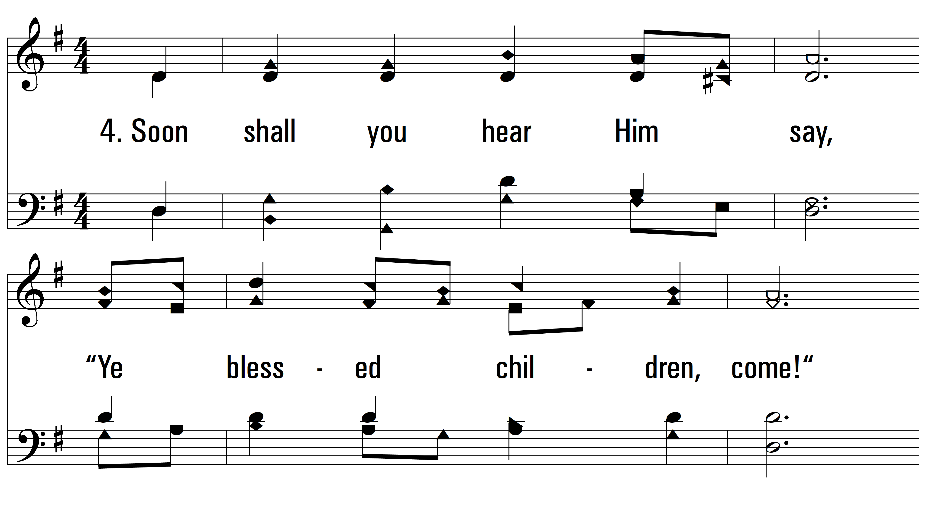
vs. 4 ~ Awake, And Sing The Song

Slide 9
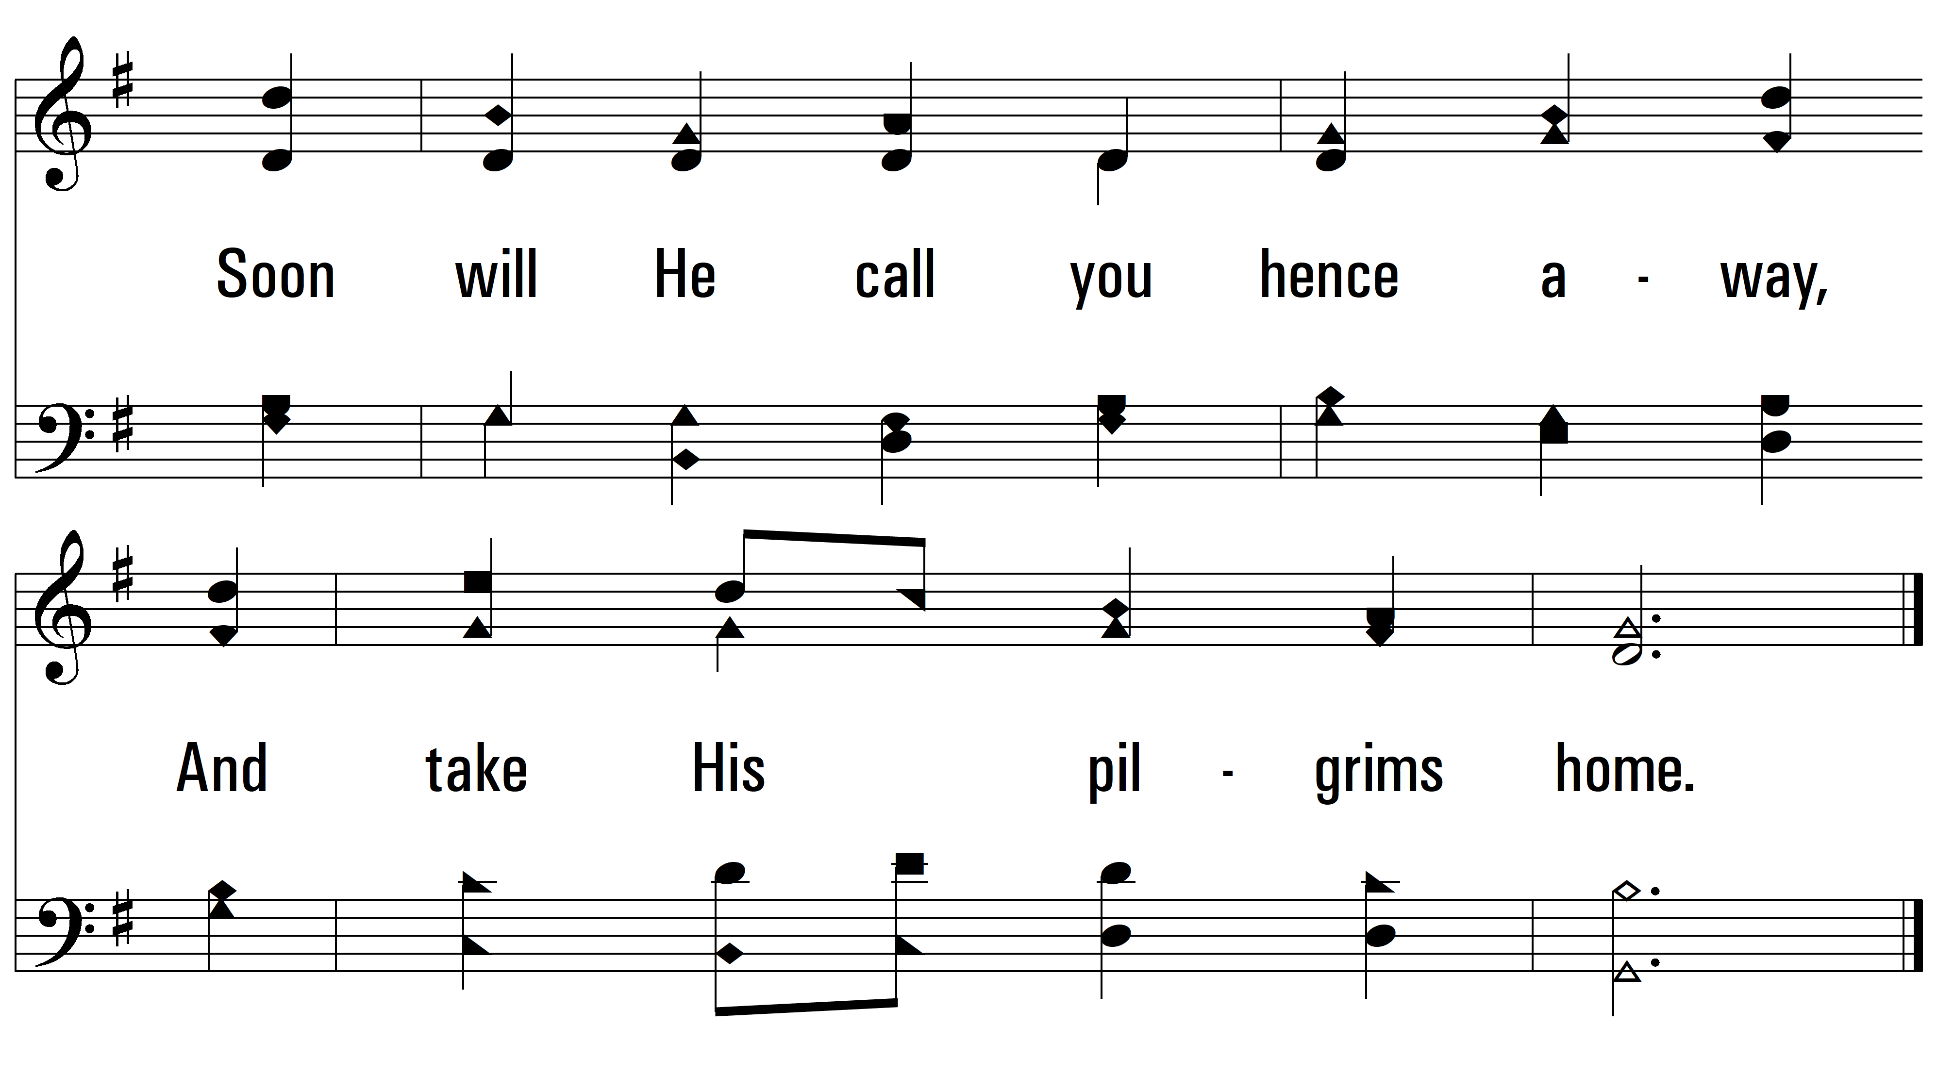
vs. 4
PDHymns.com
END

