Slide 1
Are You Coming To Jesus Tonight?
Words: | Jessie F. Brown (1889)
Music: | J. E. Hawes (1889)
4/4
E^{b}/B^{b} - SOL
Verses: 3/Chorus
Lead - | SOL
Alto - | MI
Tenor - | SOL
Bass - | DO
PDHymns.com

Slide 2
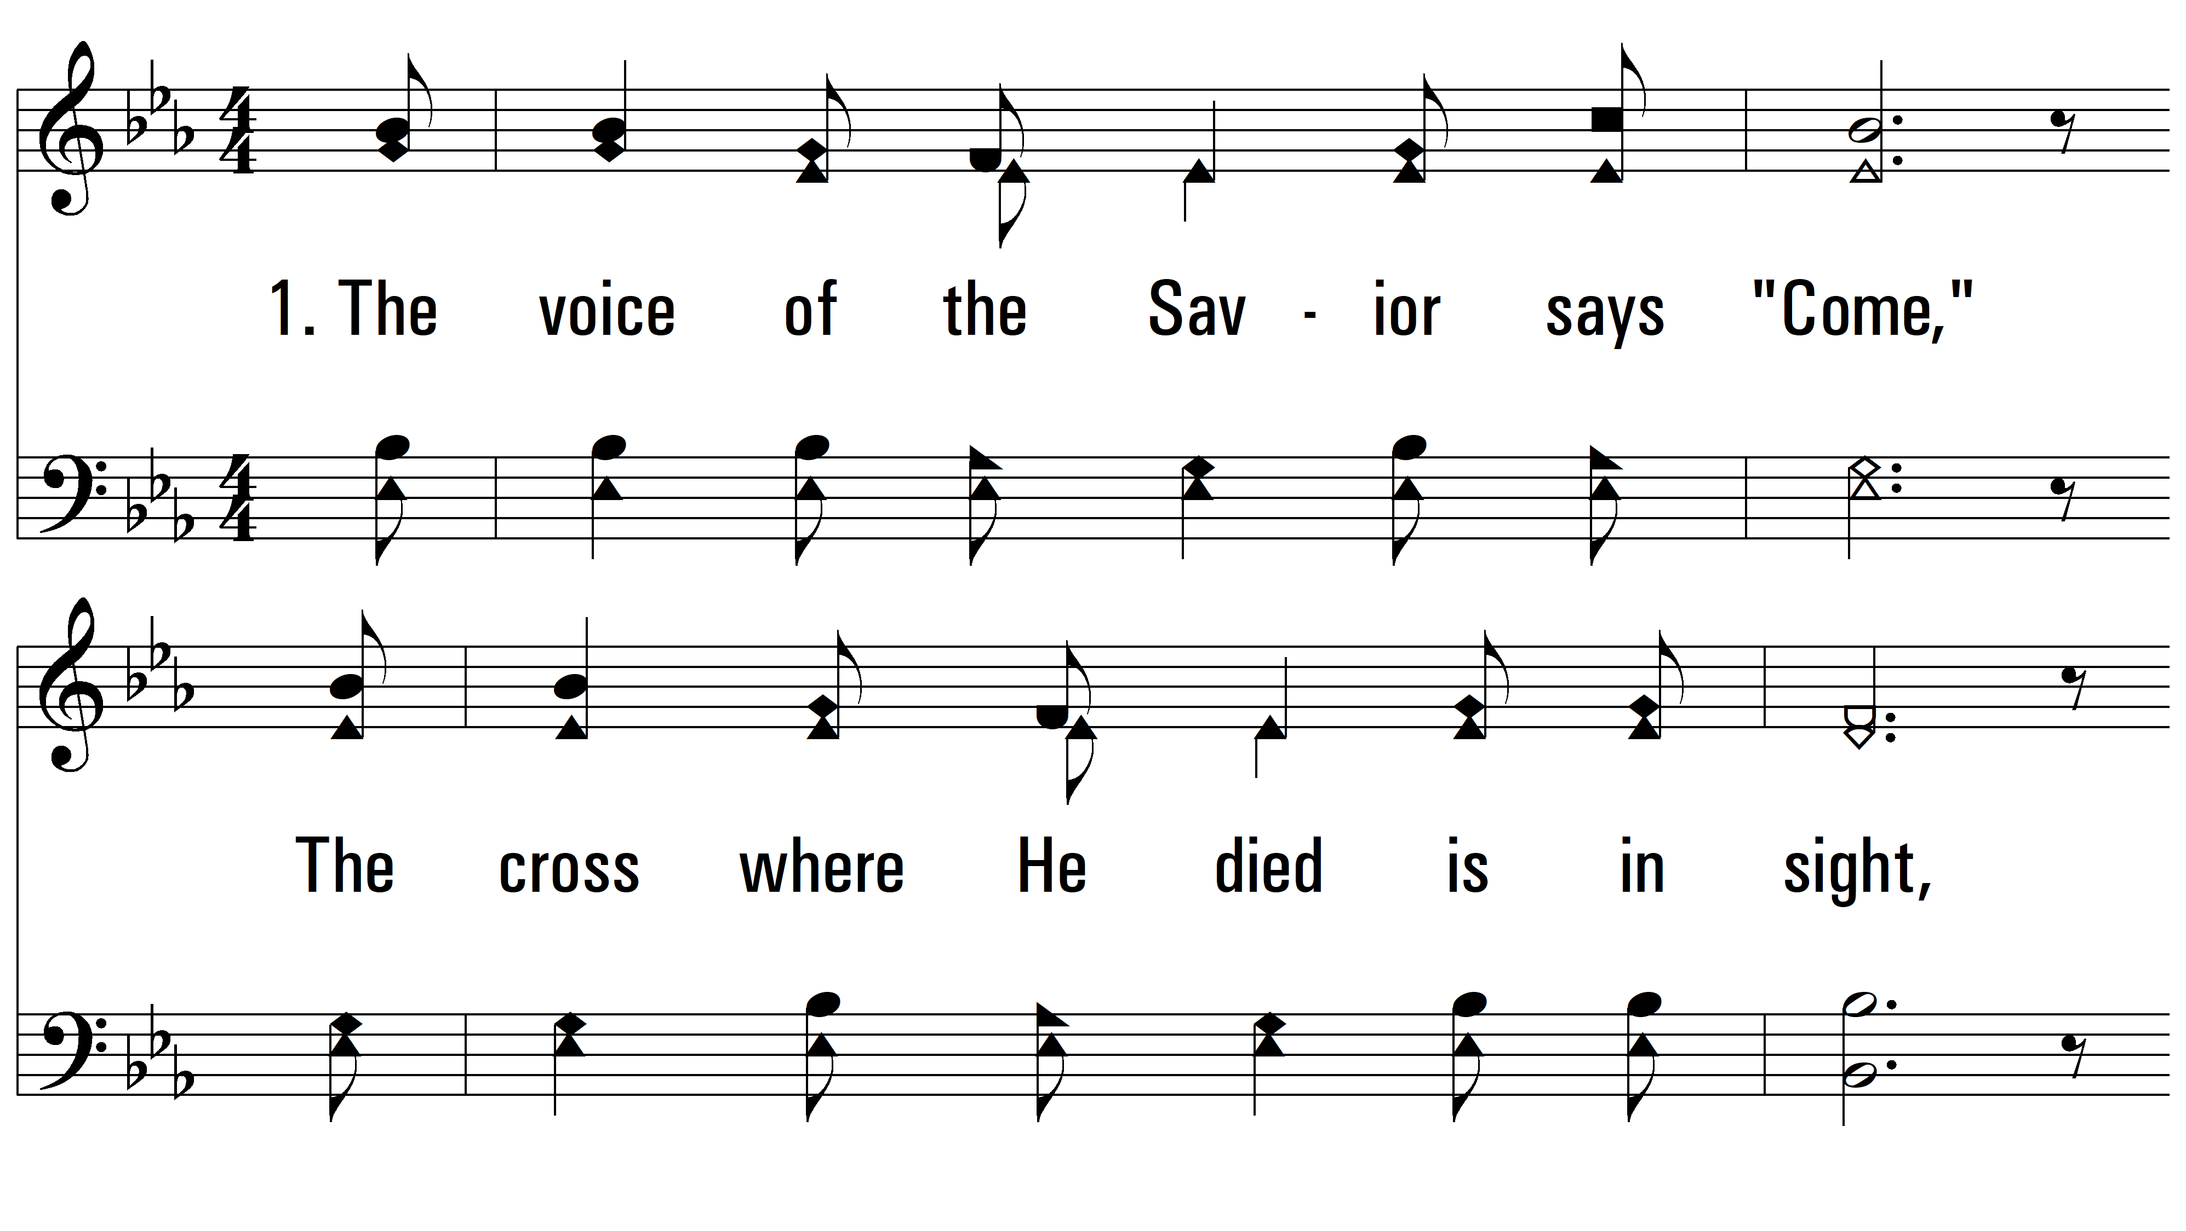
vs. 1 ~ Are You Coming To Jesus Tonight?

Slide 3
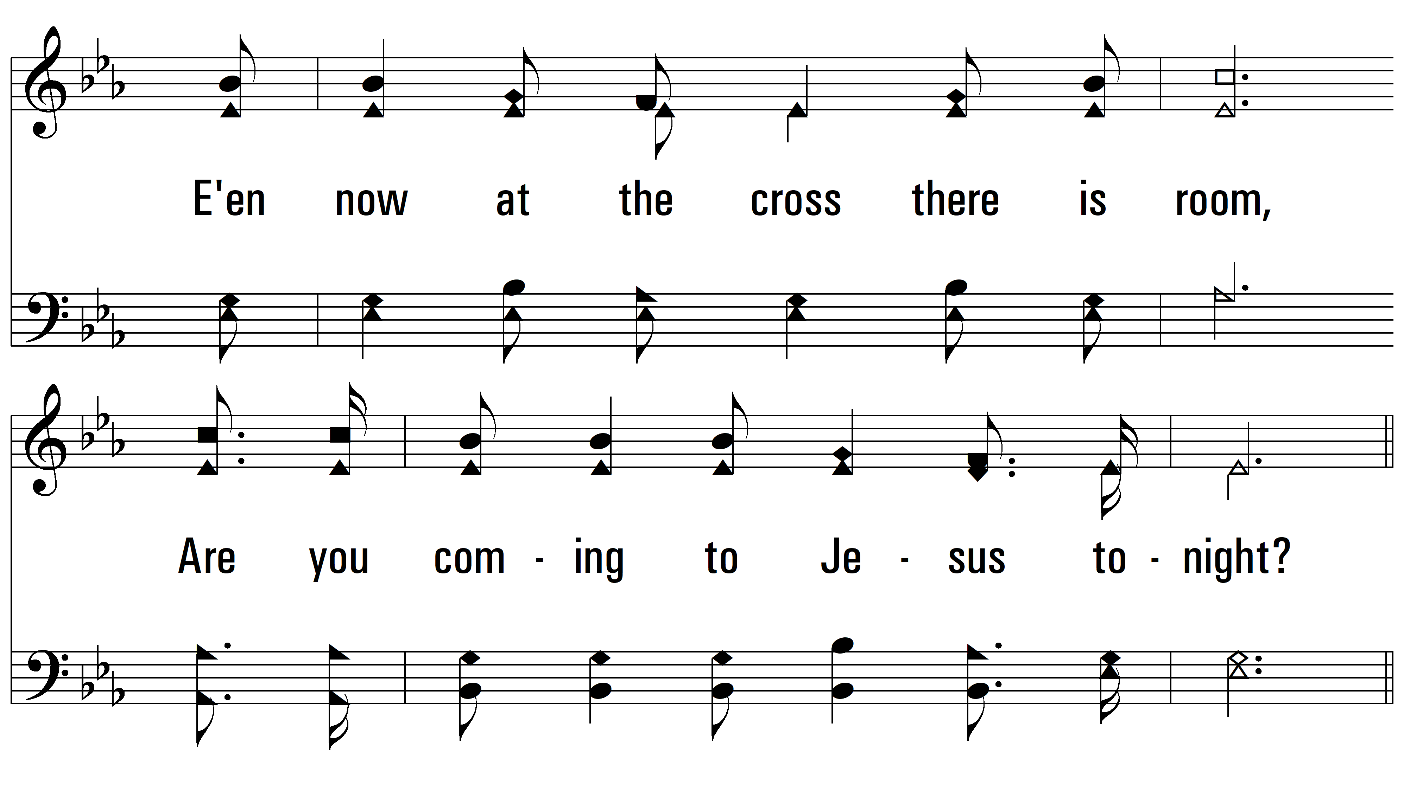
vs. 1

Slide 4
vs. 1

Slide 5
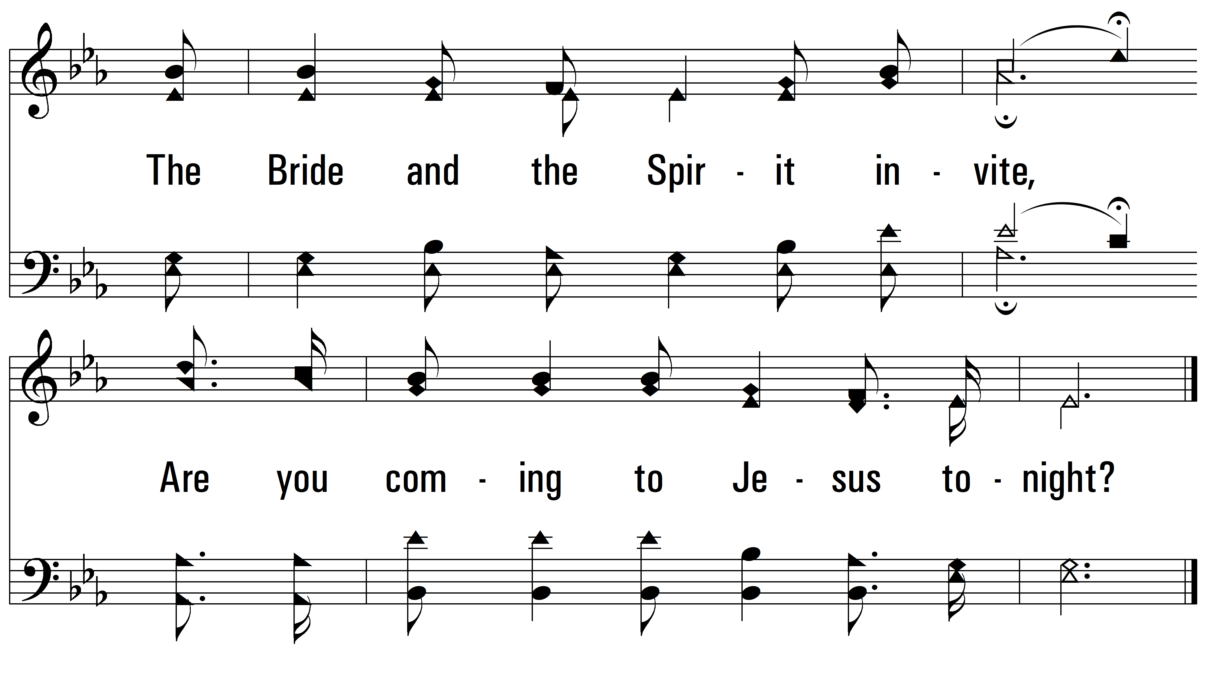
vs. 1

Slide 6
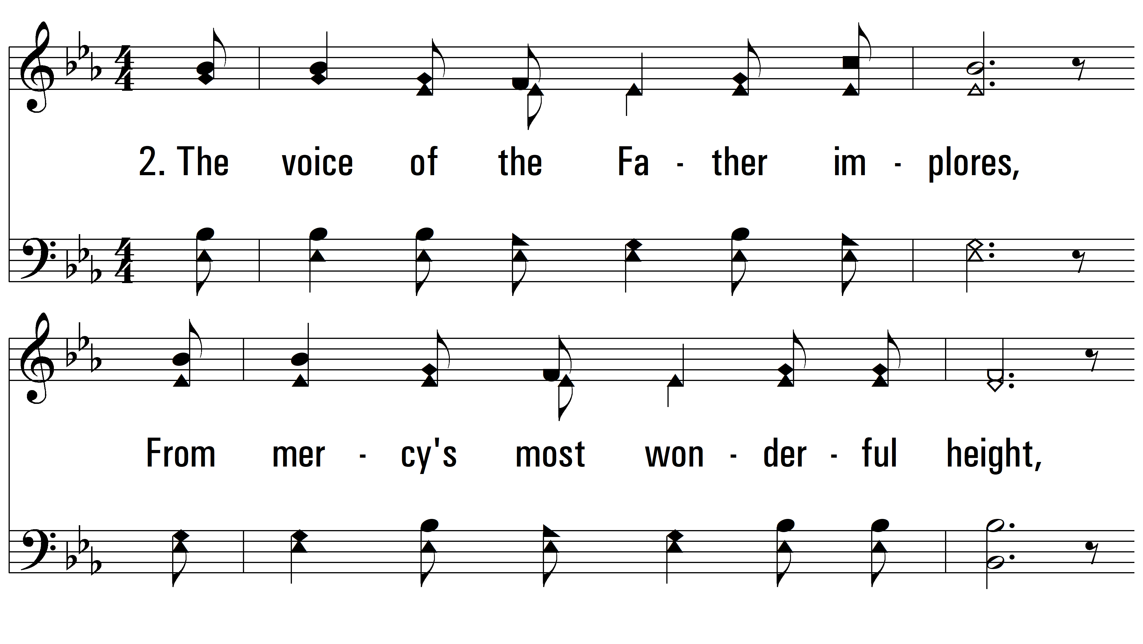
vs. 2 ~ Are You Coming To Jesus Tonight?

Slide 7
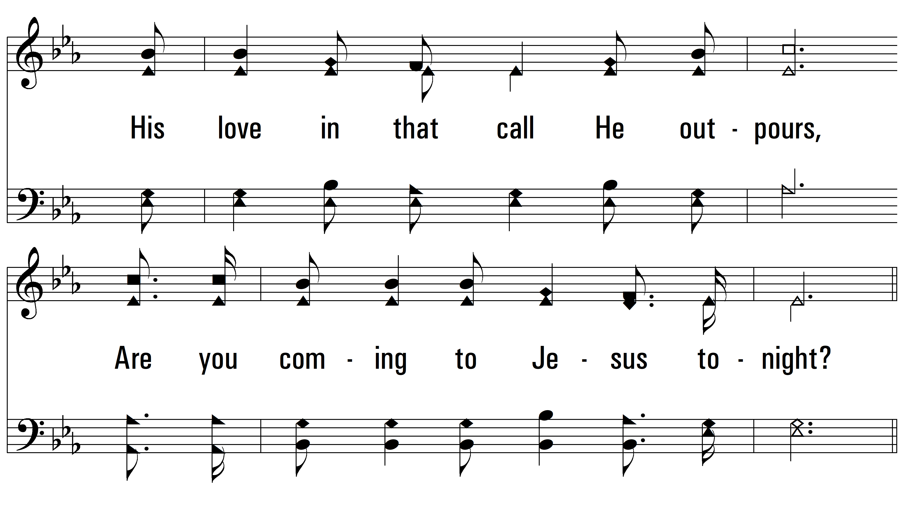
vs. 2

Slide 8
vs. 2

Slide 9
vs. 2

Slide 10
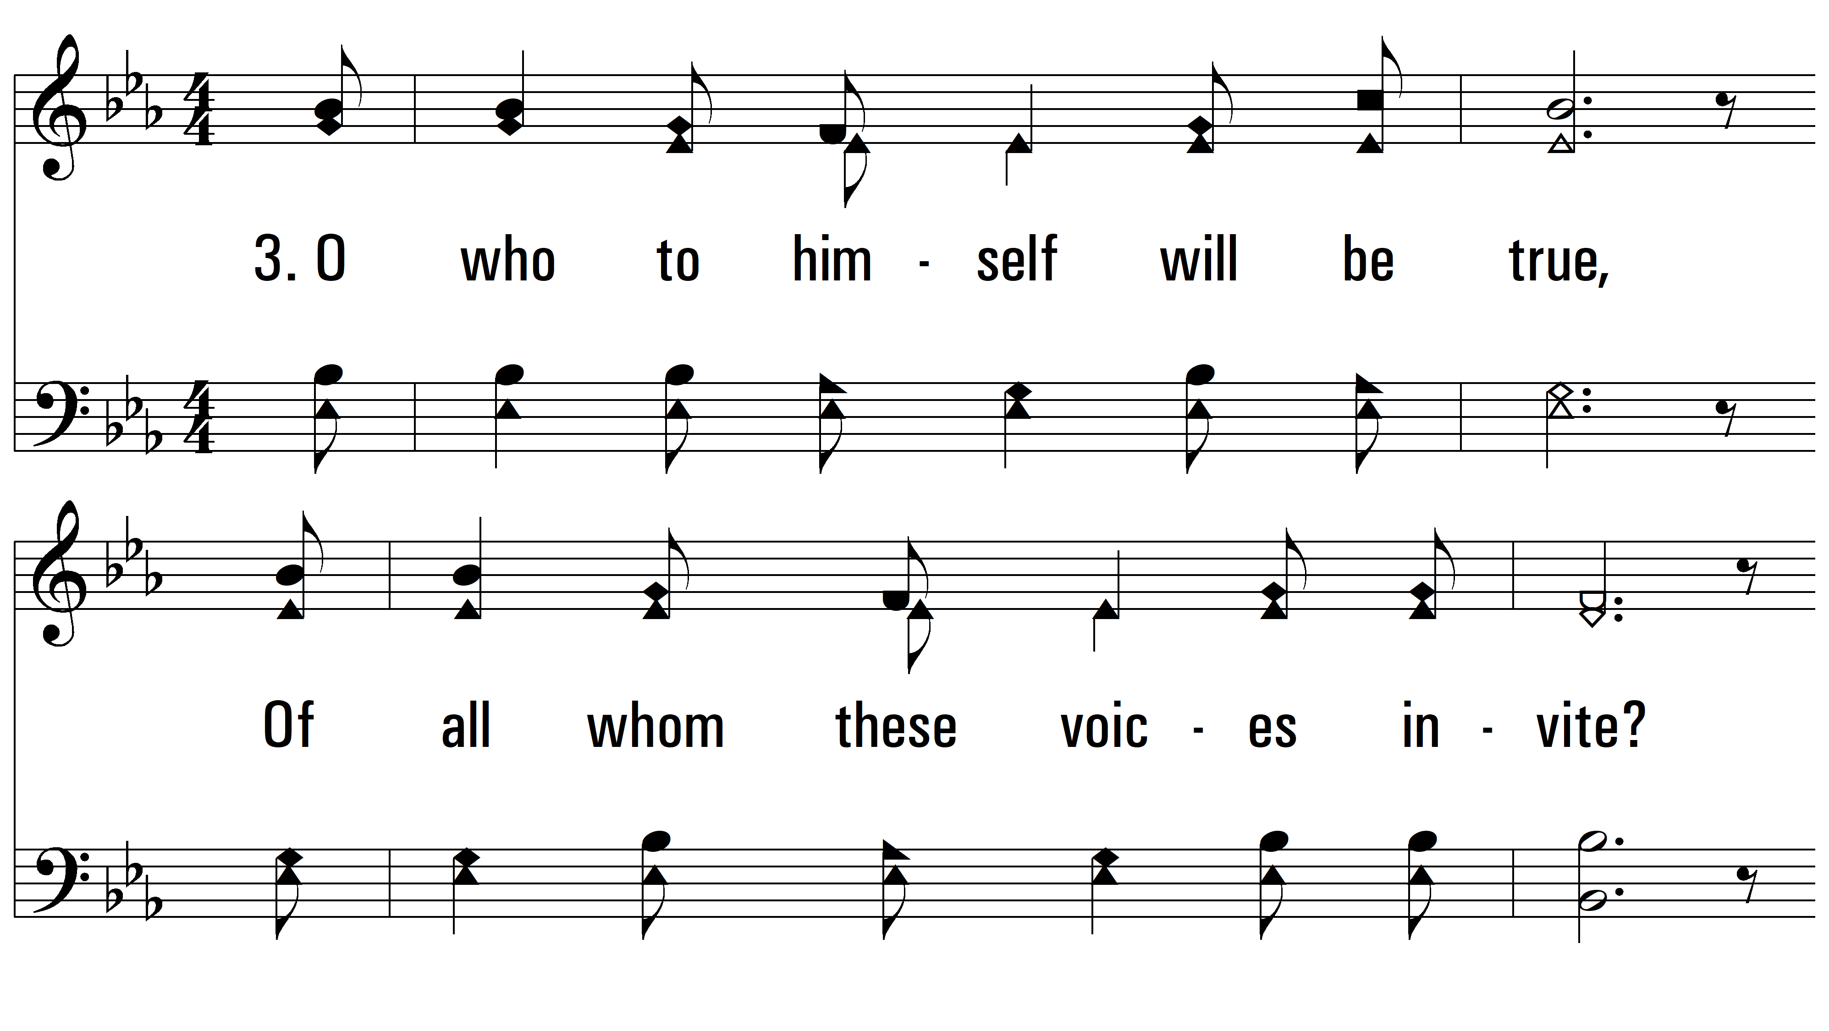
vs. 3 ~ Are You Coming To Jesus Tonight?

Slide 11
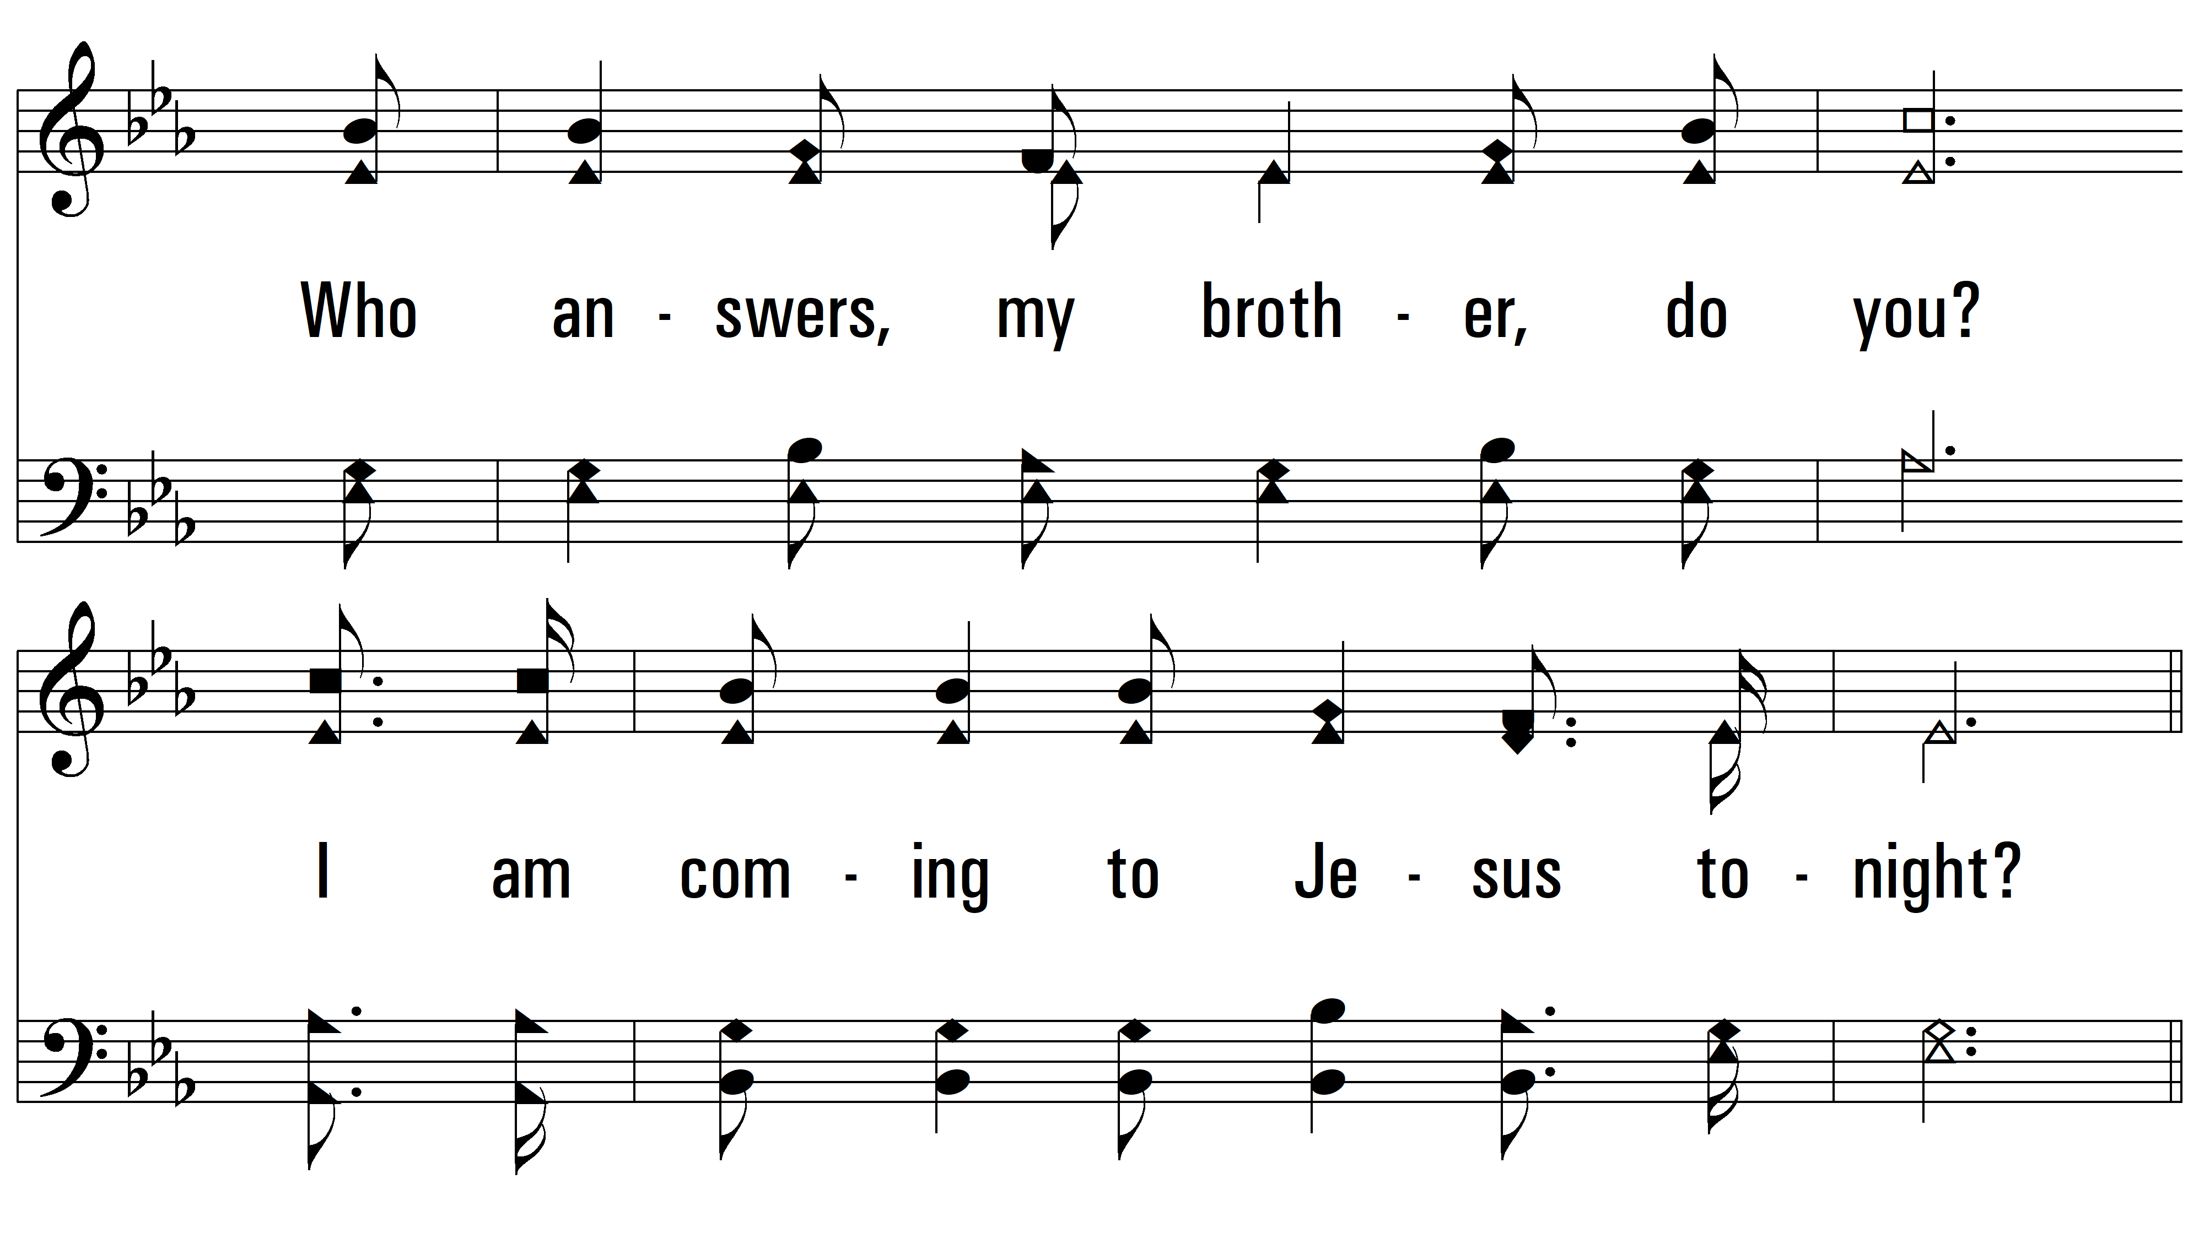
vs. 3

Slide 12
vs. 3

Slide 13
vs. 3
PDHymns.com
END

