Slide 1
Anywhere With Jesus
Words: | Jessie Brown Pounds (1887), vs. 3 by Mrs. C. M. A. (1915)
Music: | D. B. Towner (1887)
6/8
D/A - SOL
Verses: 5/Chorus
Lead - | SOL
Alto - | MI
Tenor - | DO
Bass - | DO
PDHymns.com

Slide 2
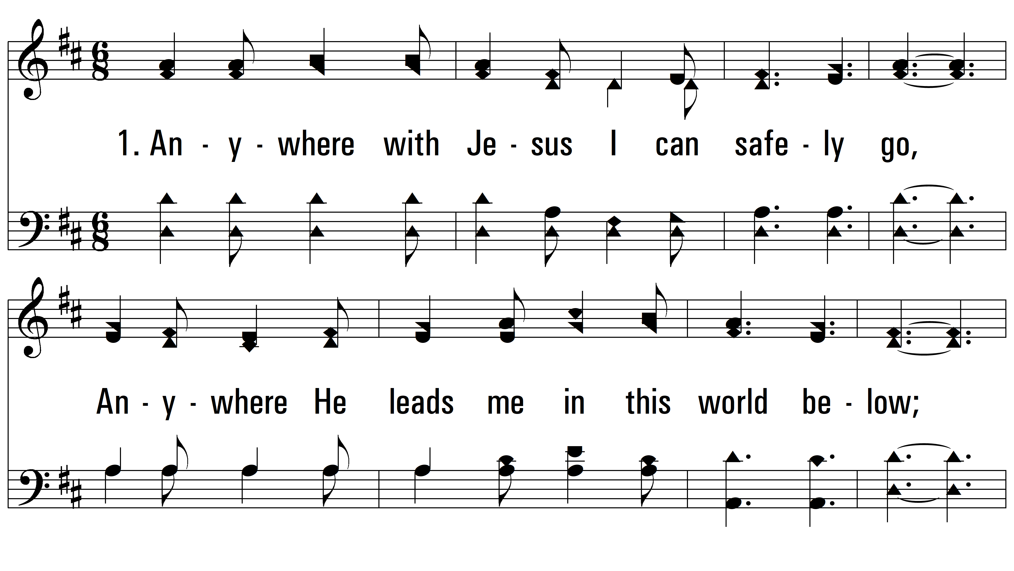
vs. 1 ~ Anywhere With Jesus

Slide 3
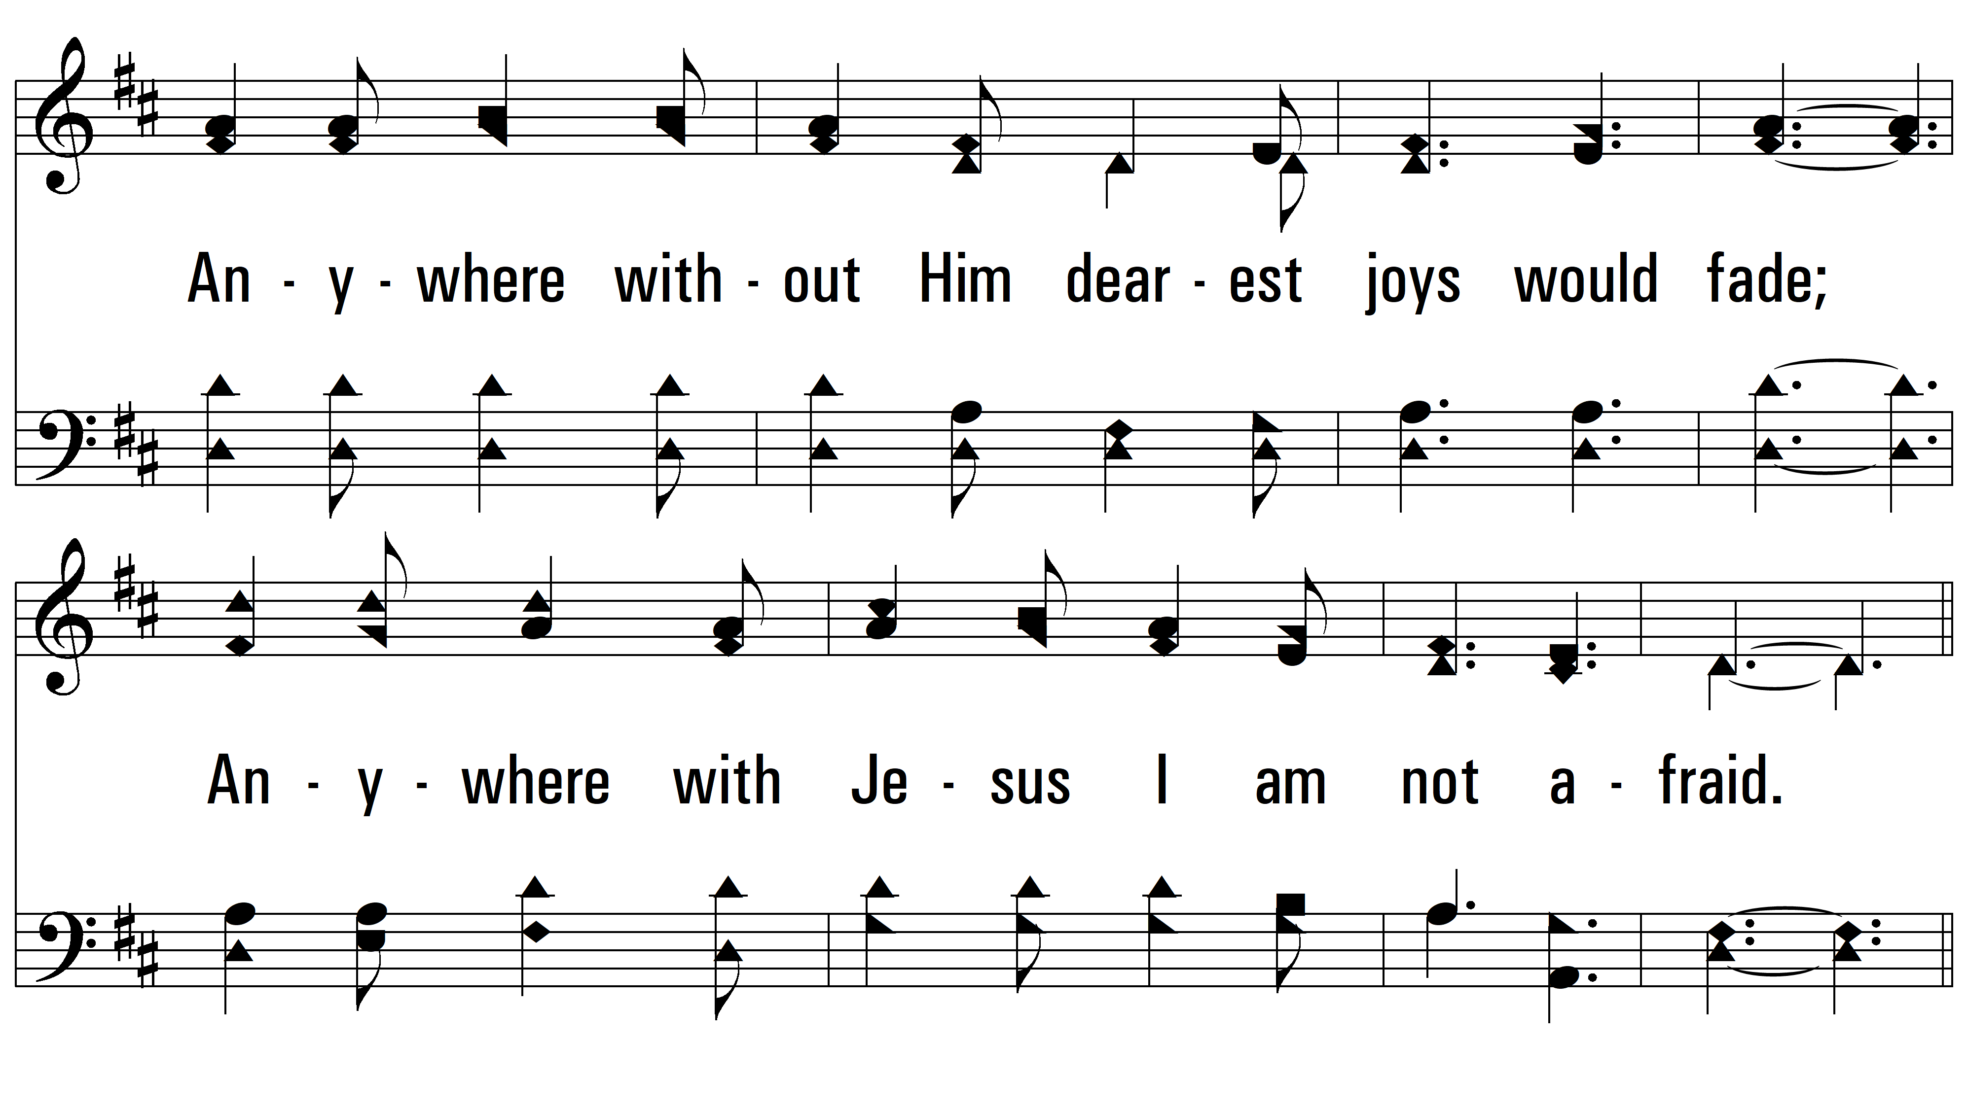
vs. 1

Slide 4
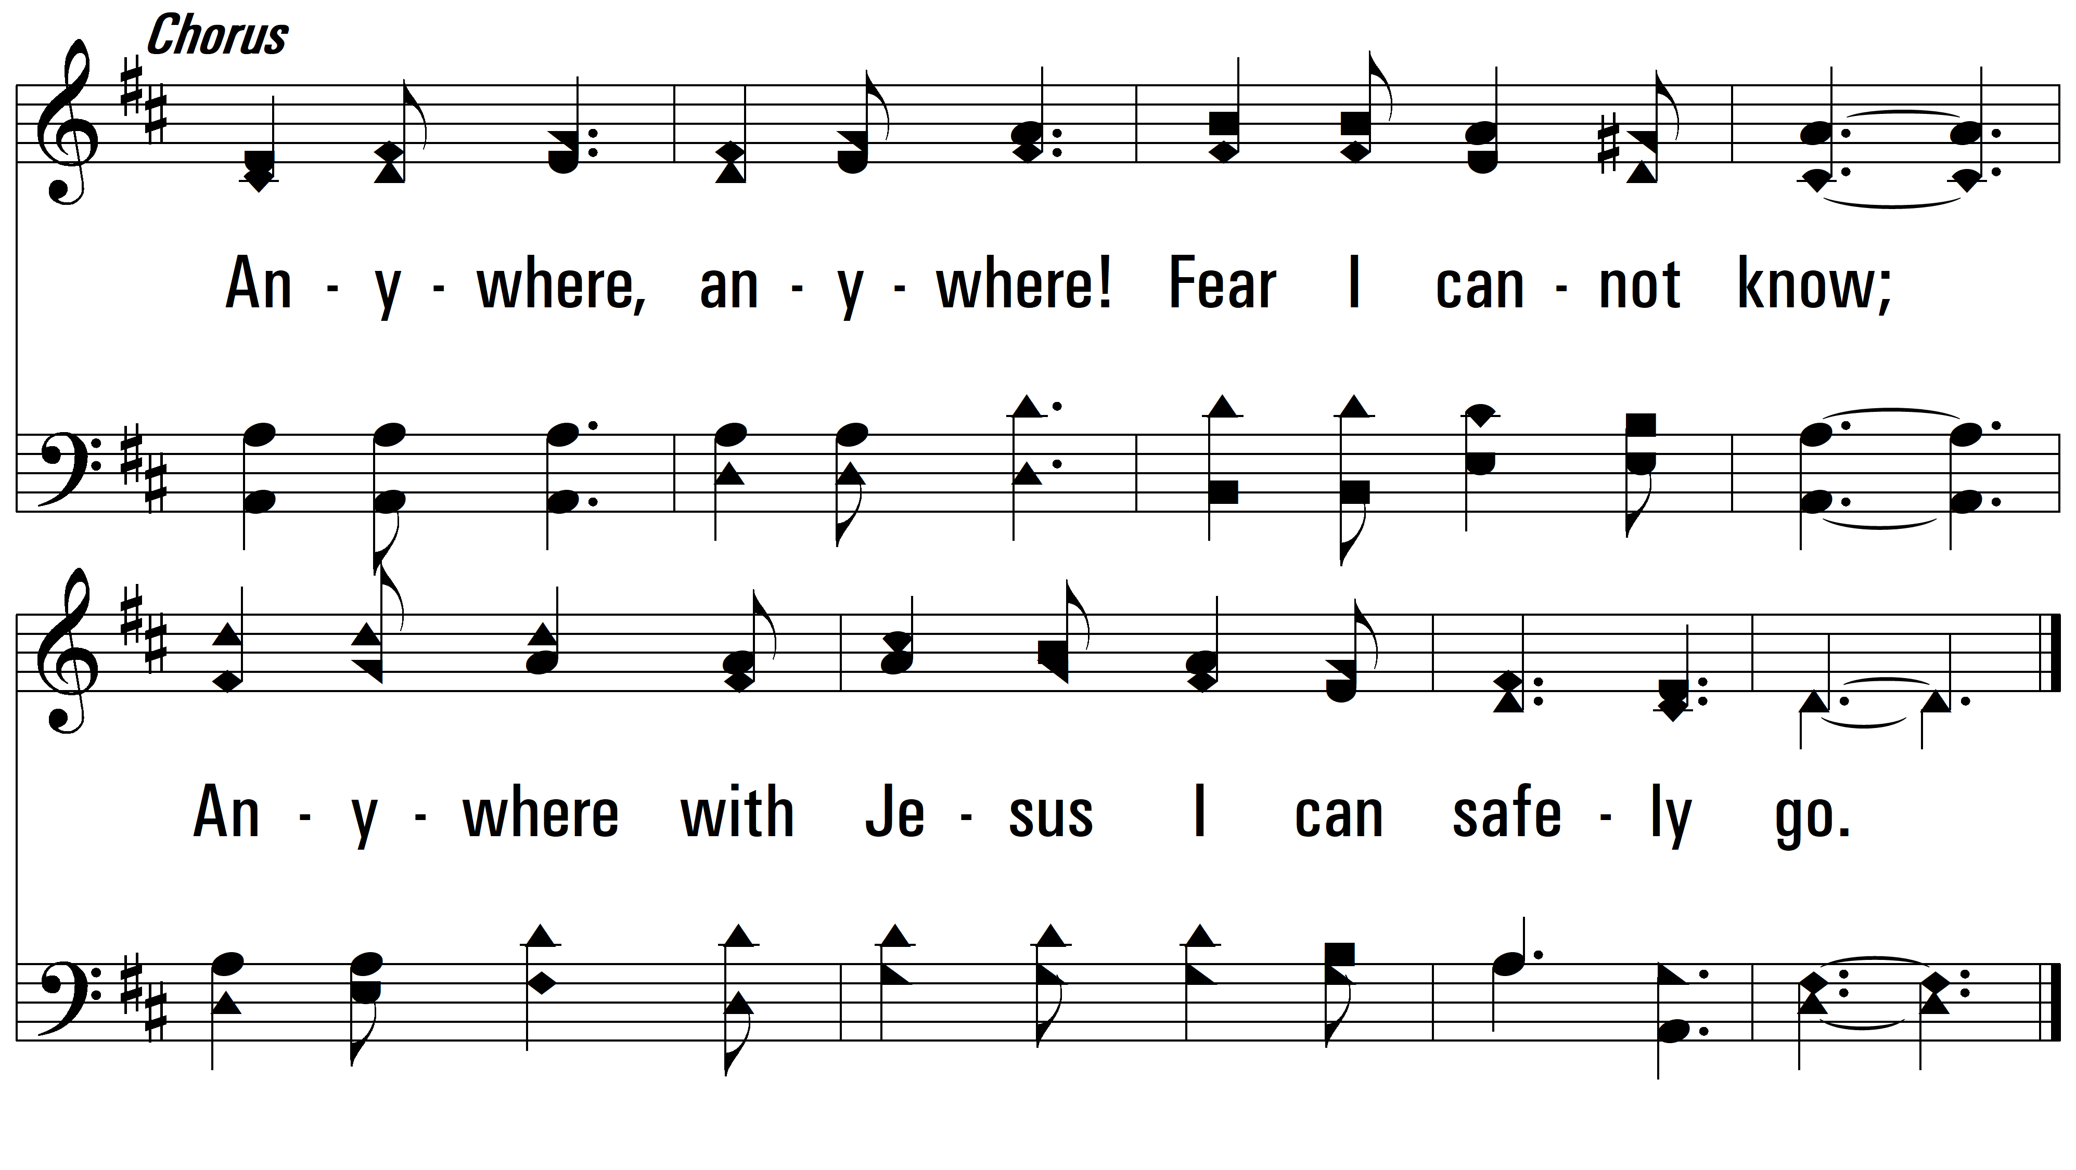
vs. 1

Slide 5
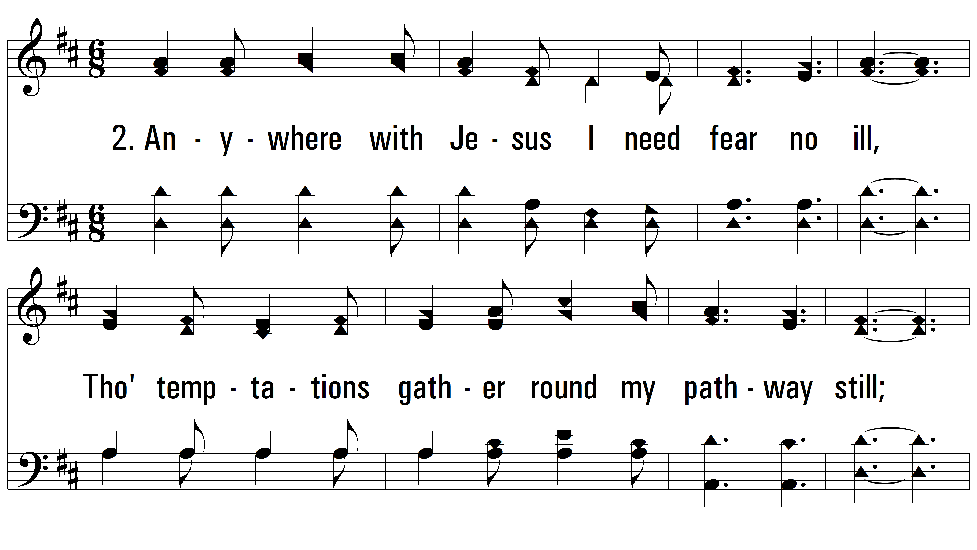
vs. 2 ~ Anywhere With Jesus

Slide 6
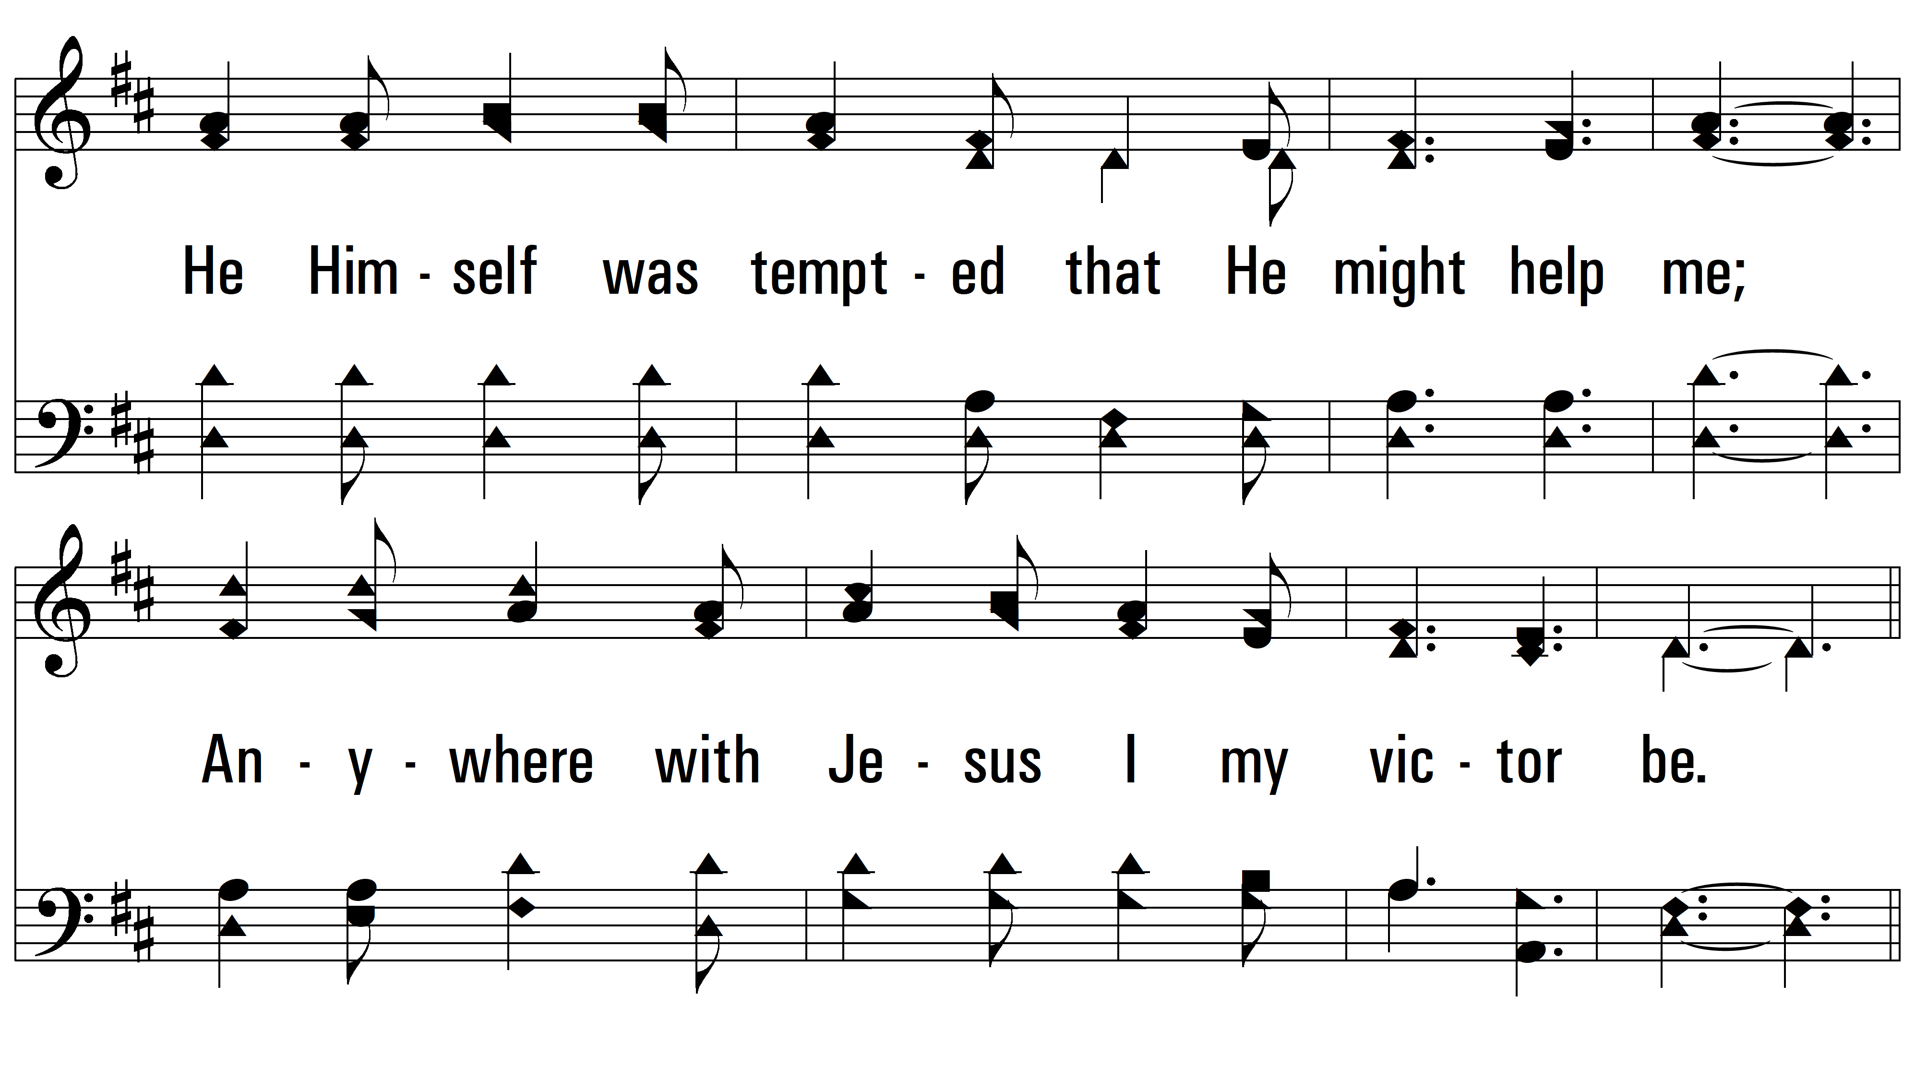
vs. 2

Slide 7
vs. 2

Slide 8
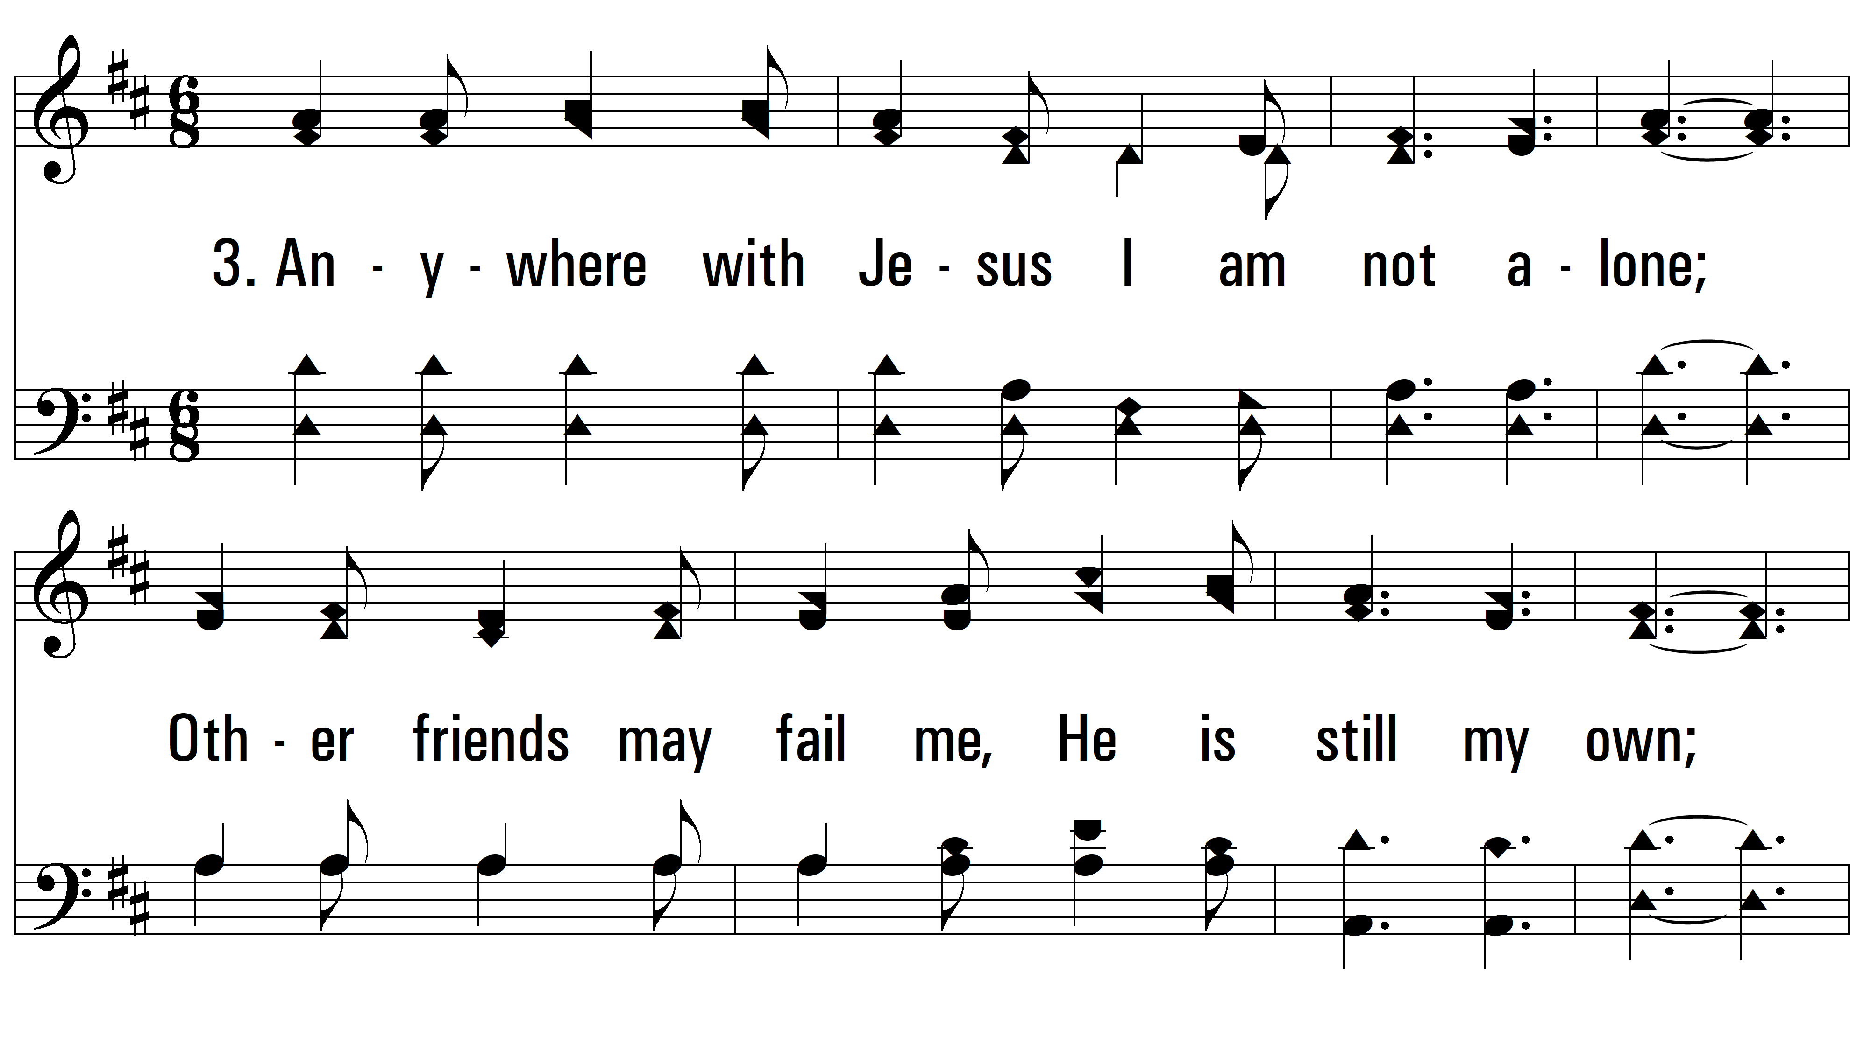
vs. 3 ~ Anywhere With Jesus

Slide 9
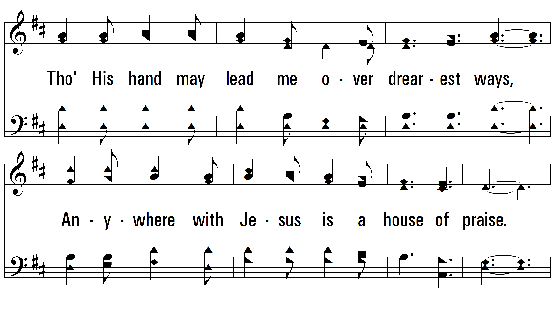
vs. 3

Slide 10
vs. 3

Slide 11
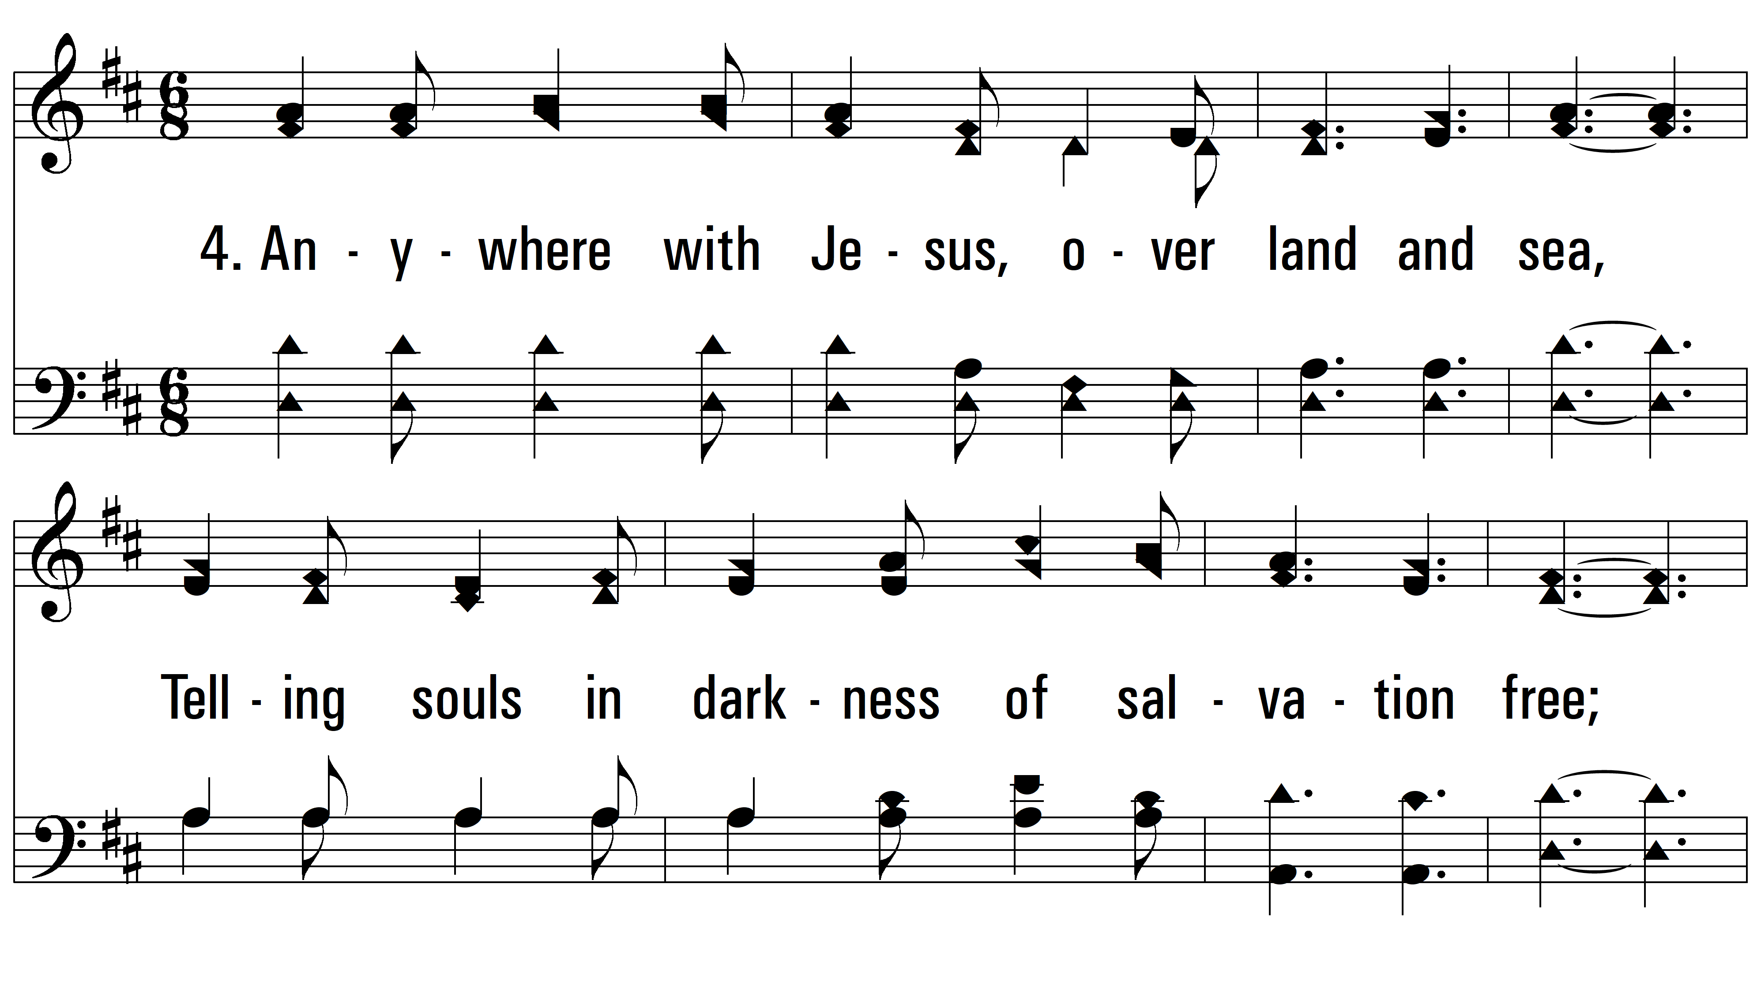
vs. 4 ~ Anywhere With Jesus

Slide 12
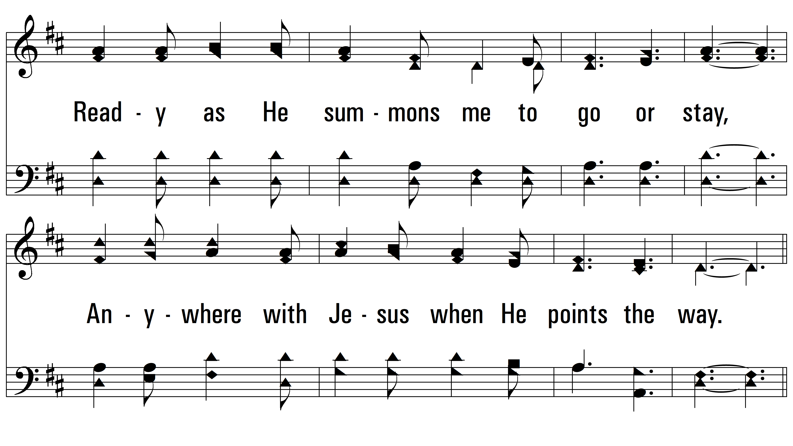
vs. 4

Slide 13
vs. 4

Slide 14
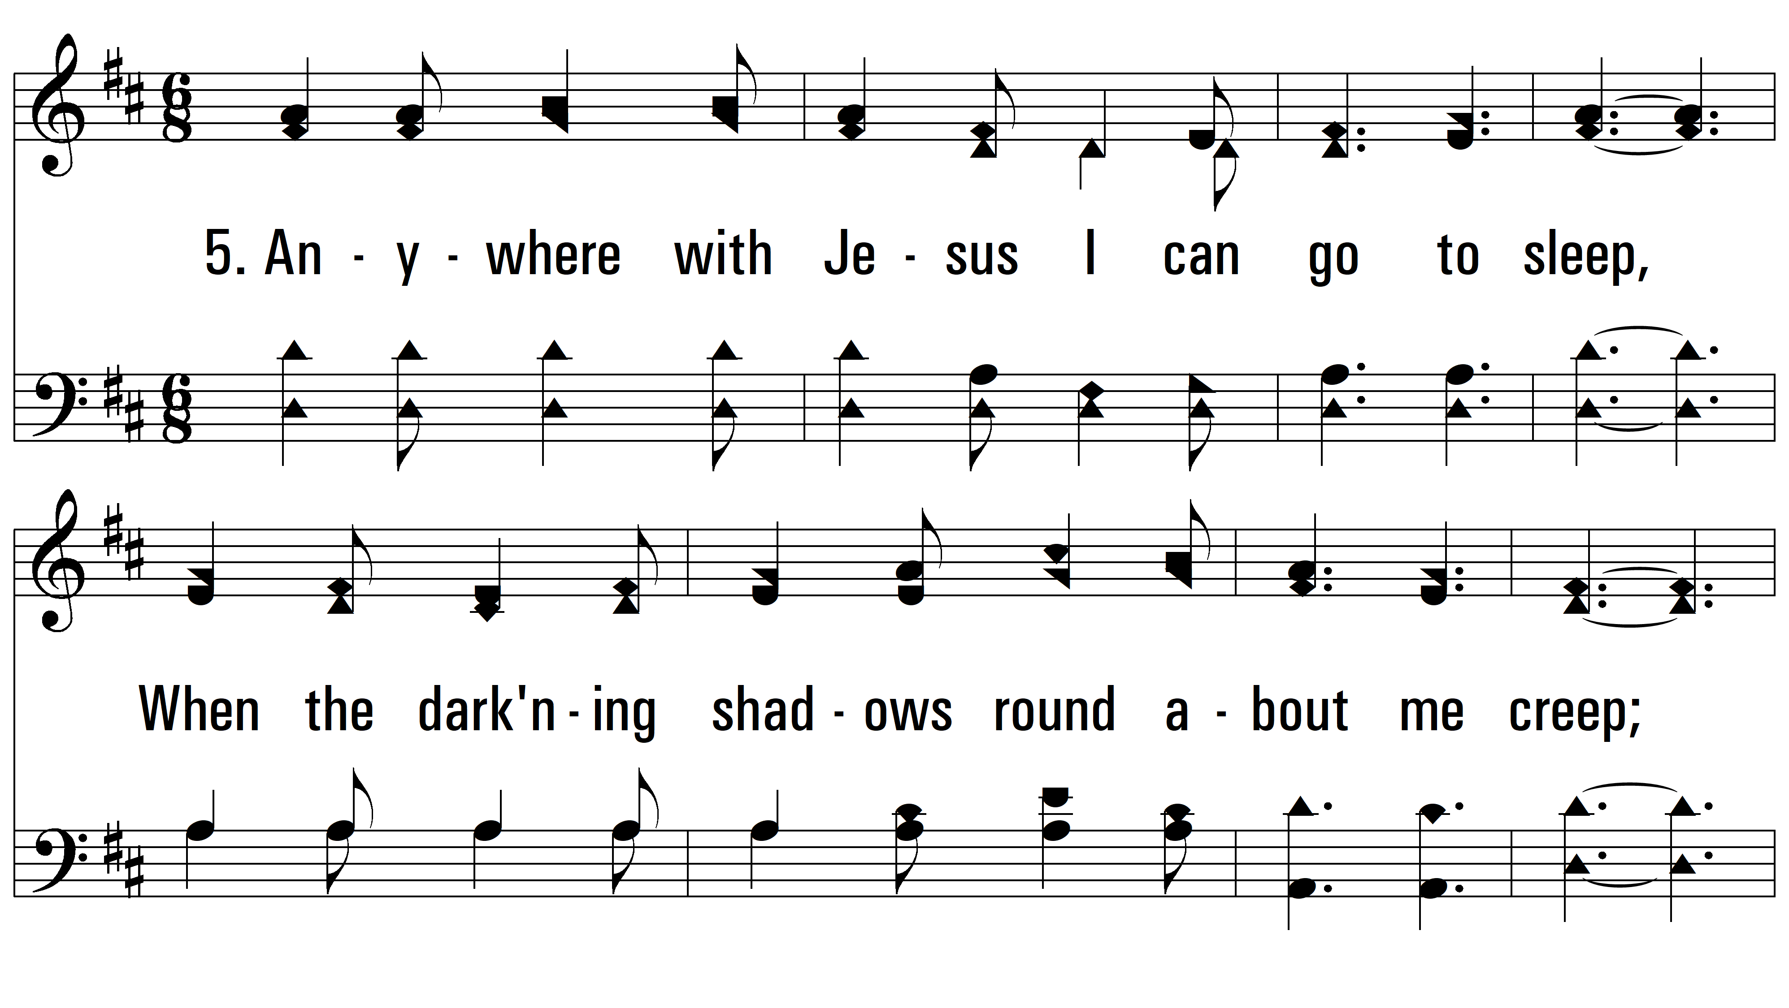
vs. 5 ~ Anywhere With Jesus

Slide 15
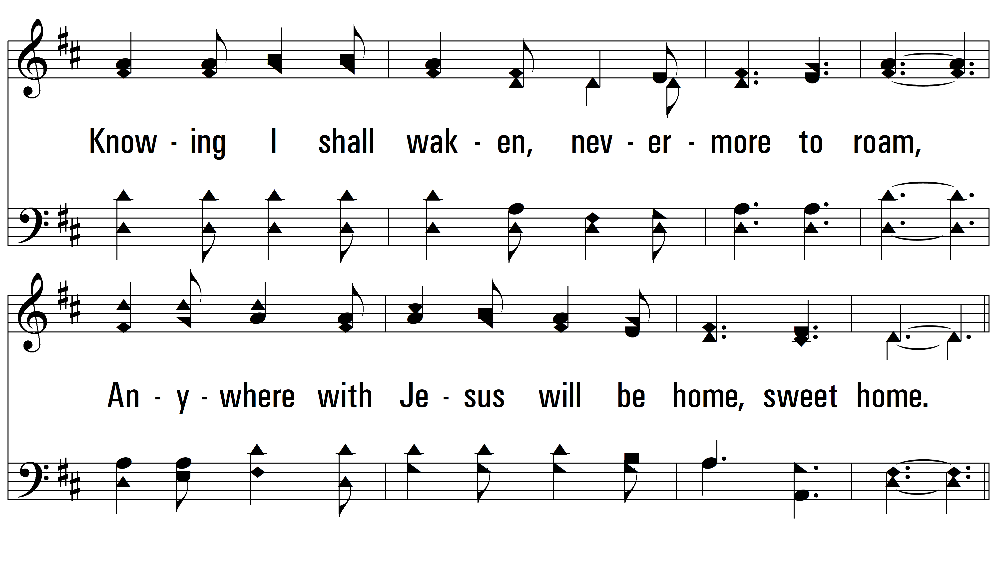
vs. 5

Slide 16
vs. 5
PDHymns.com
END

