Slide 1
Another Year Is Dawning
ELLACOMBE
7, 6, 7, 6, D
Words: | Frances R. Havergal (1874)
Music: | Gesangbuch der Würtemgergischen Hofkapelle (1784)
4/4
B^{b}/F - SOL
Verses: 3
Lead - | SOL
Alto - | SOL
Tenor - | SOL
Bass - | SOL
PDHymns.com

Slide 2
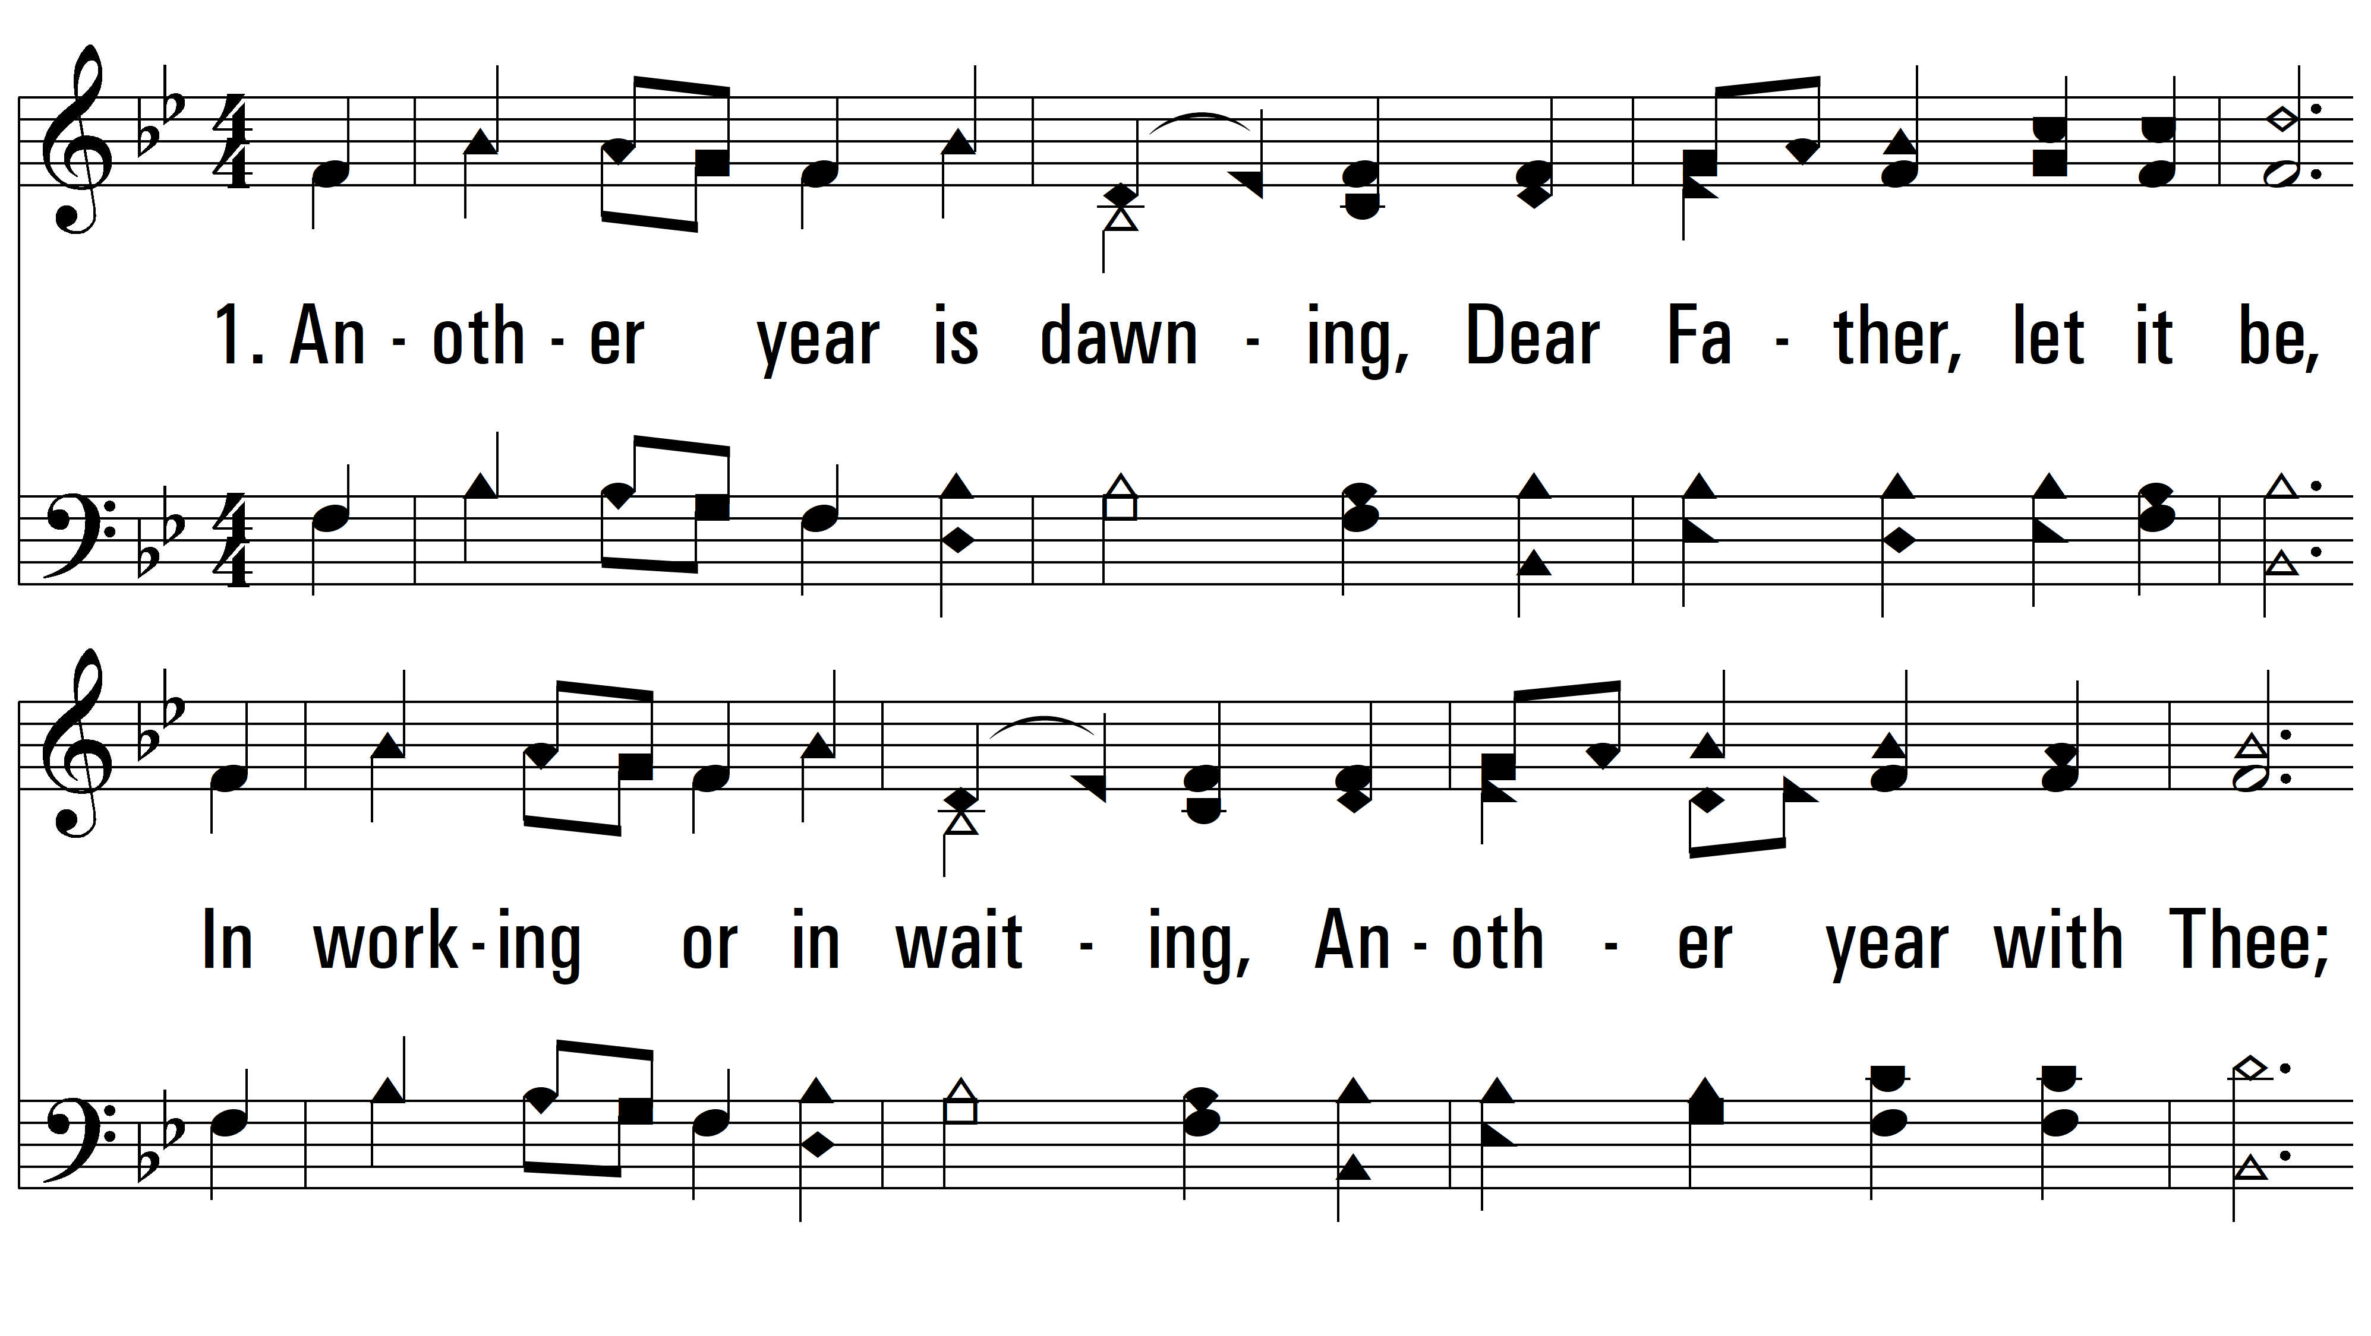
vs. 1 ~ Another Year Is Dawning

Slide 3
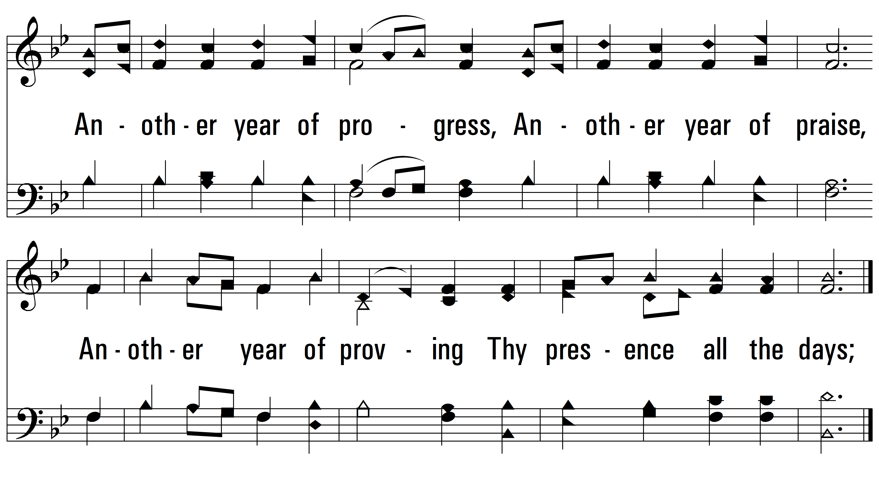
vs. 1

Slide 4
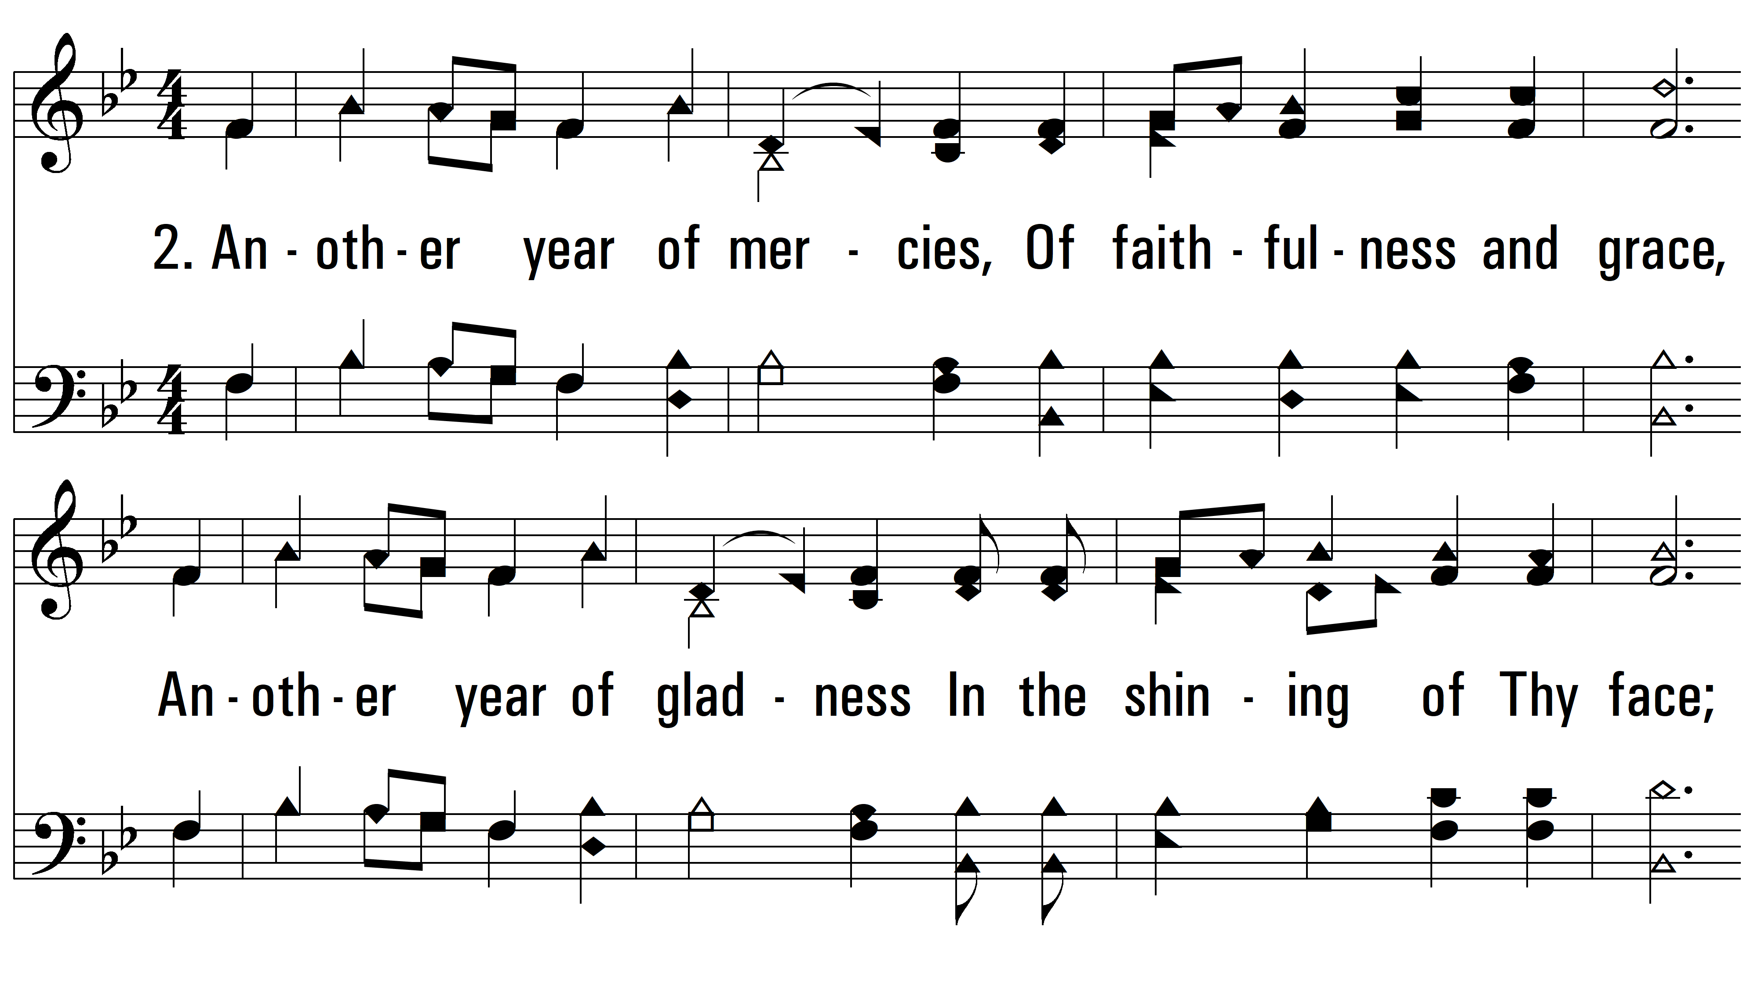
vs. 2 ~ Another Year Is Dawning

Slide 5
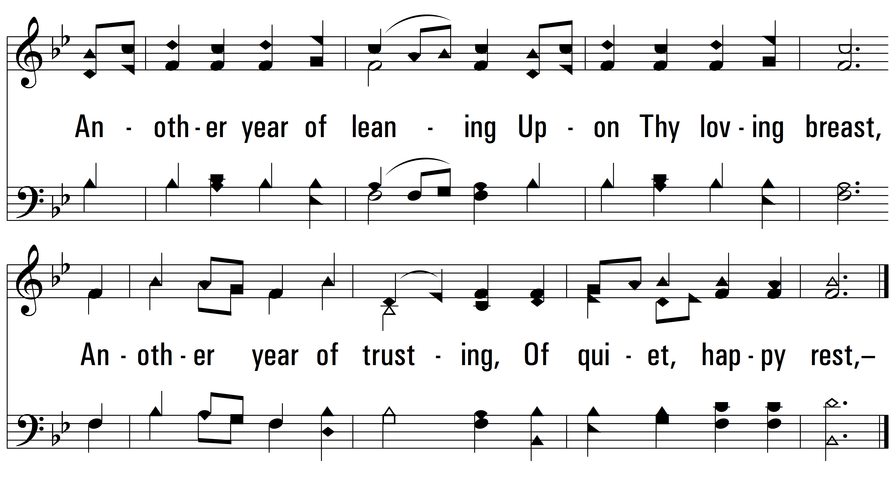
vs. 2

Slide 6
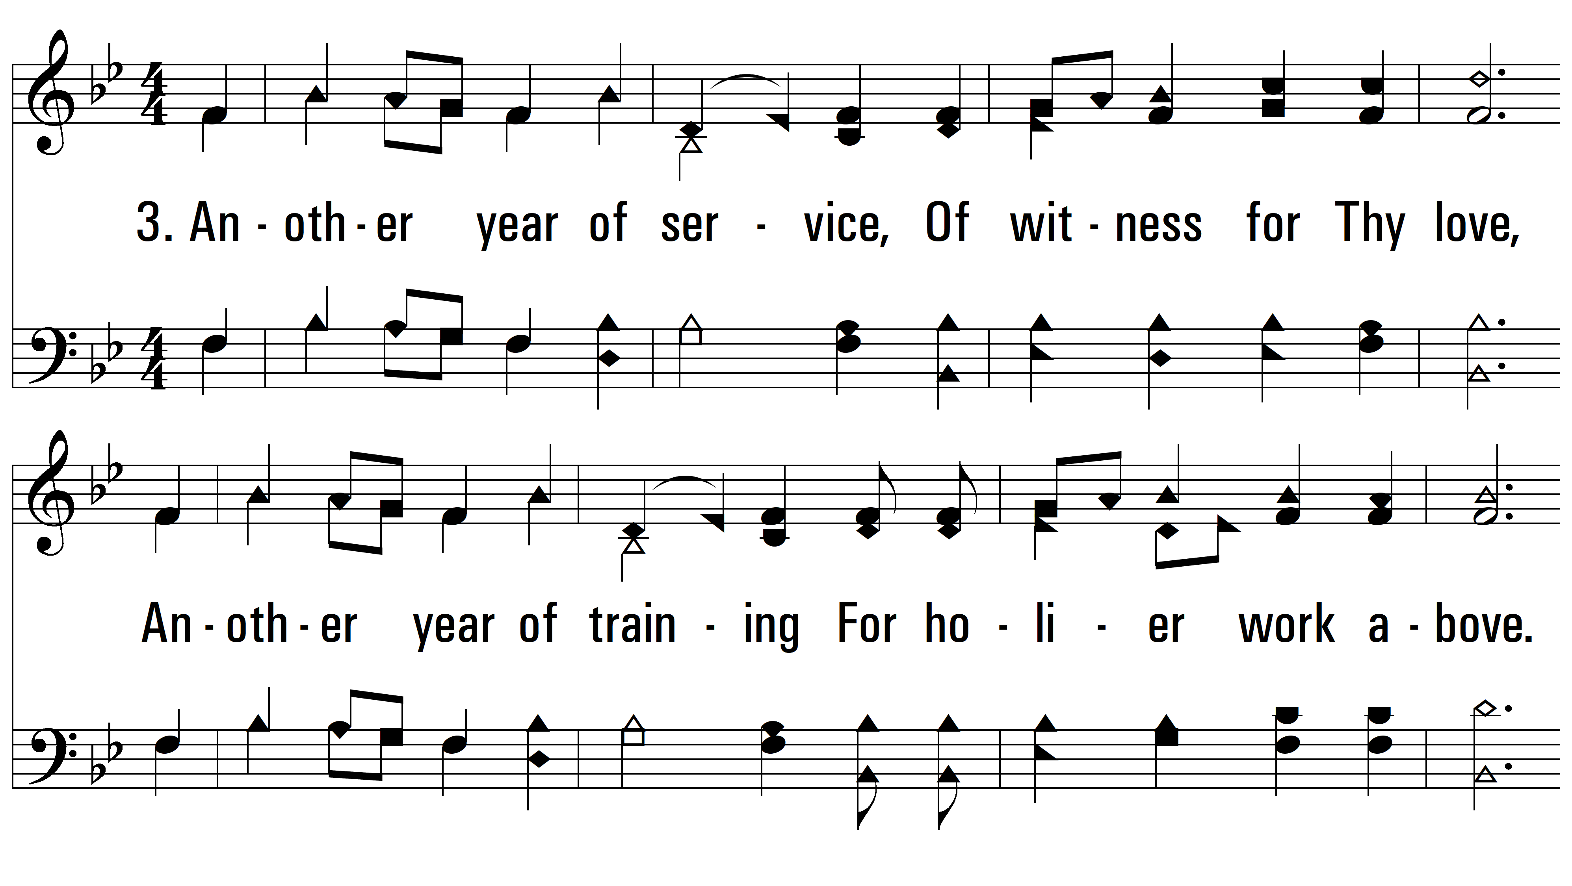
vs. 3 ~ Another Year Is Dawning

Slide 7
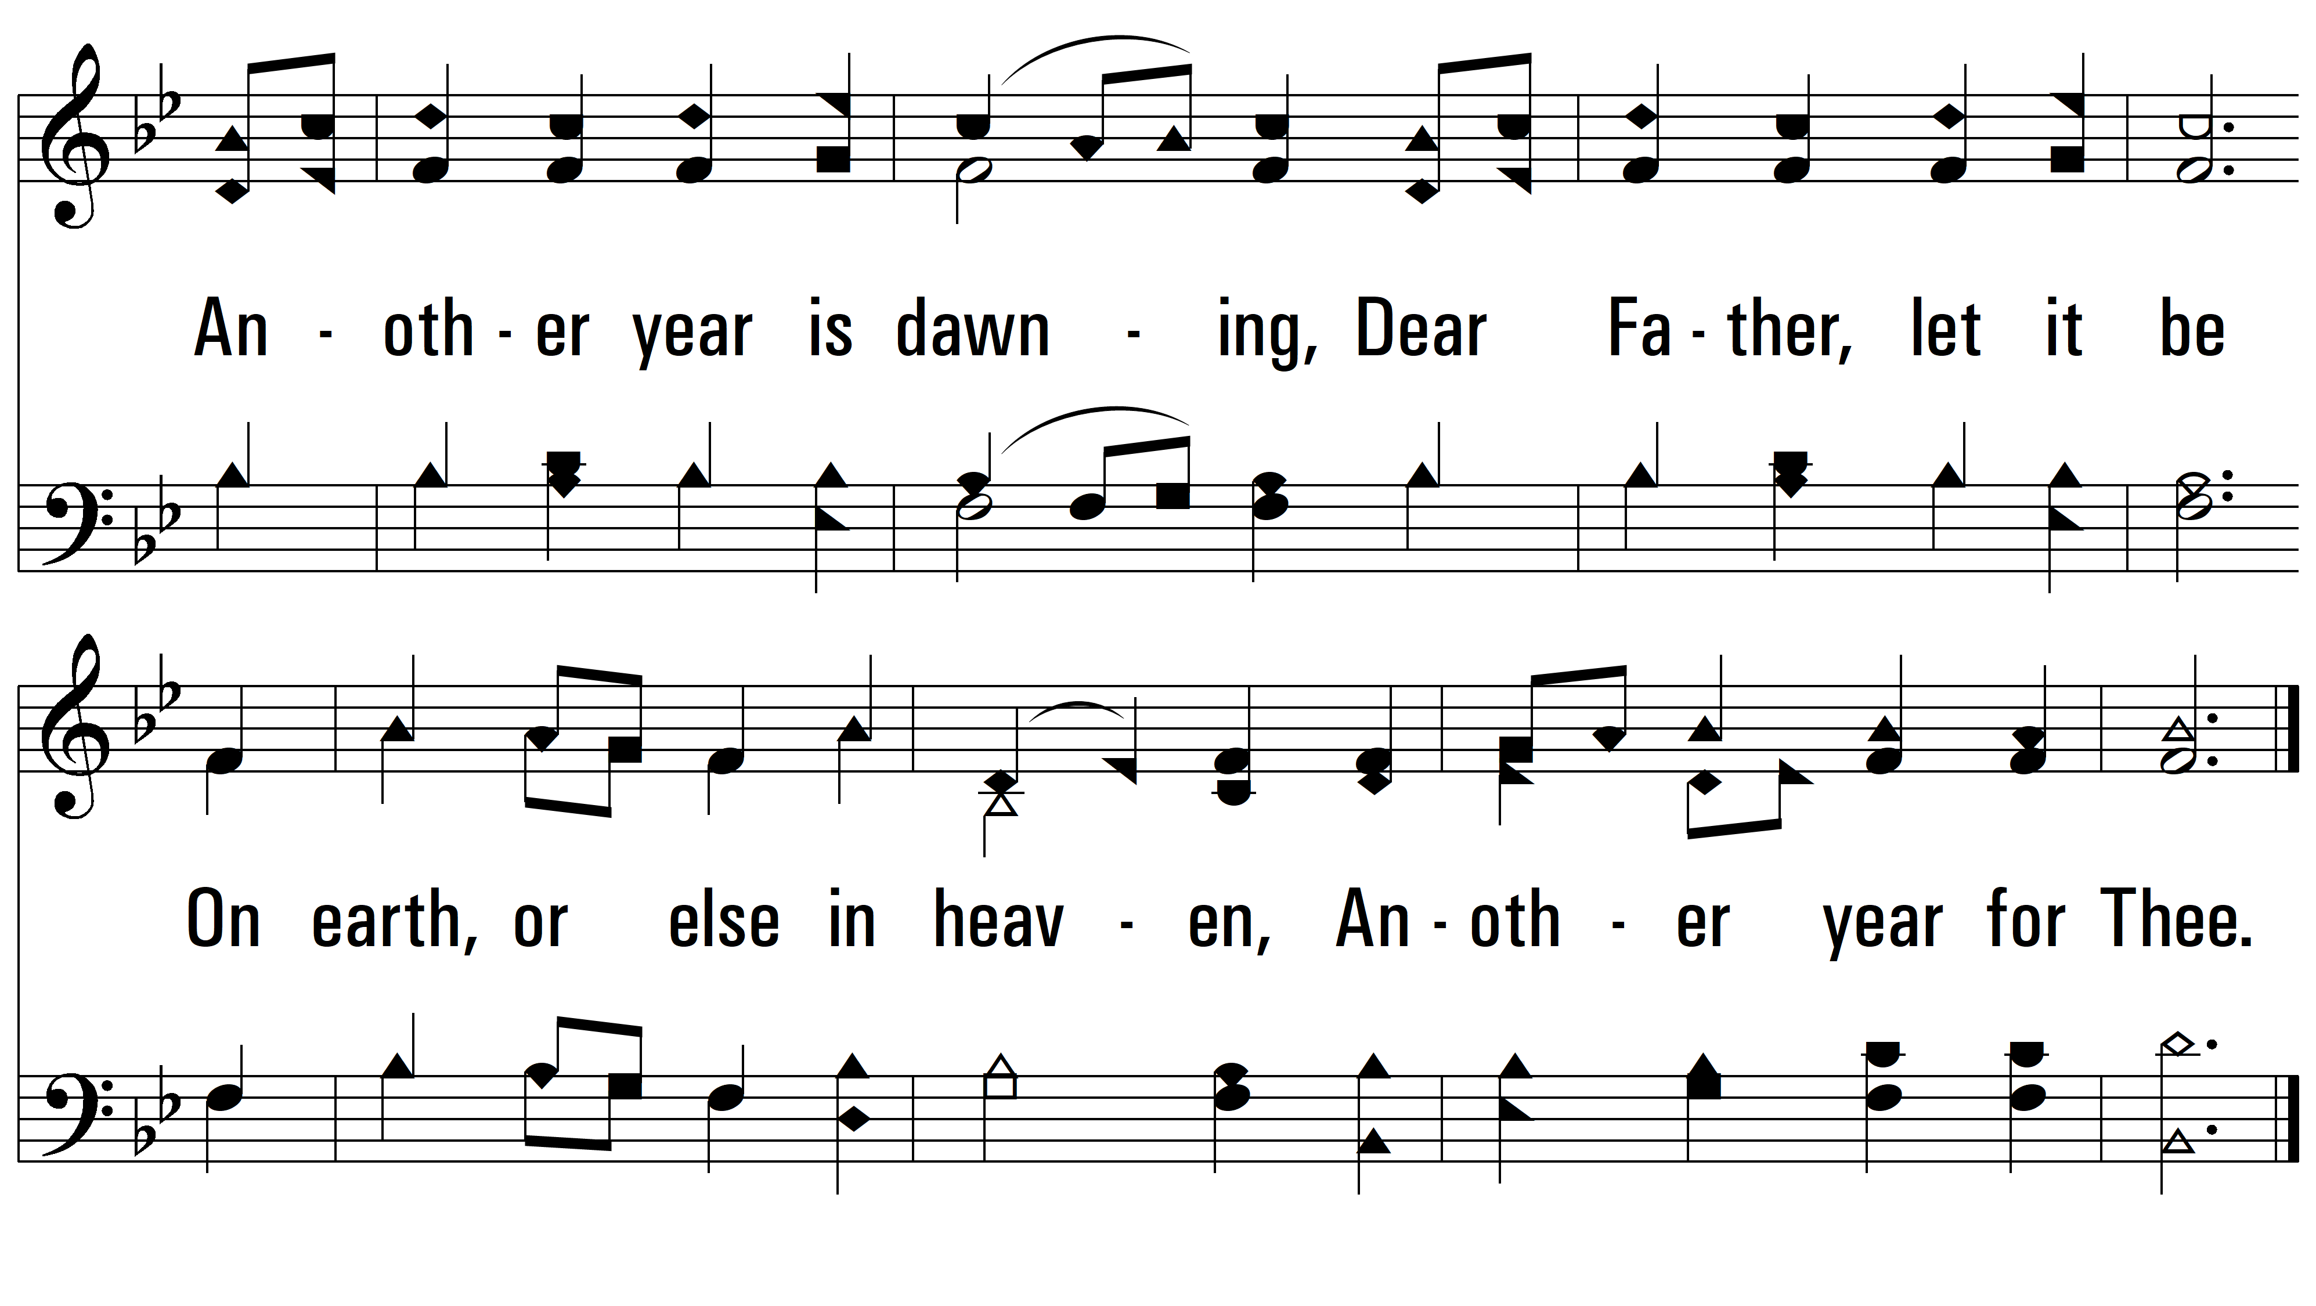
vs. 3
PDHymns.com
END

