Slide 1
Another Year Is Dawning
AURELIA
7, 6, 7, 6, D
Words: | Frances R. Havergal (1874)
Music: | Samuel S. Wesley (1864)
4/4
E^{b}/G - MI
Verses: 3
Lead - | MI
Alto - | DO
Tenor - | SOL
Bass - | DO
PDHymns.com

Slide 2
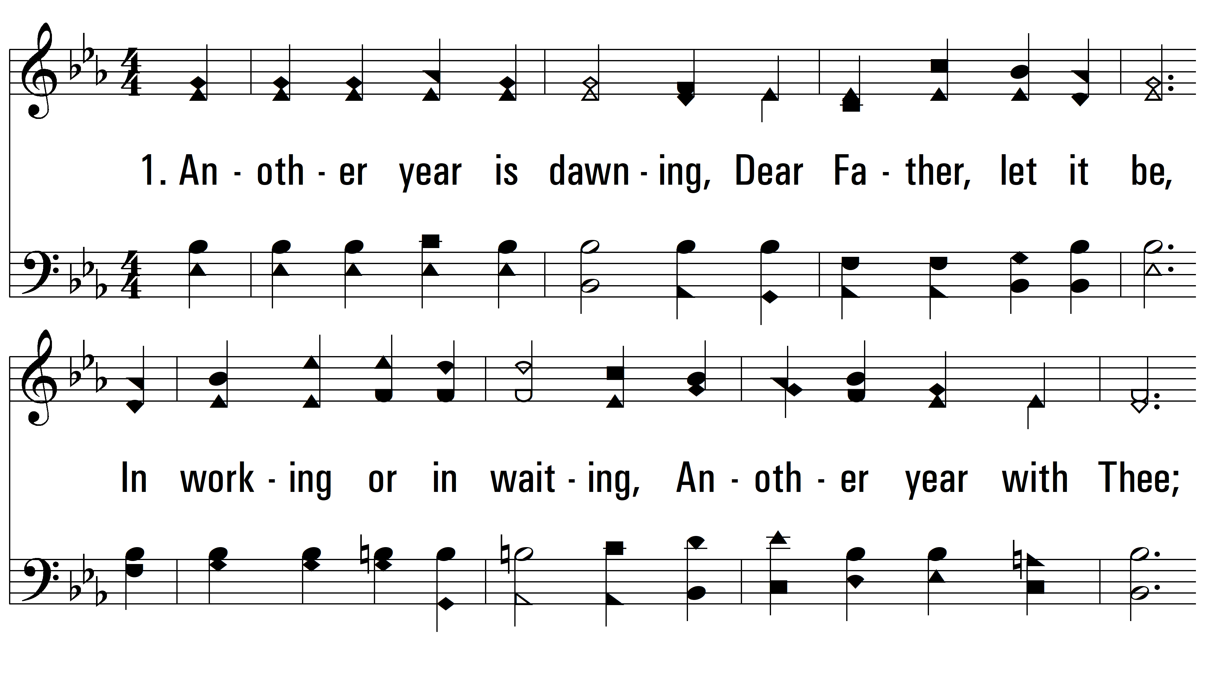
vs. 1 ~ Another Year Is Dawning

Slide 3
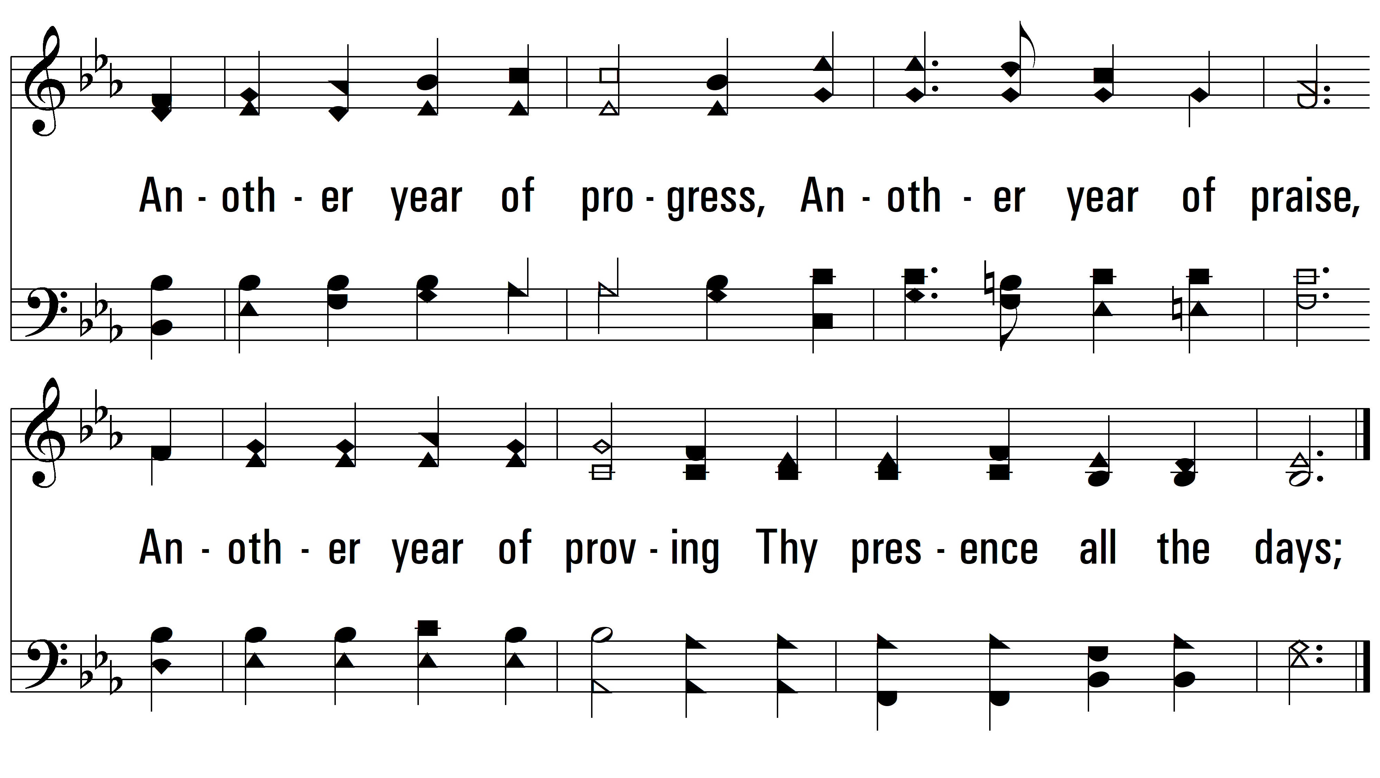
vs. 1

Slide 4
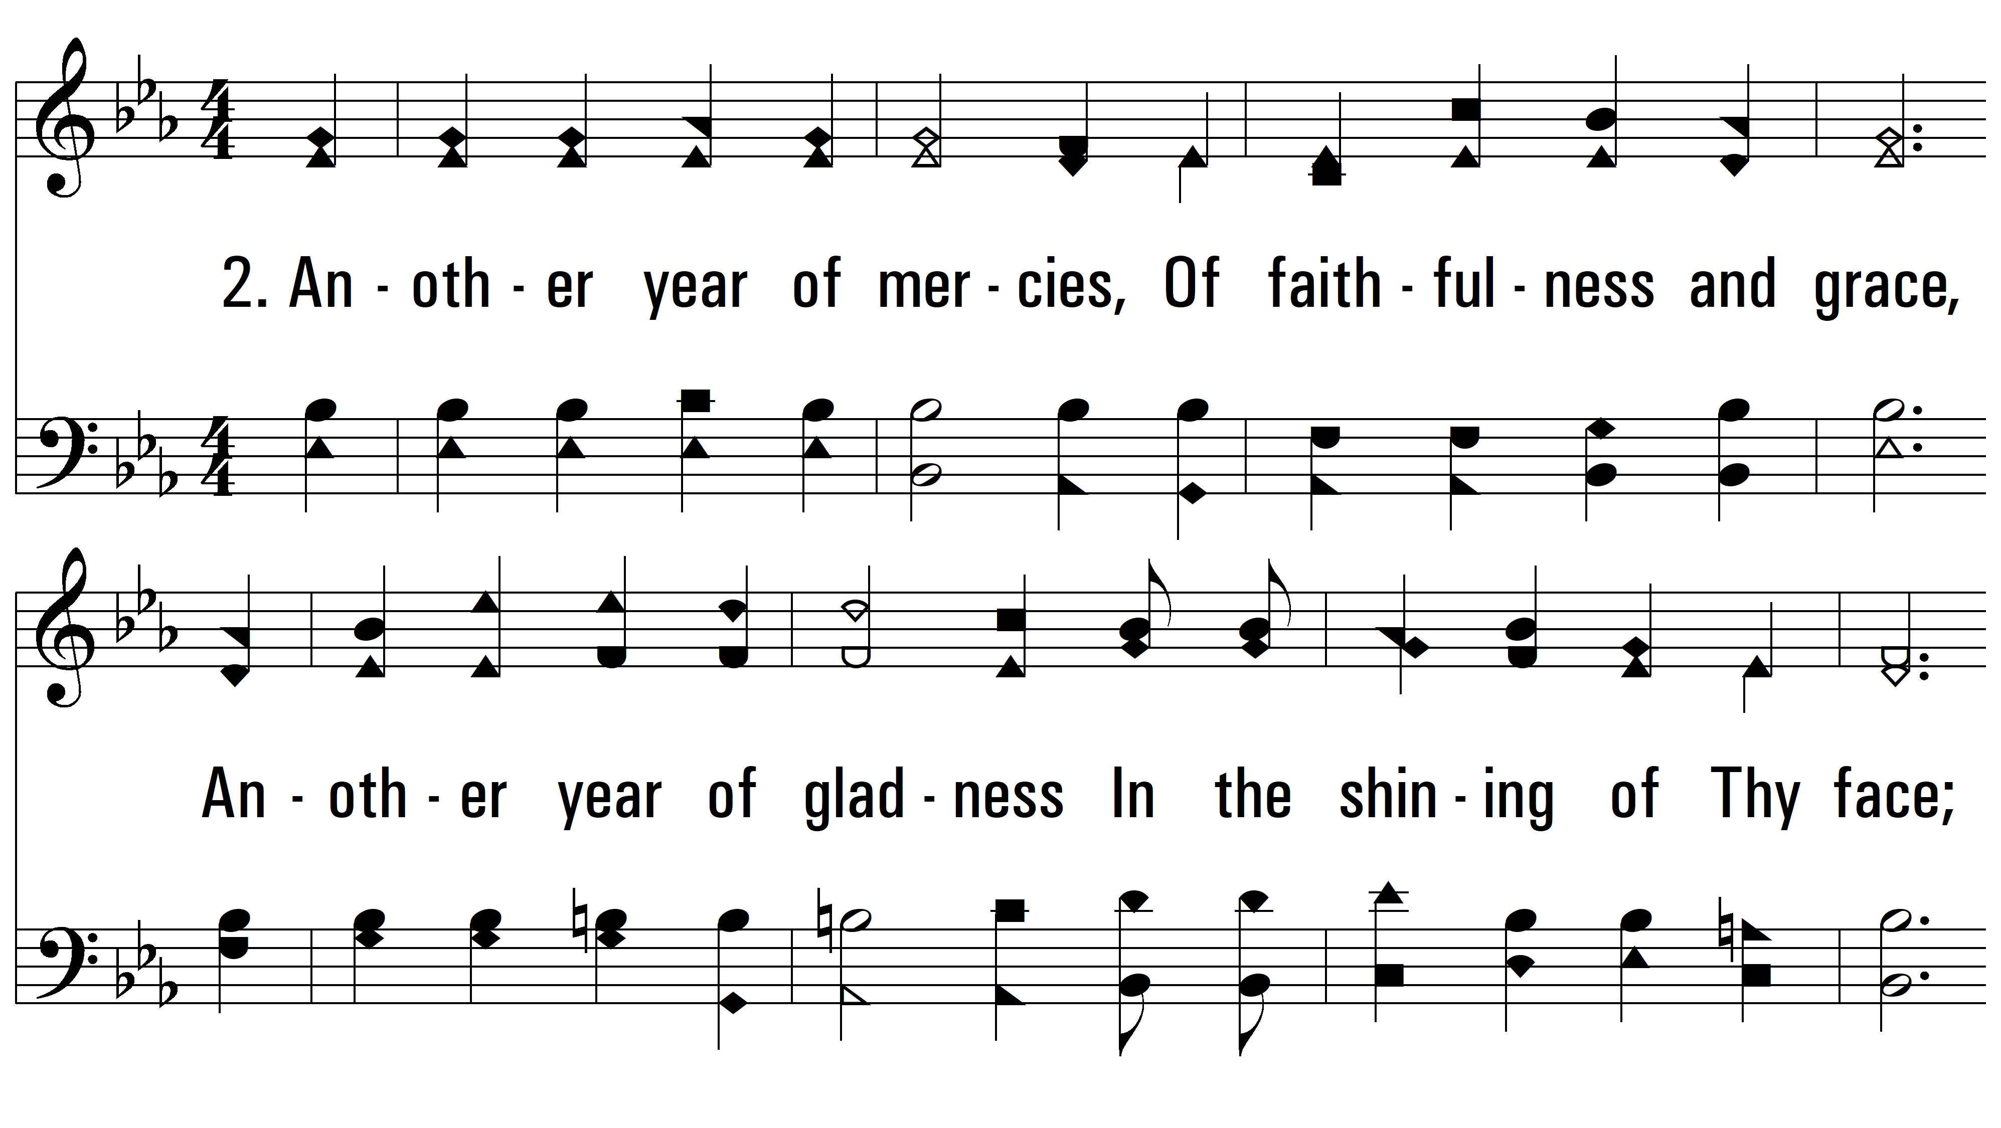
vs. 2 ~ Another Year Is Dawning

Slide 5
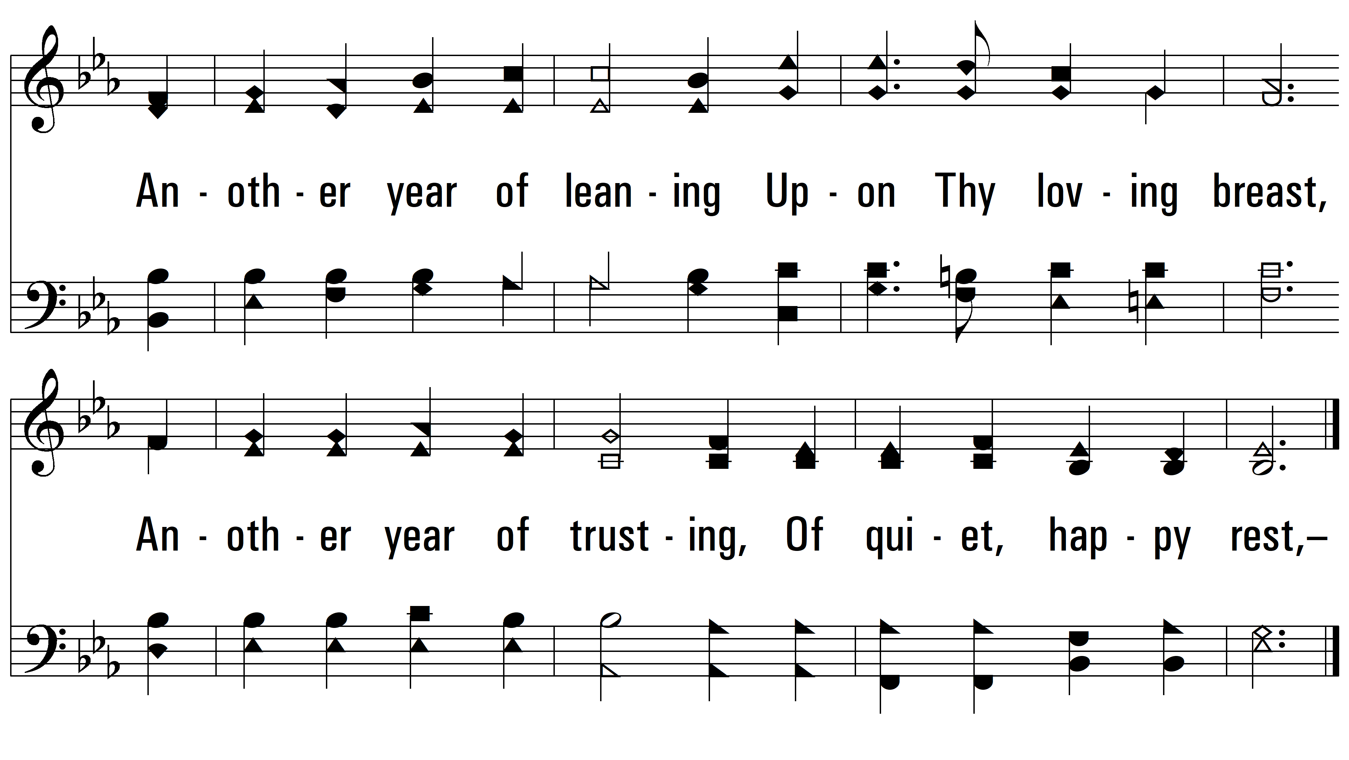
vs. 2

Slide 6
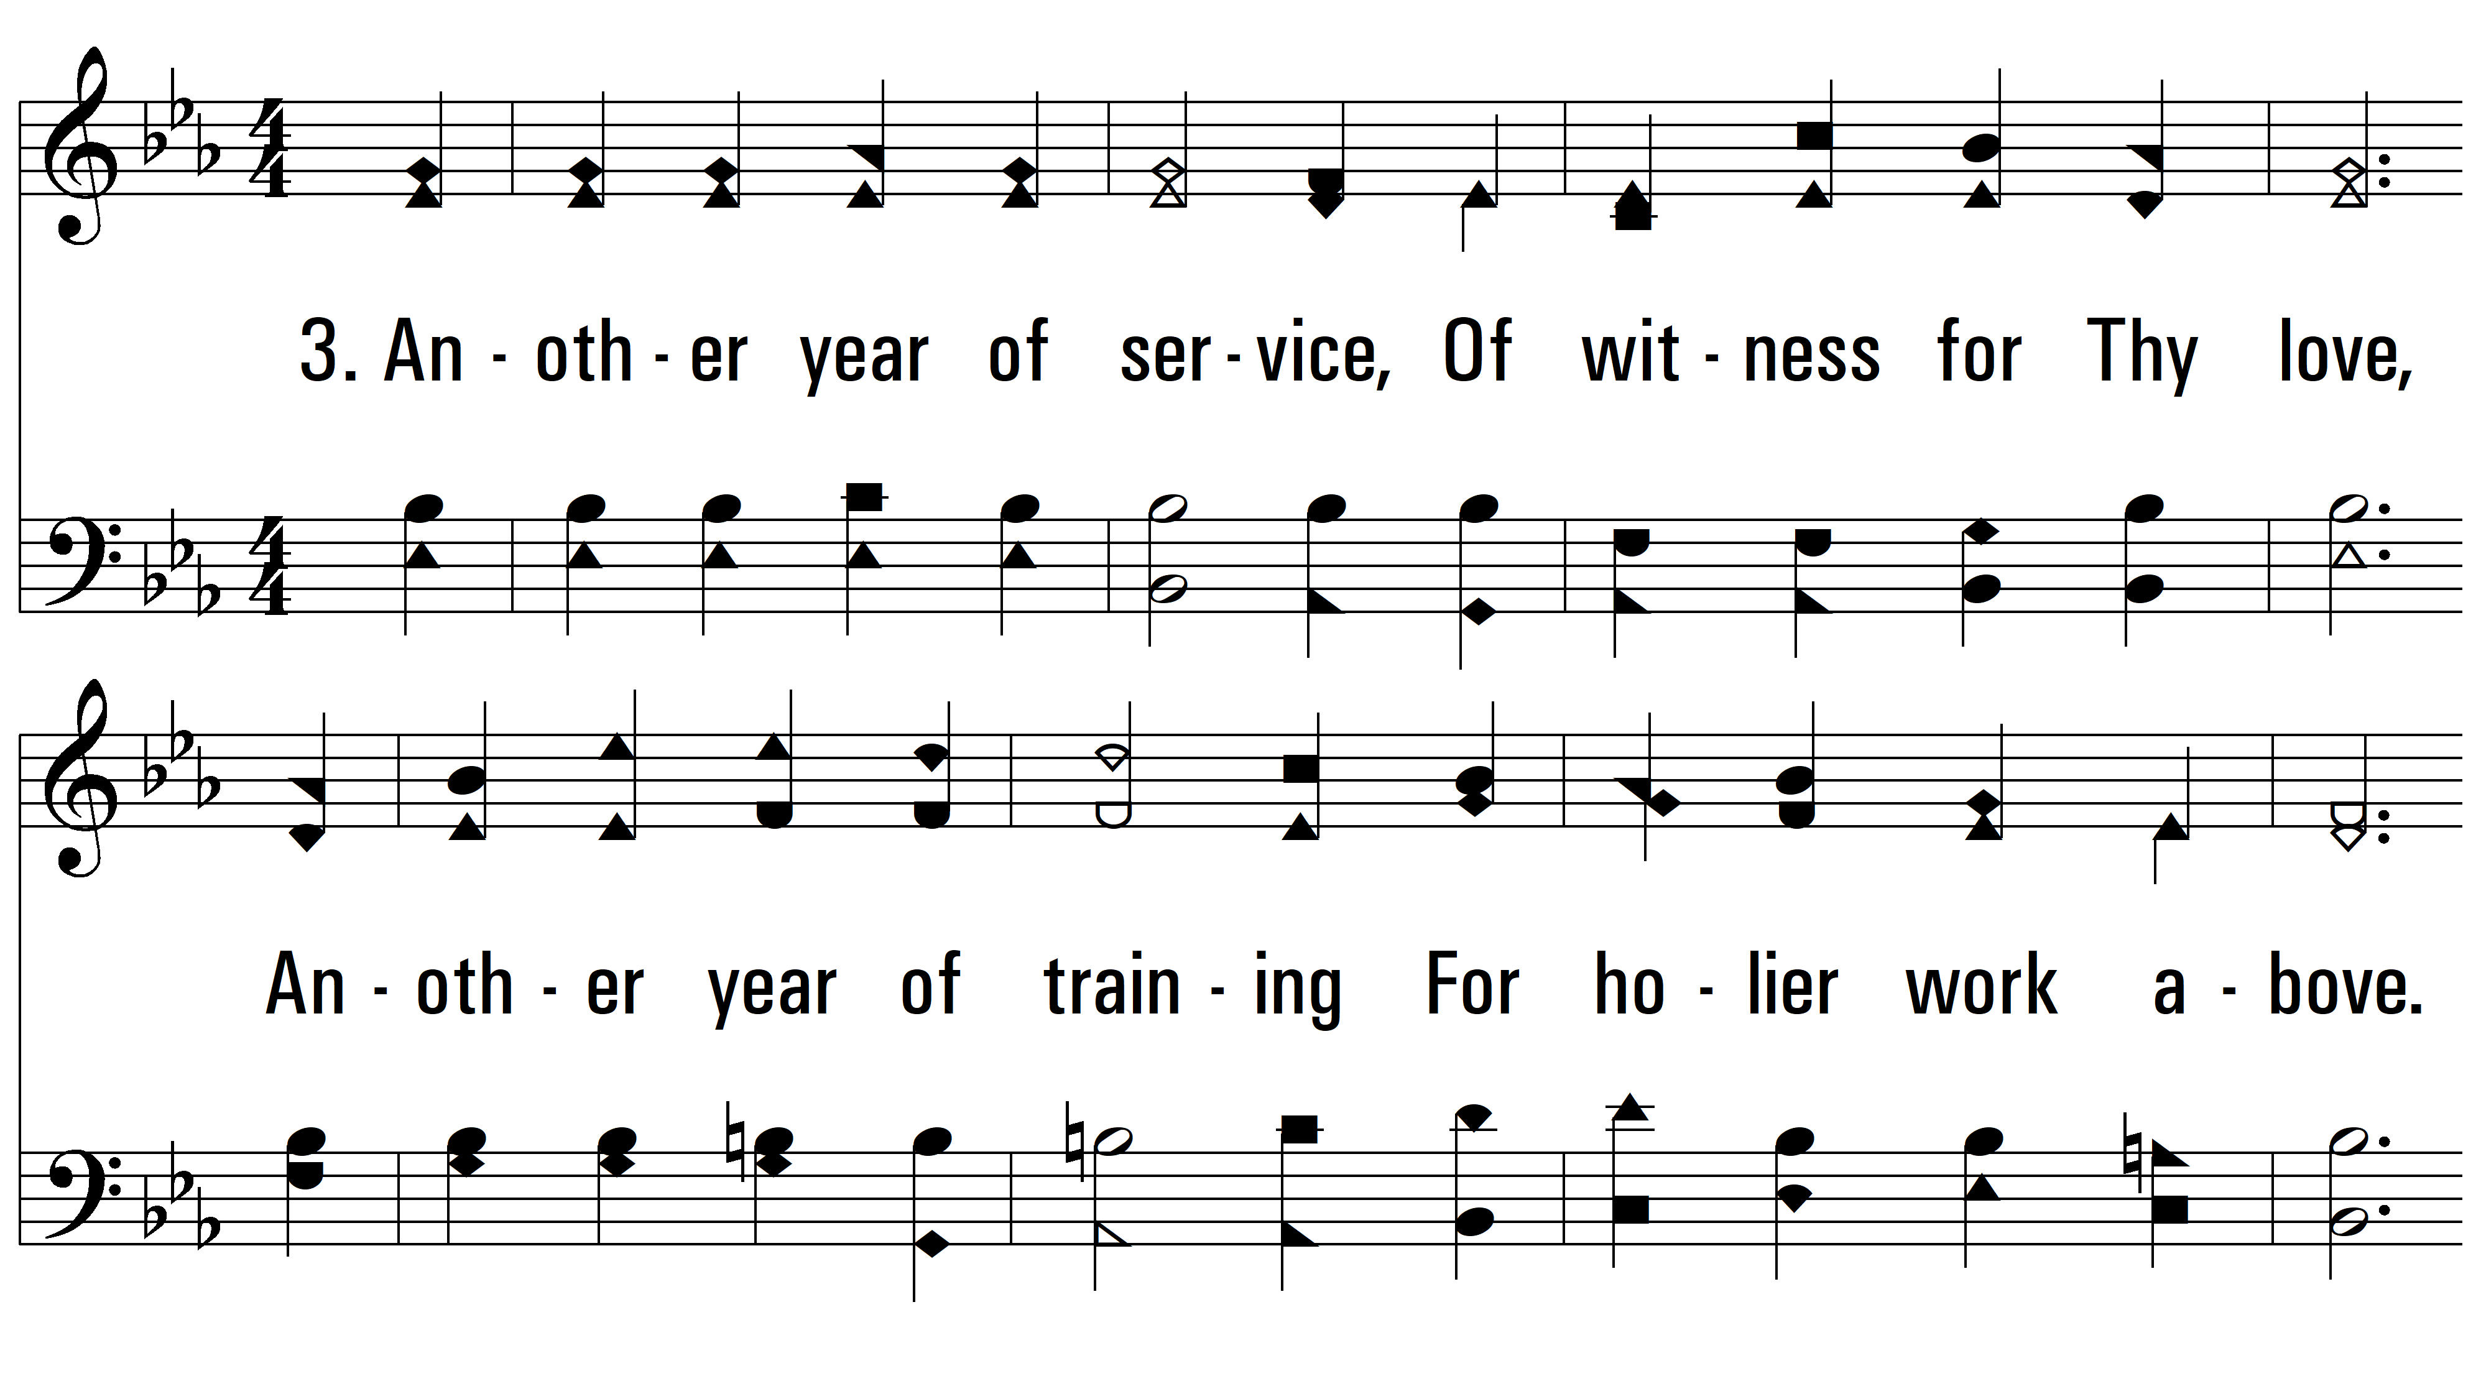
vs. 3 ~ Another Year Is Dawning

Slide 7
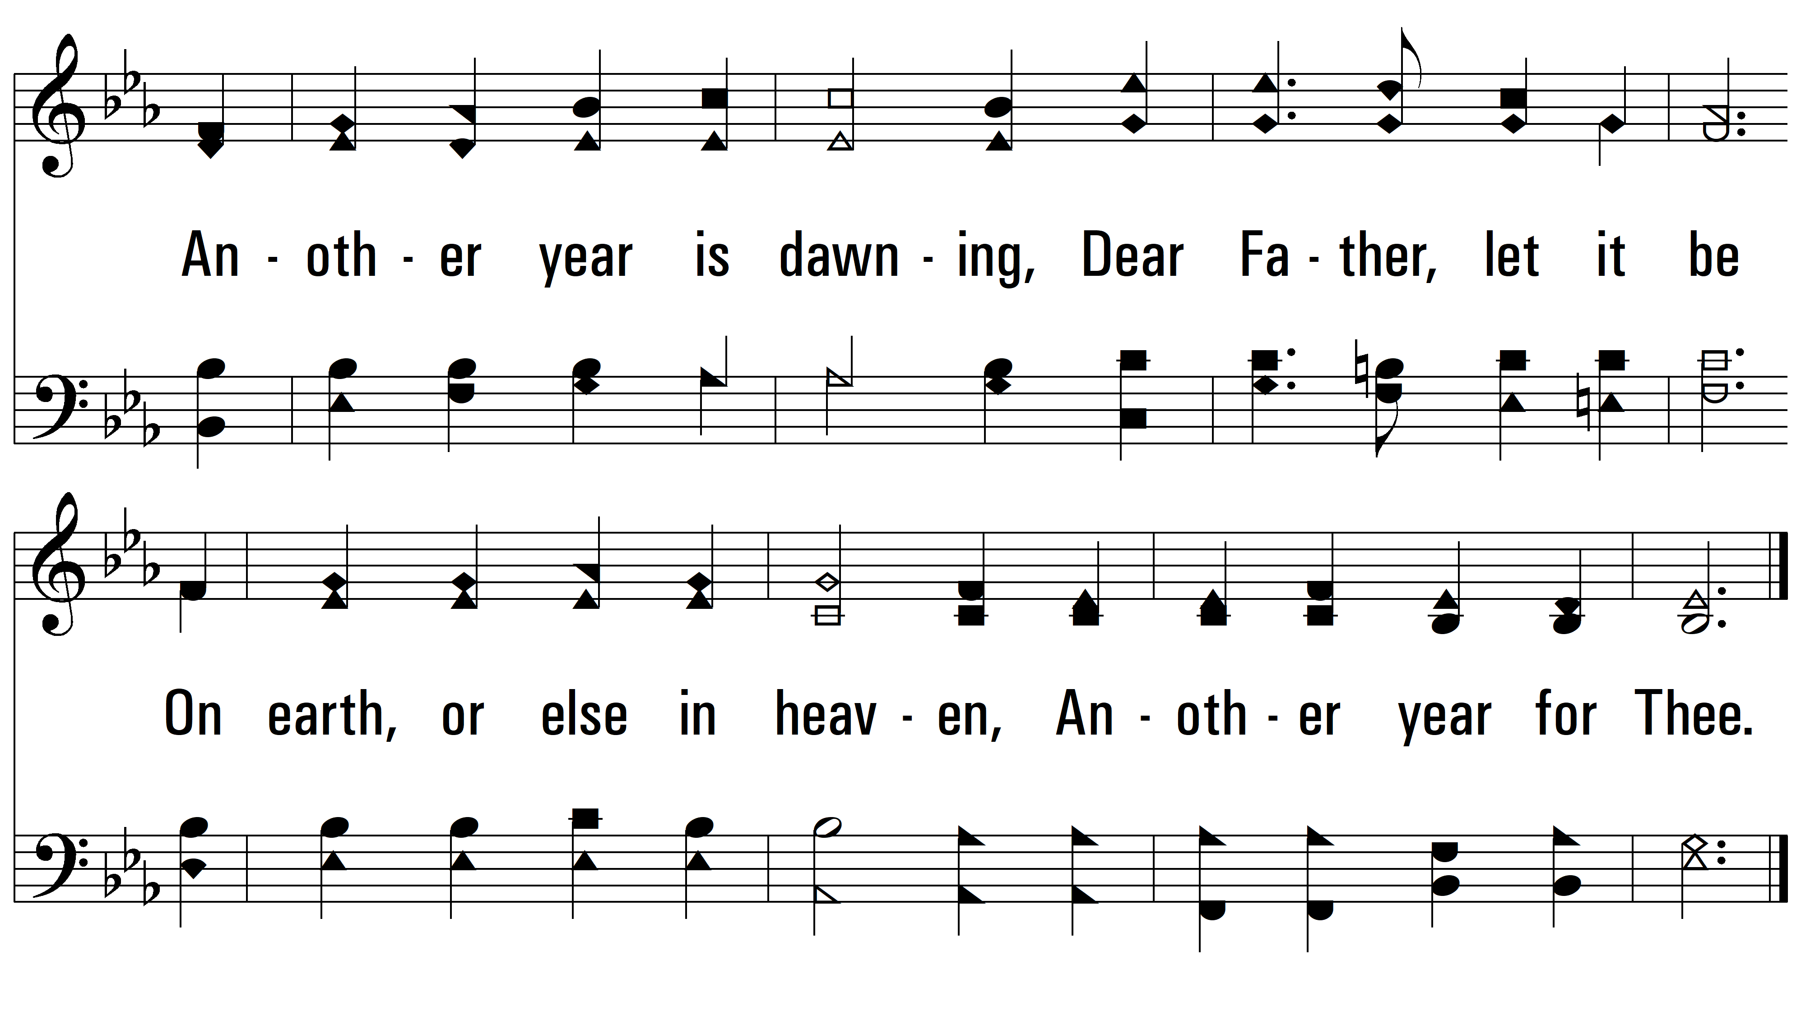
vs. 3
PDHymns.com
END

