Slide 1
Angry Words
(Love One Another)
Words: | Sunday School Teacher (1867), st. 3 by Betty Bender
Music: | H. R. Palmer (1867), Arr. by Will W. Slater (1944)
3/4
E^{b}/B^{b} - SOL
Verses: 3/Chorus
Lead - | SOL
Alto - | MI
Tenor - | SOL
Bass - | DO
PDHymns.com

Slide 2
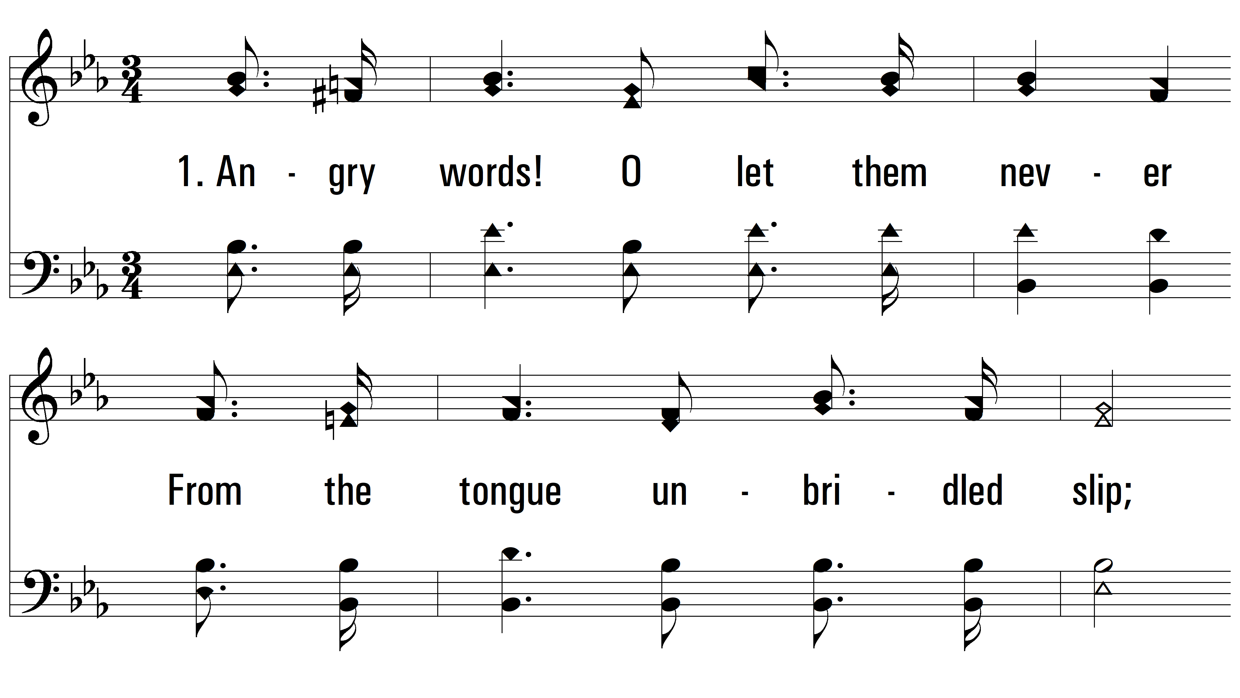
vs. 1 ~ Angry Words

Slide 3
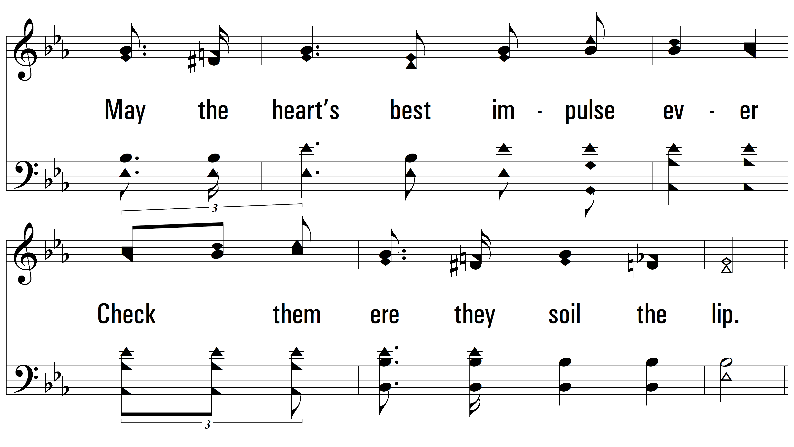
vs. 1

Slide 4
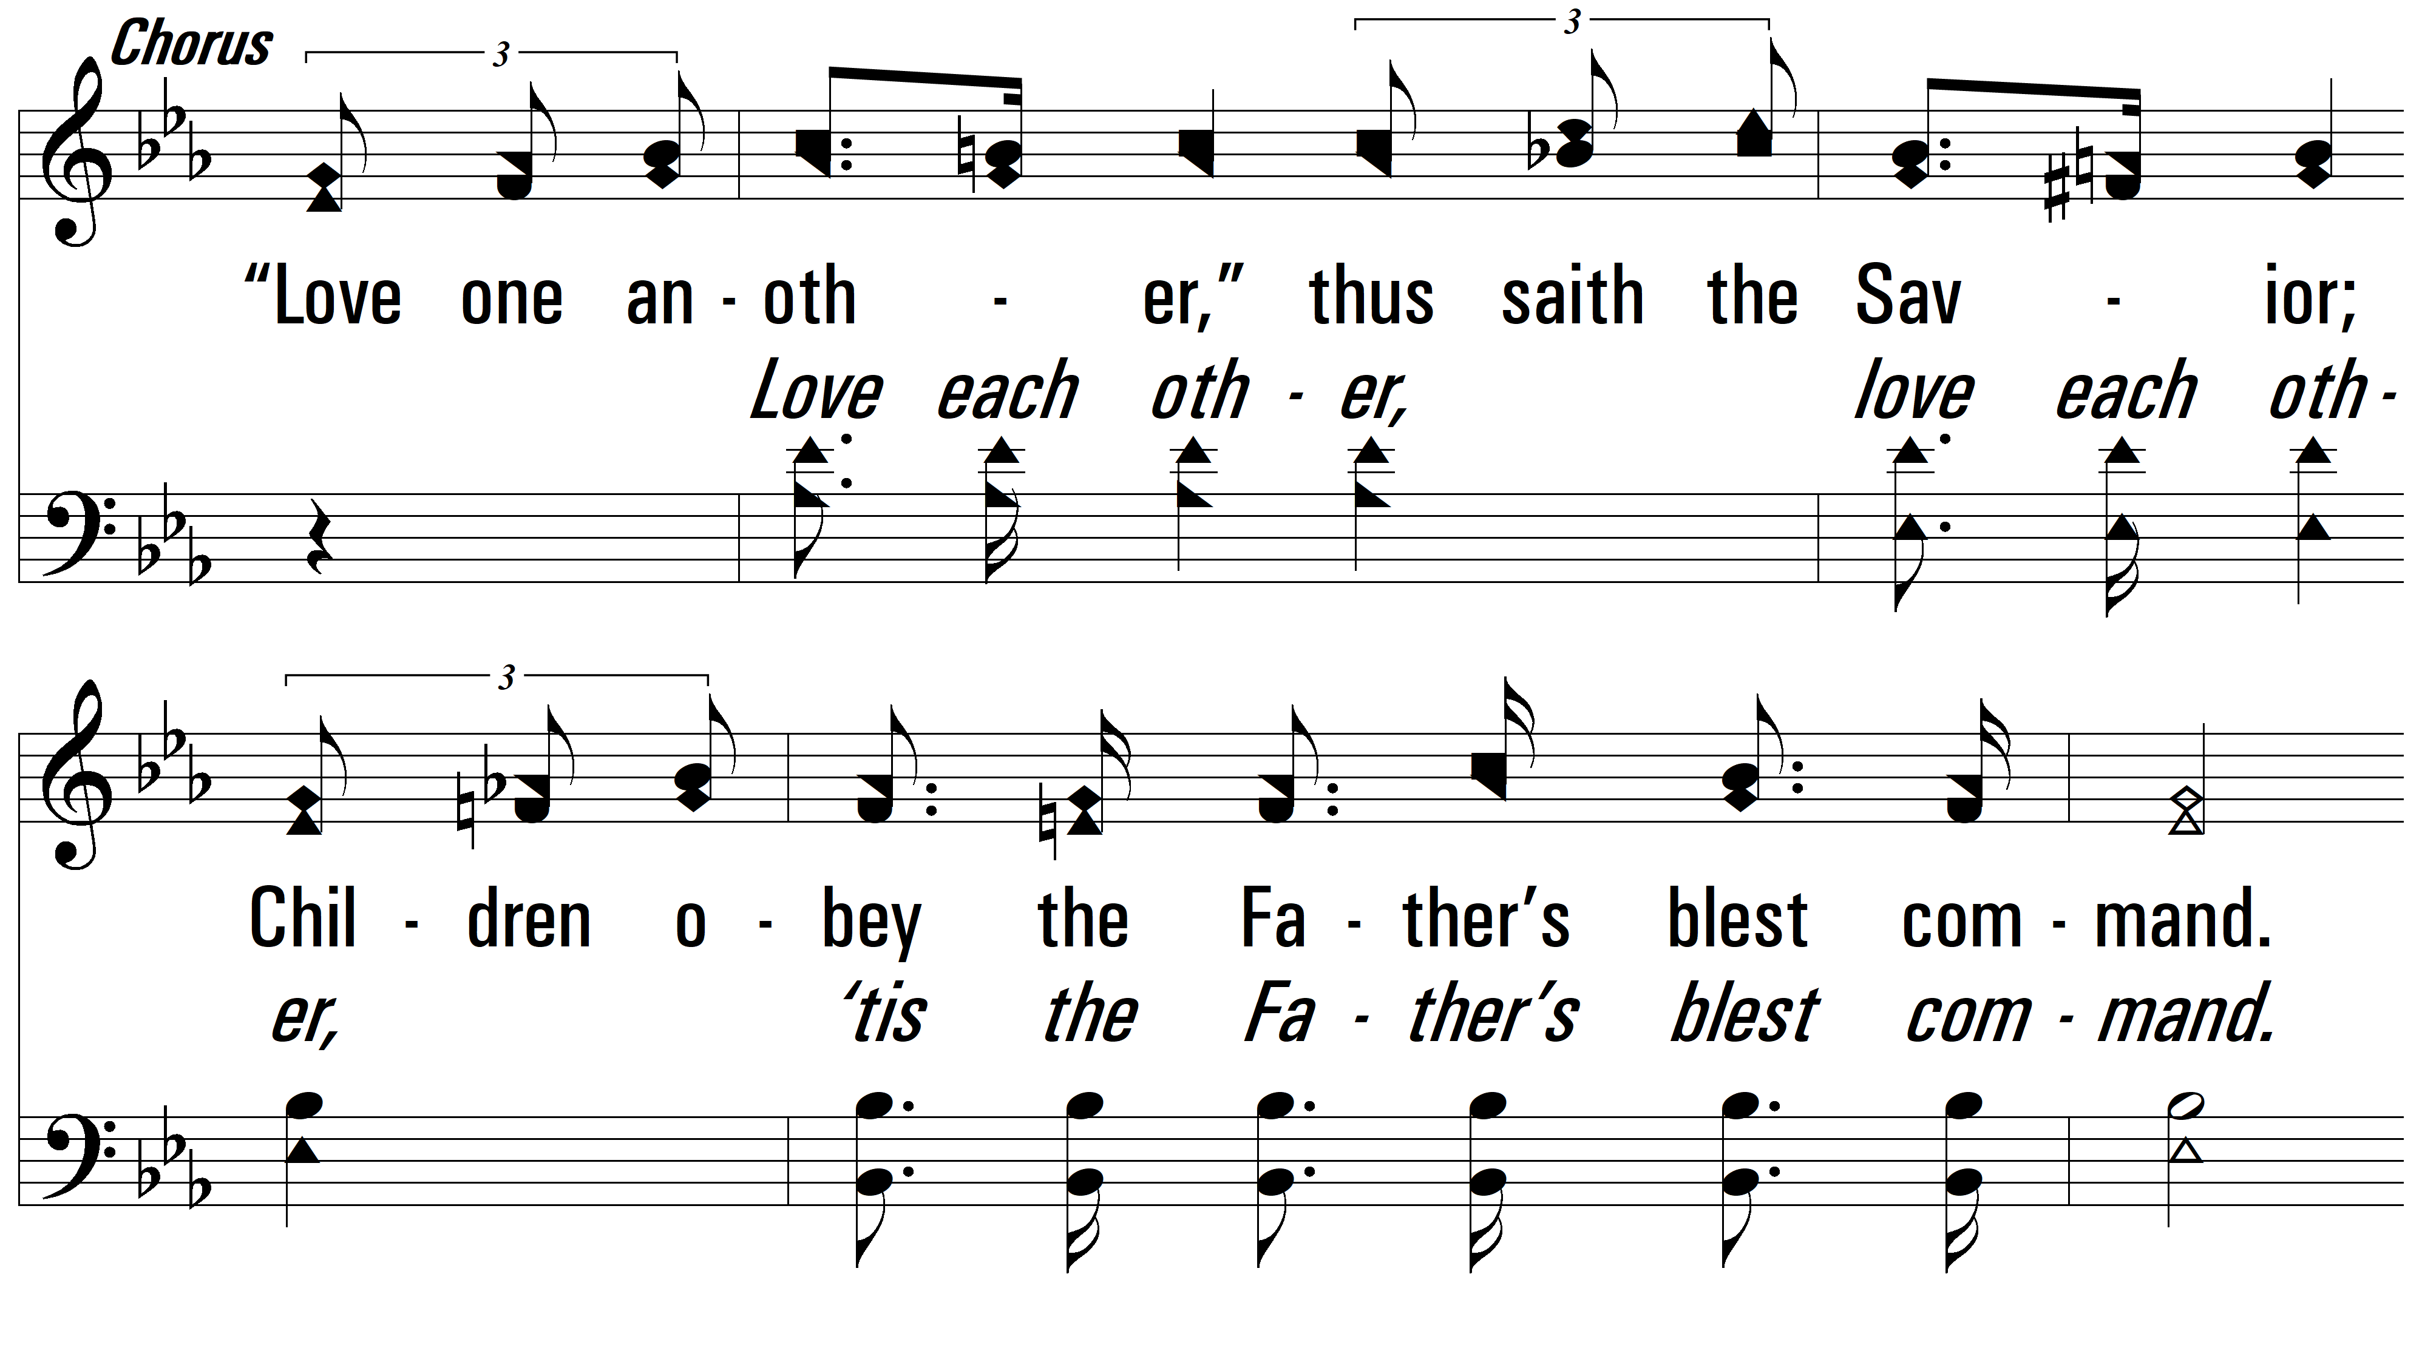
vs. 1

Slide 5
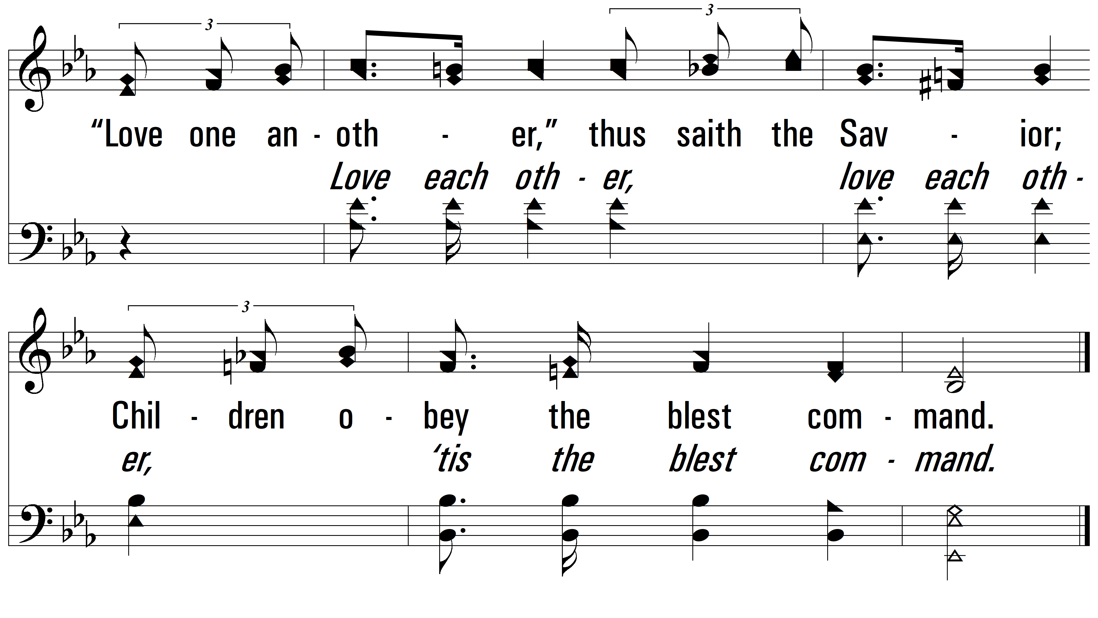
vs. 1

Slide 6
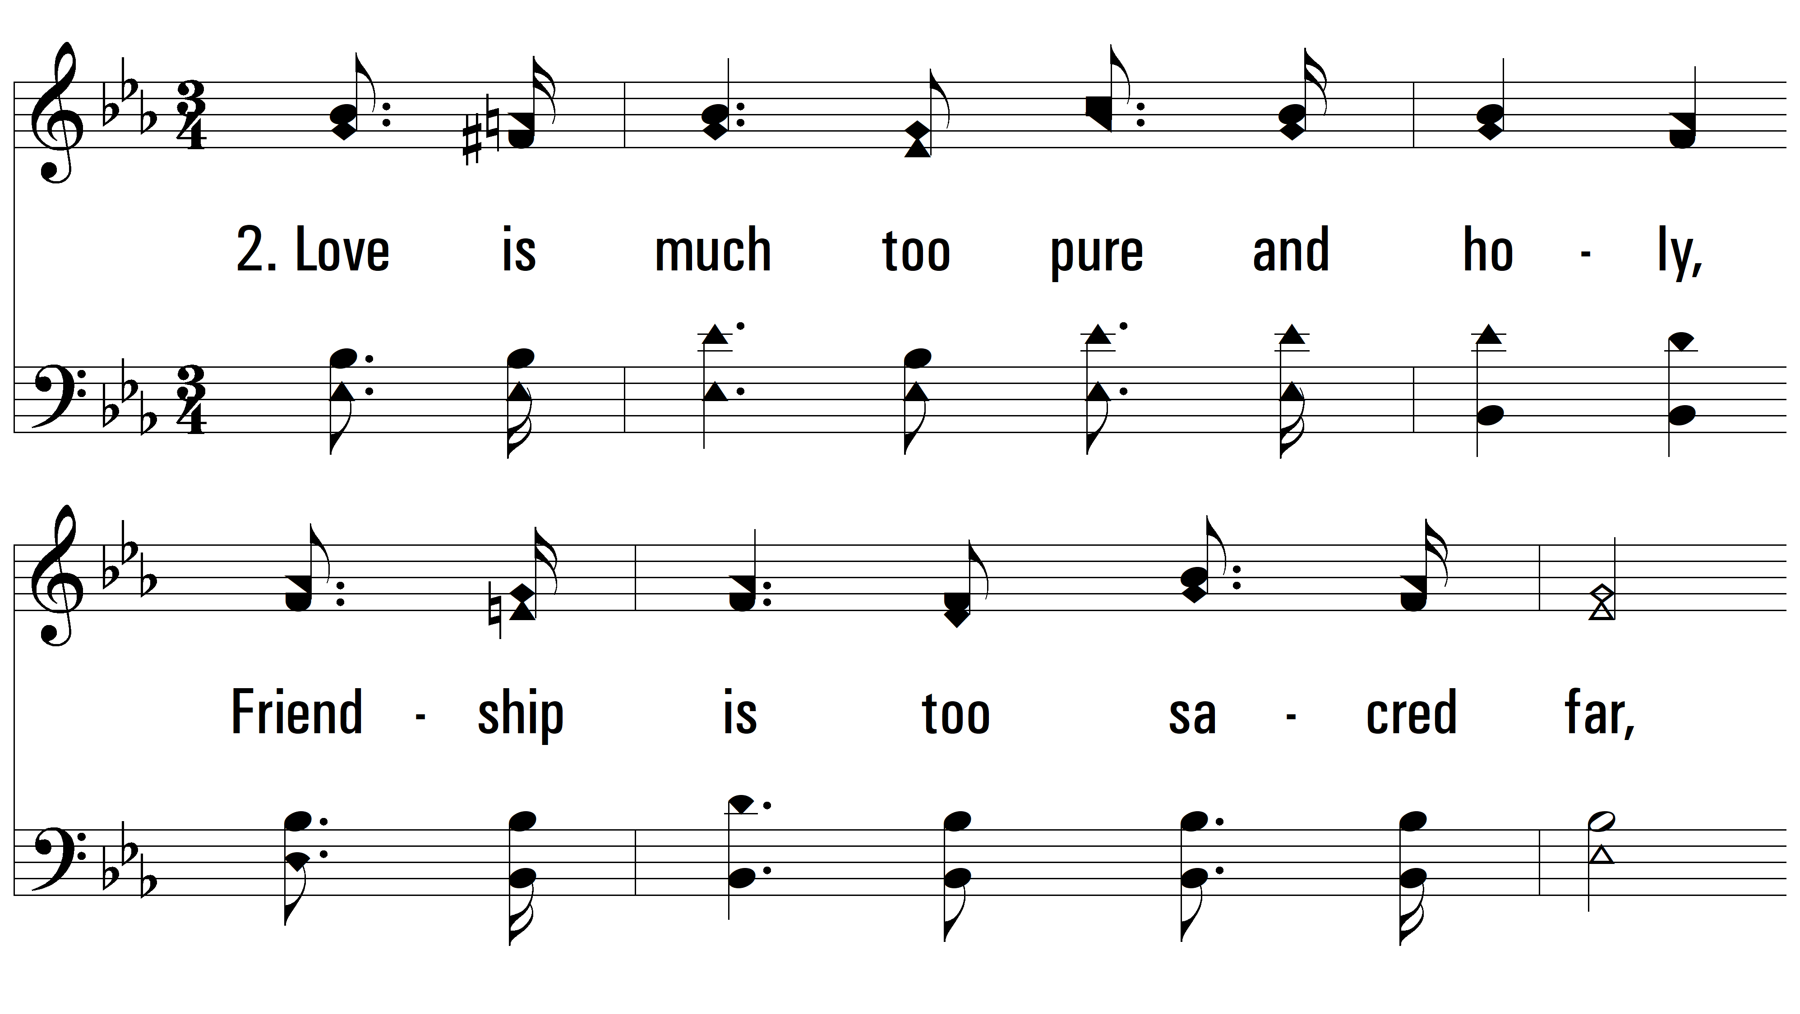
vs. 2 ~ Angry Words

Slide 7
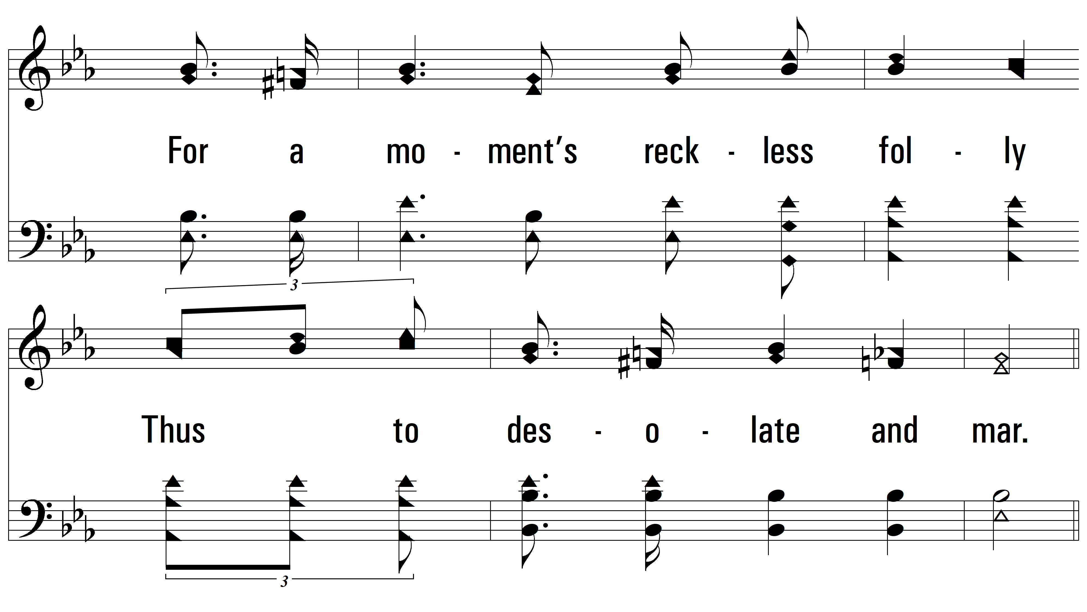
vs. 2

Slide 8
vs. 2

Slide 9
vs. 2

Slide 10
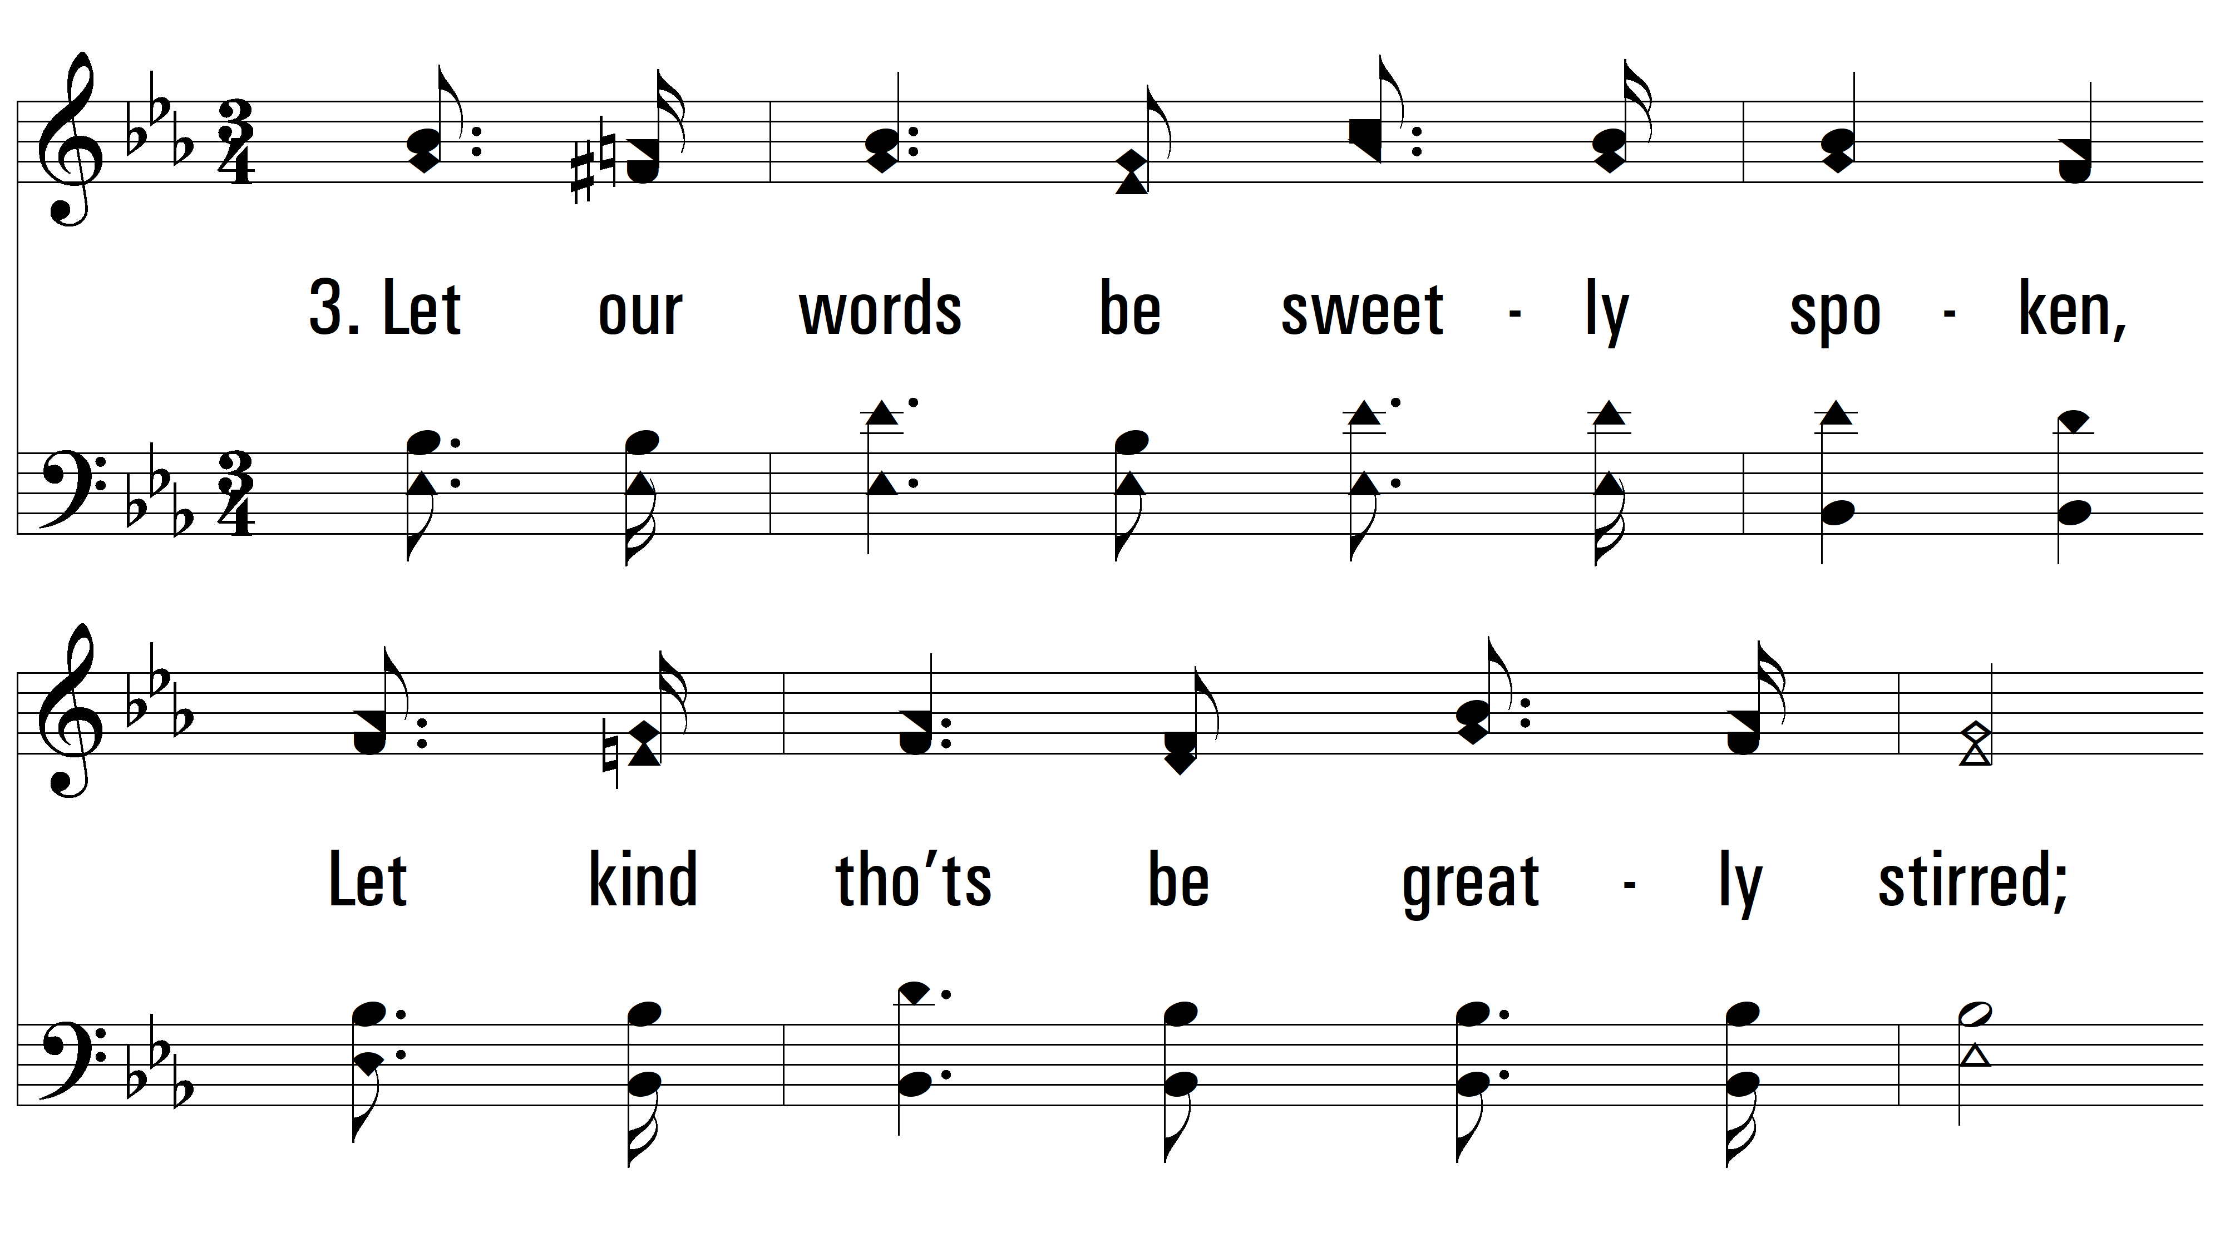
vs. 3 ~ Angry Words

Slide 11
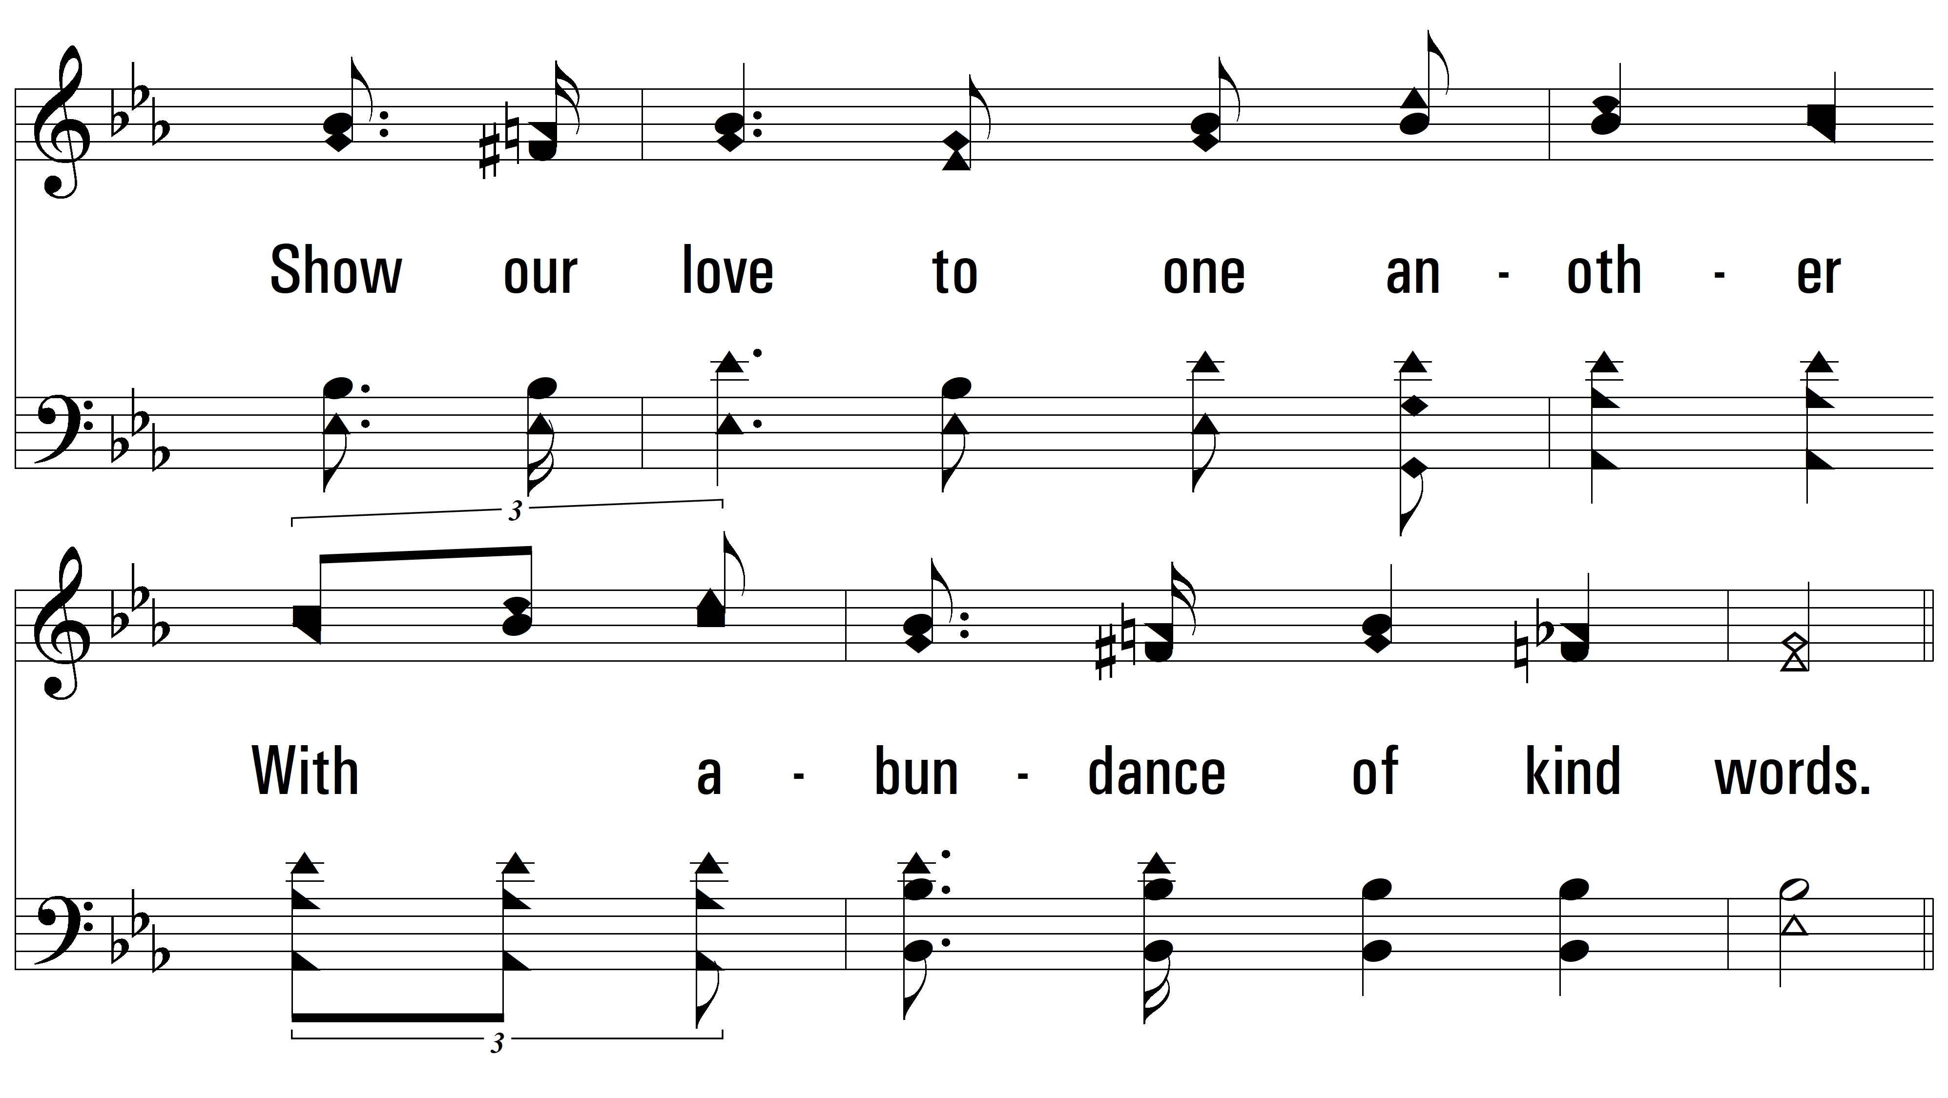
vs. 3

Slide 12
vs. 3

Slide 13
vs. 3
PDHymns.com
END

