Slide 1
America The Beautiful
Words: | Katherine Lee Bates (1893)
Music: | Samuel A. Ward (1882)
4/4
C/G - SOL
Verses: 4
Lead - | SOL
Alto - | MI
Tenor - | DO
Bass - | DO
PDHymns.com

Slide 2
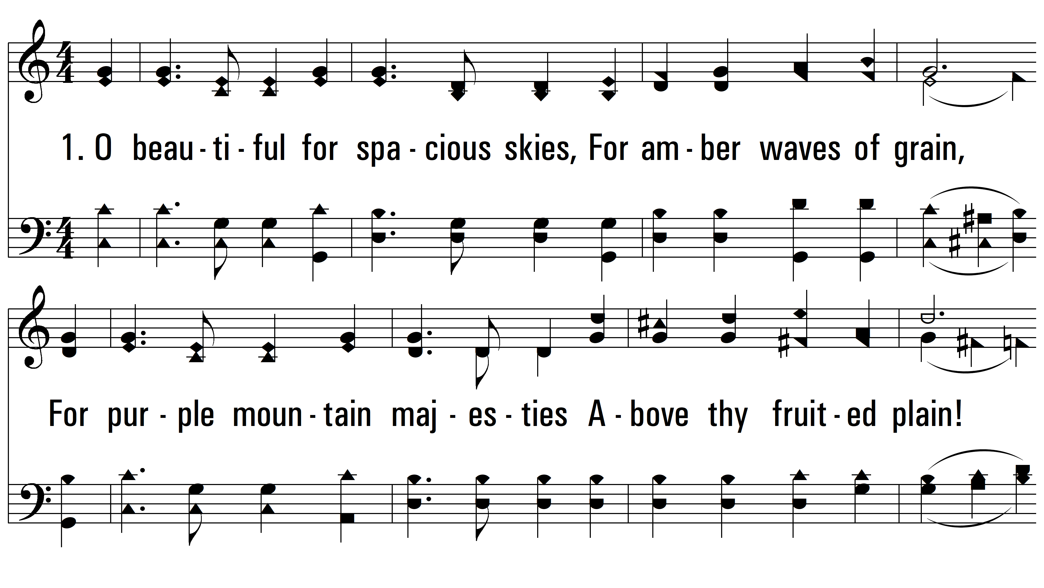
vs. 1 ~ America The Beautiful

Slide 3
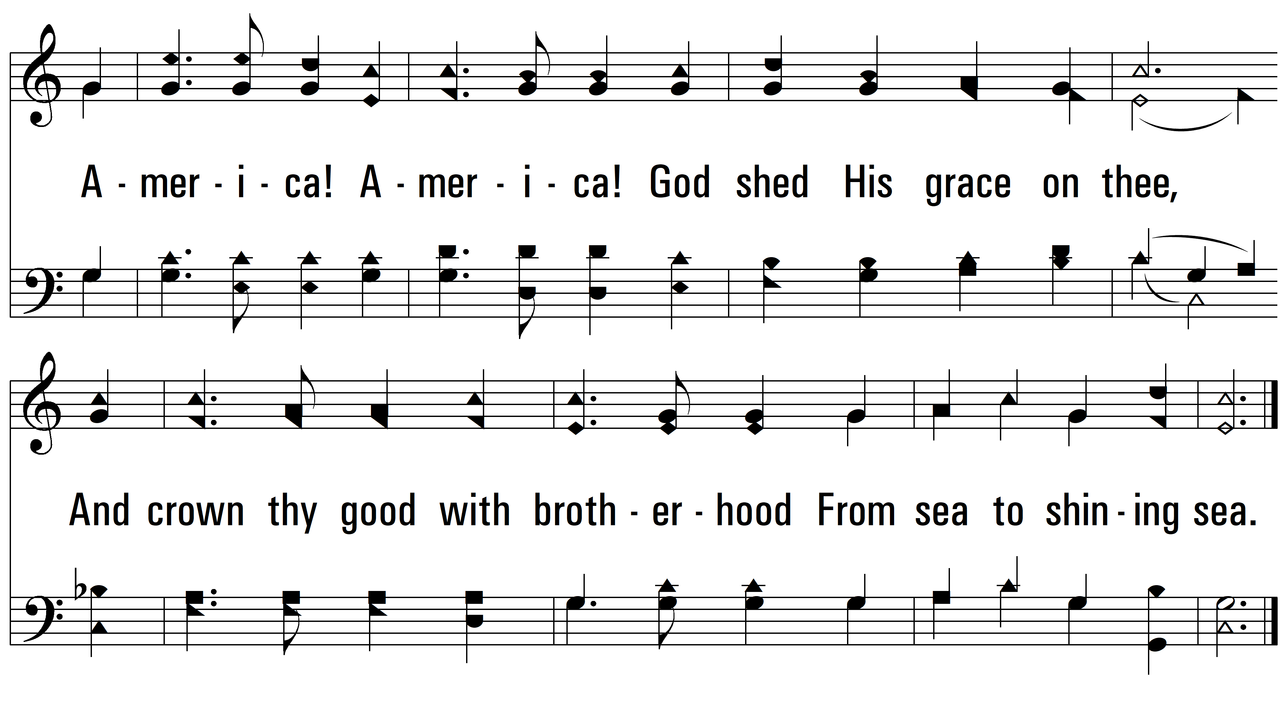
vs. 1

Slide 4
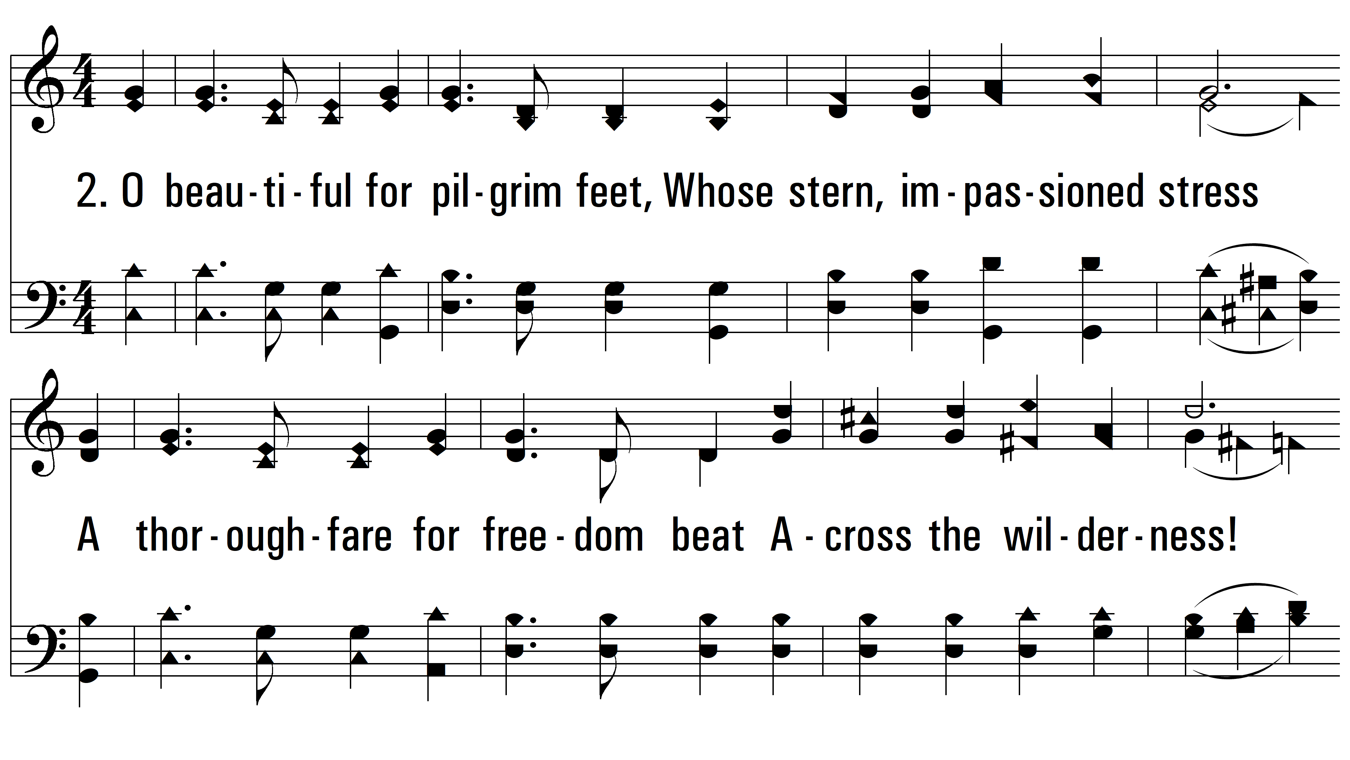
vs. 2 ~ America The Beautiful

Slide 5
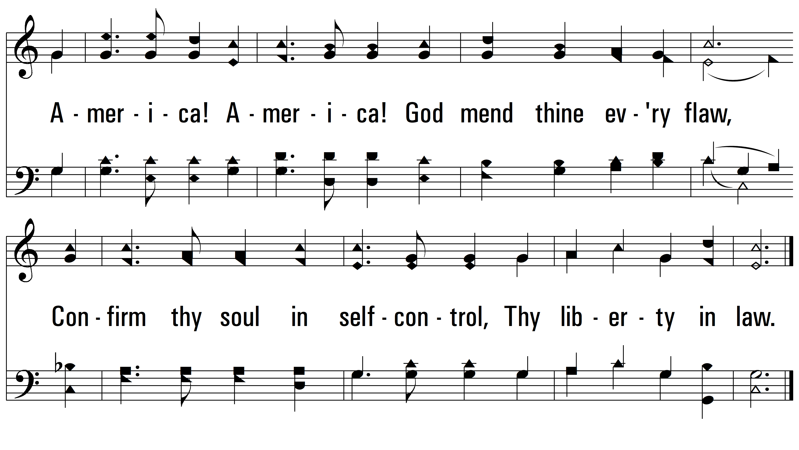
vs. 2

Slide 6
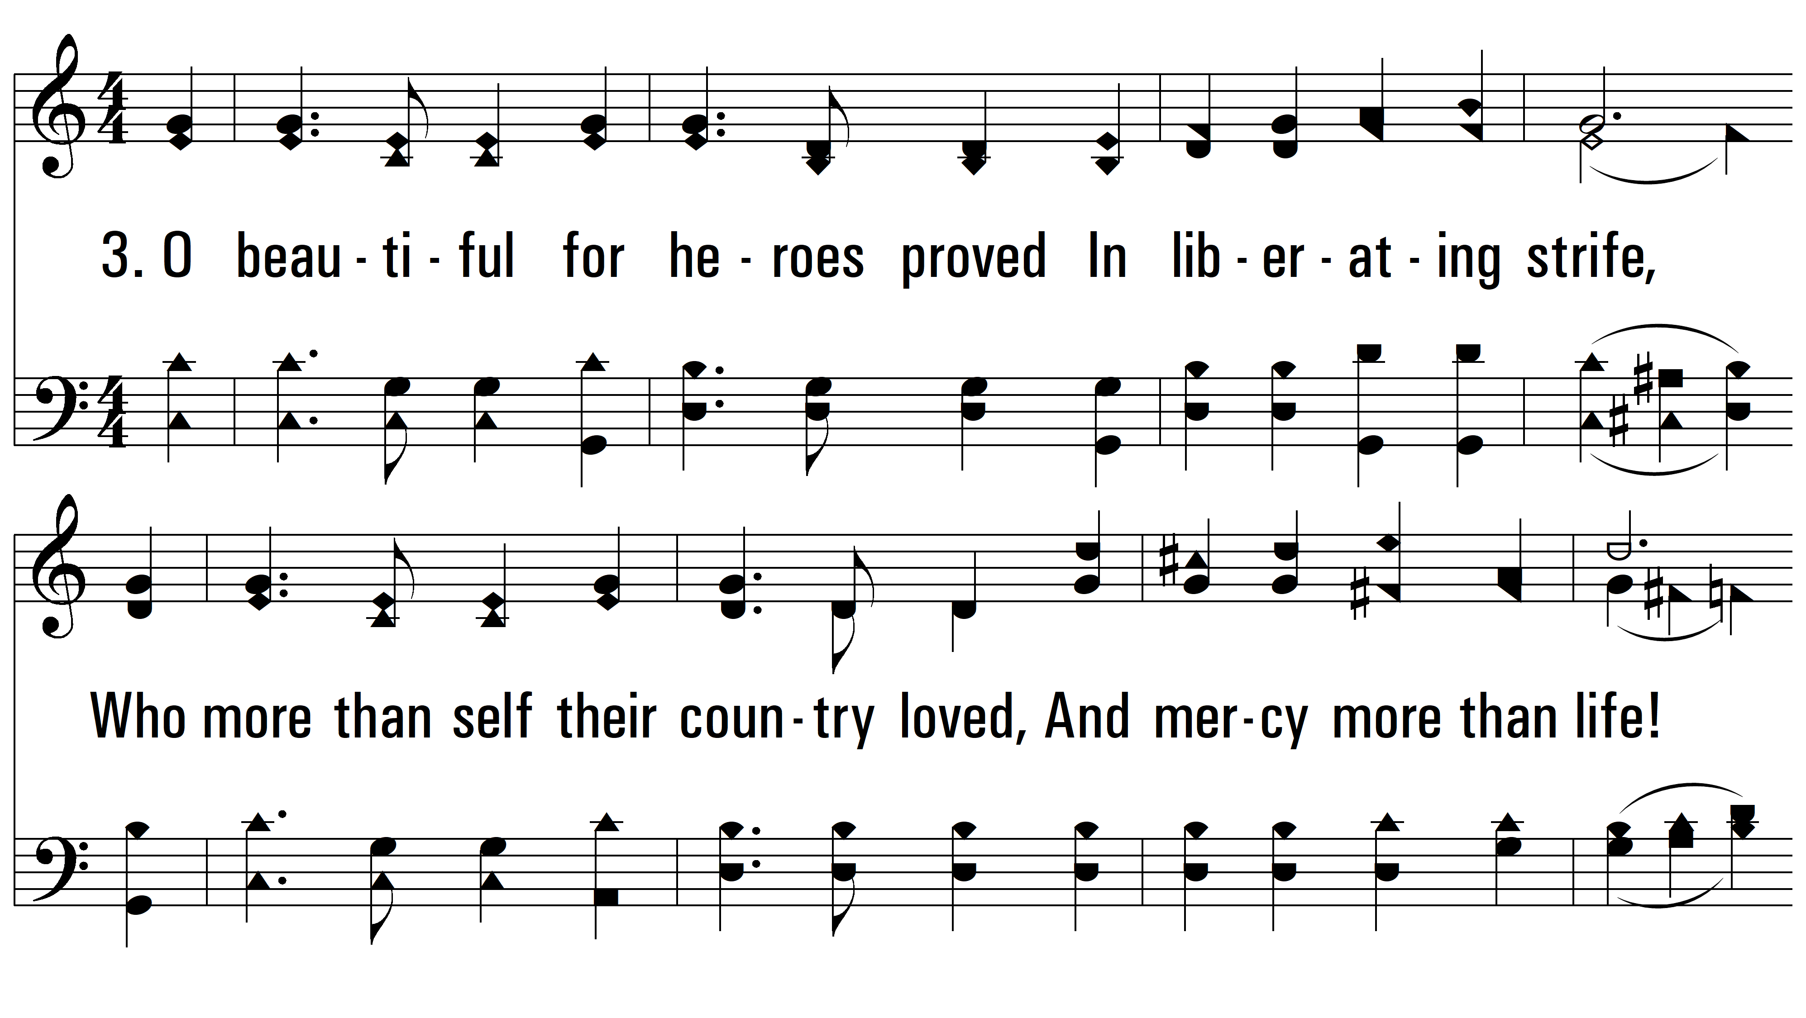
vs. 3 ~ America The Beautiful

Slide 7
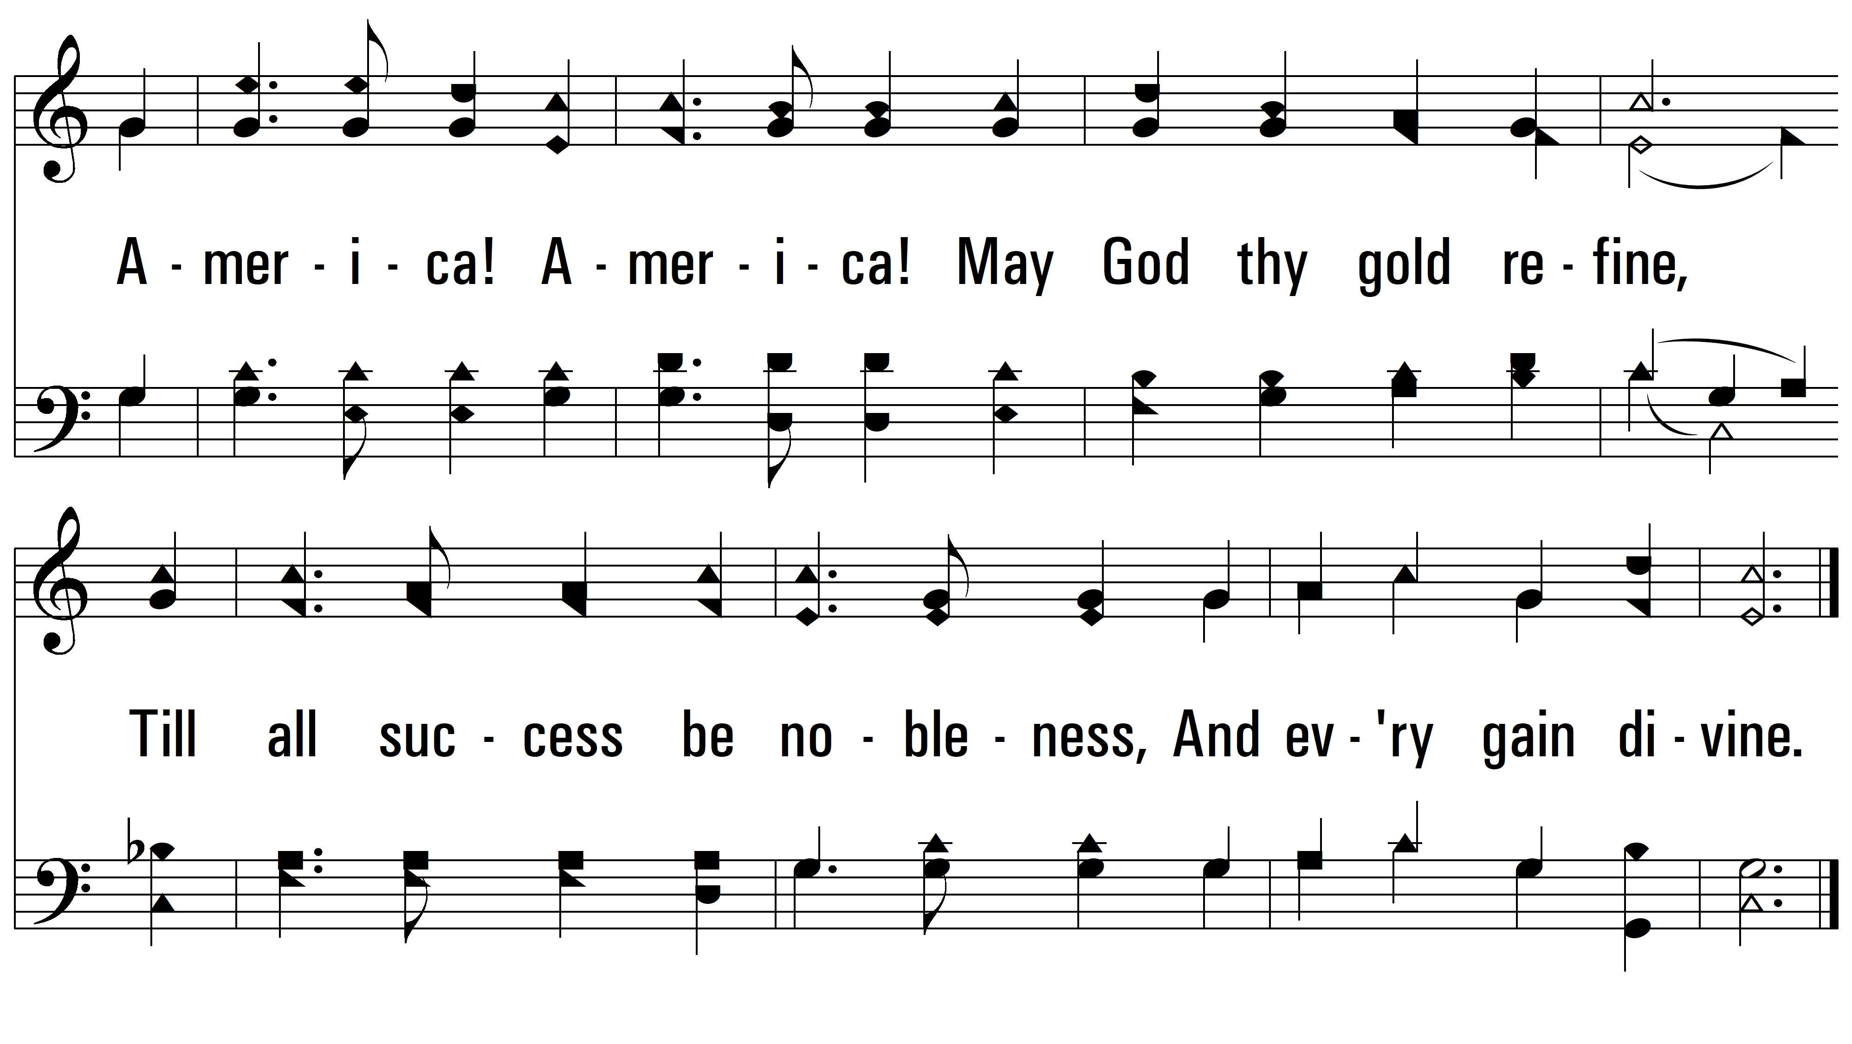
vs. 3

Slide 8
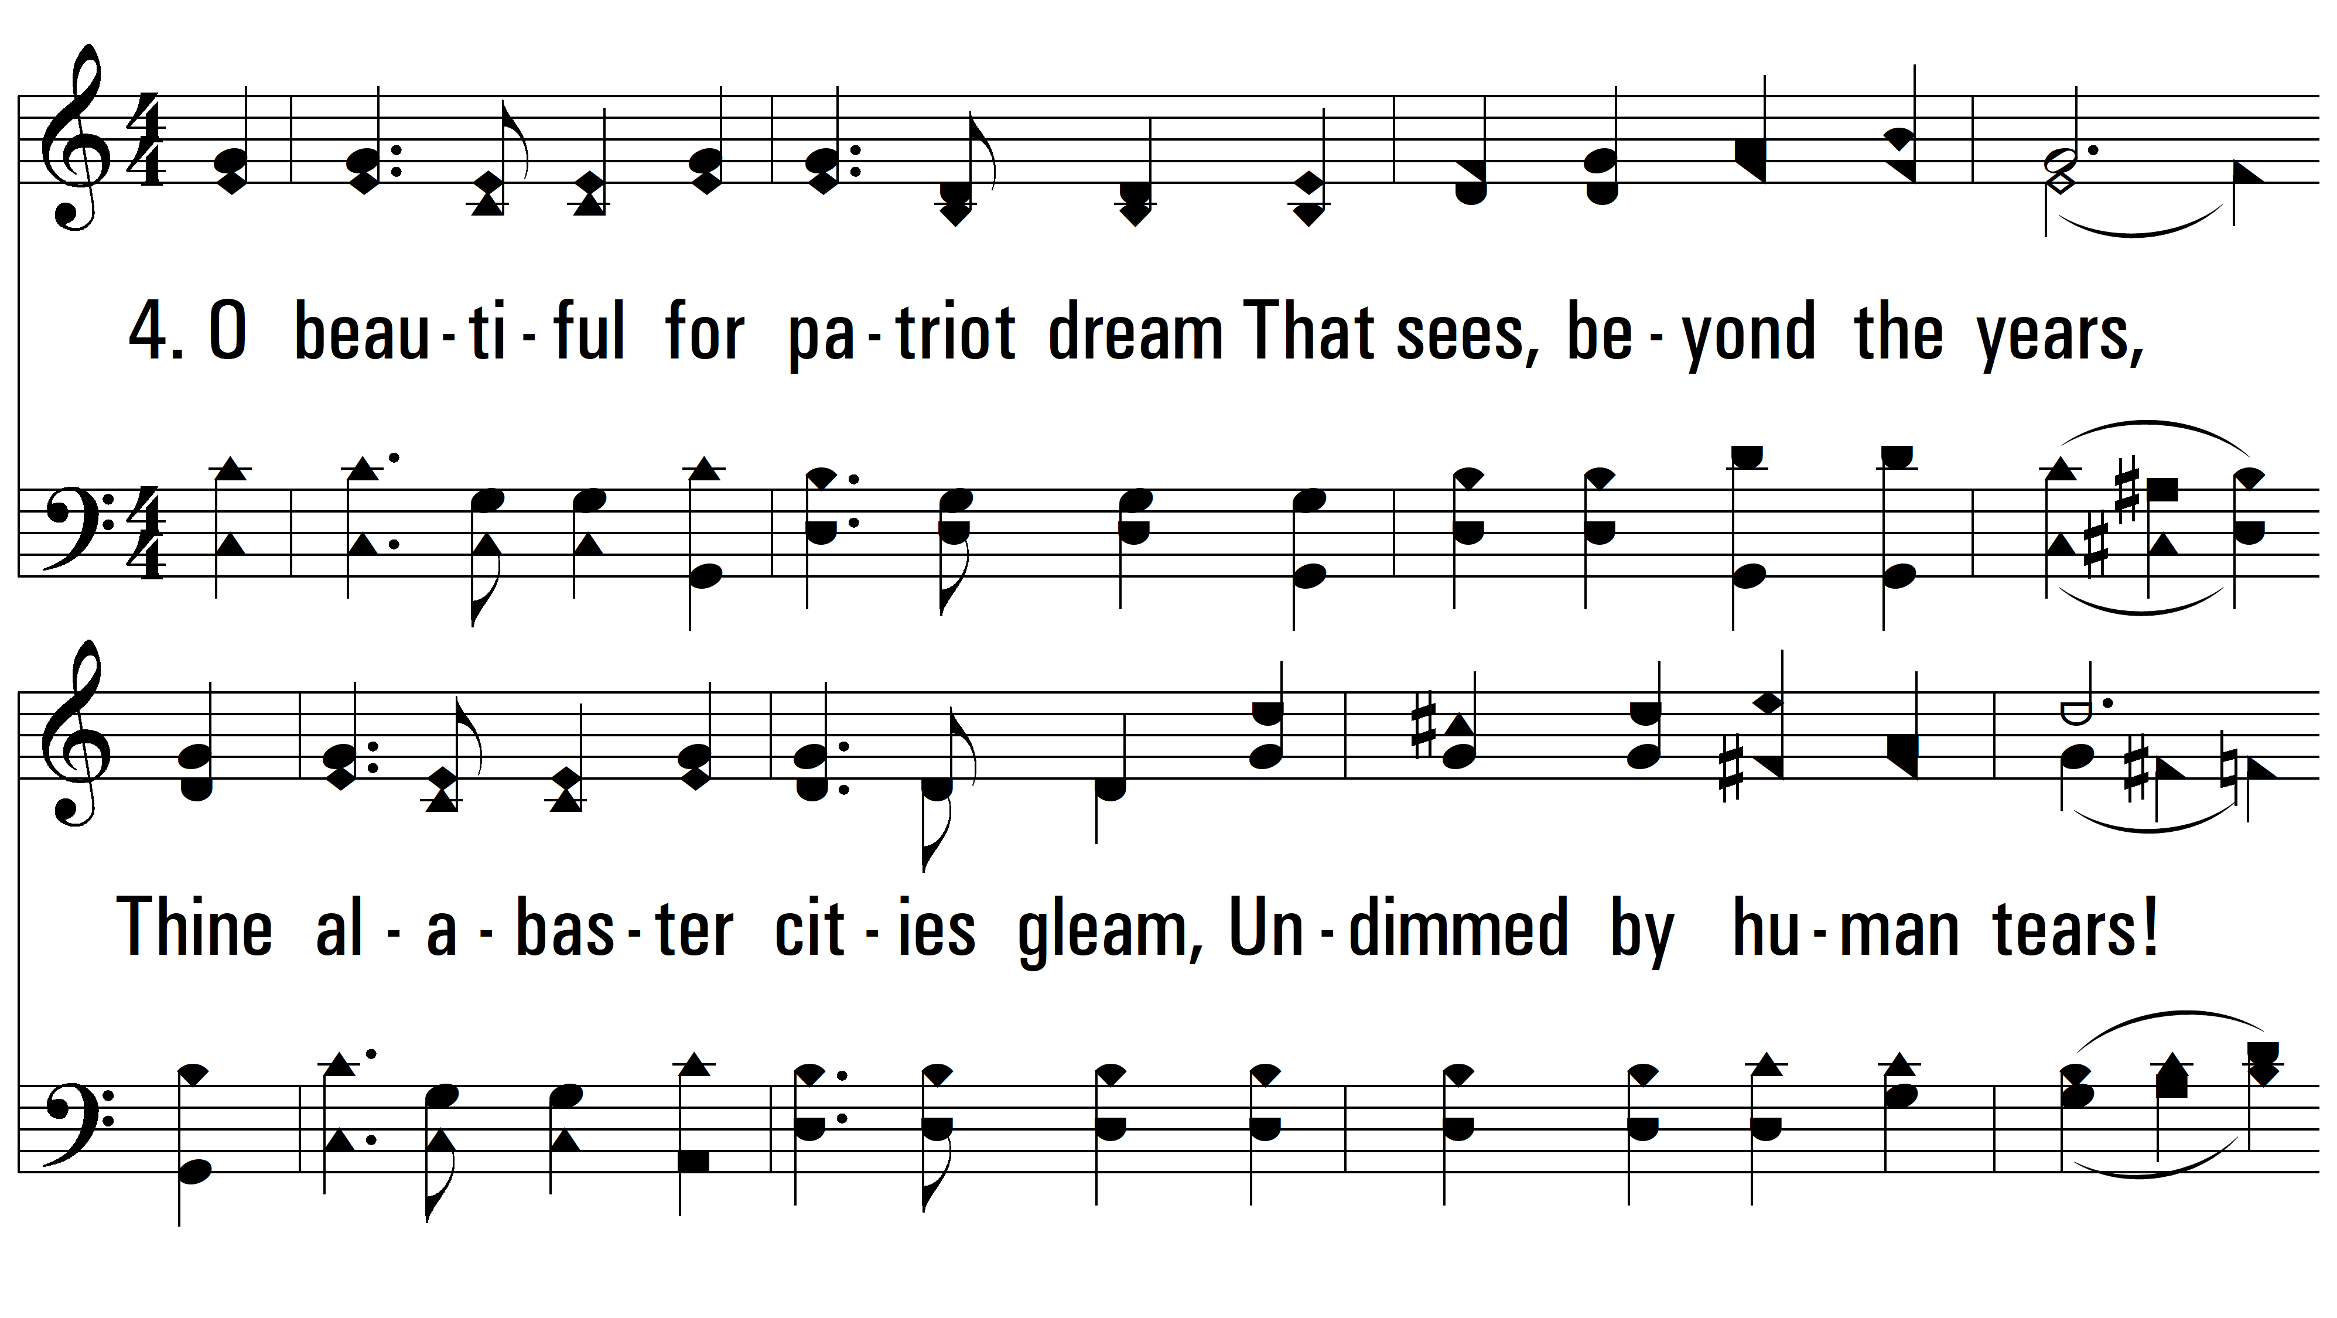
vs. 4 ~ America The Beautiful

Slide 9
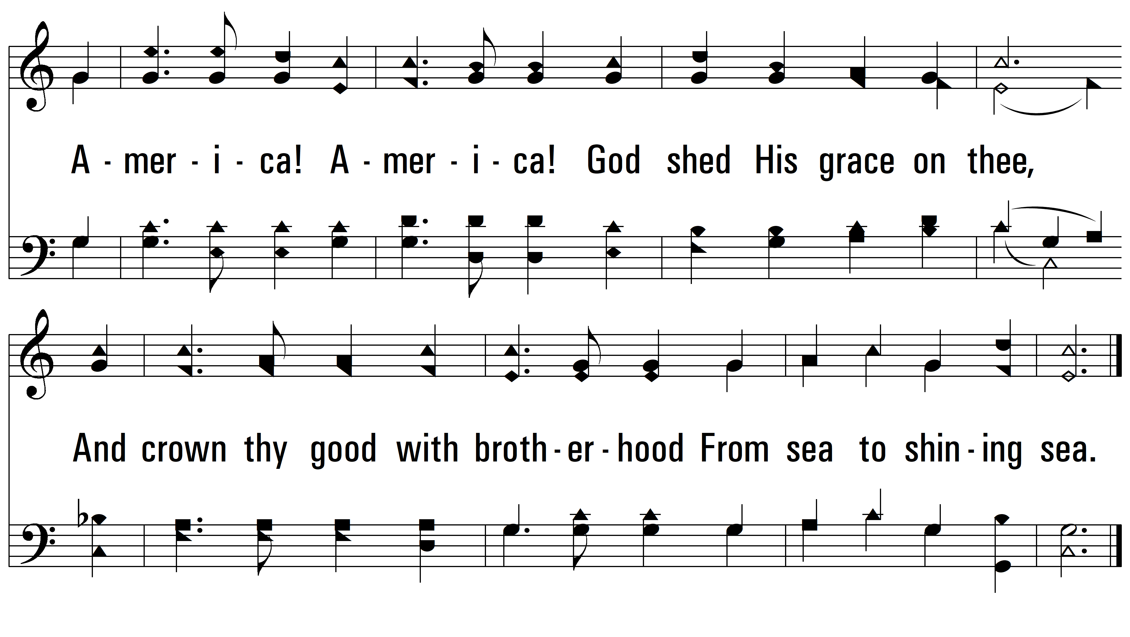
vs. 4
PDHymns.com
END

