Slide 1
Amazing Grace
NEW BRITAIN
CM
Words: | John Newton (1779)
Music: | Early American Melody
3/4
A^{b}/E^{b} - SOL
Verses: 5
Lead - | SOL
Alto - | MI
Tenor - | DO
Bass - | DO
PDHymns.com

Slide 2
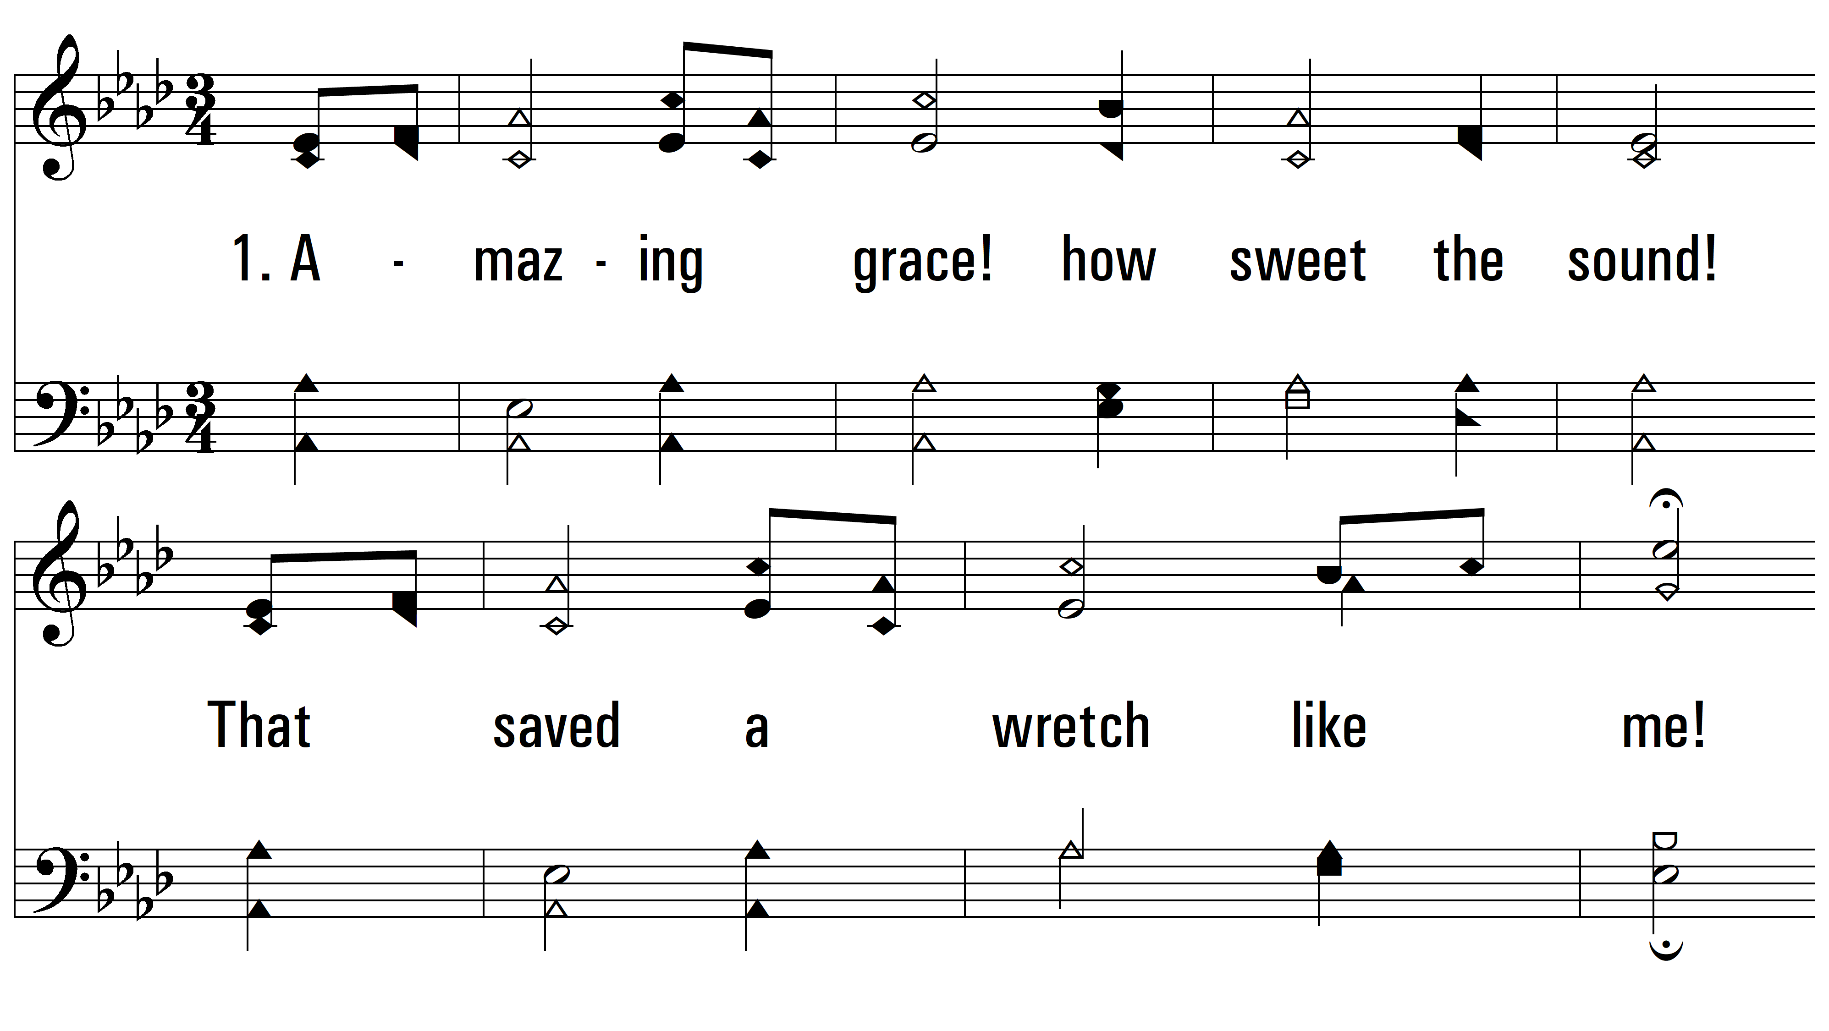
vs. 1 ~ Amazing Grace

Slide 3
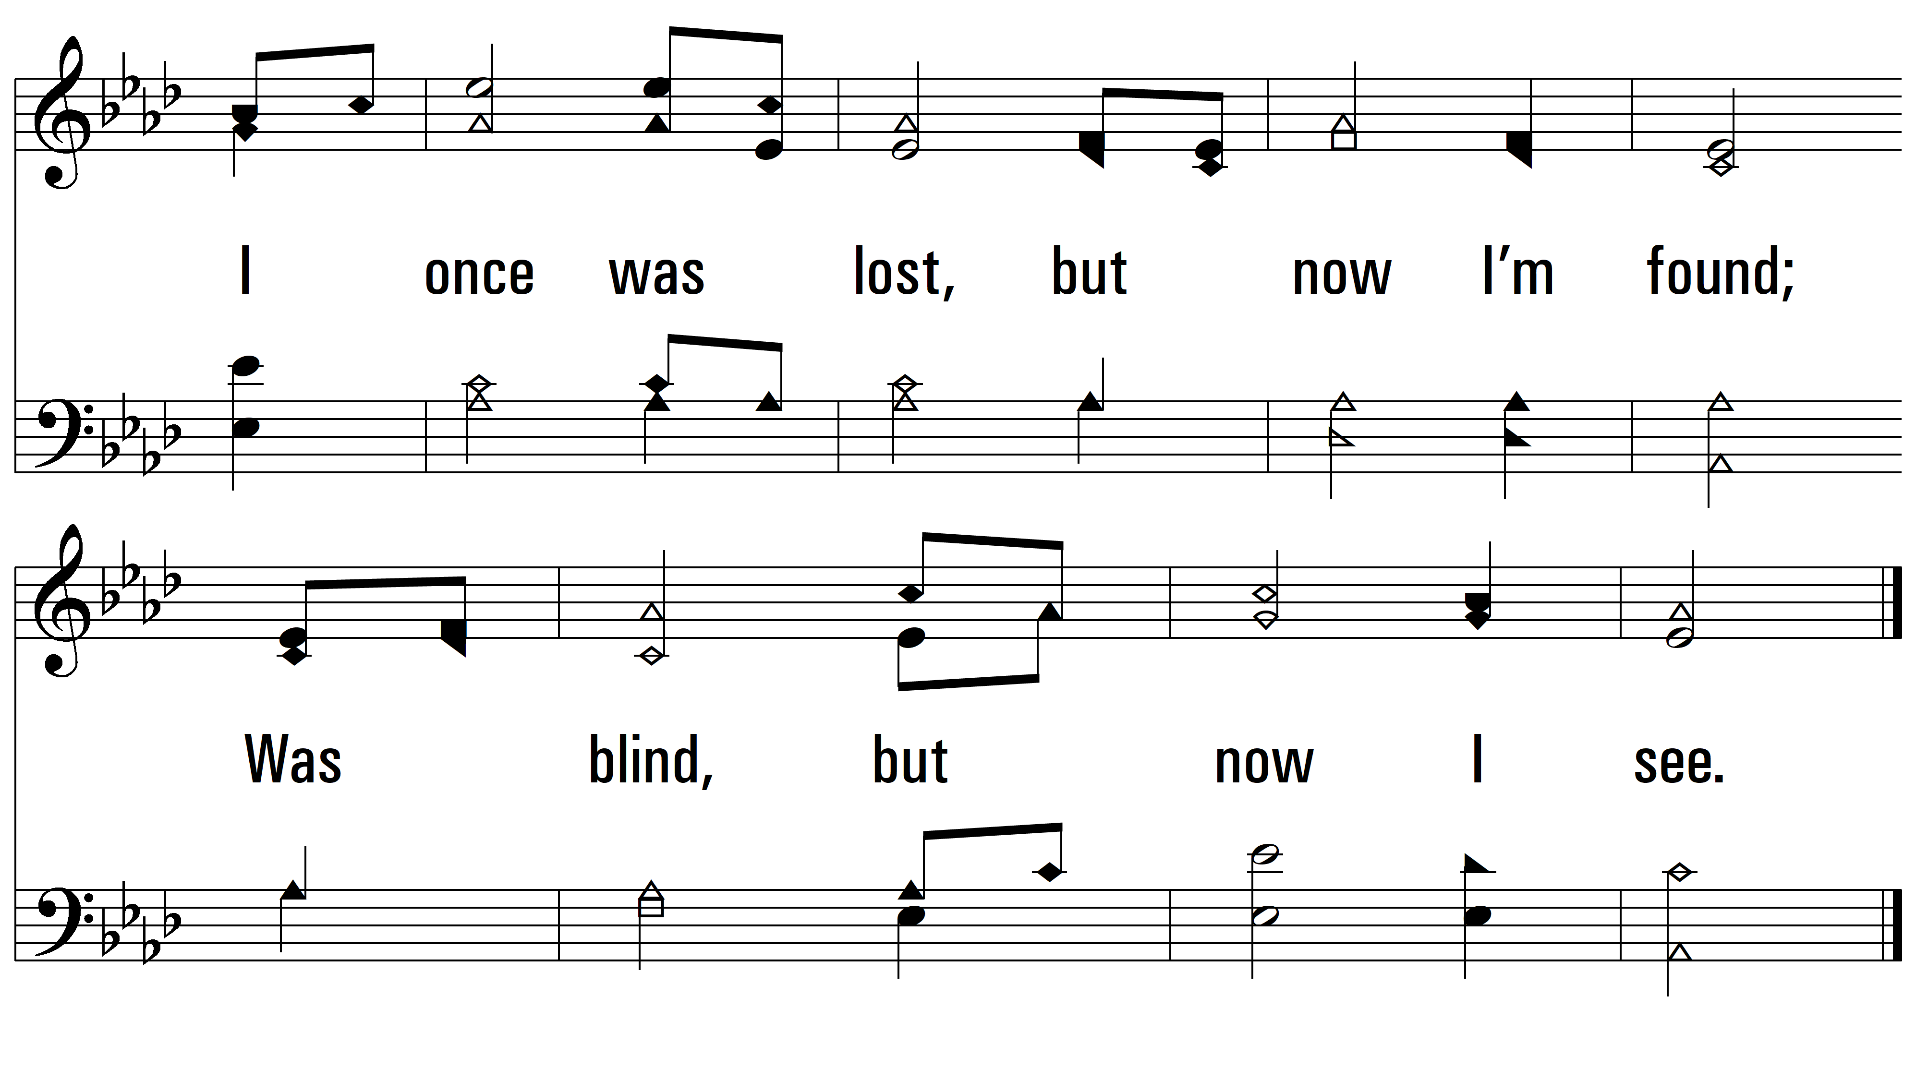
vs. 1

Slide 4
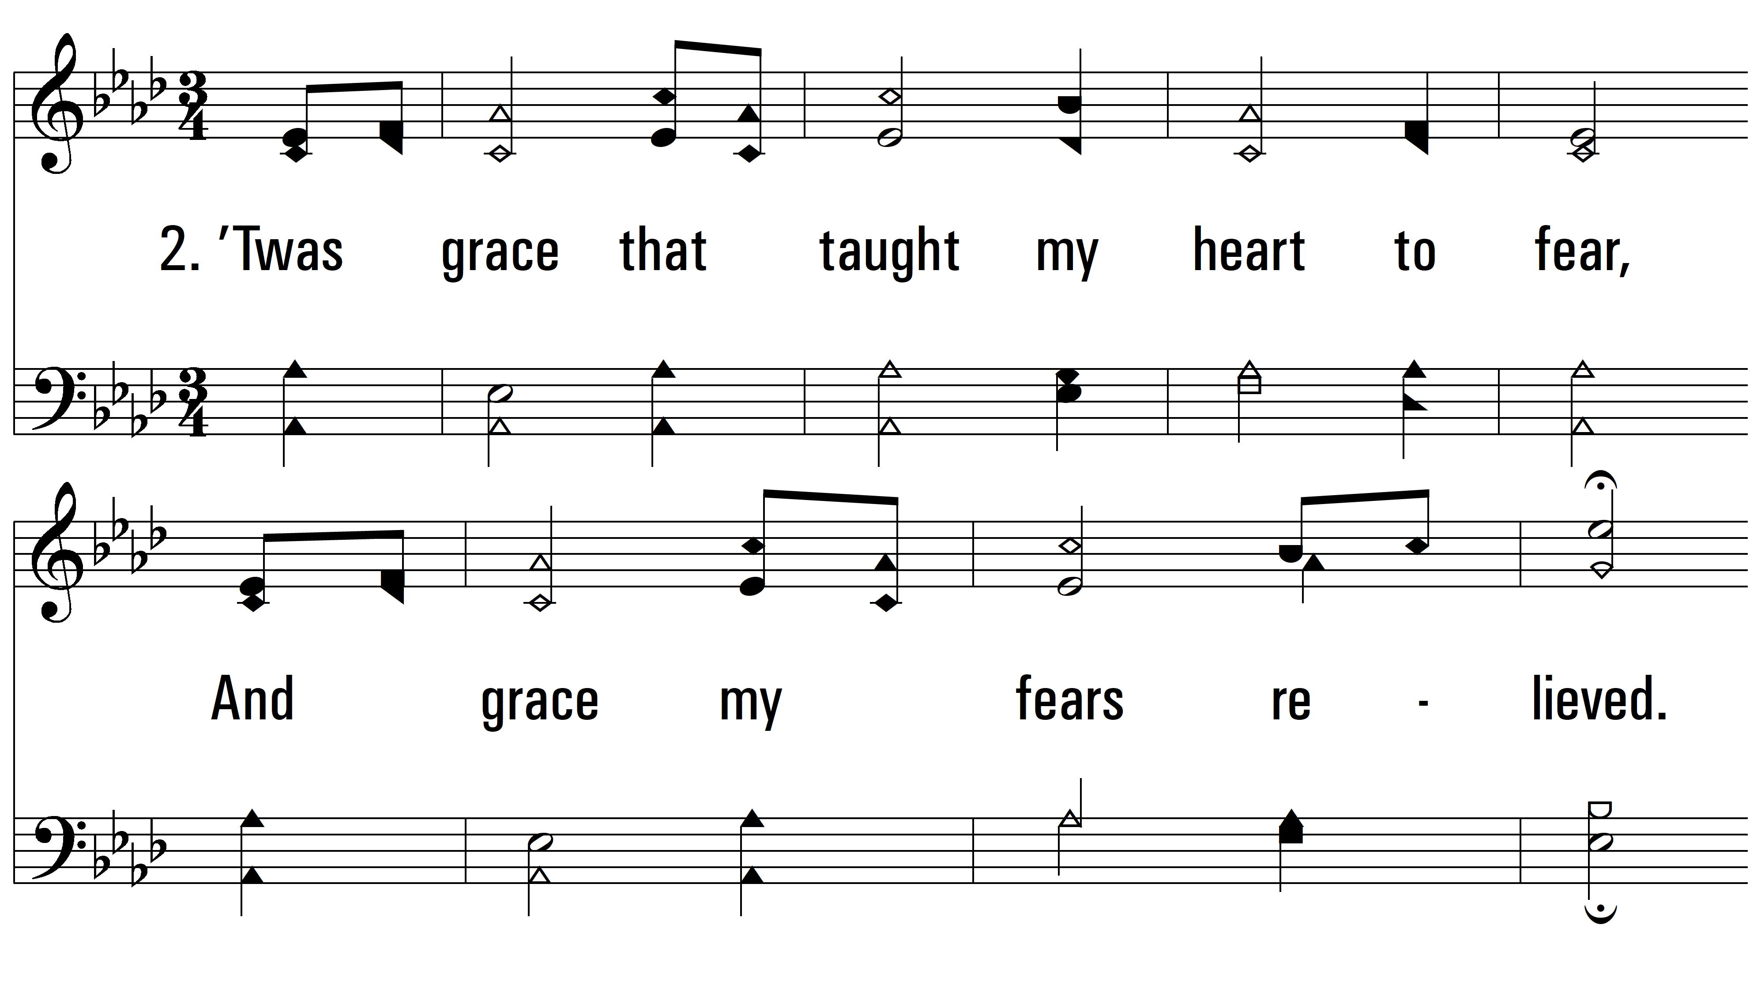
vs. 2 ~ Amazing Grace

Slide 5
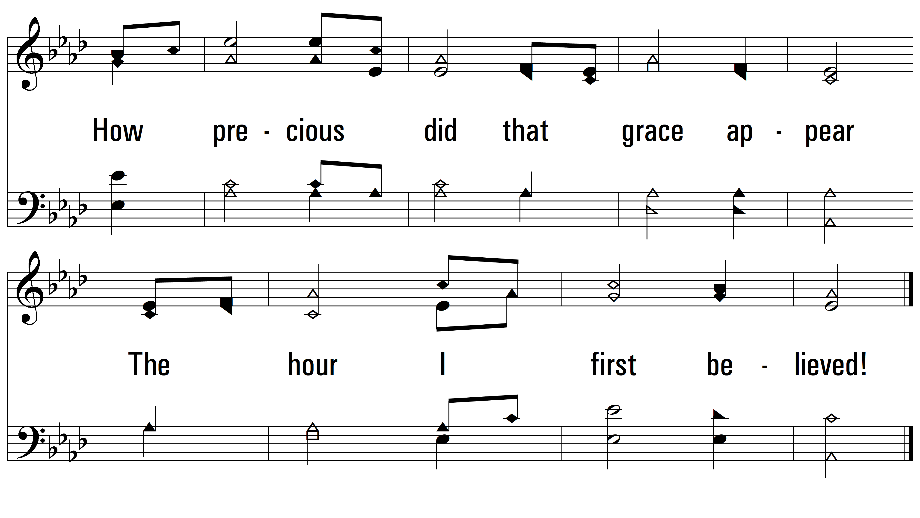
vs. 2

Slide 6
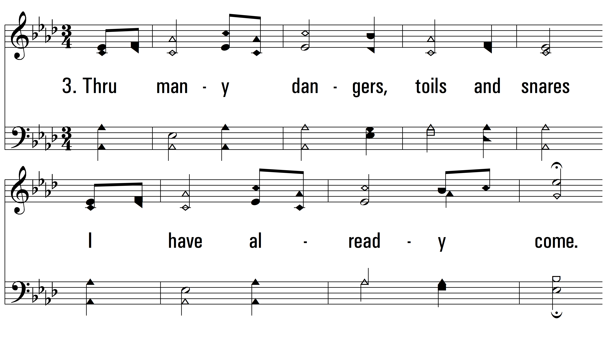
vs. 3 ~ Amazing Grace

Slide 7
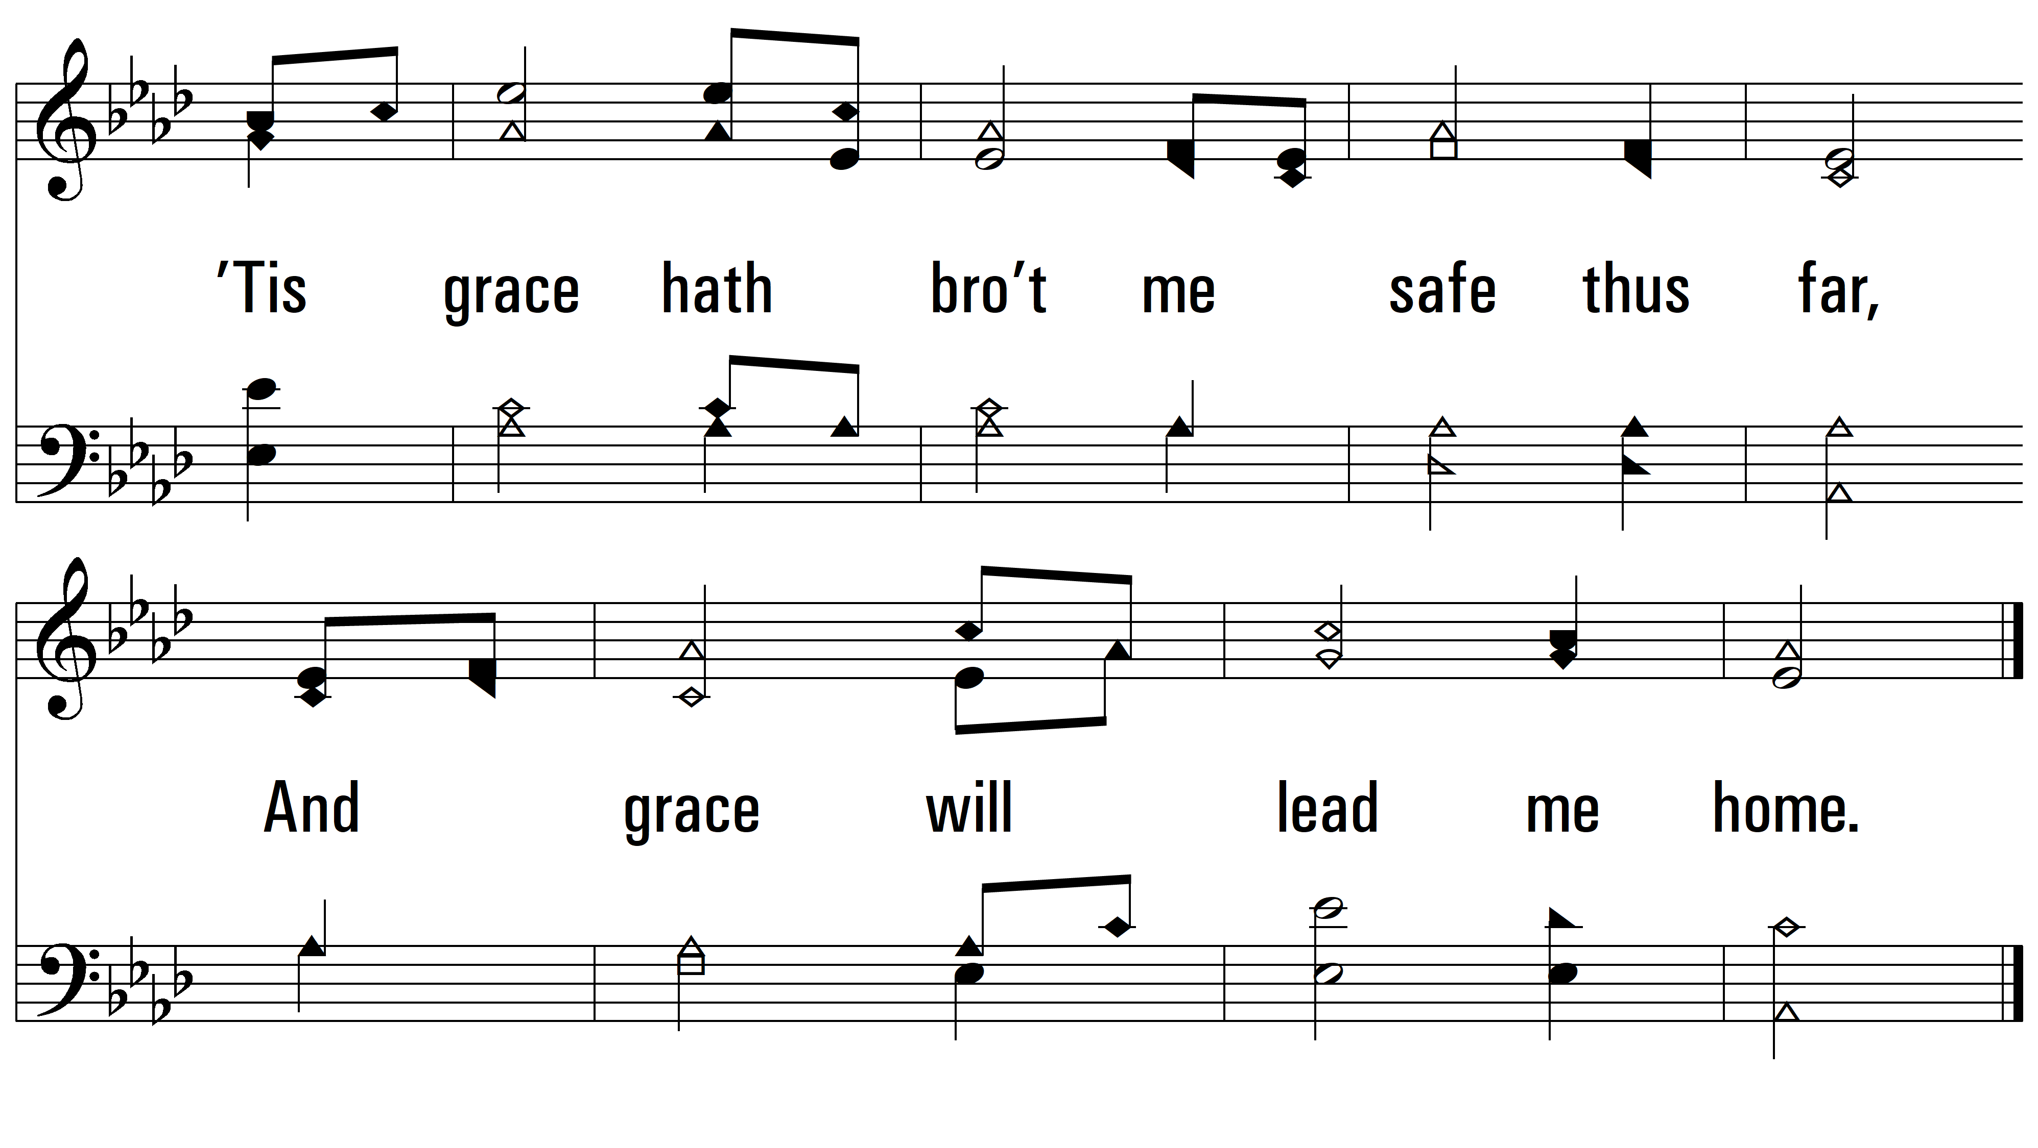
vs. 3

Slide 8
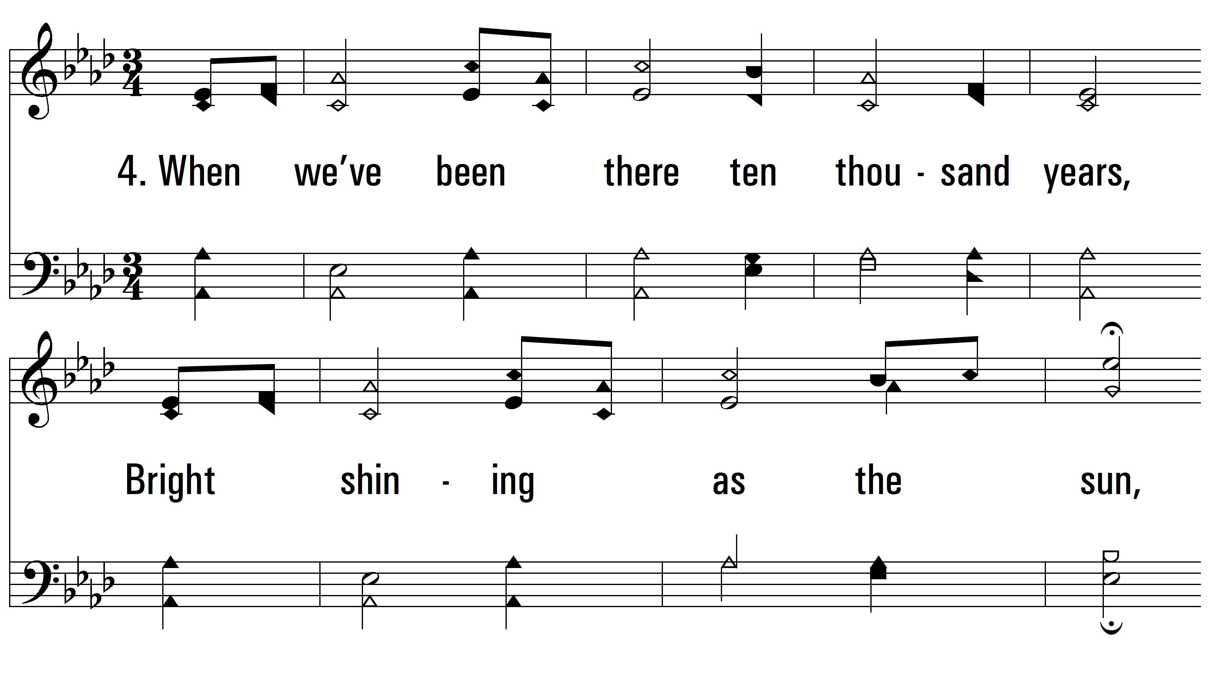
vs. 4 ~ Amazing Grace

Slide 9
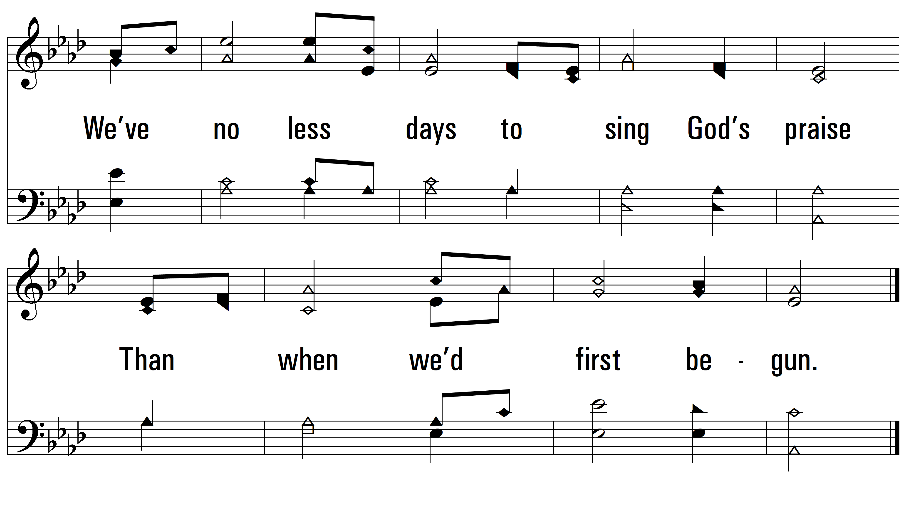
vs. 4

Slide 10
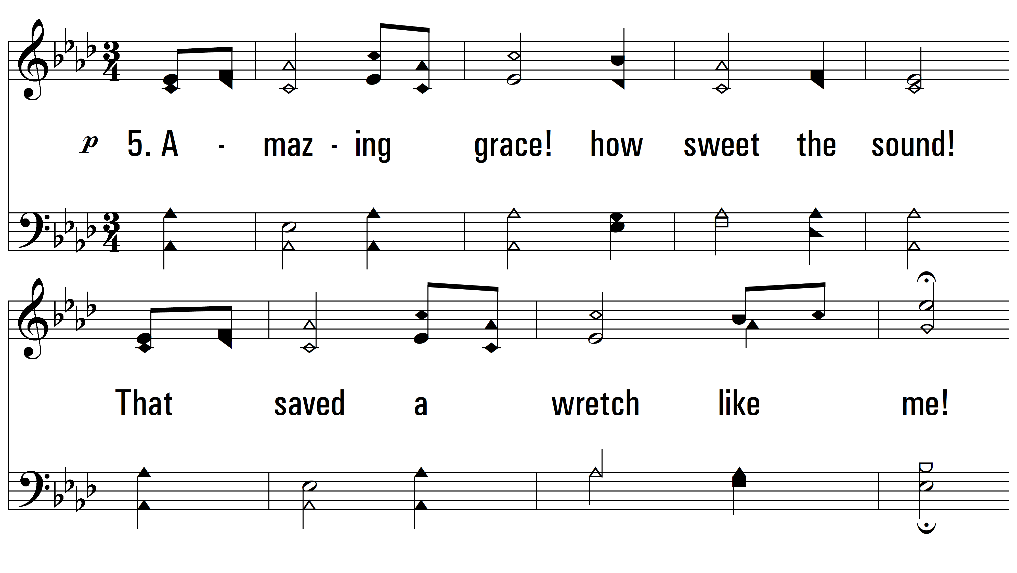
vs. 5 ~ Amazing Grace

Slide 11
vs. 5
PDHymns.com
END

