Slide 1
Am I A Soldier Of The Cross?
ARLINGTON
CM
Words: | Isaac Watts (1724)
Music: | Thomas A. Arne (1762)
3/2
G/G - DO
Verses: 4
Lead - | DO
Alto - | SOL
Tenor - | MI
Bass - | DO
PDHymns.com

Slide 2
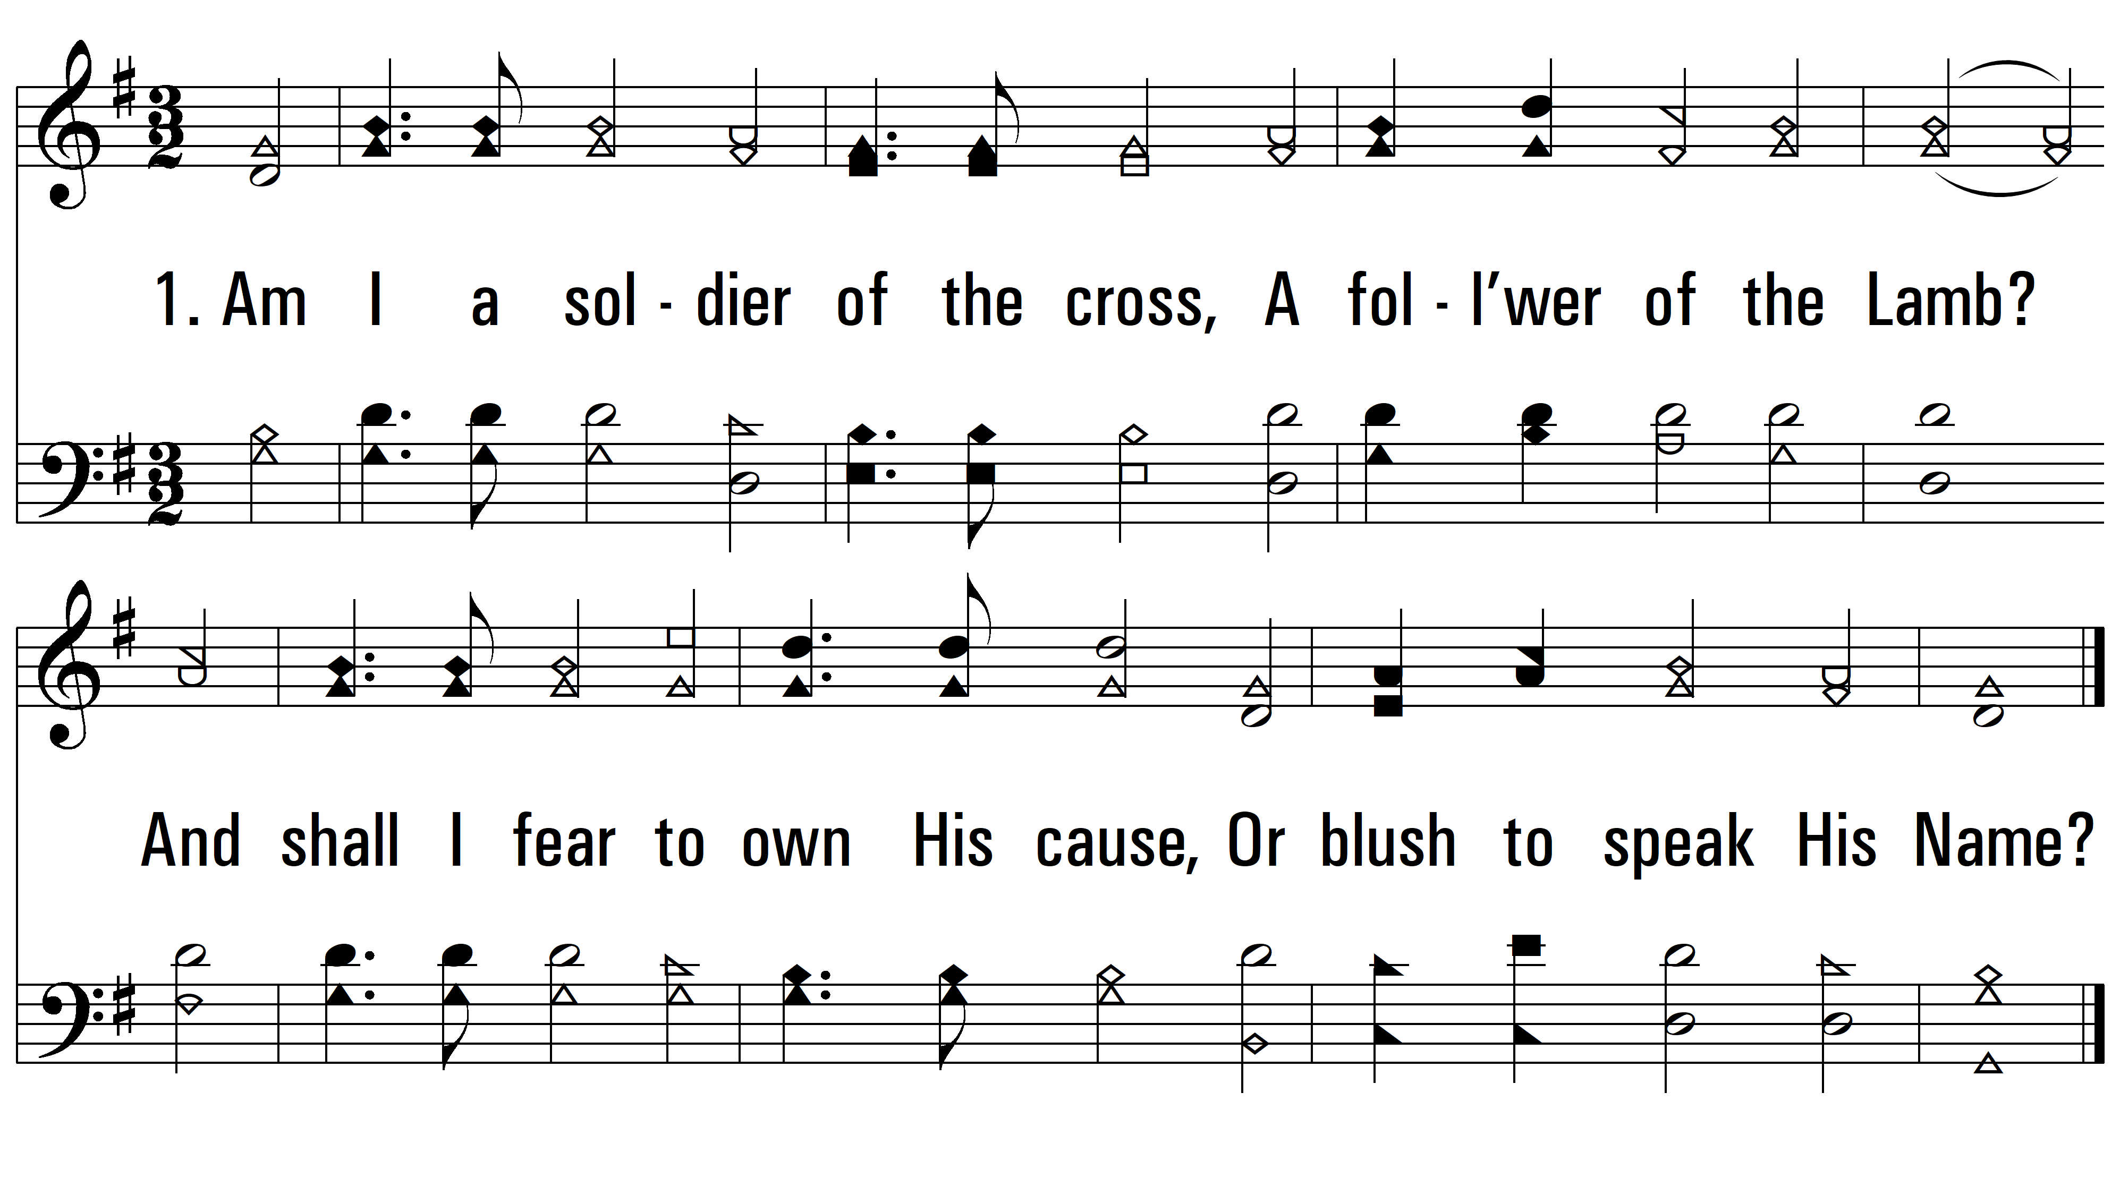
vs. 1 ~ Am I A Soldier Of The Cross?

Slide 3
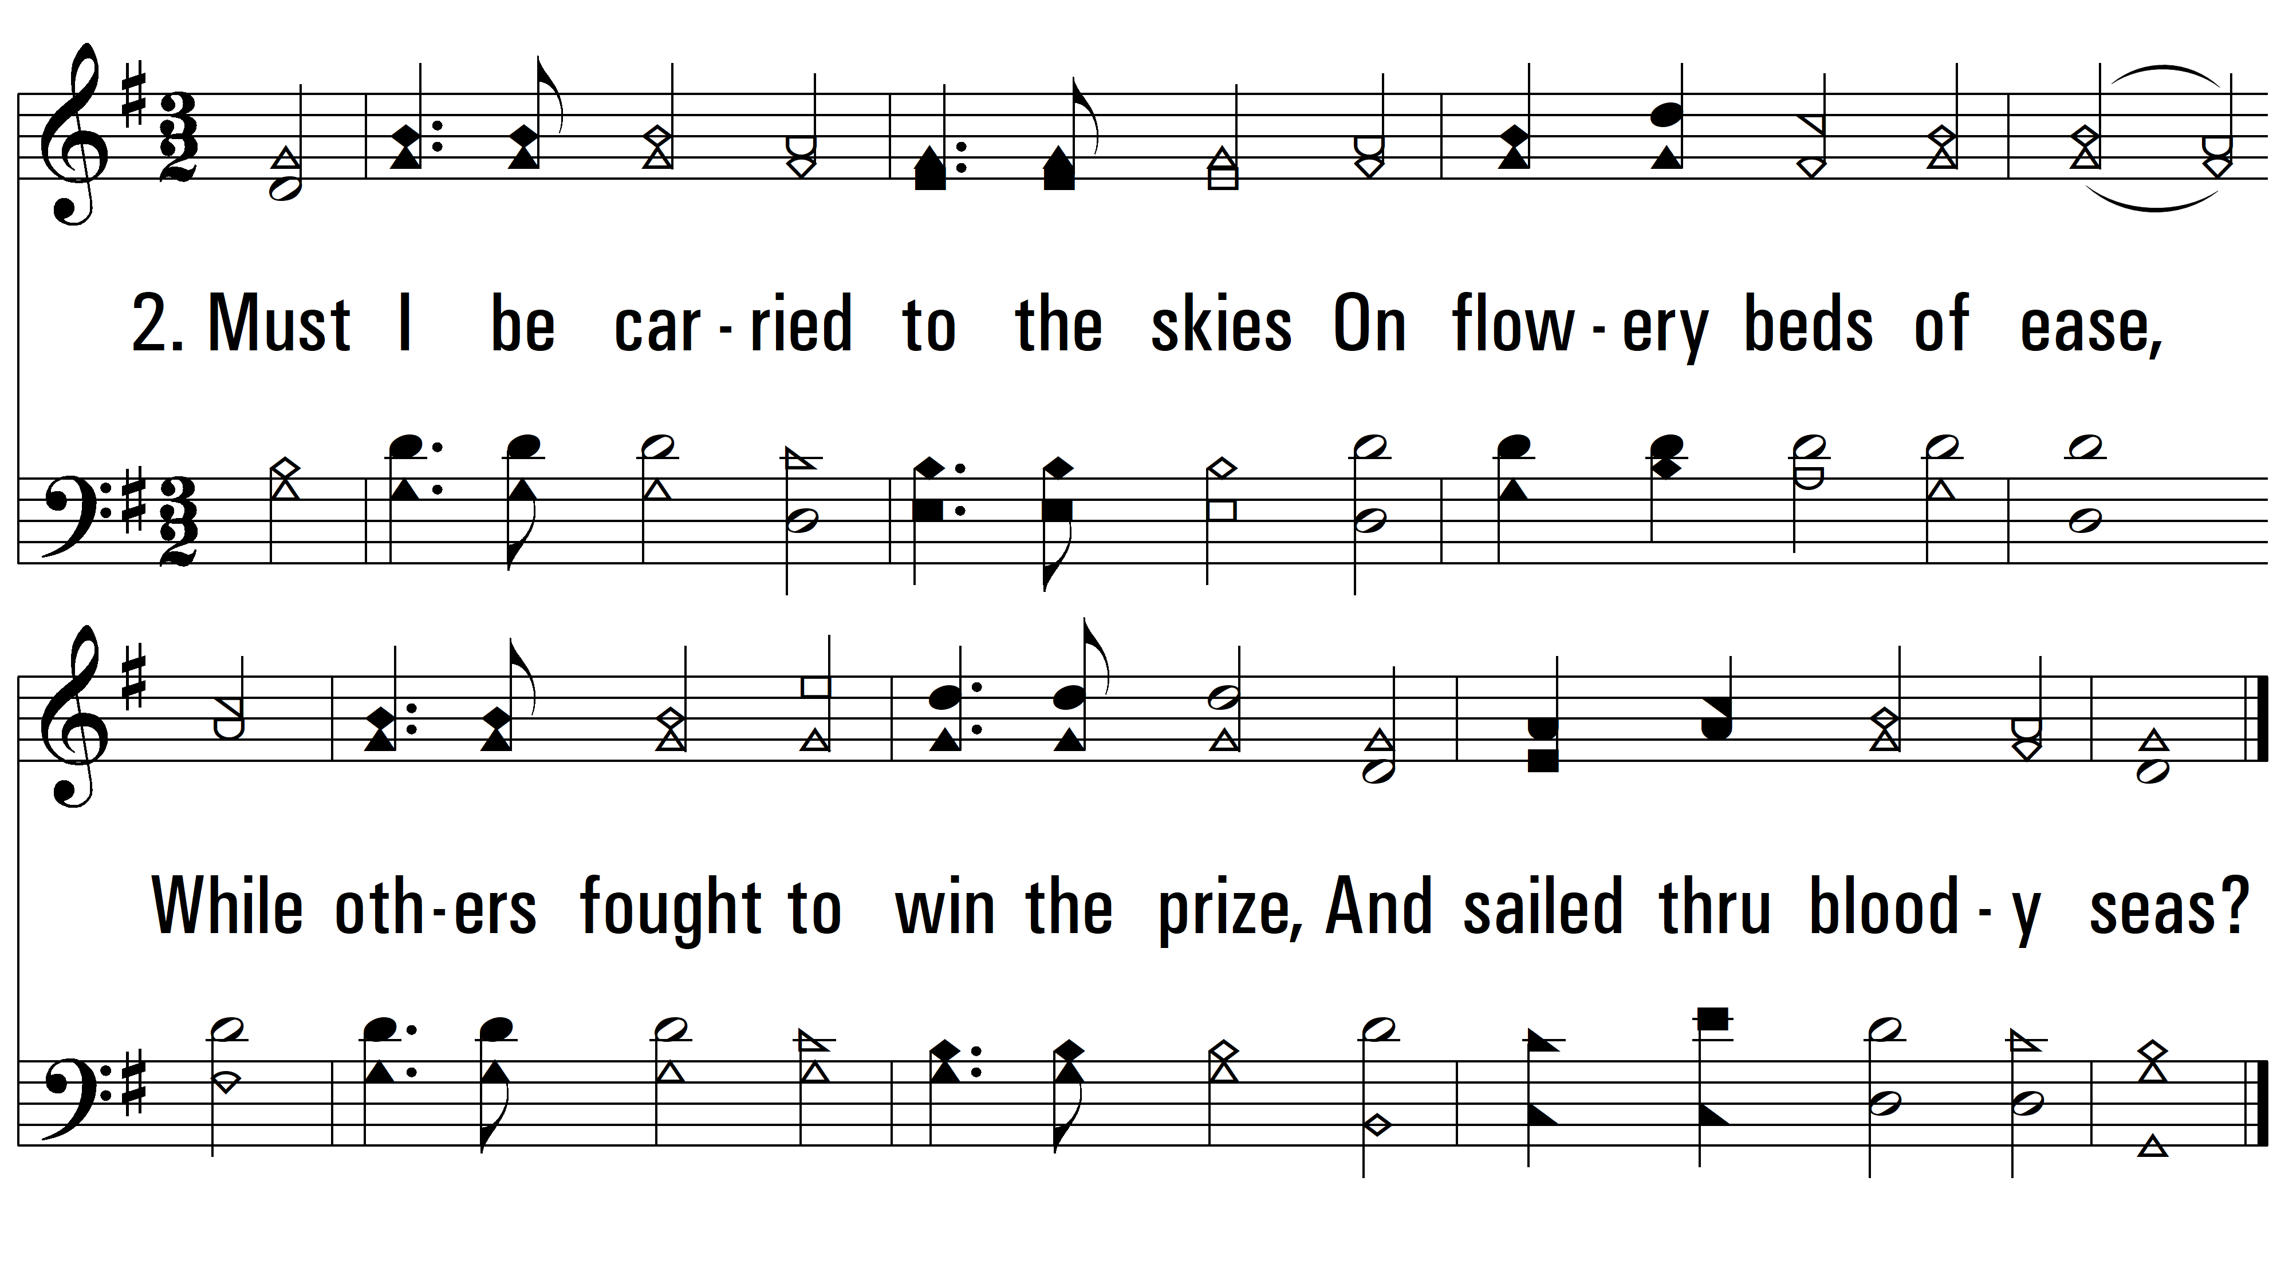
vs. 2 ~ Am I A Soldier Of The Cross?

Slide 4
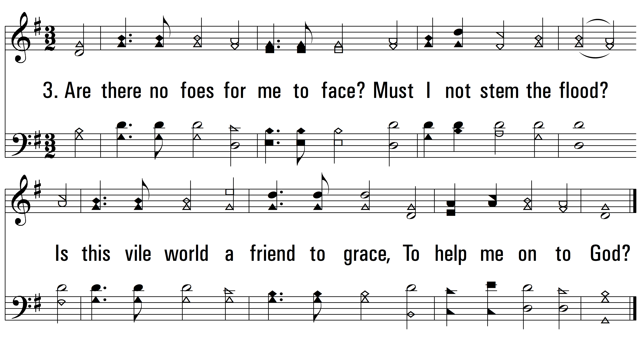
vs. 3 ~ Am I A Soldier Of The Cross?

Slide 5
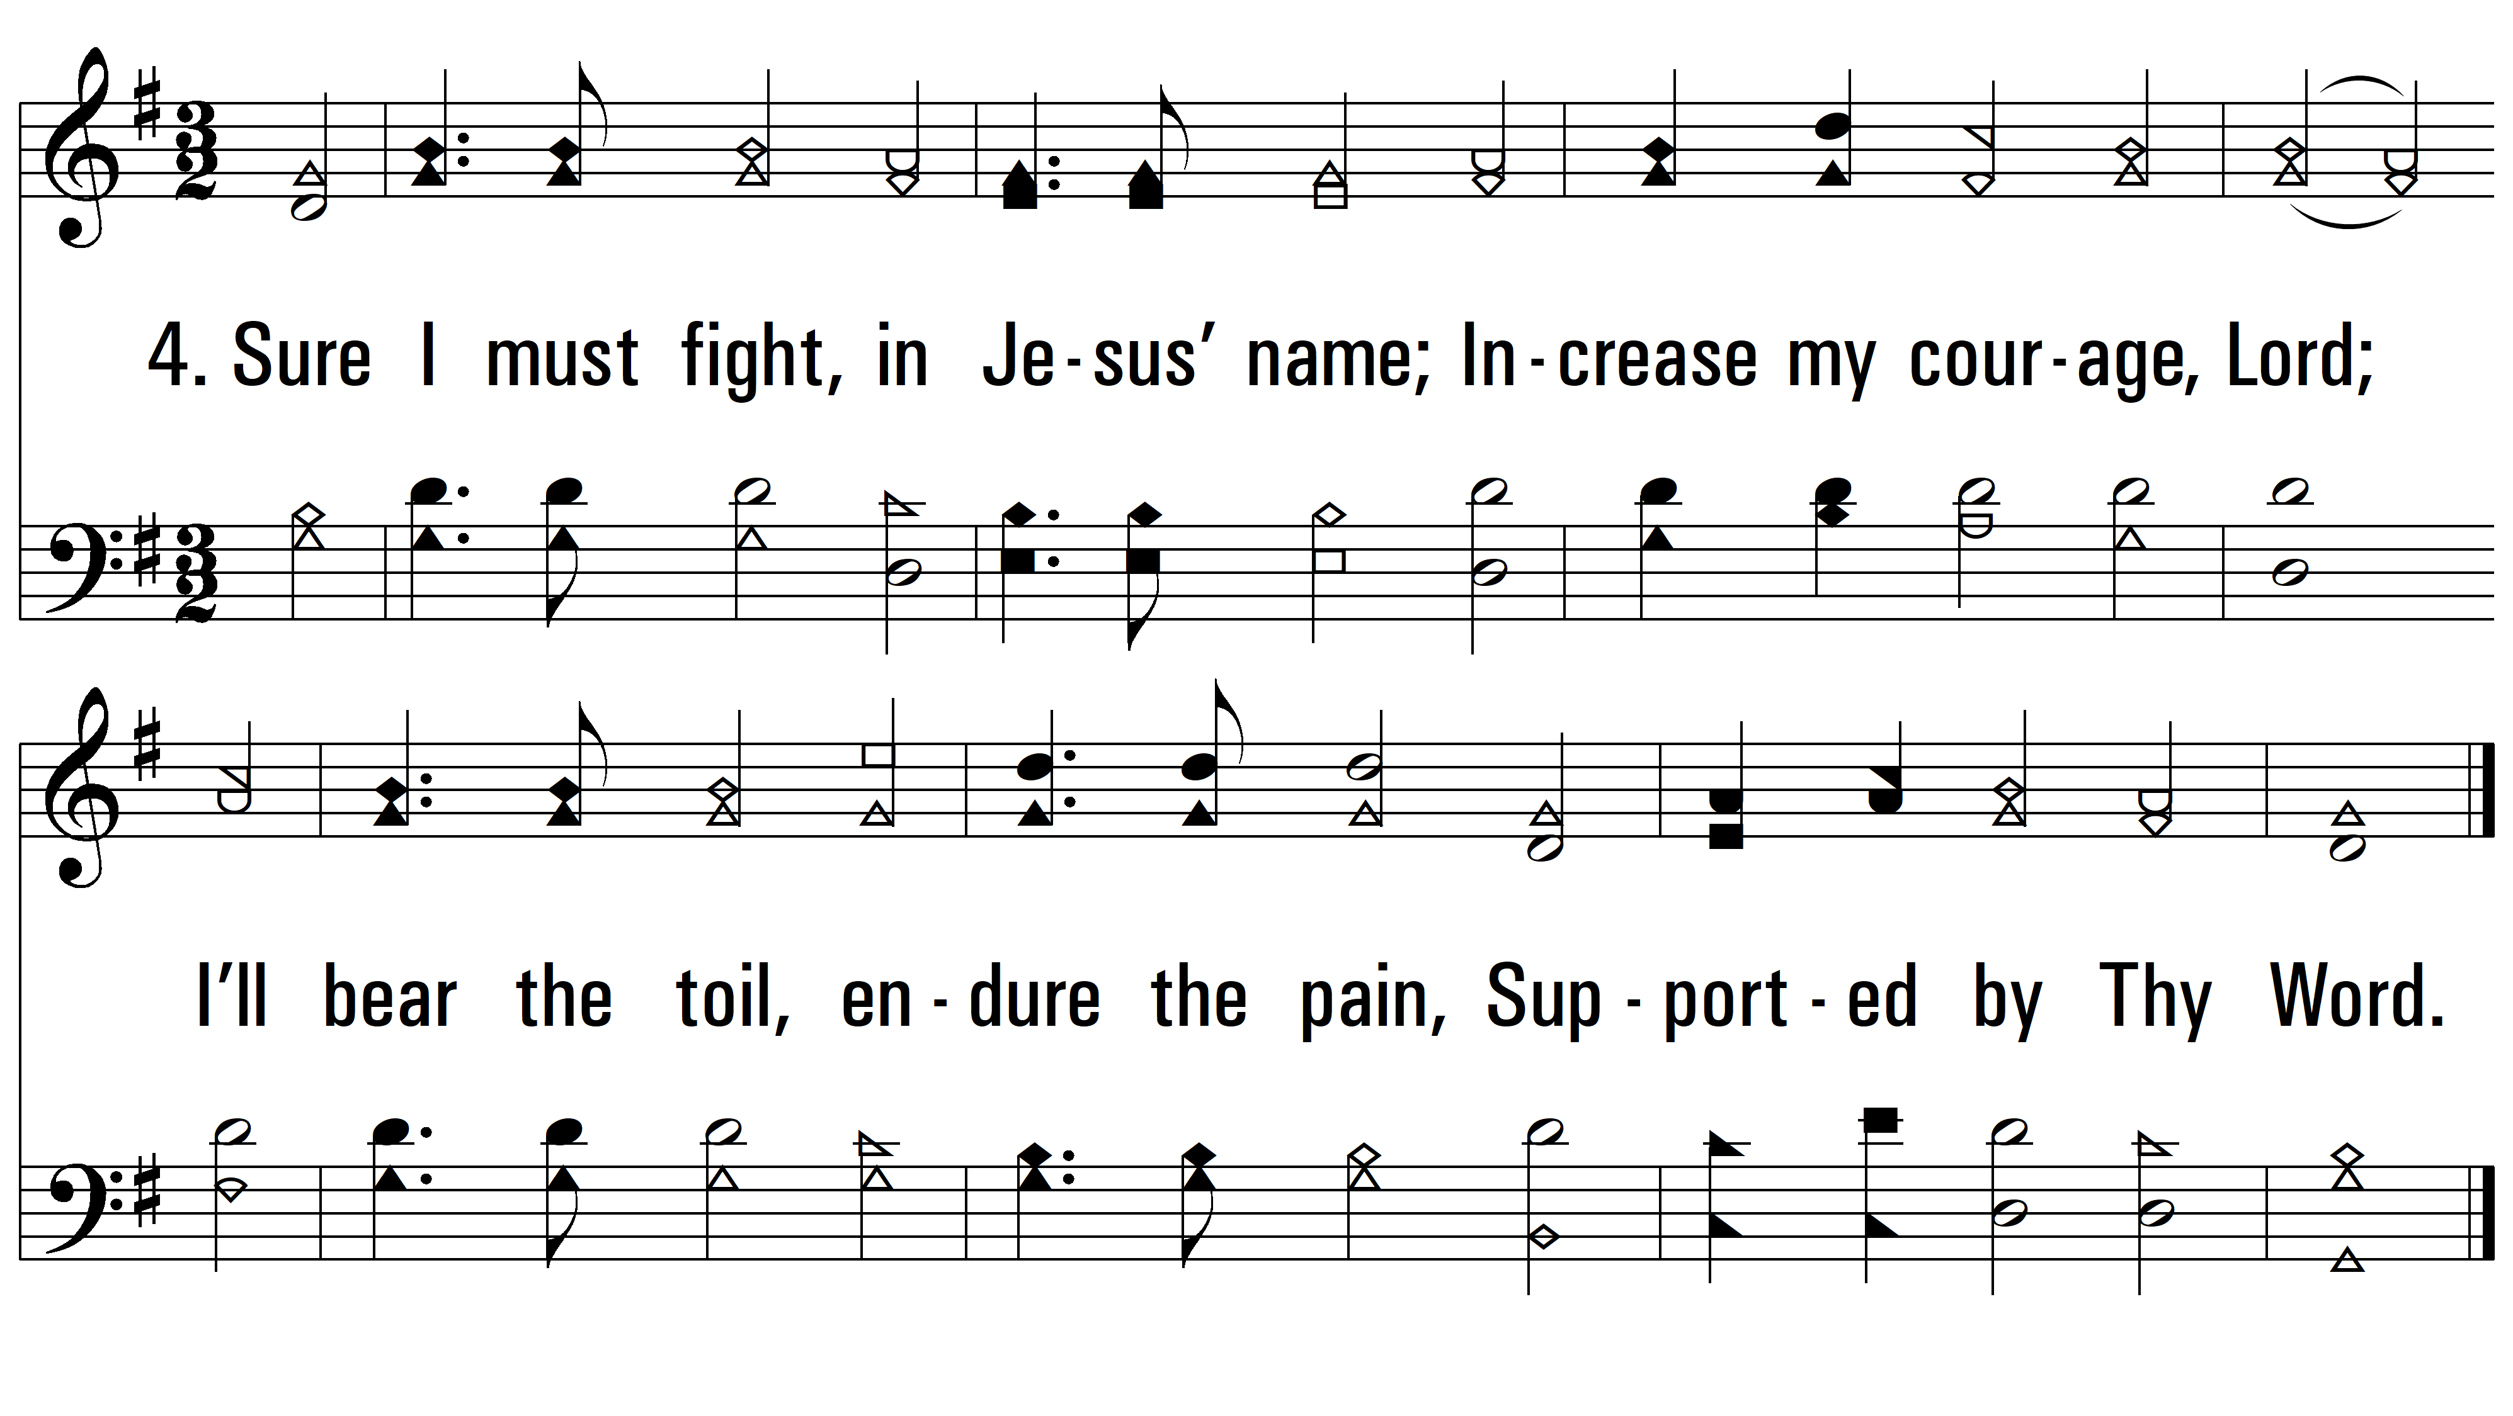
vs. 4 ~ Am I A Soldier Of The Cross?
PDHymns.com
END

