Slide 1
Almost Persuaded
Words: | Phillip P. Bliss (1871)
Music: | Phillip P. Bliss (1871)
6/8
G/B - MI
Verses: 3
Lead - | MI
Alto - | SOL
Tenor - | DO
Bass - | DO
PDHymns.com

Slide 2
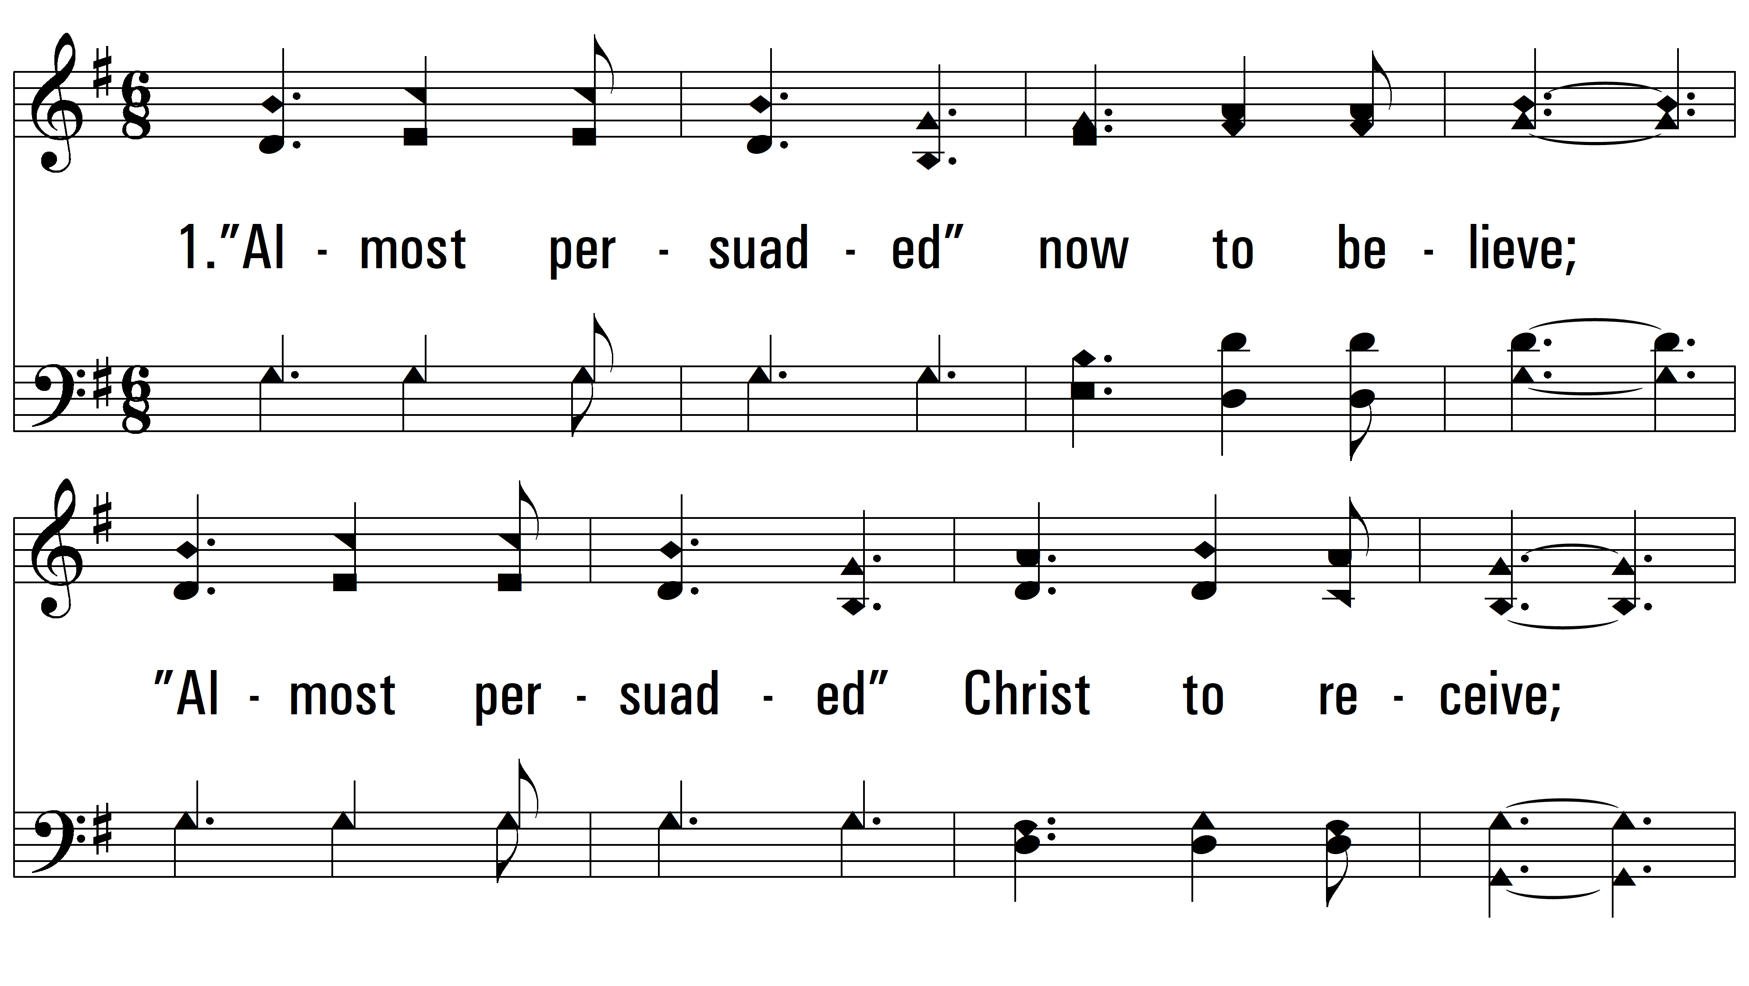
vs. 1 ~ Almost Persuaded

Slide 3
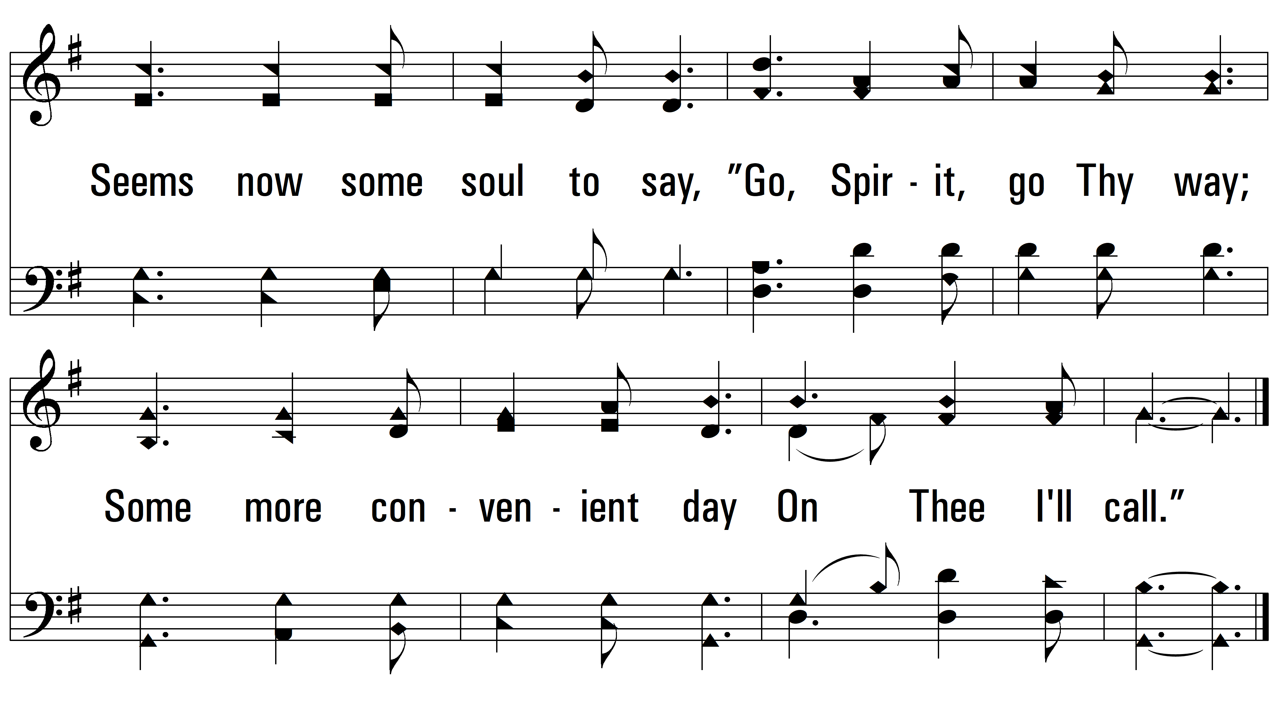
vs. 1

Slide 4
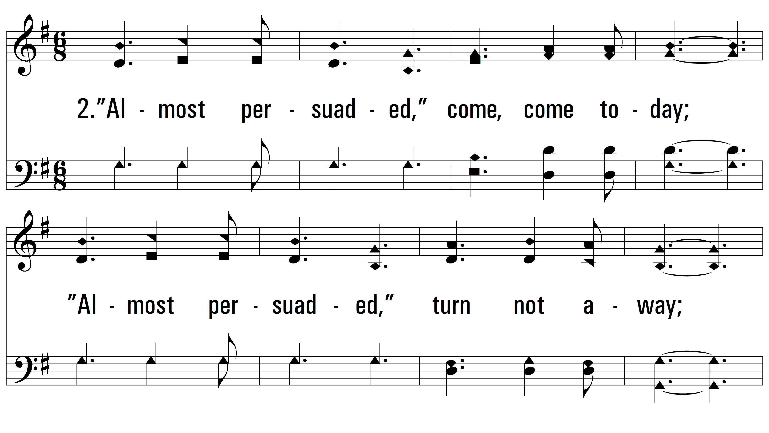
vs. 2 ~ Almost Persuaded

Slide 5
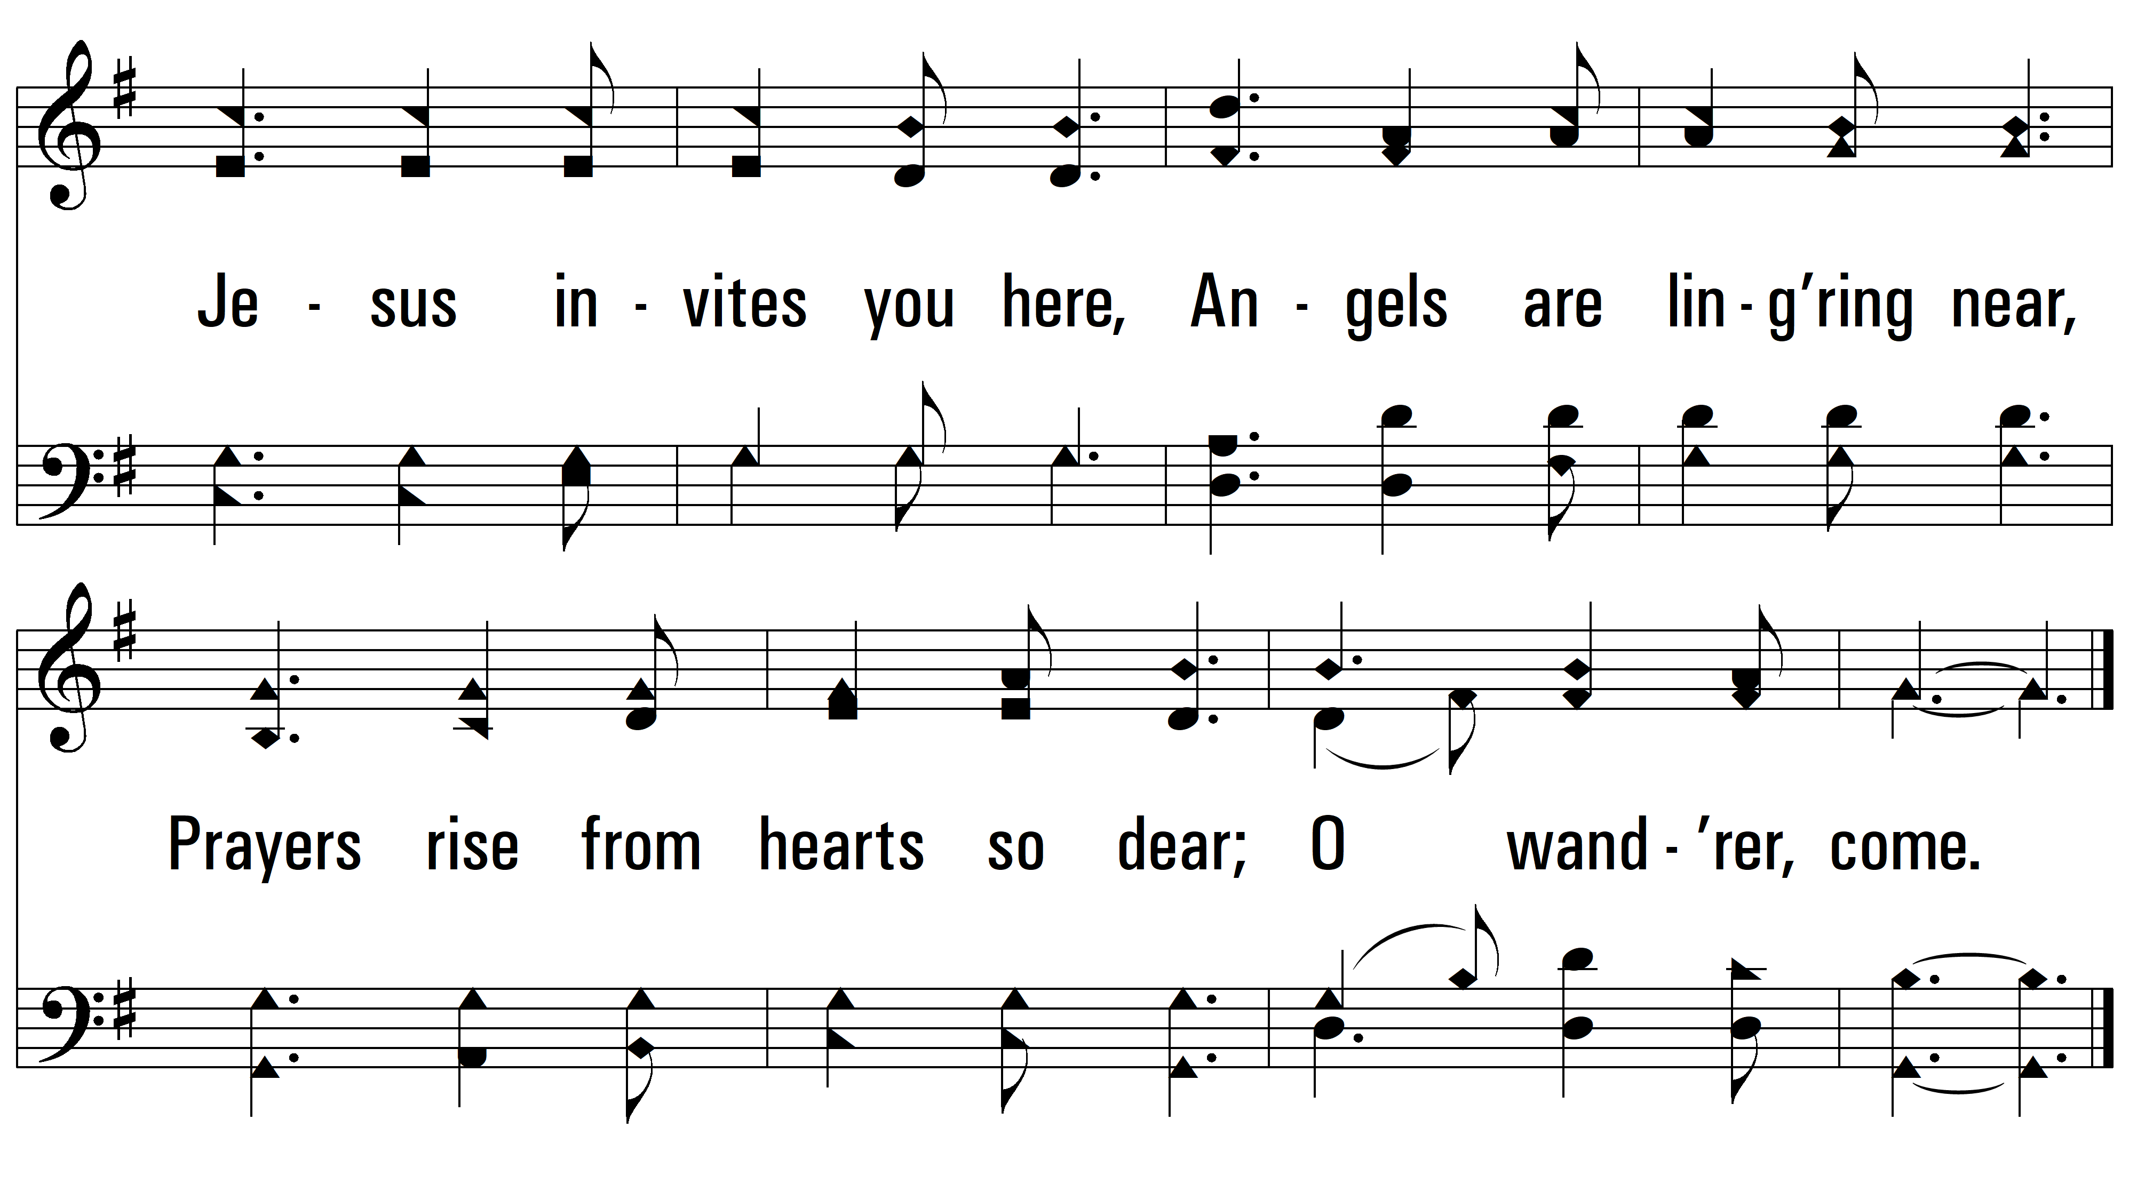
vs. 2

Slide 6
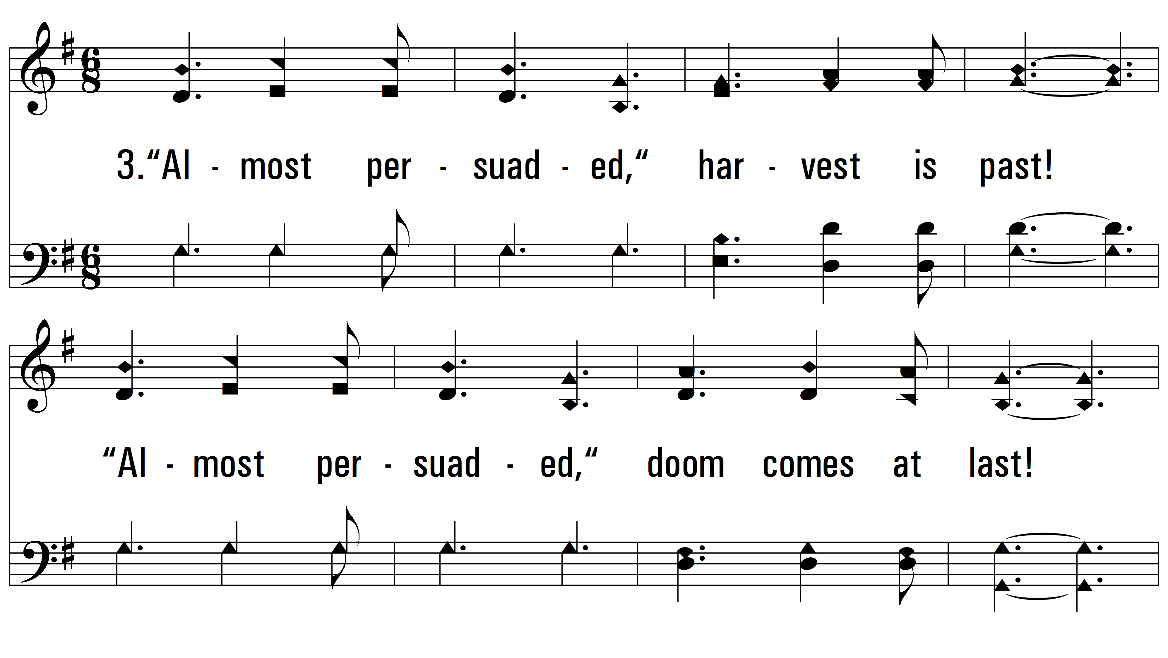
vs. 3 ~ Almost Persuaded

Slide 7
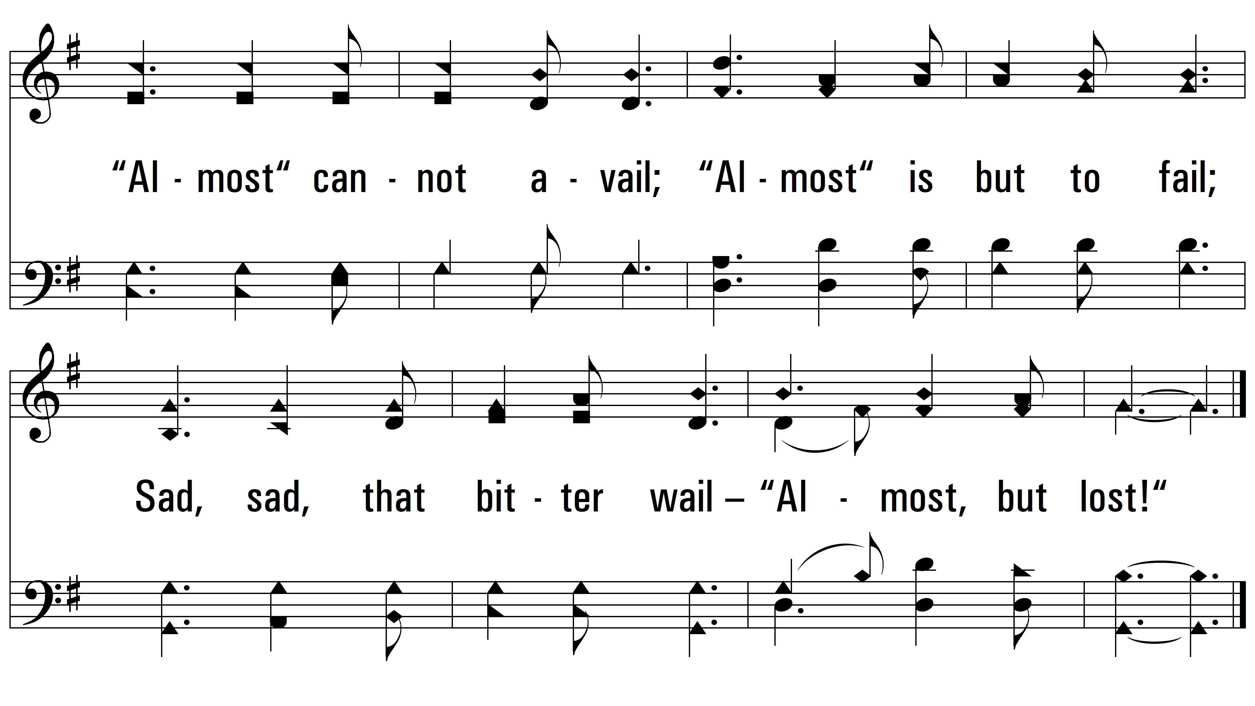
vs. 3
PDHymns.com
END

