Slide 1
Alleluia, Alleluia! Hearts To Heaven
ODE TO JOY
8.7.8.7.D
Words: | Christopher Wordsworth (1862)
Music: | Beethoven (1824), Adapt. by Edward Hodges (1864)
4/4
G/B - MI
Verses: 3
Lead - | MI
Alto - | SOL
Tenor - | DO
Bass - | DO
PDHymns.com

Slide 2
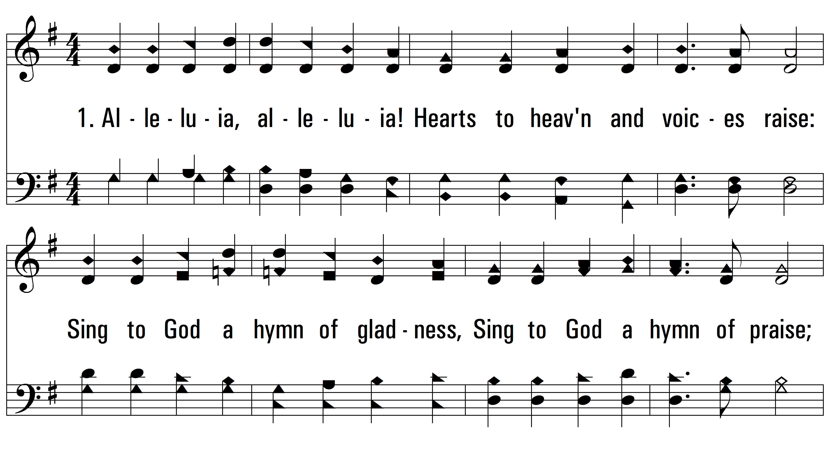
vs. 1 ~ Alleluia, Alleluia! Hearts To Heaven

Slide 3
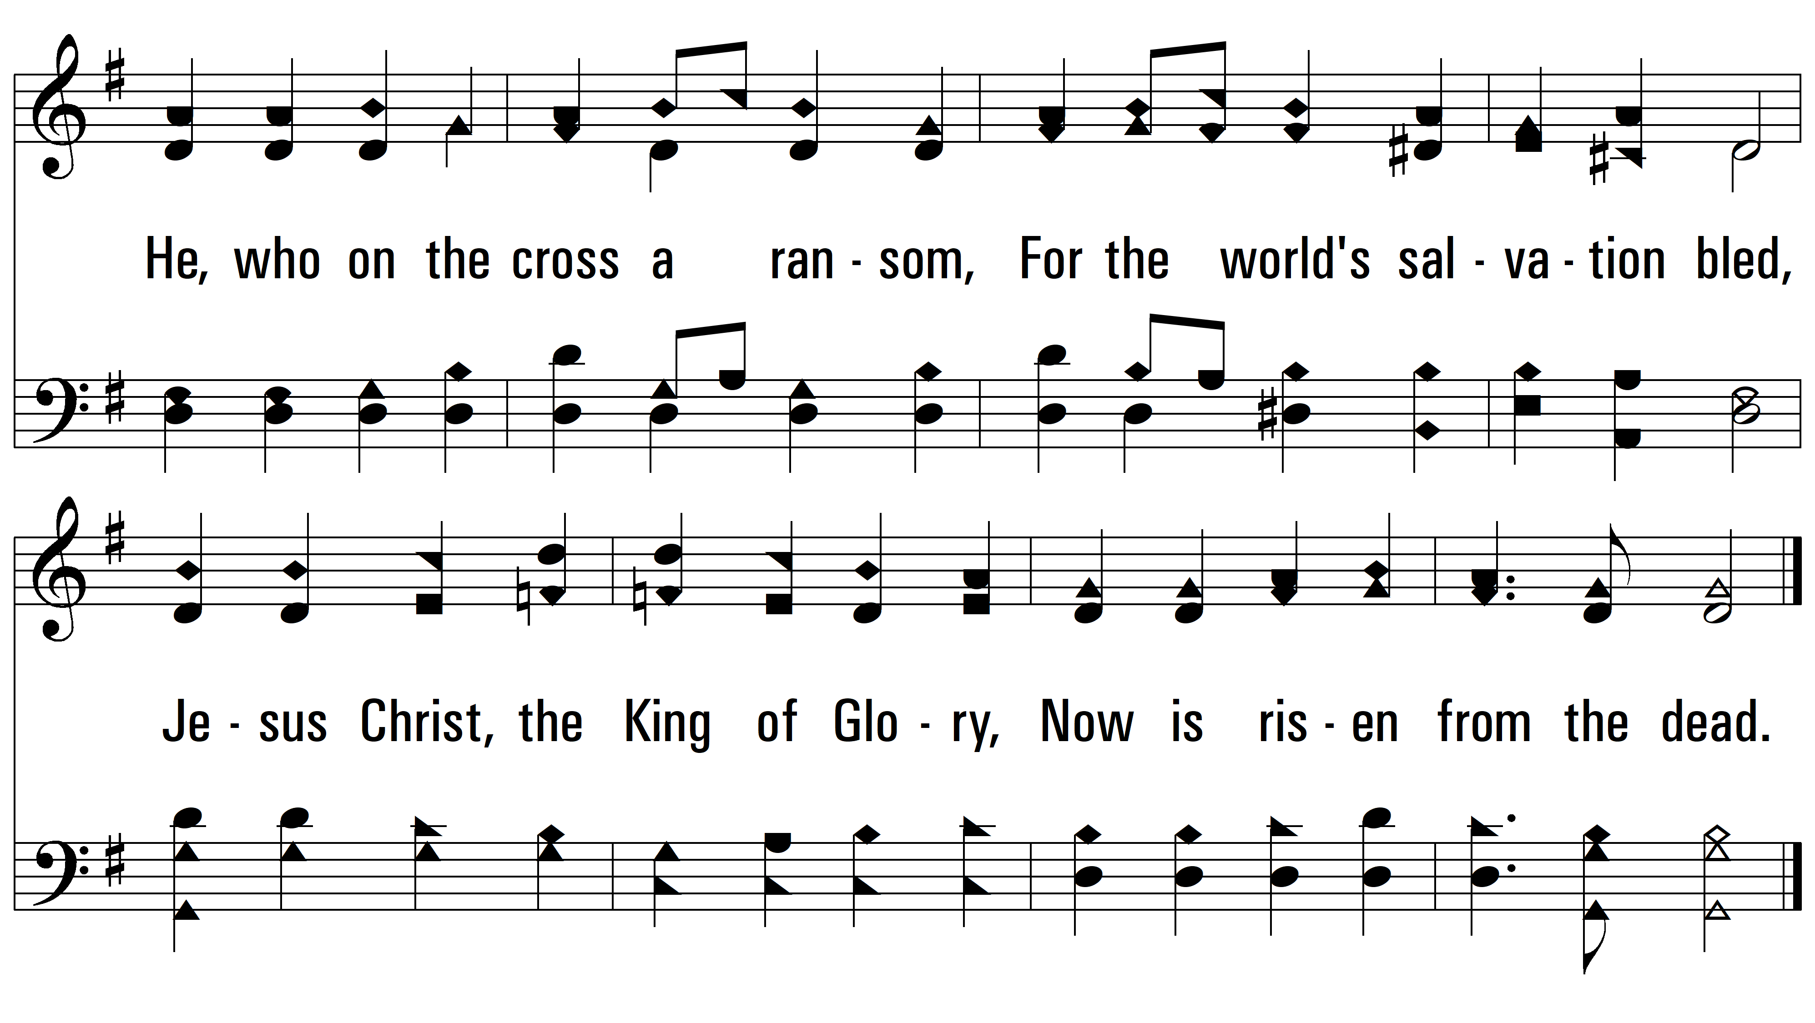
vs. 1

Slide 4
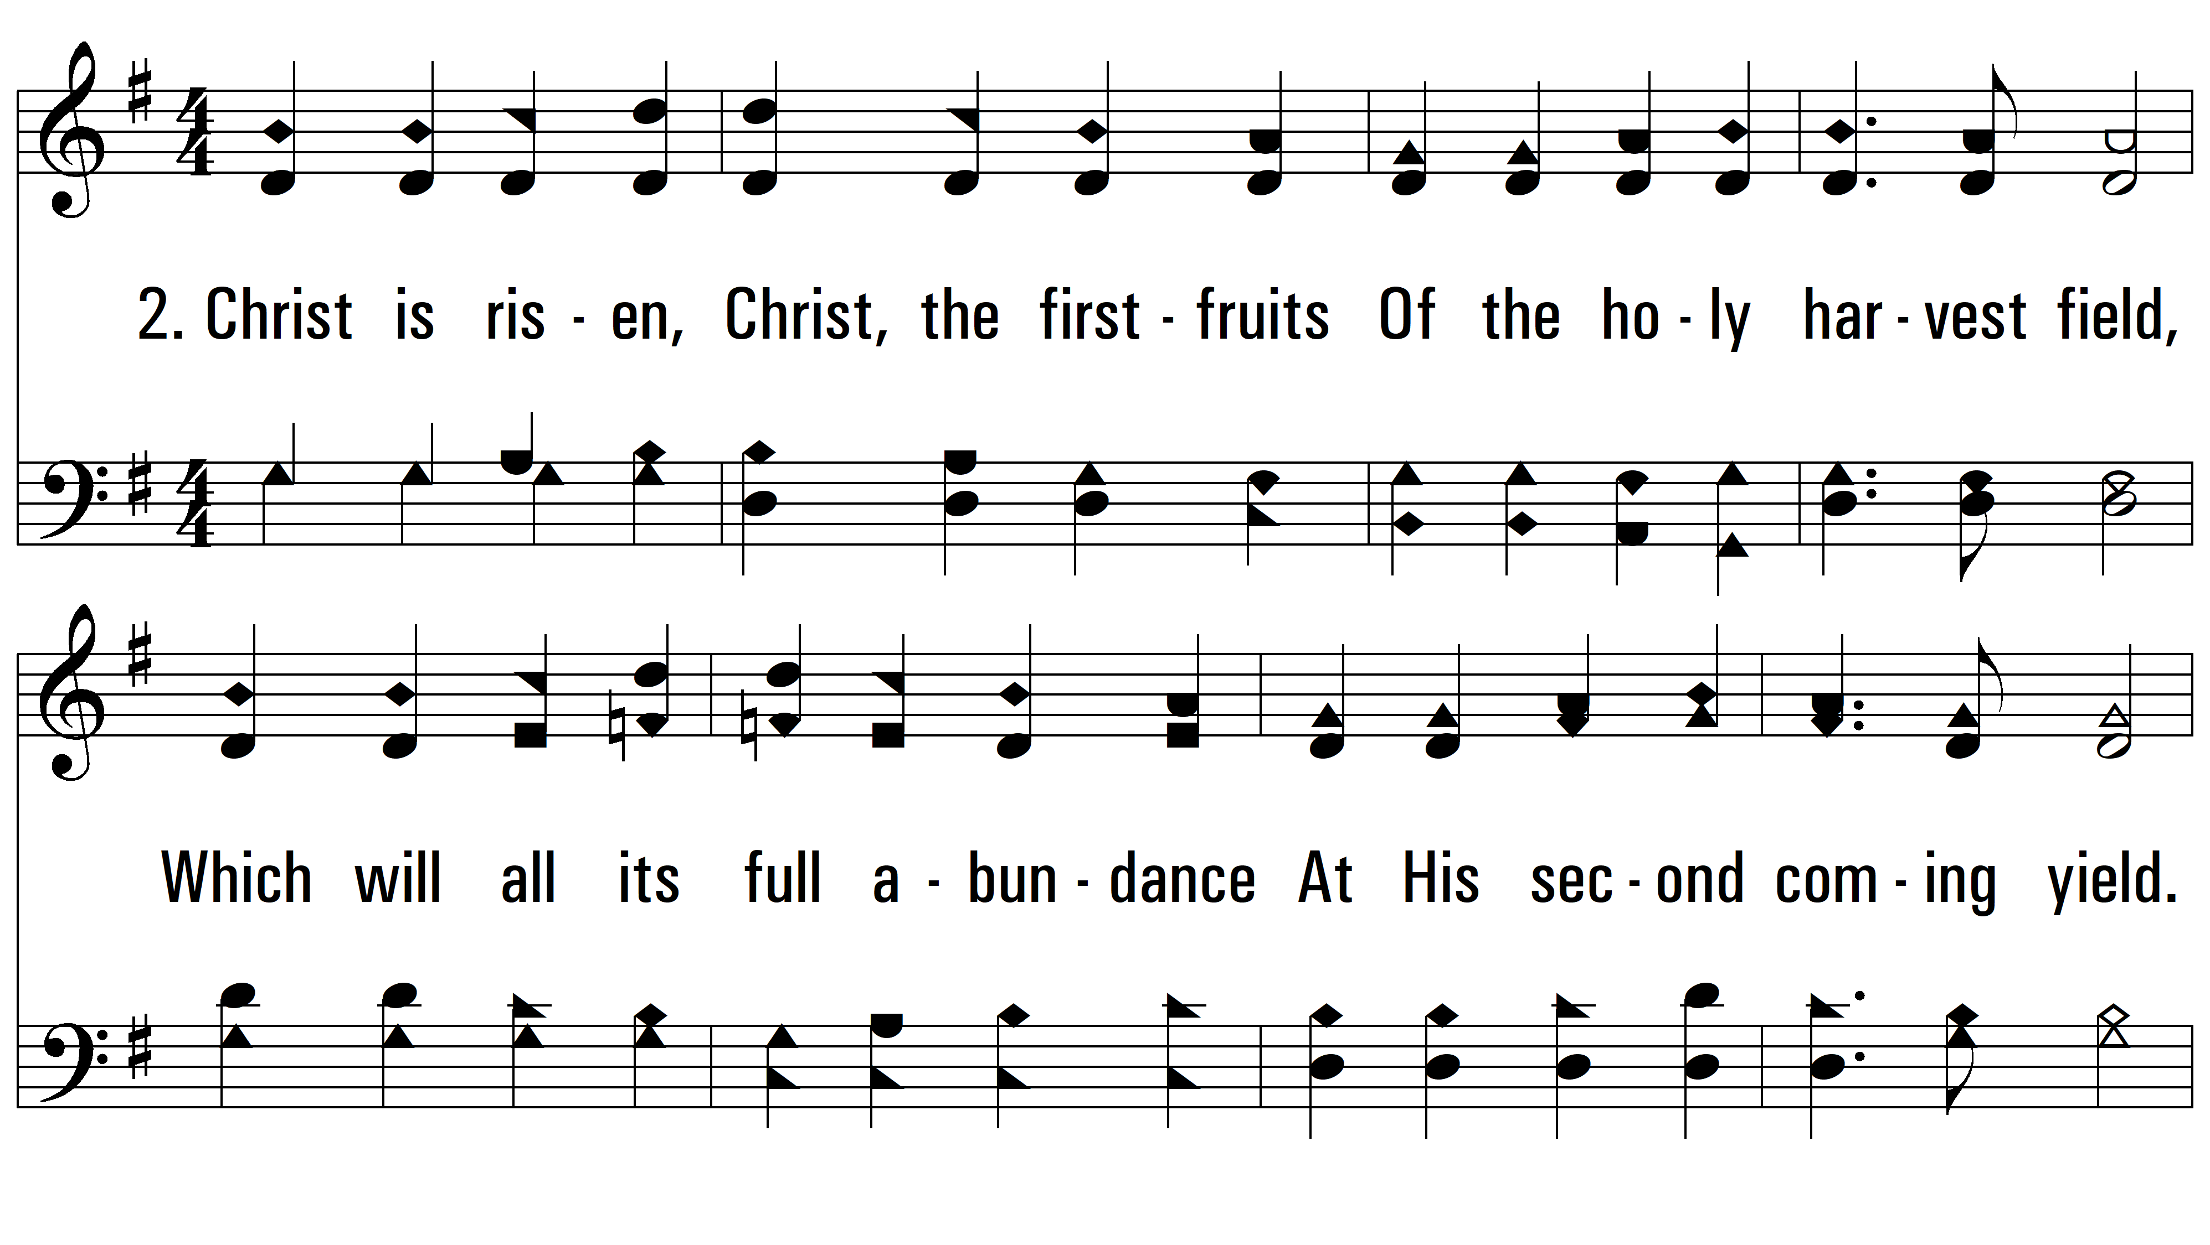
vs. 2 ~ Alleluia, Alleluia! Hearts To Heaven

Slide 5
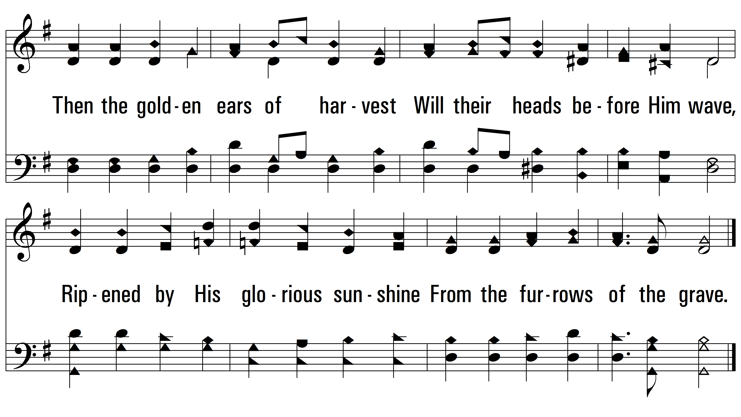
vs. 2

Slide 6
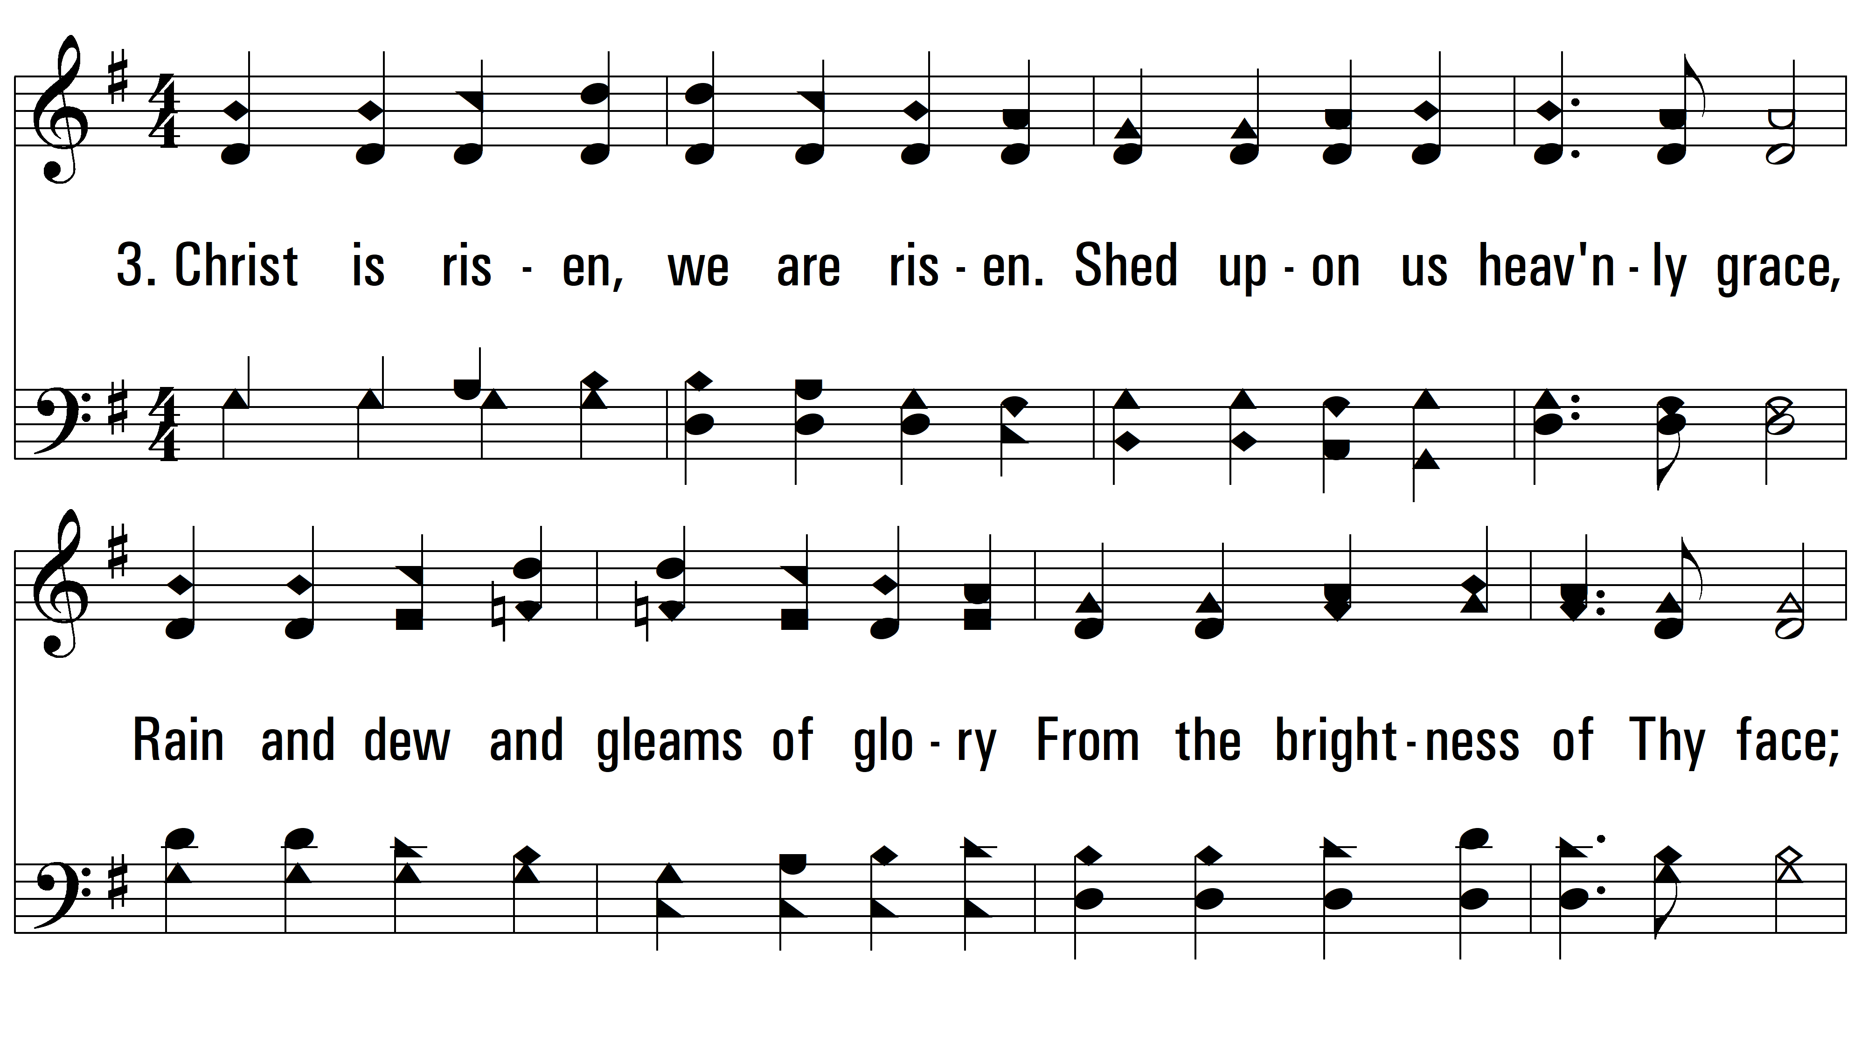
vs. 3 ~ Alleluia, Alleluia! Hearts To Heaven

Slide 7
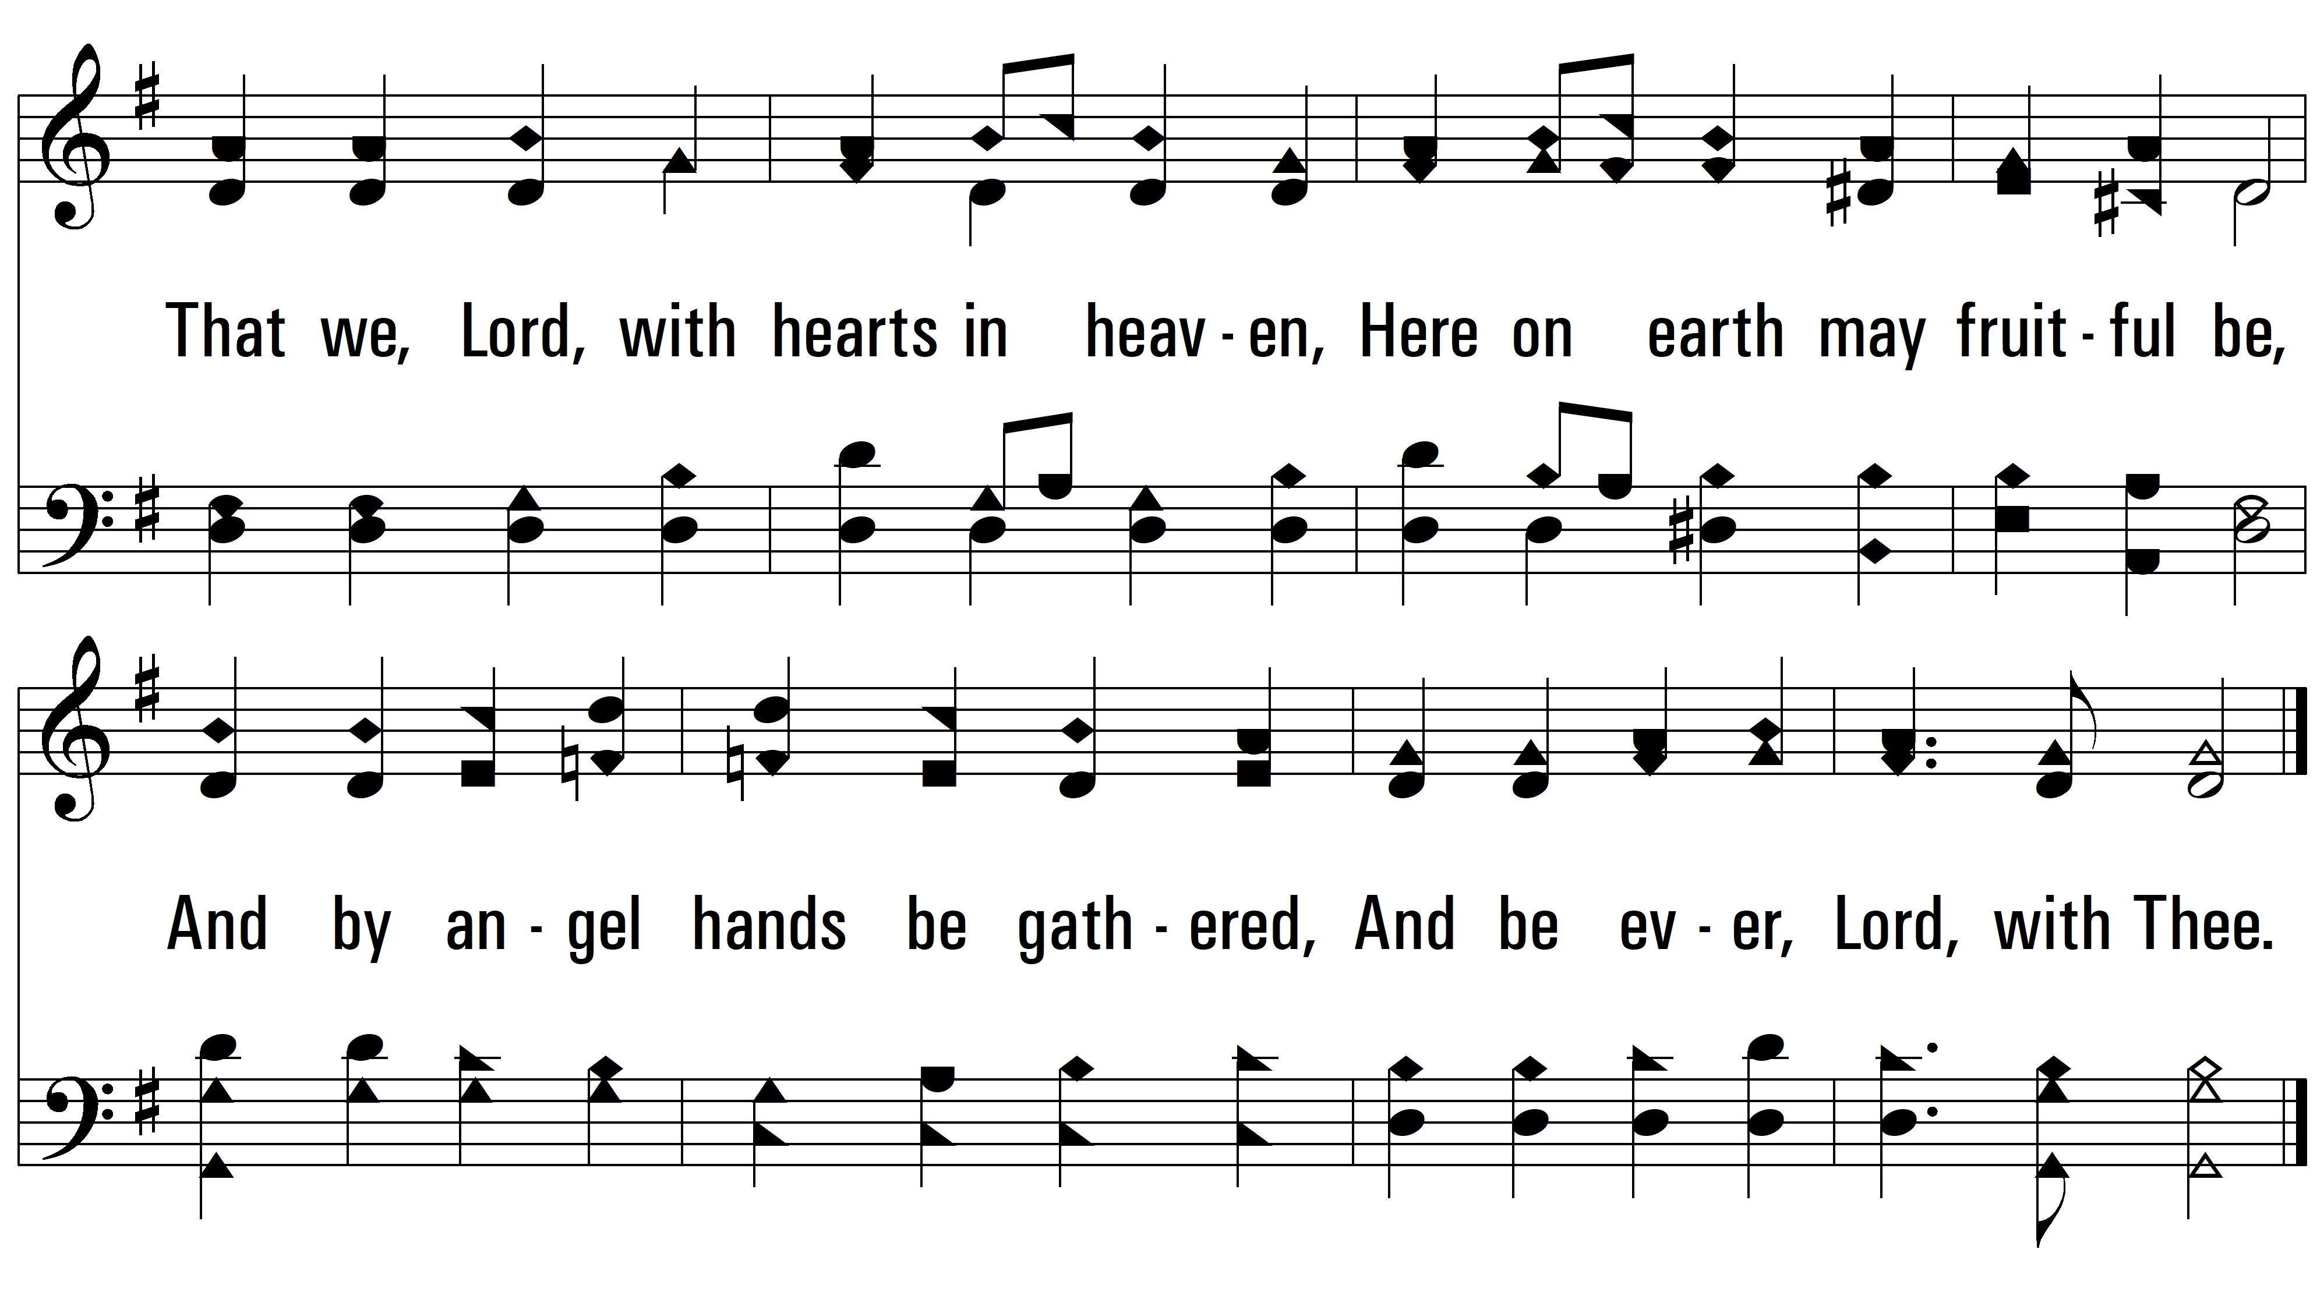
vs. 3
PDHymns.com
END

