Slide 1
All Things Praise Thee
DIX
7.7.7.7.7.7
Words: | G. W. Conder (1853)
Music: | Conrad Kocher 1838), Arr. by William H. Monk (1861)
4/4
A/A - DO
Verses: 3
Lead - | DO
Alto - | SOL
Tenor - | MI
Bass - | DO
PDHymns.com

Slide 2
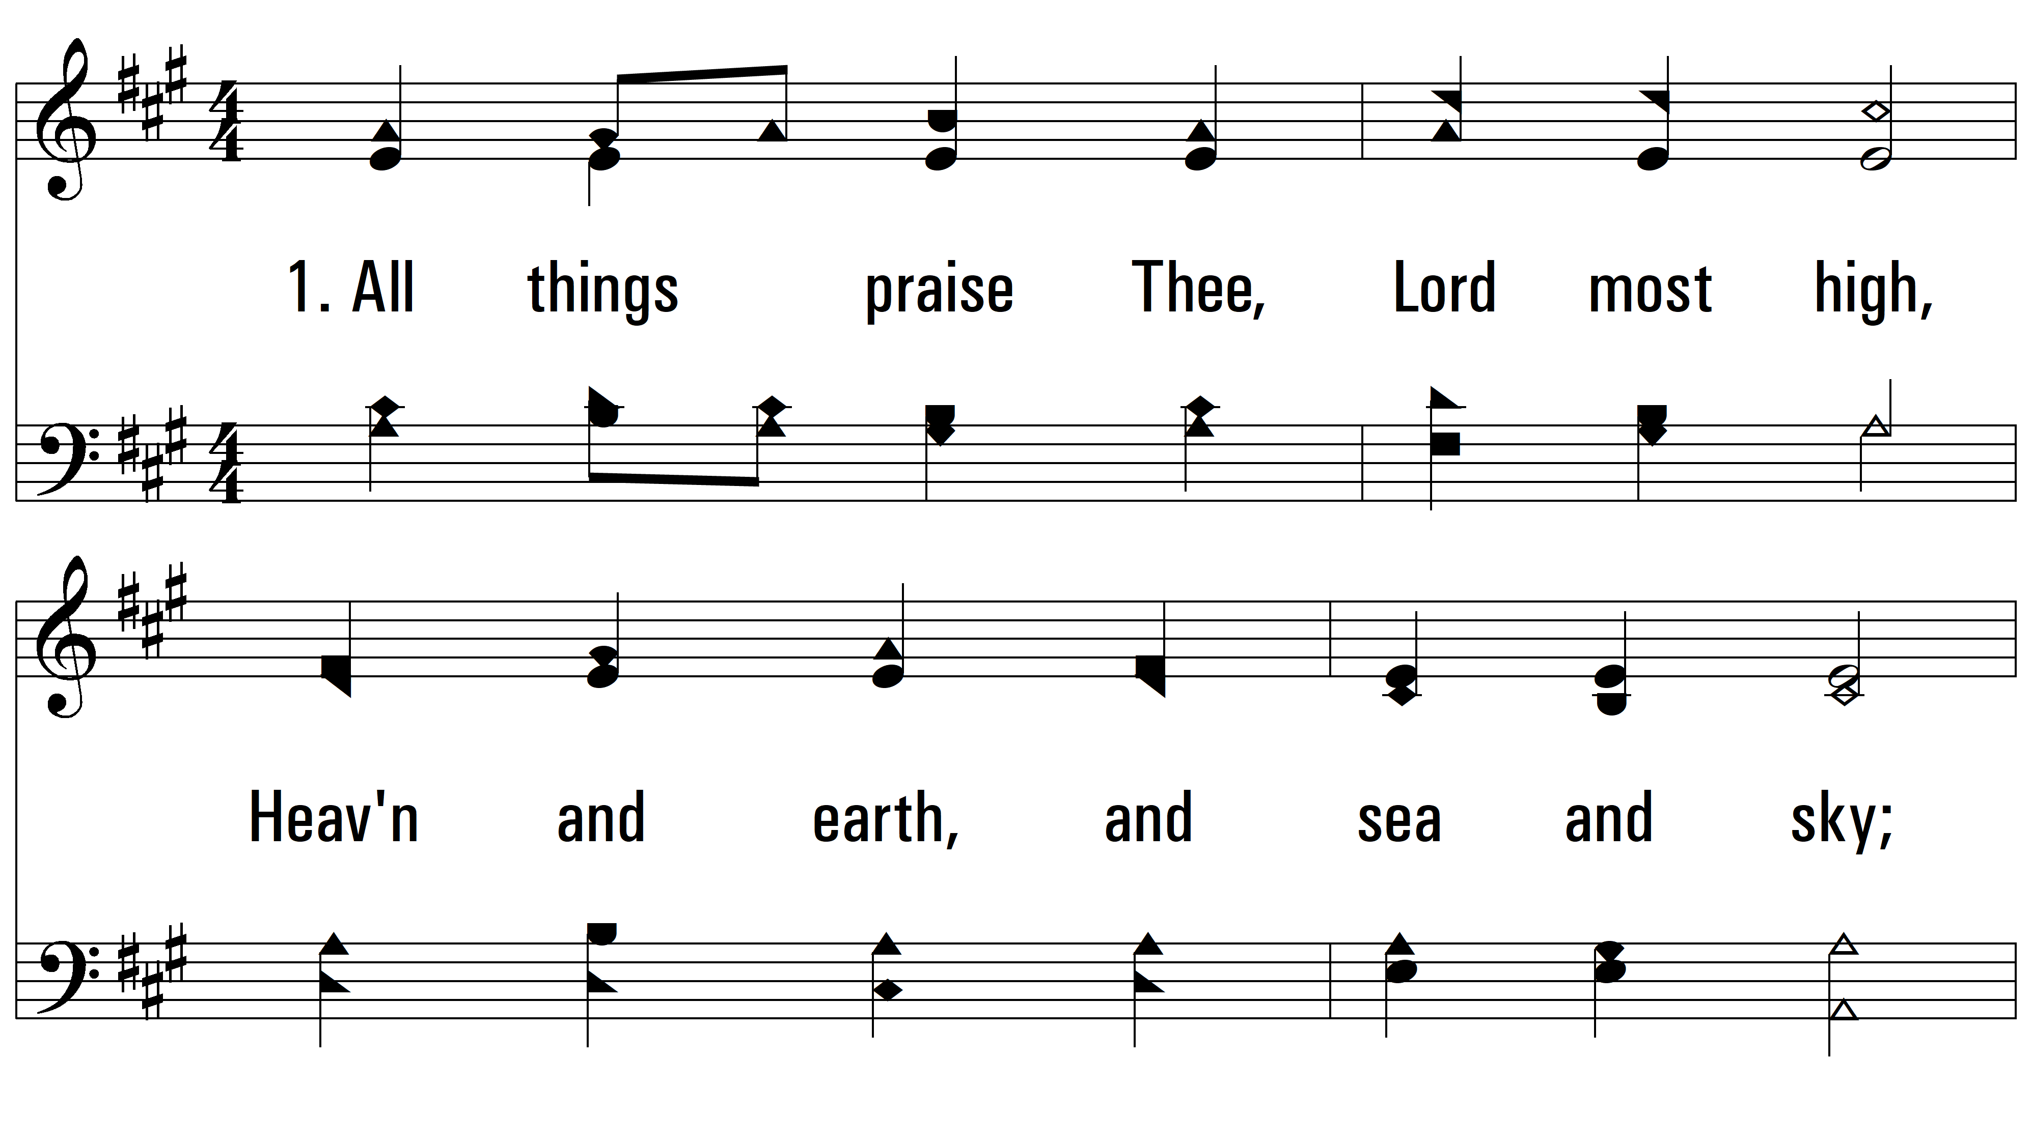
vs. 1 ~ All Things Praise Thee

Slide 3
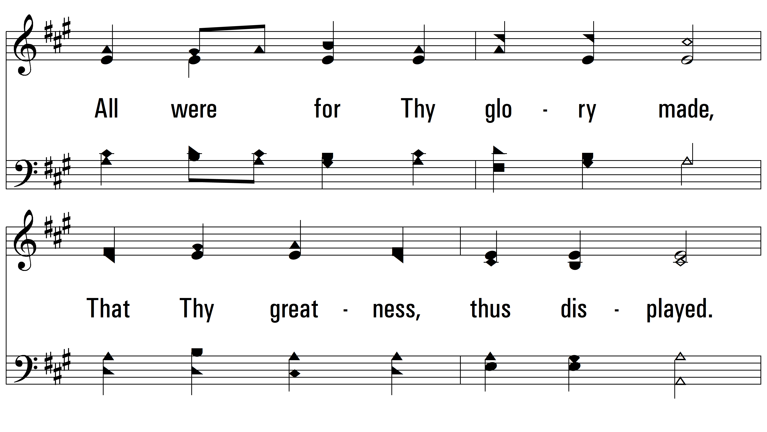
vs. 1

Slide 4
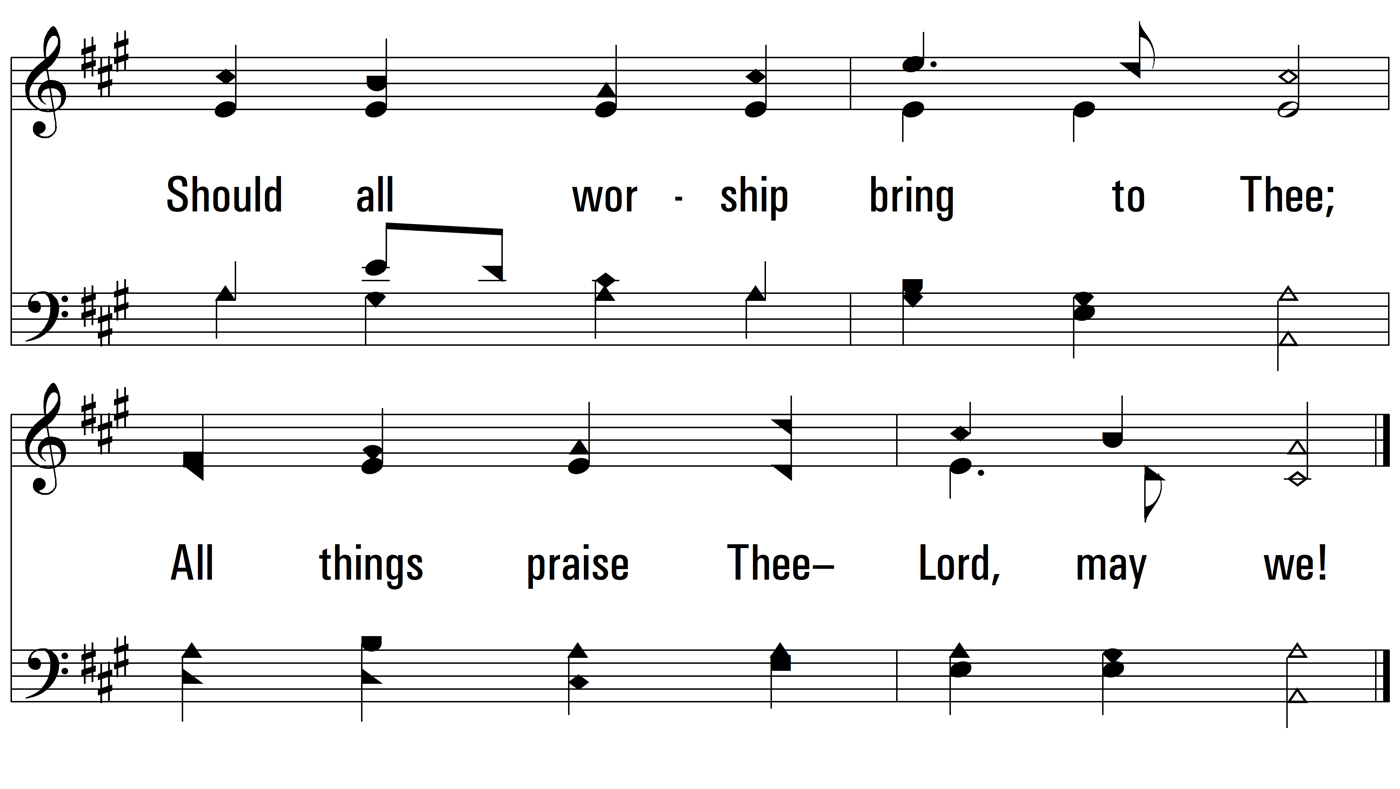
vs. 1

Slide 5
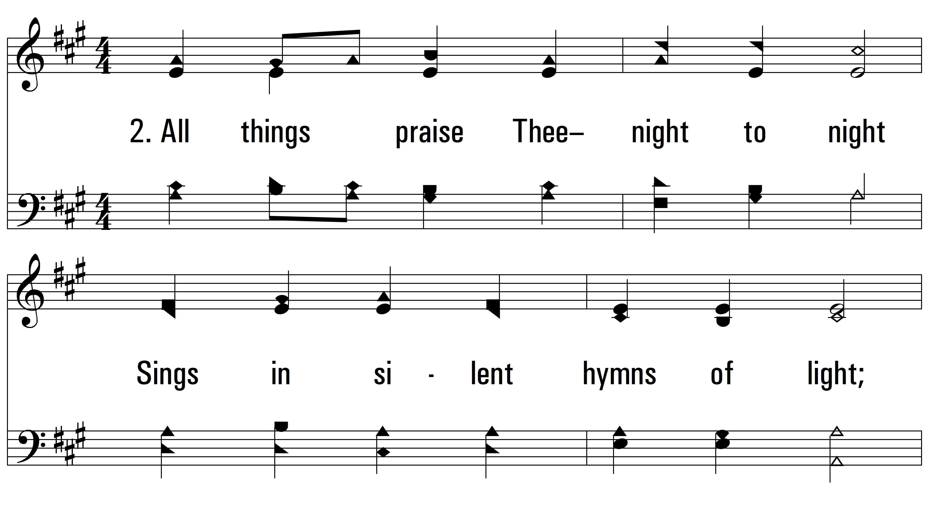
vs. 2 ~ All Things Praise Thee

Slide 6
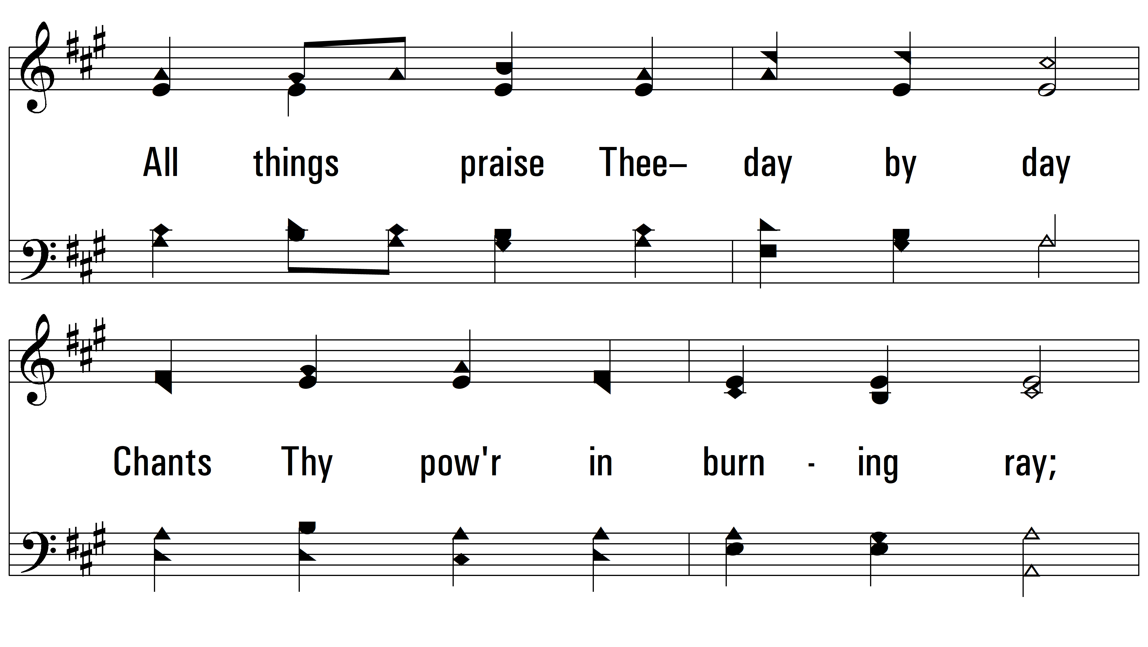
vs. 2

Slide 7
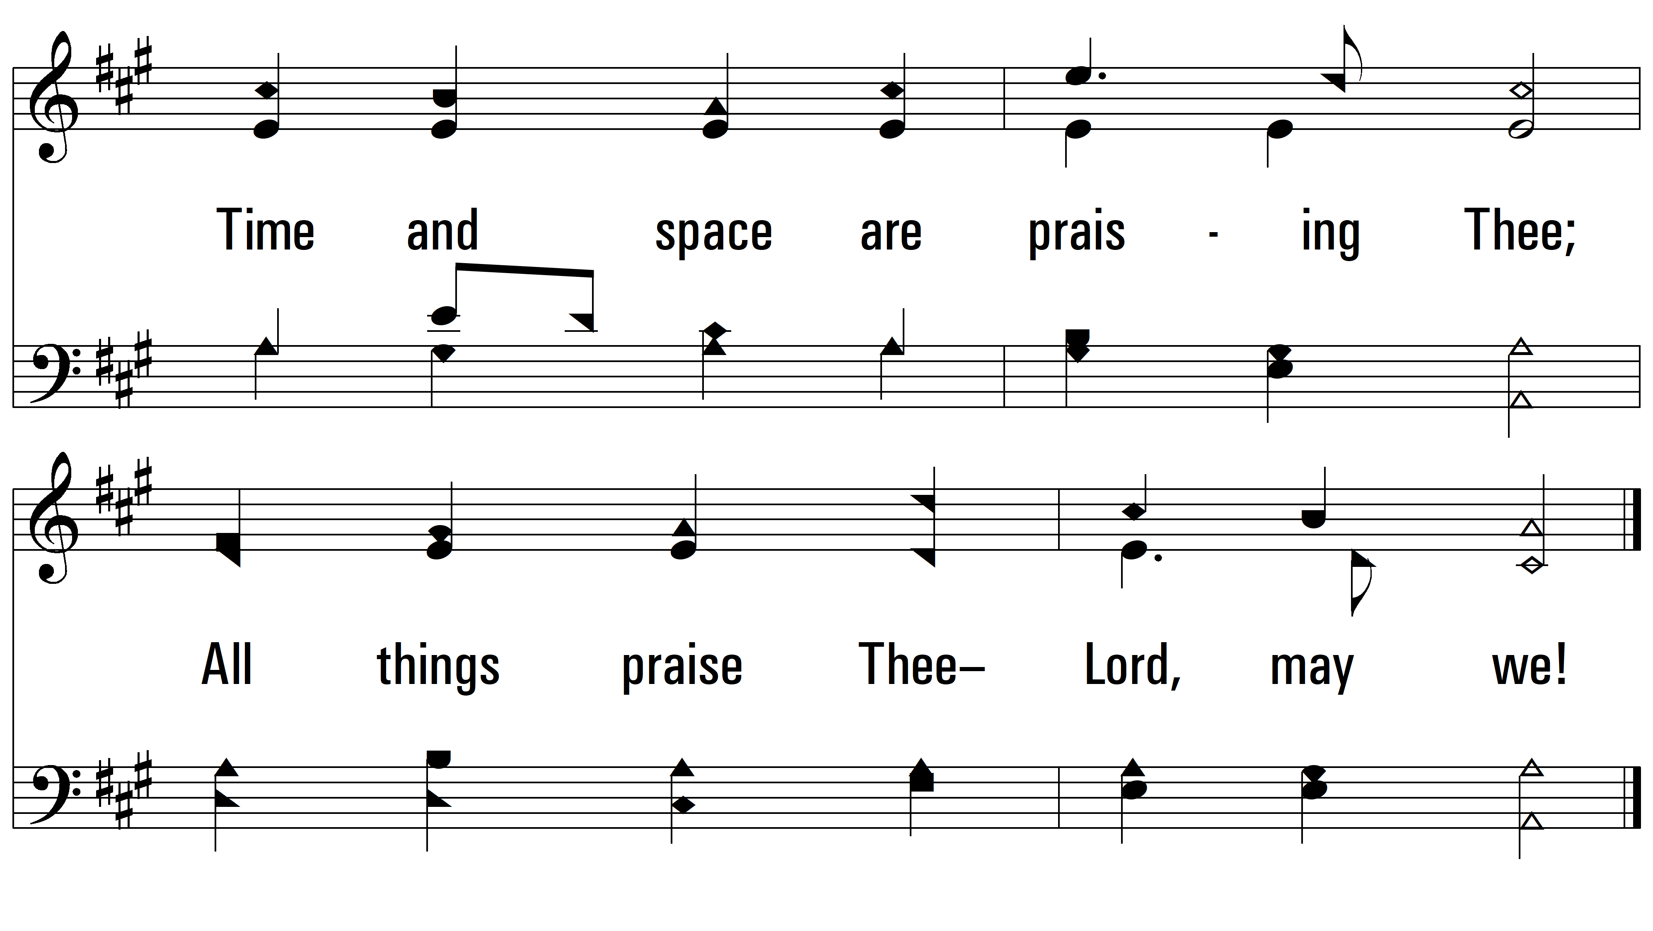
vs. 2

Slide 8
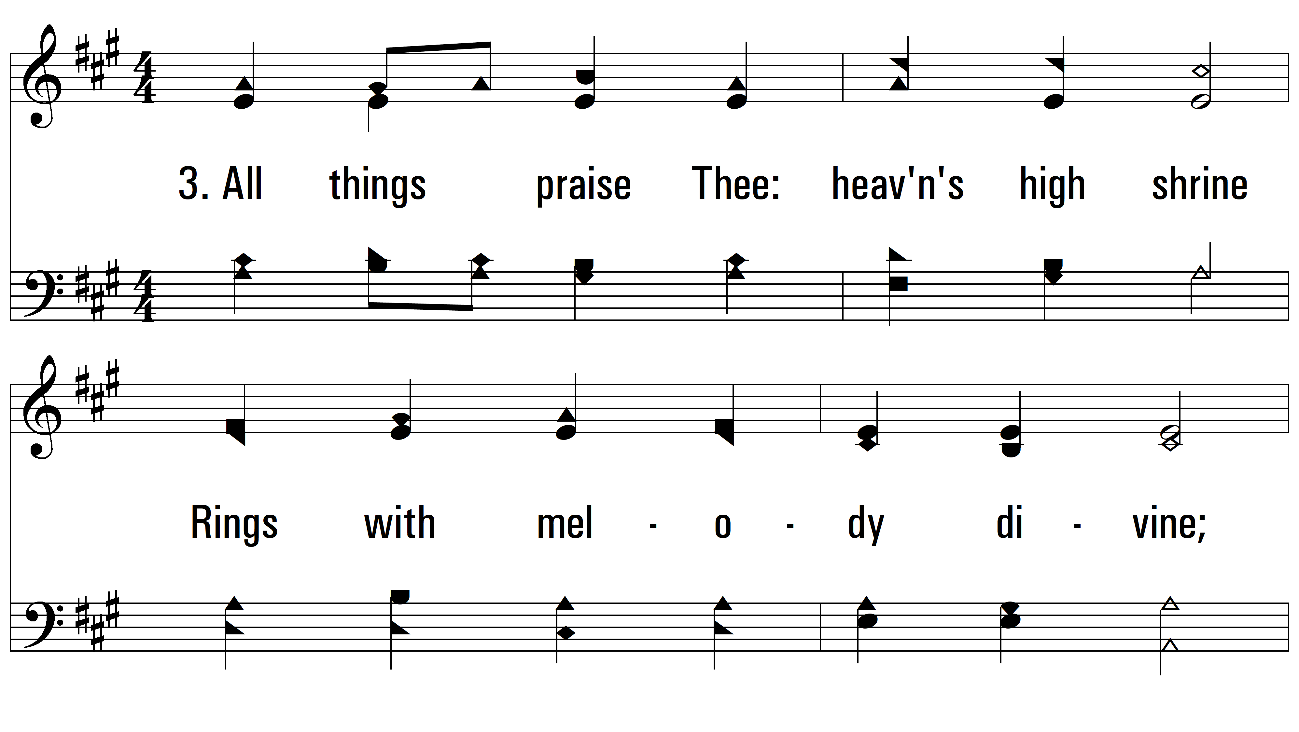
vs. 3 ~ All Things Praise Thee

Slide 9
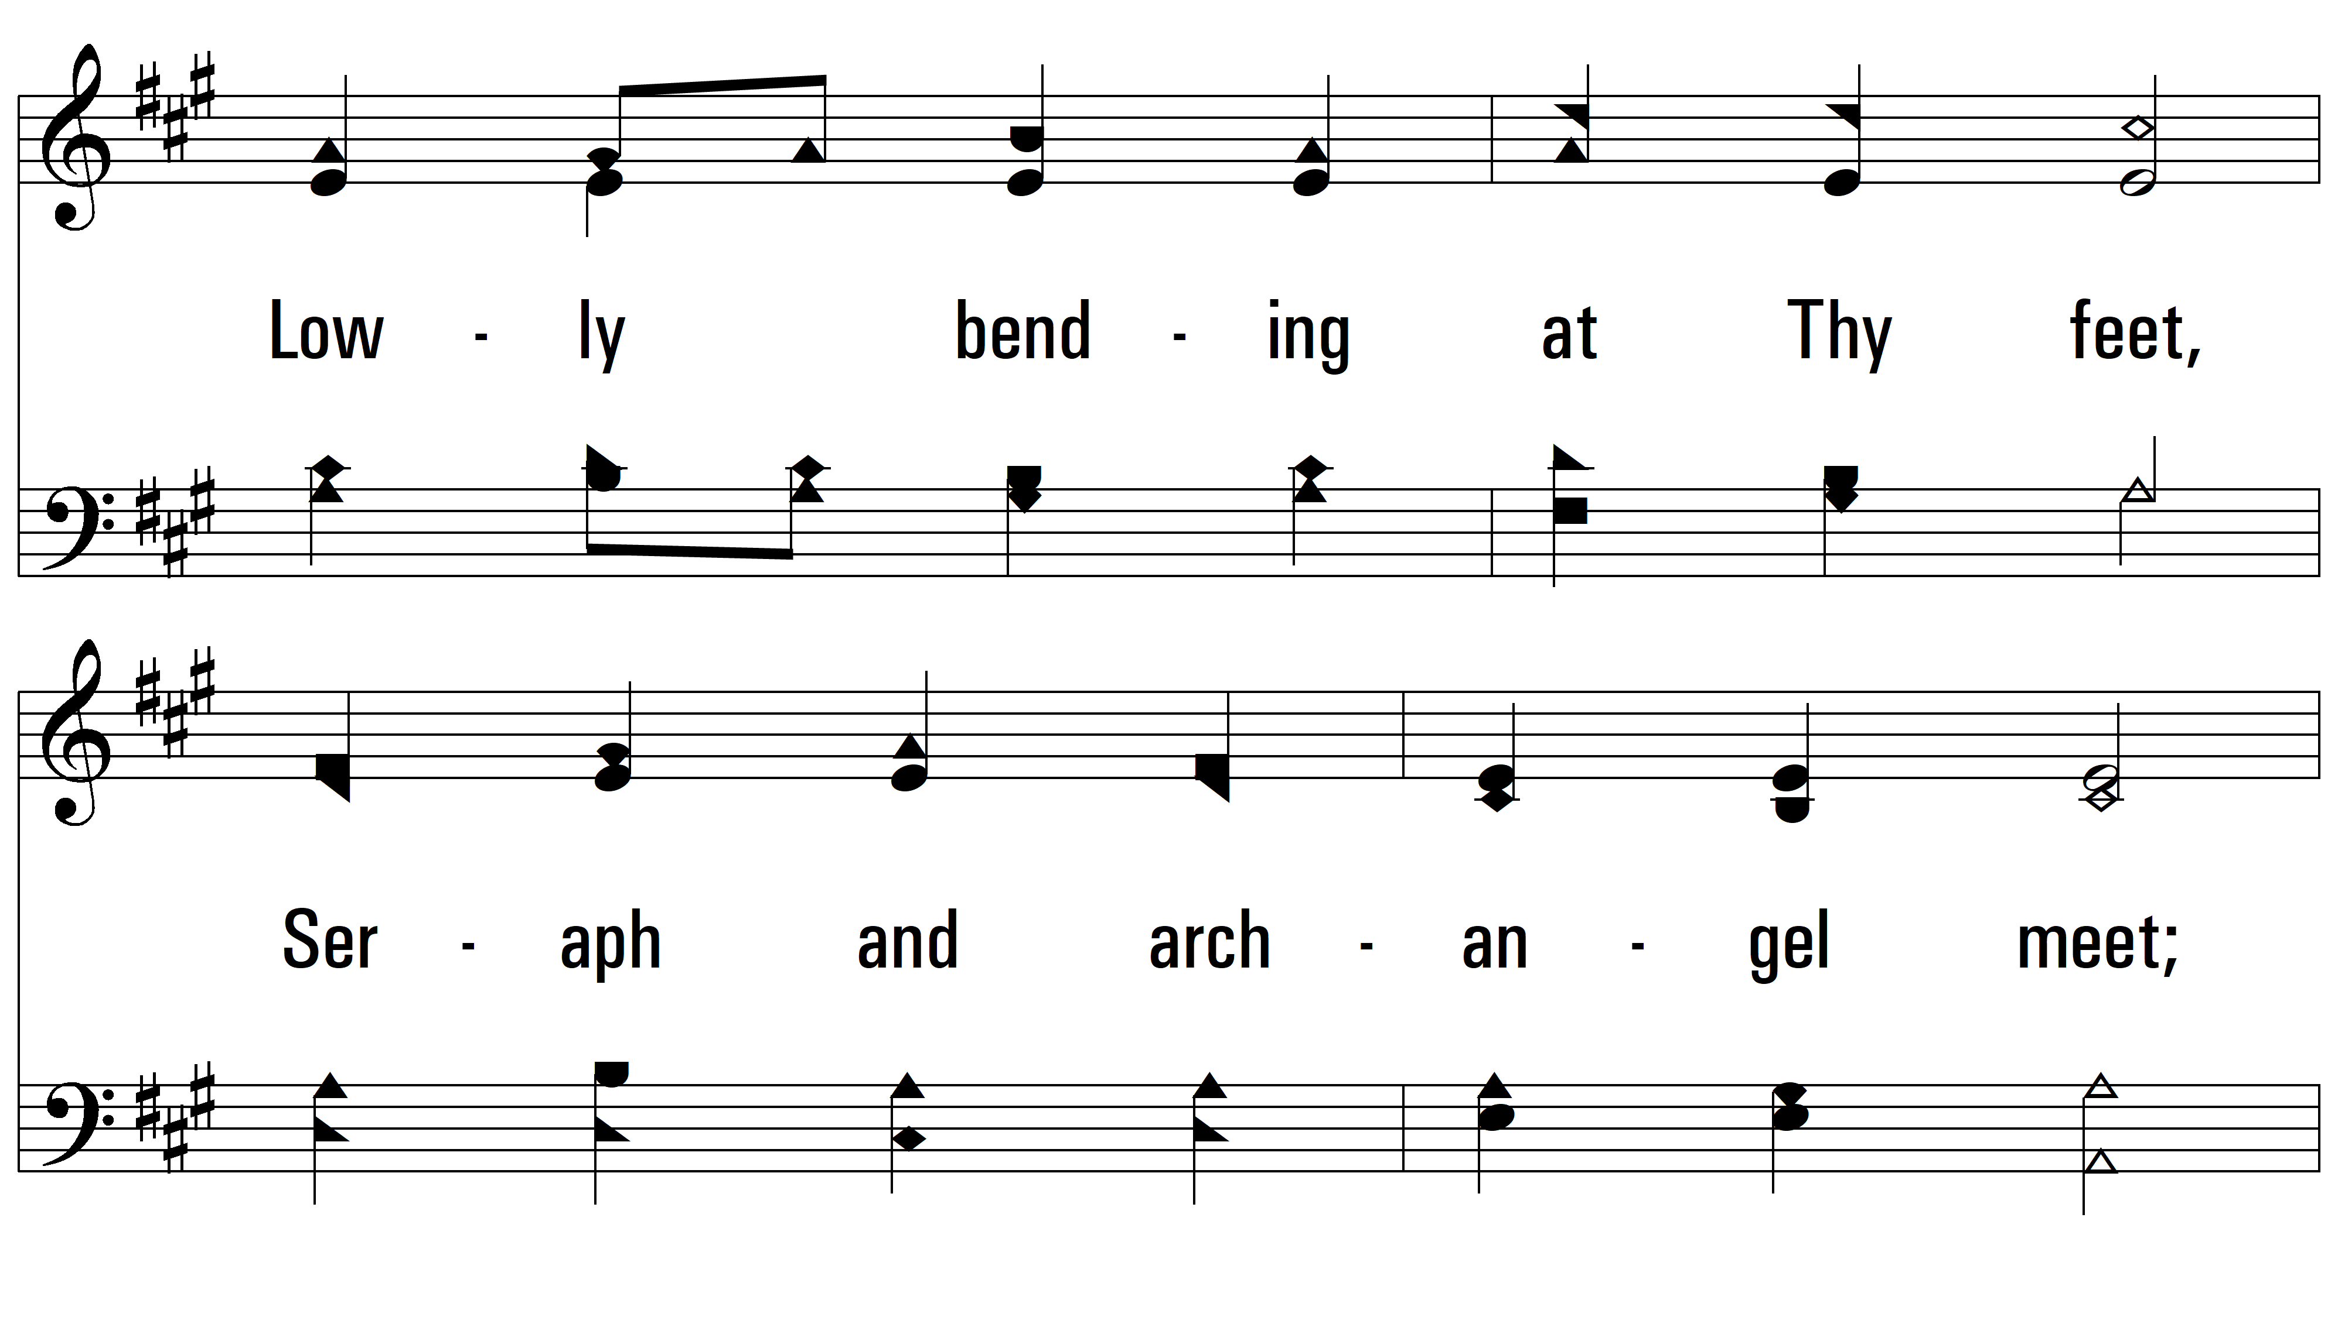
vs. 3

Slide 10
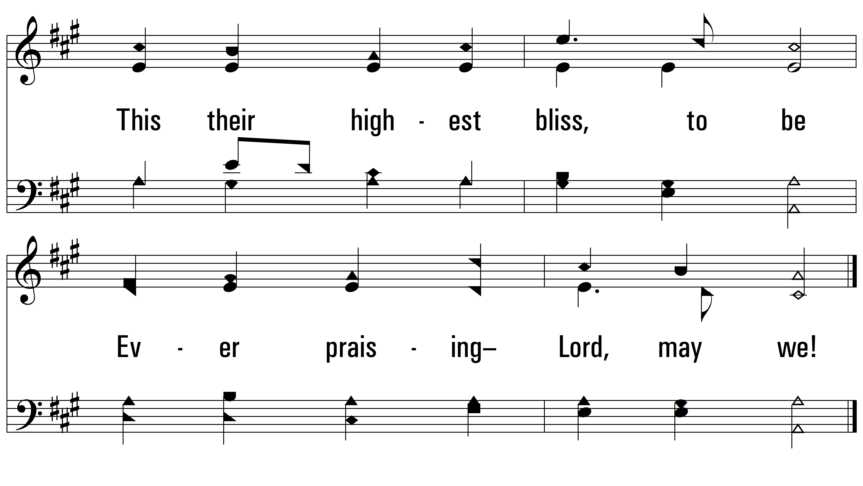
vs. 3
PDHymns.com
END

