Slide 1
All The Way My Savior Leads Me
Words: | Fanny J. Crosby (1875)
Music: | Robert Lowry (1875)
3/4
A^{b}/C - MI
Verses: 3
Lead - | MI
Alto - | SOL
Tenor - | DO
Bass - | DO
PDHymns.com

Slide 2
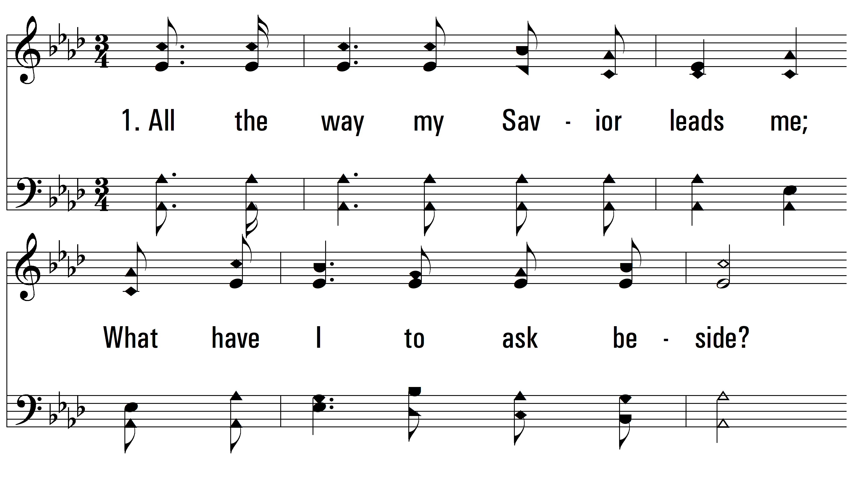
vs. 1 ~ All The Way My Savior Leads Me

Slide 3
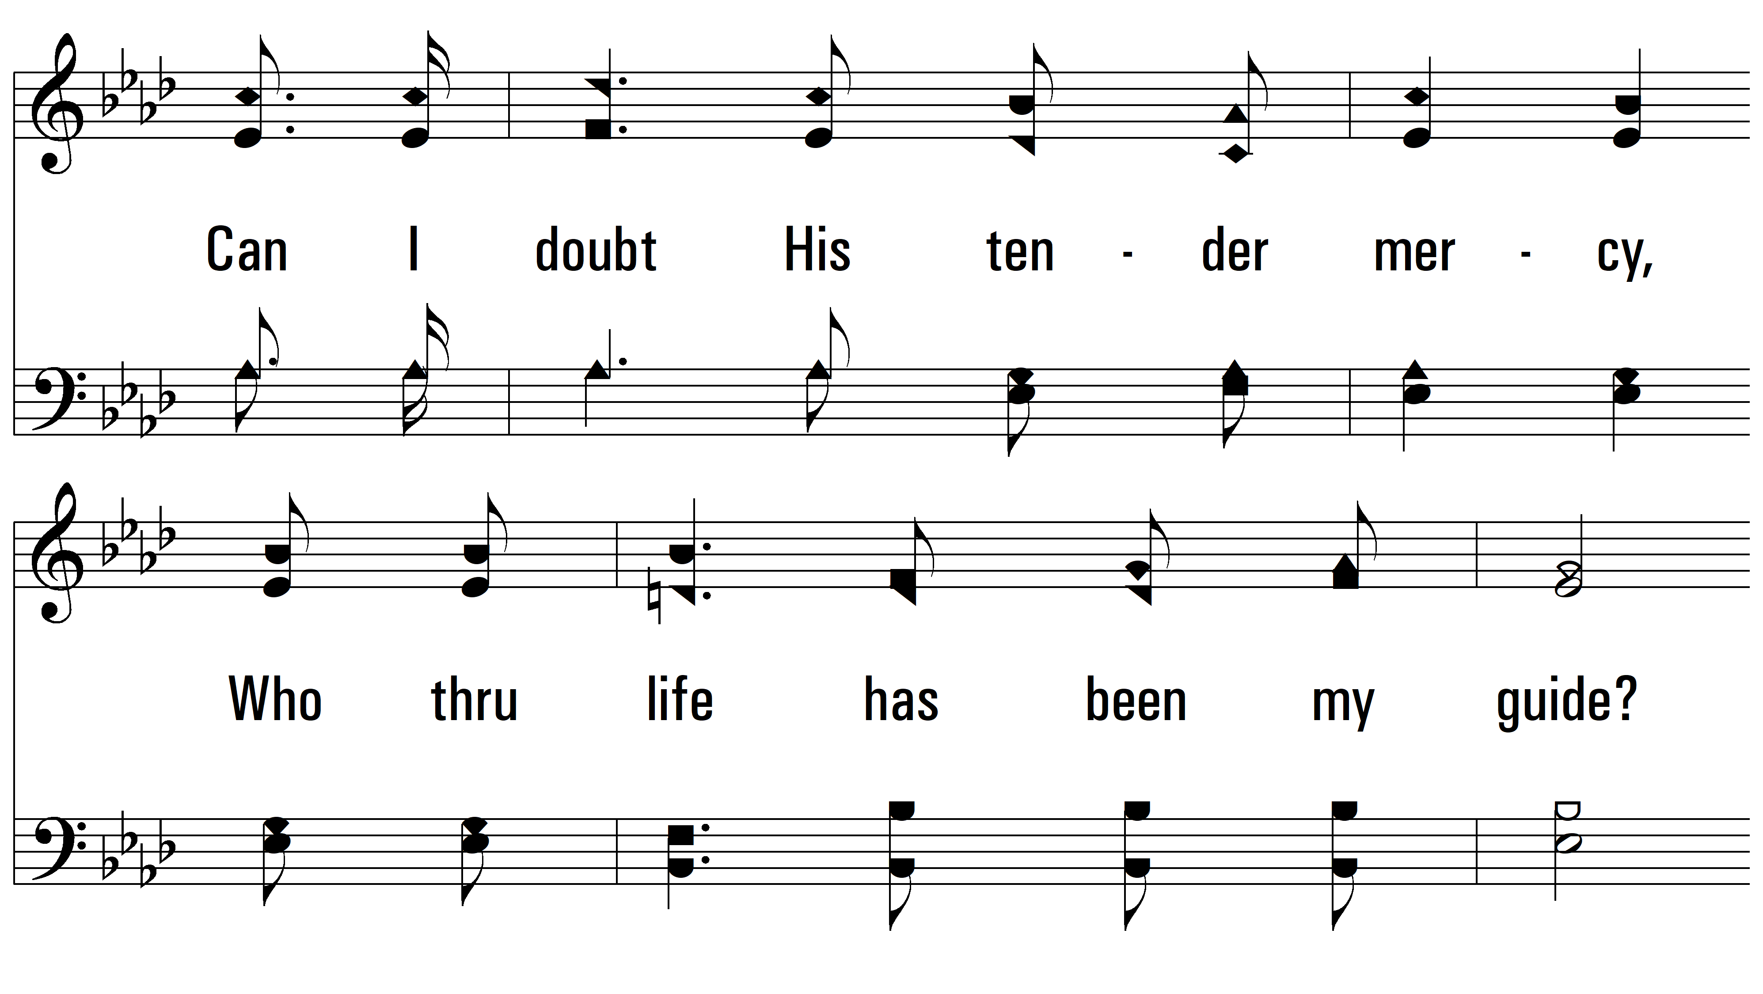
vs. 1

Slide 4
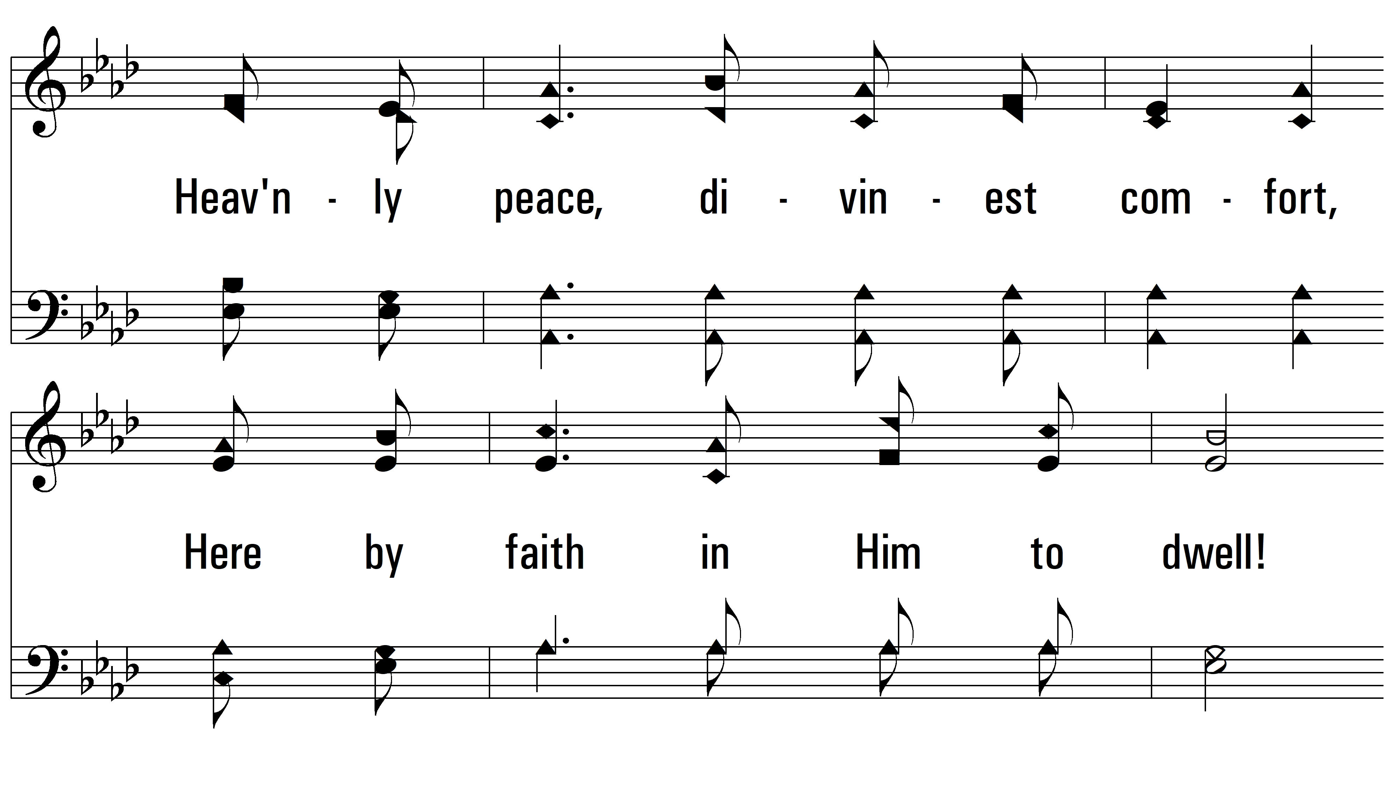
vs. 1

Slide 5
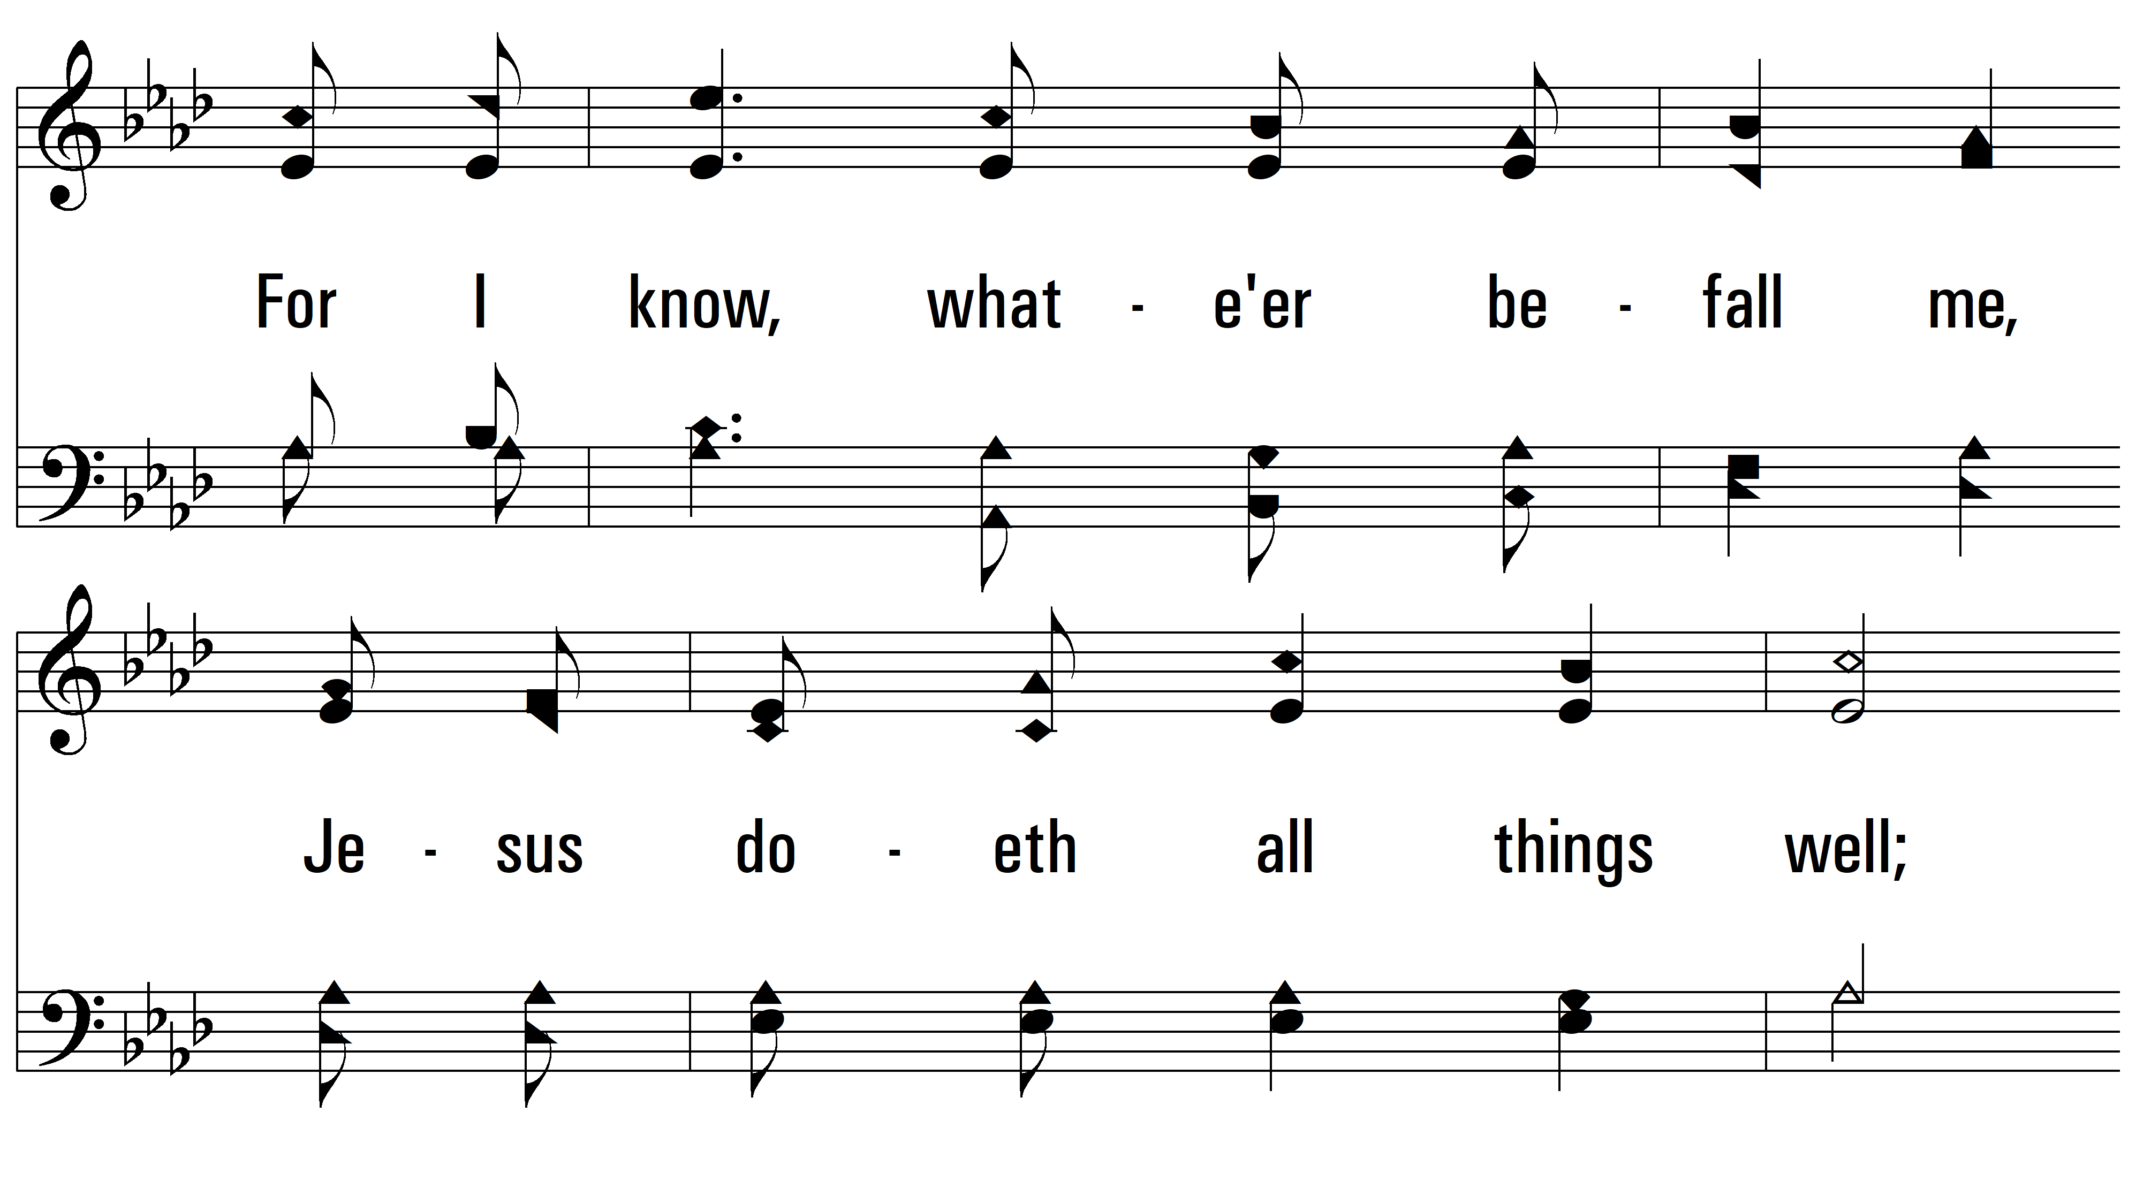
vs. 1

Slide 6
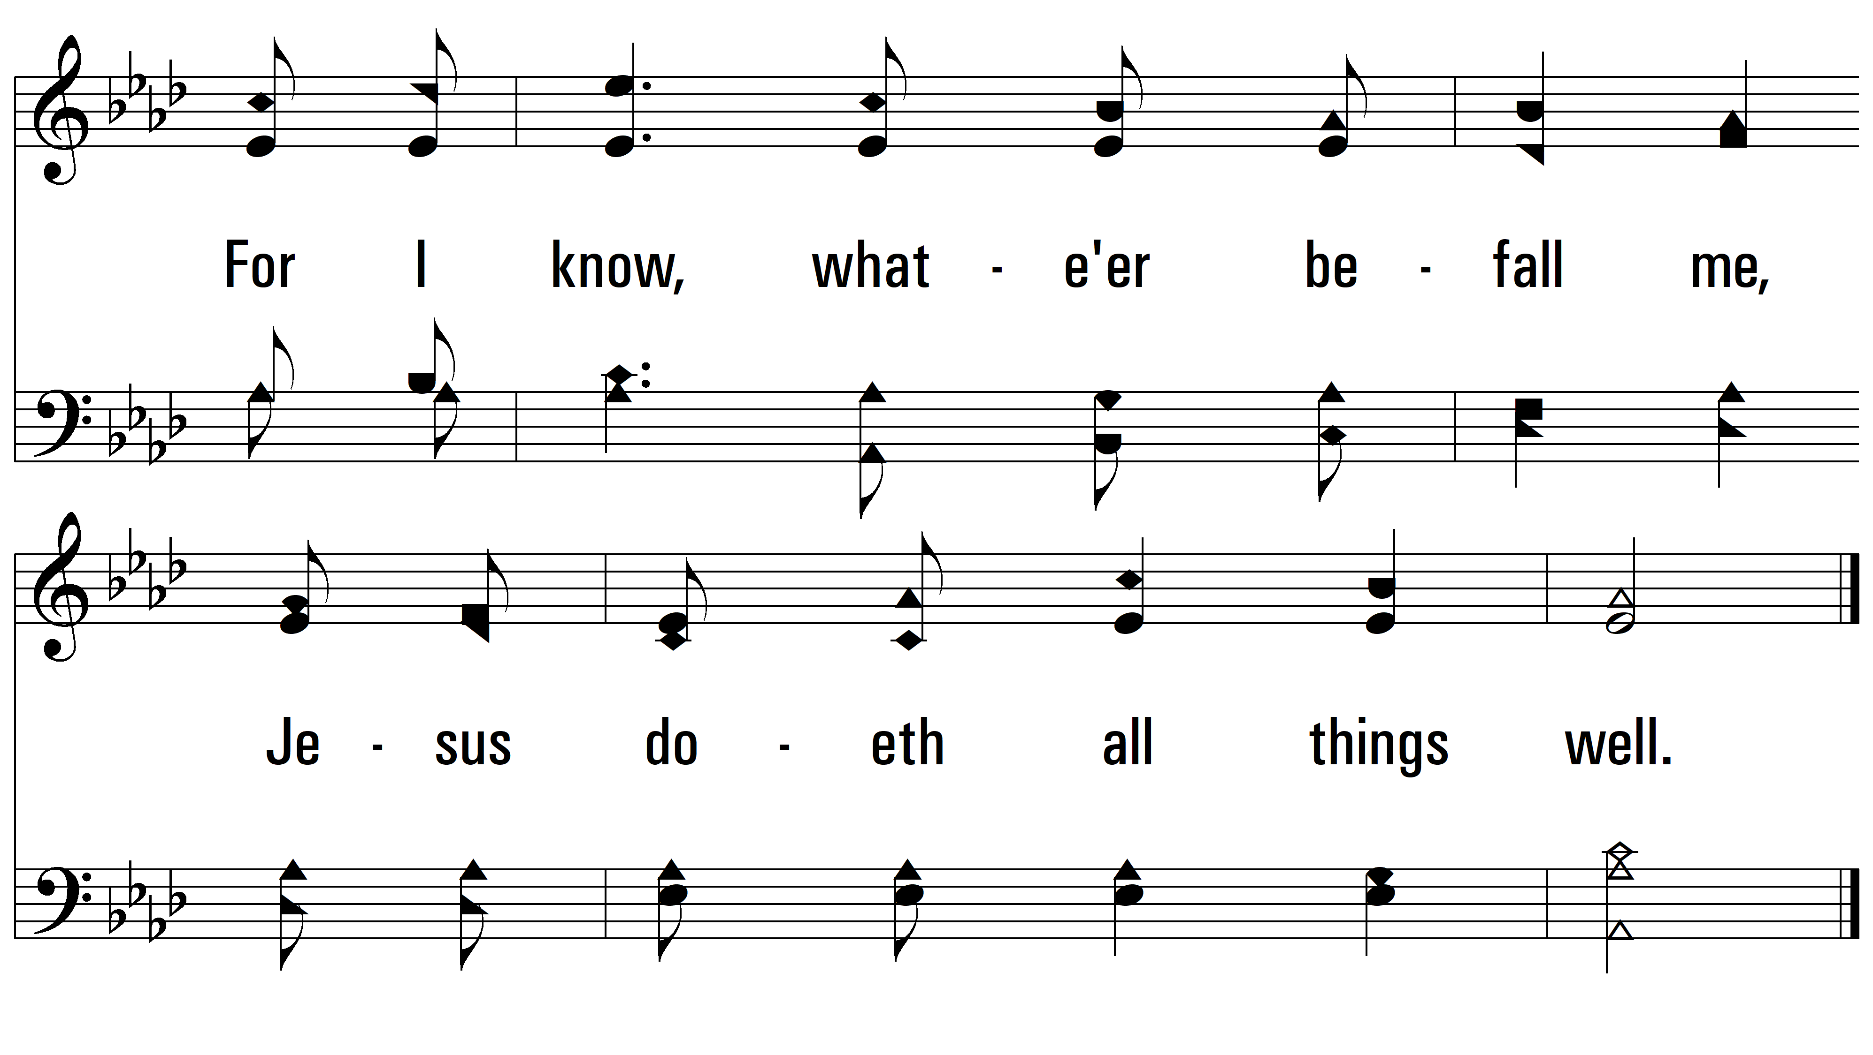
vs. 1

Slide 7
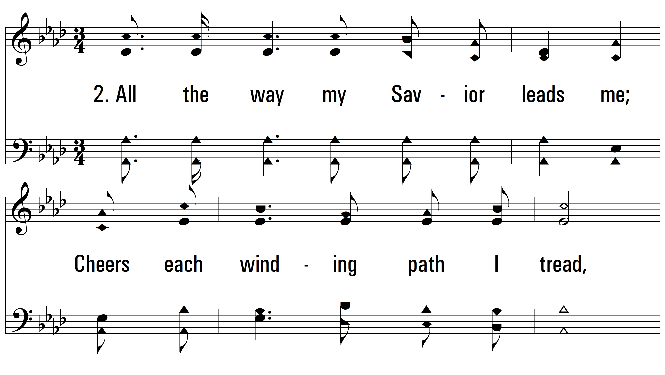
vs. 2 ~ All The Way My Savior Leads Me

Slide 8
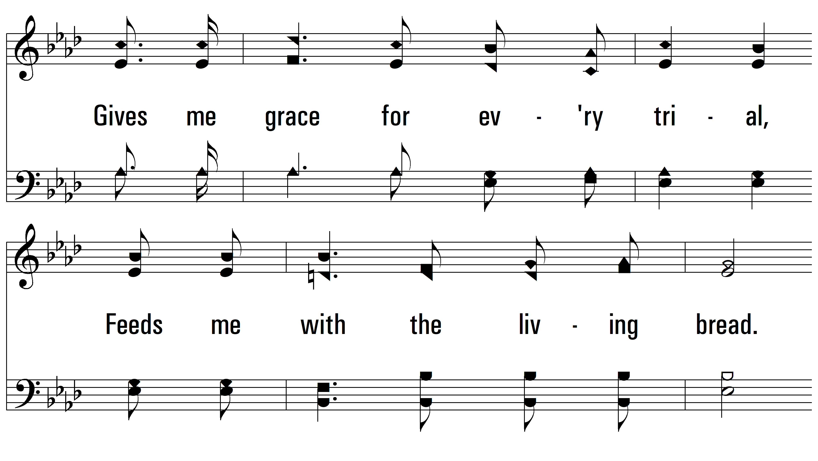
vs. 2

Slide 9
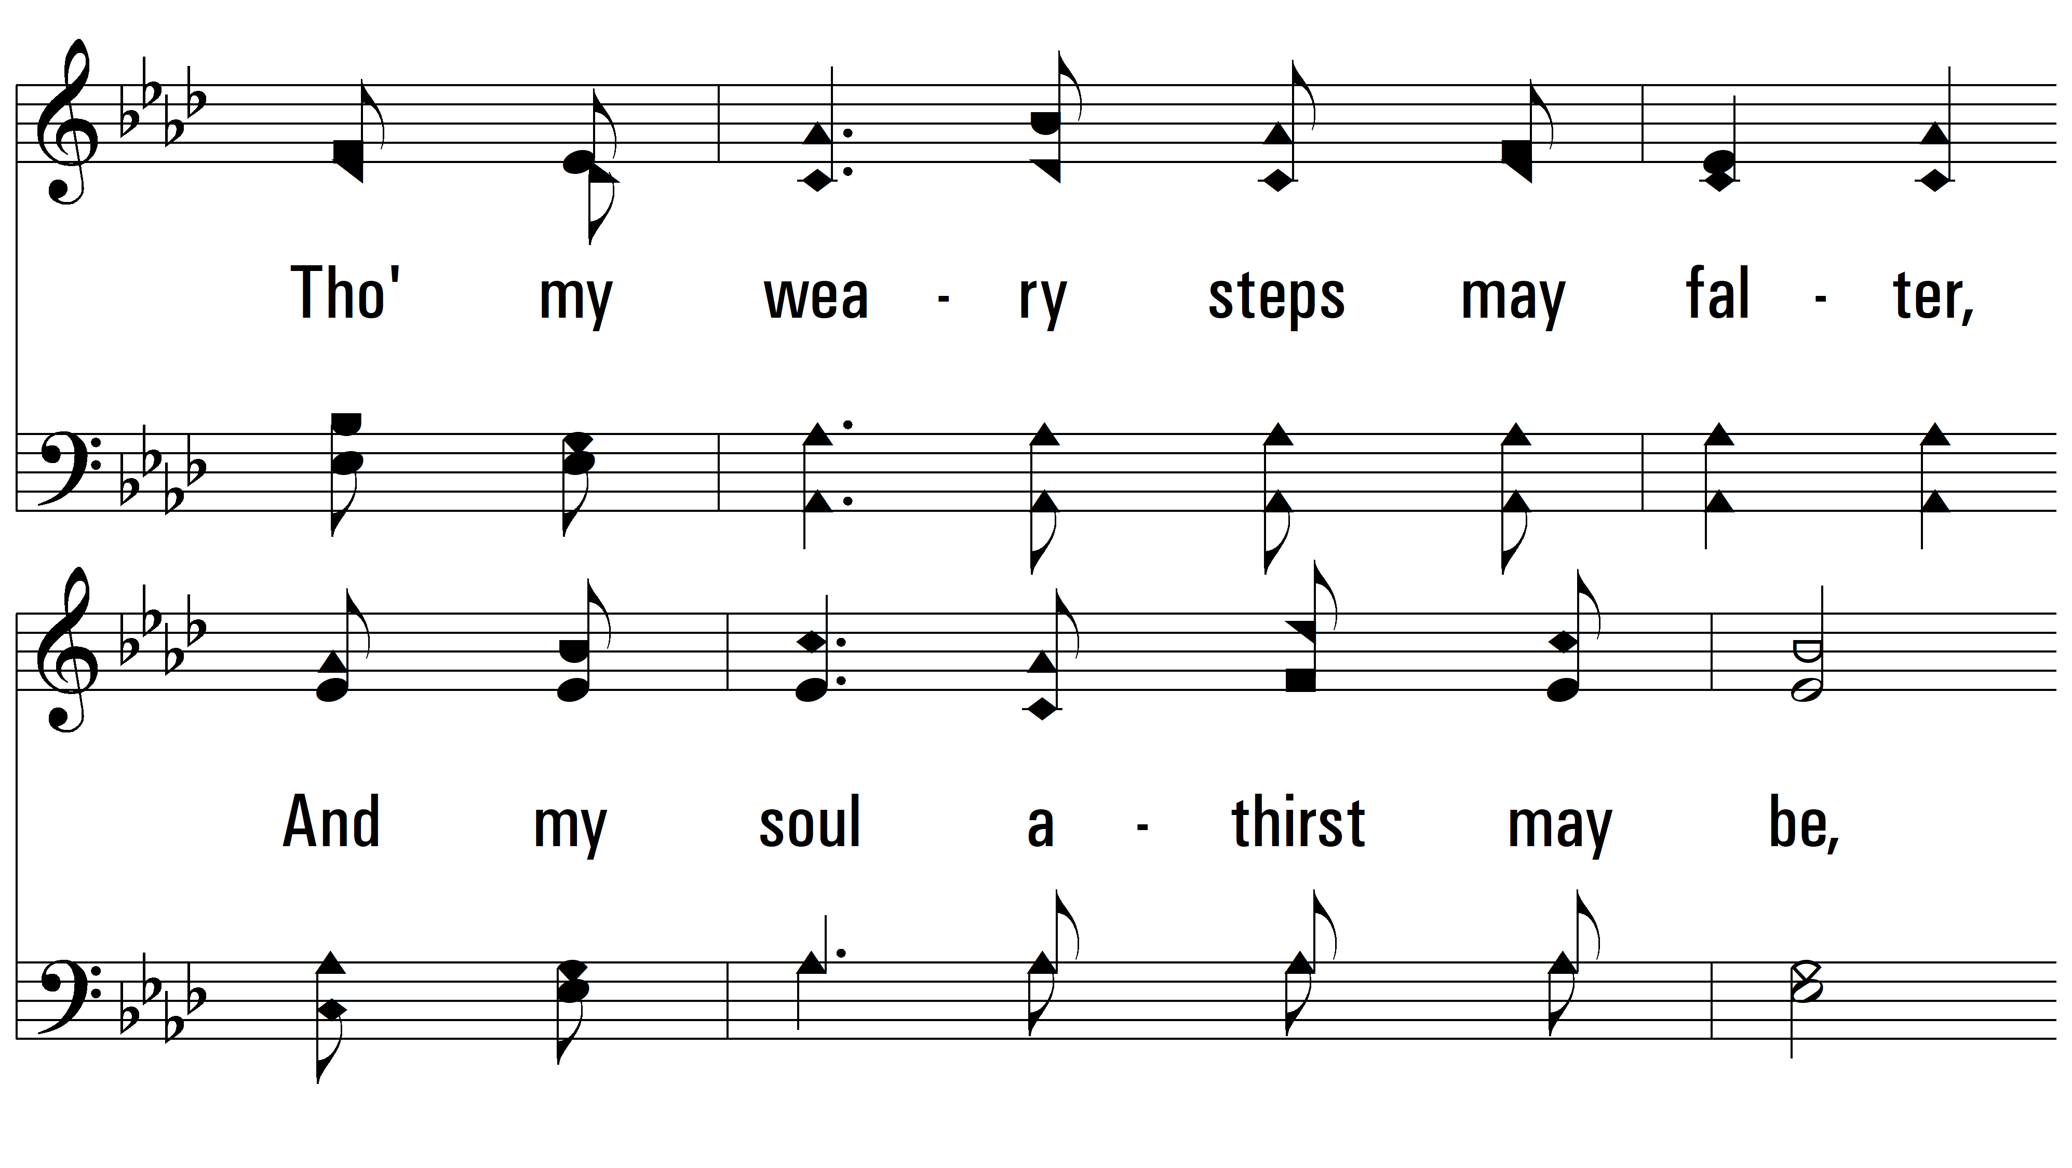
vs. 2

Slide 10
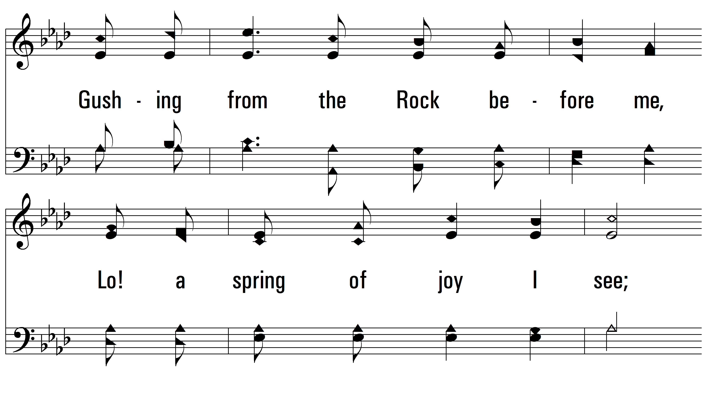
vs. 2

Slide 11
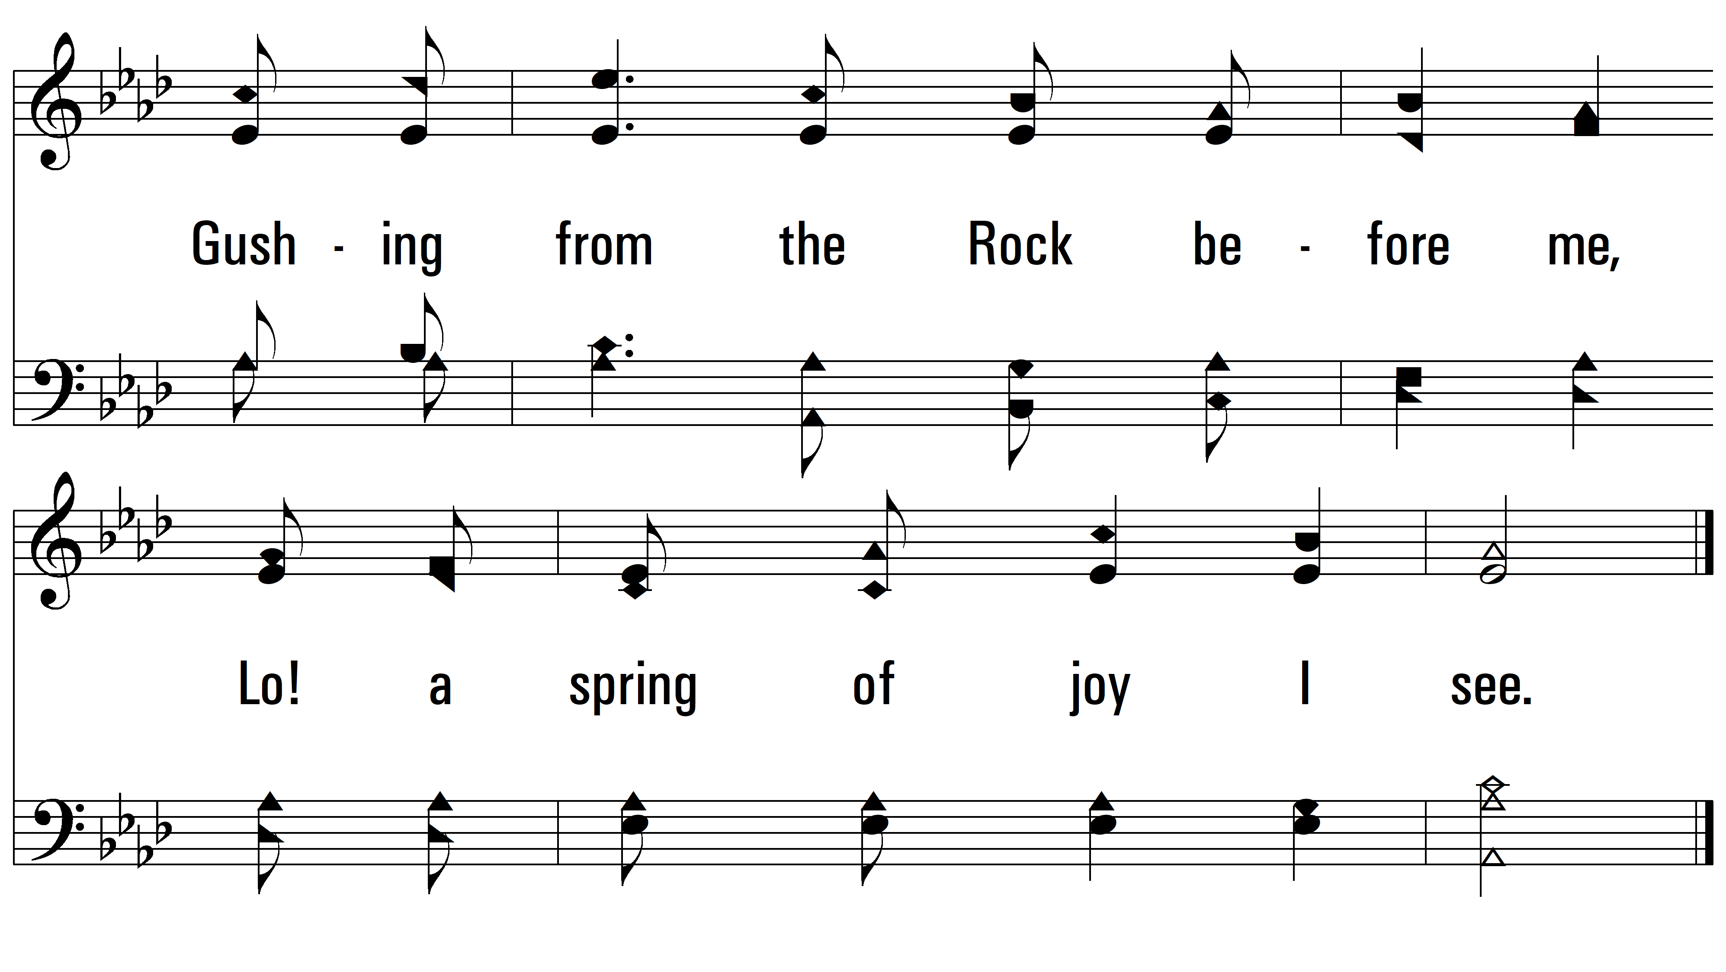
vs. 2

Slide 12
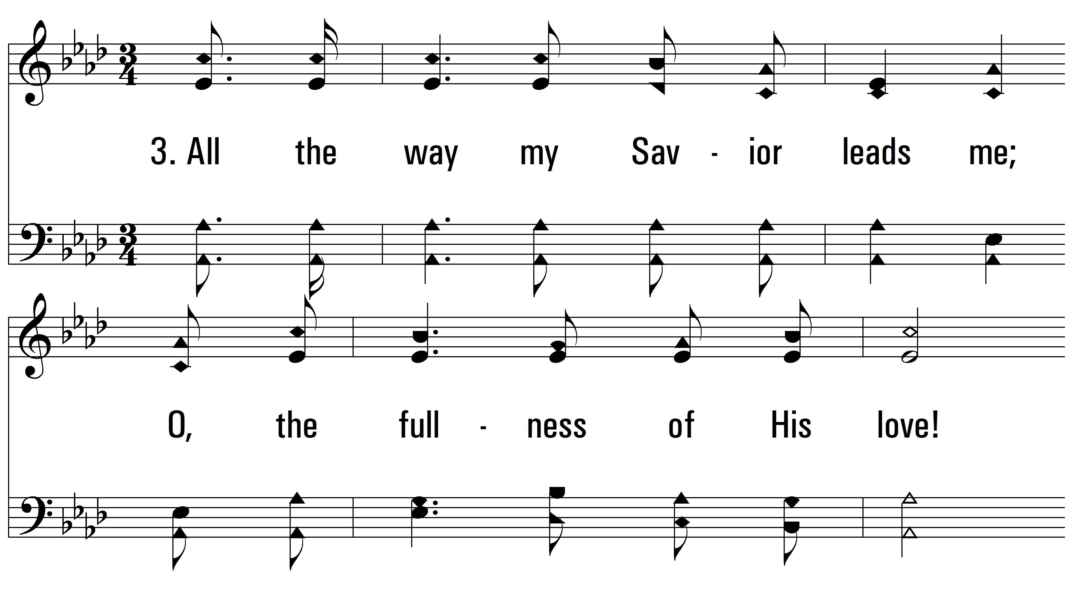
vs. 3 ~ All The Way My Savior Leads Me

Slide 13
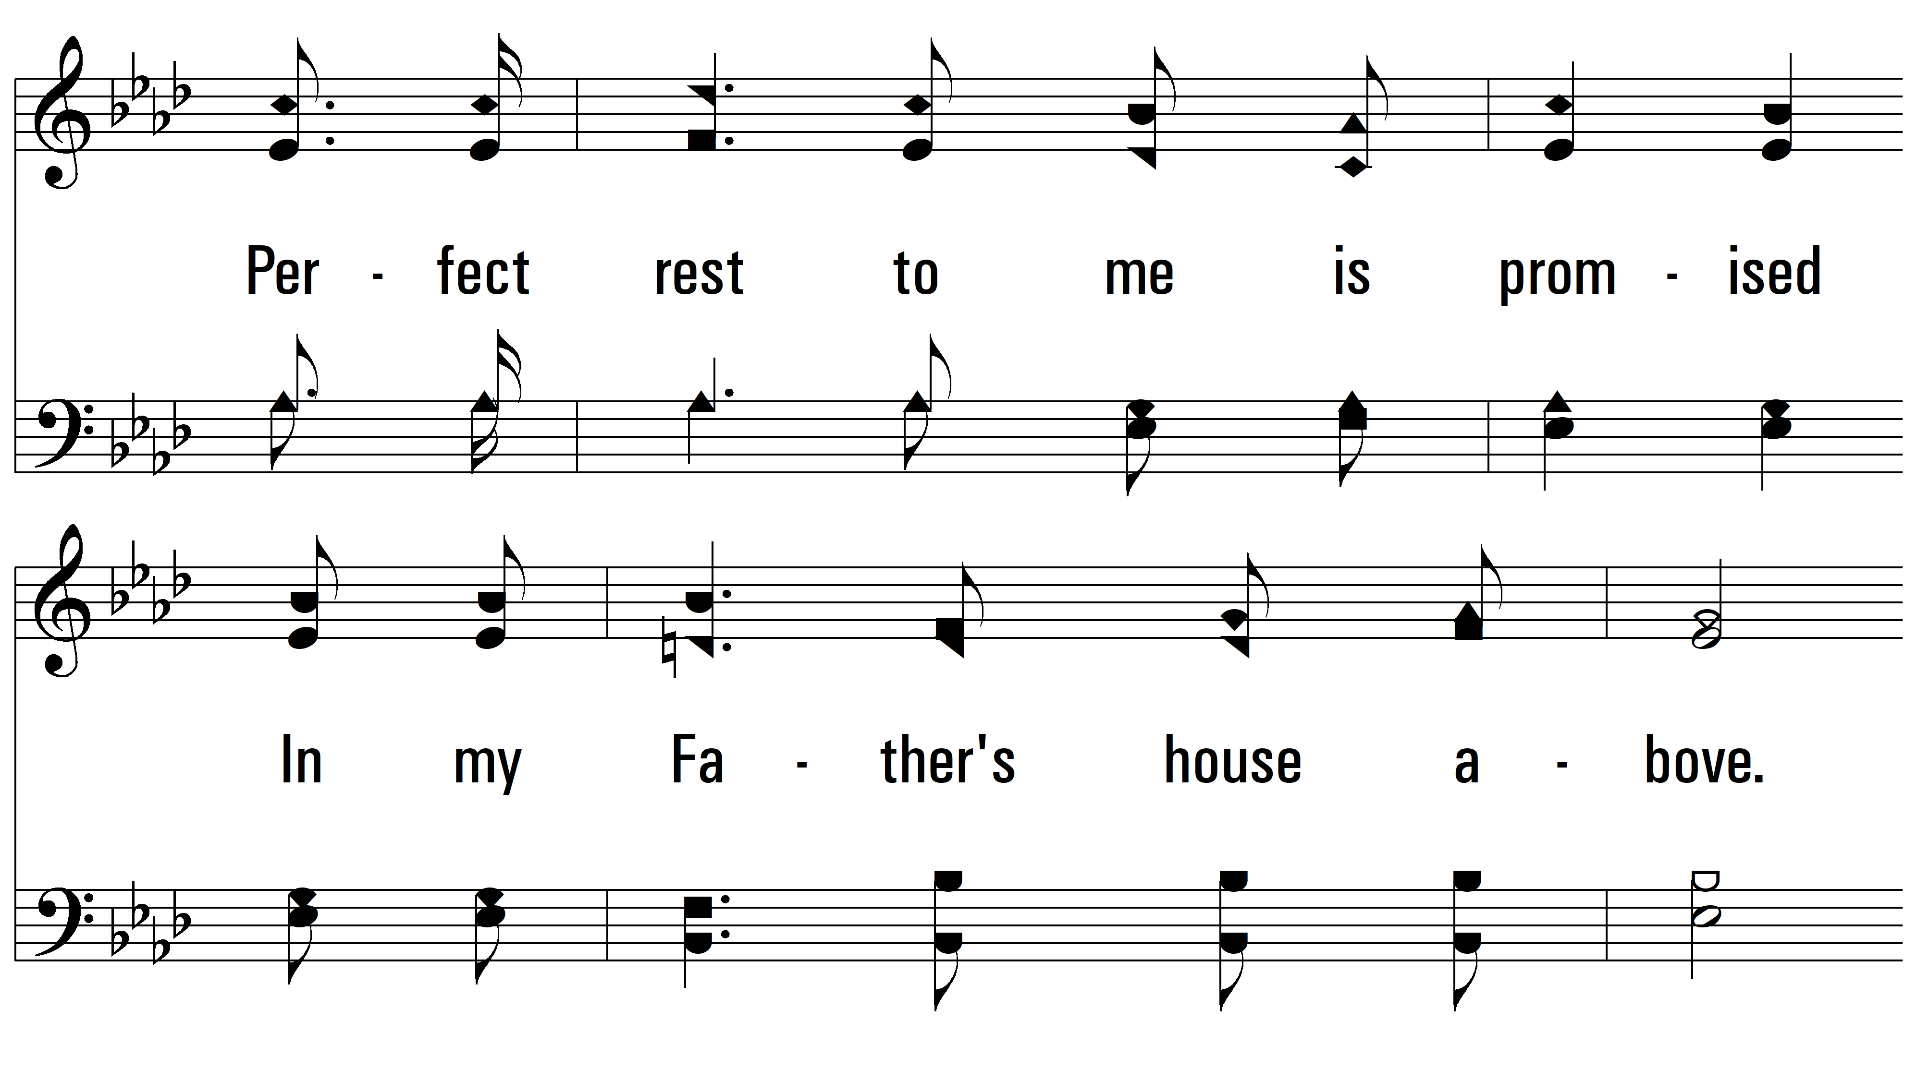
vs. 3

Slide 14
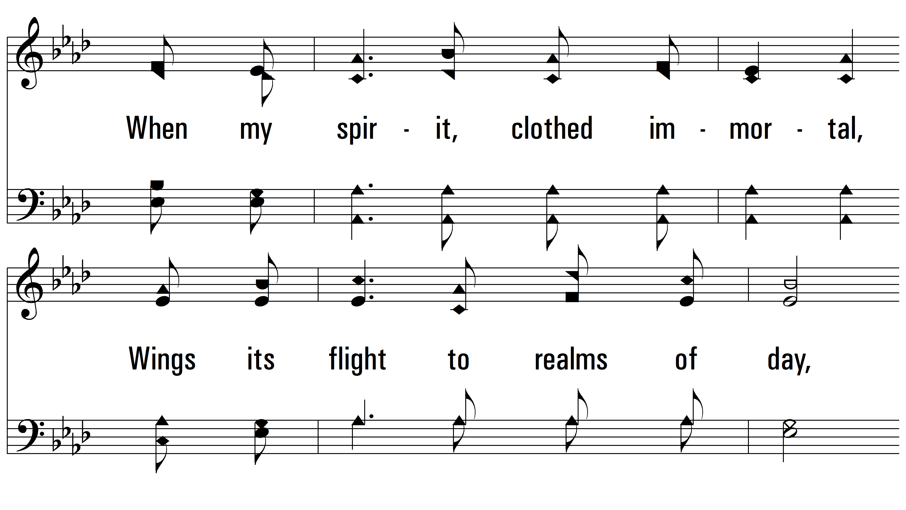
vs. 3

Slide 15
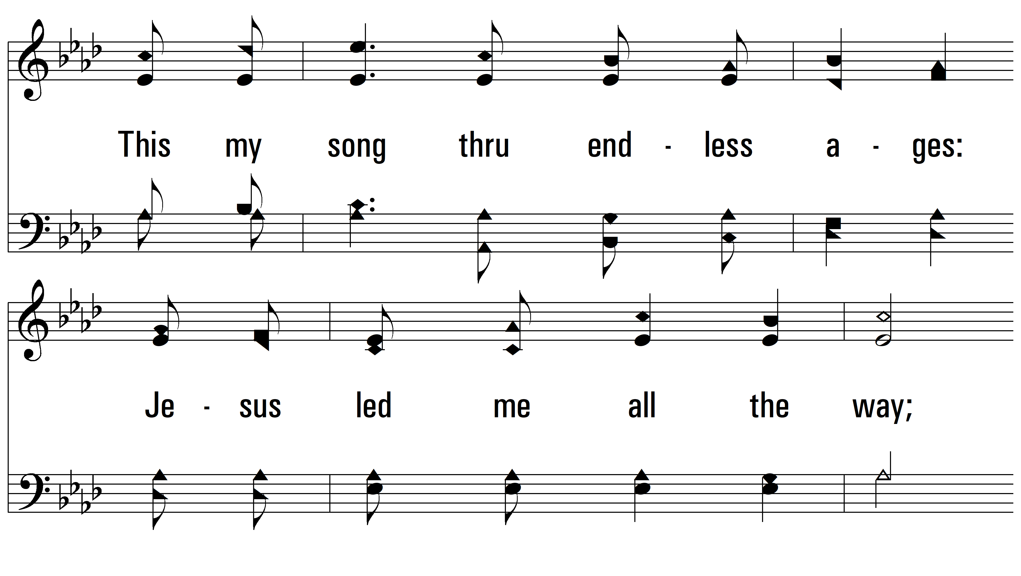
vs. 3

Slide 16
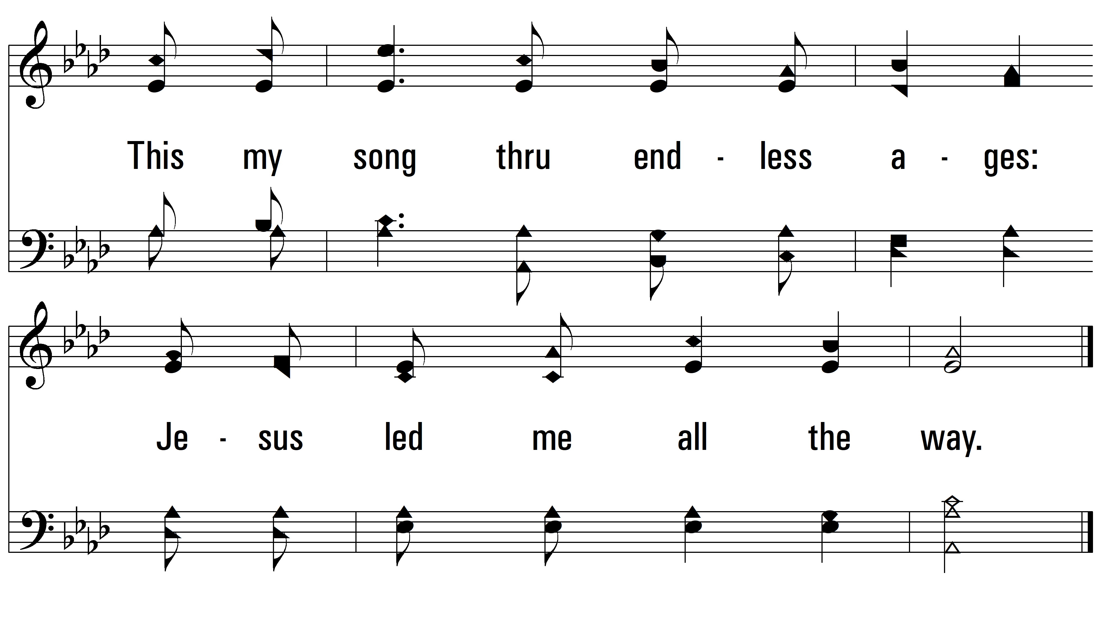
vs. 3
PDHymns.com
END

