Slide 1
All People That On Earth Do Dwell
OLD HUNDRETH
LM
Words: | Psalm 100, Arr. by William Hethe (1560)
Music: | Louis Bourgeois’ Geneva Psalter (1551)
4/4
A/A - DO
Verses: 4/Chorus
Lead - | DO
Alto - | SOL
Tenor - | MI
Bass - | DO
PDHymns.com

Slide 2
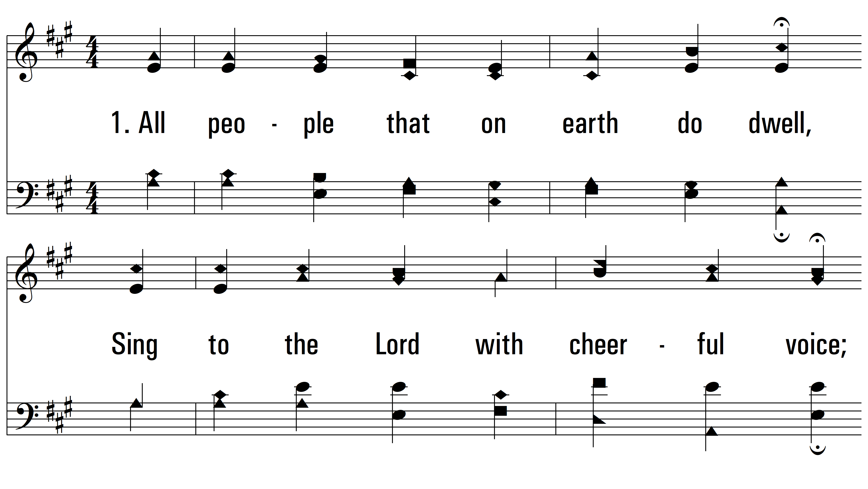
vs. 1 ~ All People That On Earth Do Dwell

Slide 3
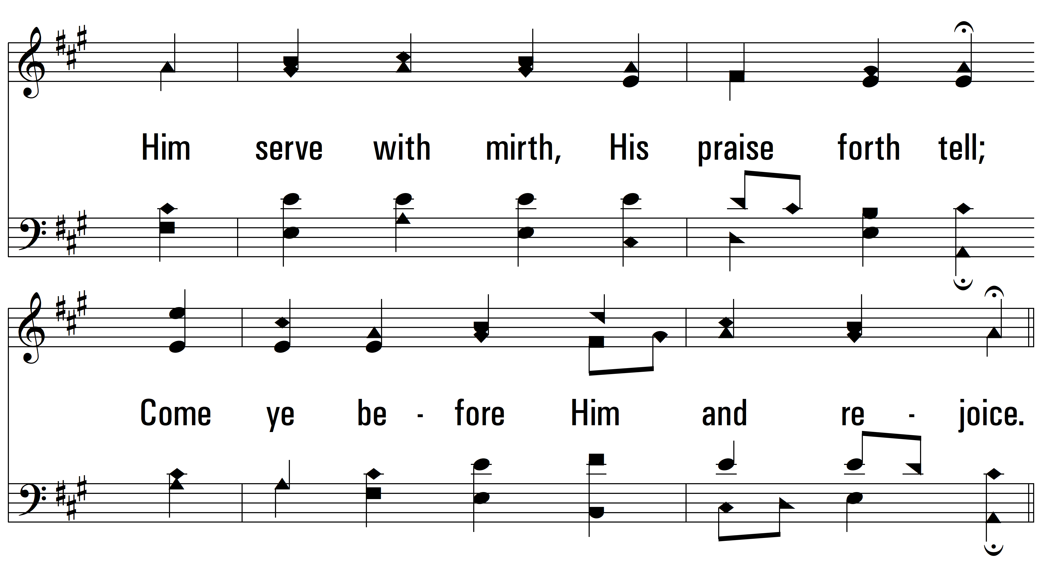
vs. 1

Slide 4
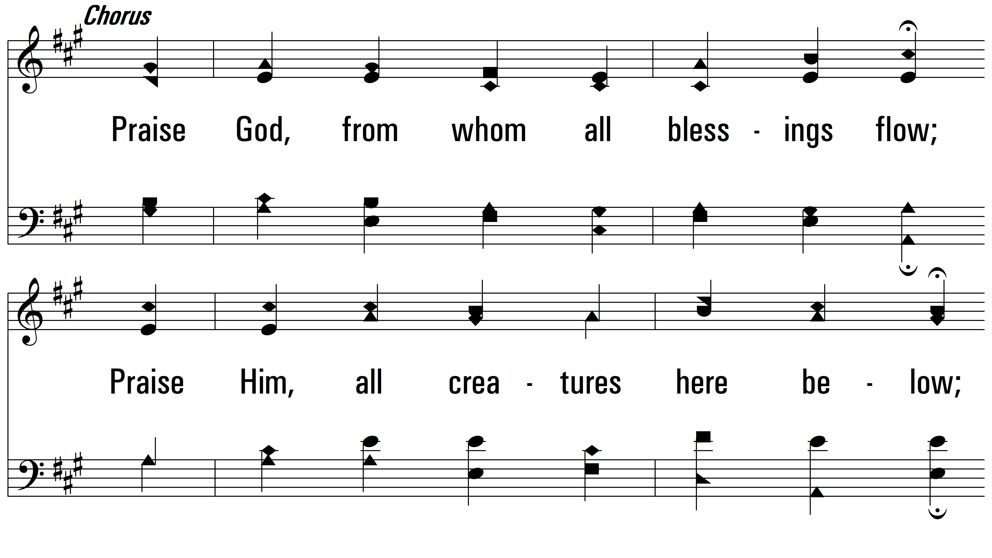
vs. 1

Slide 5
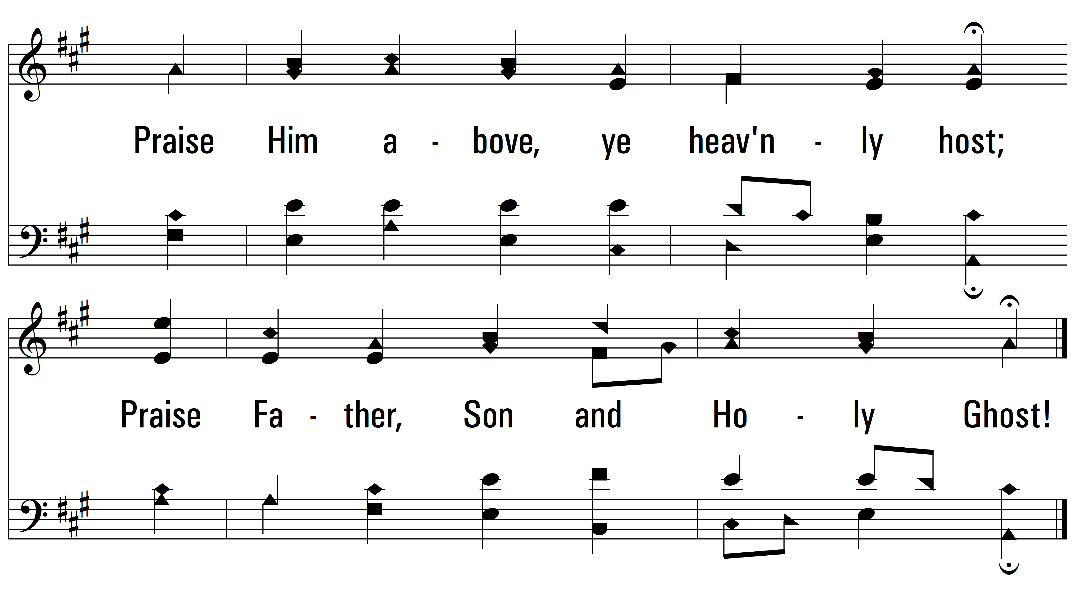
vs. 1

Slide 6
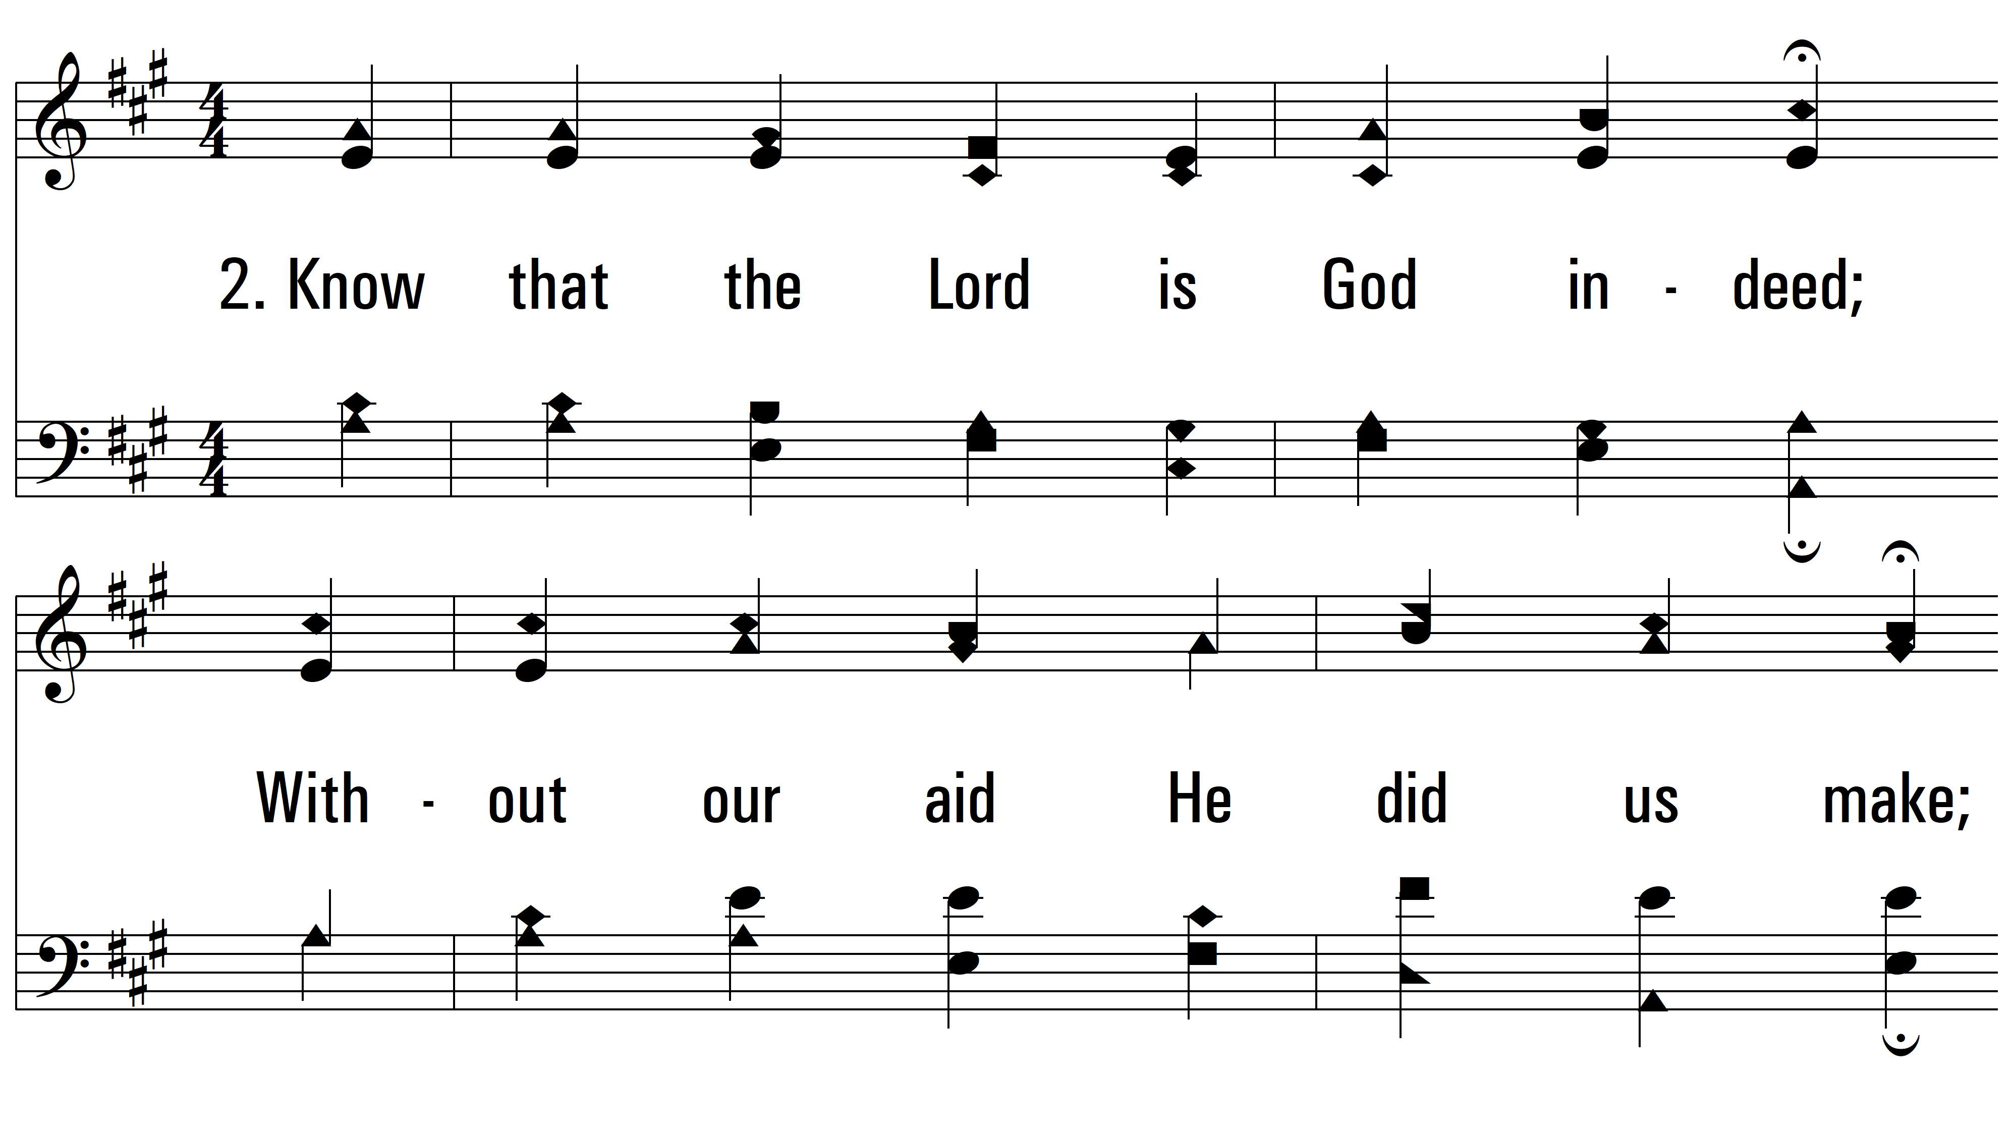
vs. 2 ~ All People That On Earth Do Dwell

Slide 7
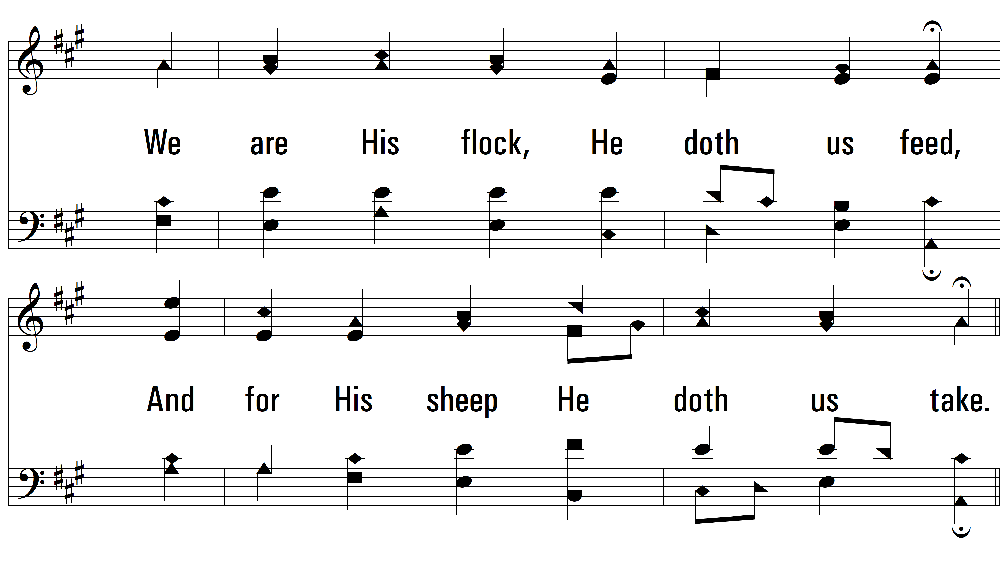
vs. 2

Slide 8
vs. 2

Slide 9
vs. 2

Slide 10
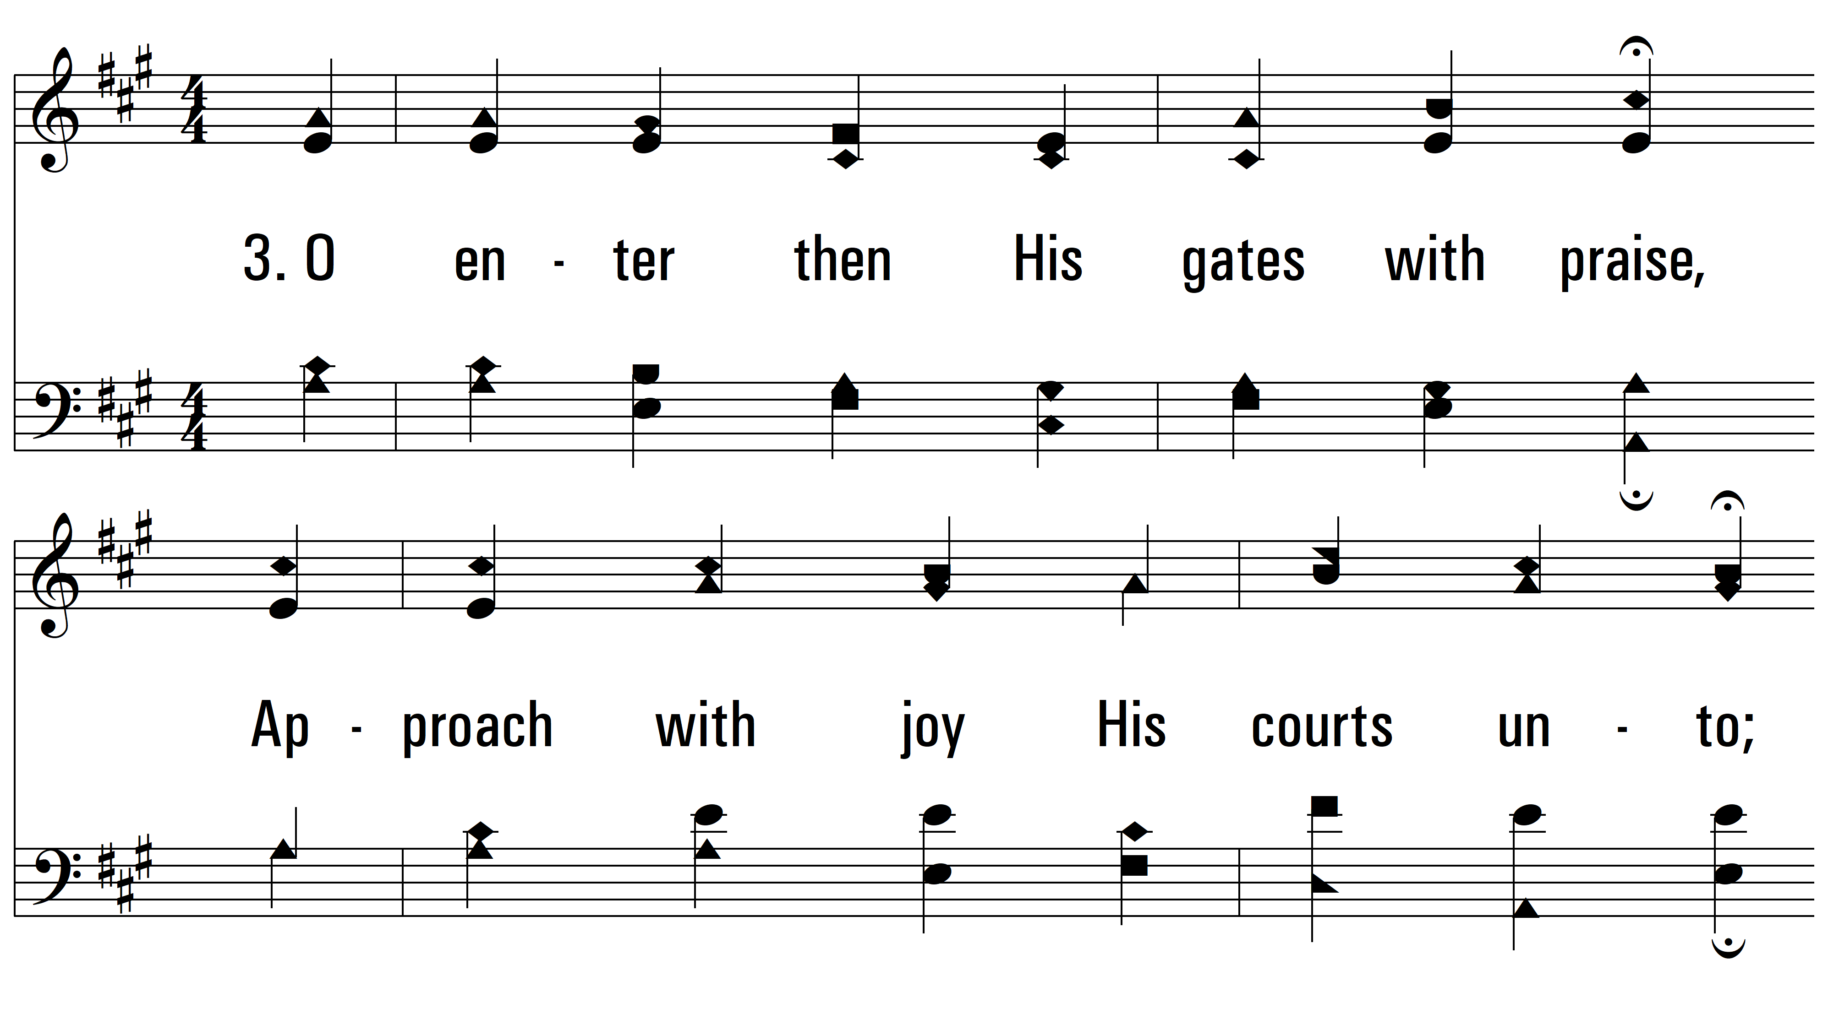
vs. 3 ~ All People That On Earth Do Dwell

Slide 11
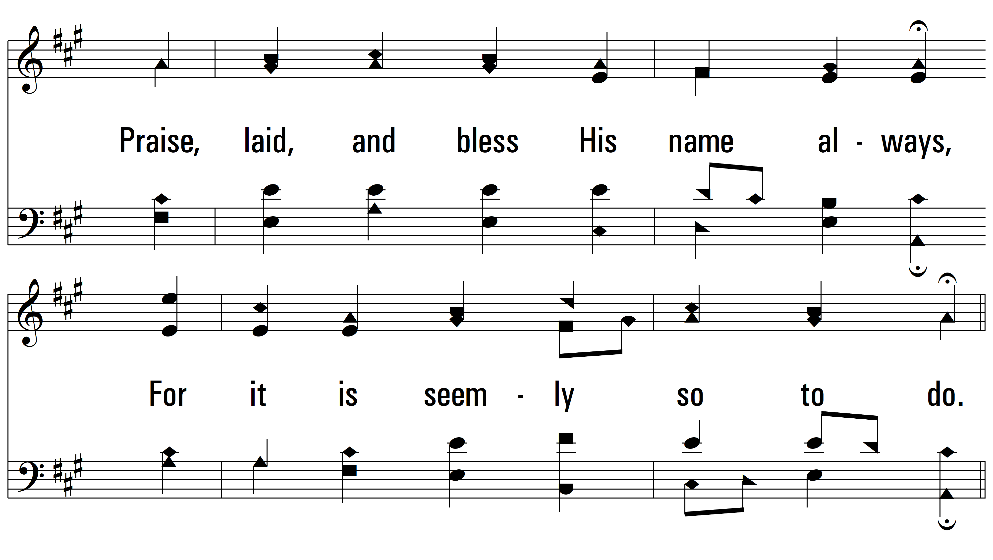
vs. 3

Slide 12
vs. 3

Slide 13
vs. 3

Slide 14
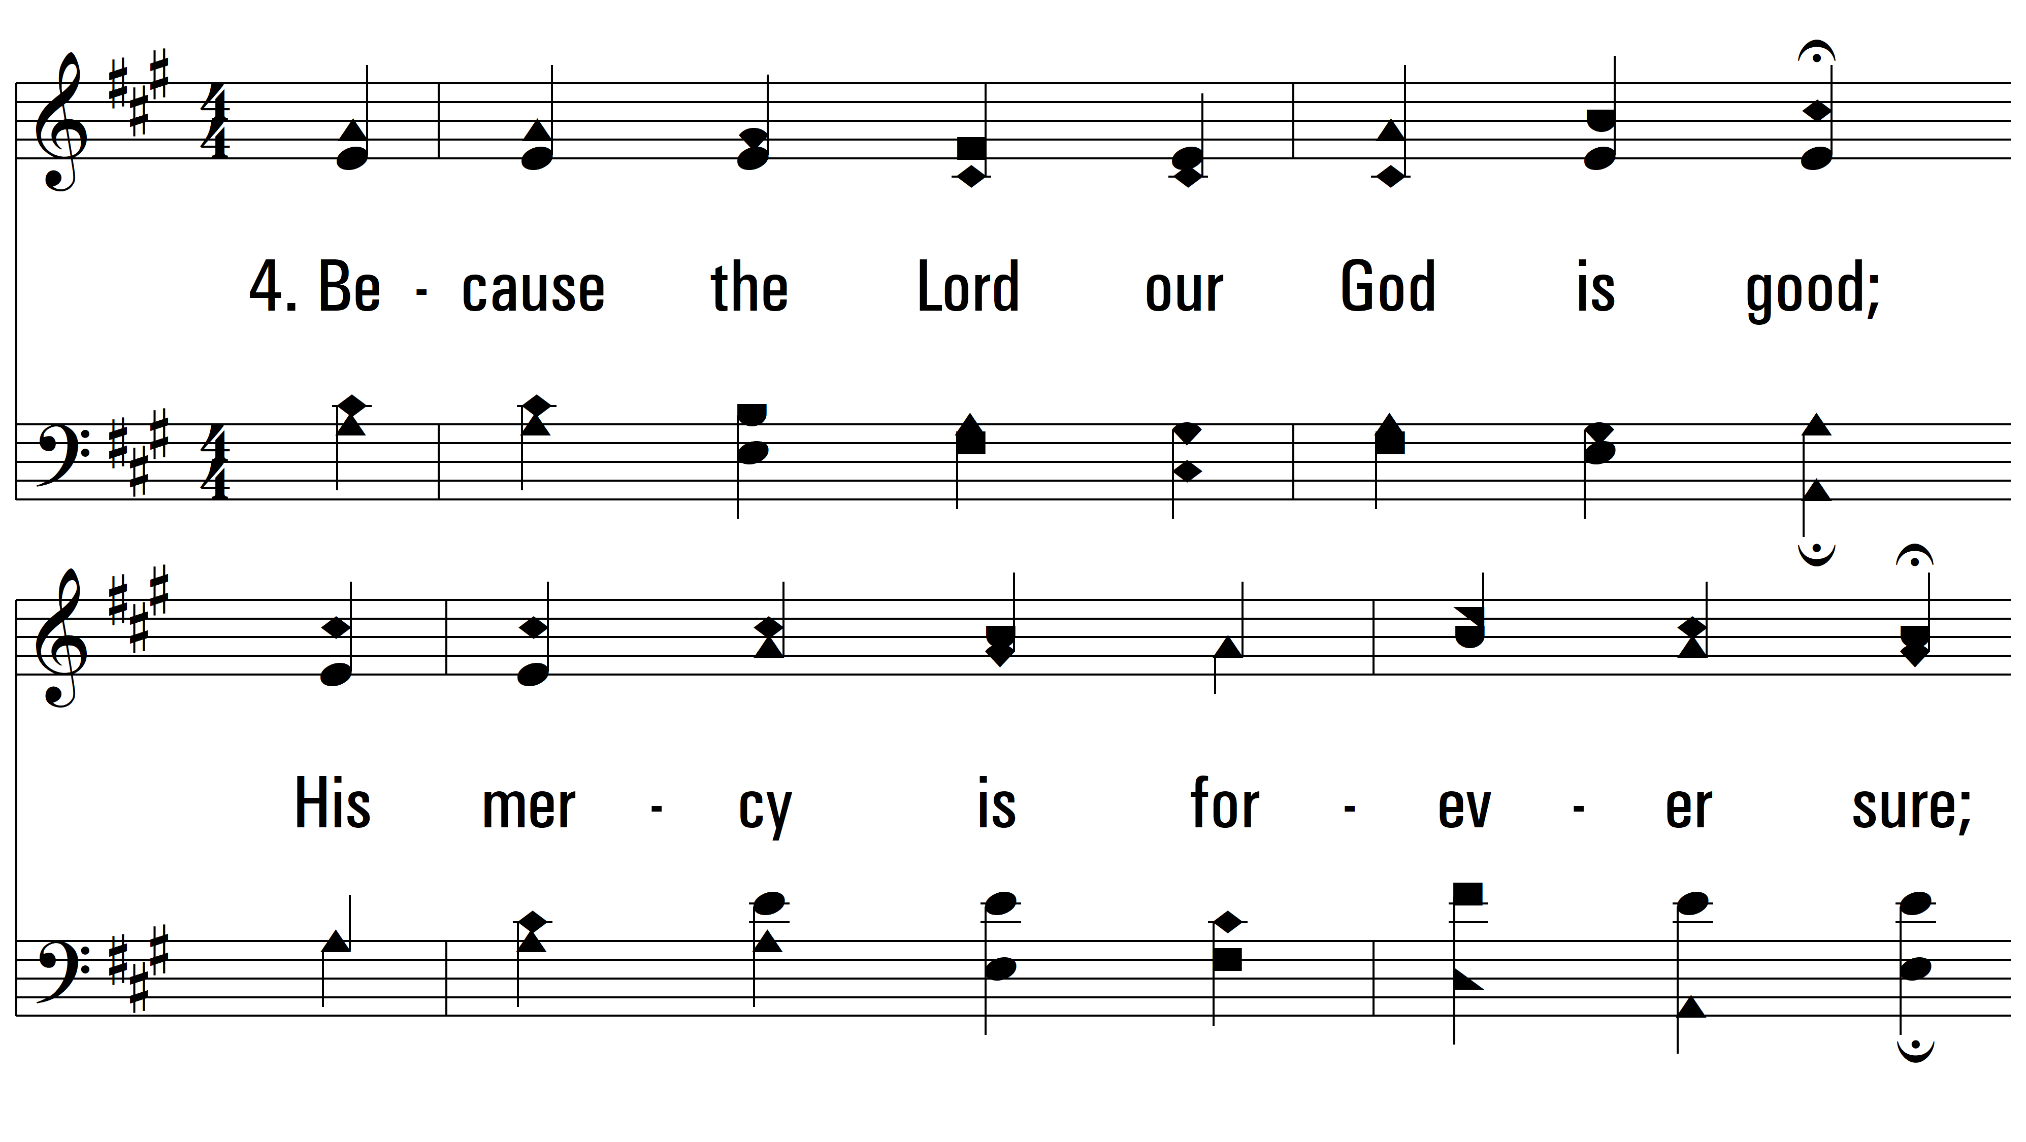
vs. 4 ~ All People That On Earth Do Dwell

Slide 15
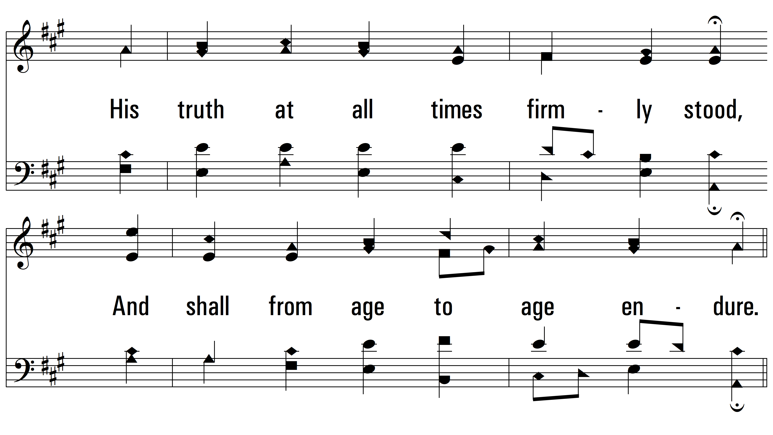
vs. 4

Slide 16
vs. 4

Slide 17
vs. 4
PDHymns.com
END

