Slide 1
All Hail The Power Of Jesus’ Name
CORONATION
CM
Words: | Edward Perronet (1780), Adapt. John Rippon (1787)
Music: | Oliver Holden (1793)
4/4
G/D - SOL
Verses: 7
Lead - | SOL
Alto - | MI
Tenor - | DO
Bass - | DO
PDHymns.com

Slide 2
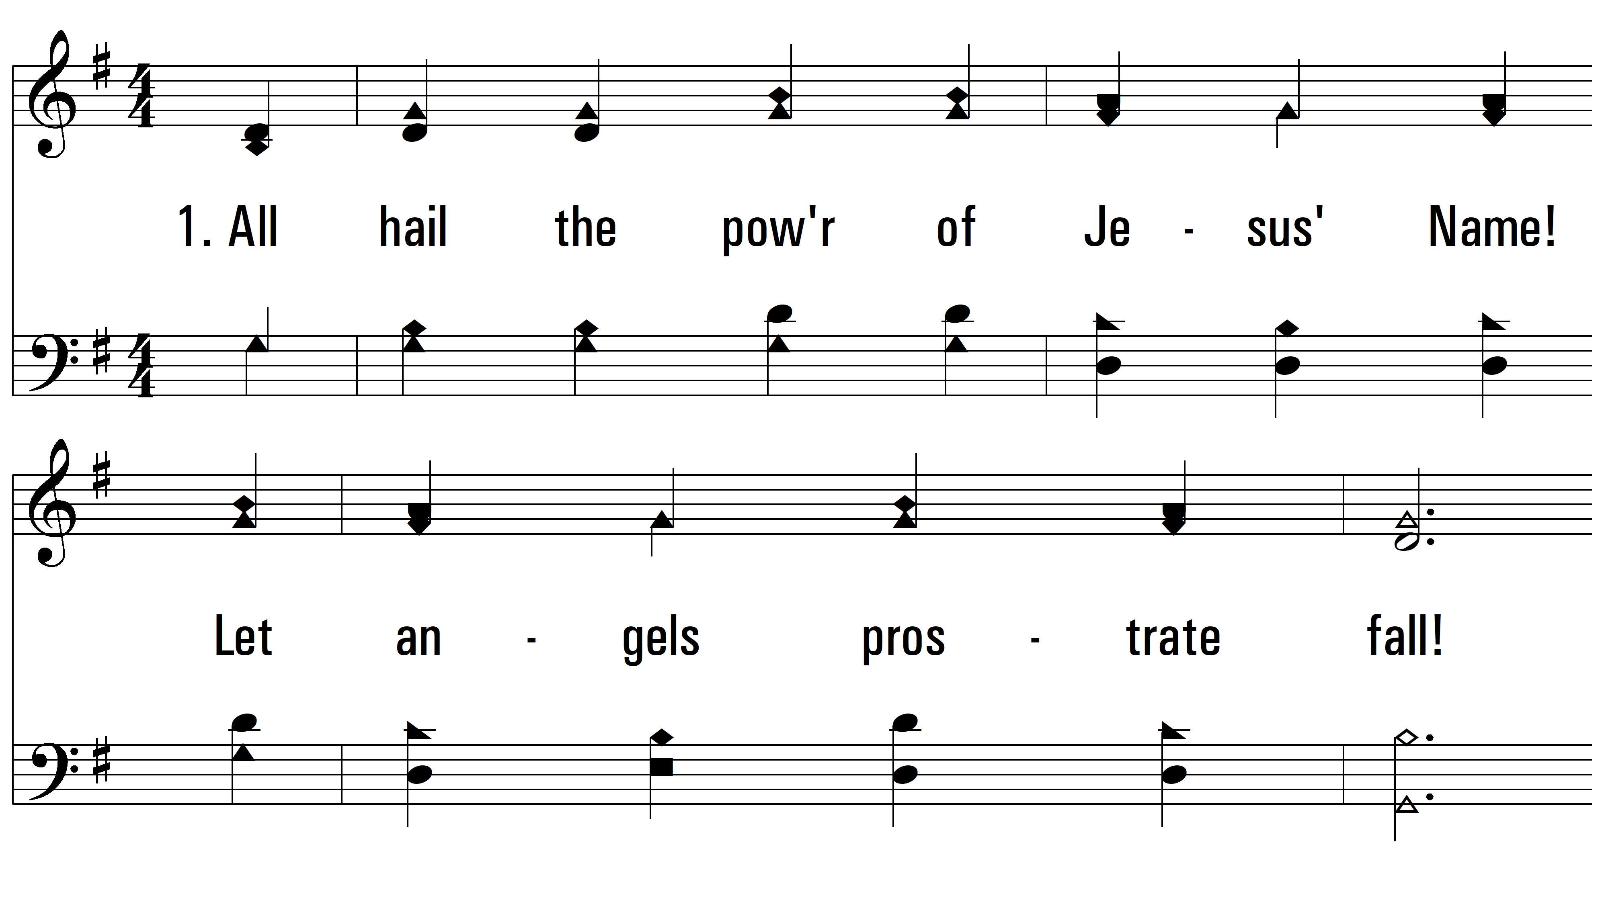
vs. 1 ~ All Hail The Power Of Jesus’ Name

Slide 3
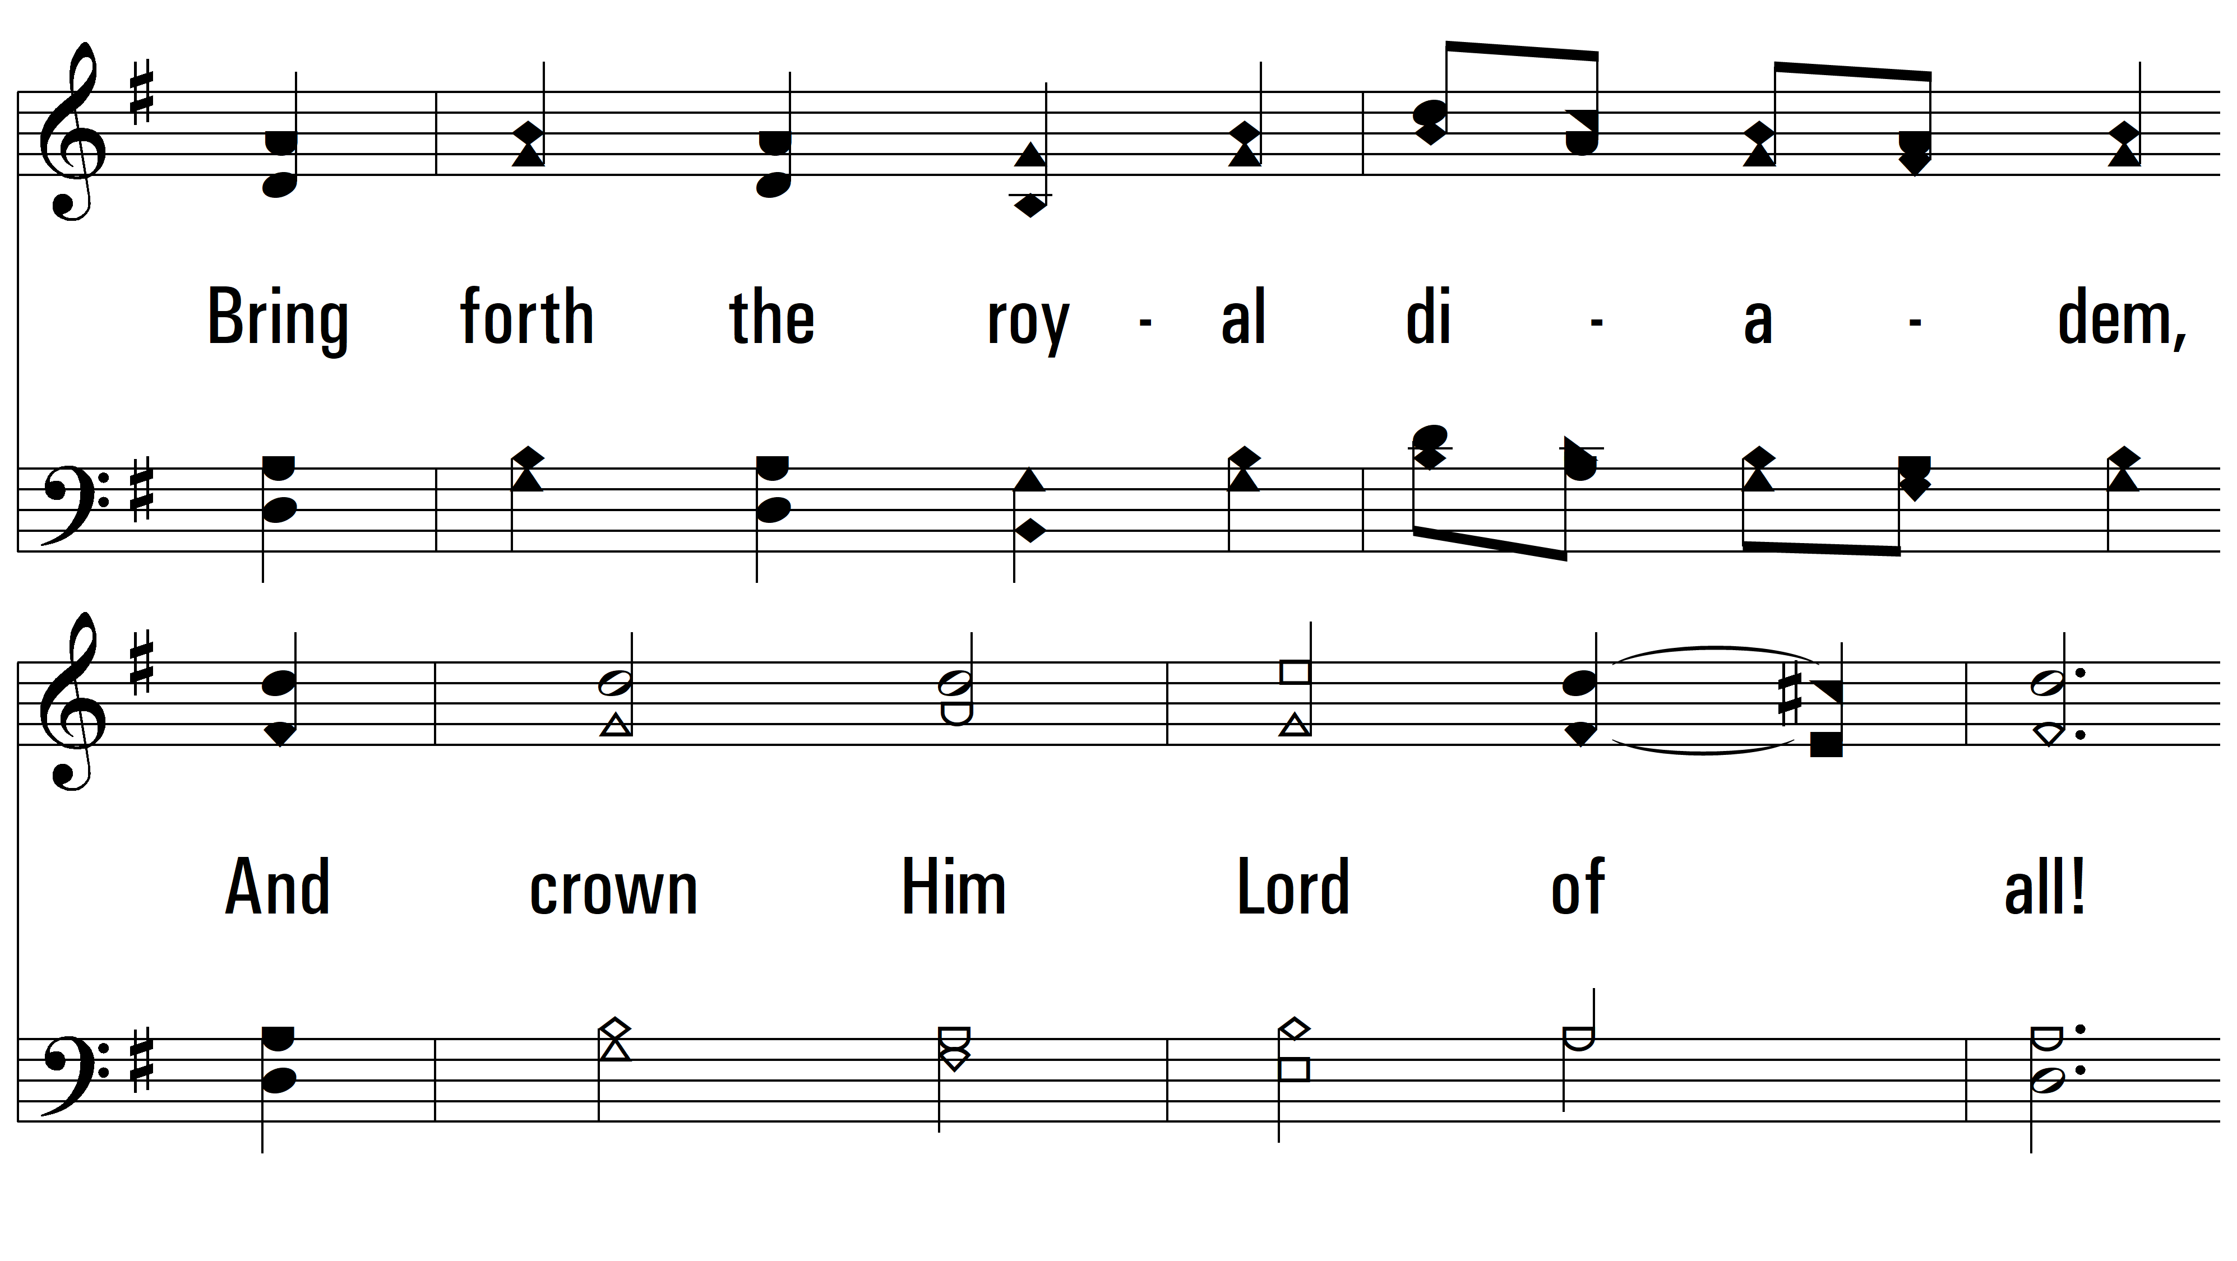
vs. 1

Slide 4
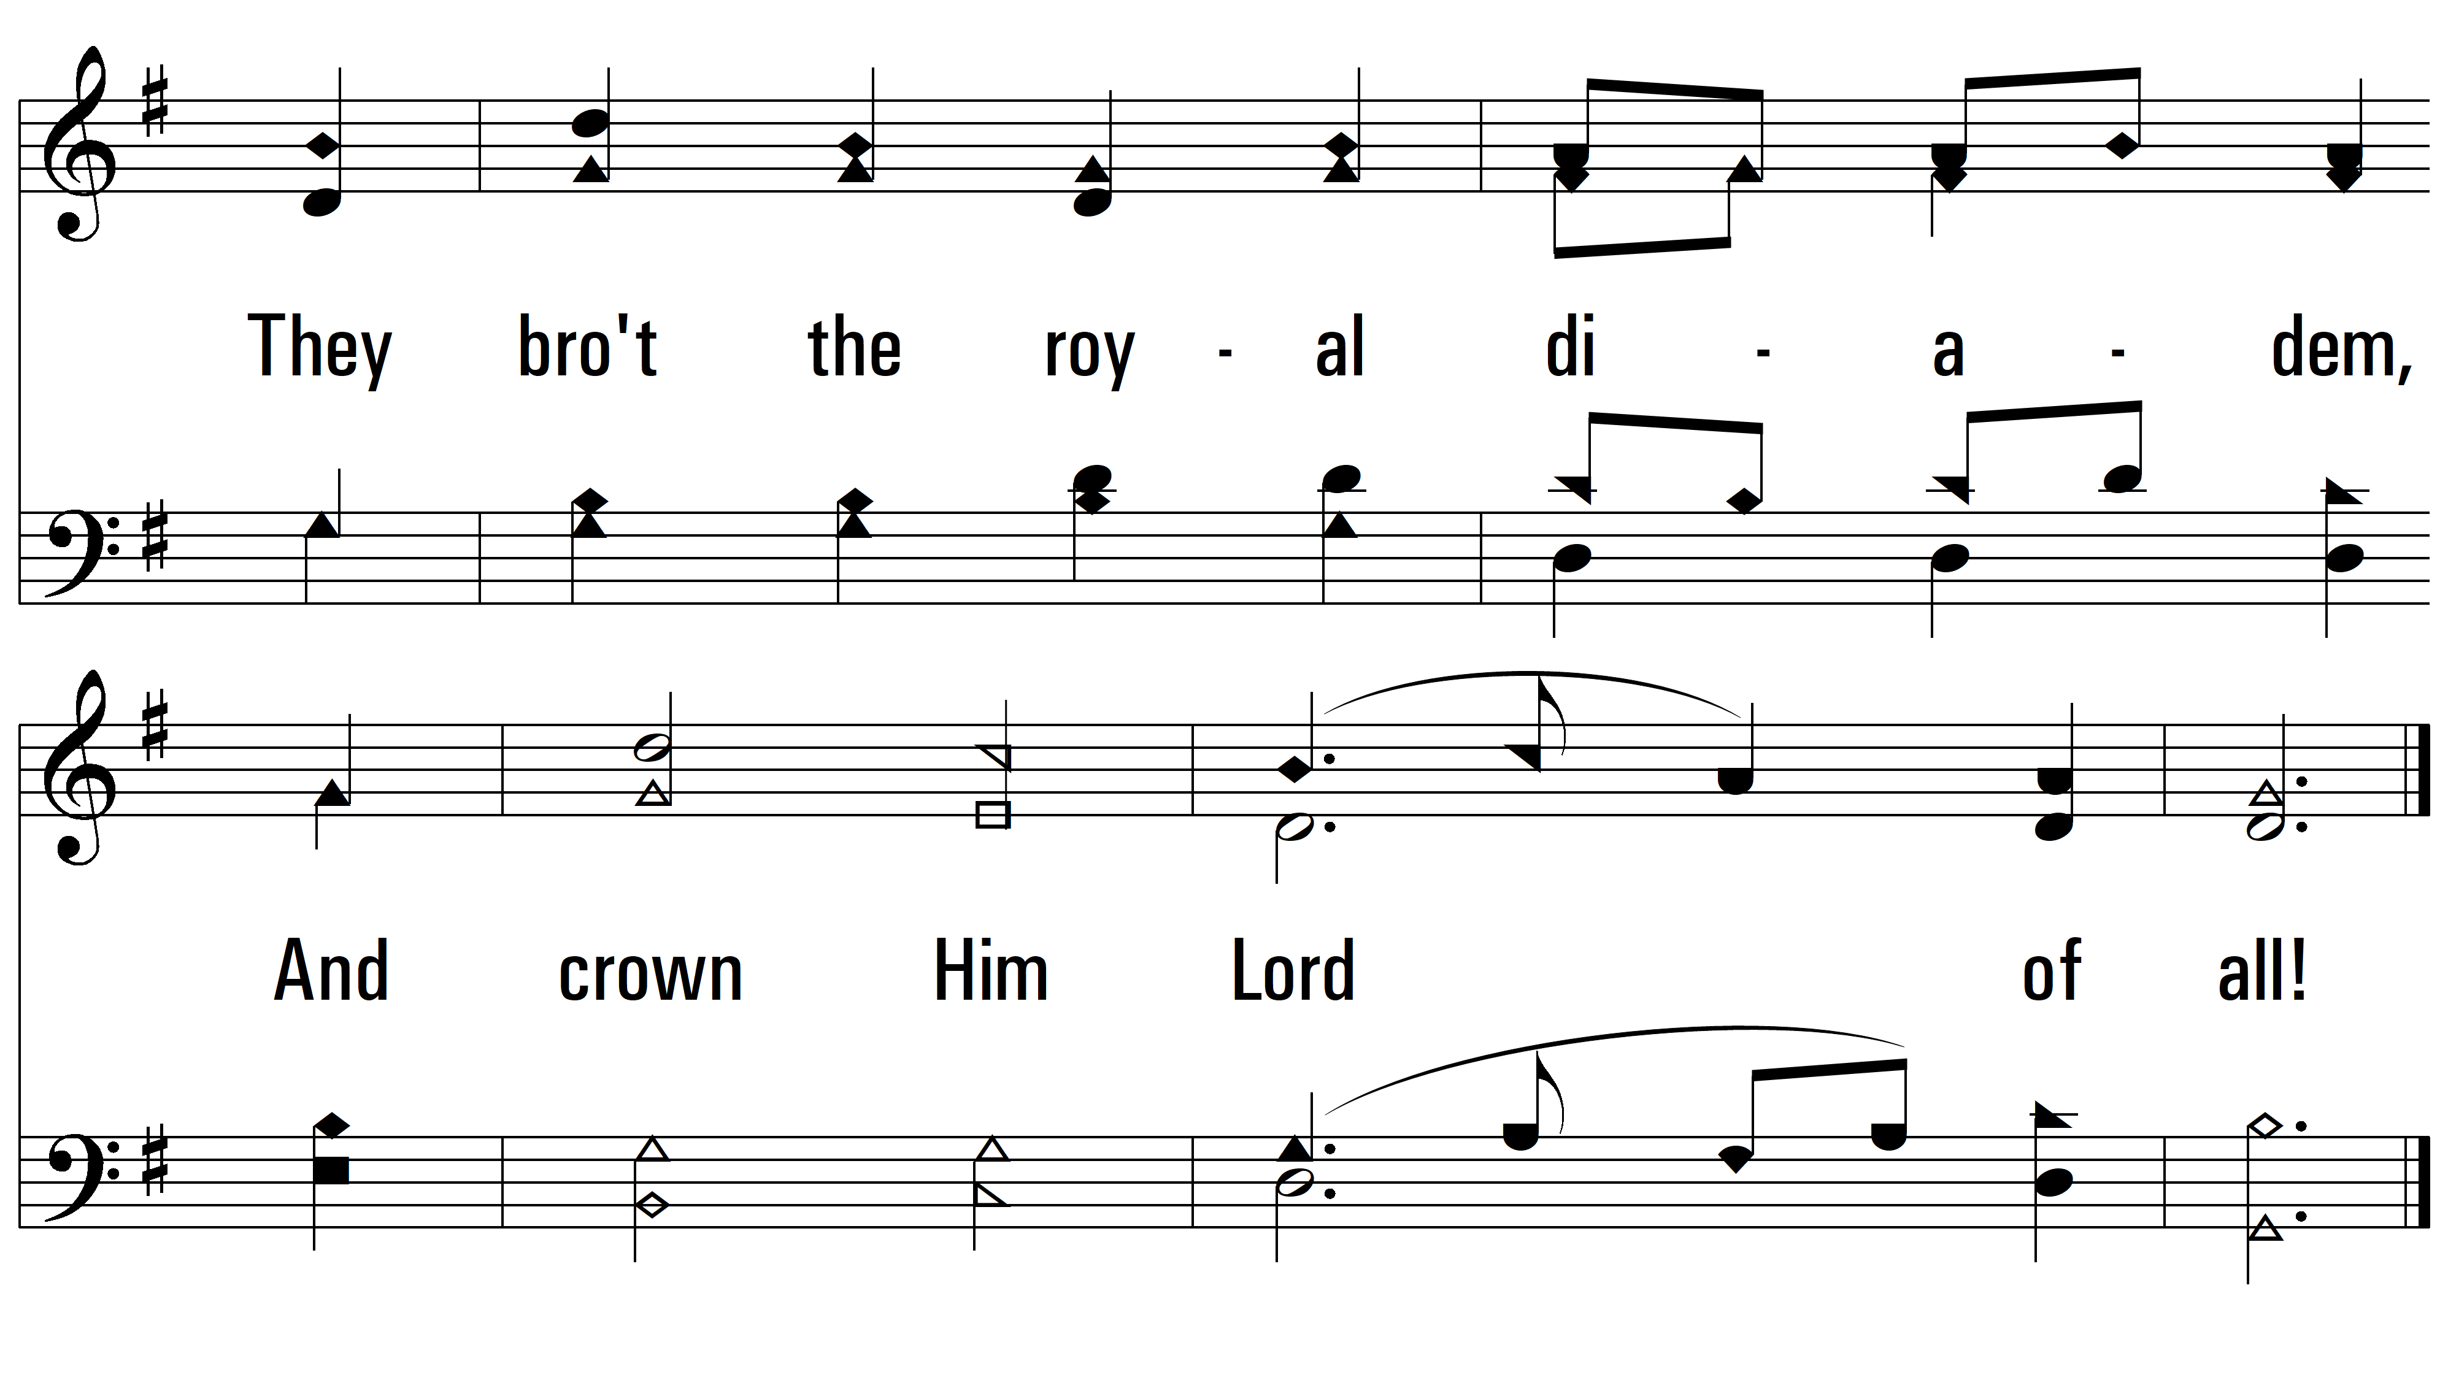
vs. 1

Slide 5
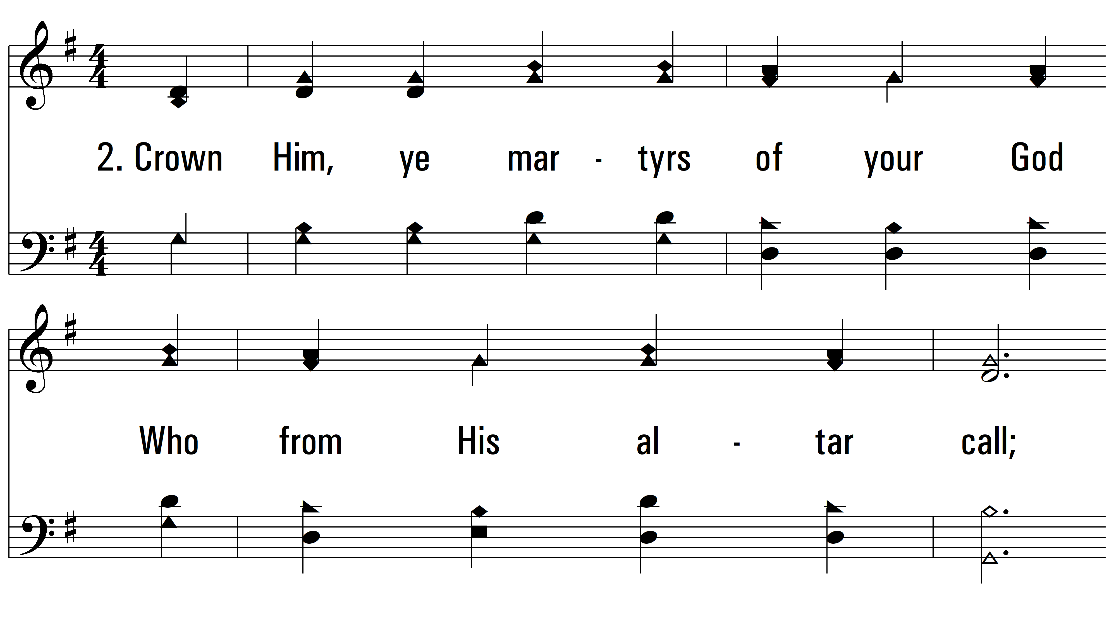
vs. 2 ~ All Hail The Power Of Jesus’ Name

Slide 6
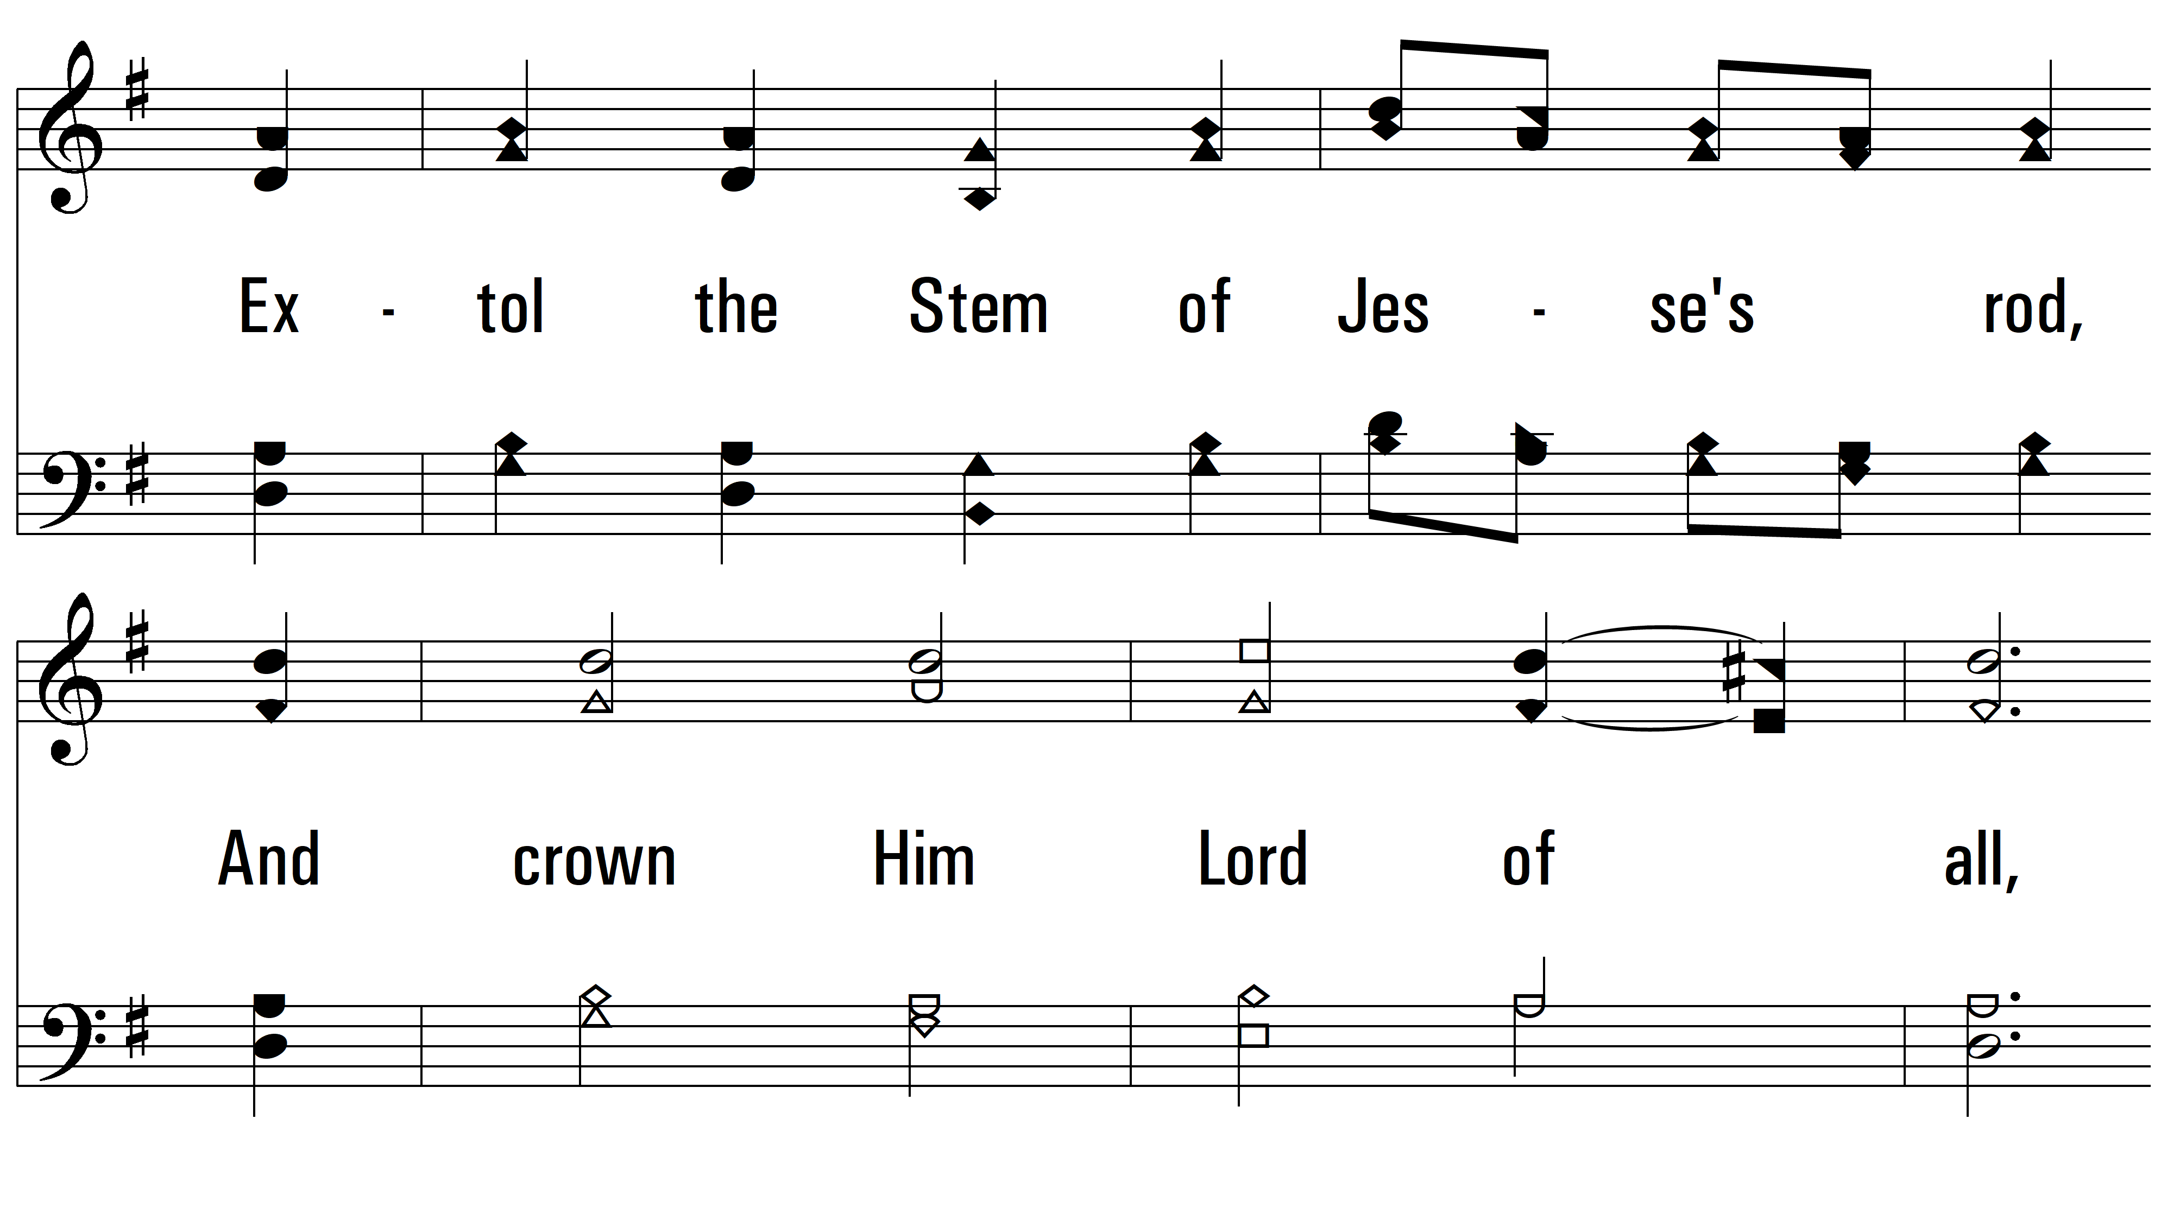
vs. 2

Slide 7
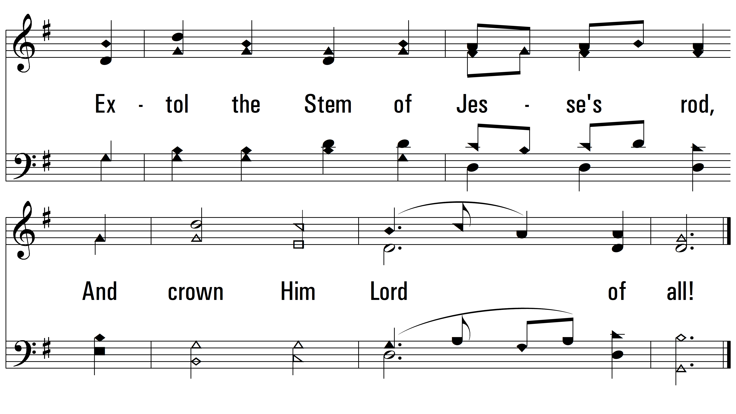
vs. 2

Slide 8
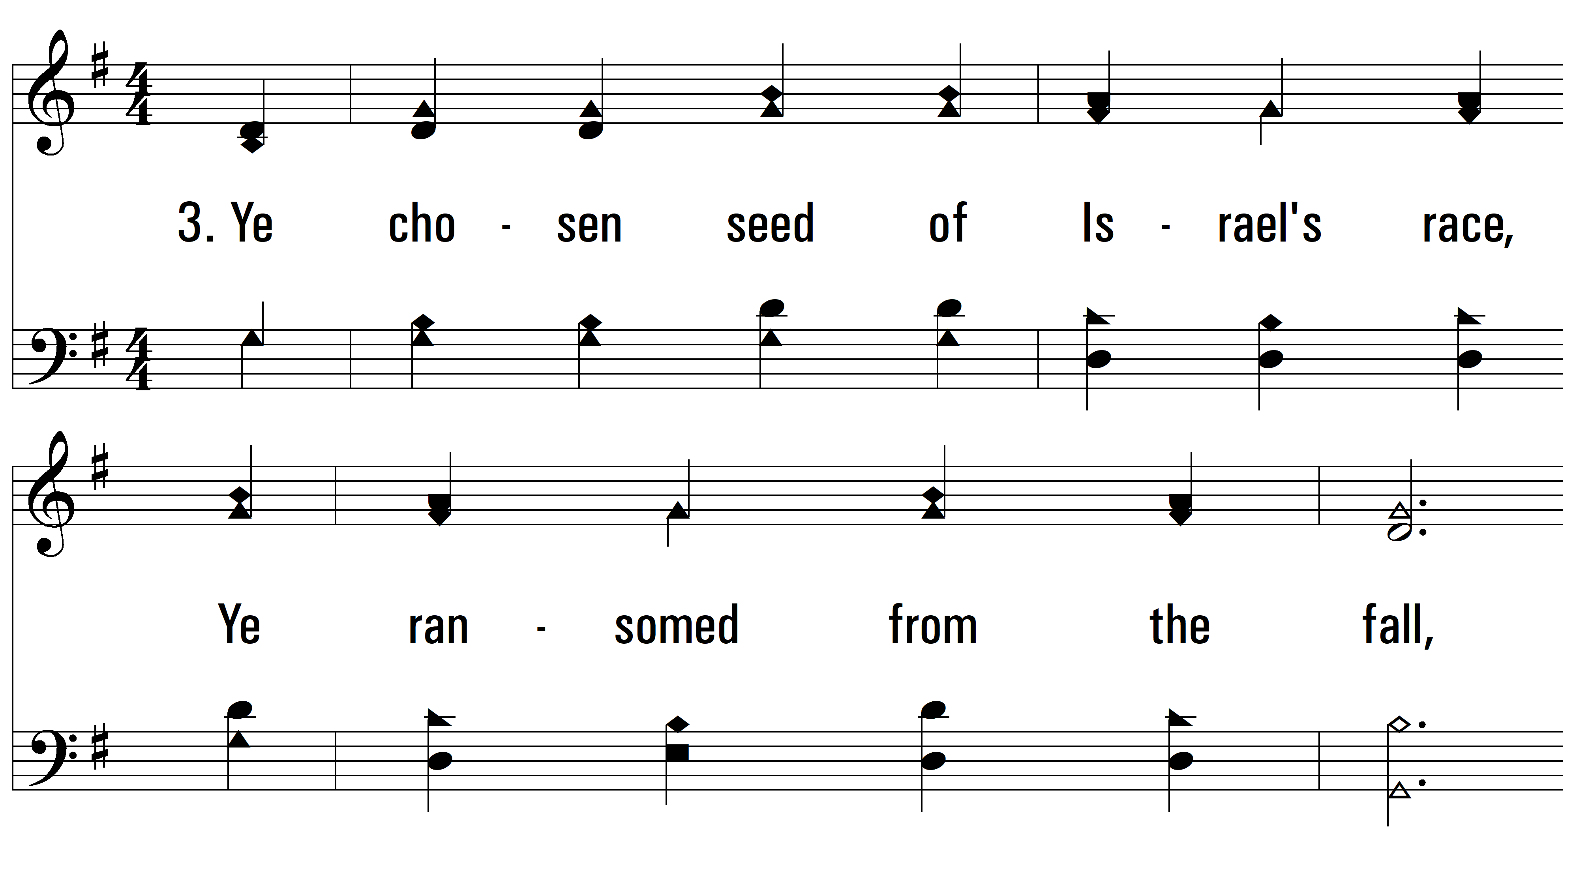
vs. 3 ~ All Hail The Power Of Jesus’ Name

Slide 9
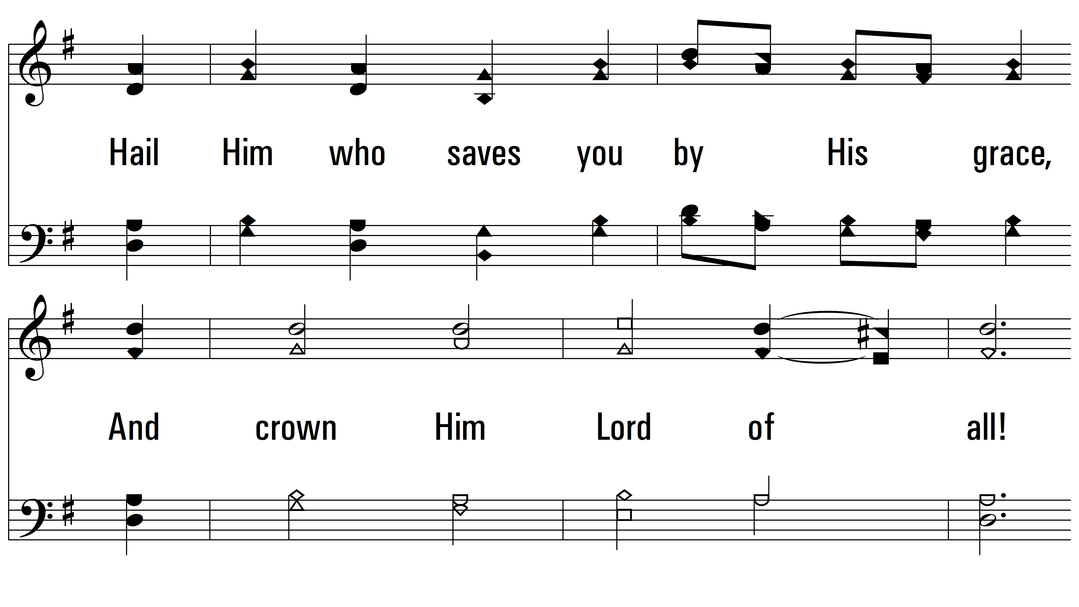
vs. 3

Slide 10
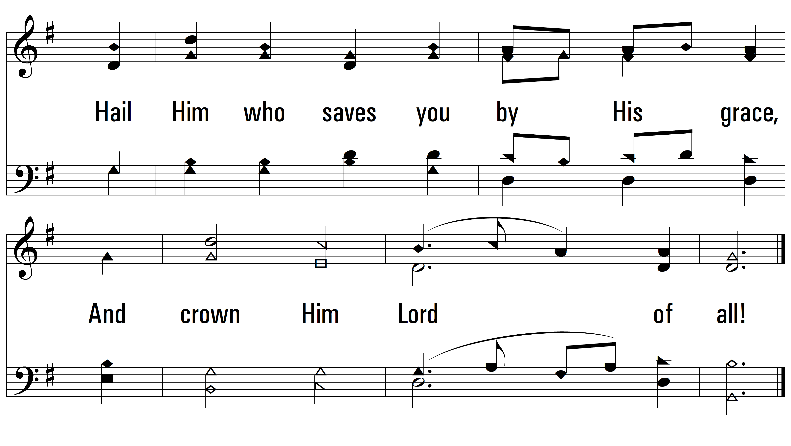
vs. 3

Slide 11
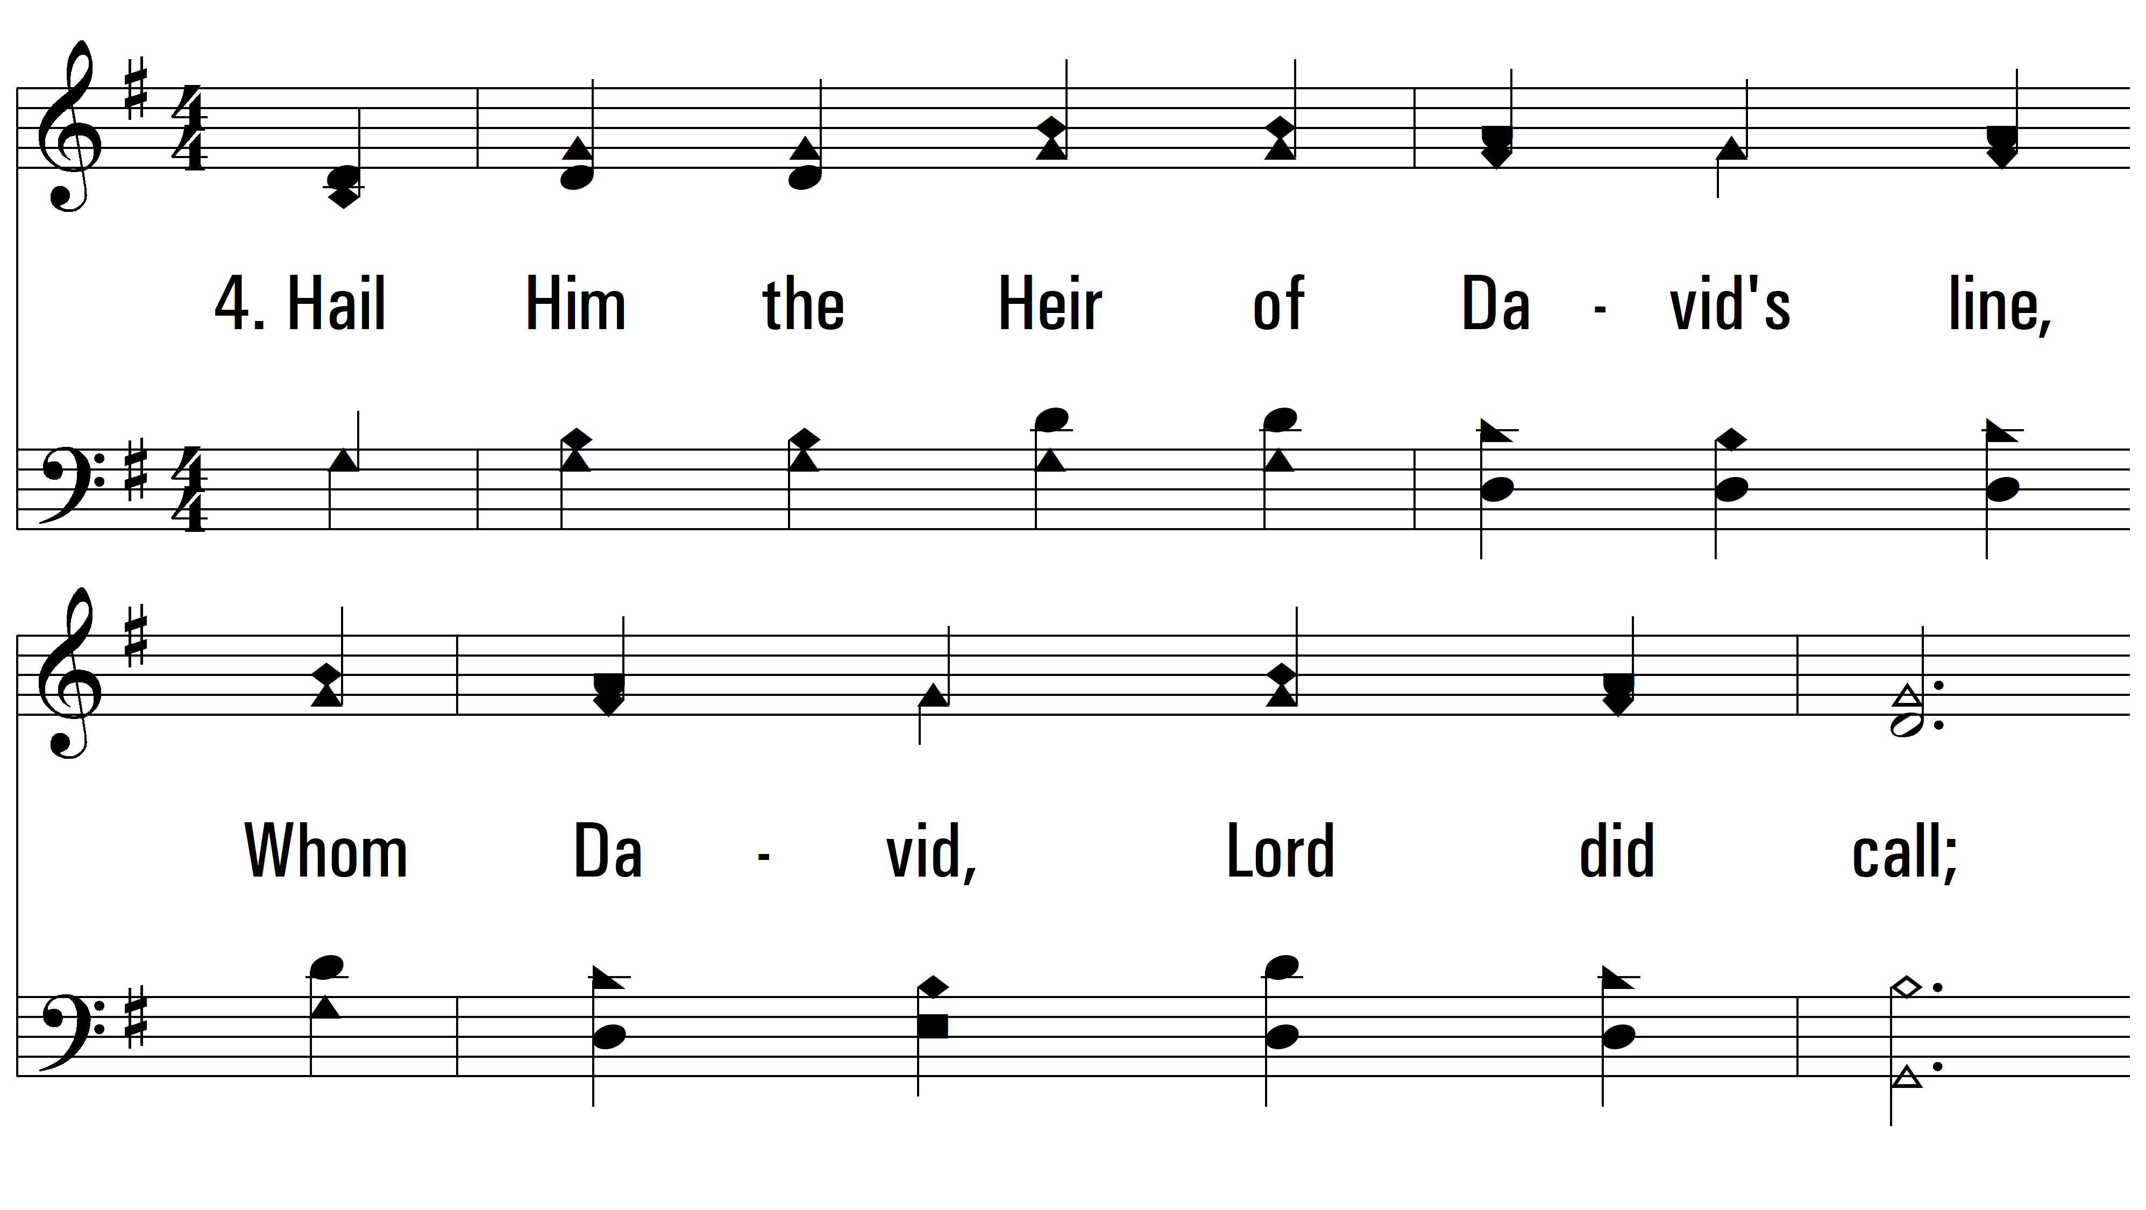
vs. 4 ~ All Hail The Power Of Jesus’ Name

Slide 12
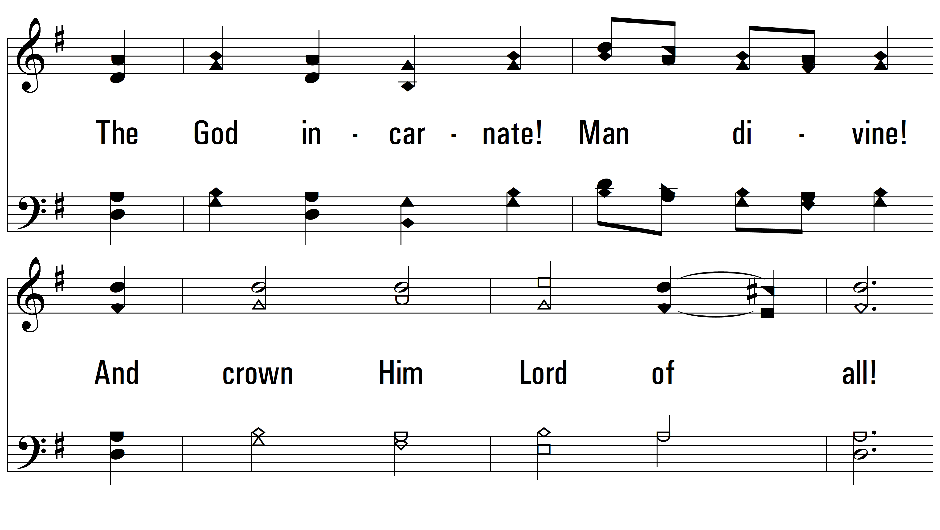
vs. 4

Slide 13
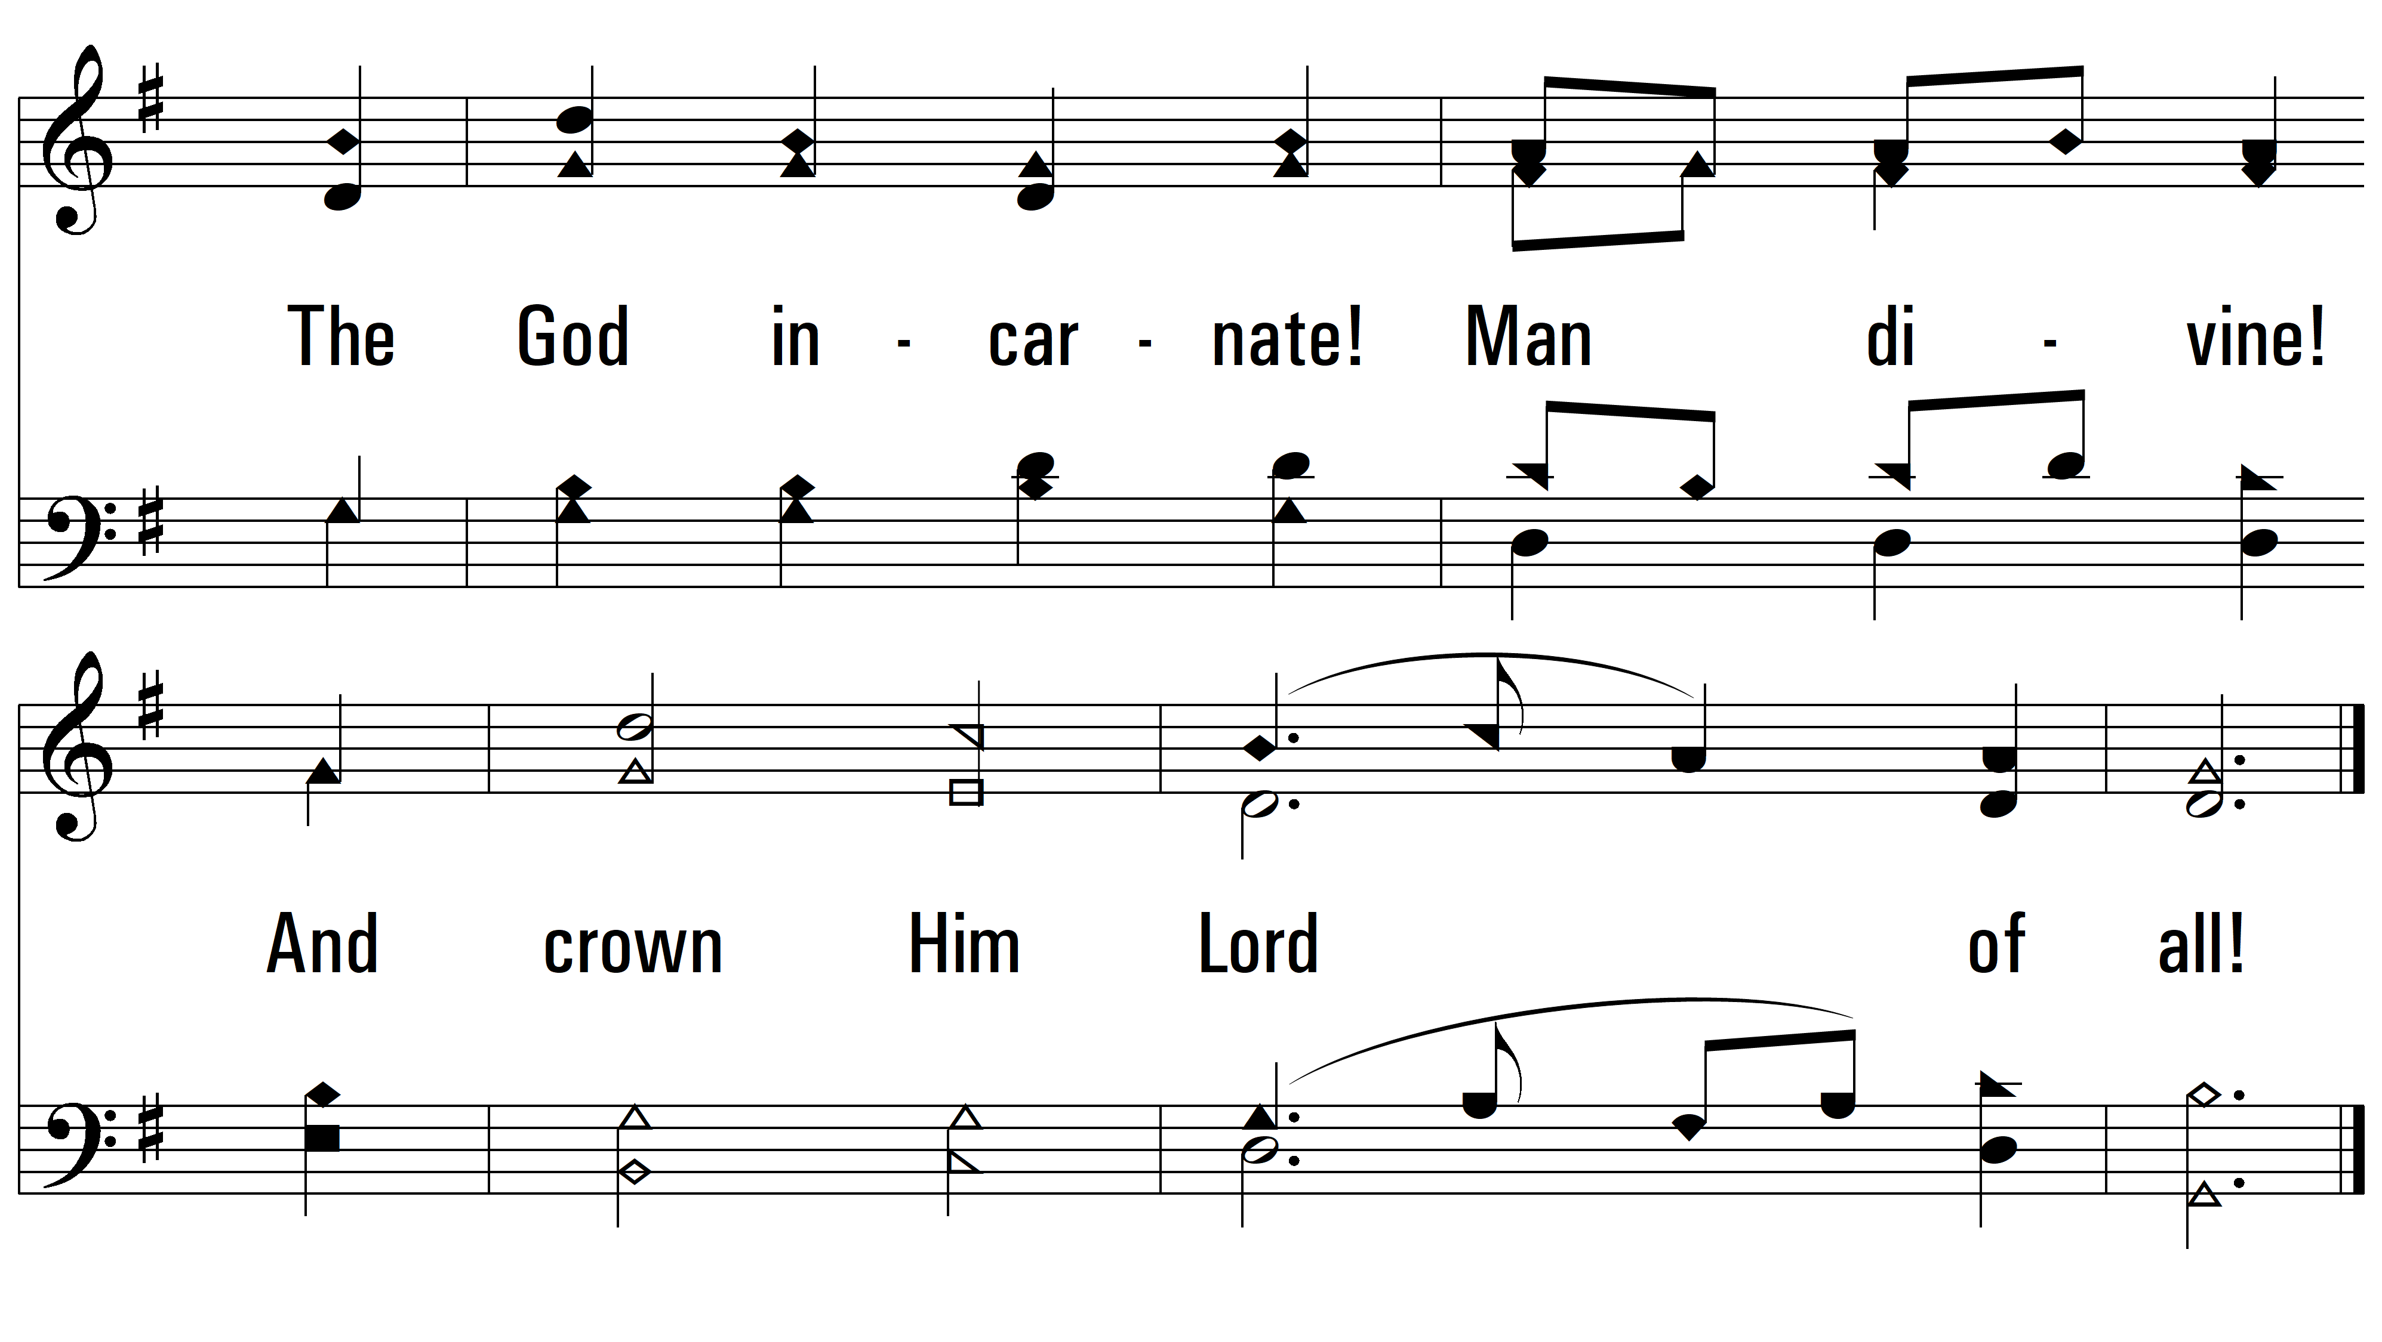
vs. 4

Slide 14
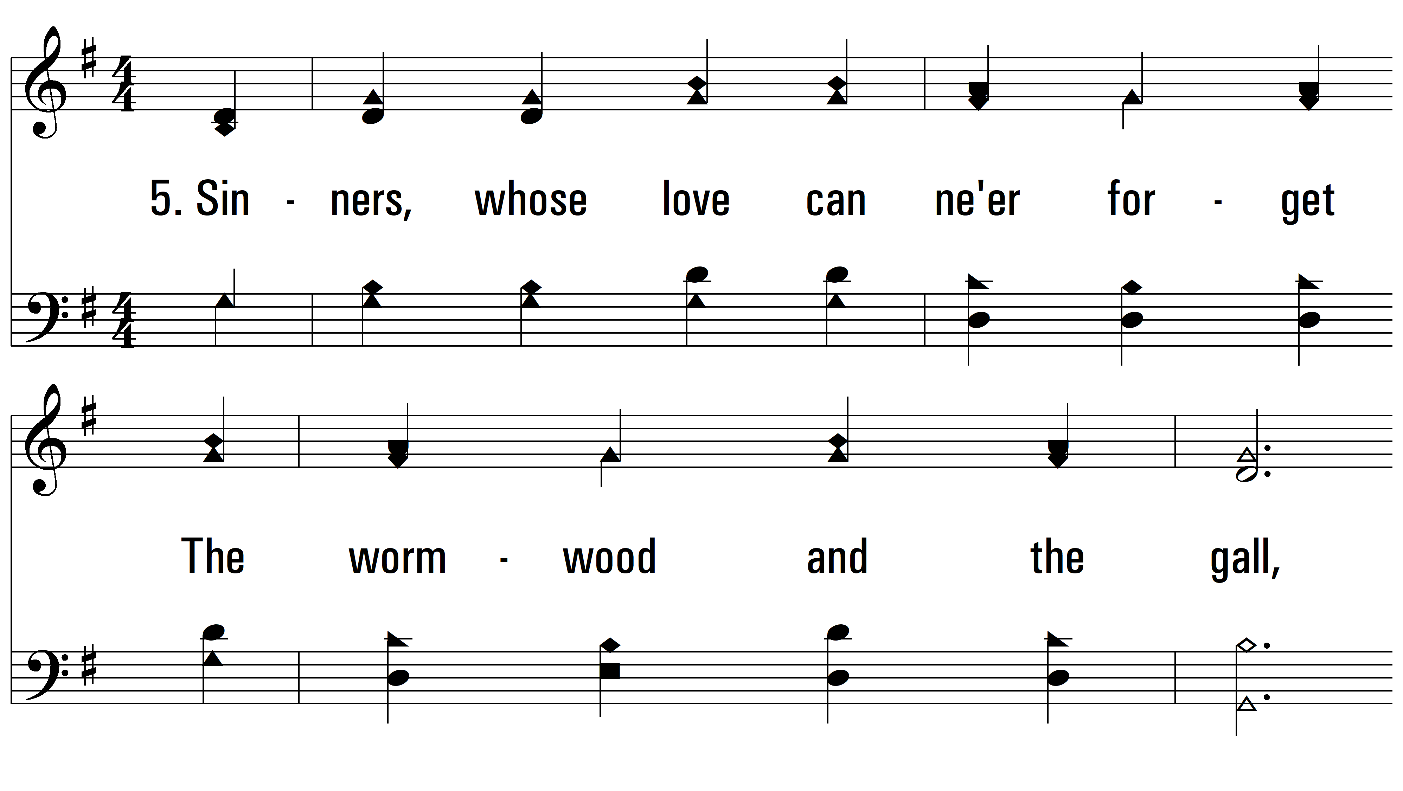
vs. 5 ~ All Hail The Power Of Jesus’ Name

Slide 15
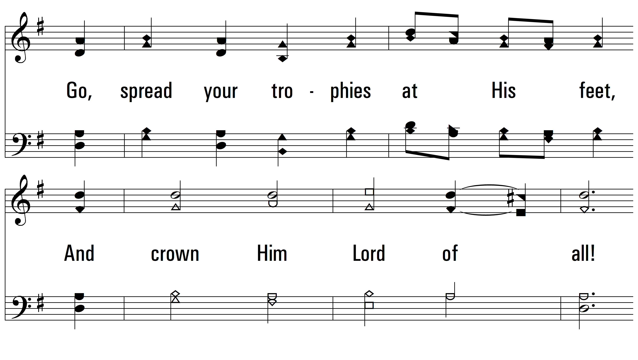
vs. 5

Slide 16
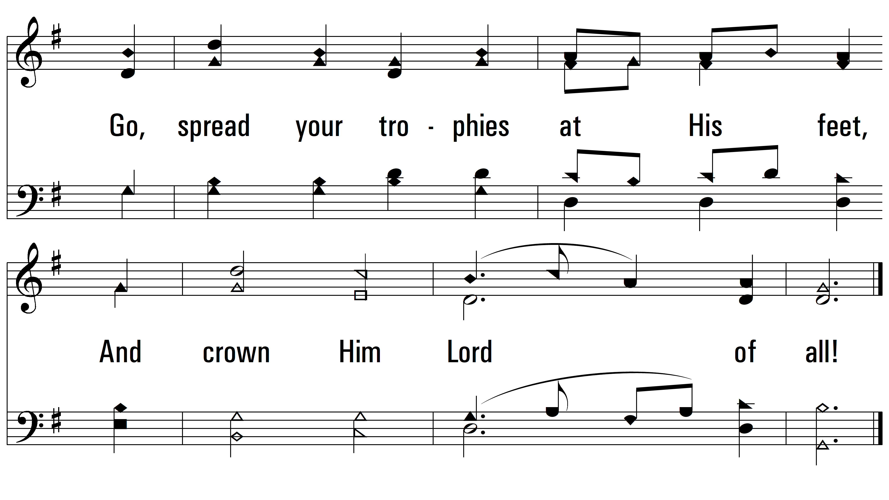
vs. 5

Slide 17
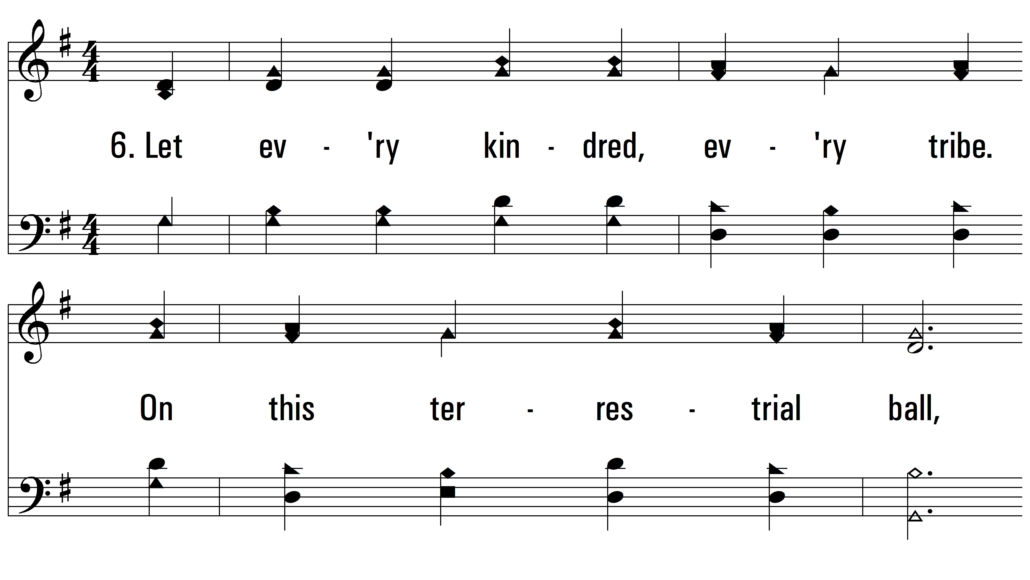
vs. 6 ~ All Hail The Power Of Jesus’ Name

Slide 18
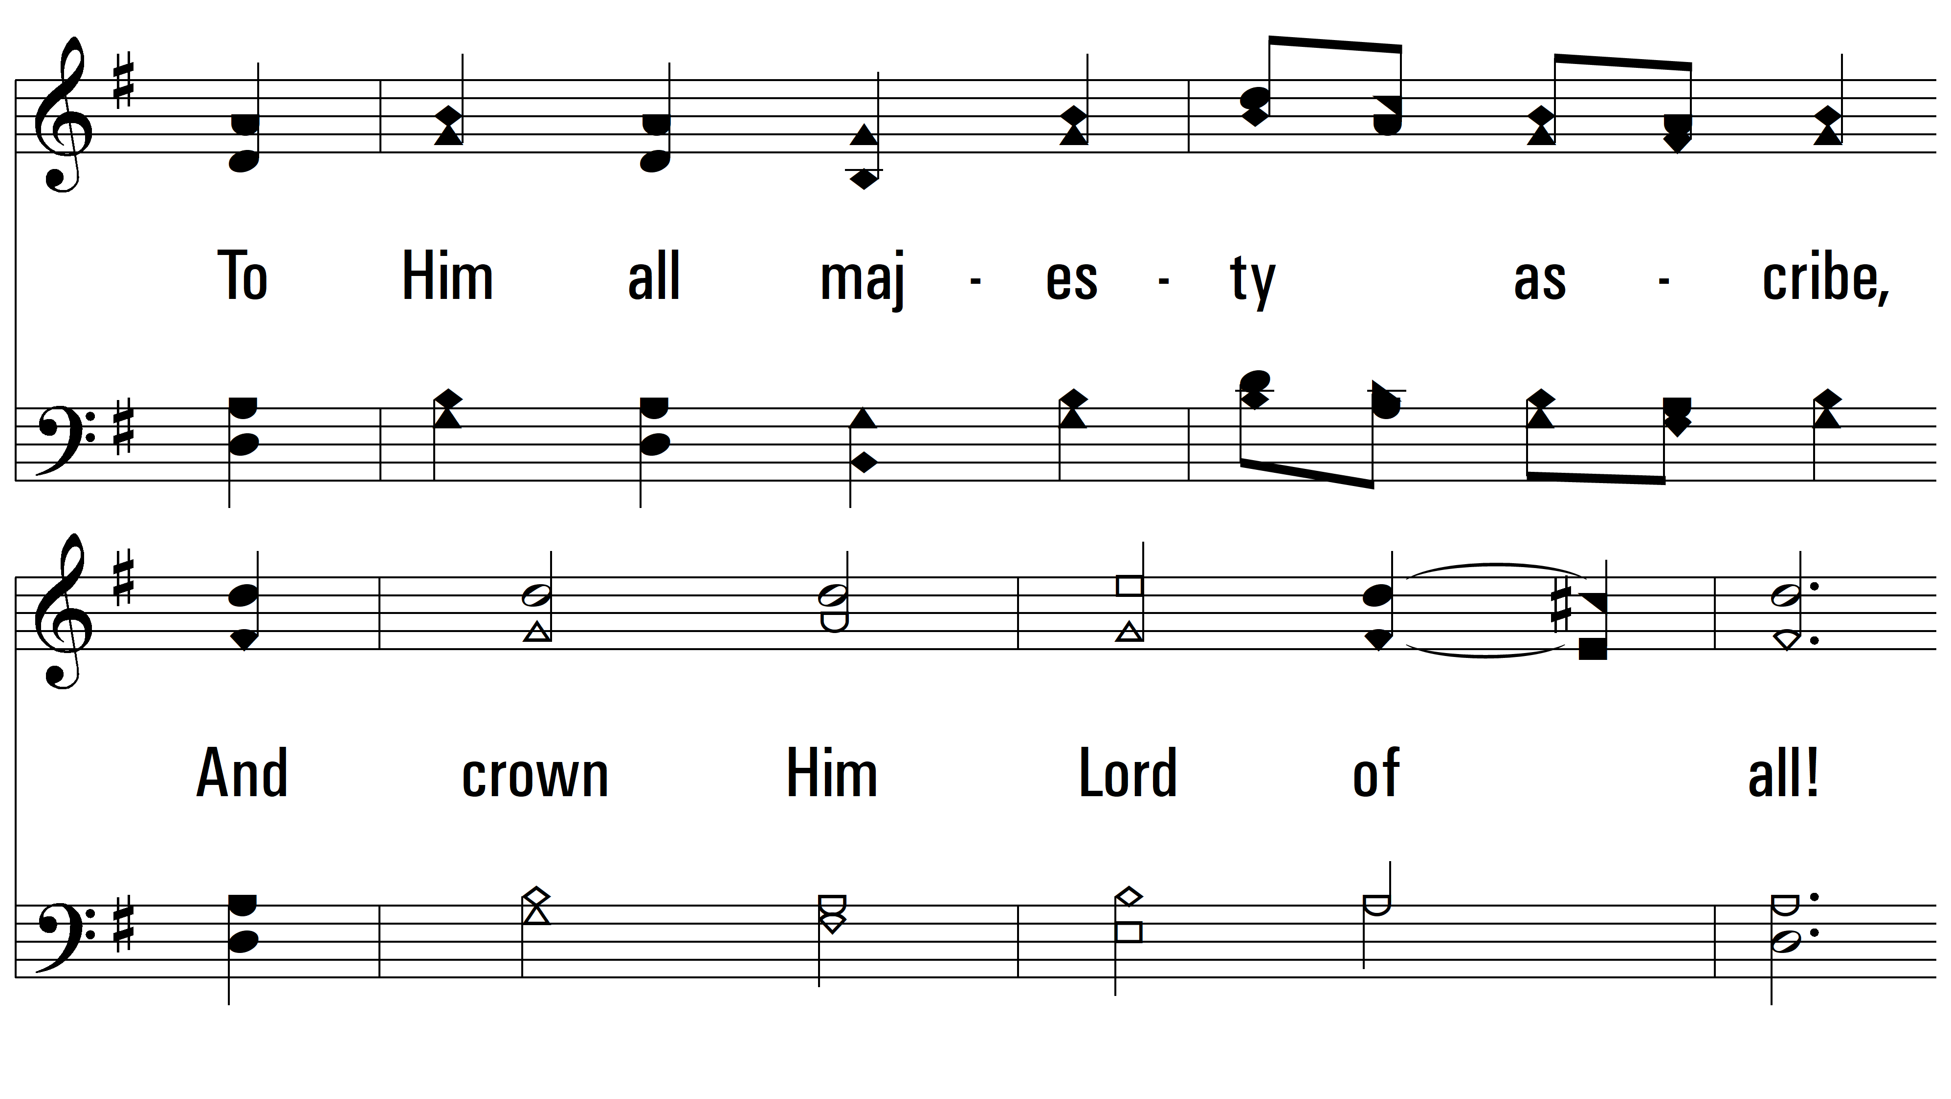
vs. 6

Slide 19
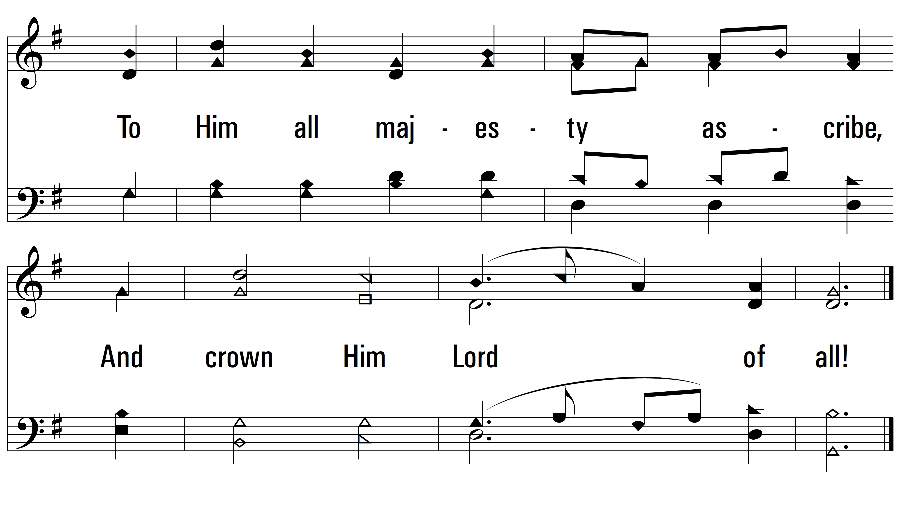
vs. 6

Slide 20
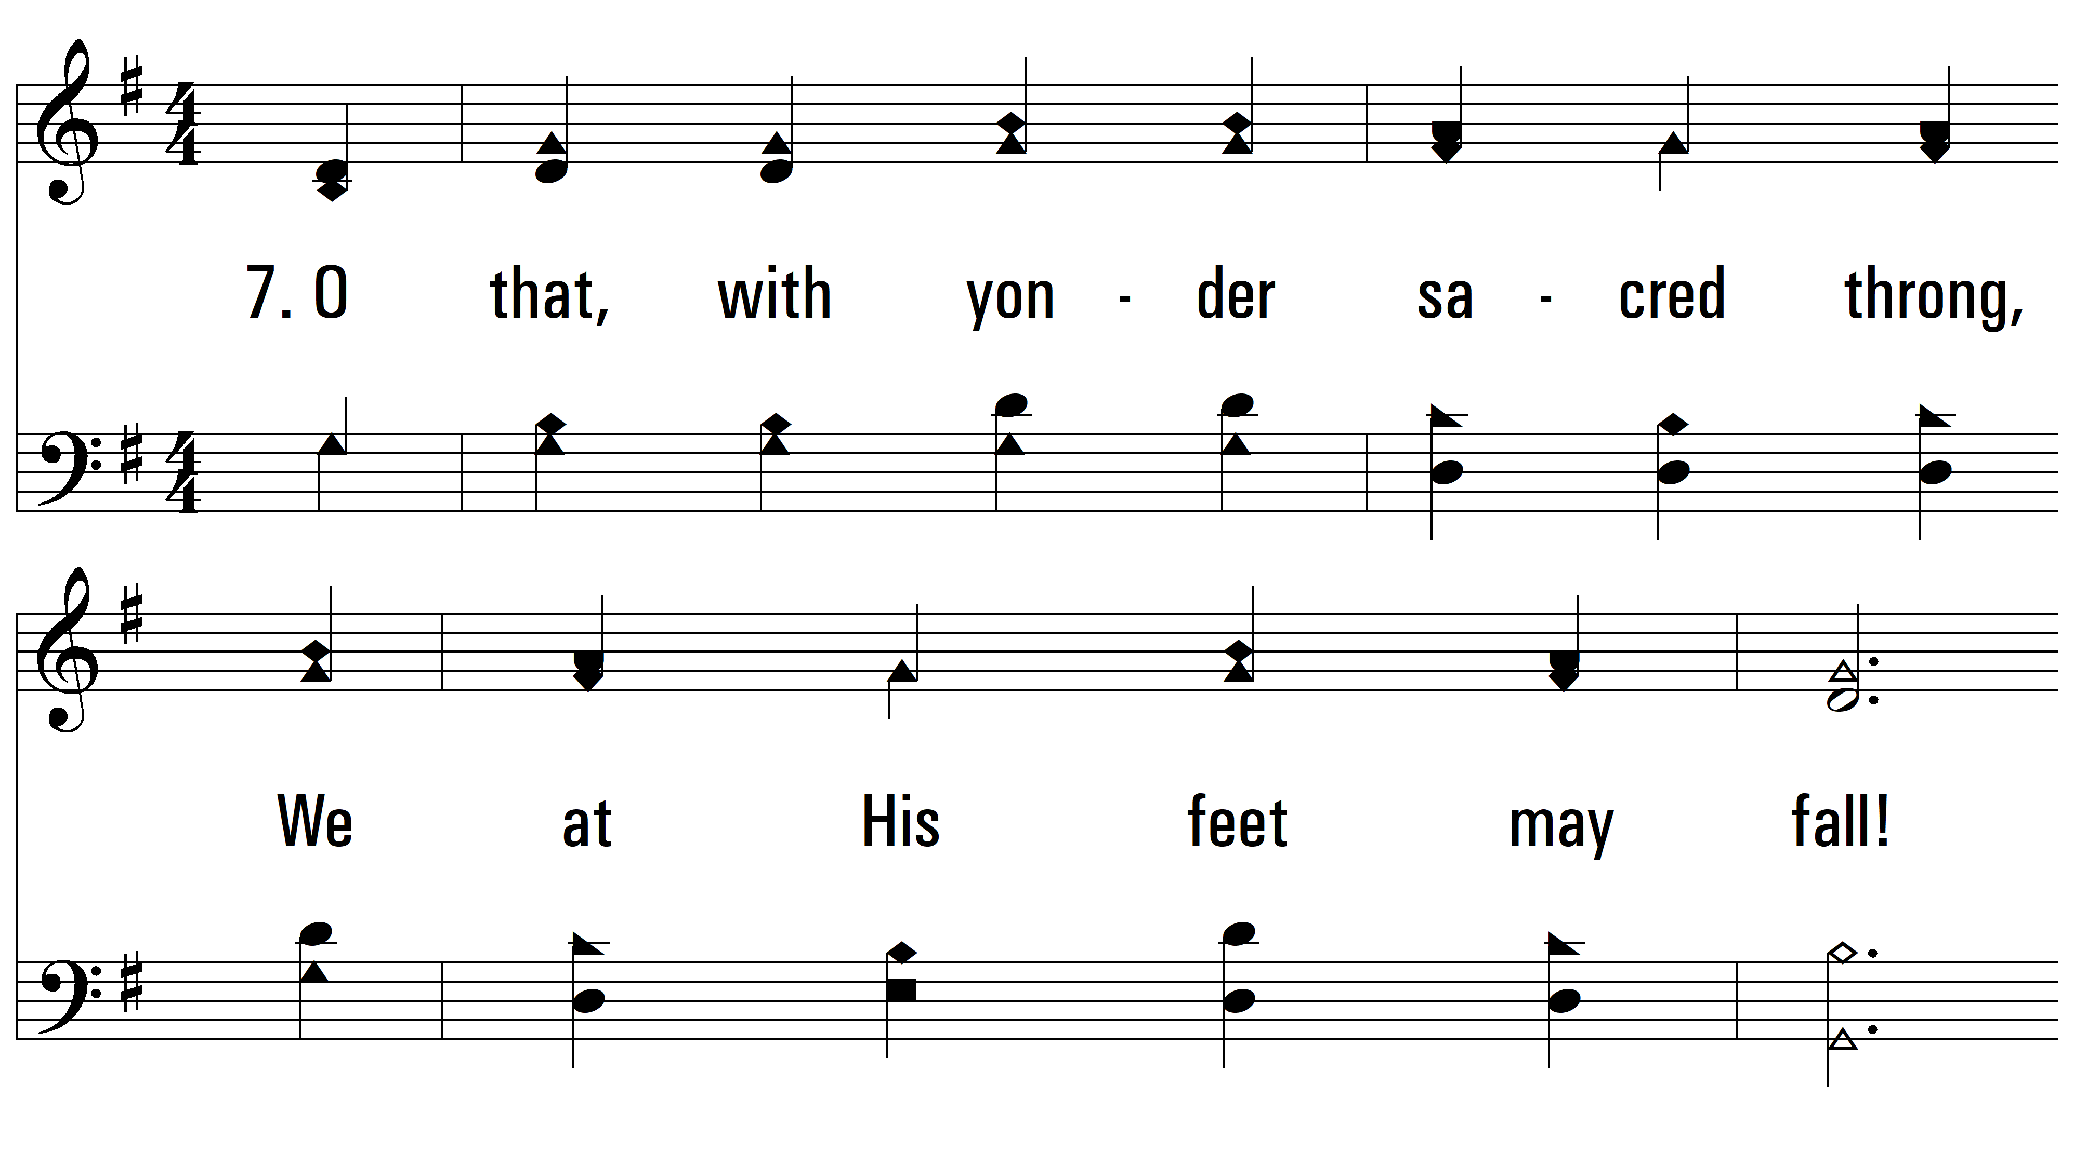
vs. 7 ~ All Hail The Power Of Jesus’ Name

Slide 21
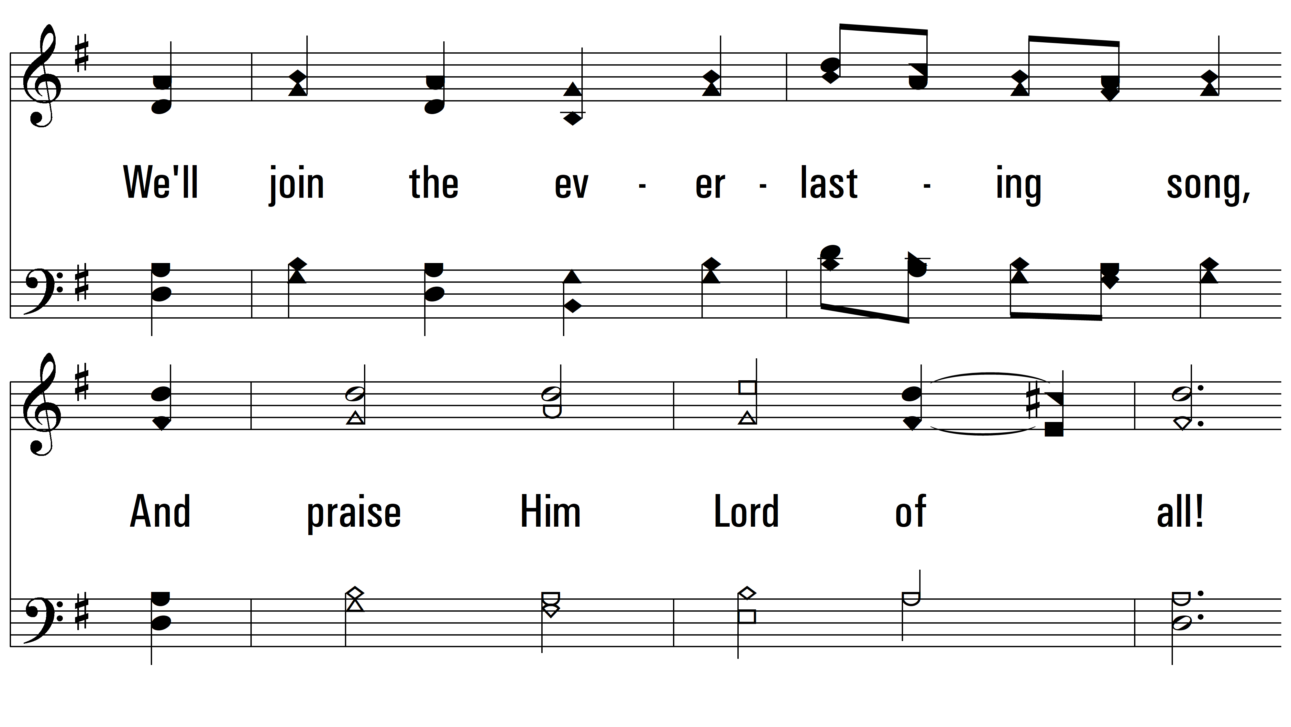
vs. 7

Slide 22
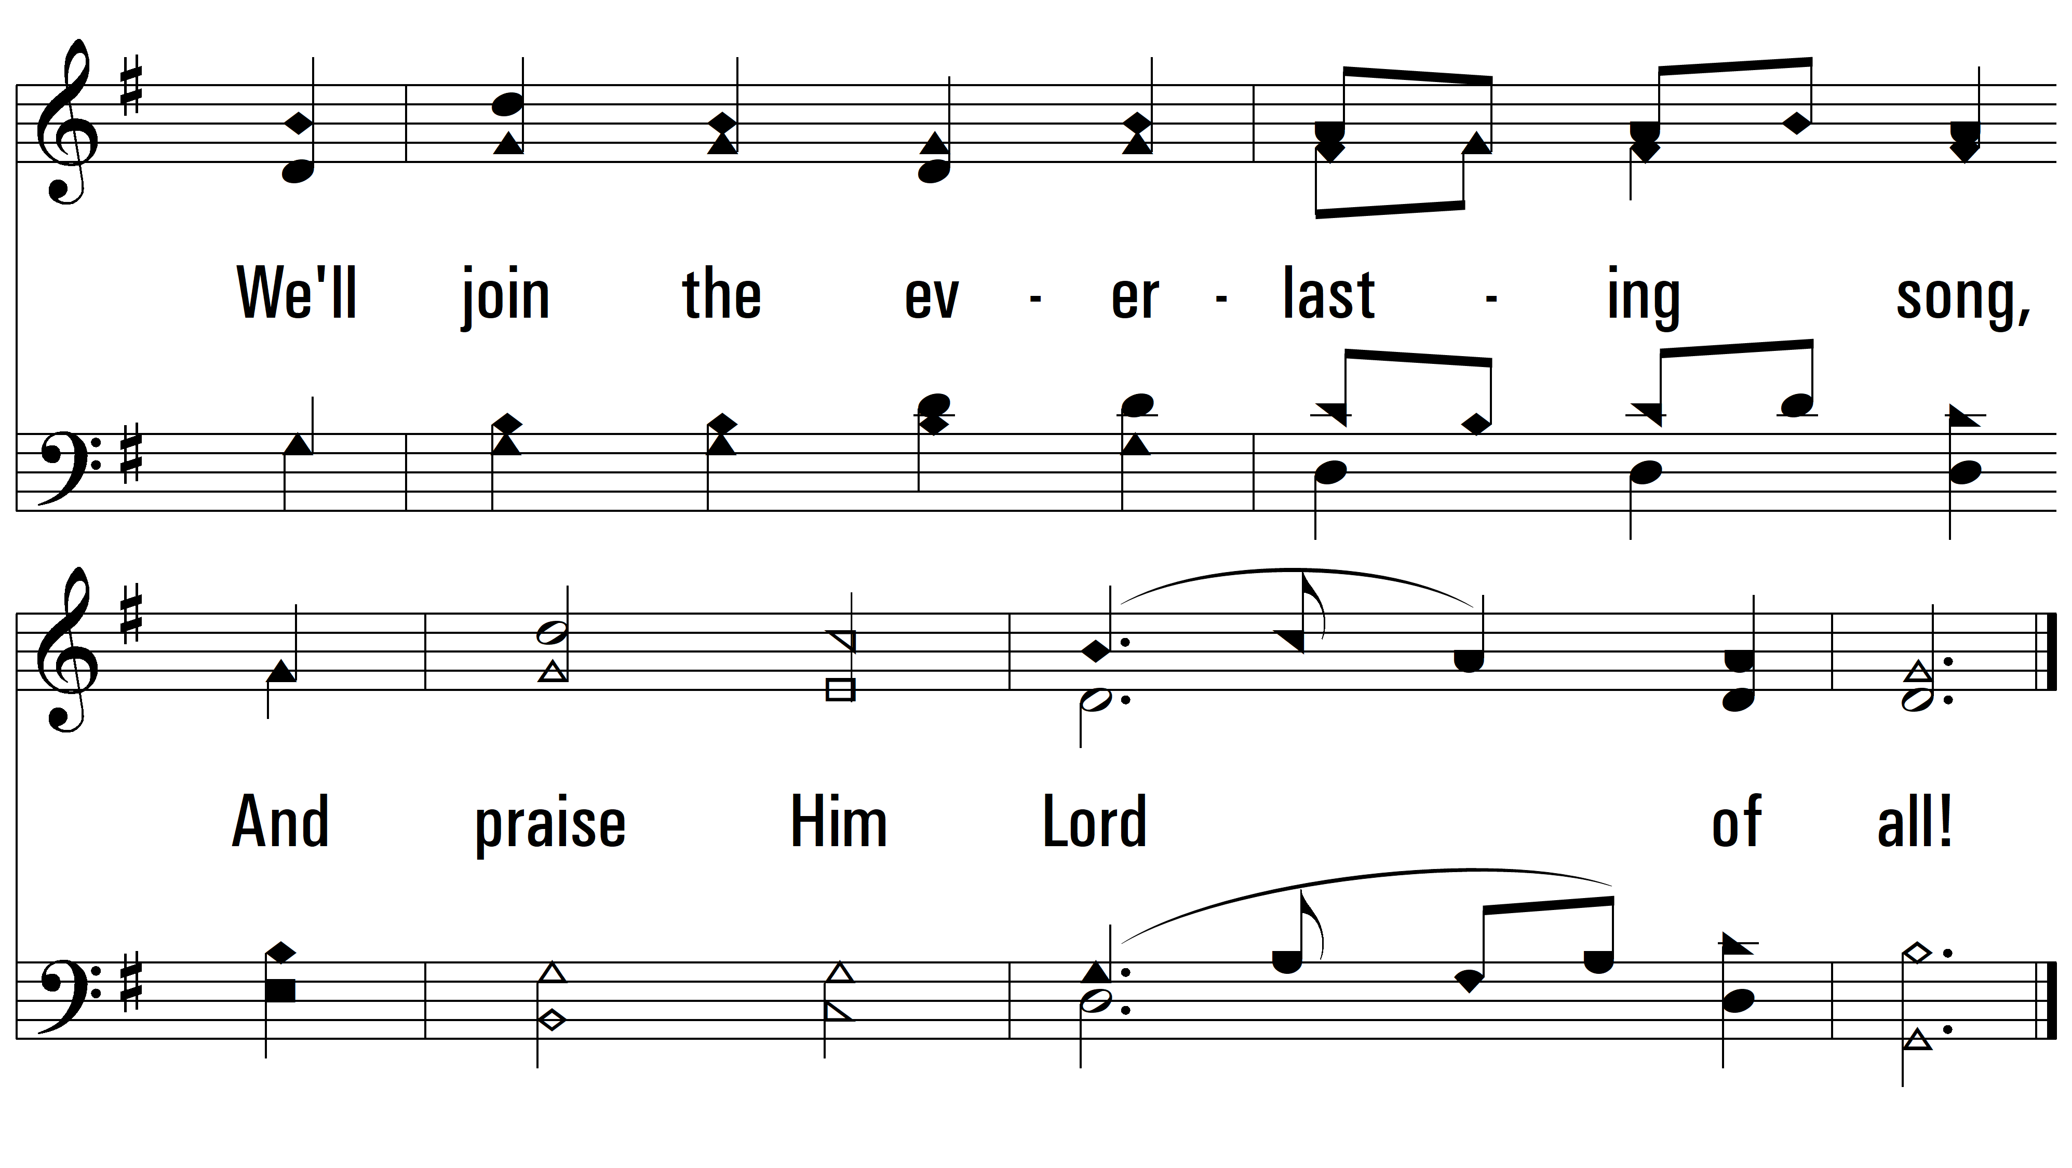
vs. 7
PDHymns.com
END

