Slide 1
All For Jesus!
CONSTANCY
8.7.8.7.8.7
Words: | Mary Dagworthy James (1871)
Music: | McDonald’s Songs of Joy & Gladness (1885)
4/4
F/A - MI
Verses: 4
Lead - | MI
Alto - | DO
Tenor - | SOL
Bass - | DO
PDHymns.com

Slide 2
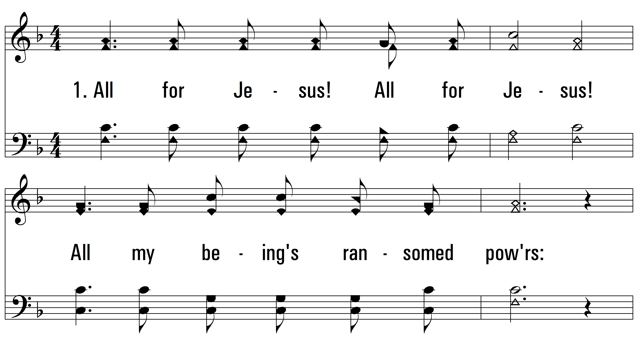
vs. 1 ~ All For Jesus!

Slide 3
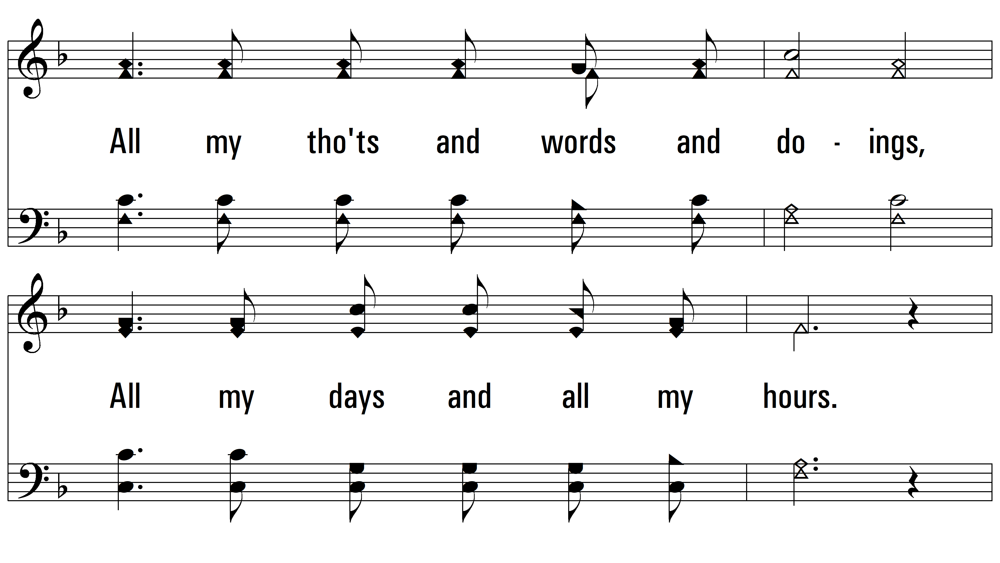
vs. 1

Slide 4
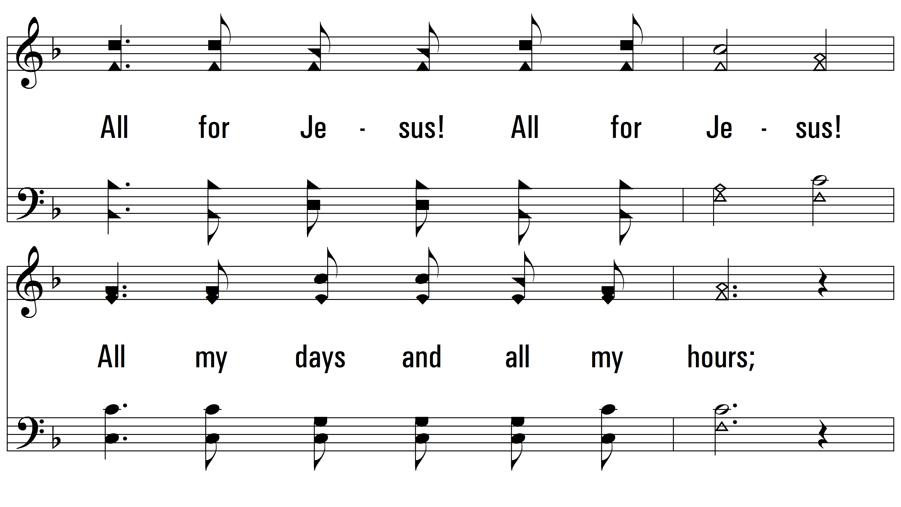
vs. 1

Slide 5
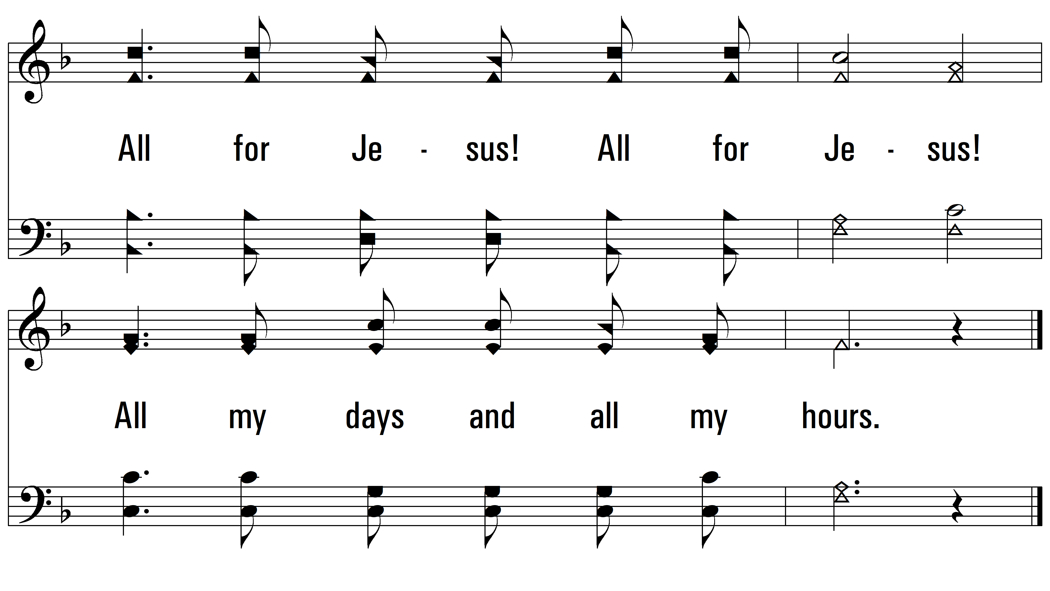
vs. 1

Slide 6
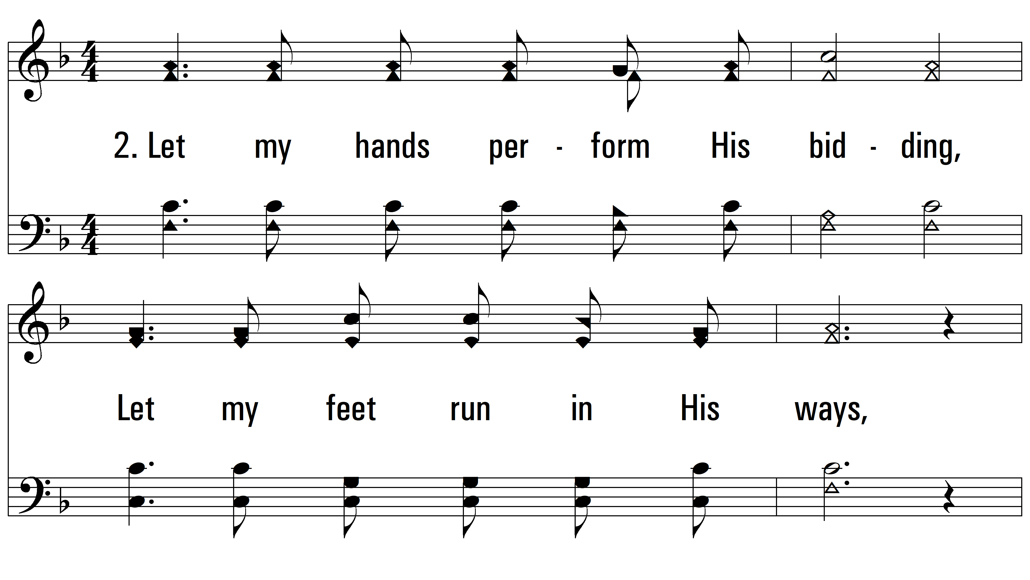
vs. 2 ~ All For Jesus!

Slide 7
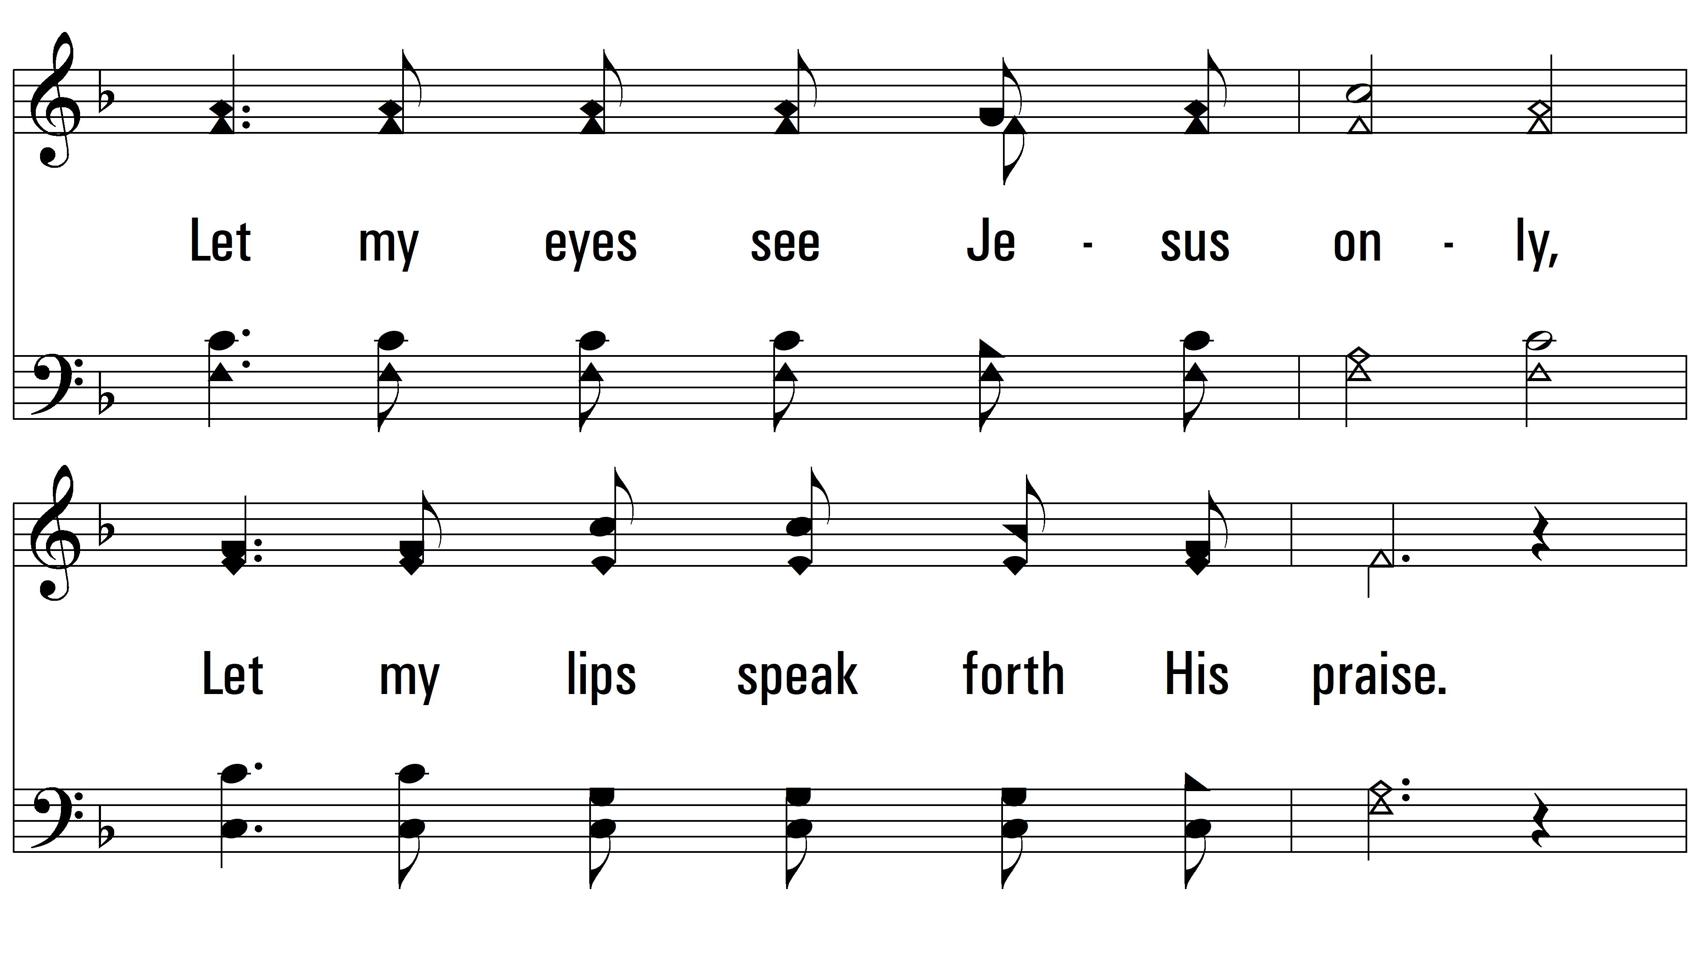
vs. 2

Slide 8
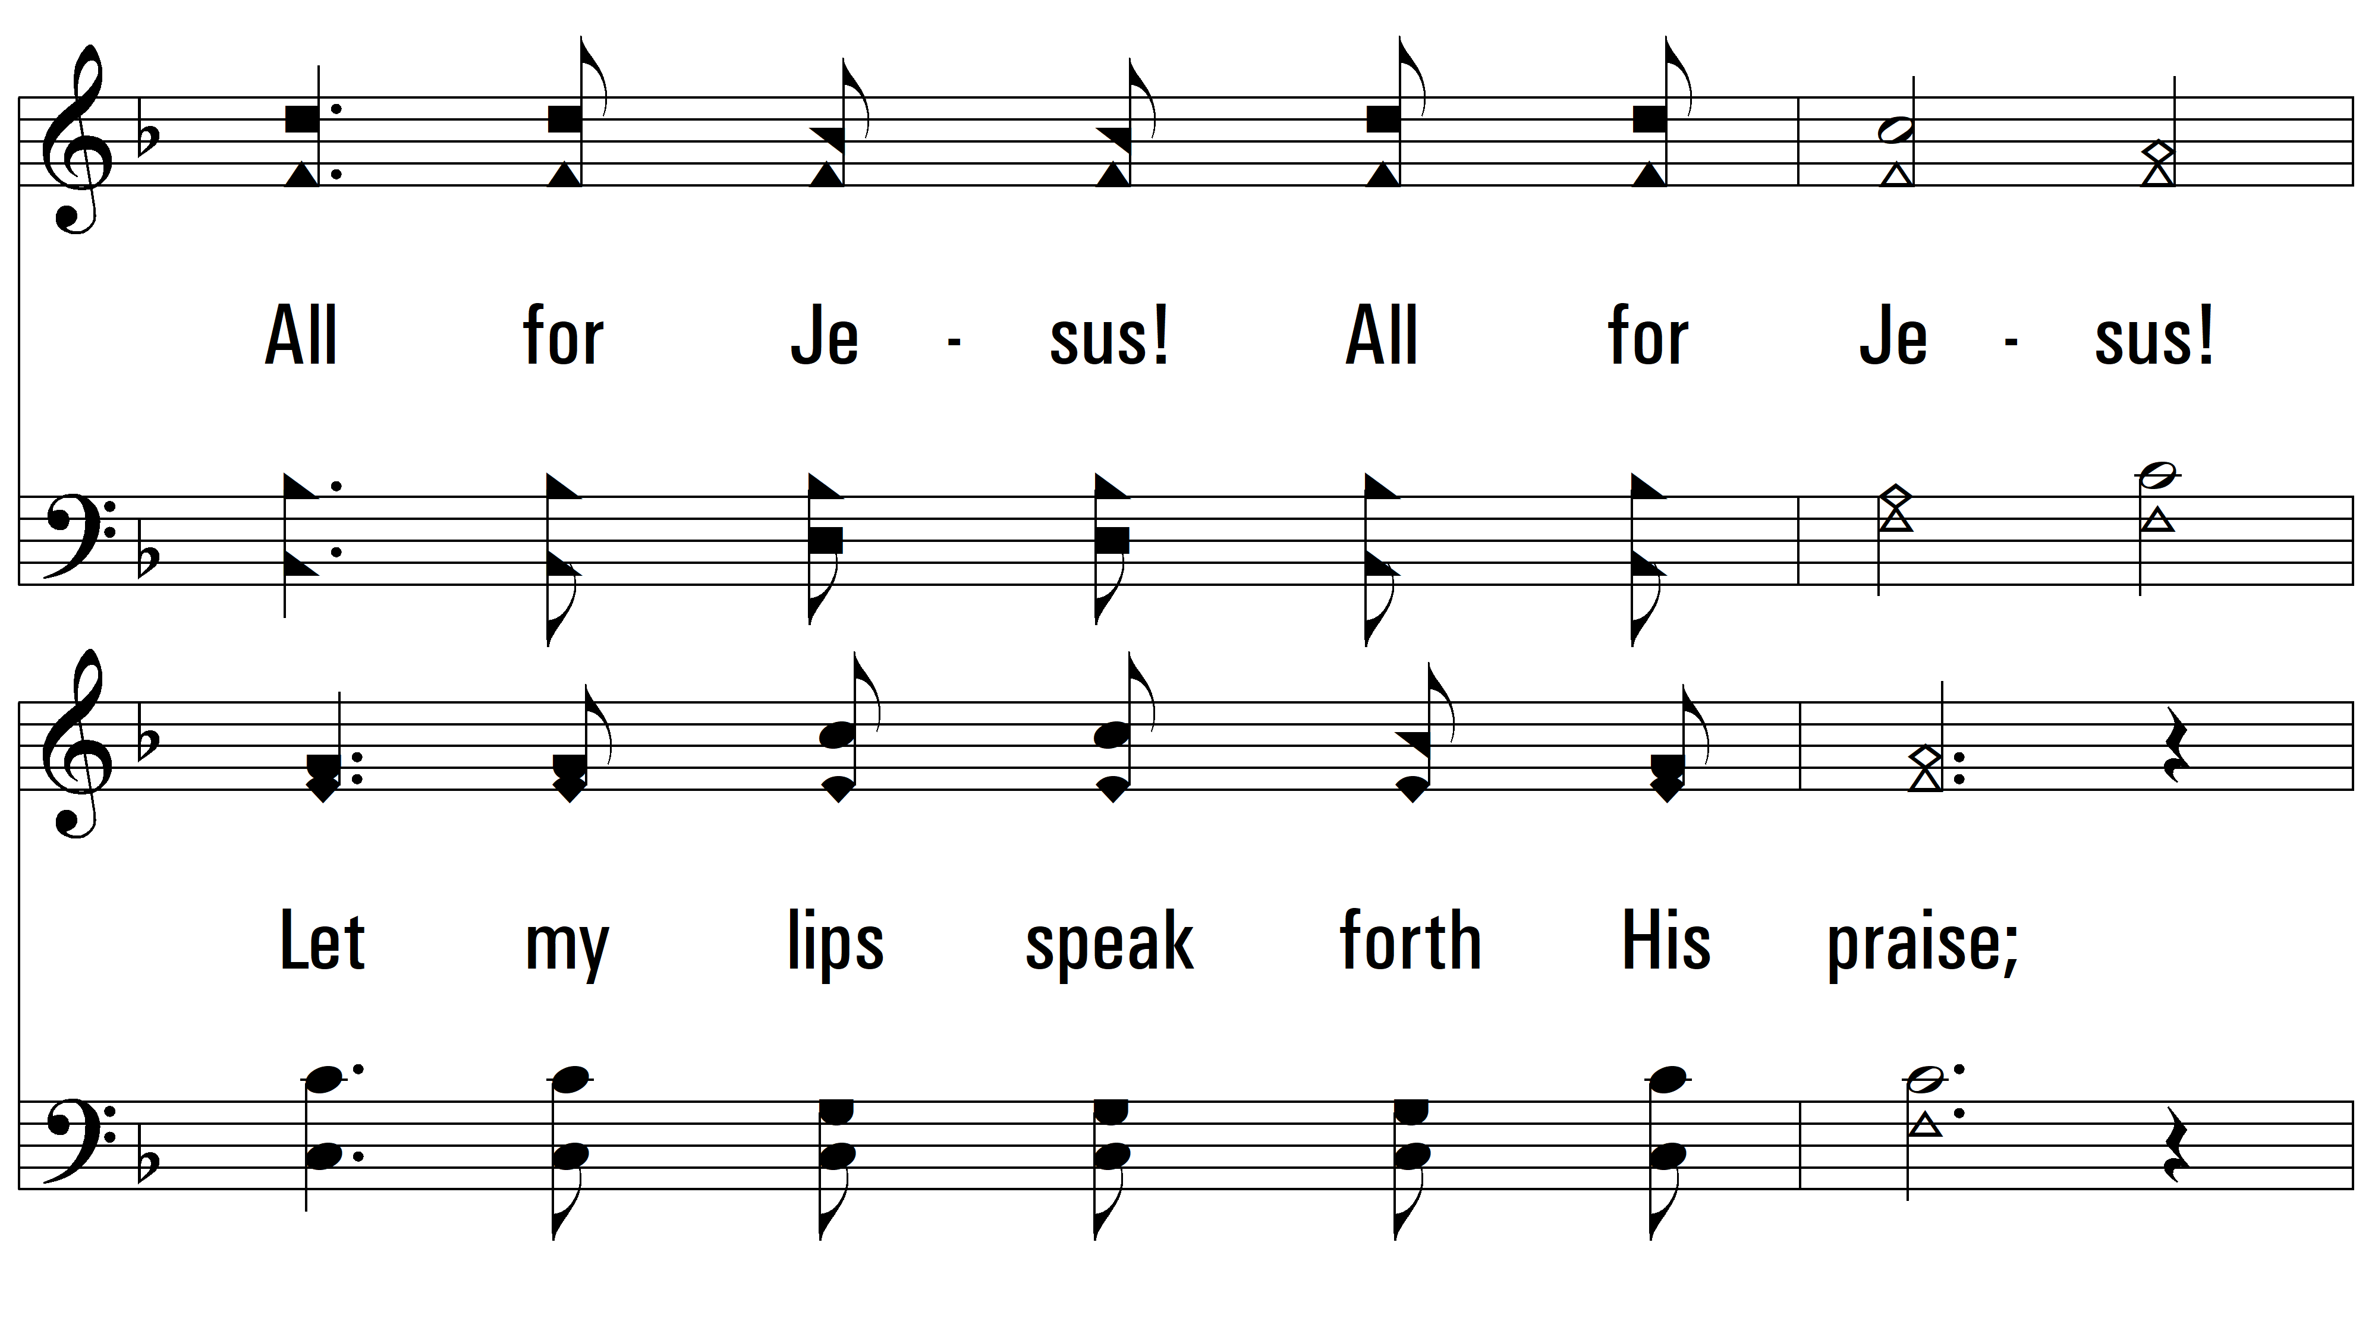
vs. 2

Slide 9
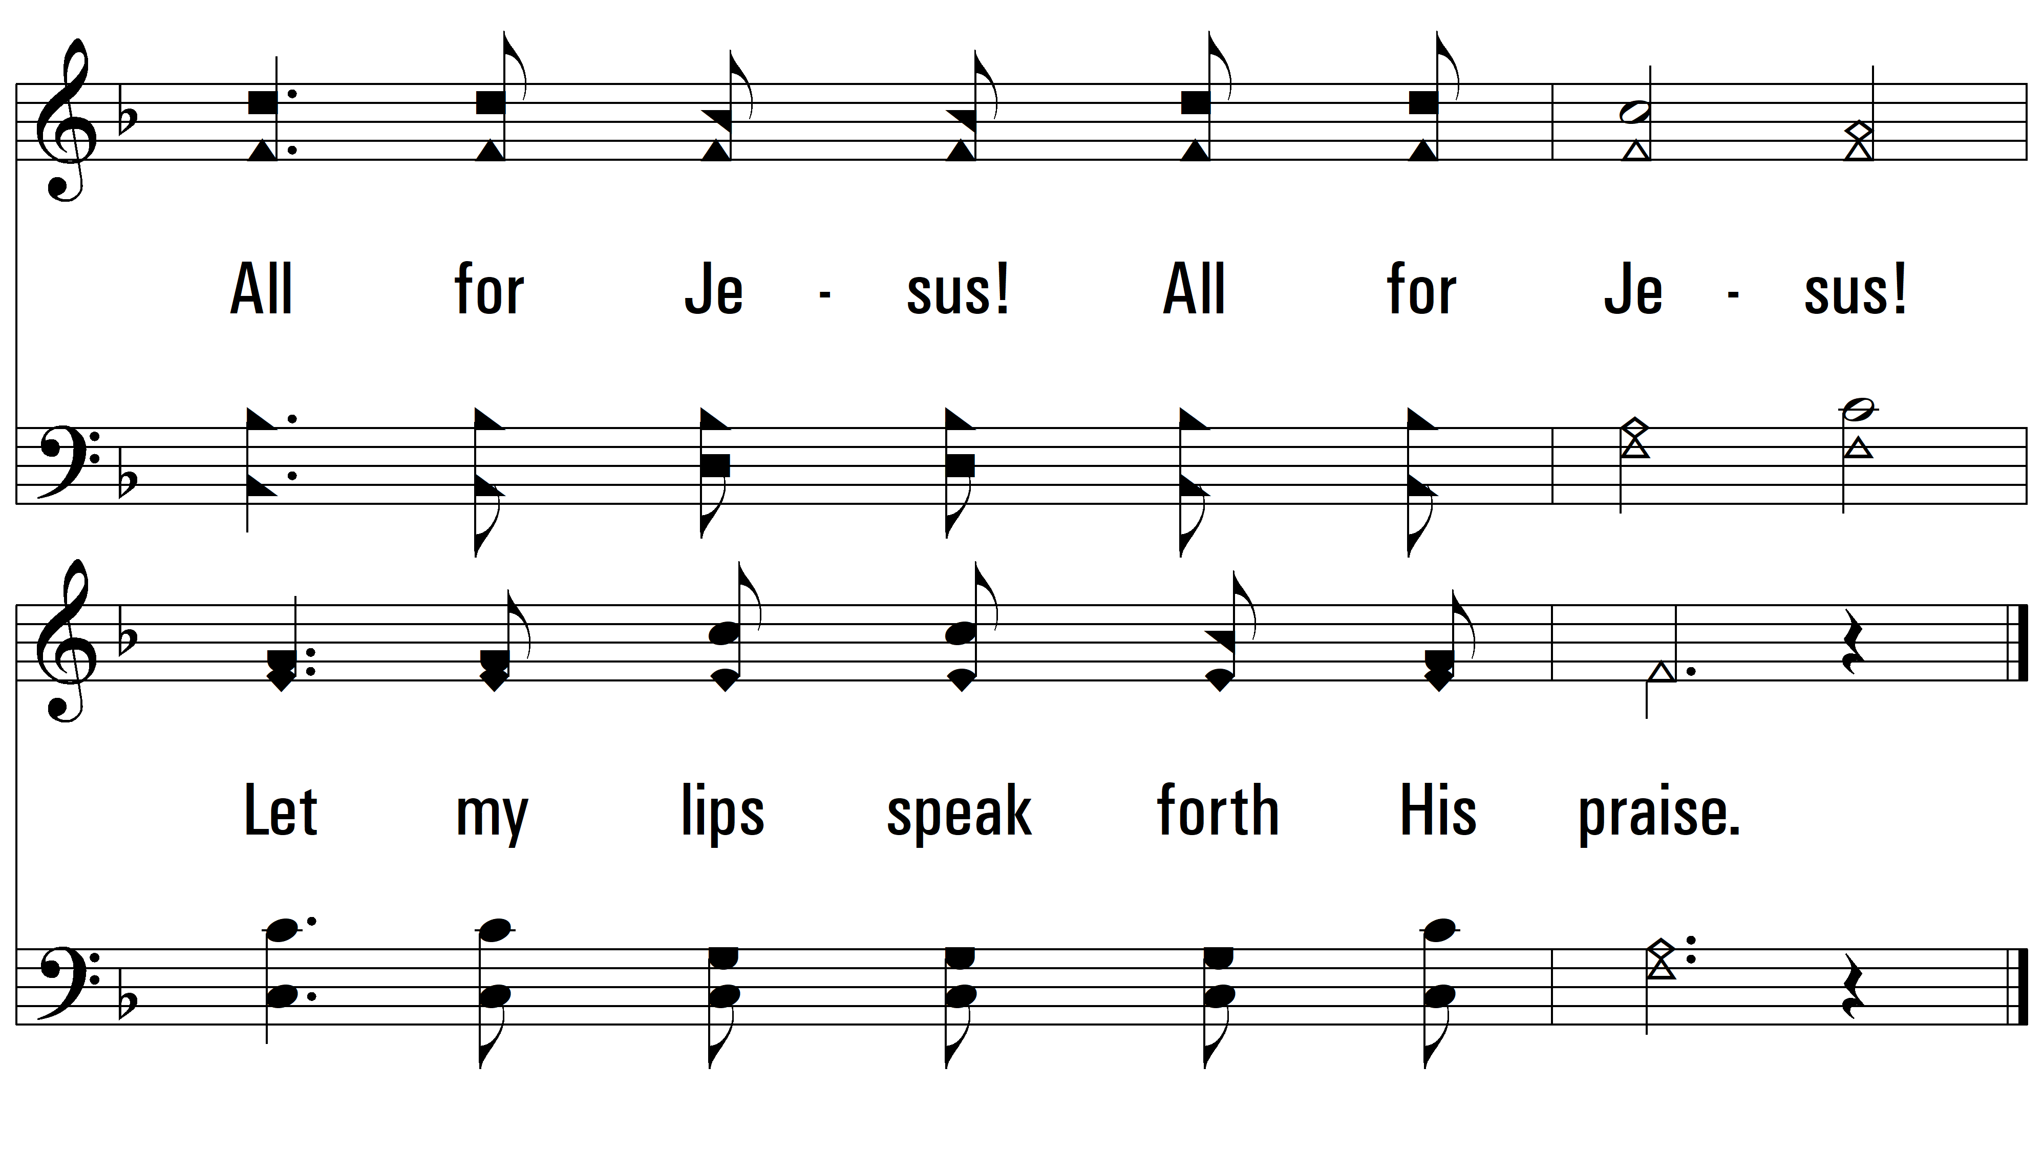
vs. 2

Slide 10
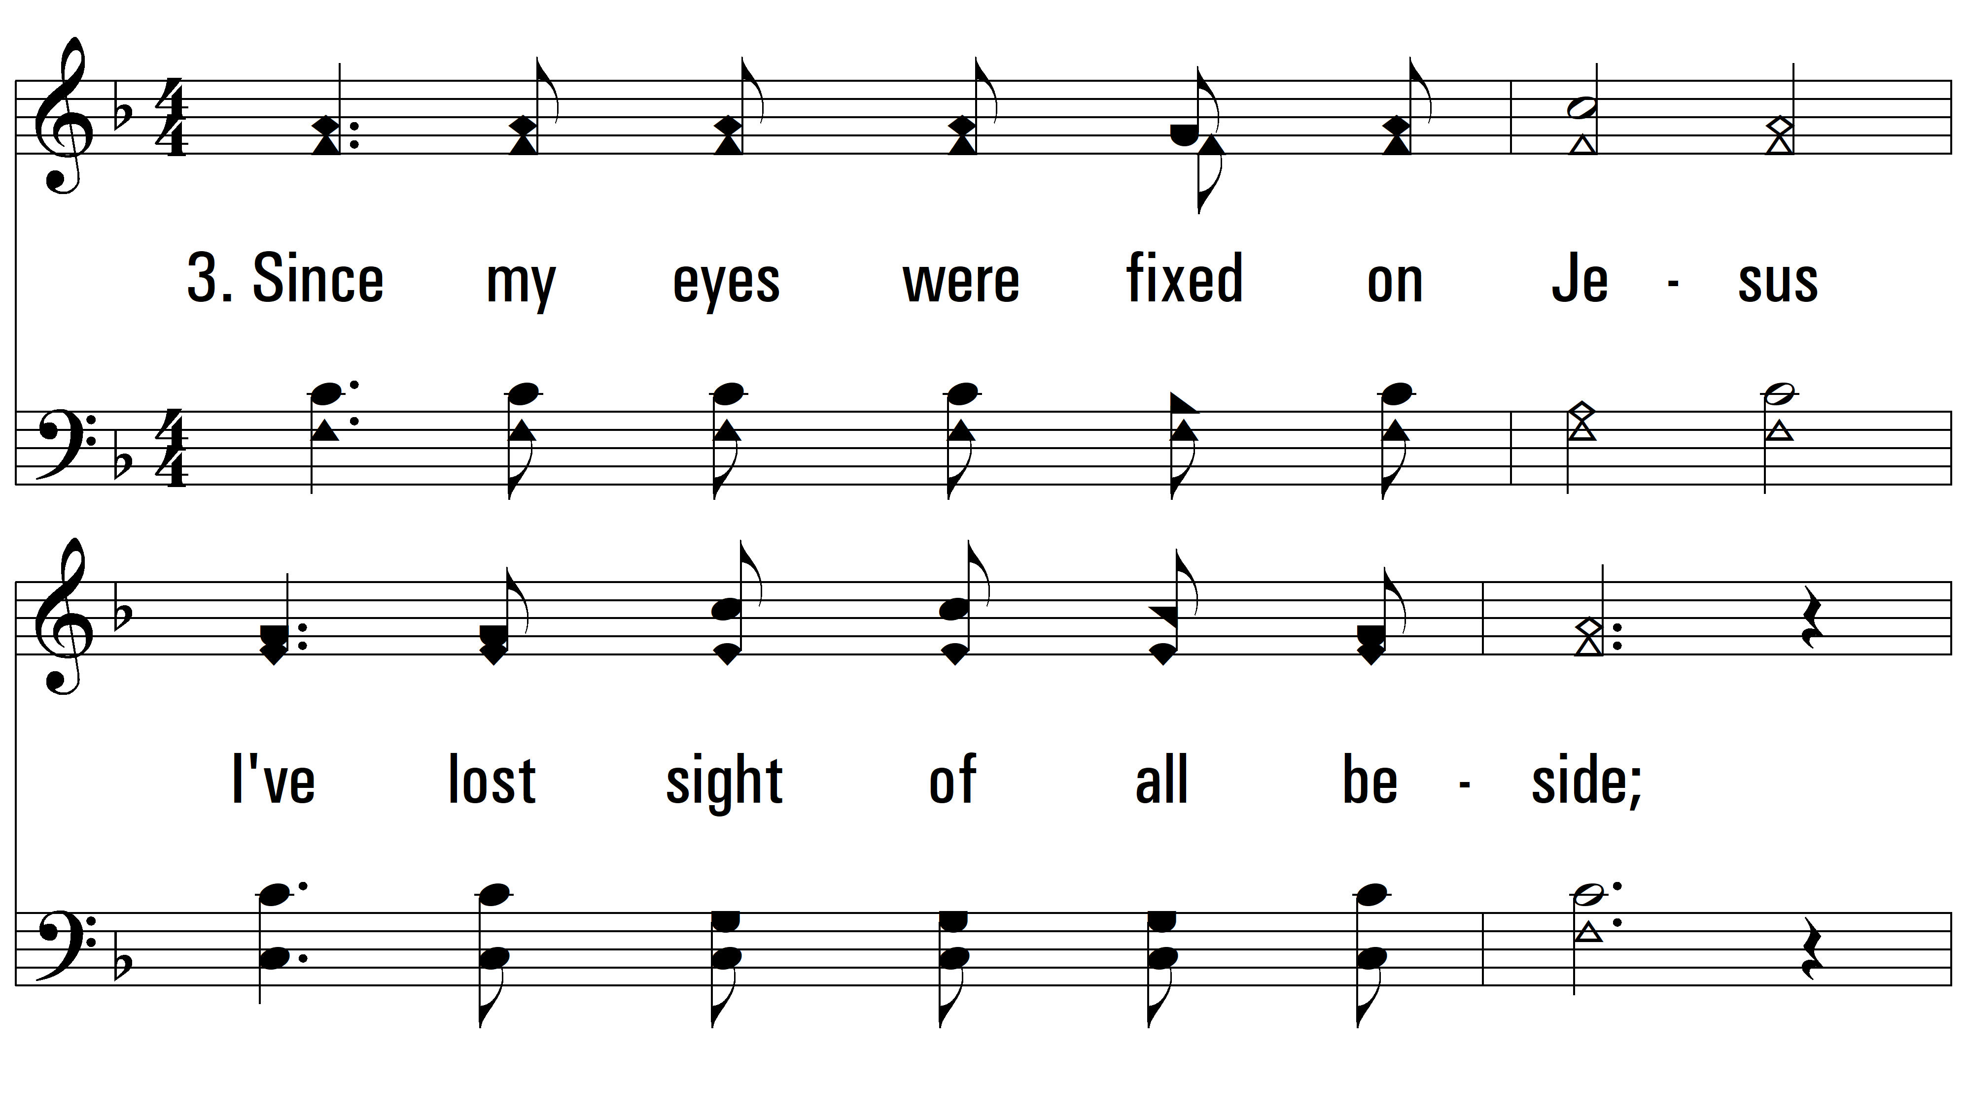
vs. 3 ~ All For Jesus!

Slide 11
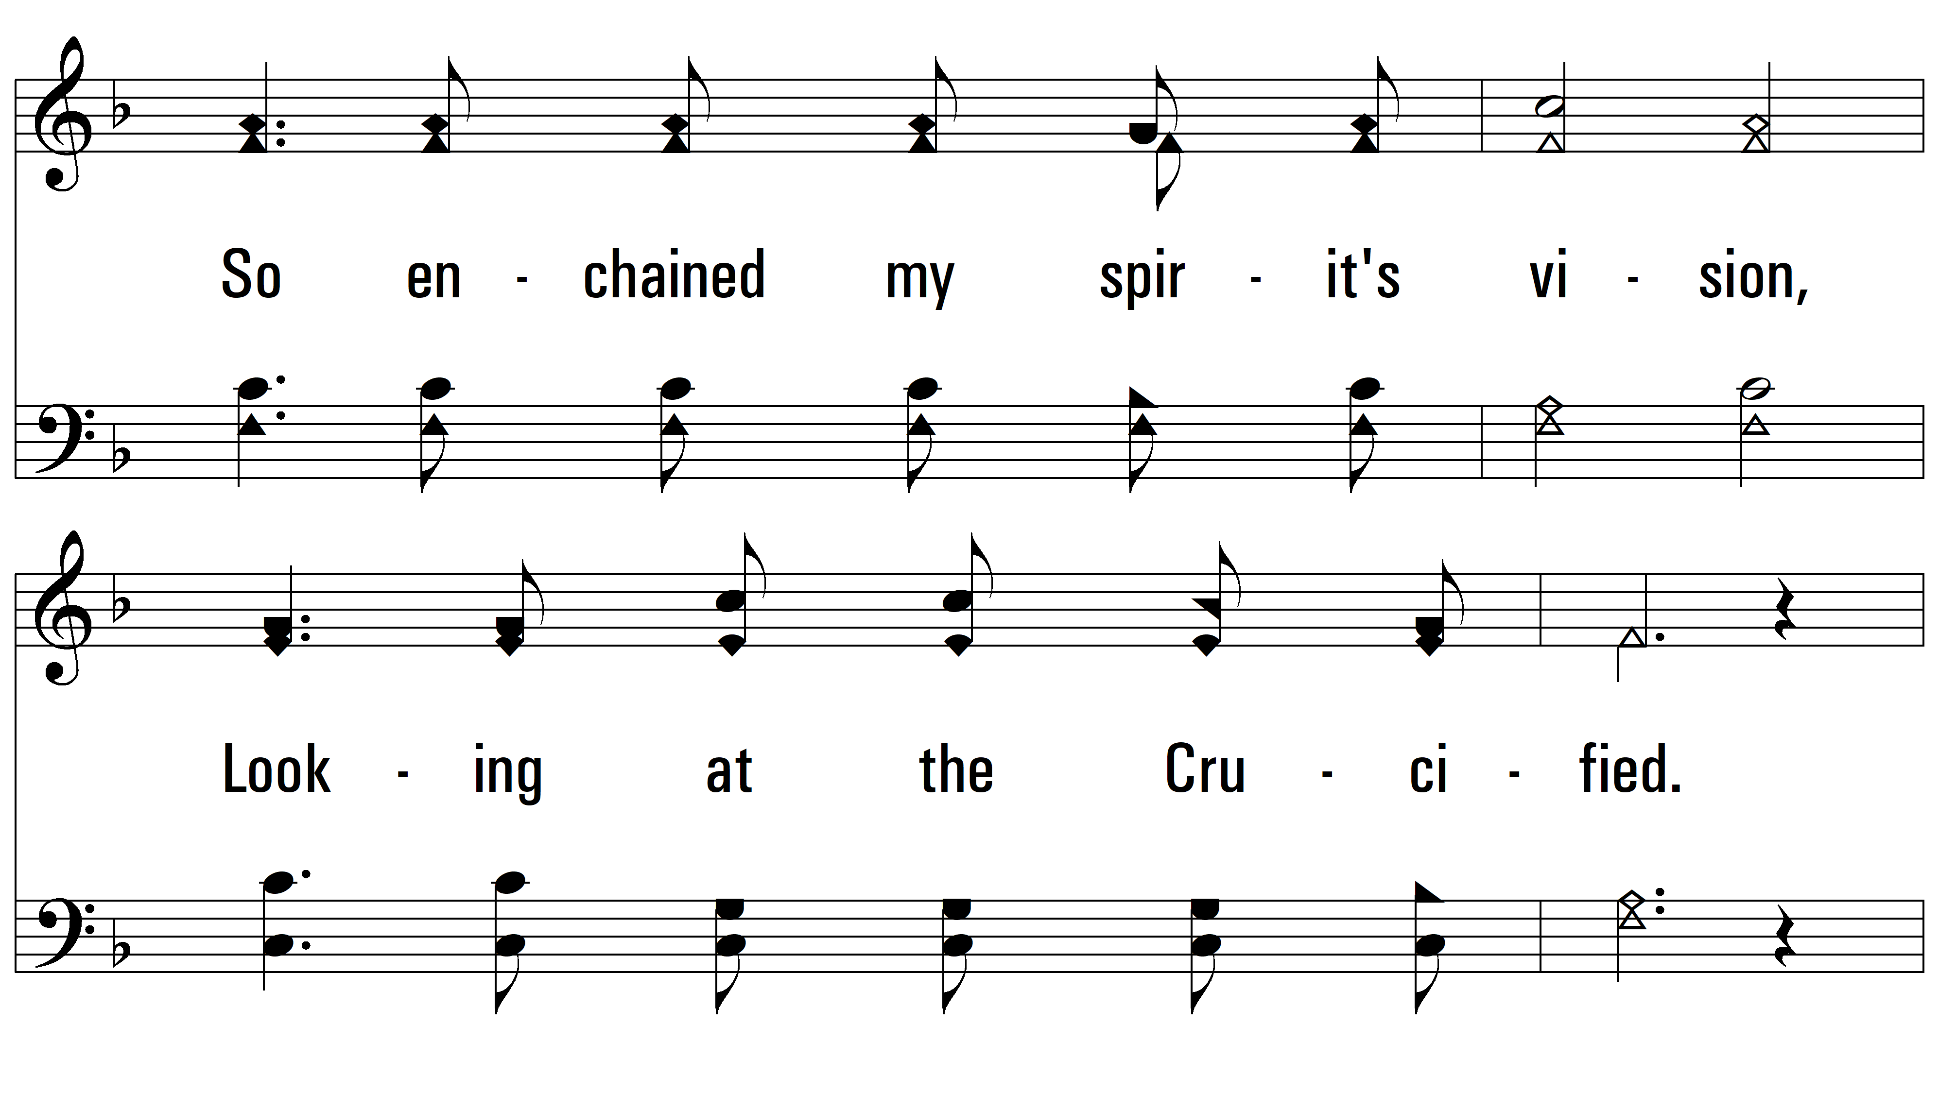
vs. 3

Slide 12
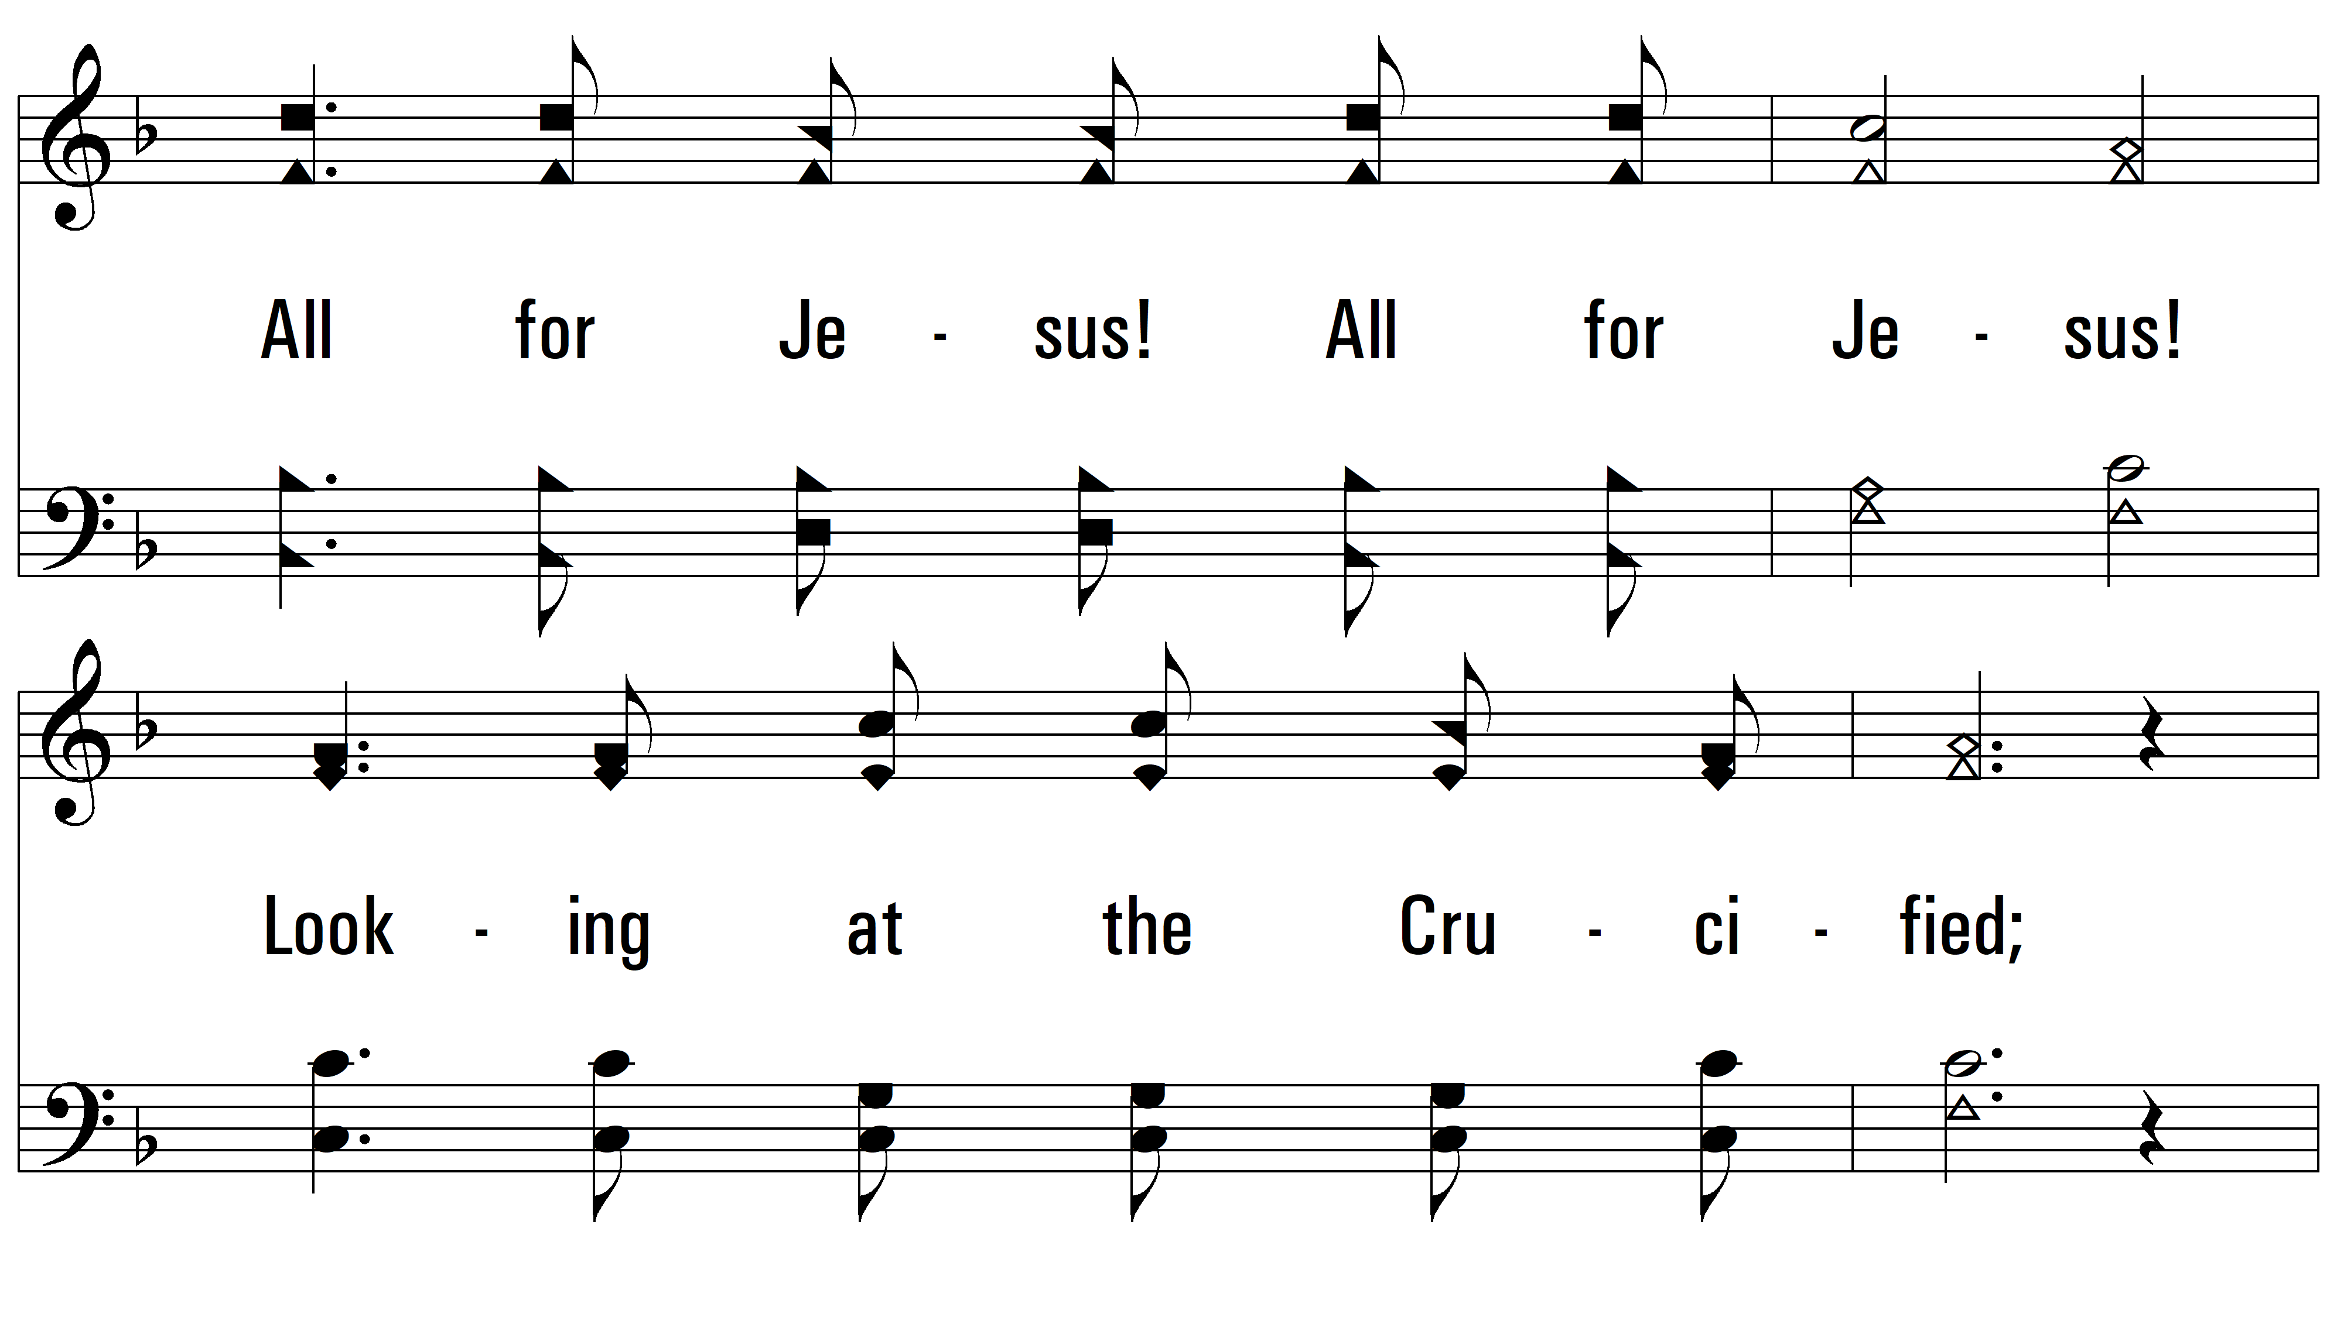
vs. 3

Slide 13
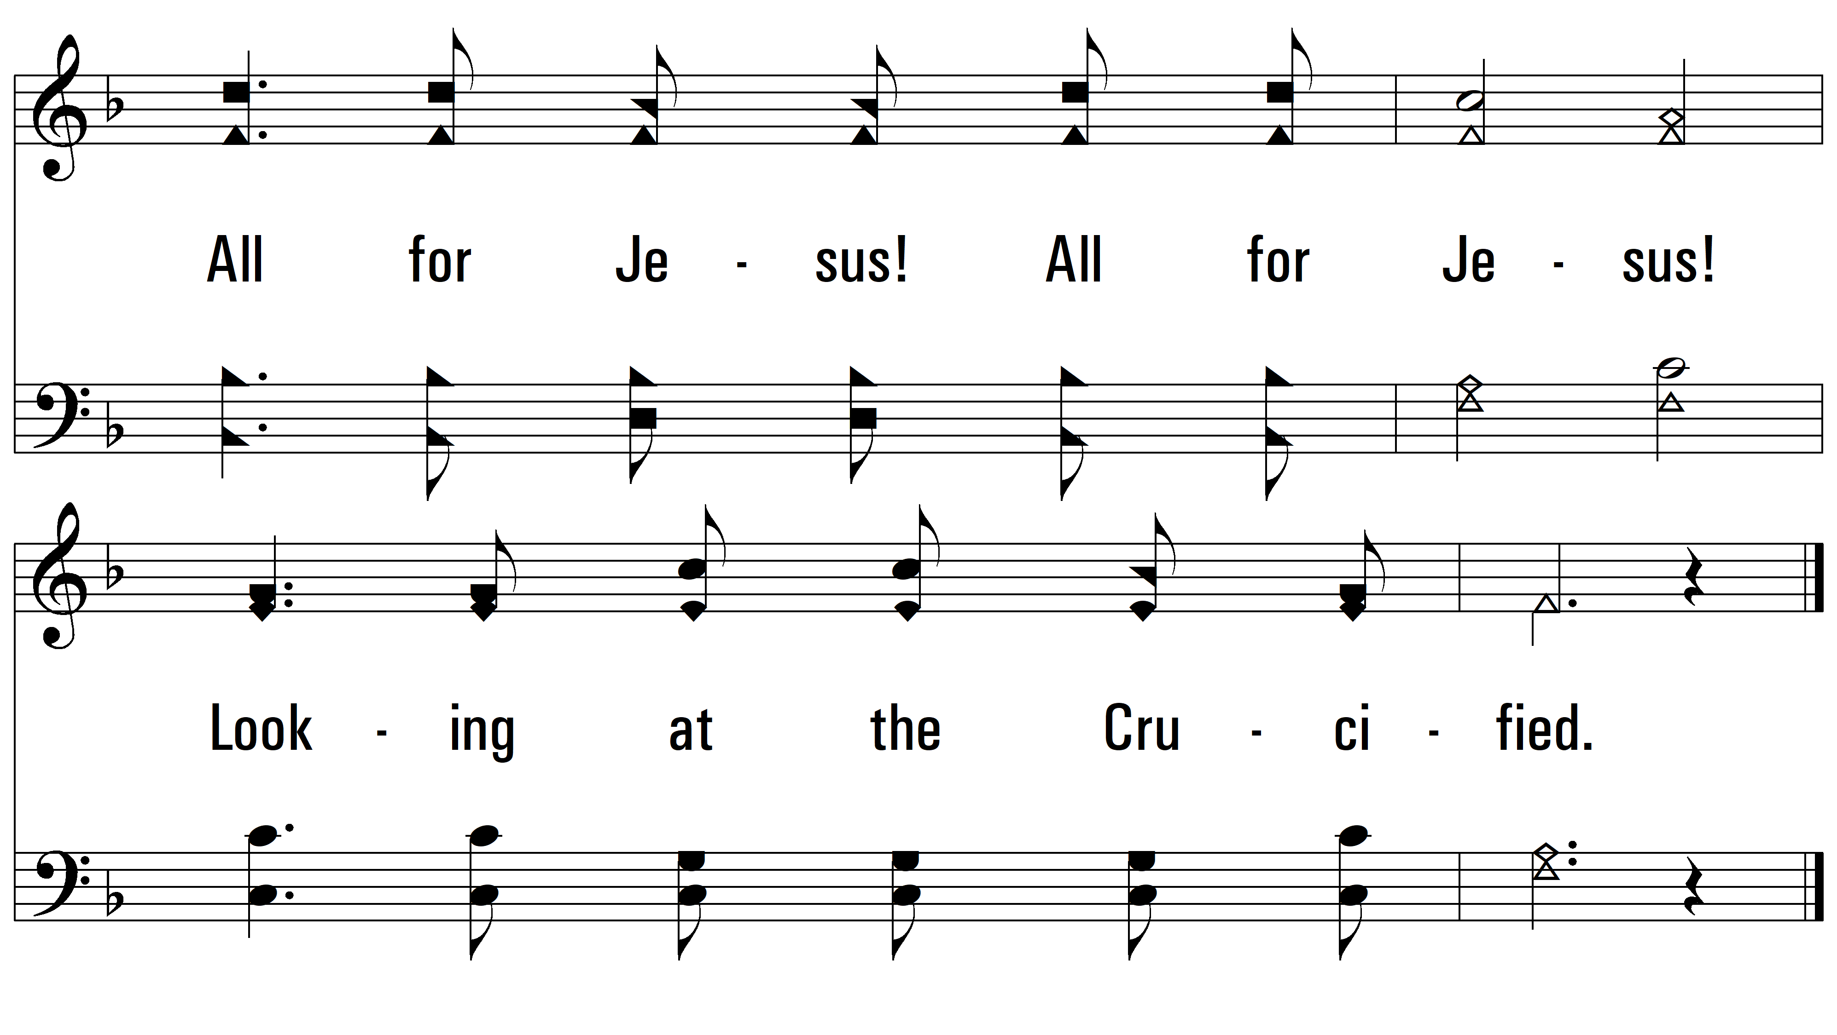
vs. 3

Slide 14
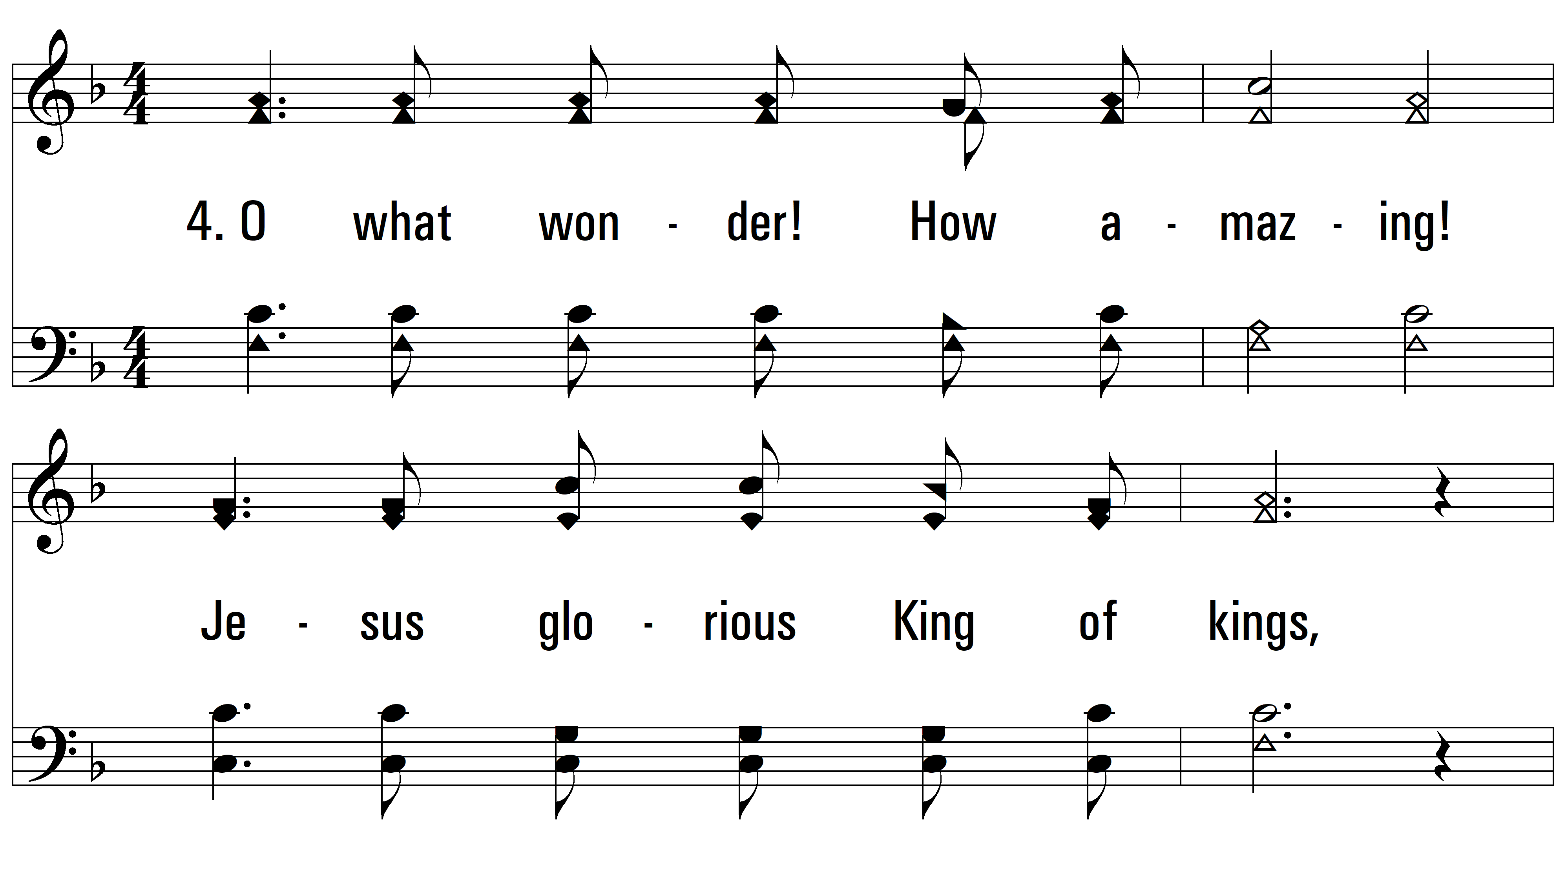
vs. 4 ~ All For Jesus!

Slide 15
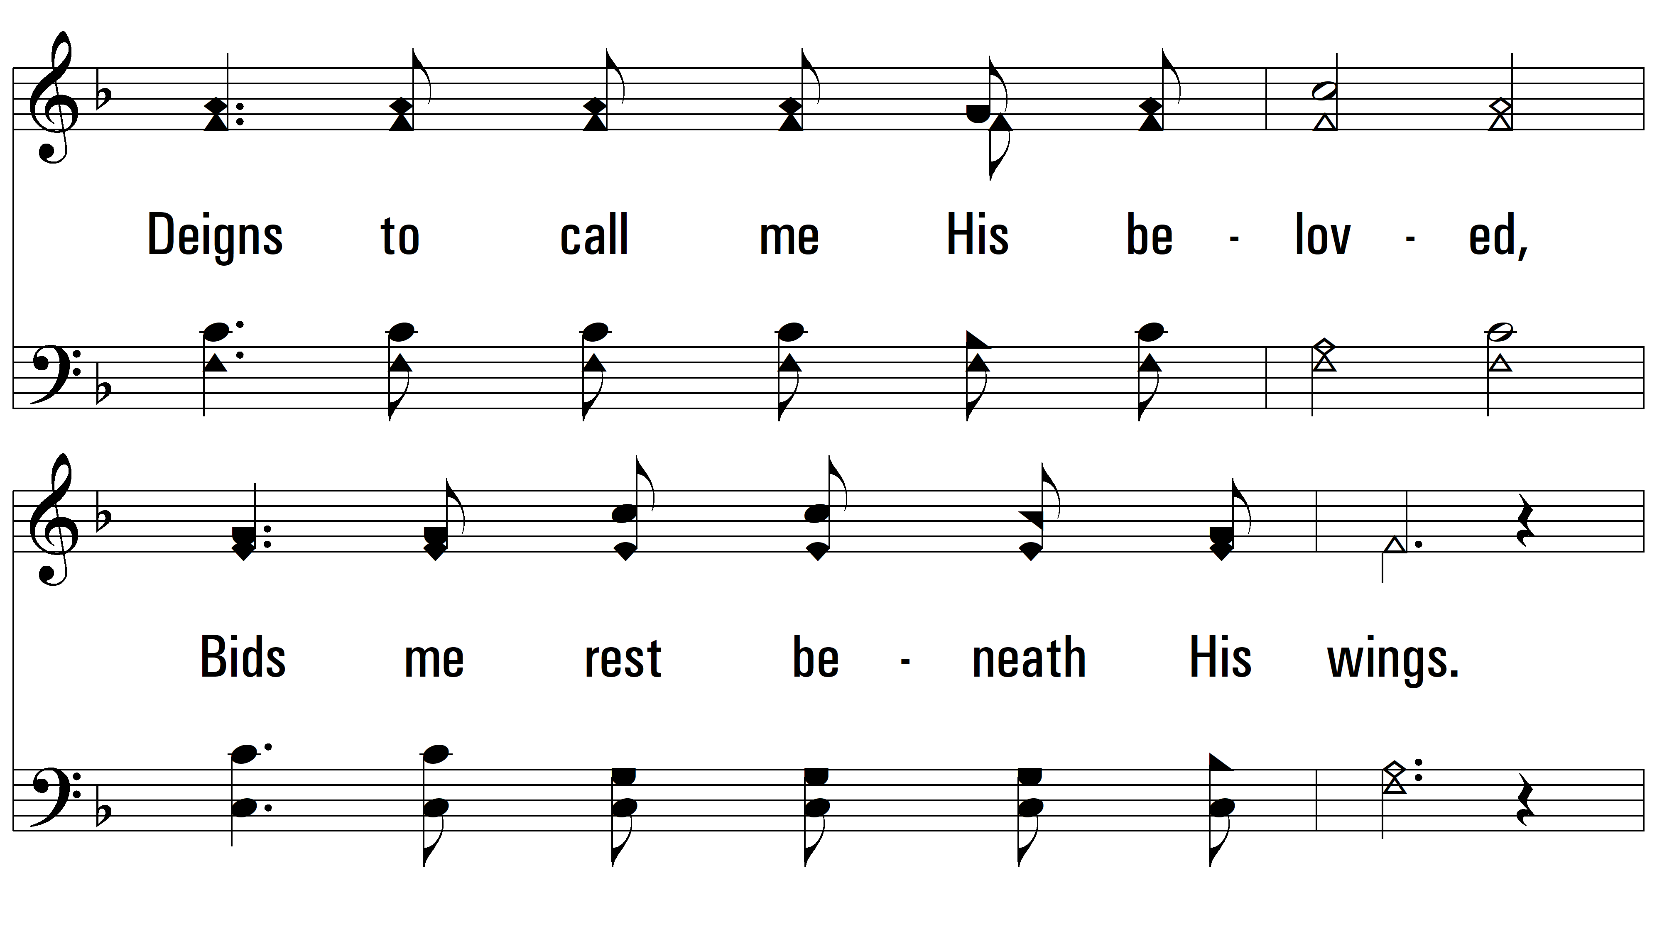
vs. 4

Slide 16
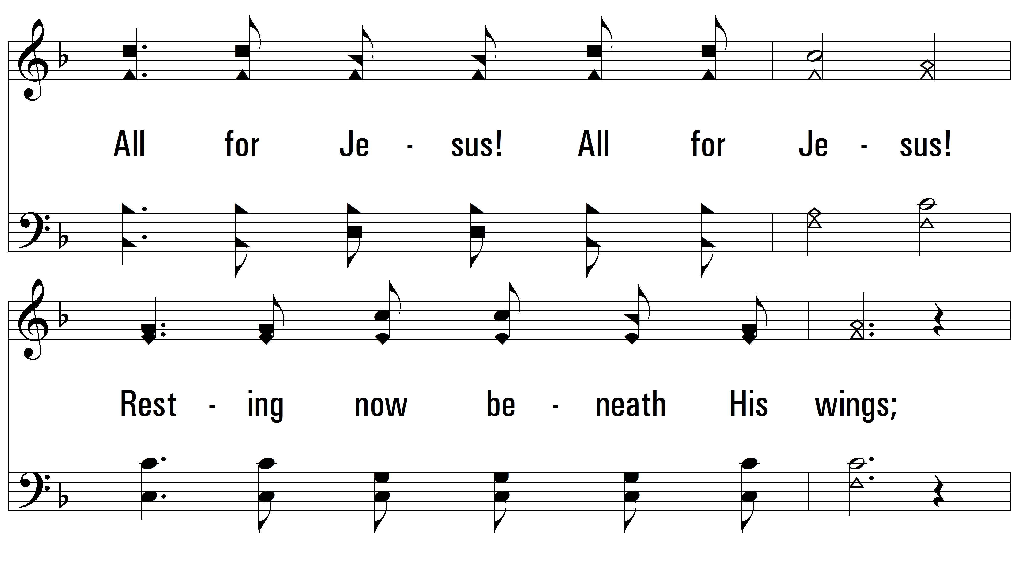
vs. 4

Slide 17
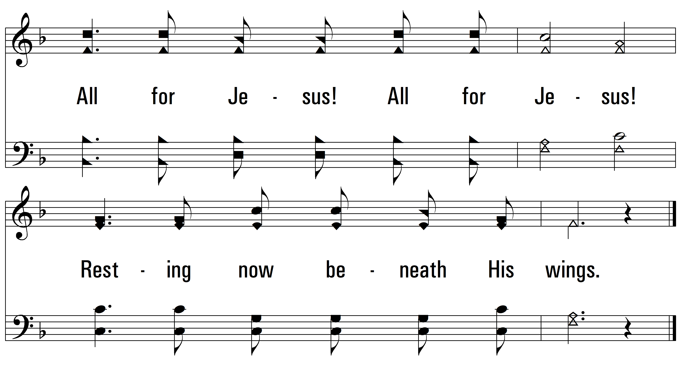
vs. 4
PDHymns.com
END

