Slide 1
All Creatures Of Our God And King
LASST UNS ERFREUEN
8.8.8.8
Words: | Francis of Assisi (1225), Tr. by William H. Draper (1926)
Music: | Brachel’s Geistliche Kirchengesang (1623), Arr. by Ralph V. Williams (1906)
3/2
E^{b}/E^{b} - DO
Verses: 4/Chorus
Lead - | DO
Alto - | SOL
Tenor - | MI
Bass - | DO
PDHymns.com

Slide 2
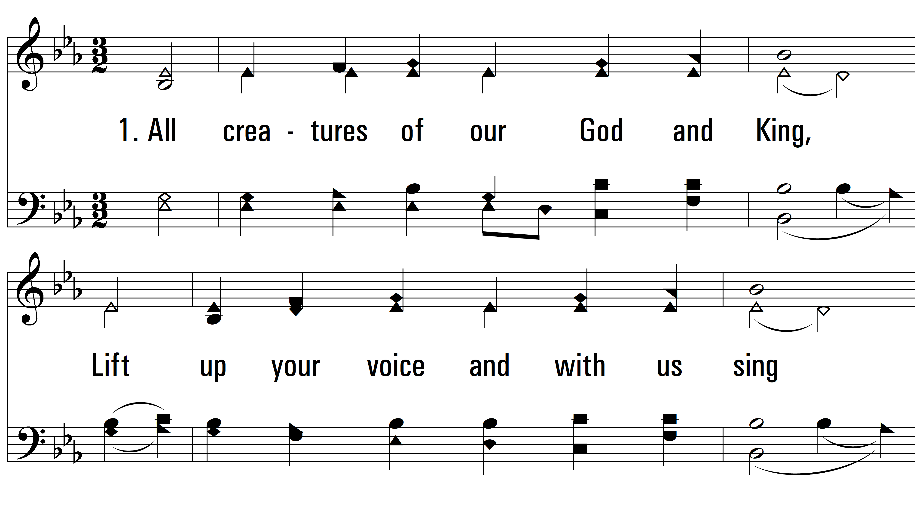
vs. 1 ~ All Creatures Of Our God And King

Slide 3
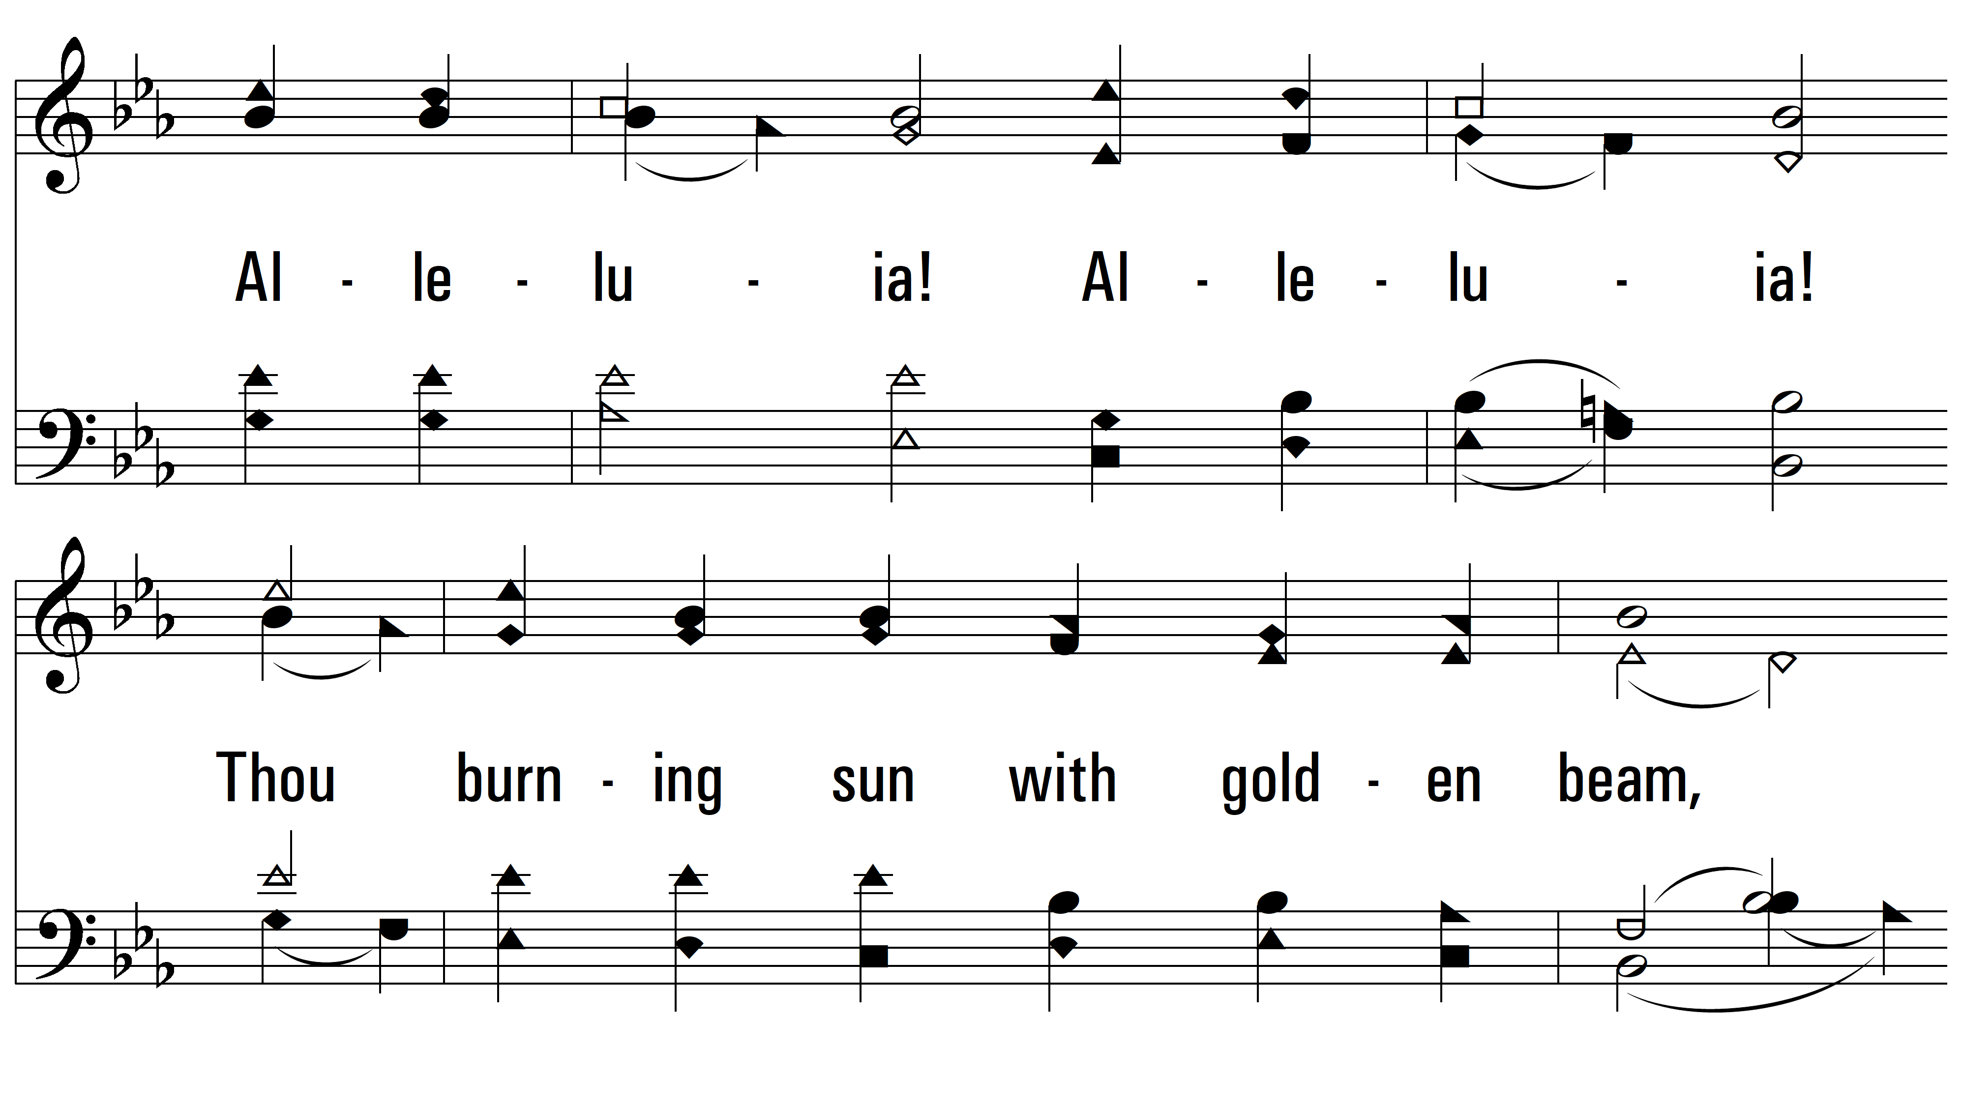
vs. 1

Slide 4
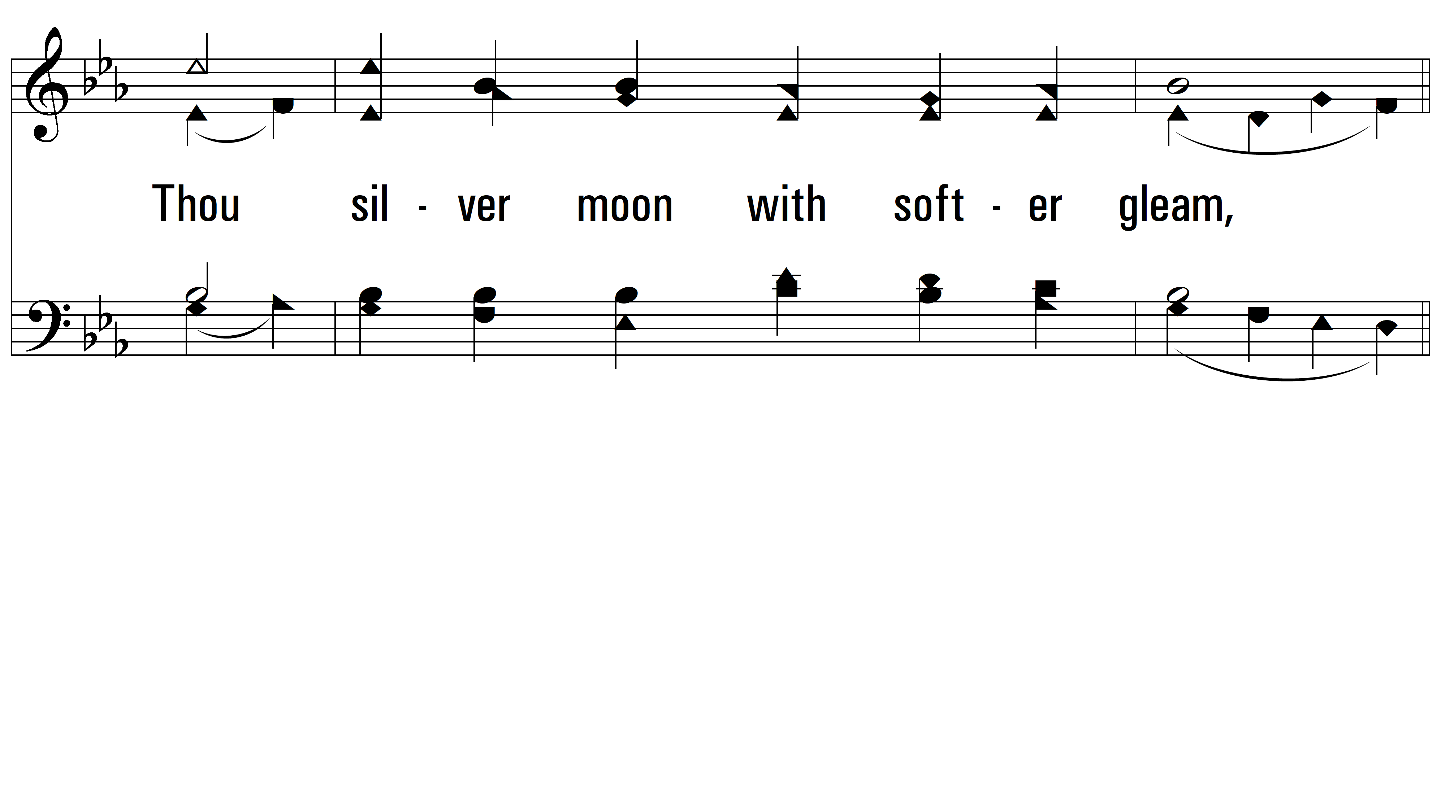
vs. 1

Slide 5
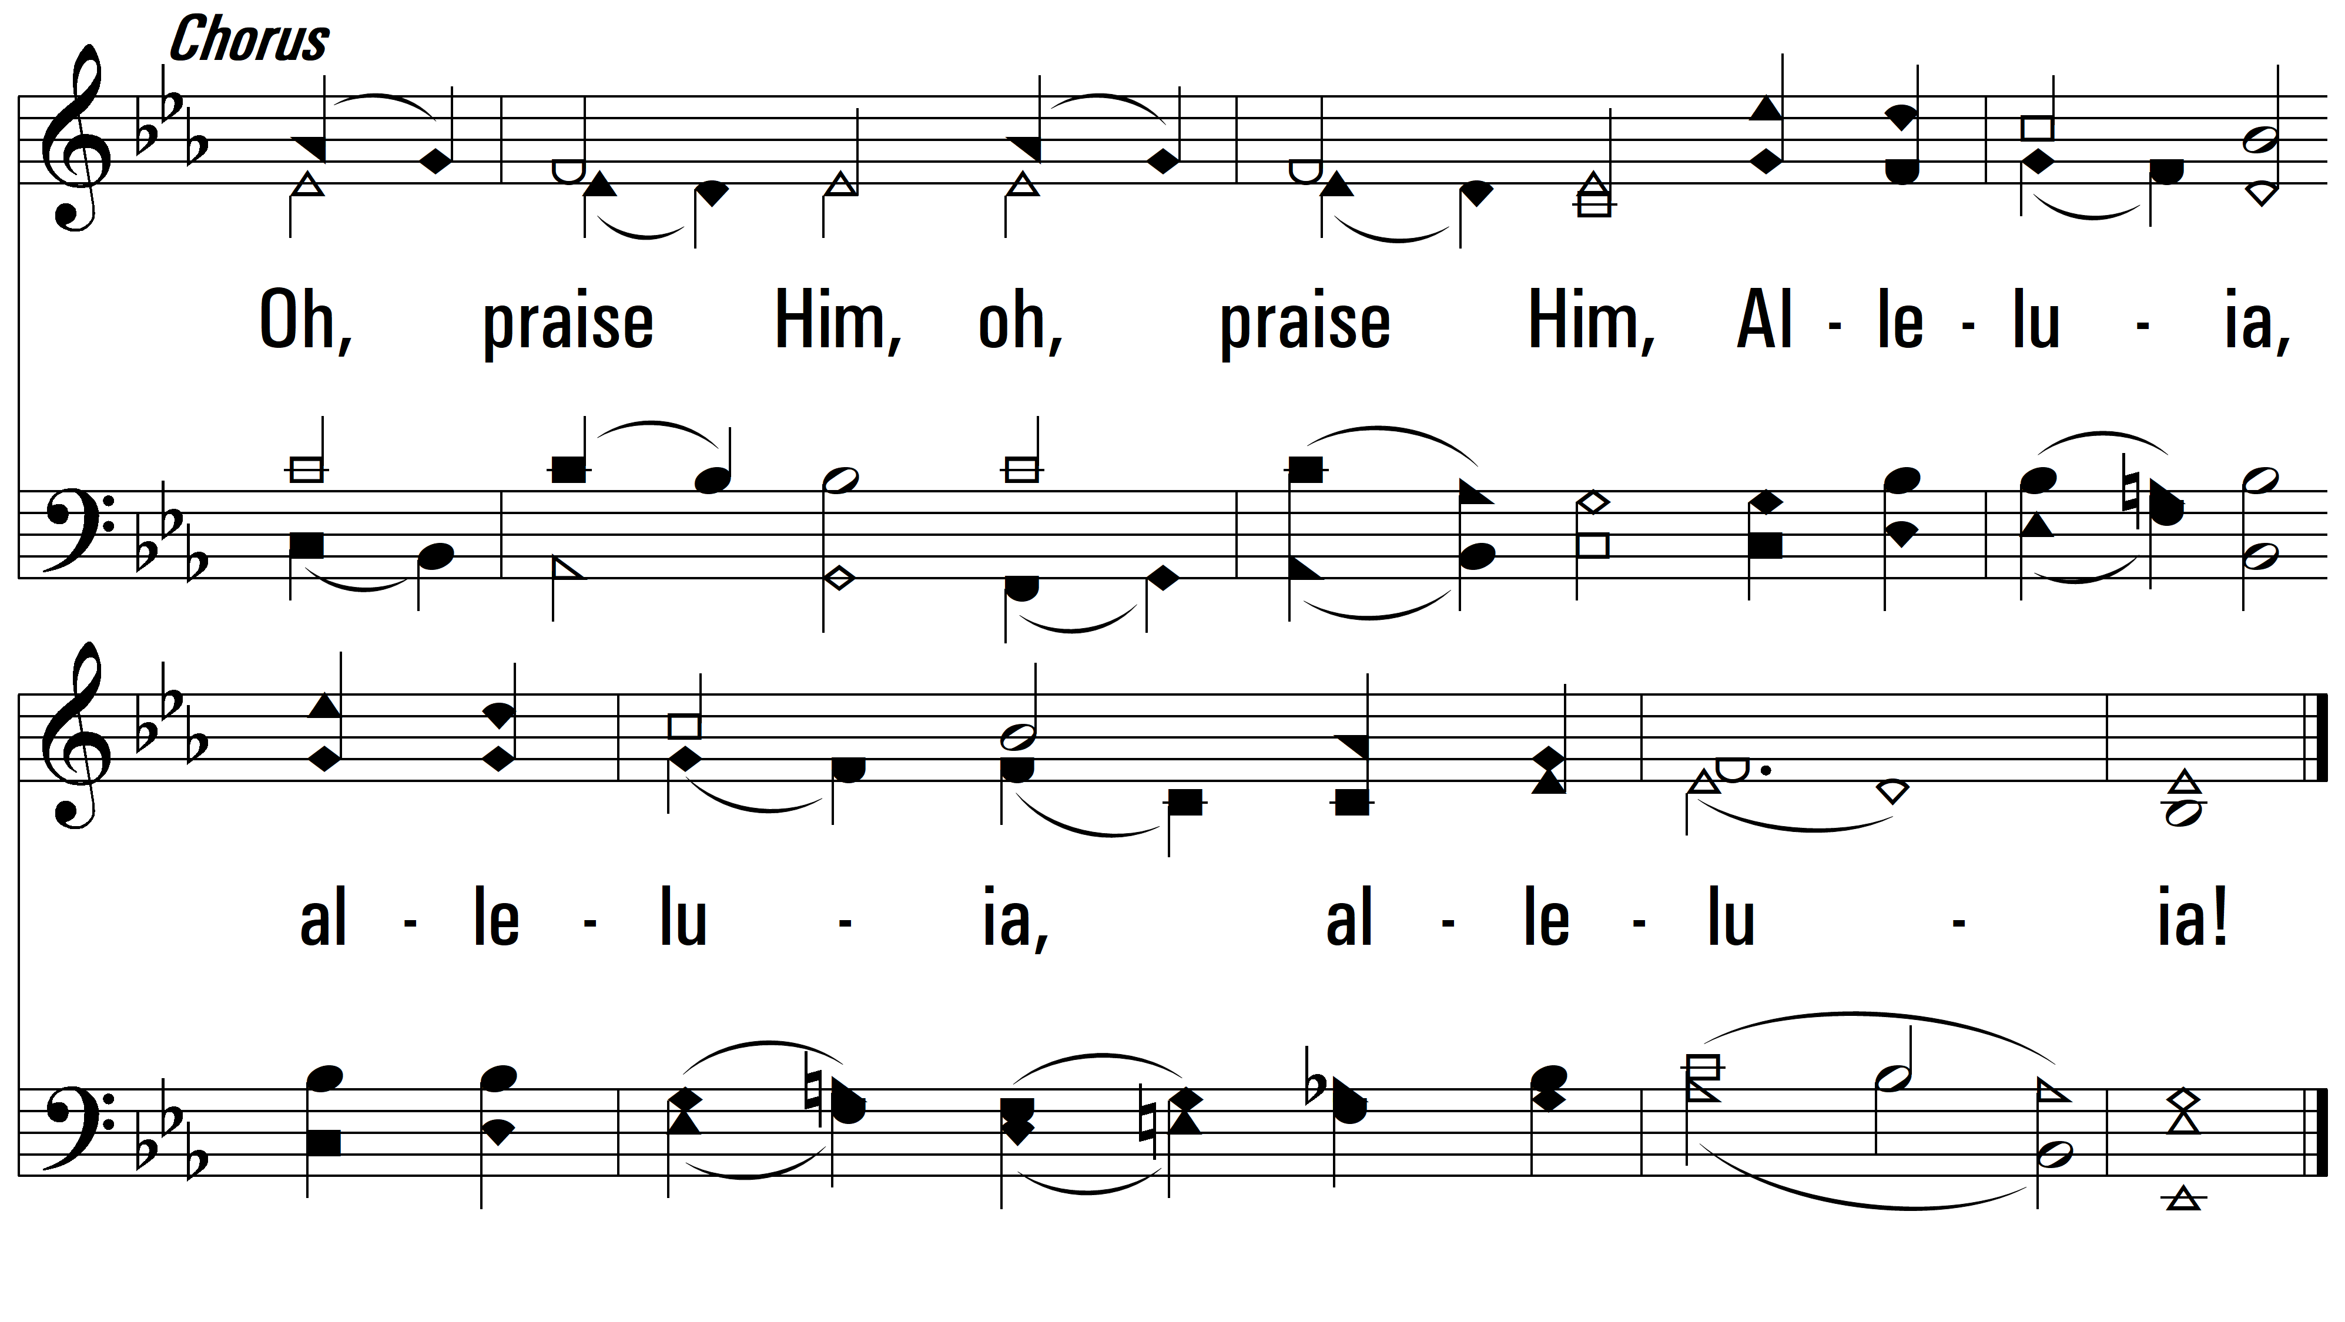
vs. 1

Slide 6
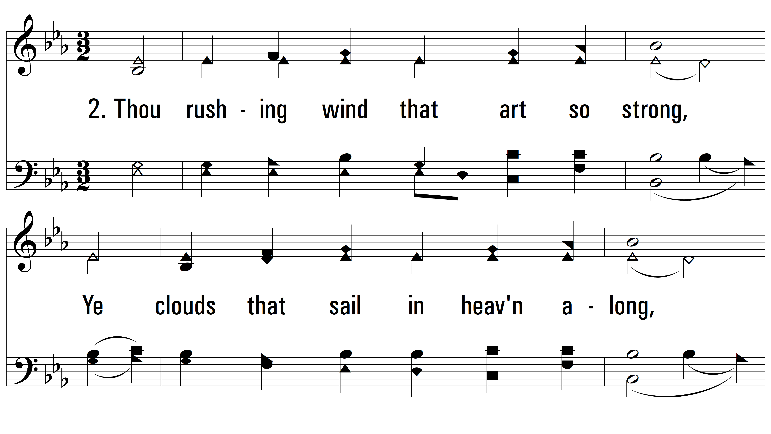
vs. 2 ~ All Creatures Of Our God And King

Slide 7
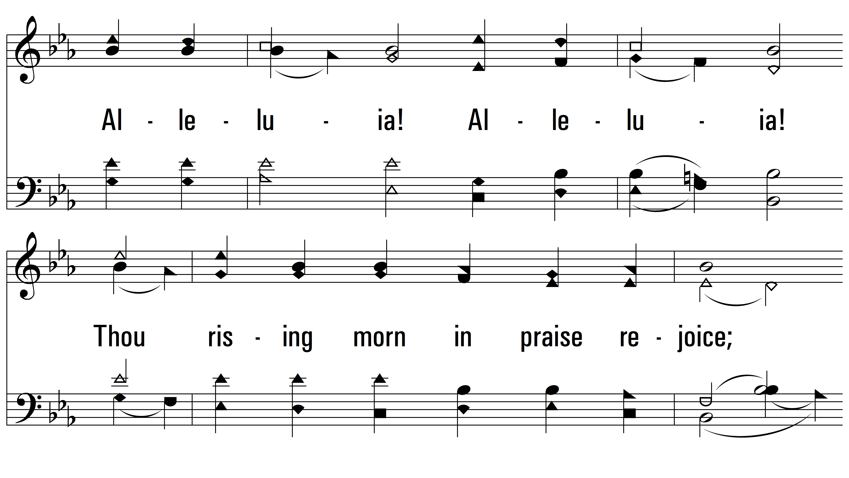
vs. 2

Slide 8
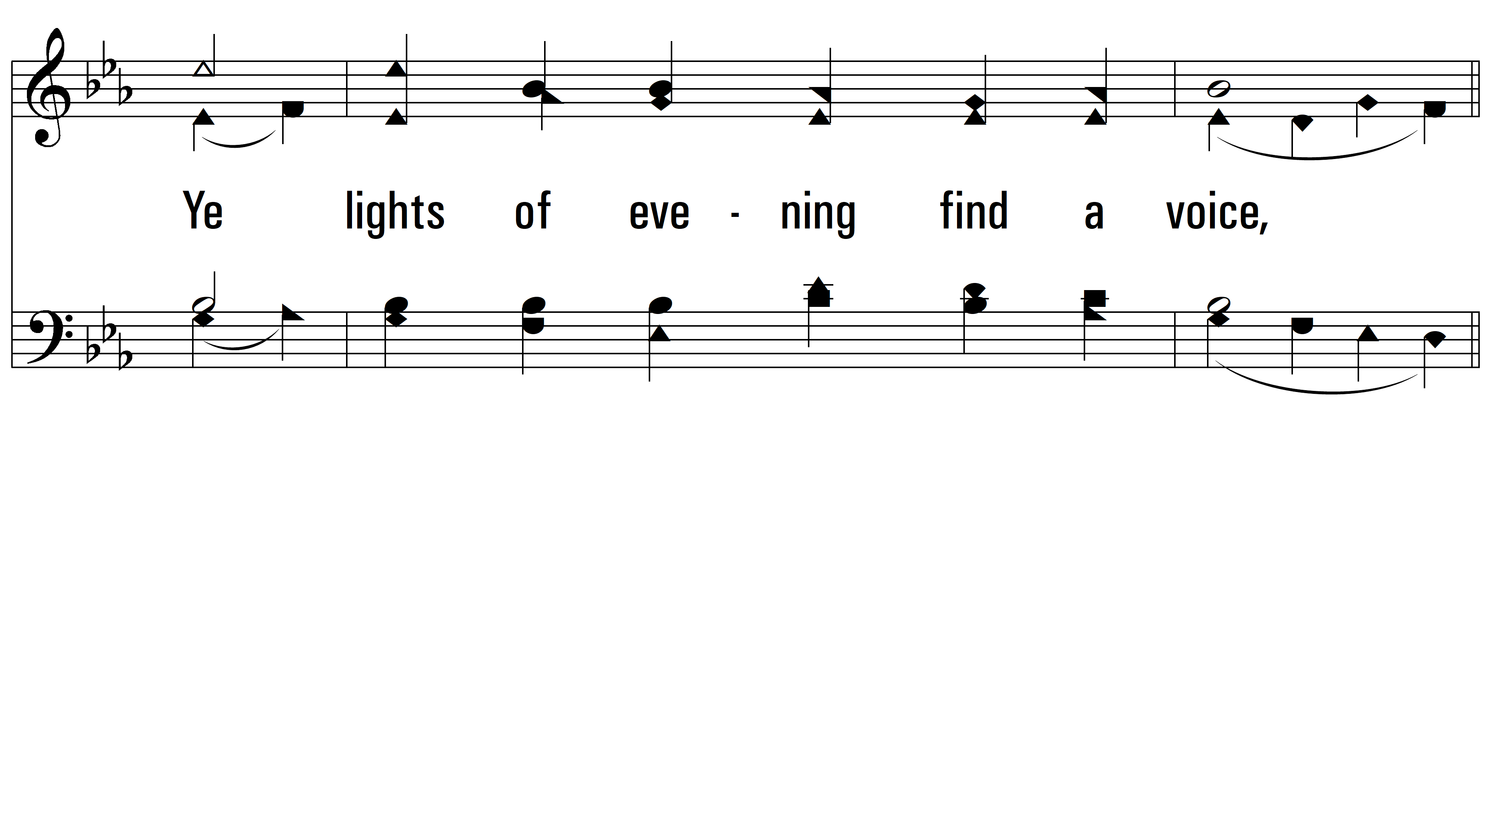
vs. 2

Slide 9
vs. 2

Slide 10
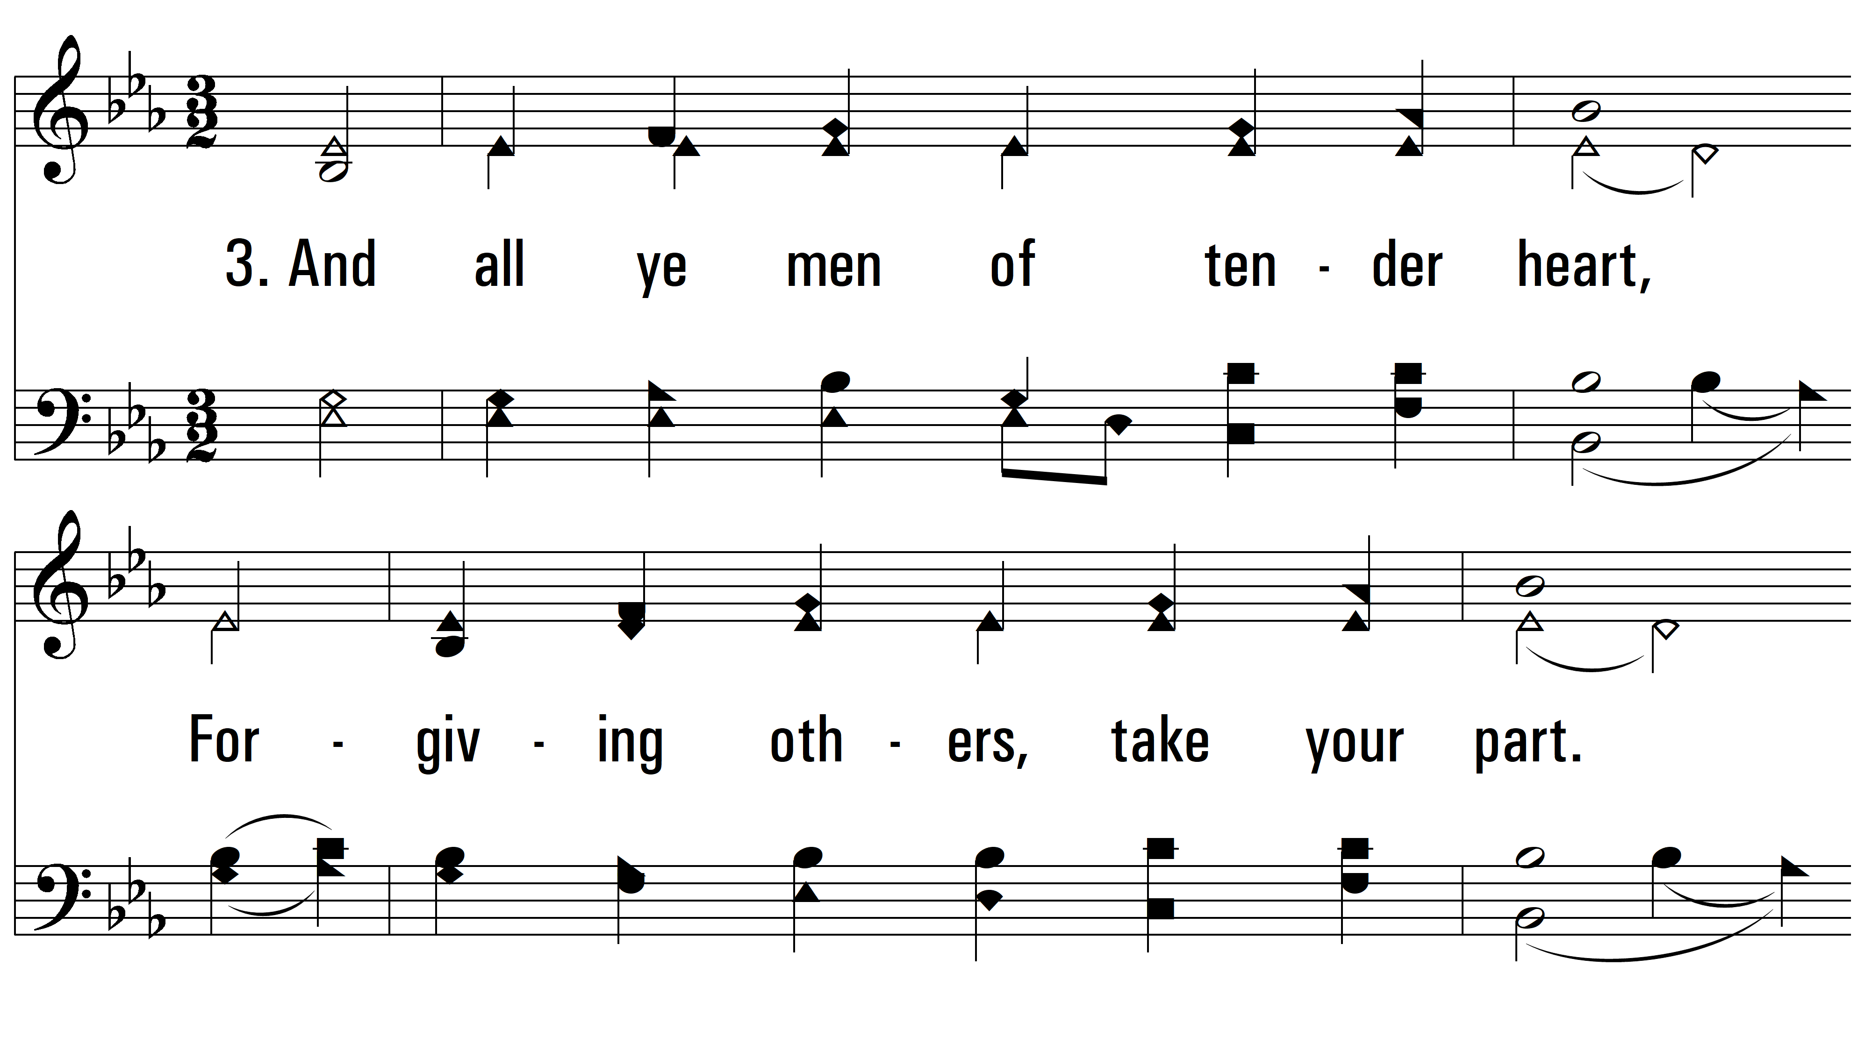
vs. 3 ~ All Creatures Of Our God And King

Slide 11
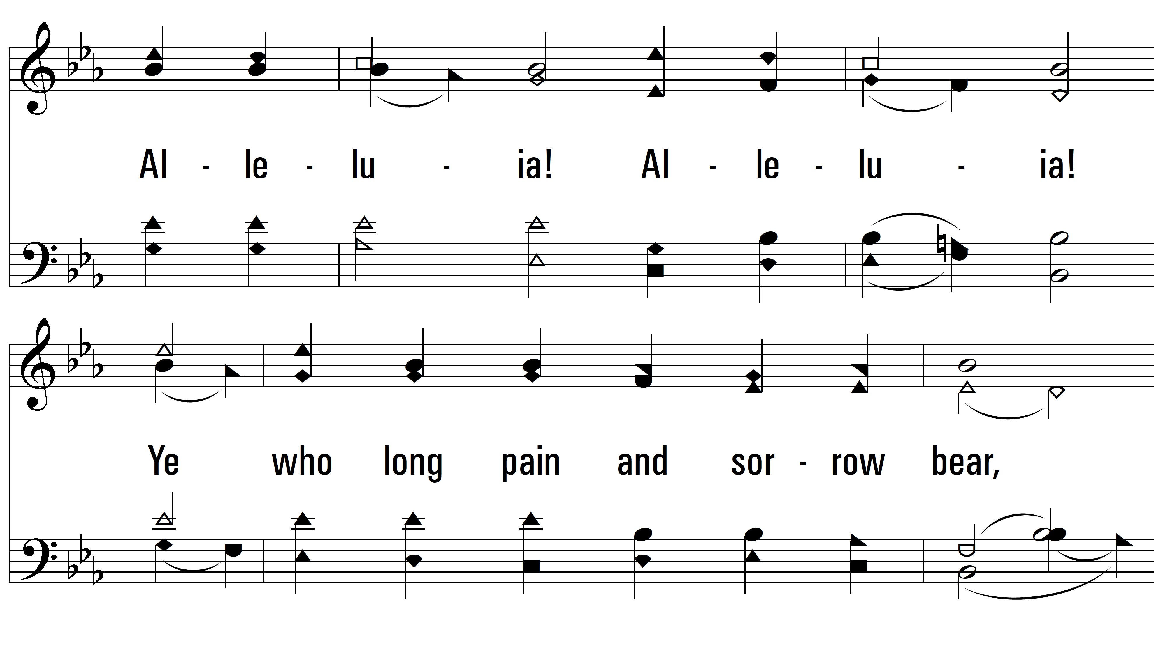
vs. 3

Slide 12
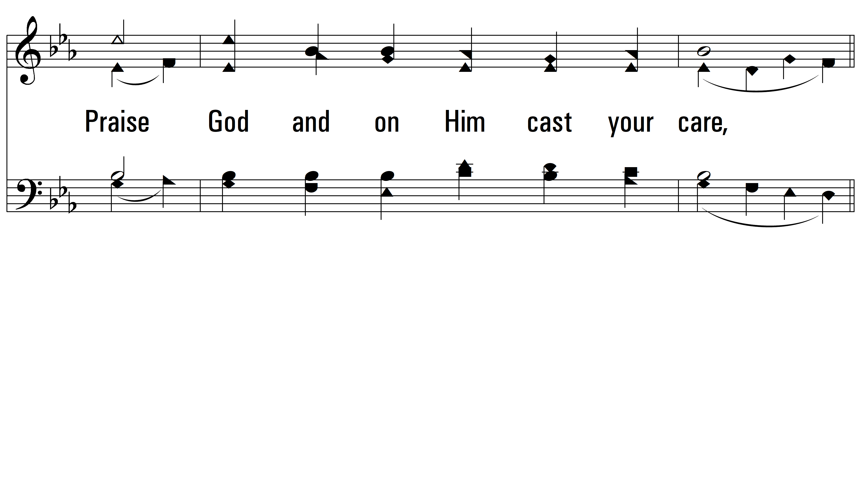
vs. 3

Slide 13
vs. 3

Slide 14
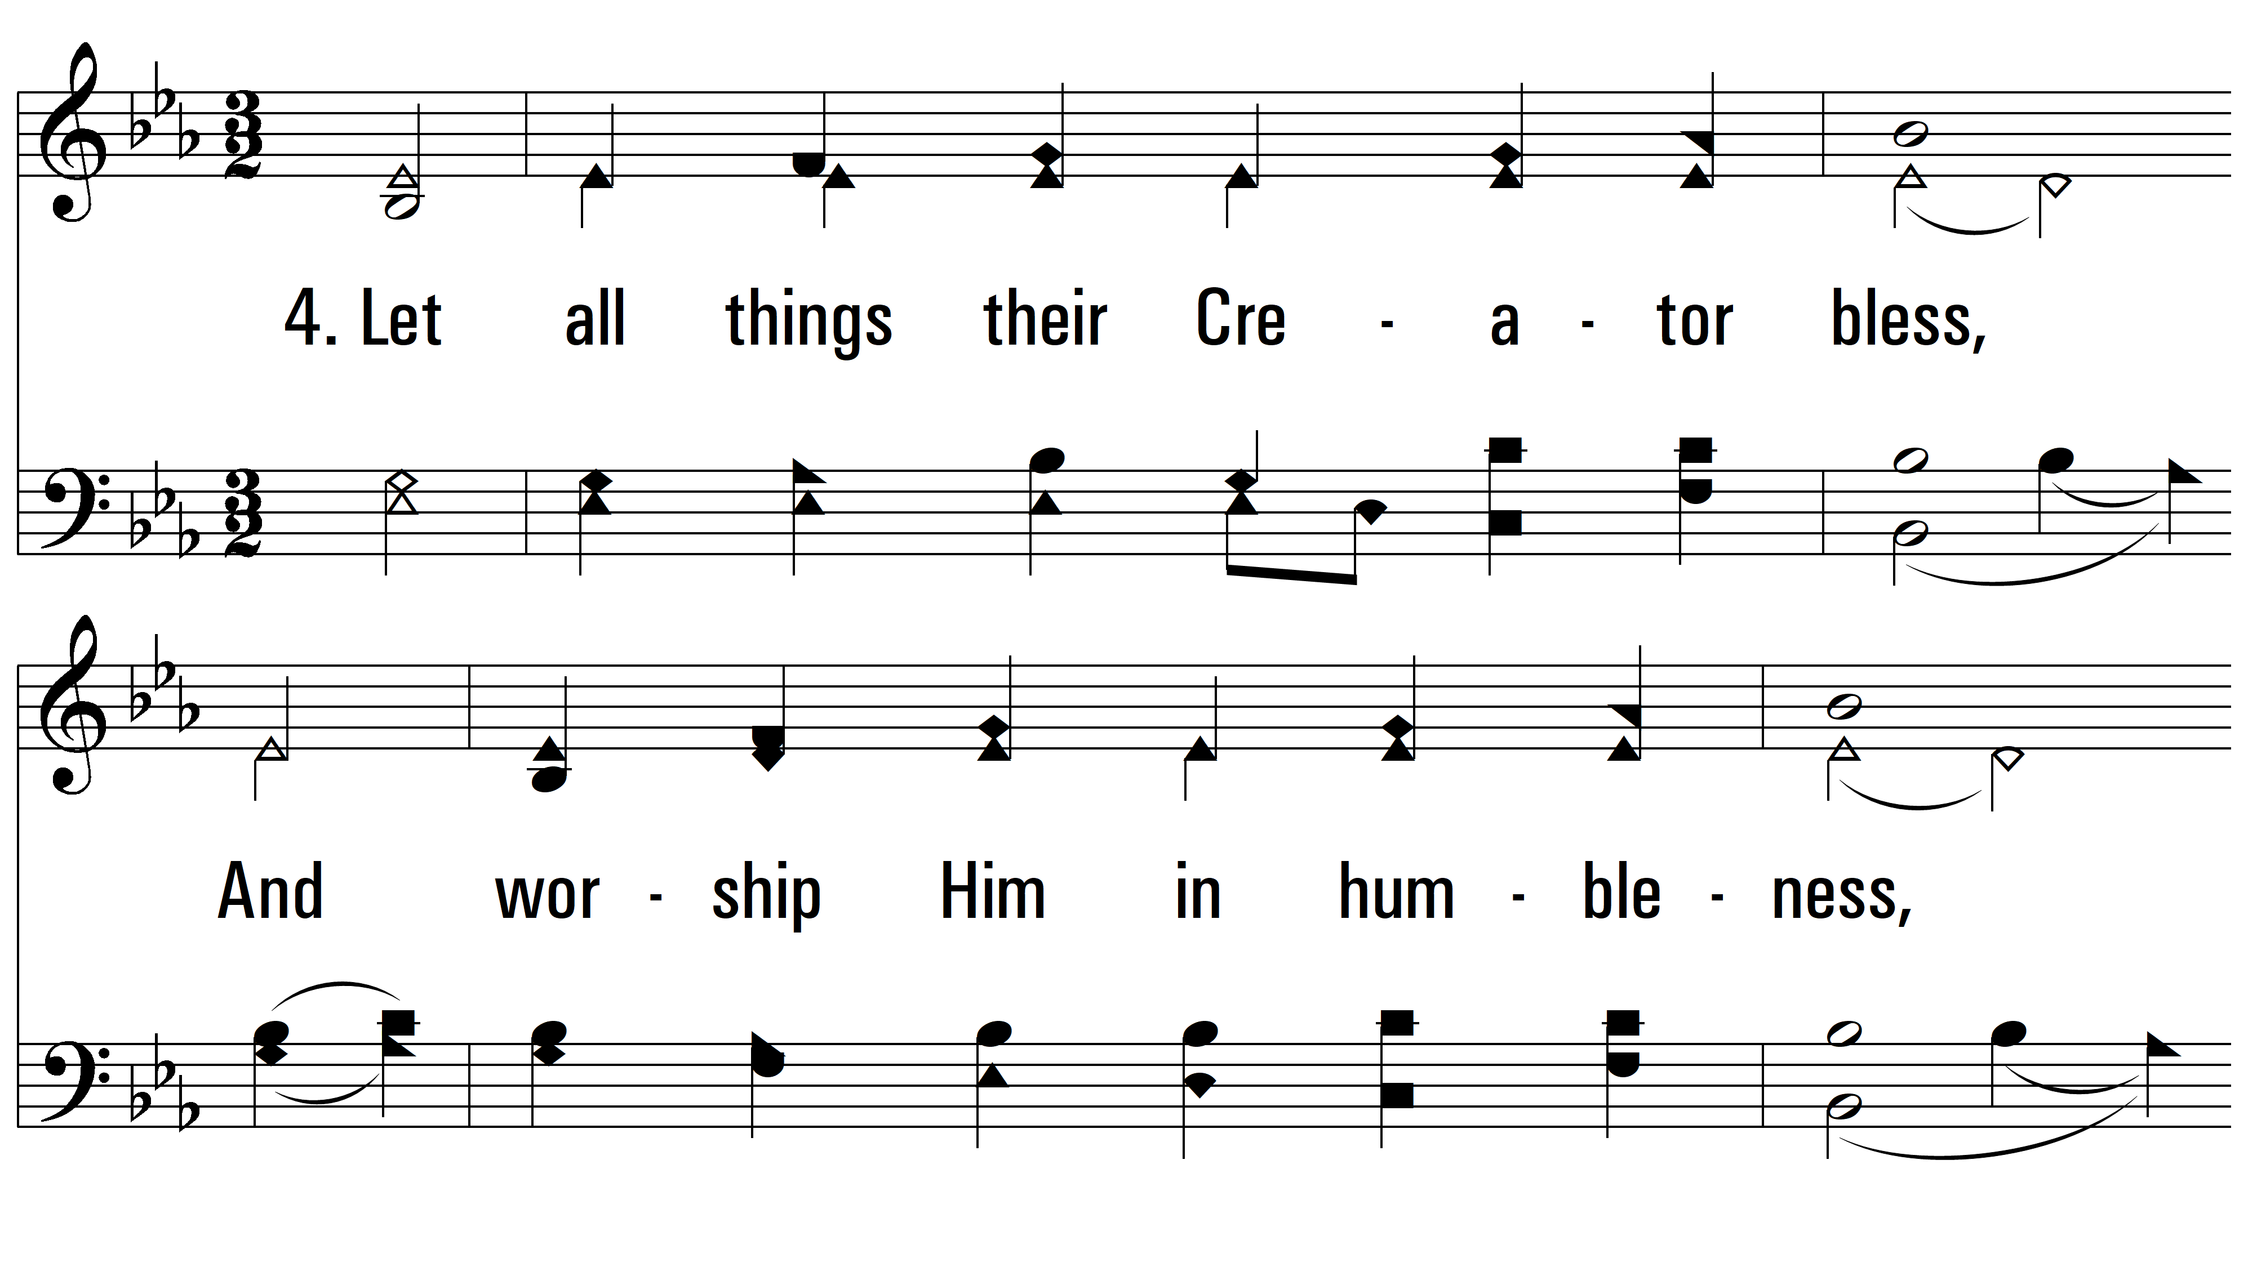
vs. 4 ~ All Creatures Of Our God And King

Slide 15
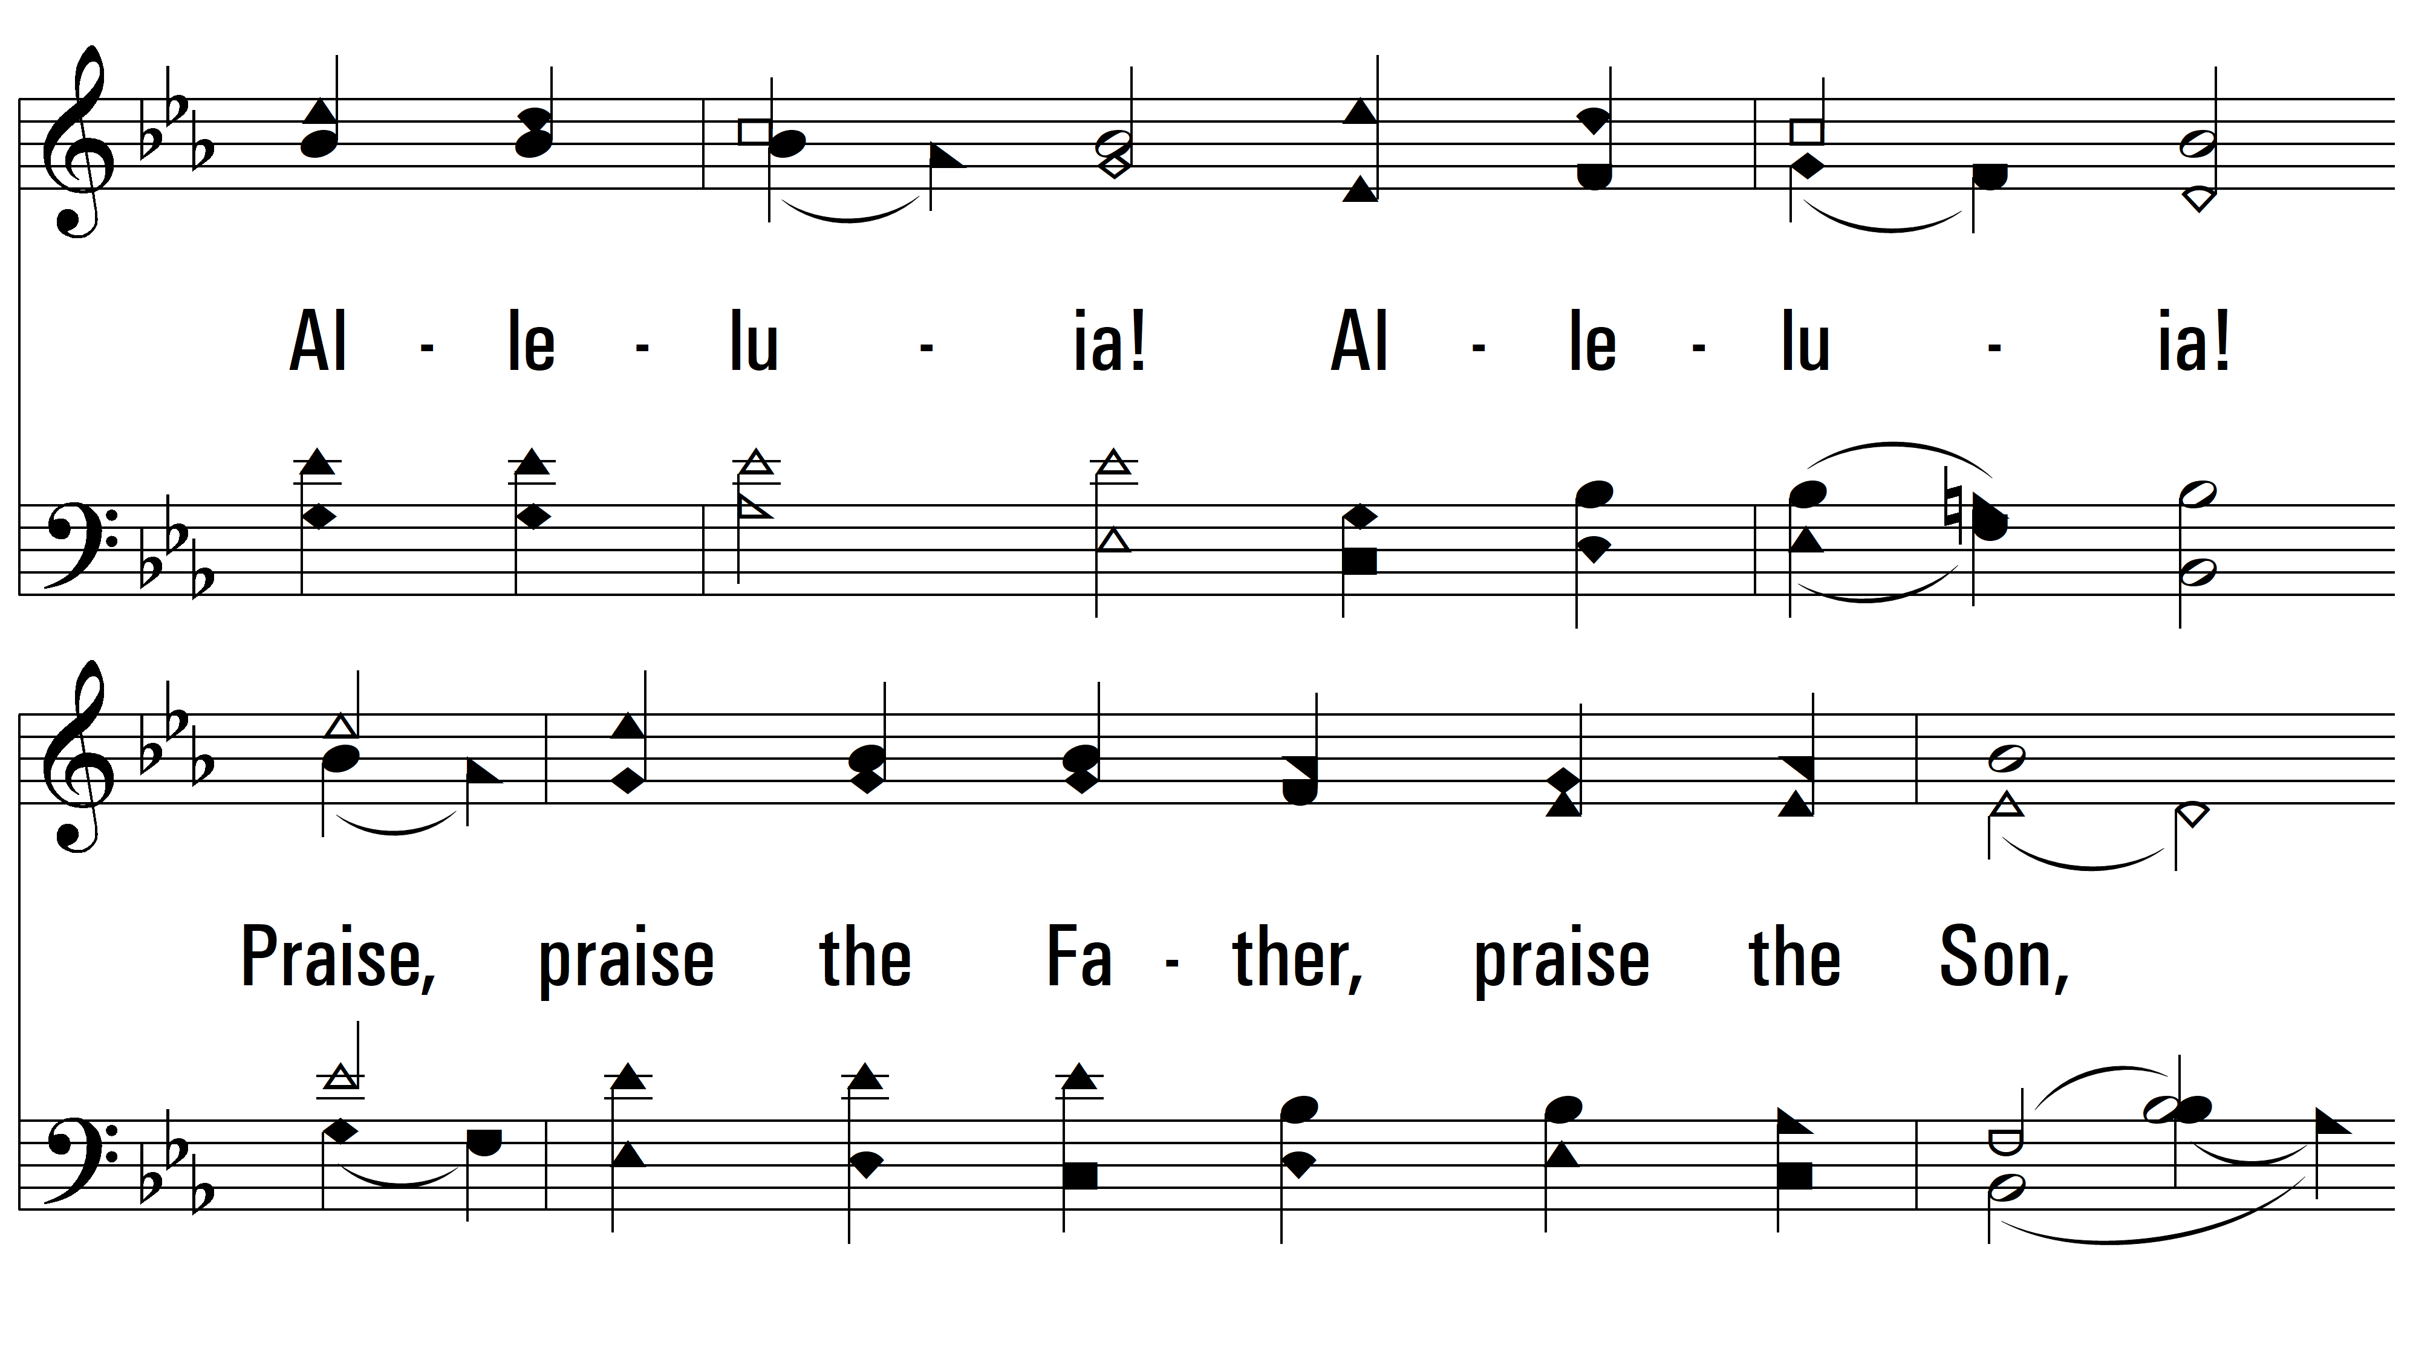
vs. 4

Slide 16
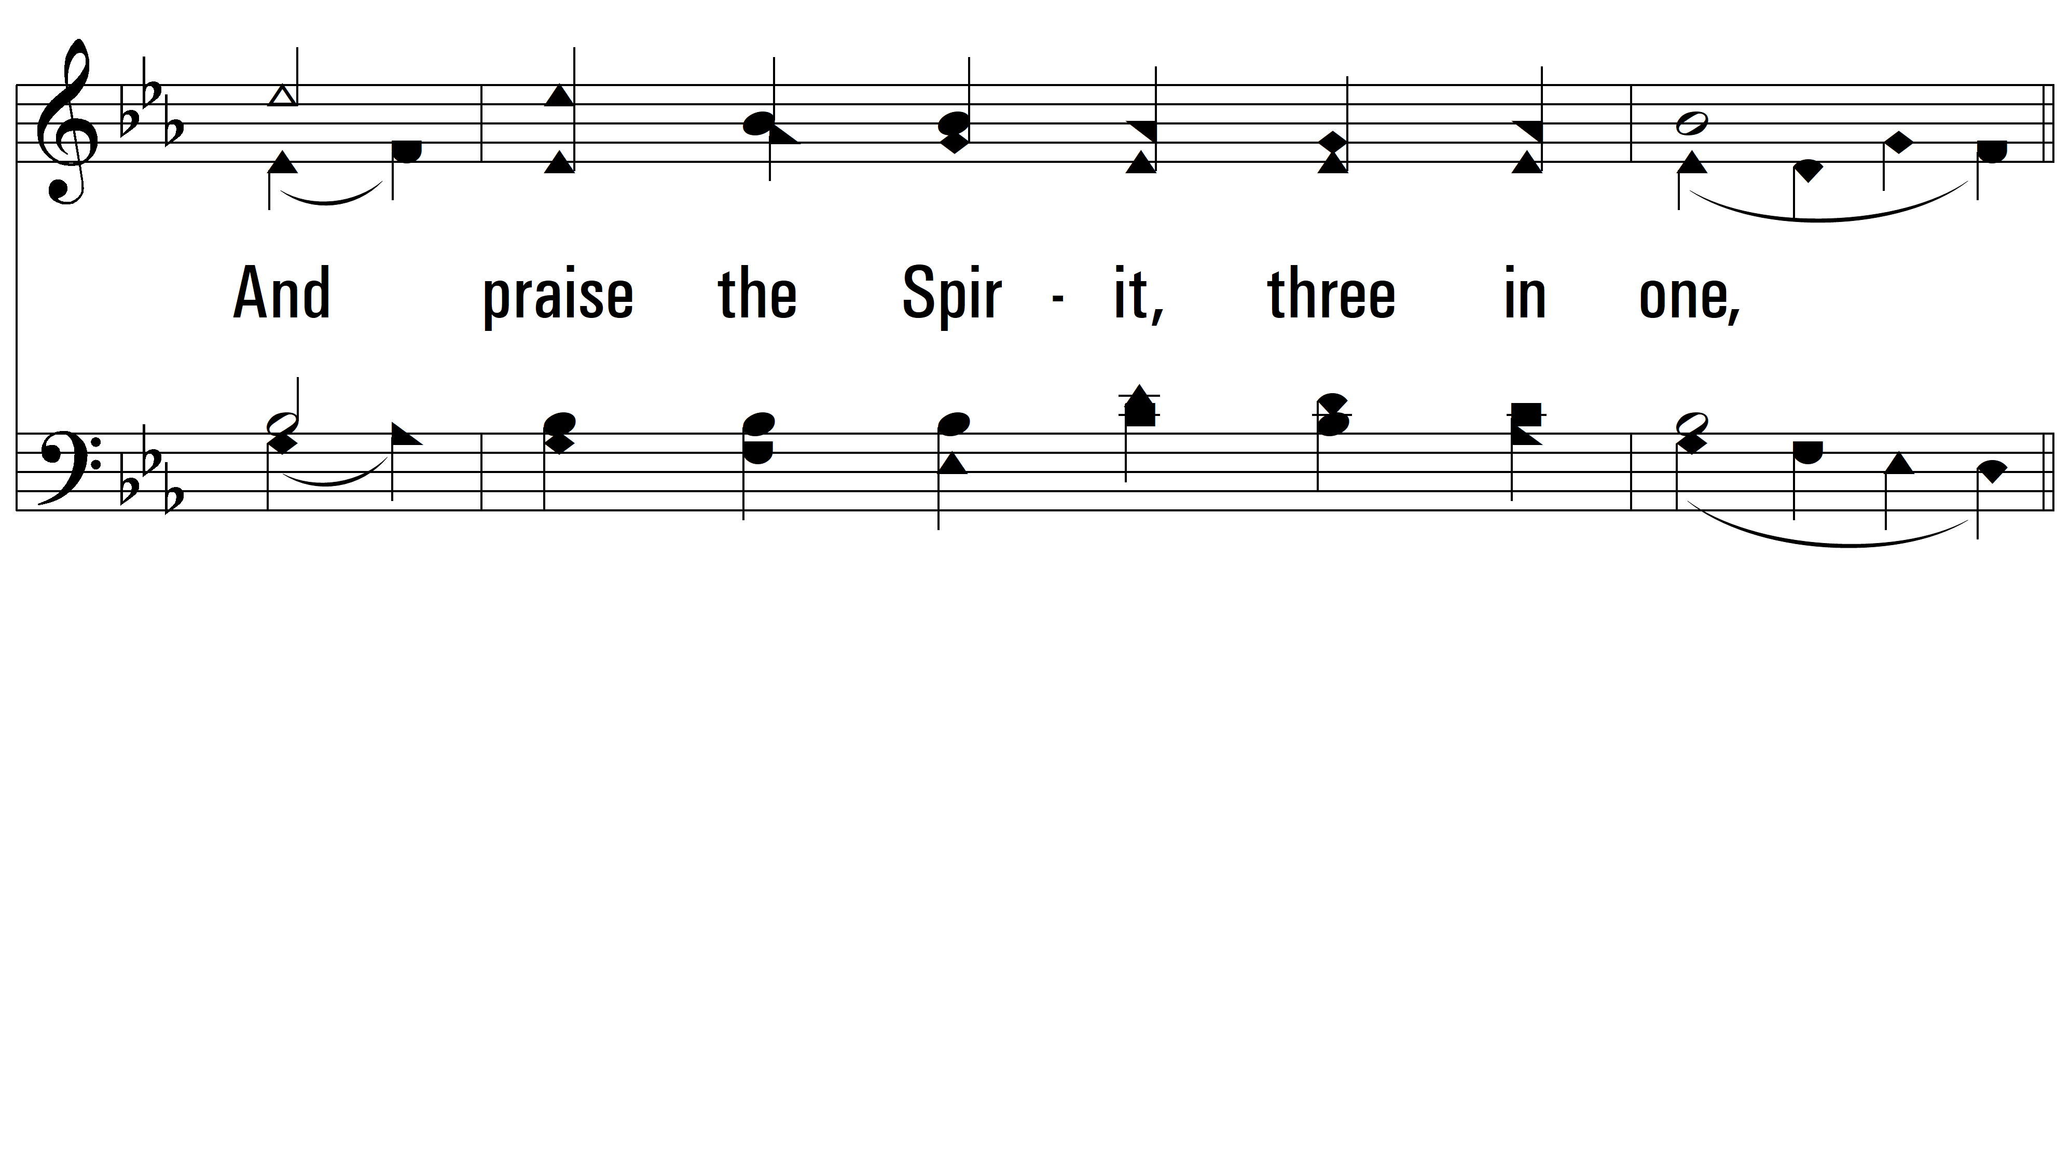
vs. 4

Slide 17
vs. 4
PDHymns.com
END

