Slide 1
Again The Lord Of Light And Life
ARLINGTON
CM
Words: | Anna L. Barbauld (1772)
Music: | Thomas A. Arne (1772), Arr. Ralph Harrison (1784)
3/2
G/G - DO
Verses: 4
Lead - | DO
Alto - | DO
Tenor - | MI
Bass - | DO
PDHymns.com

Slide 2
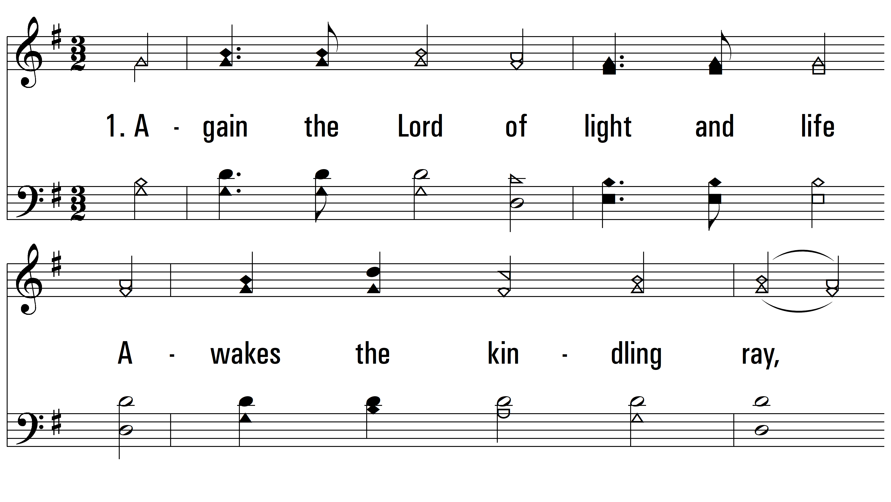
vs. 1 ~ Again The Lord Of Light And Life

Slide 3
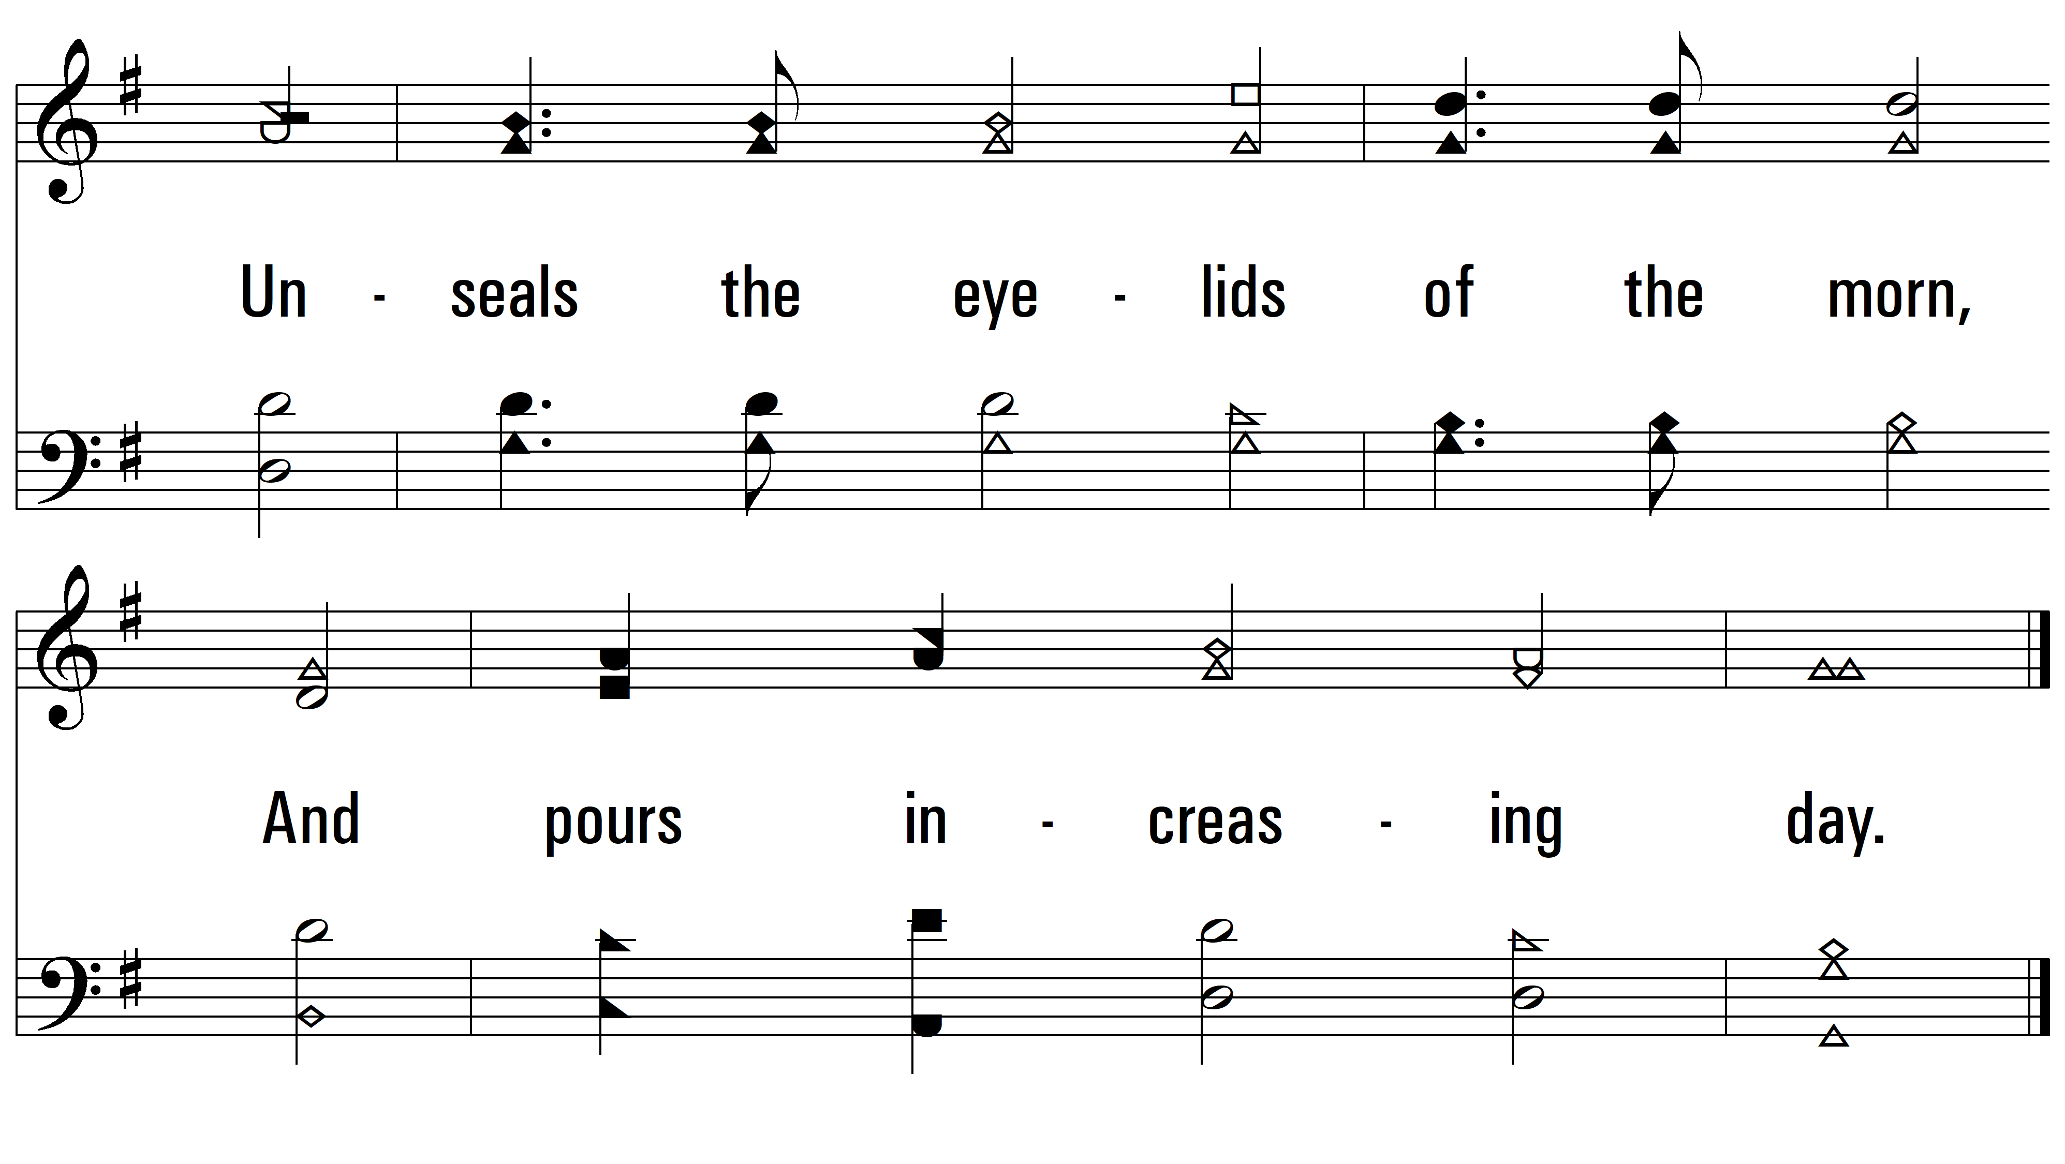
vs. 1

Slide 4
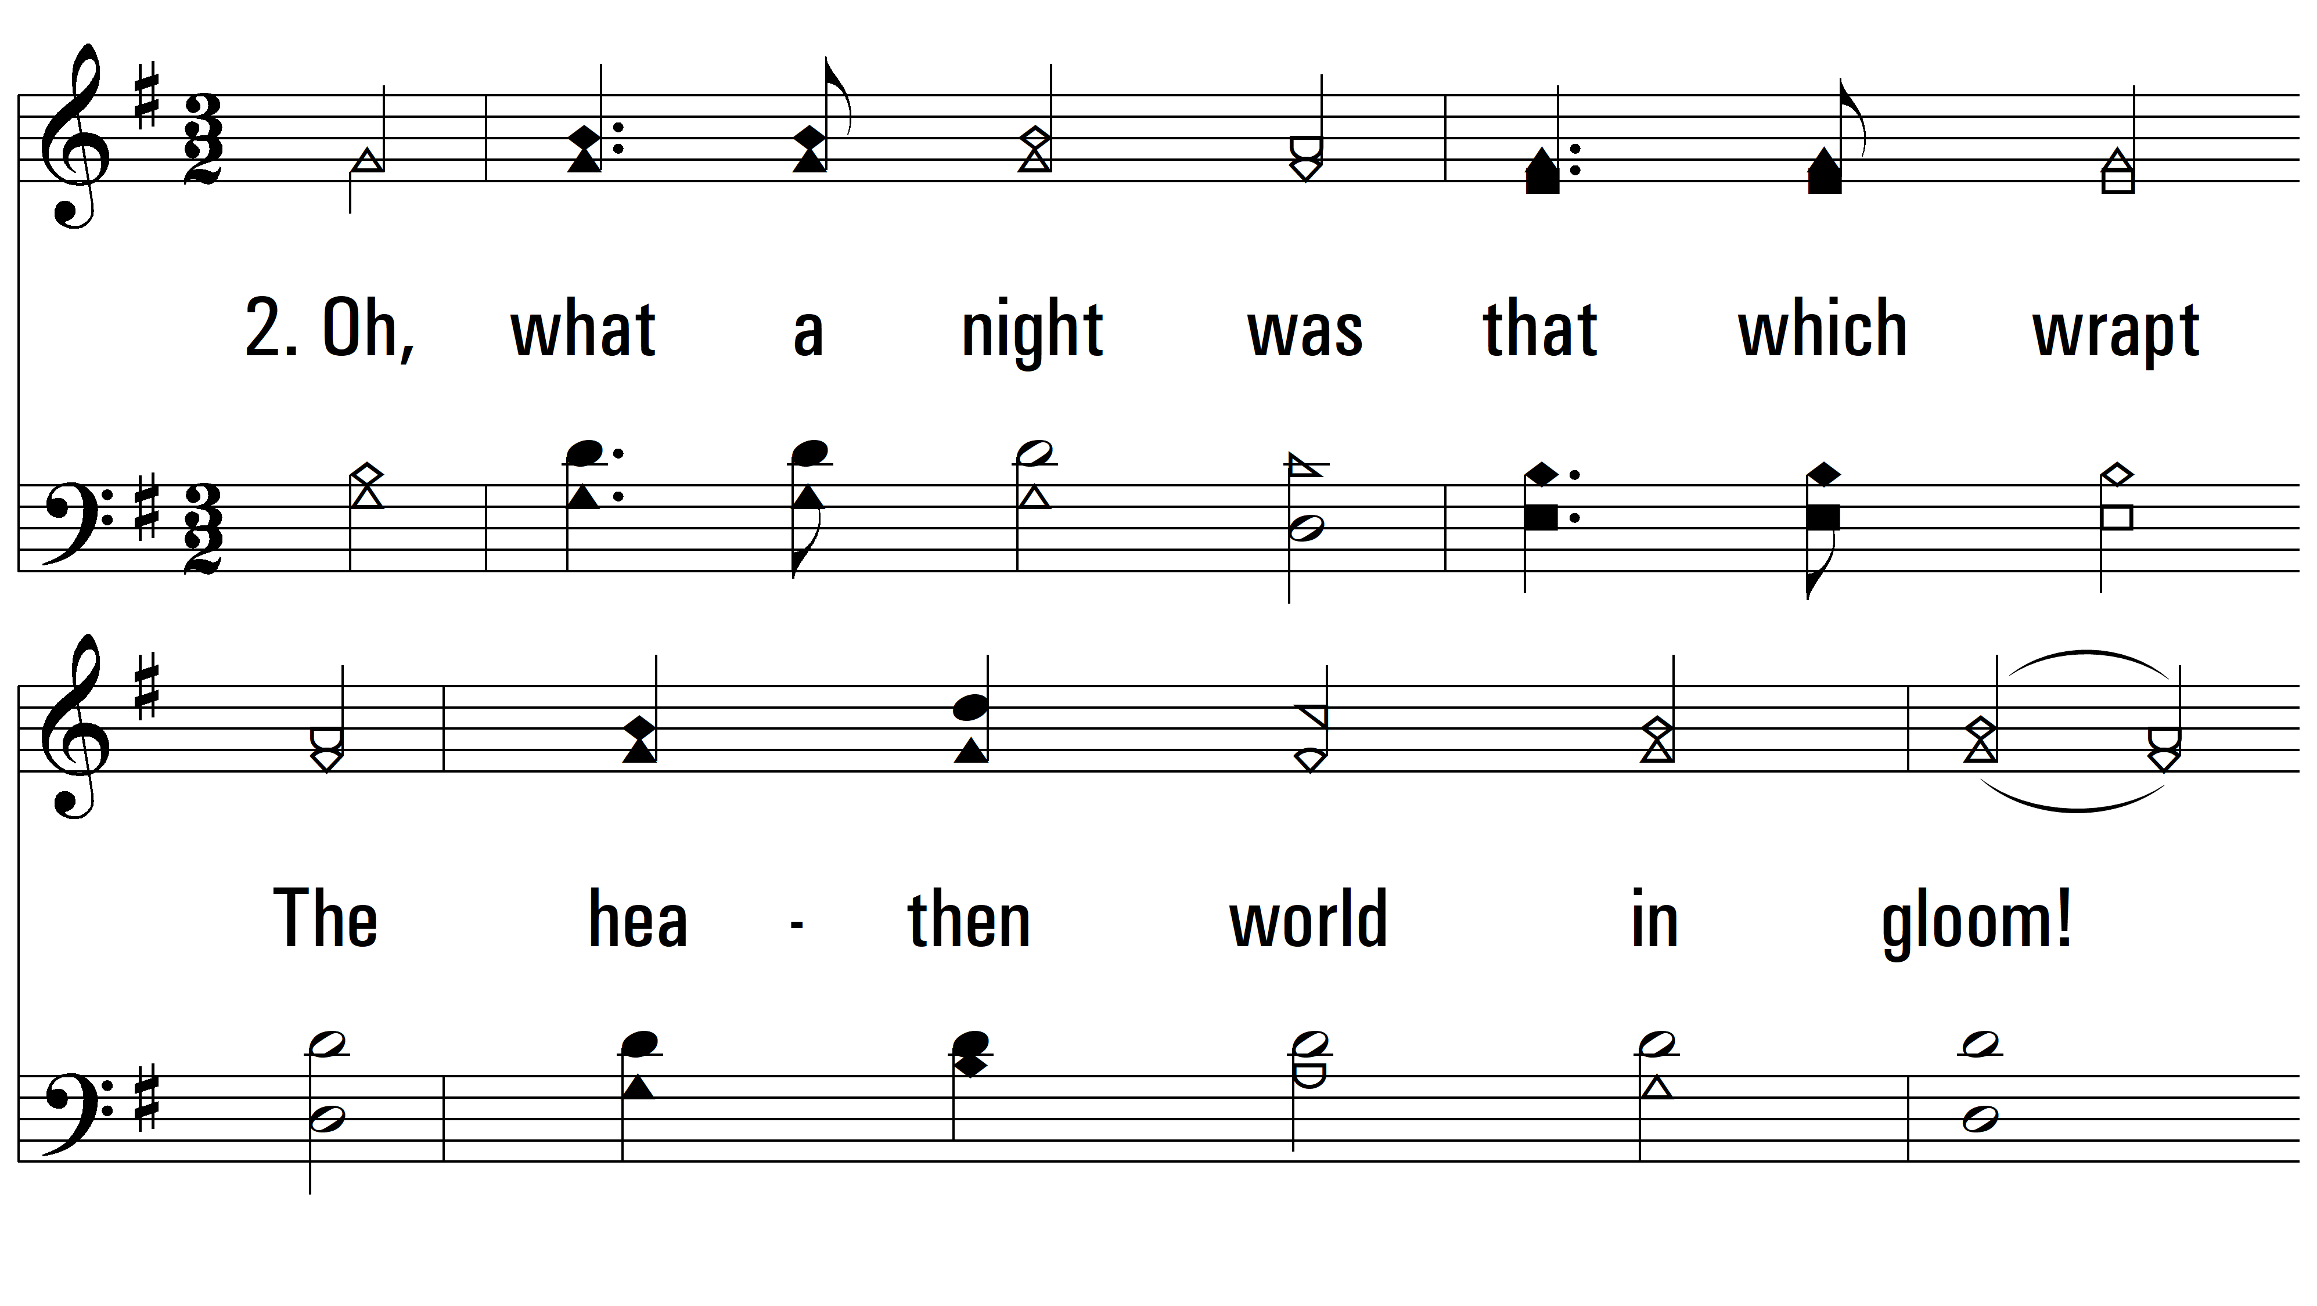
vs. 2 ~ Again The Lord Of Light And Life

Slide 5
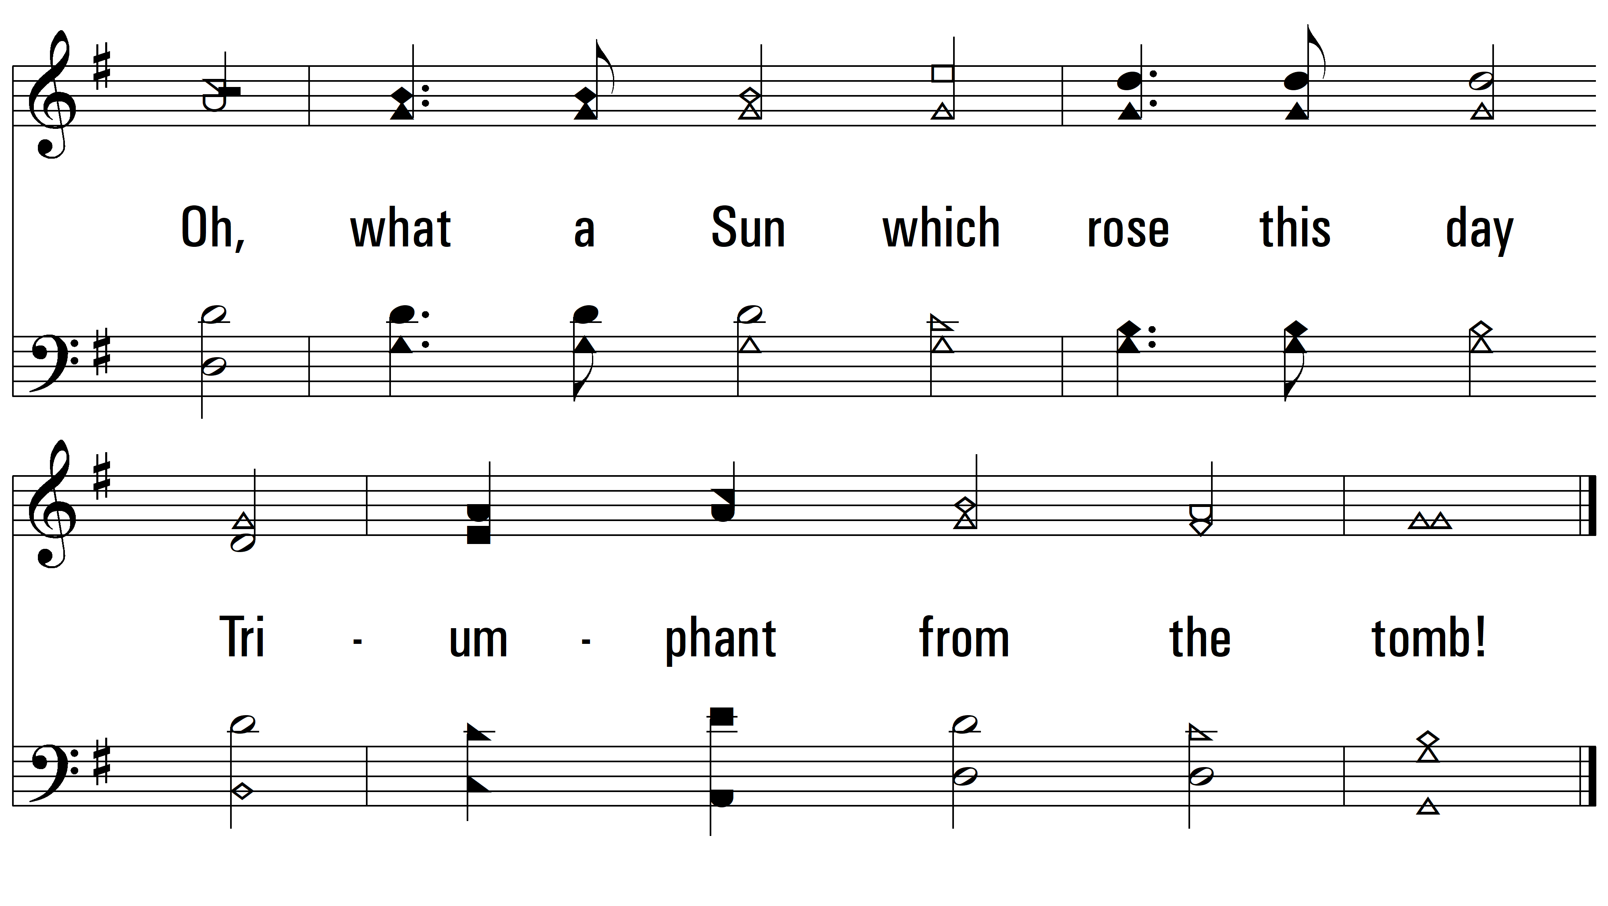
vs. 2

Slide 6
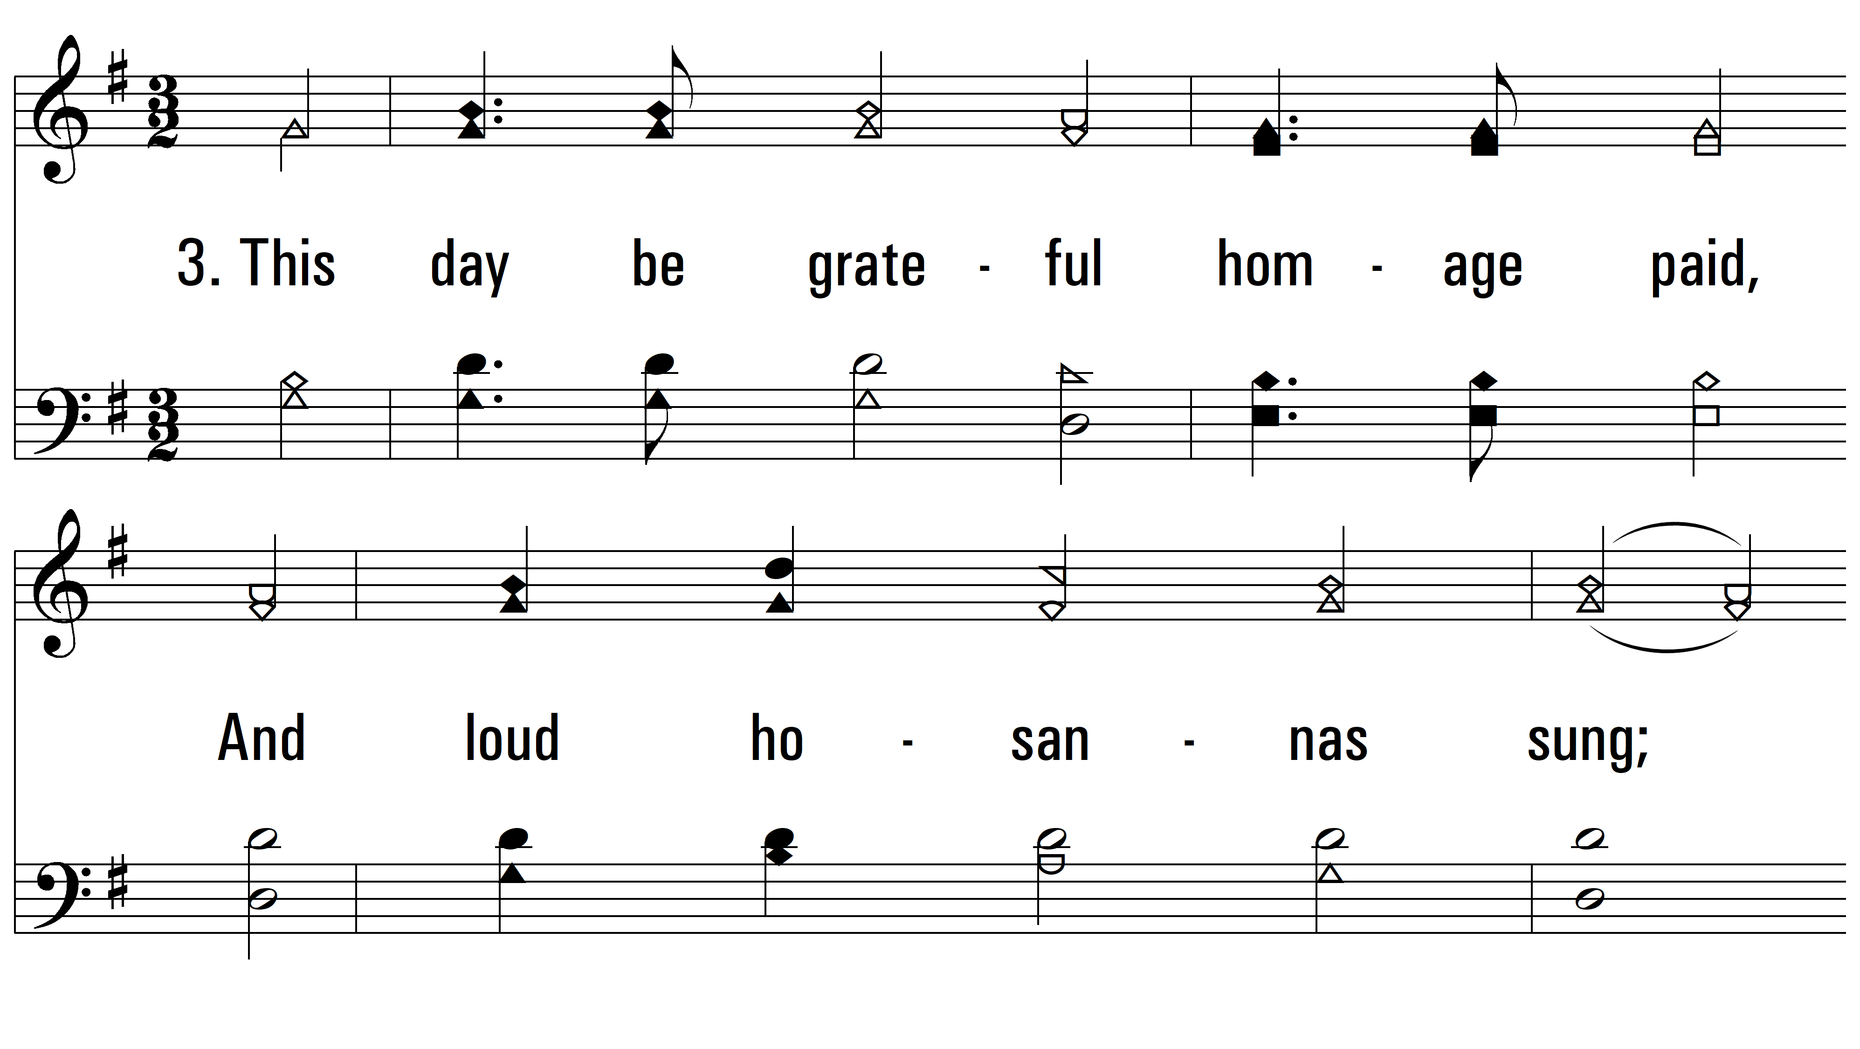
vs. 3 ~ Again The Lord Of Light And Life

Slide 7
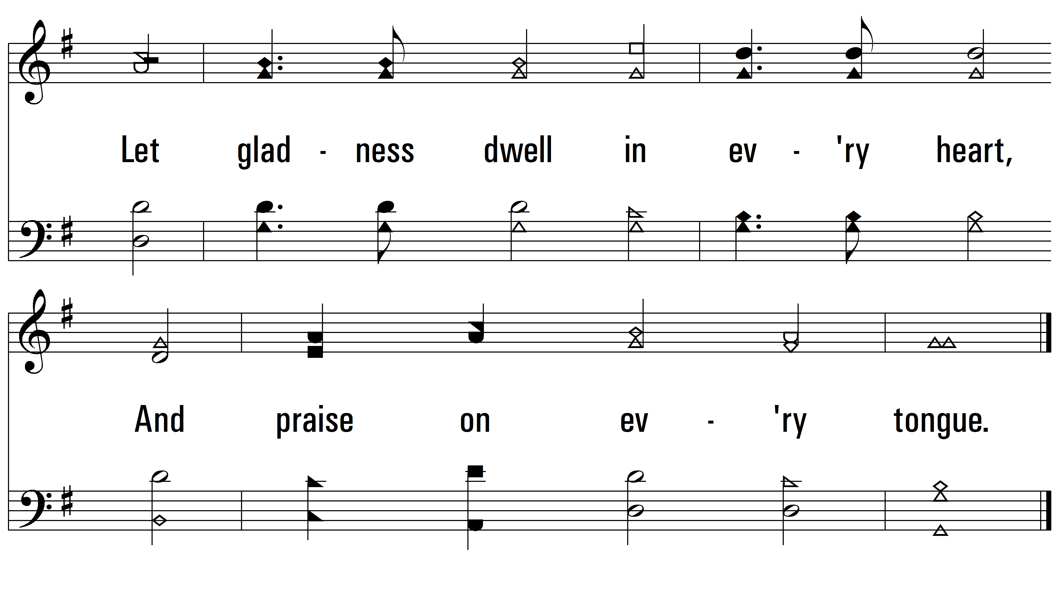
vs. 3

Slide 8
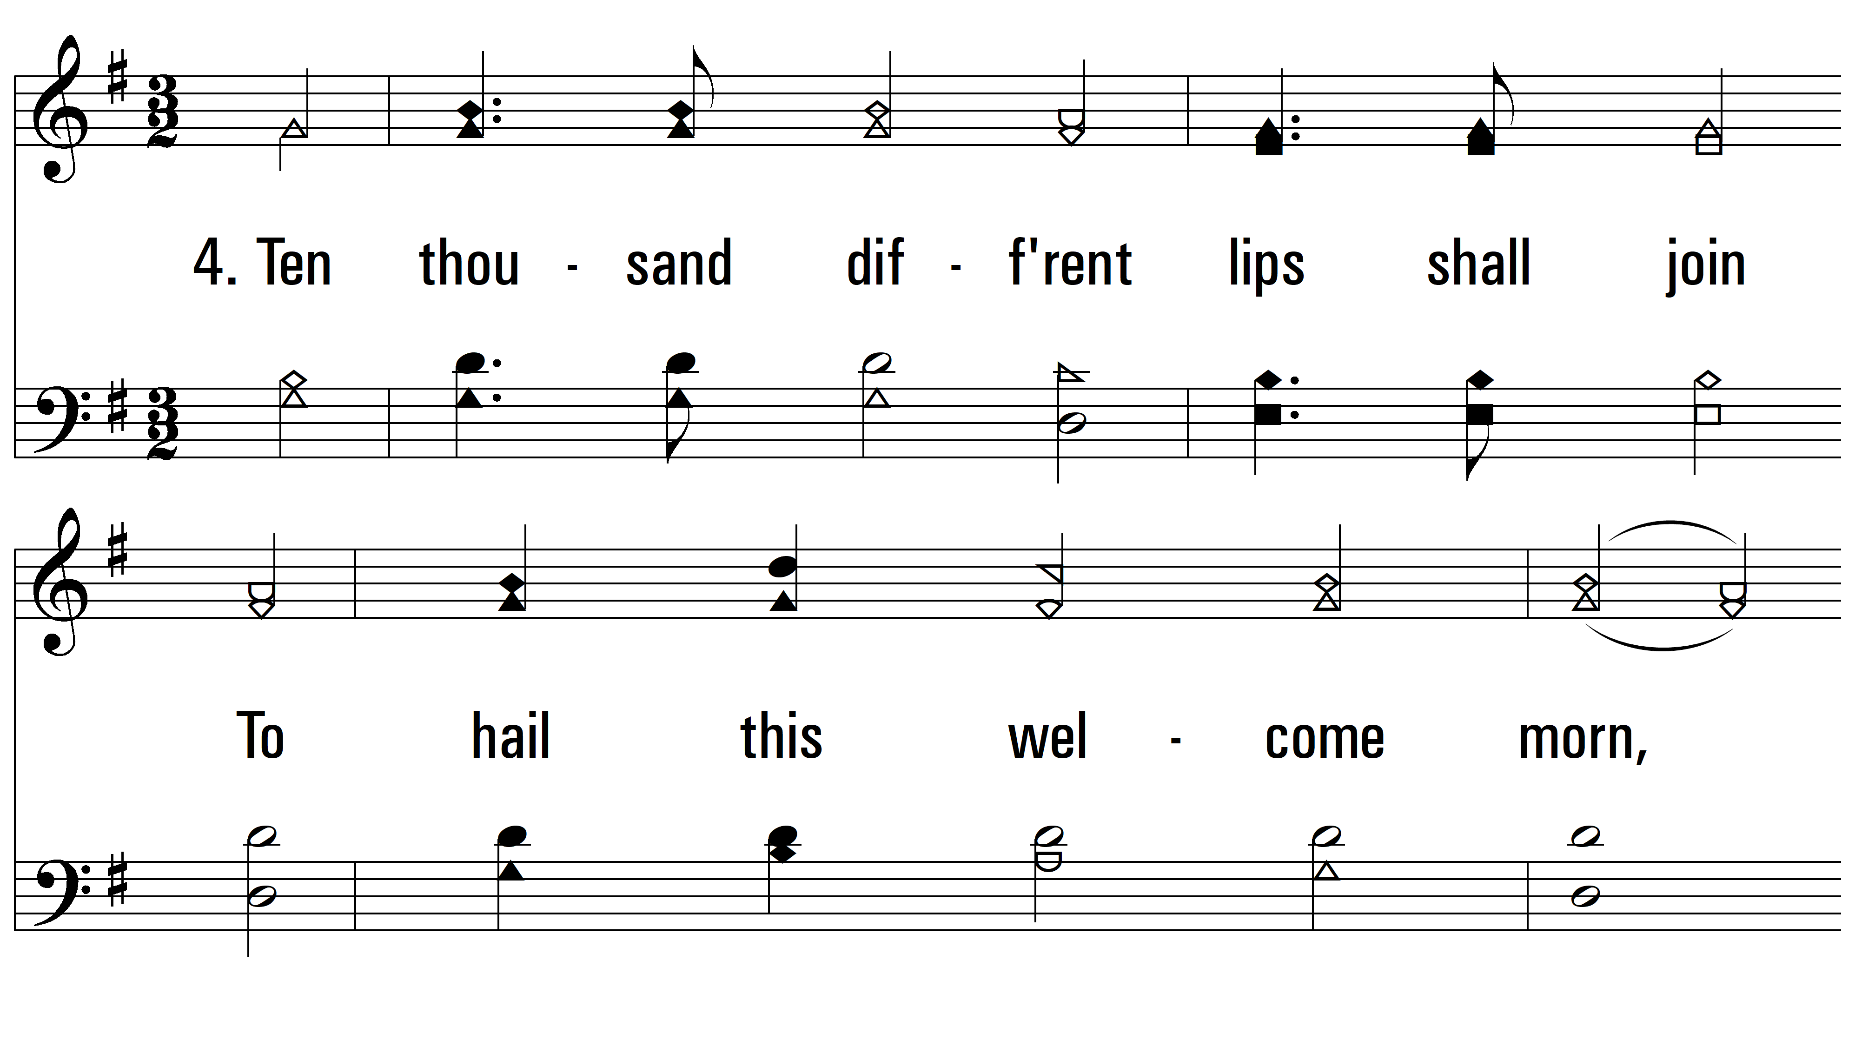
vs. 4 ~ Again The Lord Of Light And Life

Slide 9
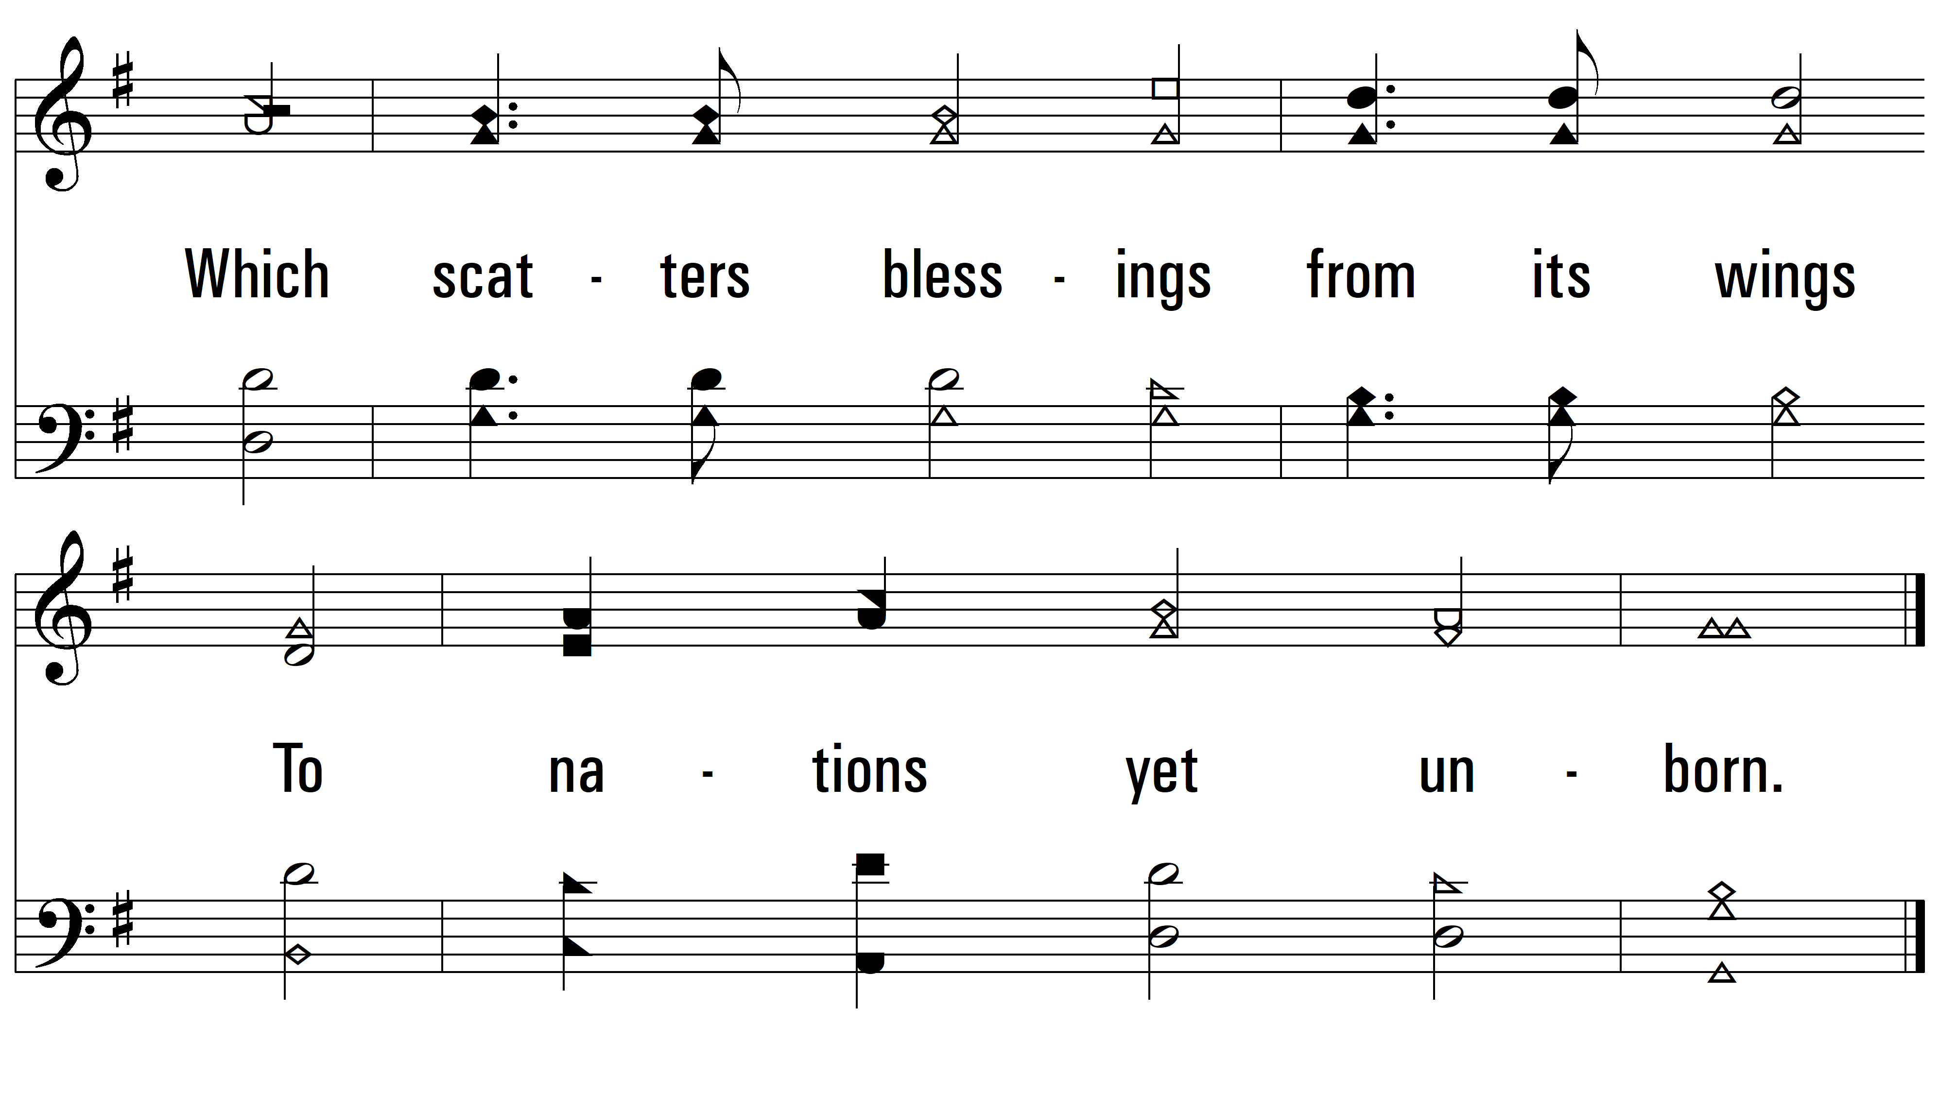
vs. 4
PDHymns.com
END

