Slide 1
Abide With Me
EVENTIDE
10.10.10.10
Words: | Henry F. Lyte (1874)
Music: | William H. Monk (1861)
4/4
F/A - MI
Verses: 7
Lead - | MI
Alto - | DO
Tenor - | SOL
Bass - | DO
PDHymns.com

Slide 2
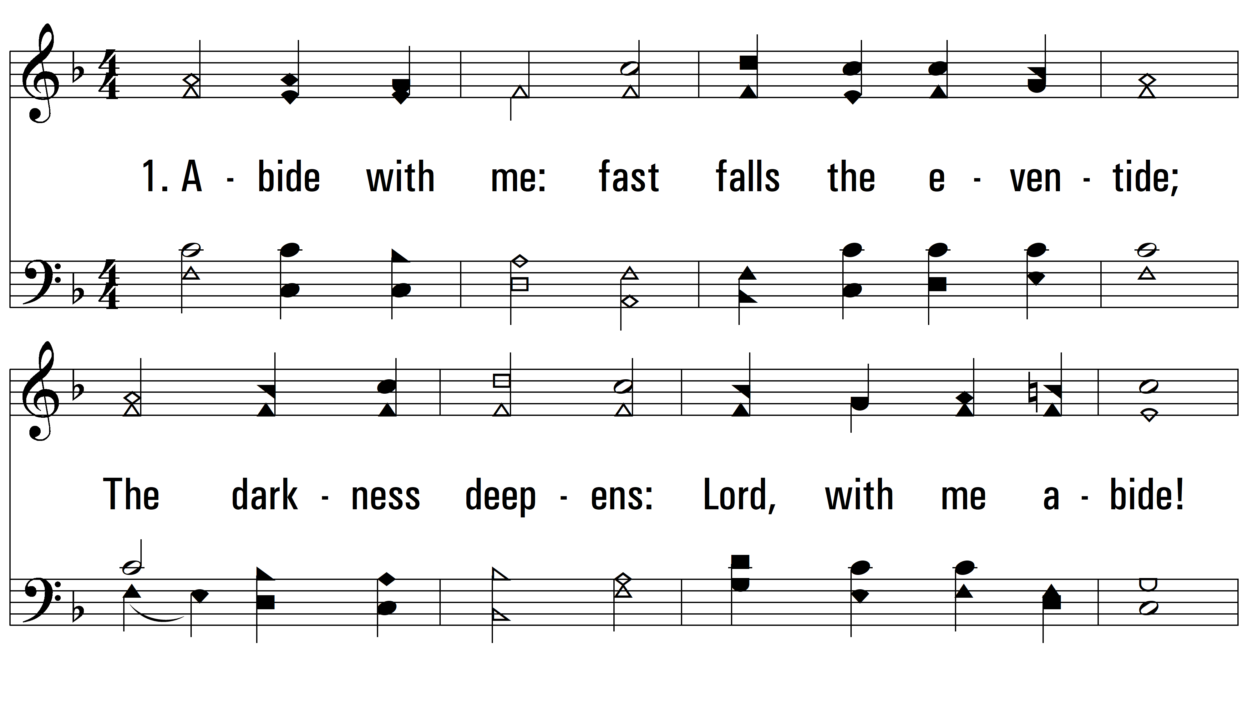
vs. 1 ~ Abide With Me

Slide 3
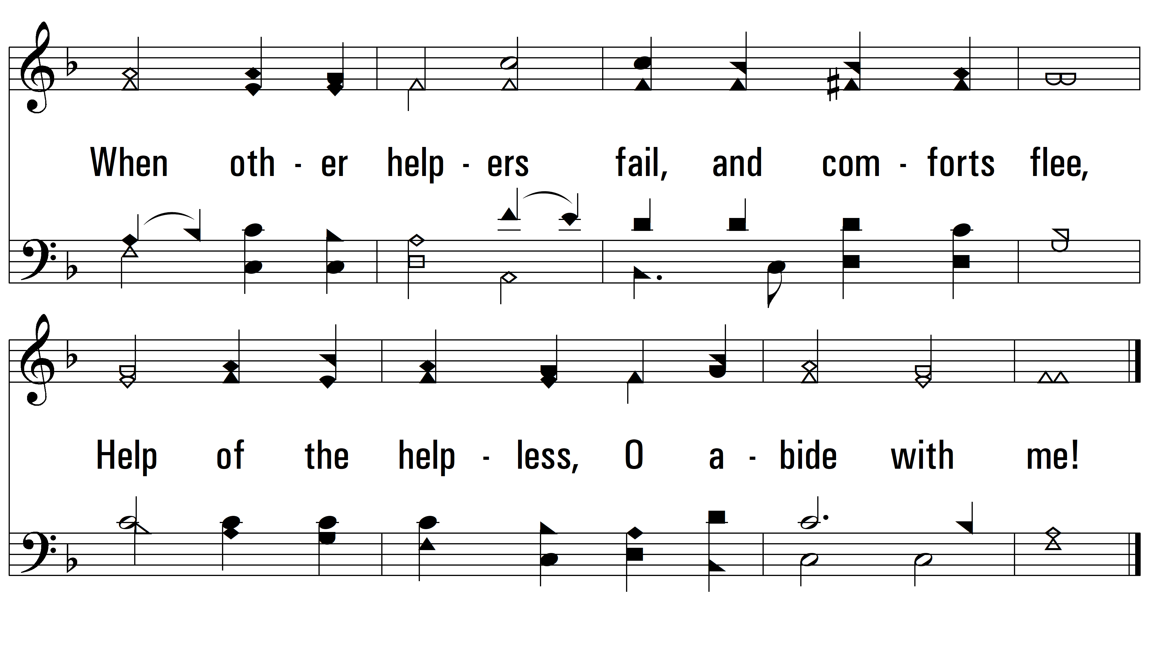
vs. 1

Slide 4
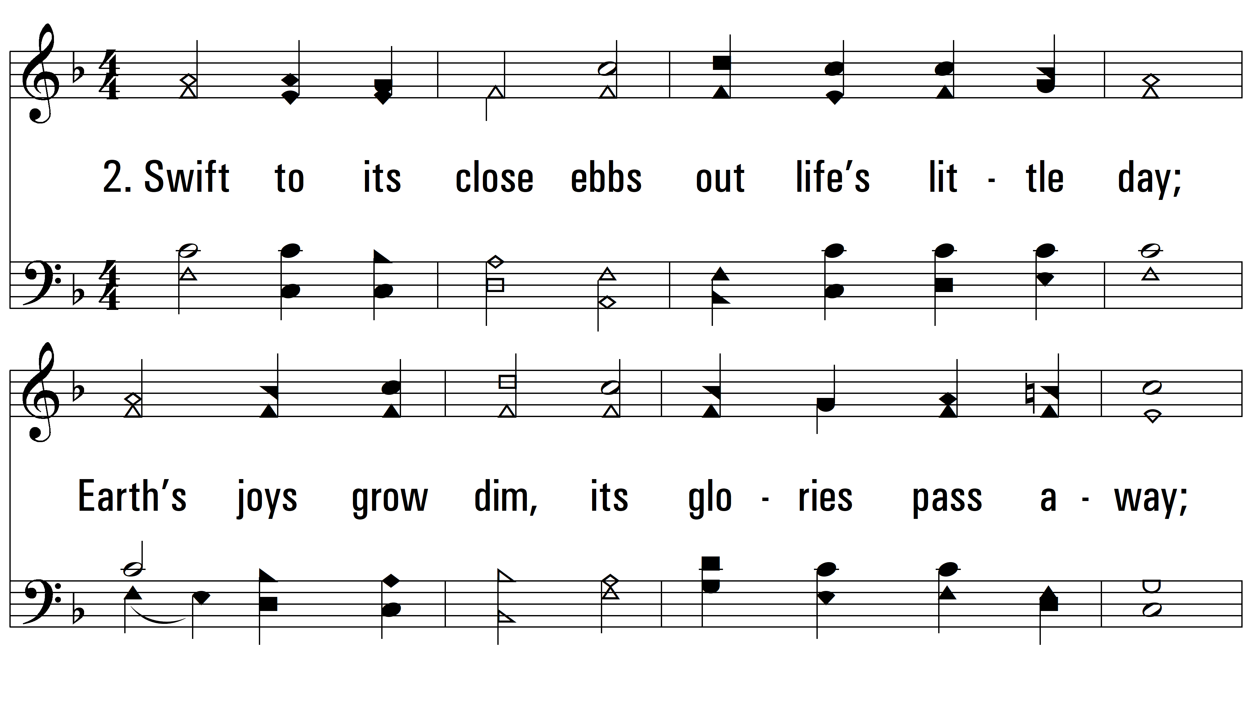
vs. 2 ~ Abide With Me

Slide 5
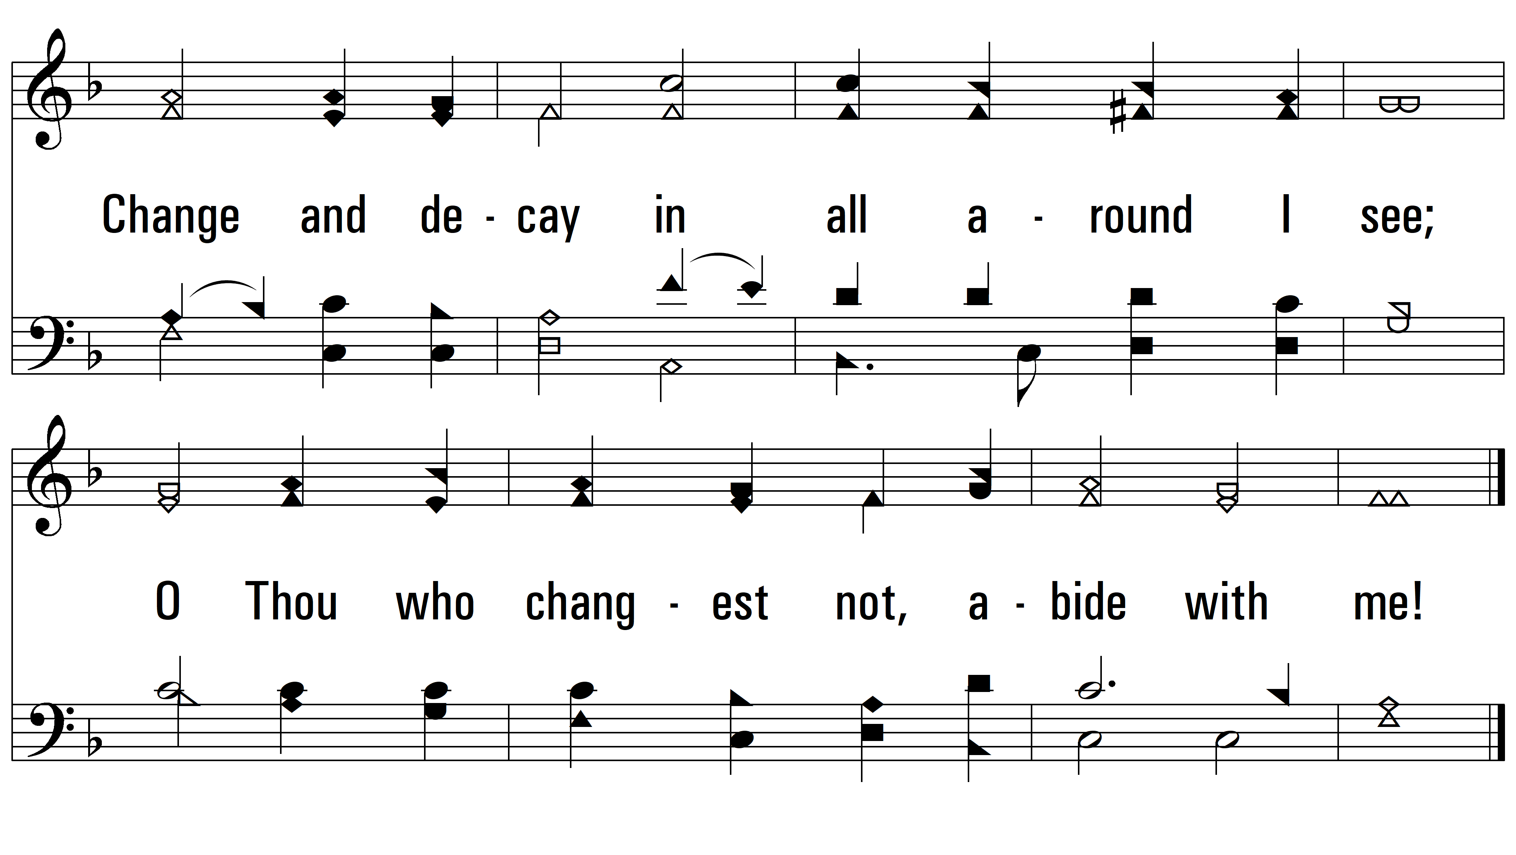
vs. 2

Slide 6
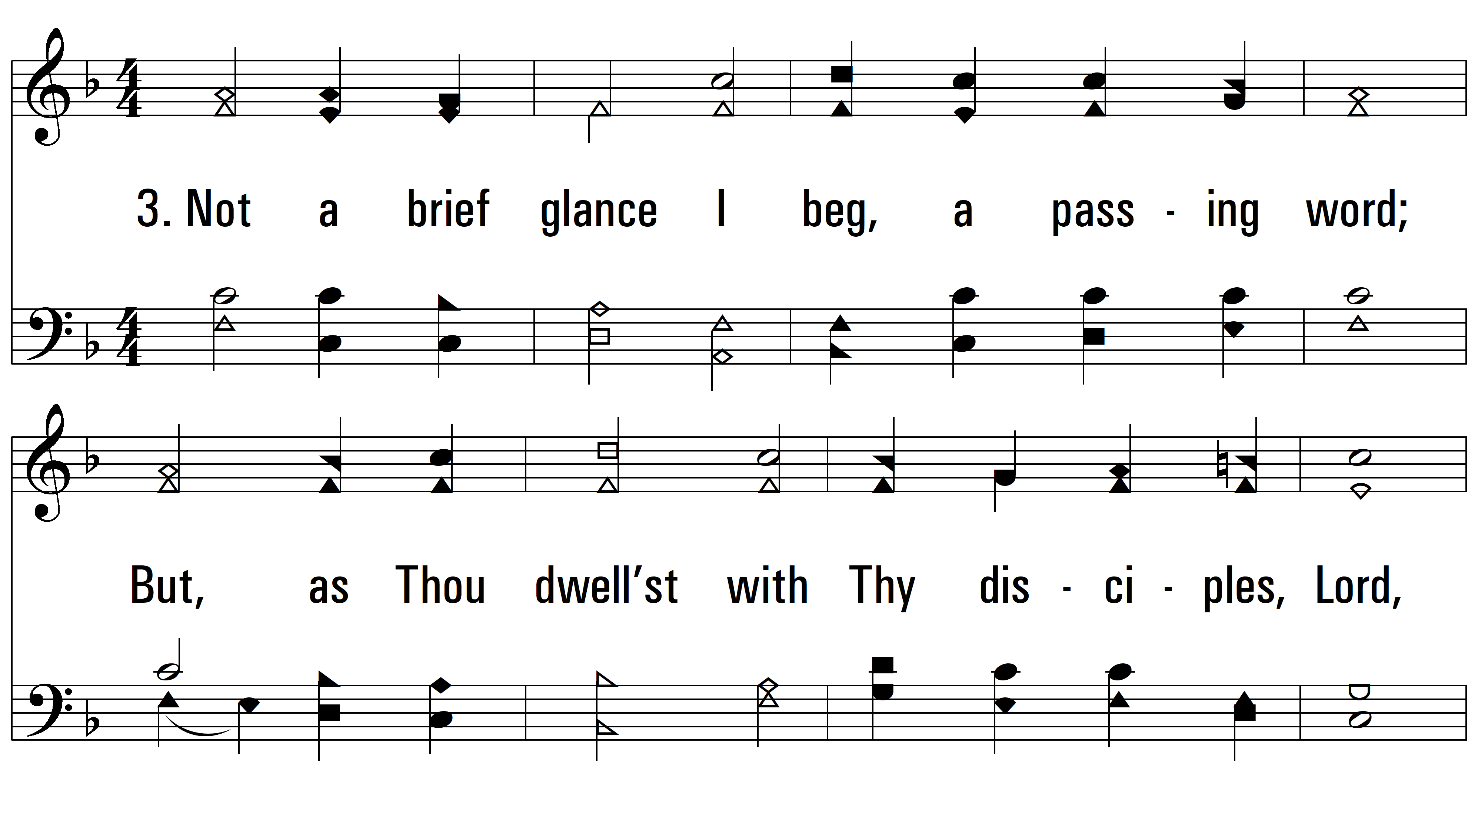
vs. 3 ~ Abide With Me

Slide 7
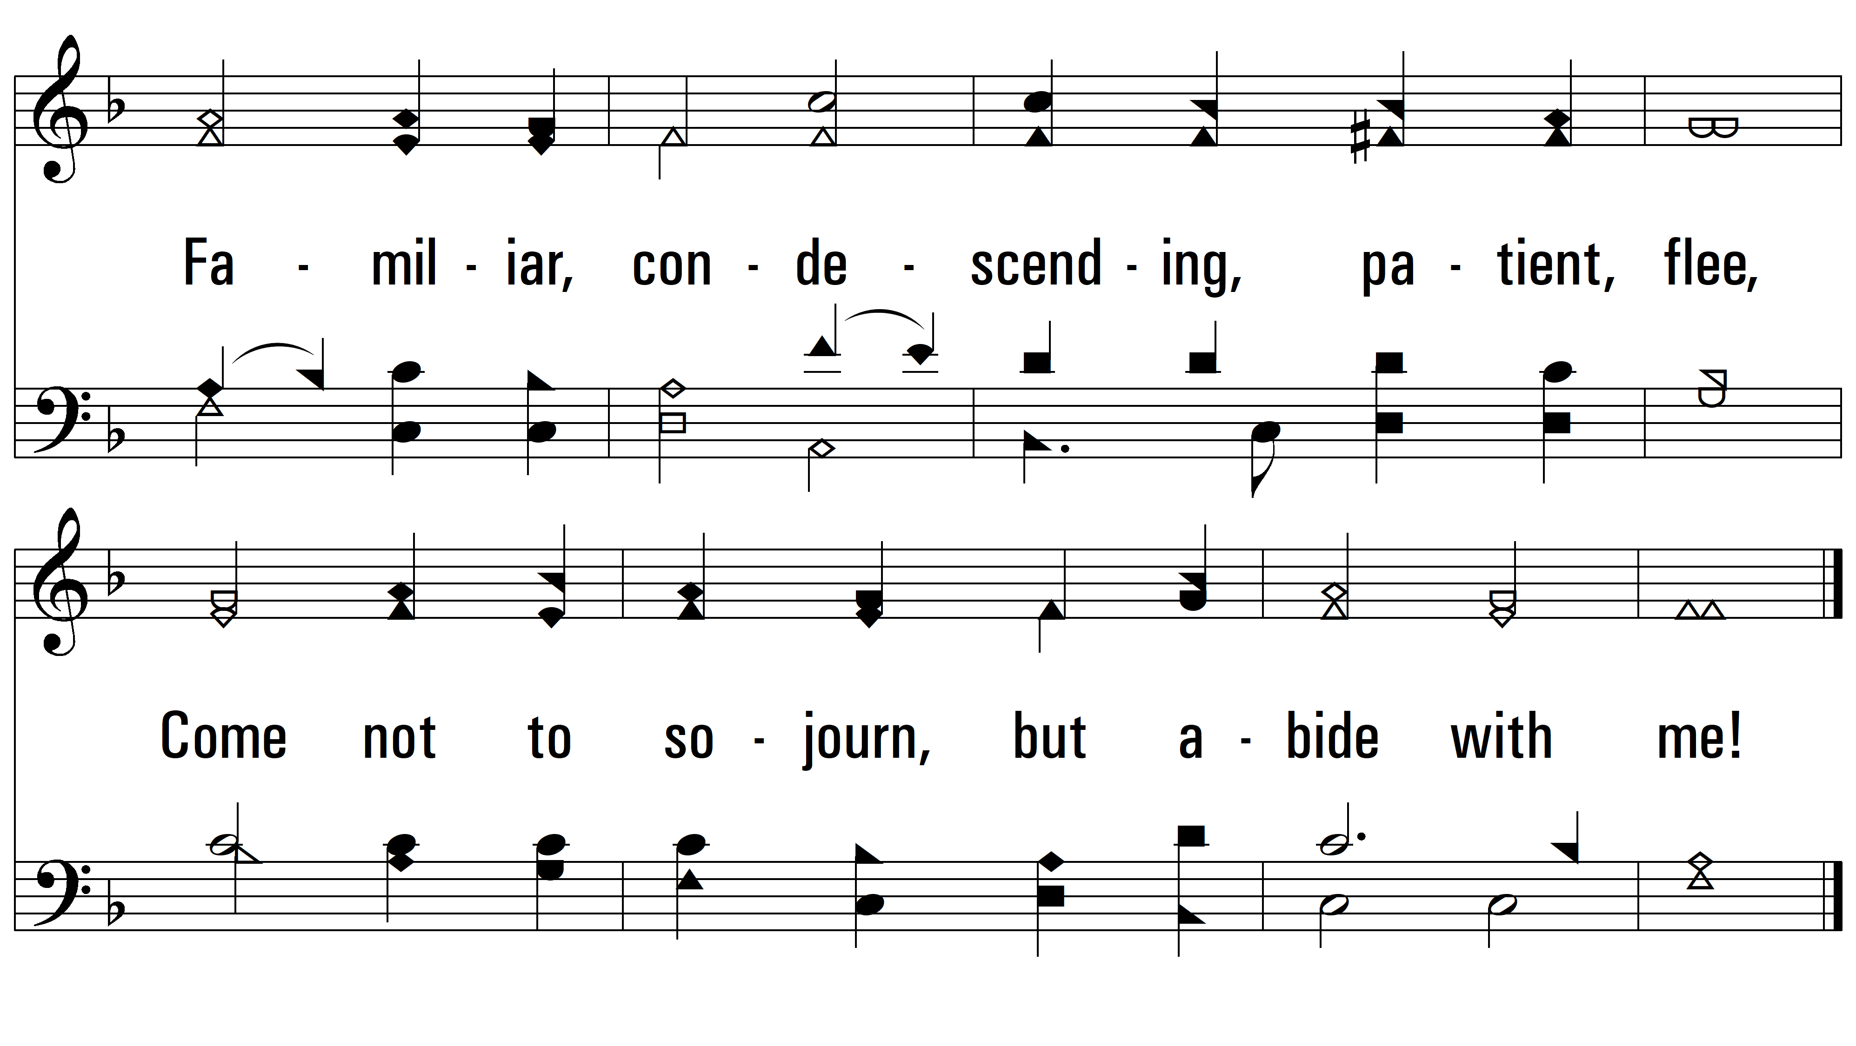
vs. 3

Slide 8
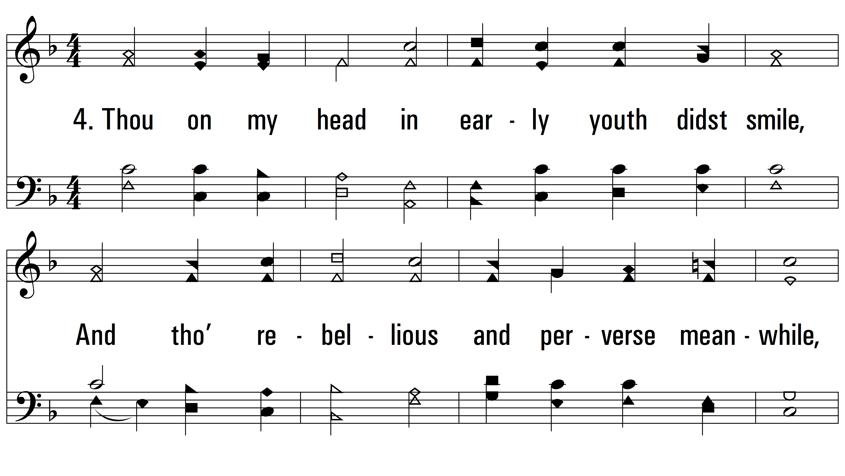
vs. 4 ~ Abide With Me

Slide 9
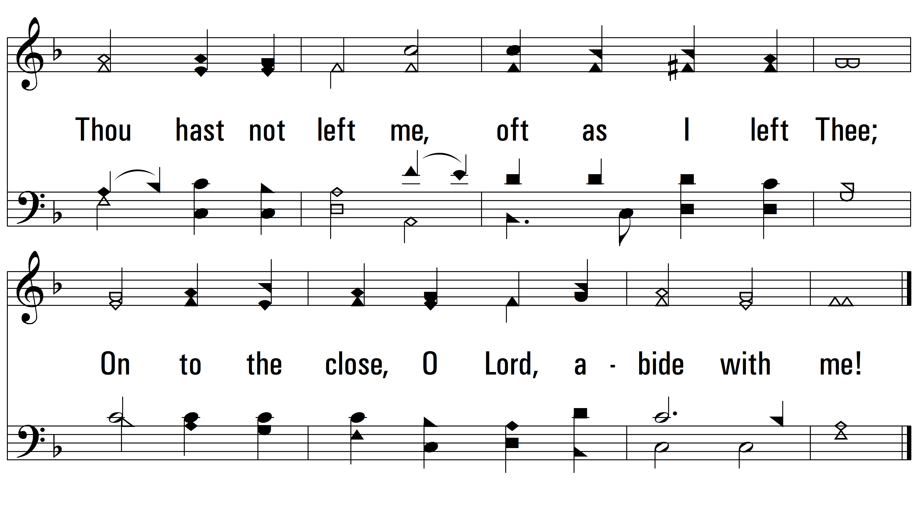
vs. 4

Slide 10
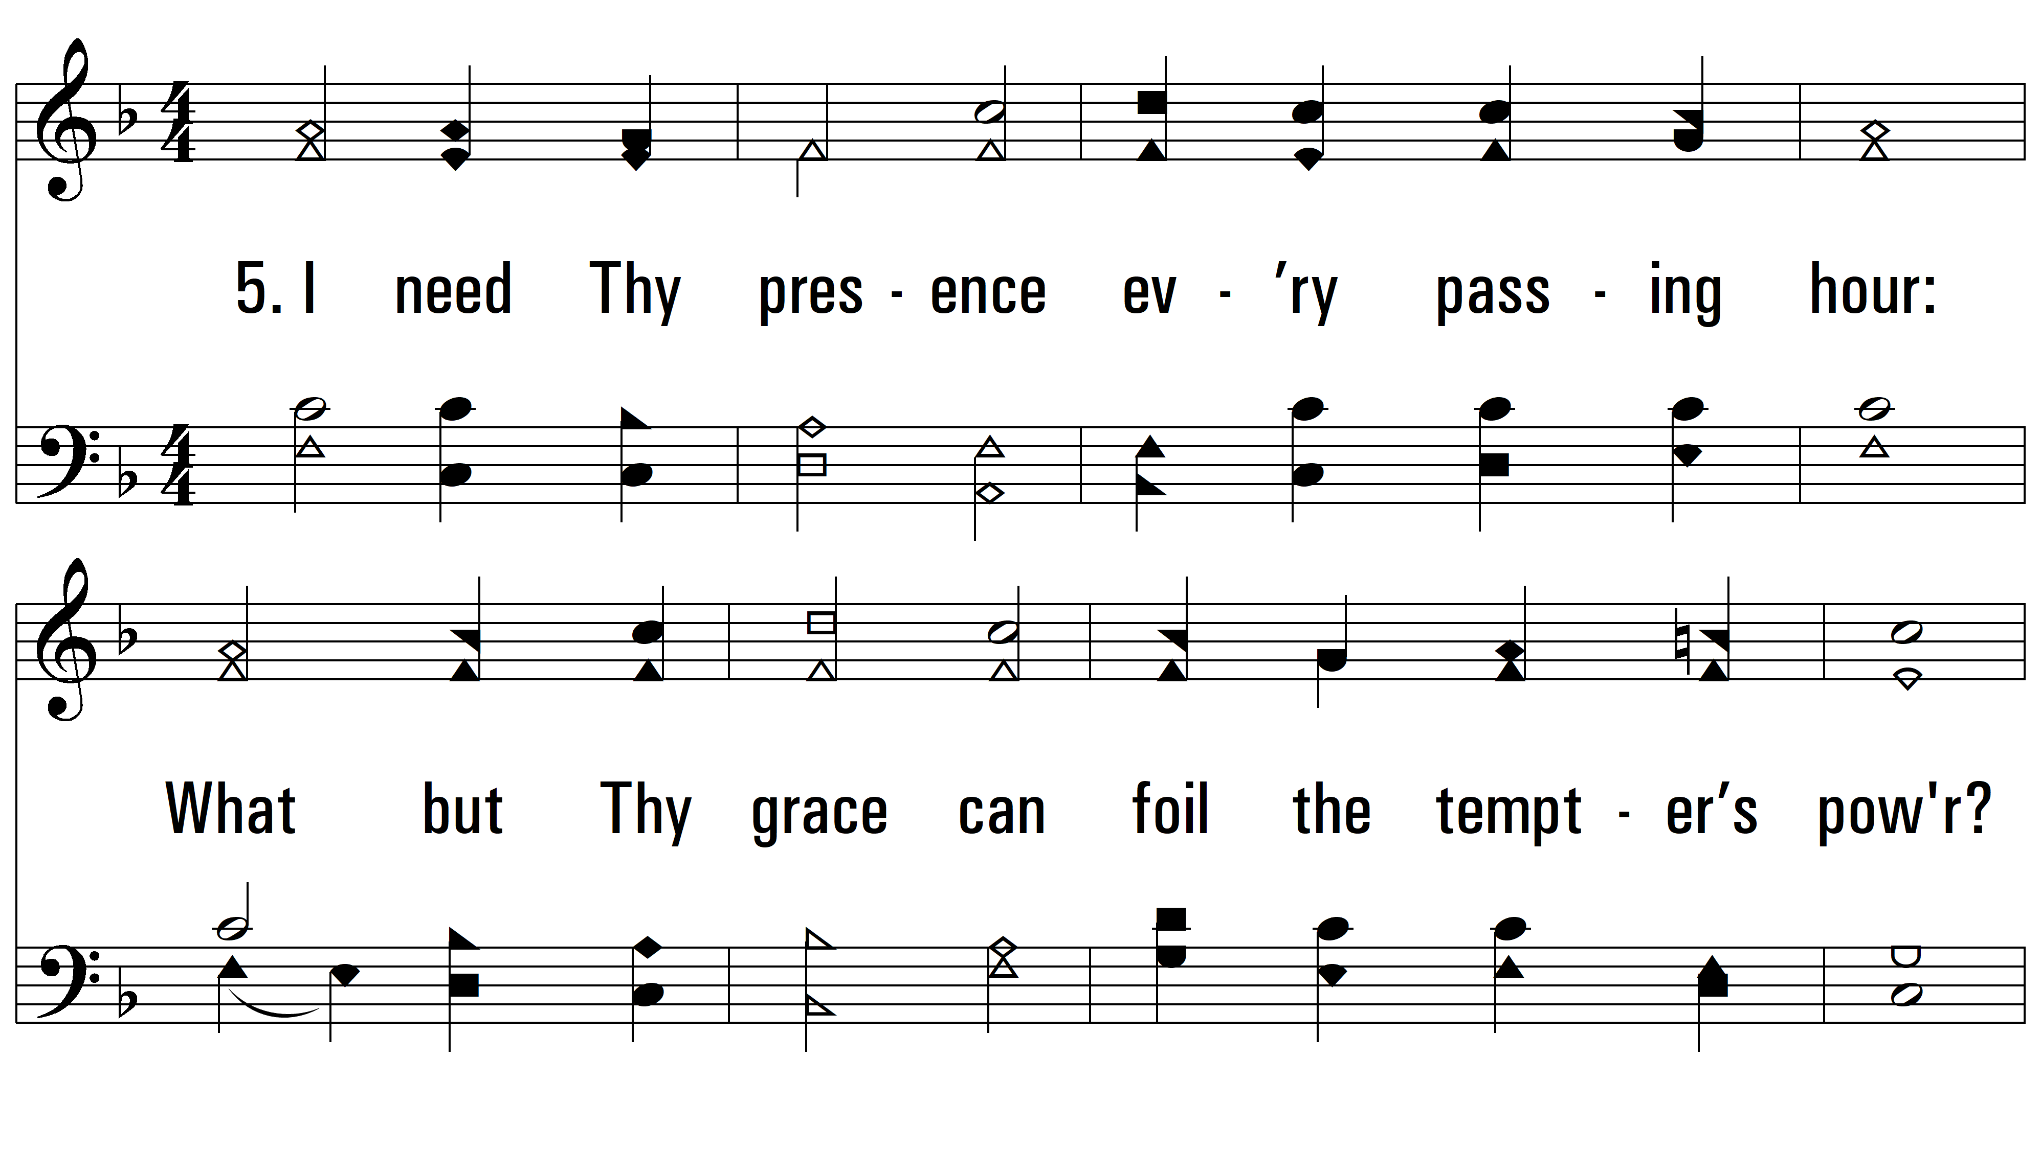
vs. 5 ~ Abide With Me

Slide 11
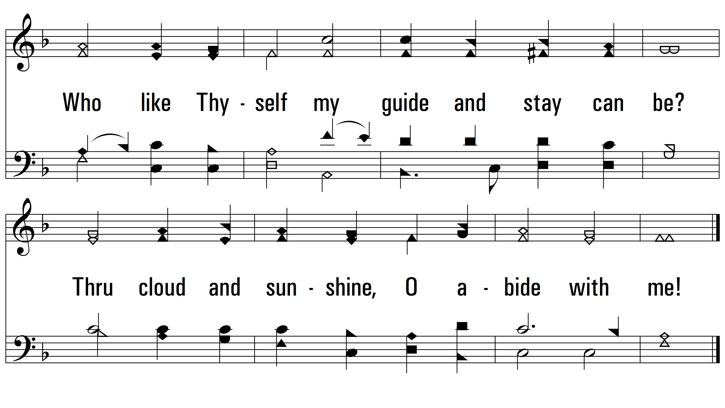
vs. 5

Slide 12
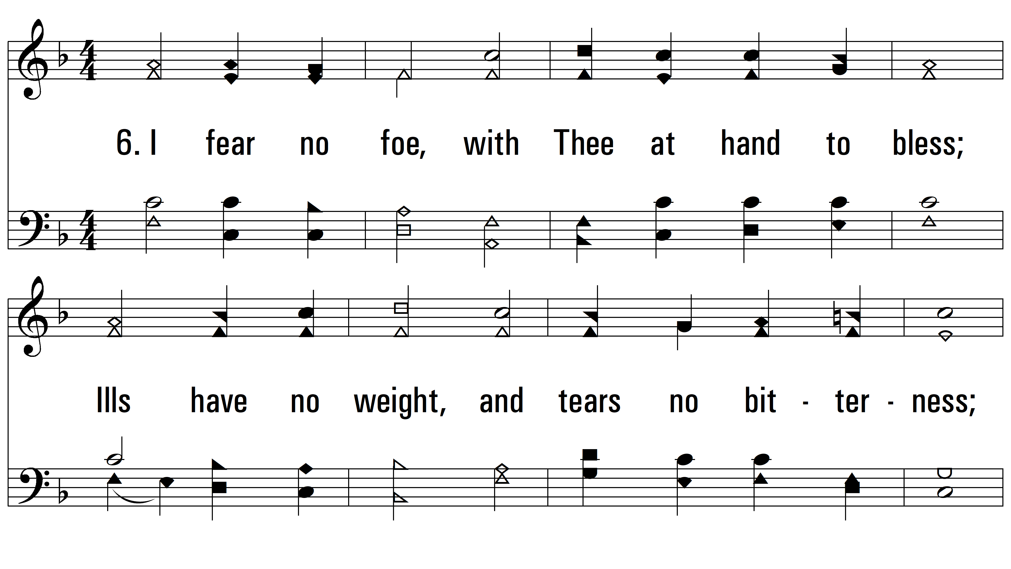
vs. 6 ~ Abide With Me

Slide 13
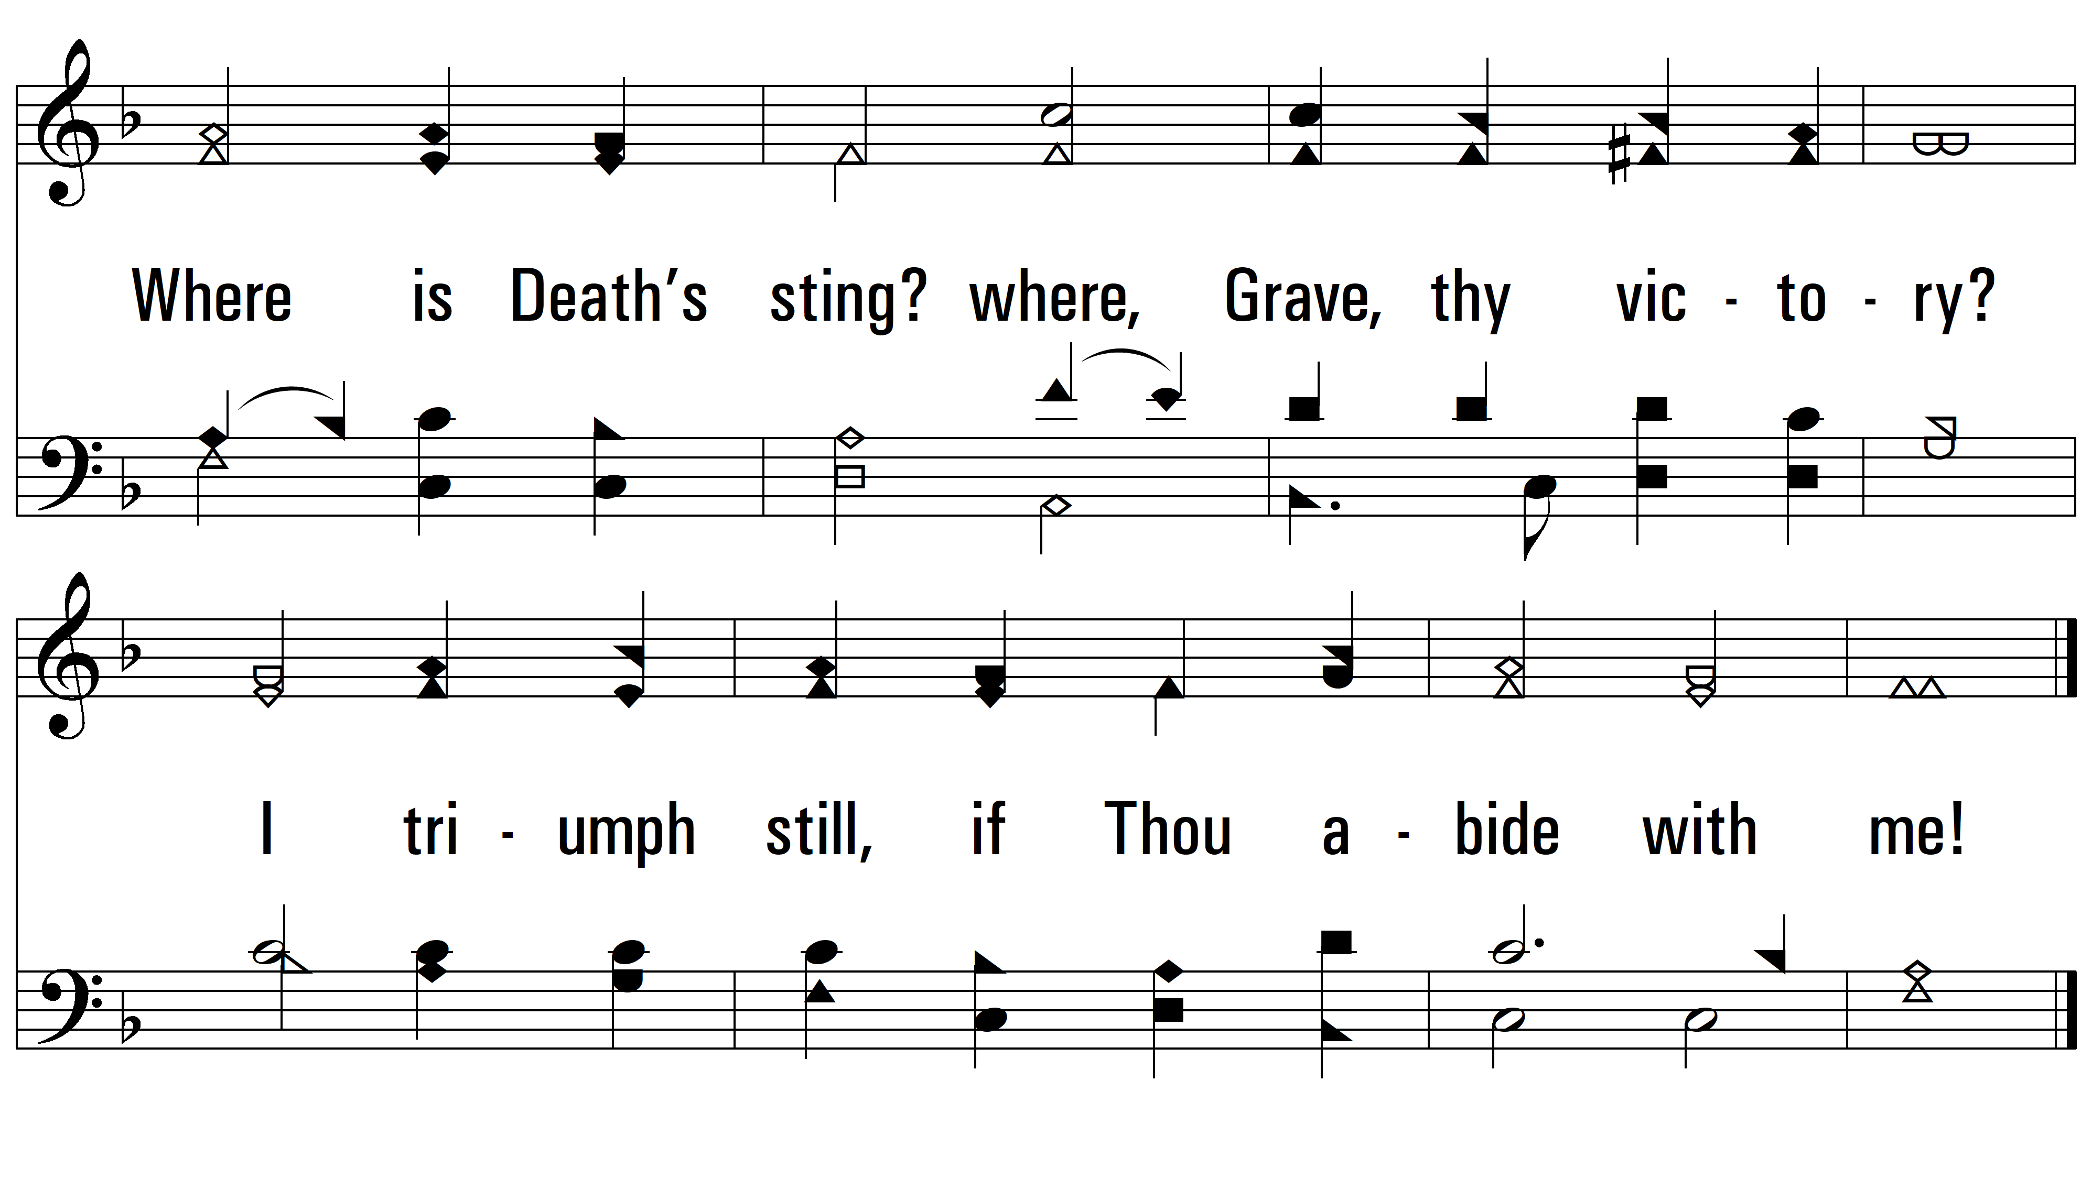
vs. 6

Slide 14
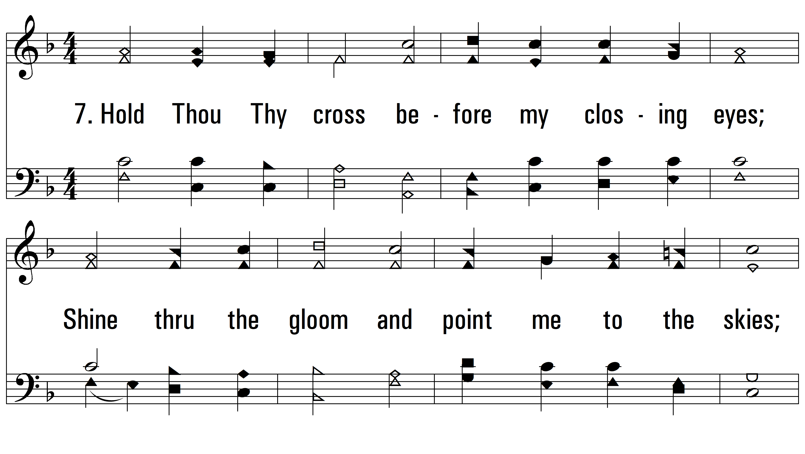
vs. 7 ~ Abide With Me

Slide 15
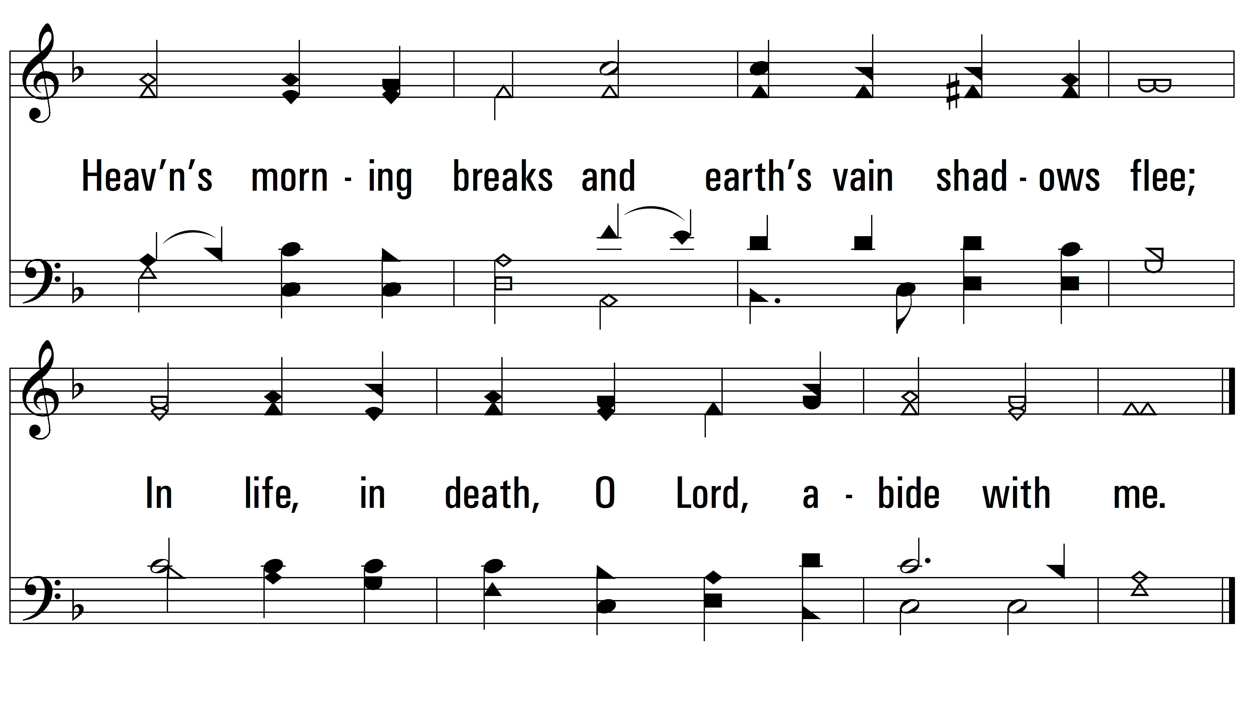
vs. 7
PDHymns.com
END

