Slide 1
A Shelter In Time Of Storm
Words: | Vernon J. Charlesworth (1880), Arr. by Ira D. Sankey (1885)
Music: | Ira D. Sankey (1885)
4/4
F/C - SOL
Verses: 4/Chorus
Lead - | SOL
Alto - | SOL
Tenor - | MI
Bass - | DO
PDHymns.com

Slide 2
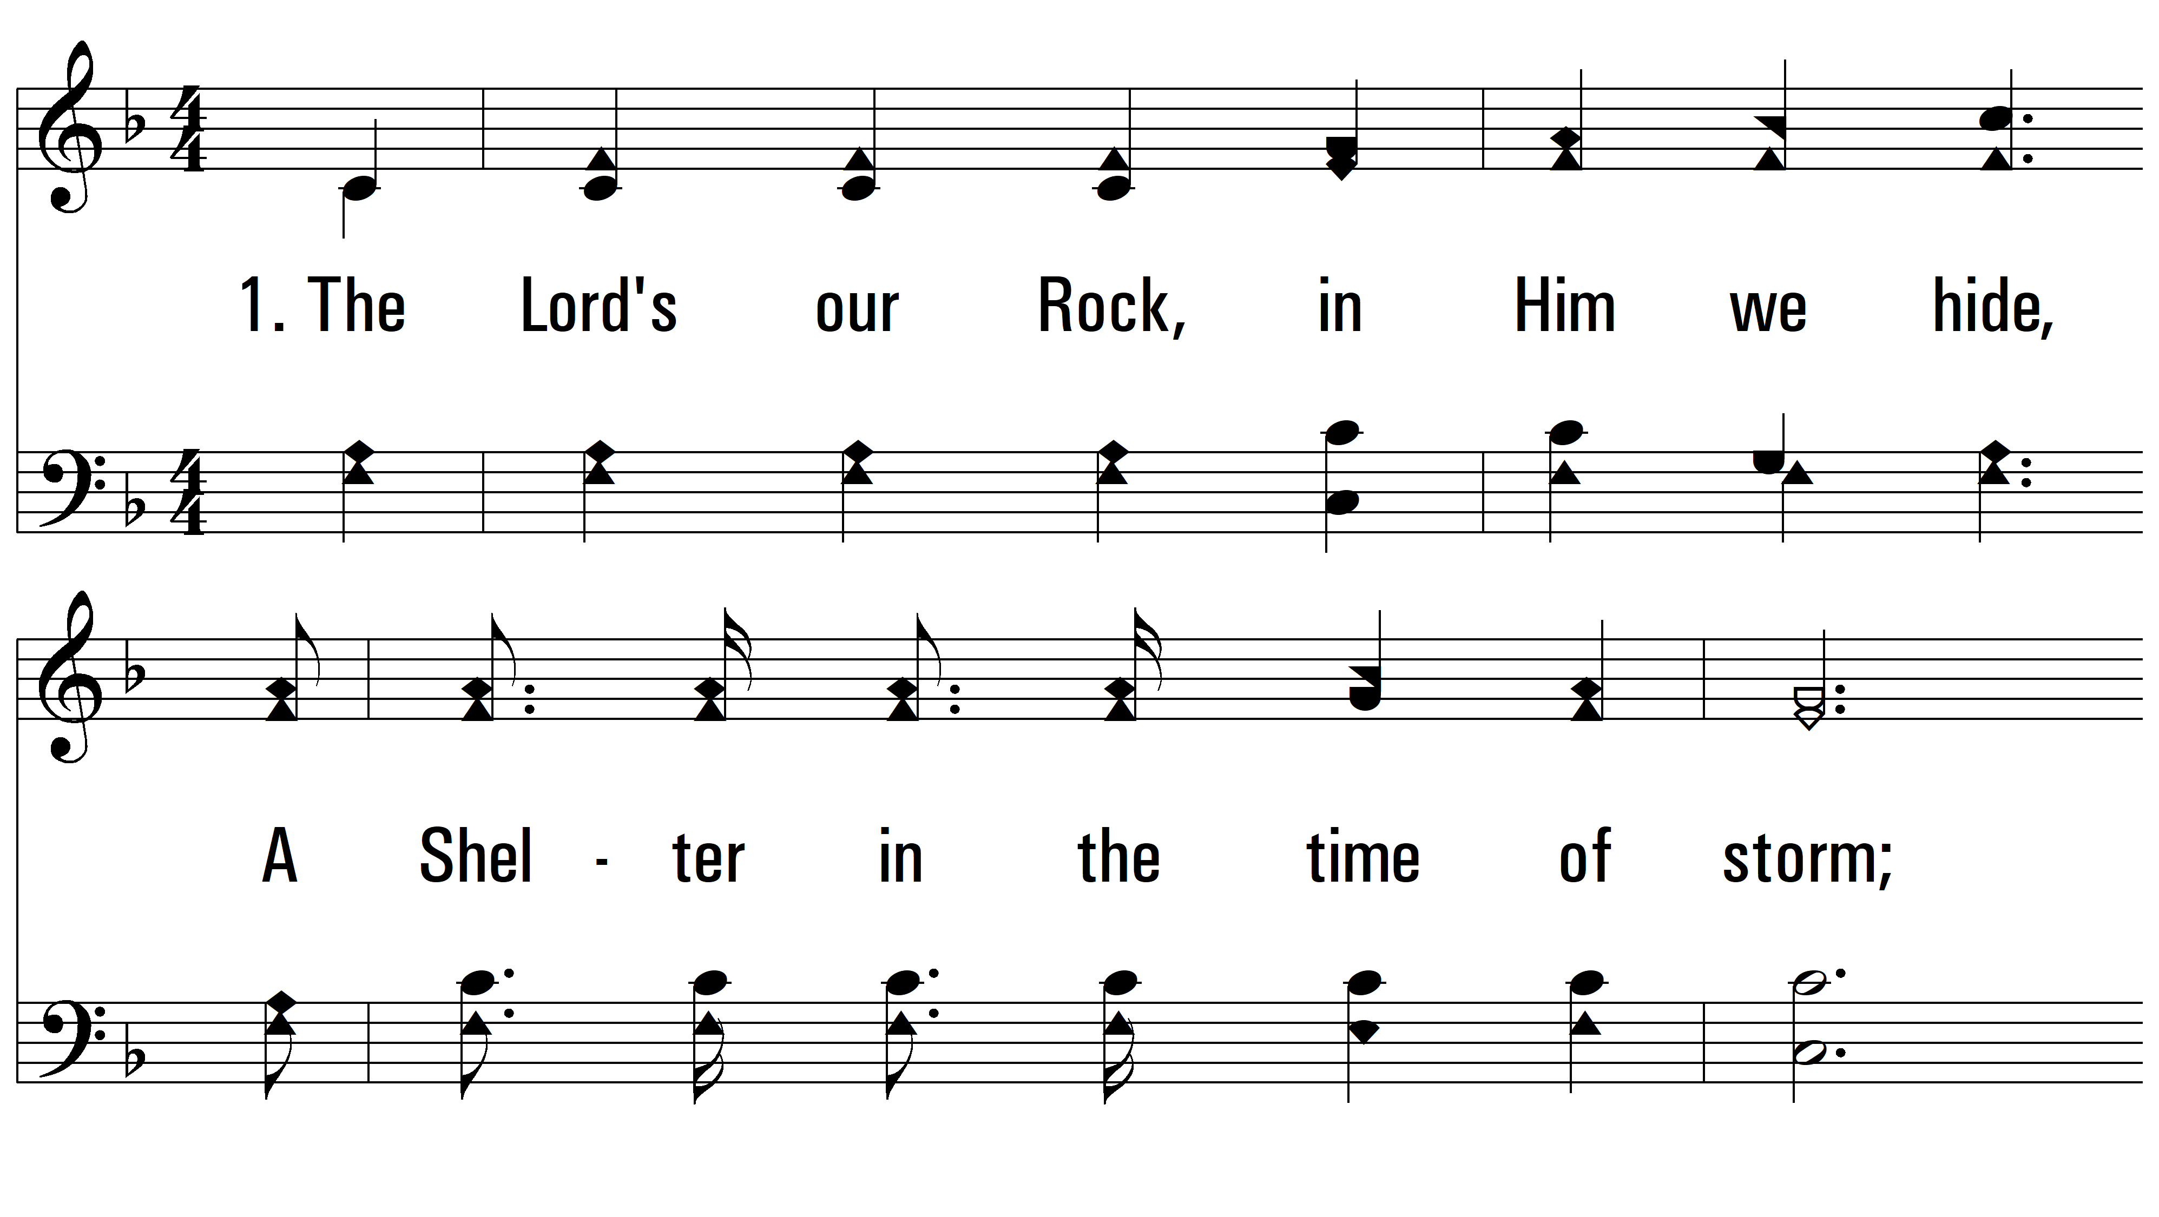
vs. 1 ~ A Shelter In Time Of Storm

Slide 3
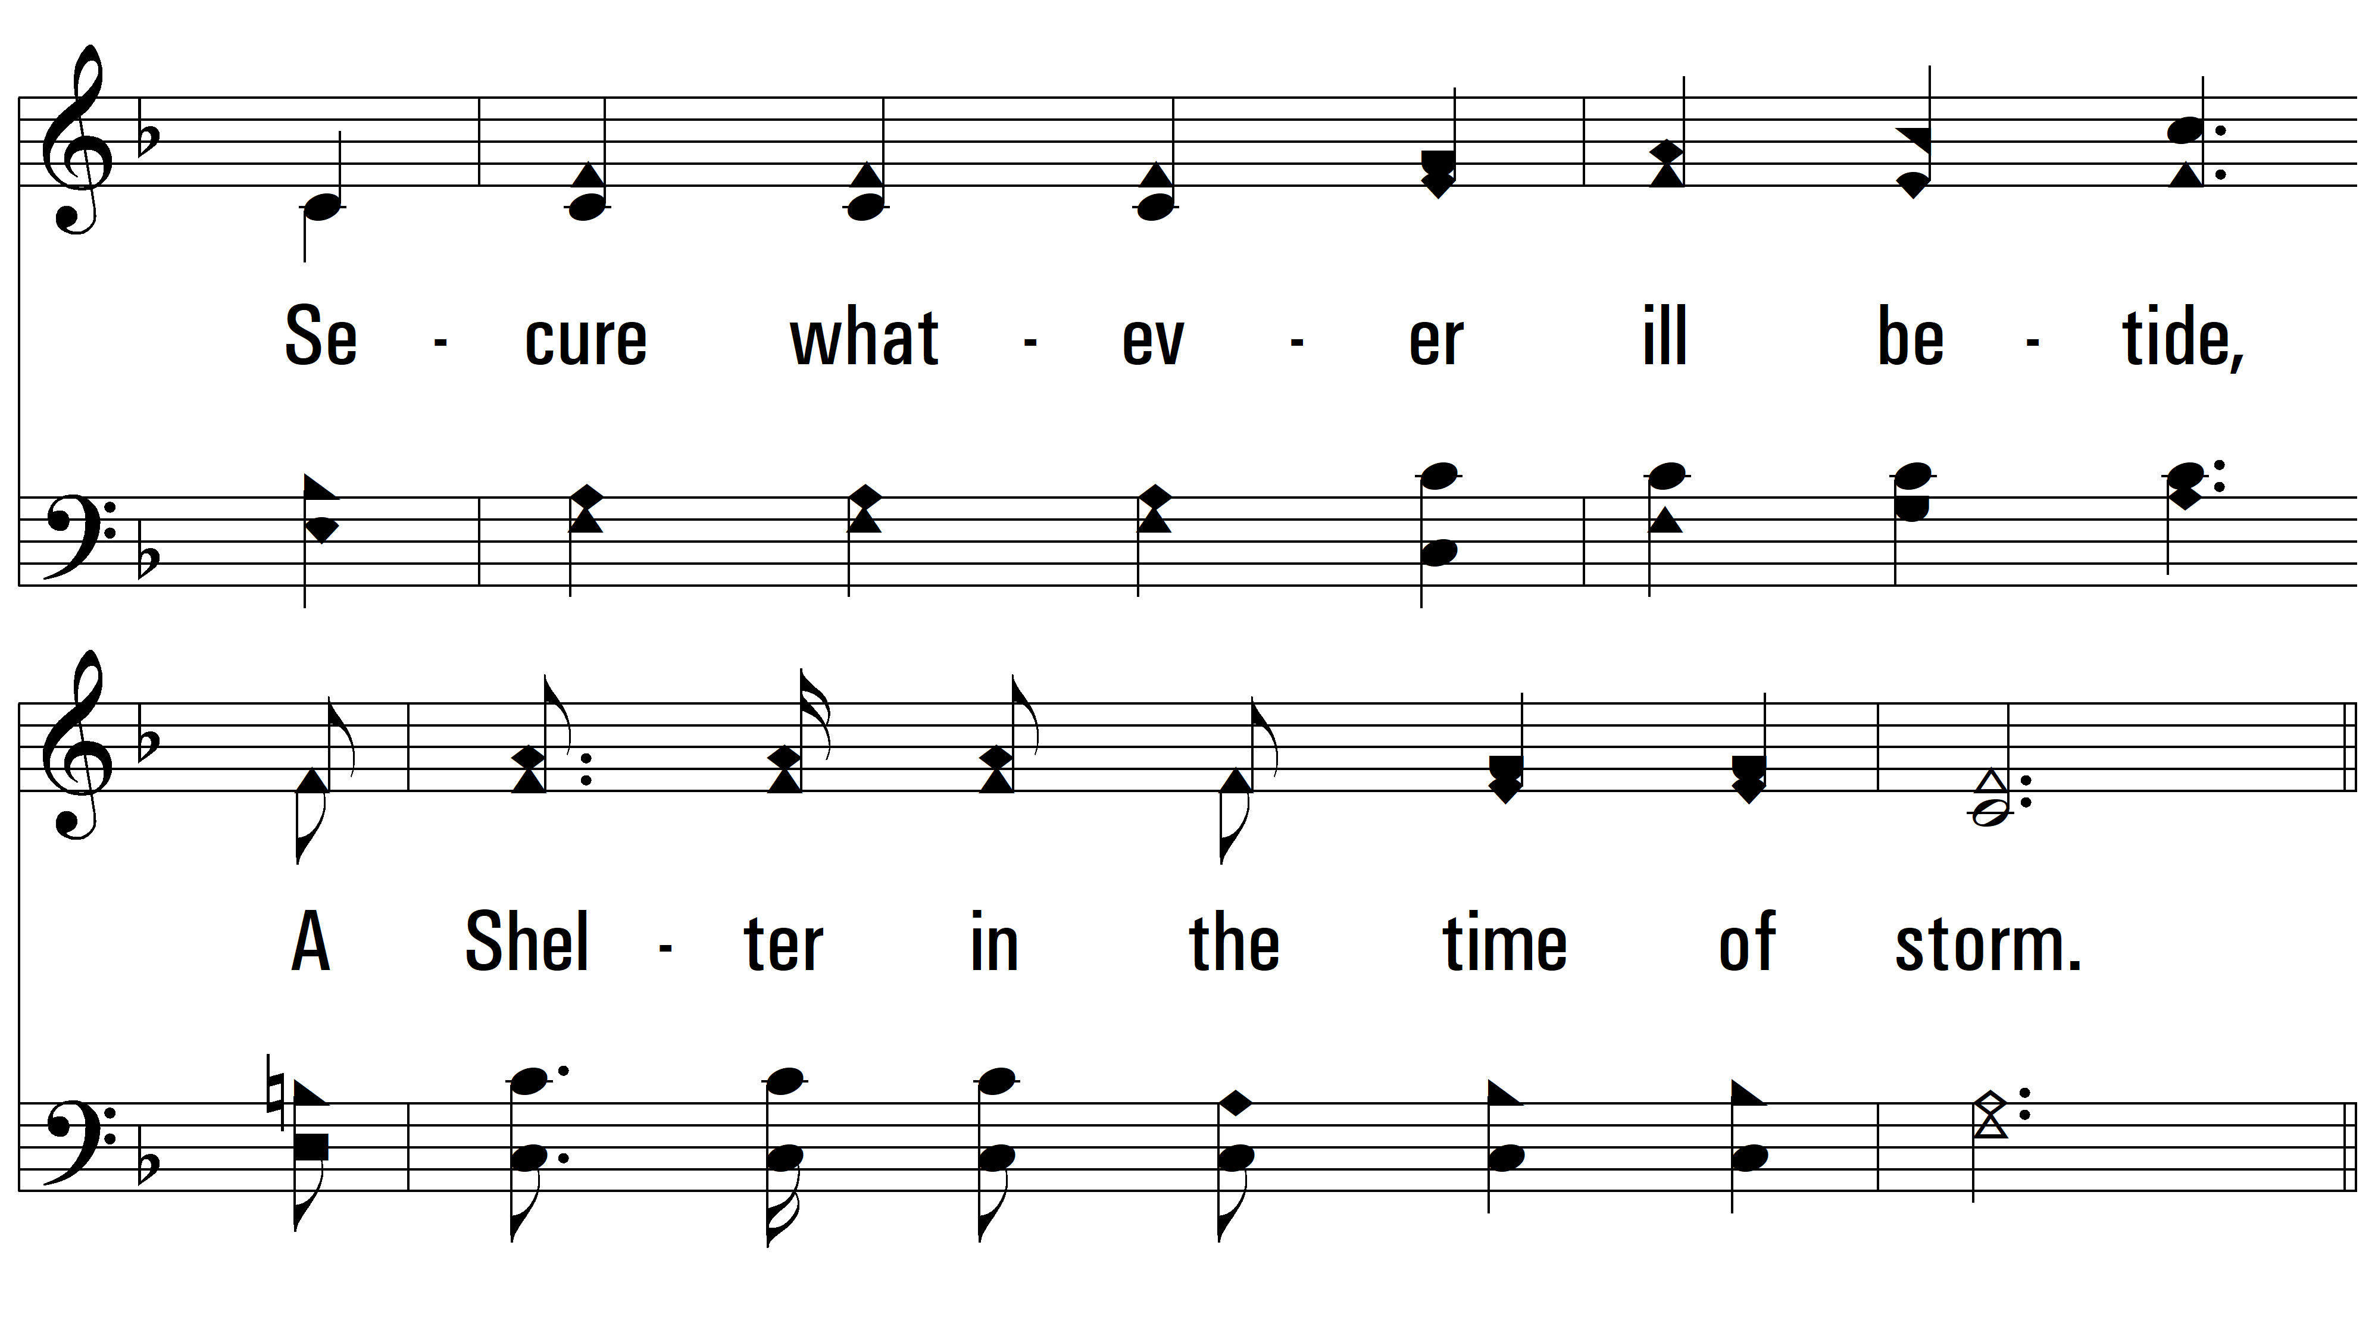
vs. 1

Slide 4
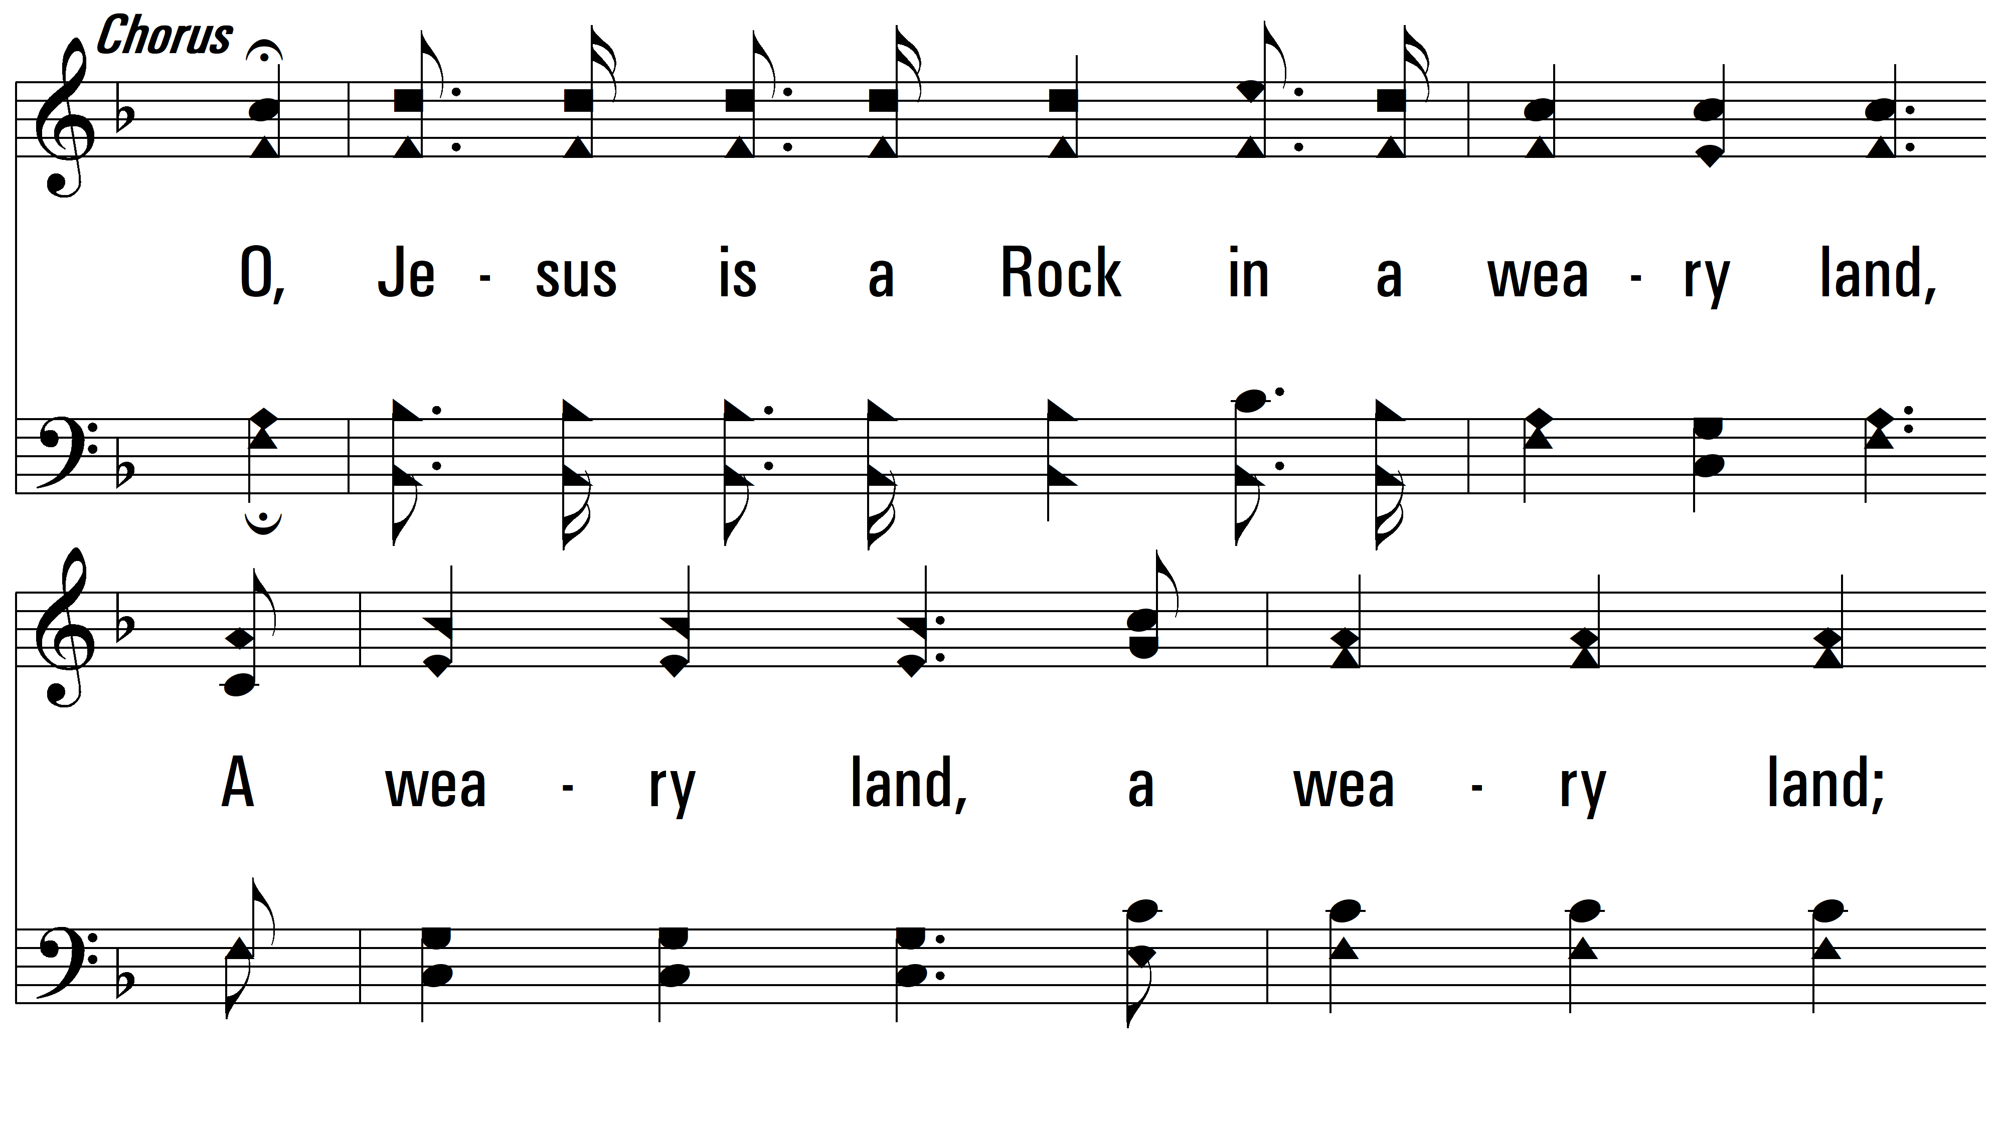
vs. 1

Slide 5
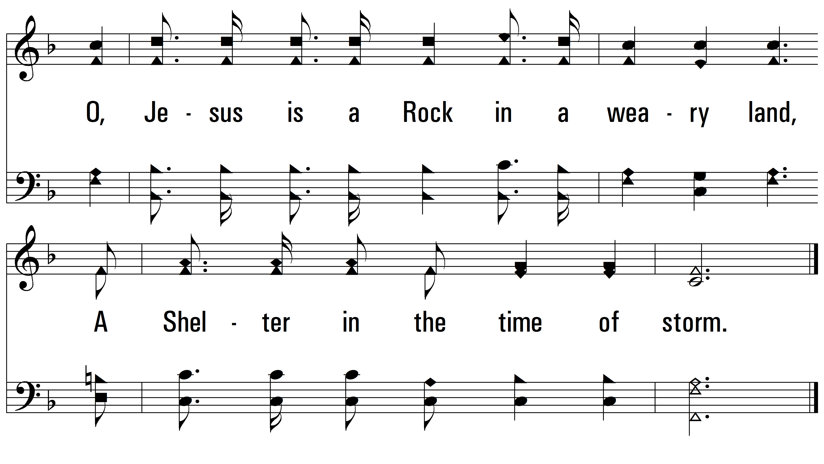
vs. 1

Slide 6
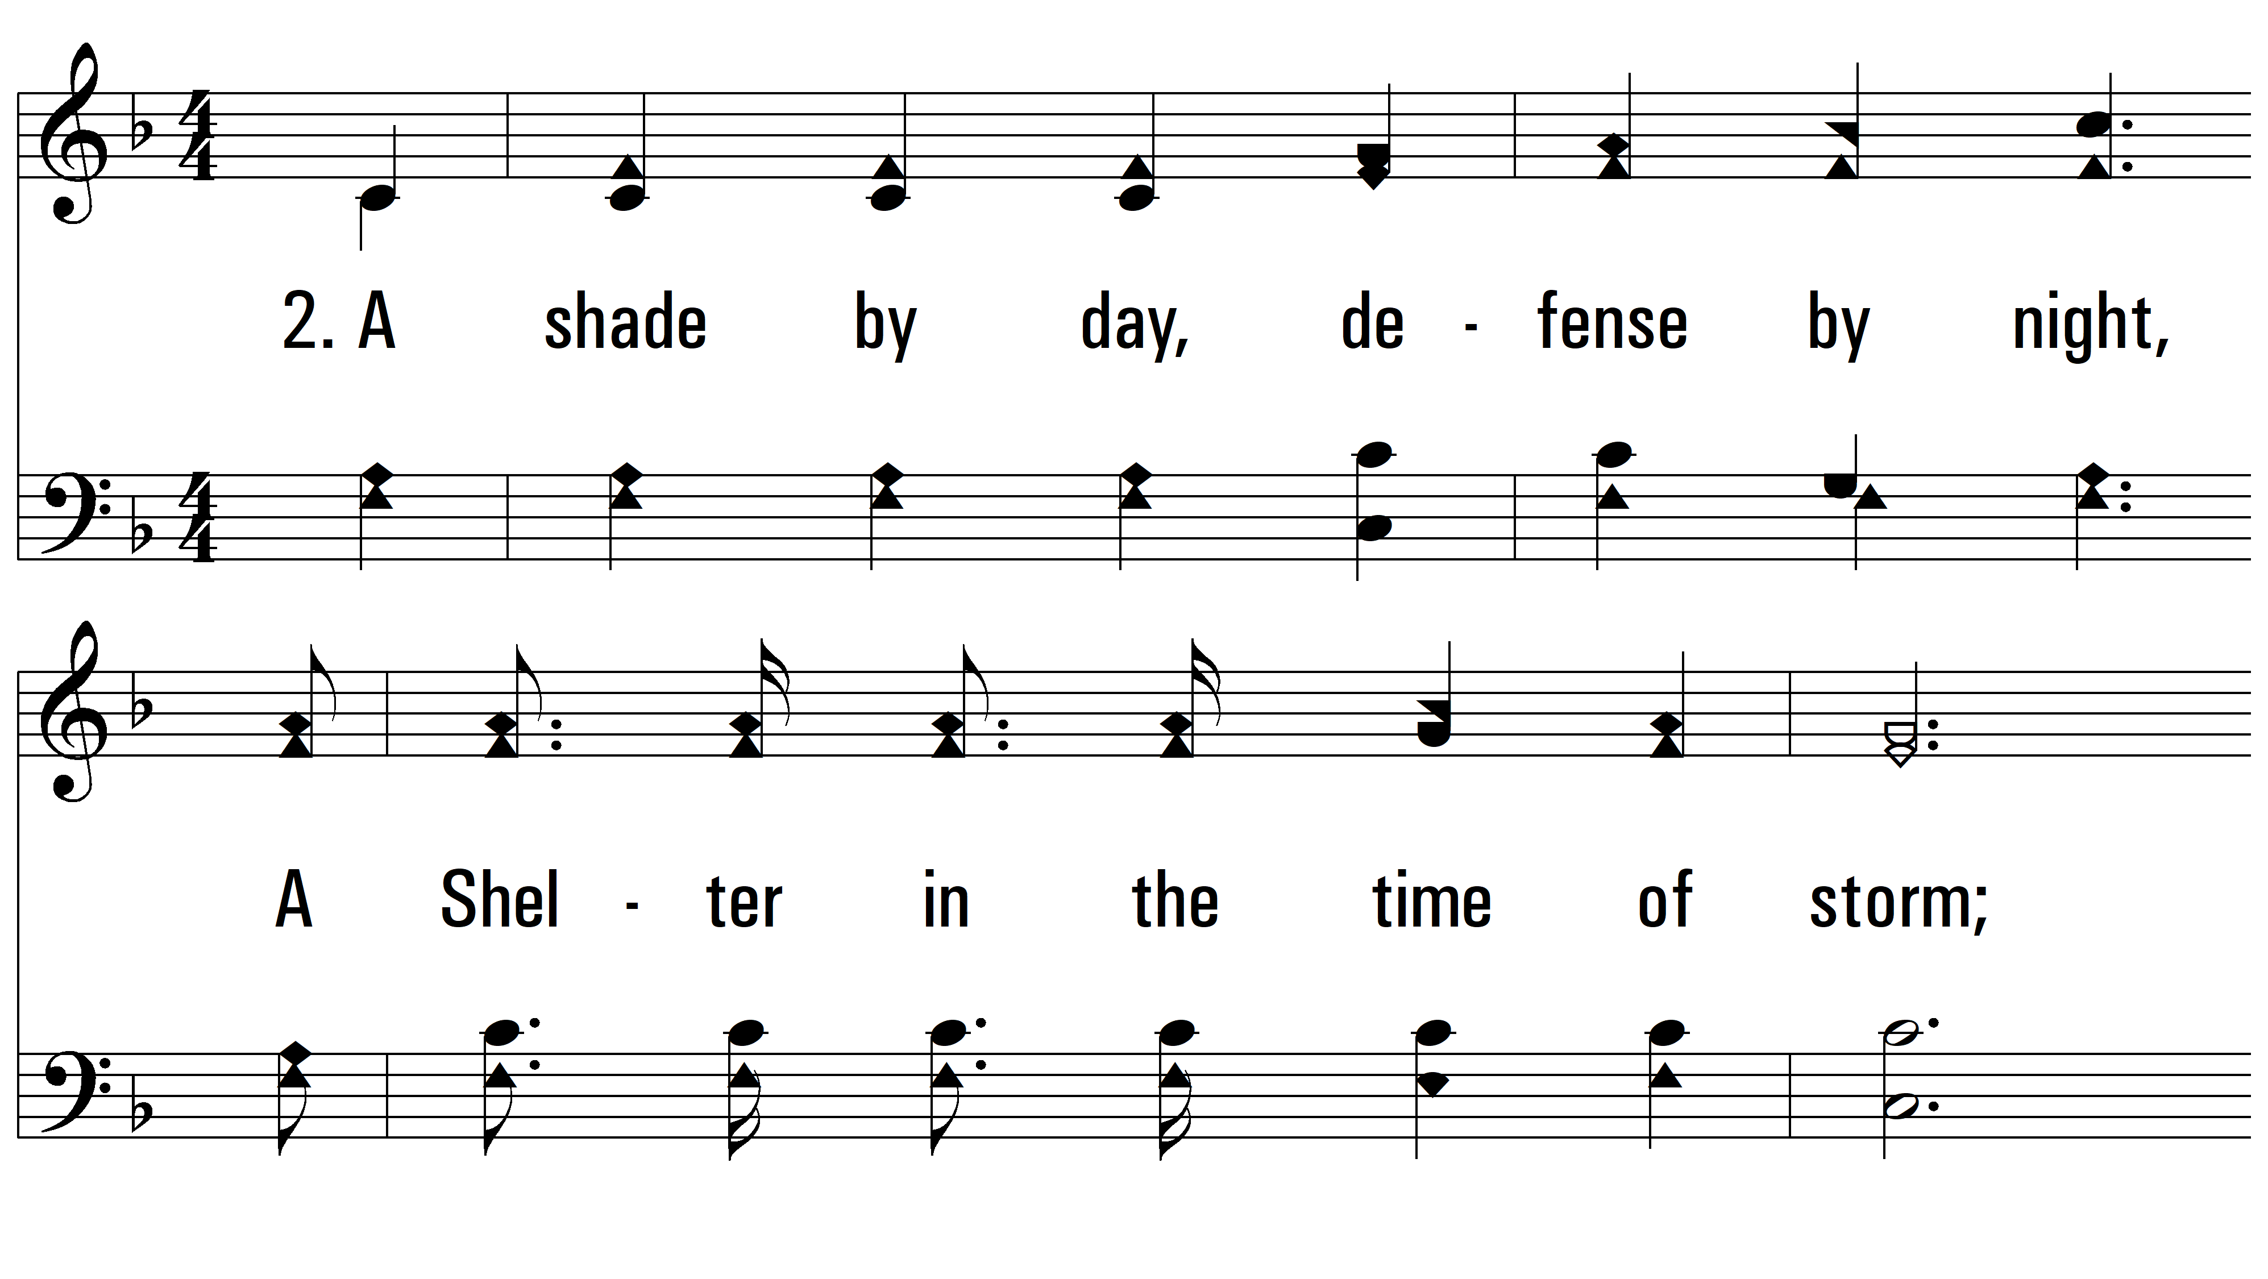
vs. 2 ~ A Shelter In Time Of Storm

Slide 7
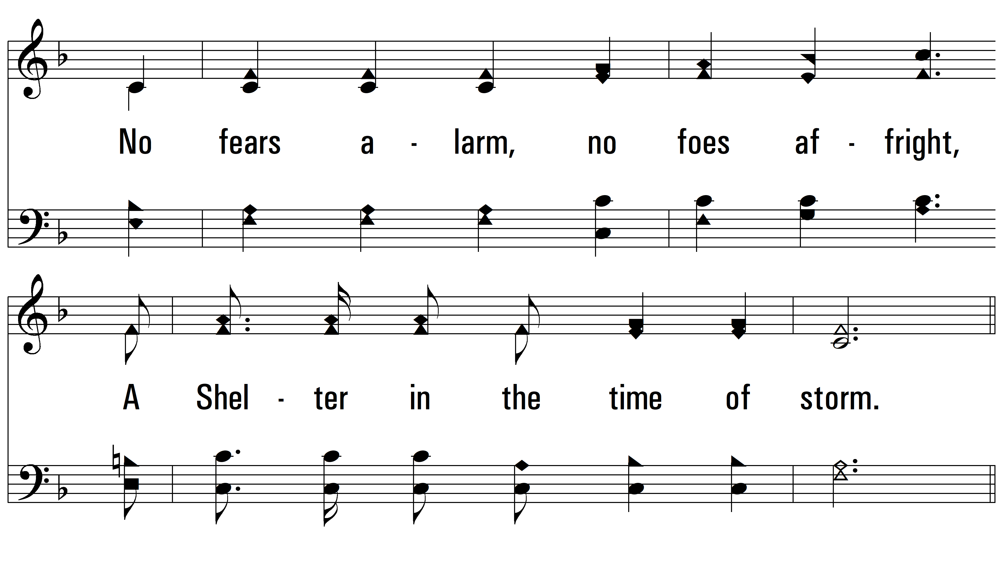
vs. 2

Slide 8
vs. 2

Slide 9
vs. 2

Slide 10
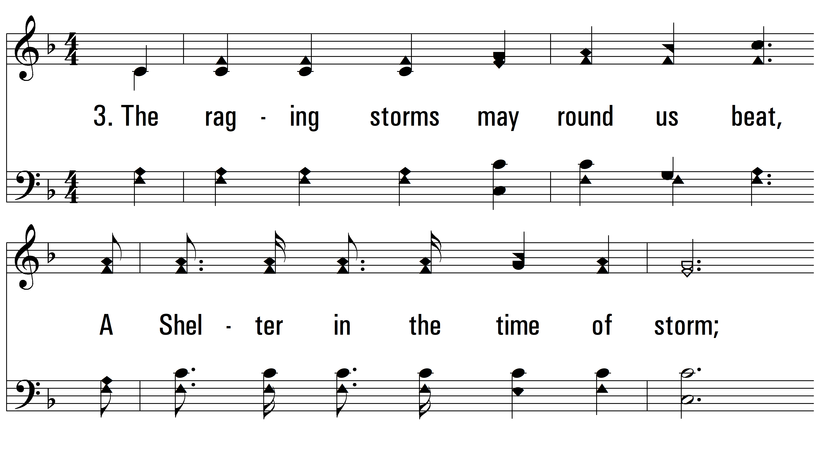
vs. 3 ~ A Shelter In Time Of Storm

Slide 11
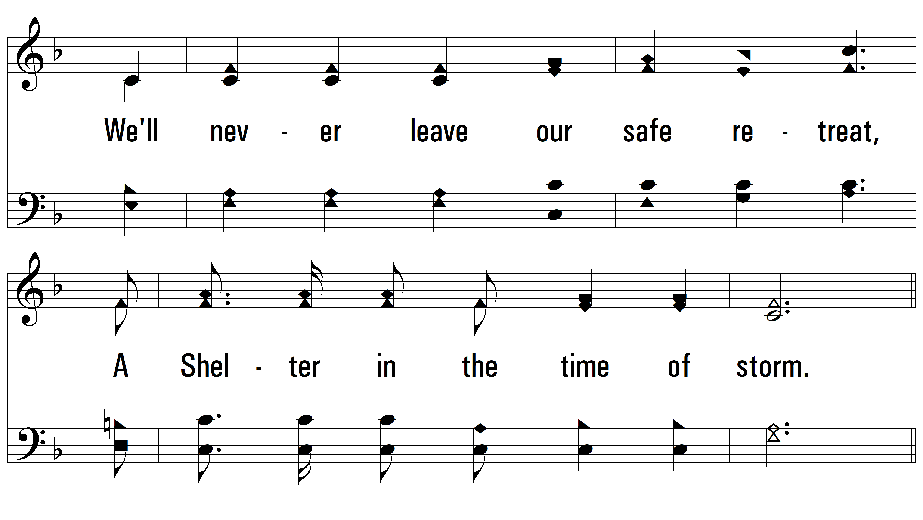
vs. 3

Slide 12
vs. 3

Slide 13
vs. 3

Slide 14
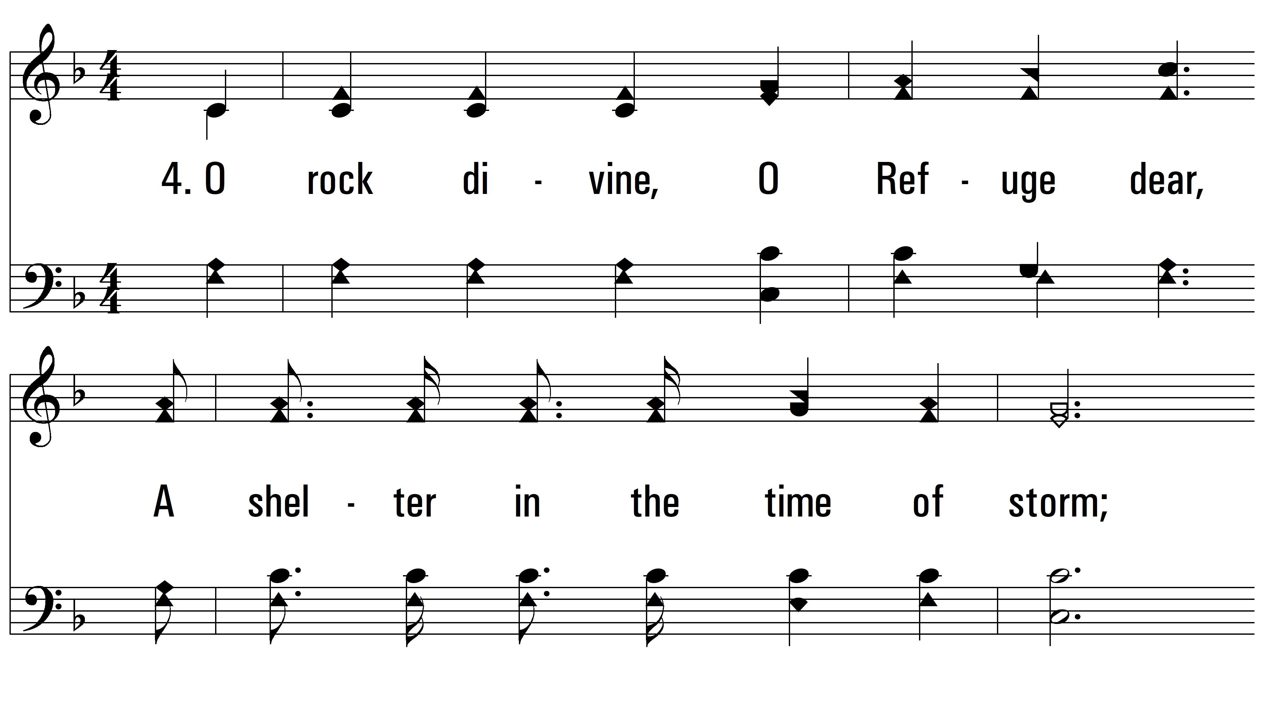
vs. 4 ~ A Shelter In Time Of Storm

Slide 15
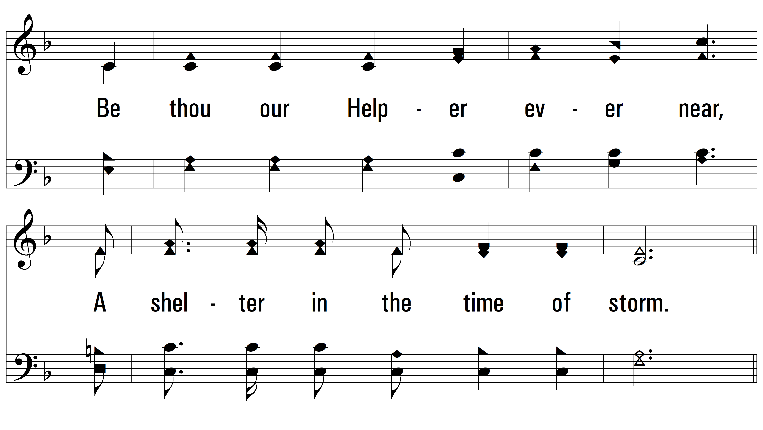
vs. 4

Slide 16
vs. 4

Slide 17
vs. 4
PDHymns.com
END

