Slide 1
A Mighty Fortress
EIN’ FESTE BURG
8.7.8.7.6.6.6.6.7
Words: | Martin Luther (1529), Tr. by F. H. Hedge (1529)
Music: | Martin Luther (1529)
2/4
D/D - DO
Verses: 4
Lead - | DO
Alto - | MI
Tenor - | SOL
Bass - | DO
PDHymns.com

Slide 2
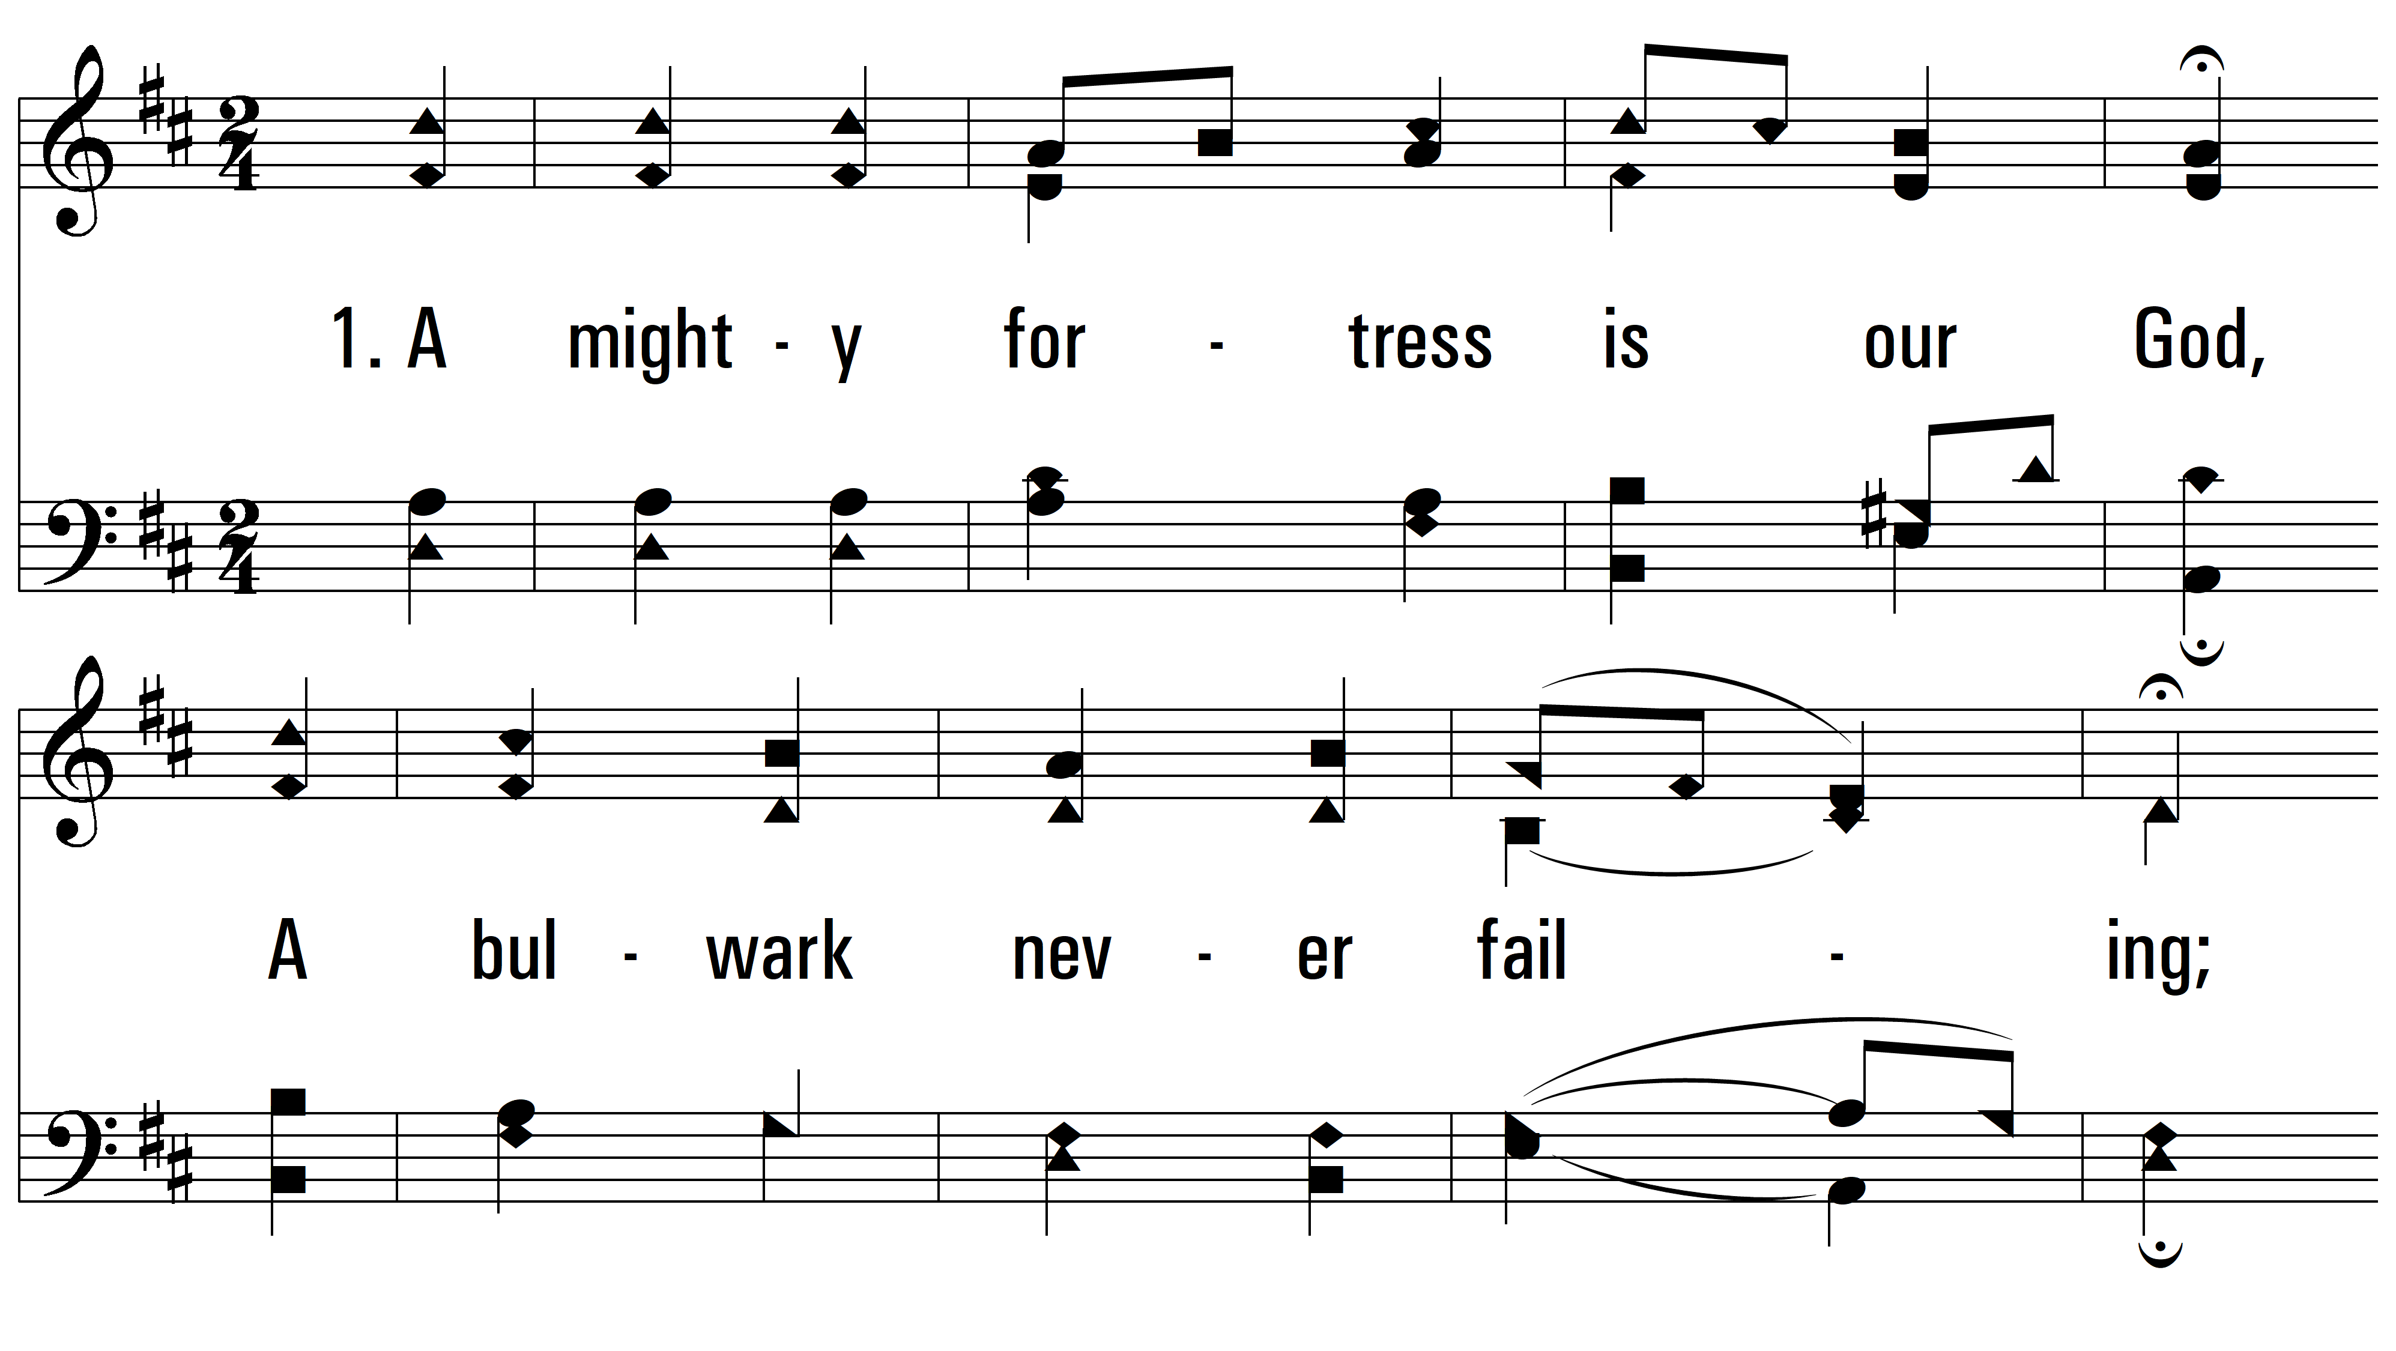
vs. 1 ~ A Mighty Fortress

Slide 3
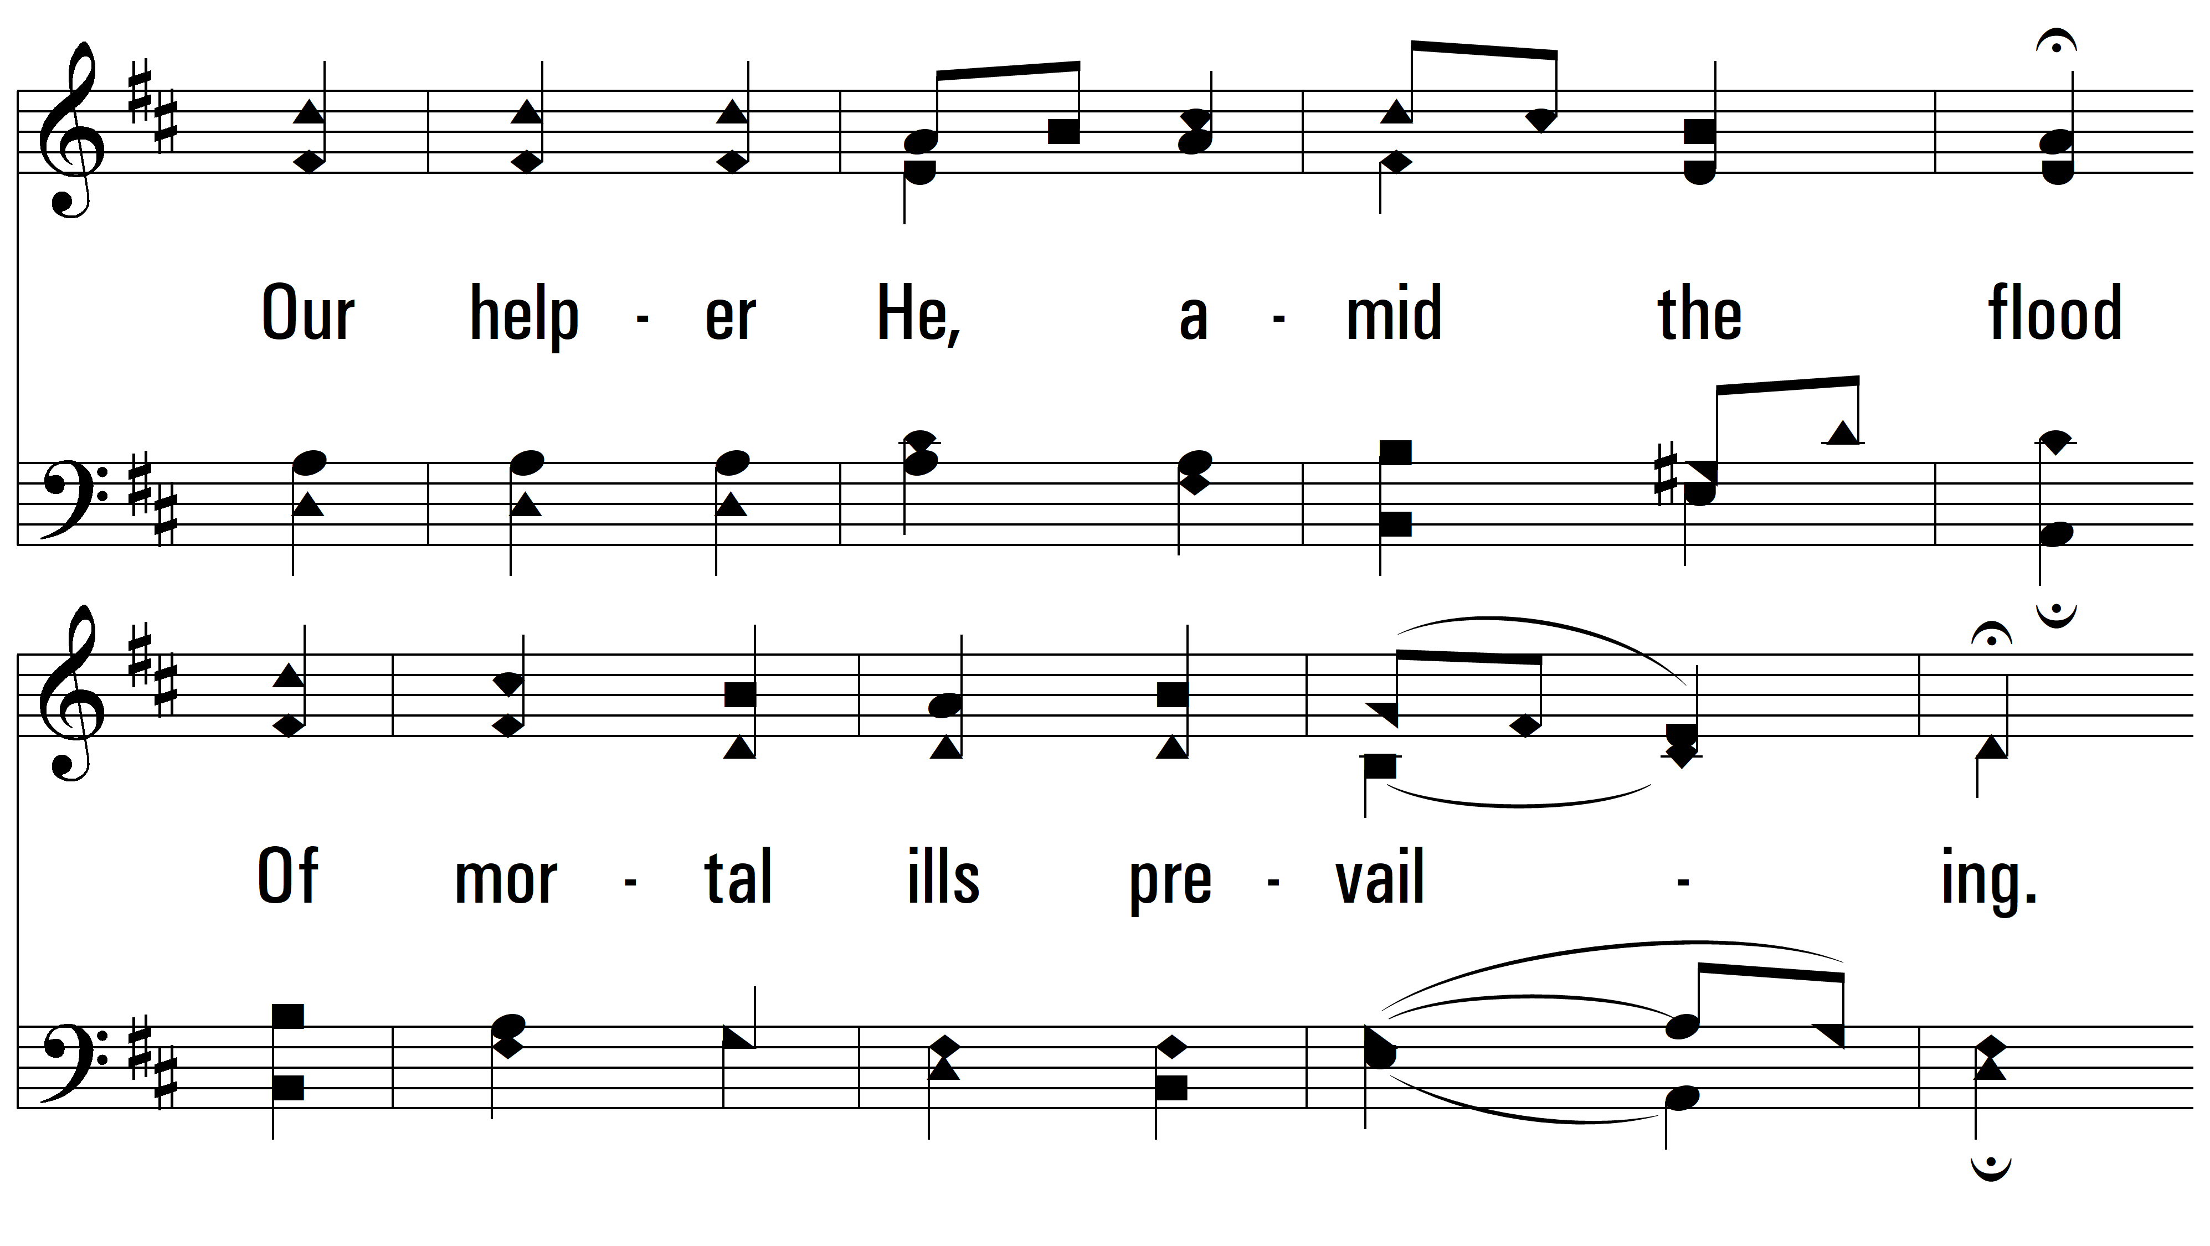
vs. 1

Slide 4
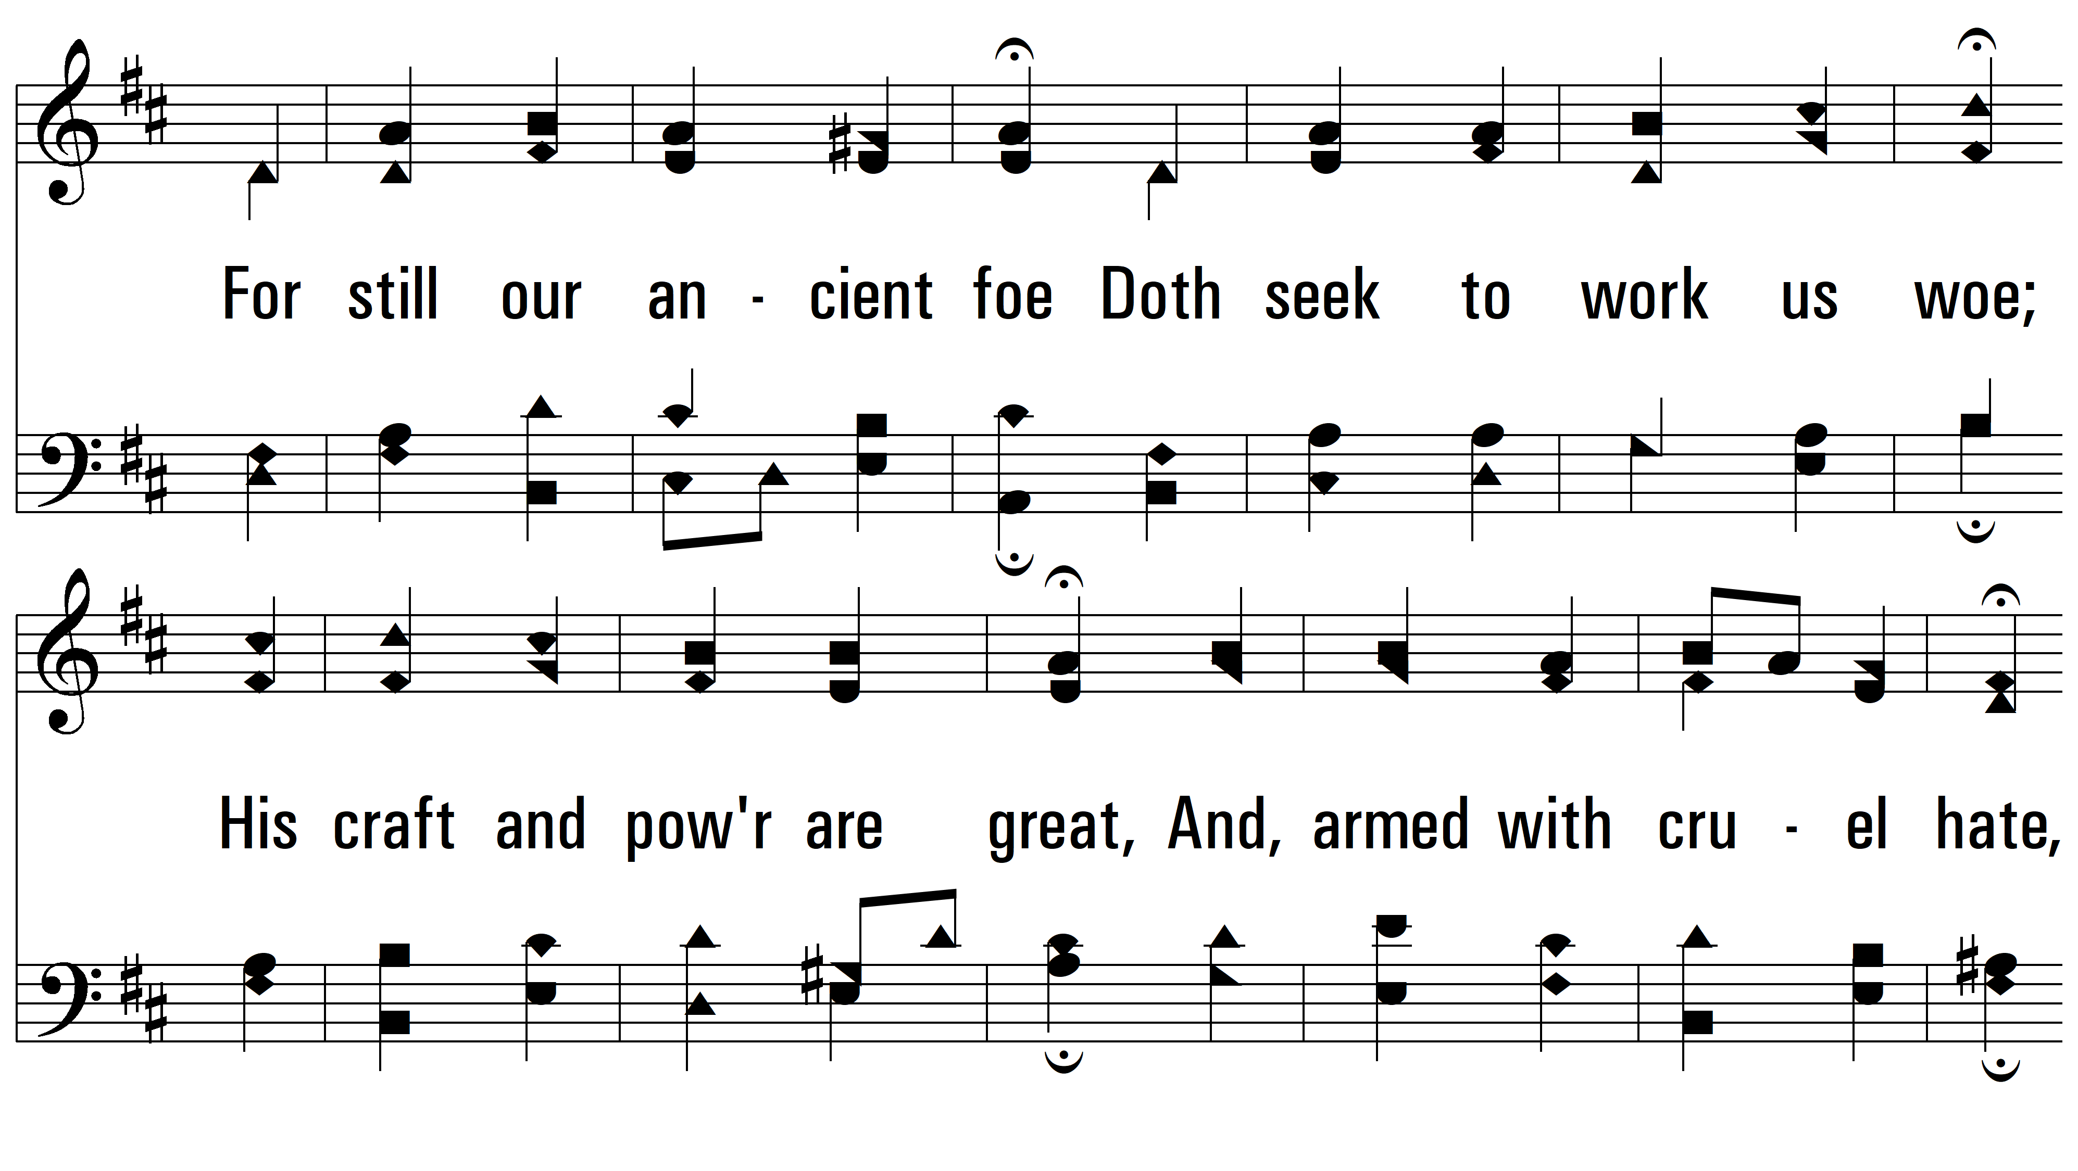
vs. 1

Slide 5
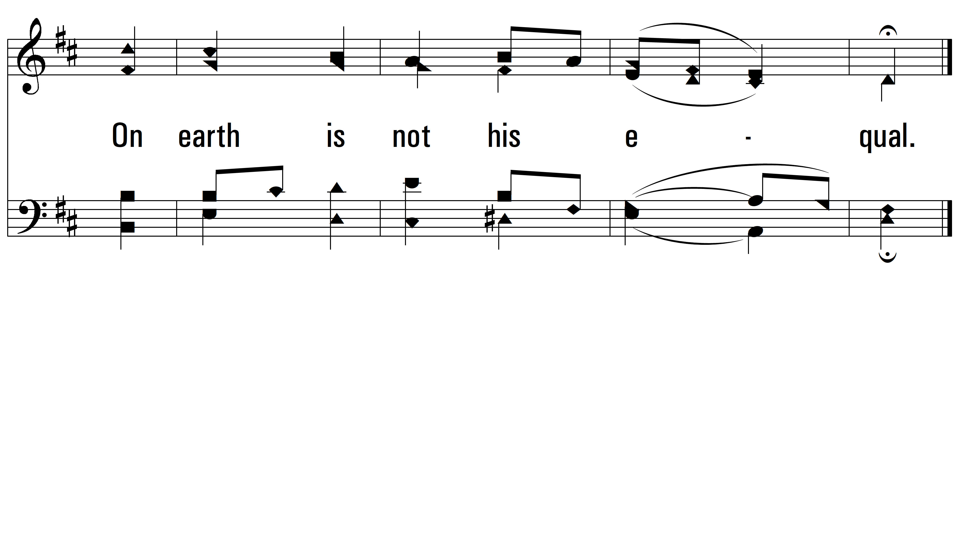
vs. 1

Slide 6
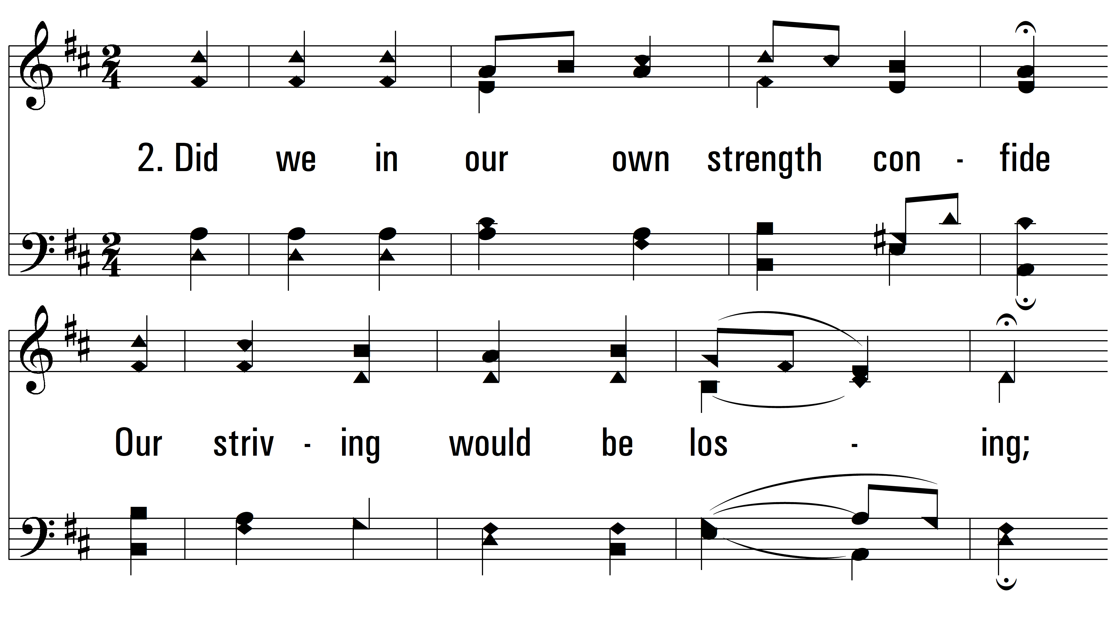
vs. 2 ~ A Mighty Fortress

Slide 7
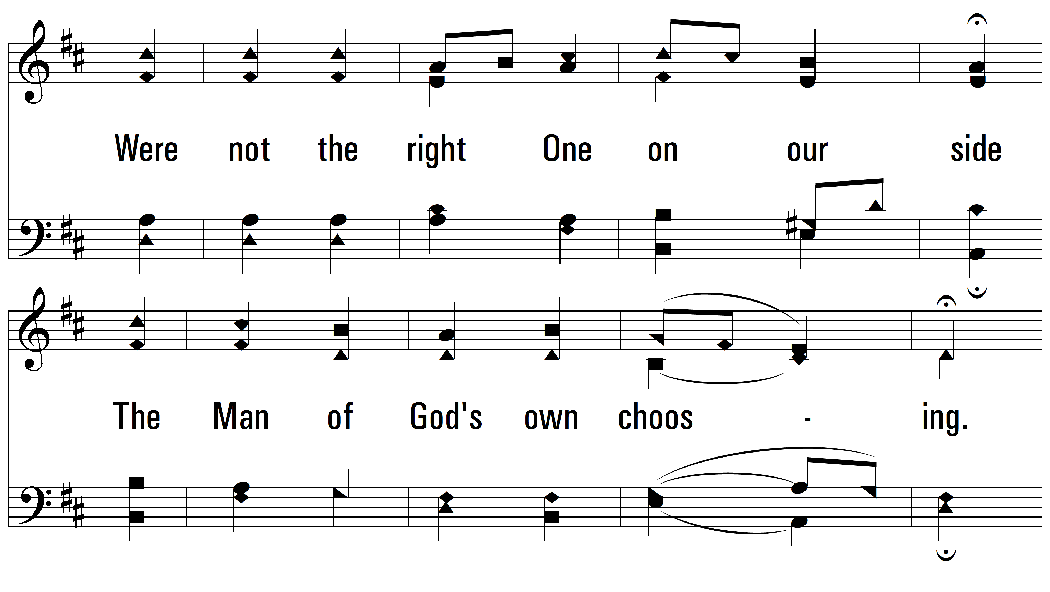
vs. 2

Slide 8
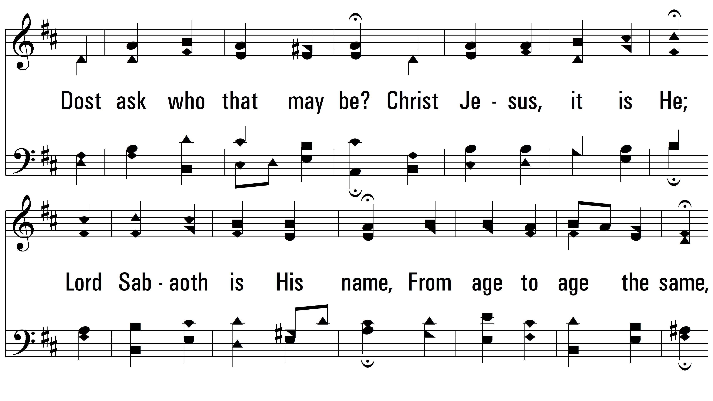
vs. 2

Slide 9
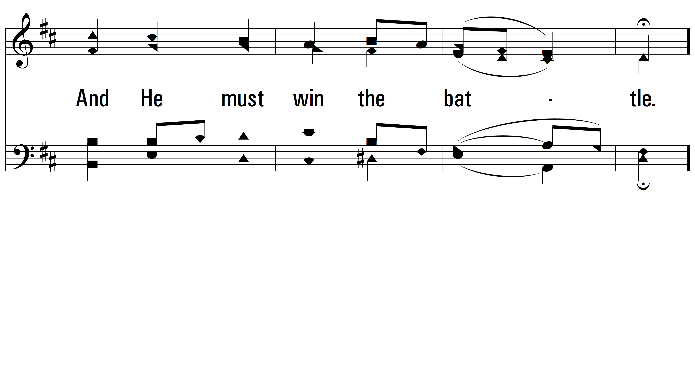
vs. 2

Slide 10
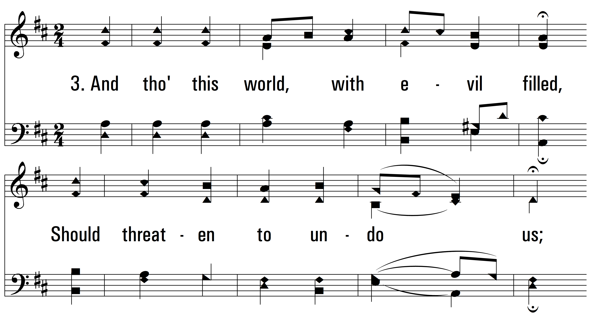
vs. 3 ~ A Mighty Fortress

Slide 11
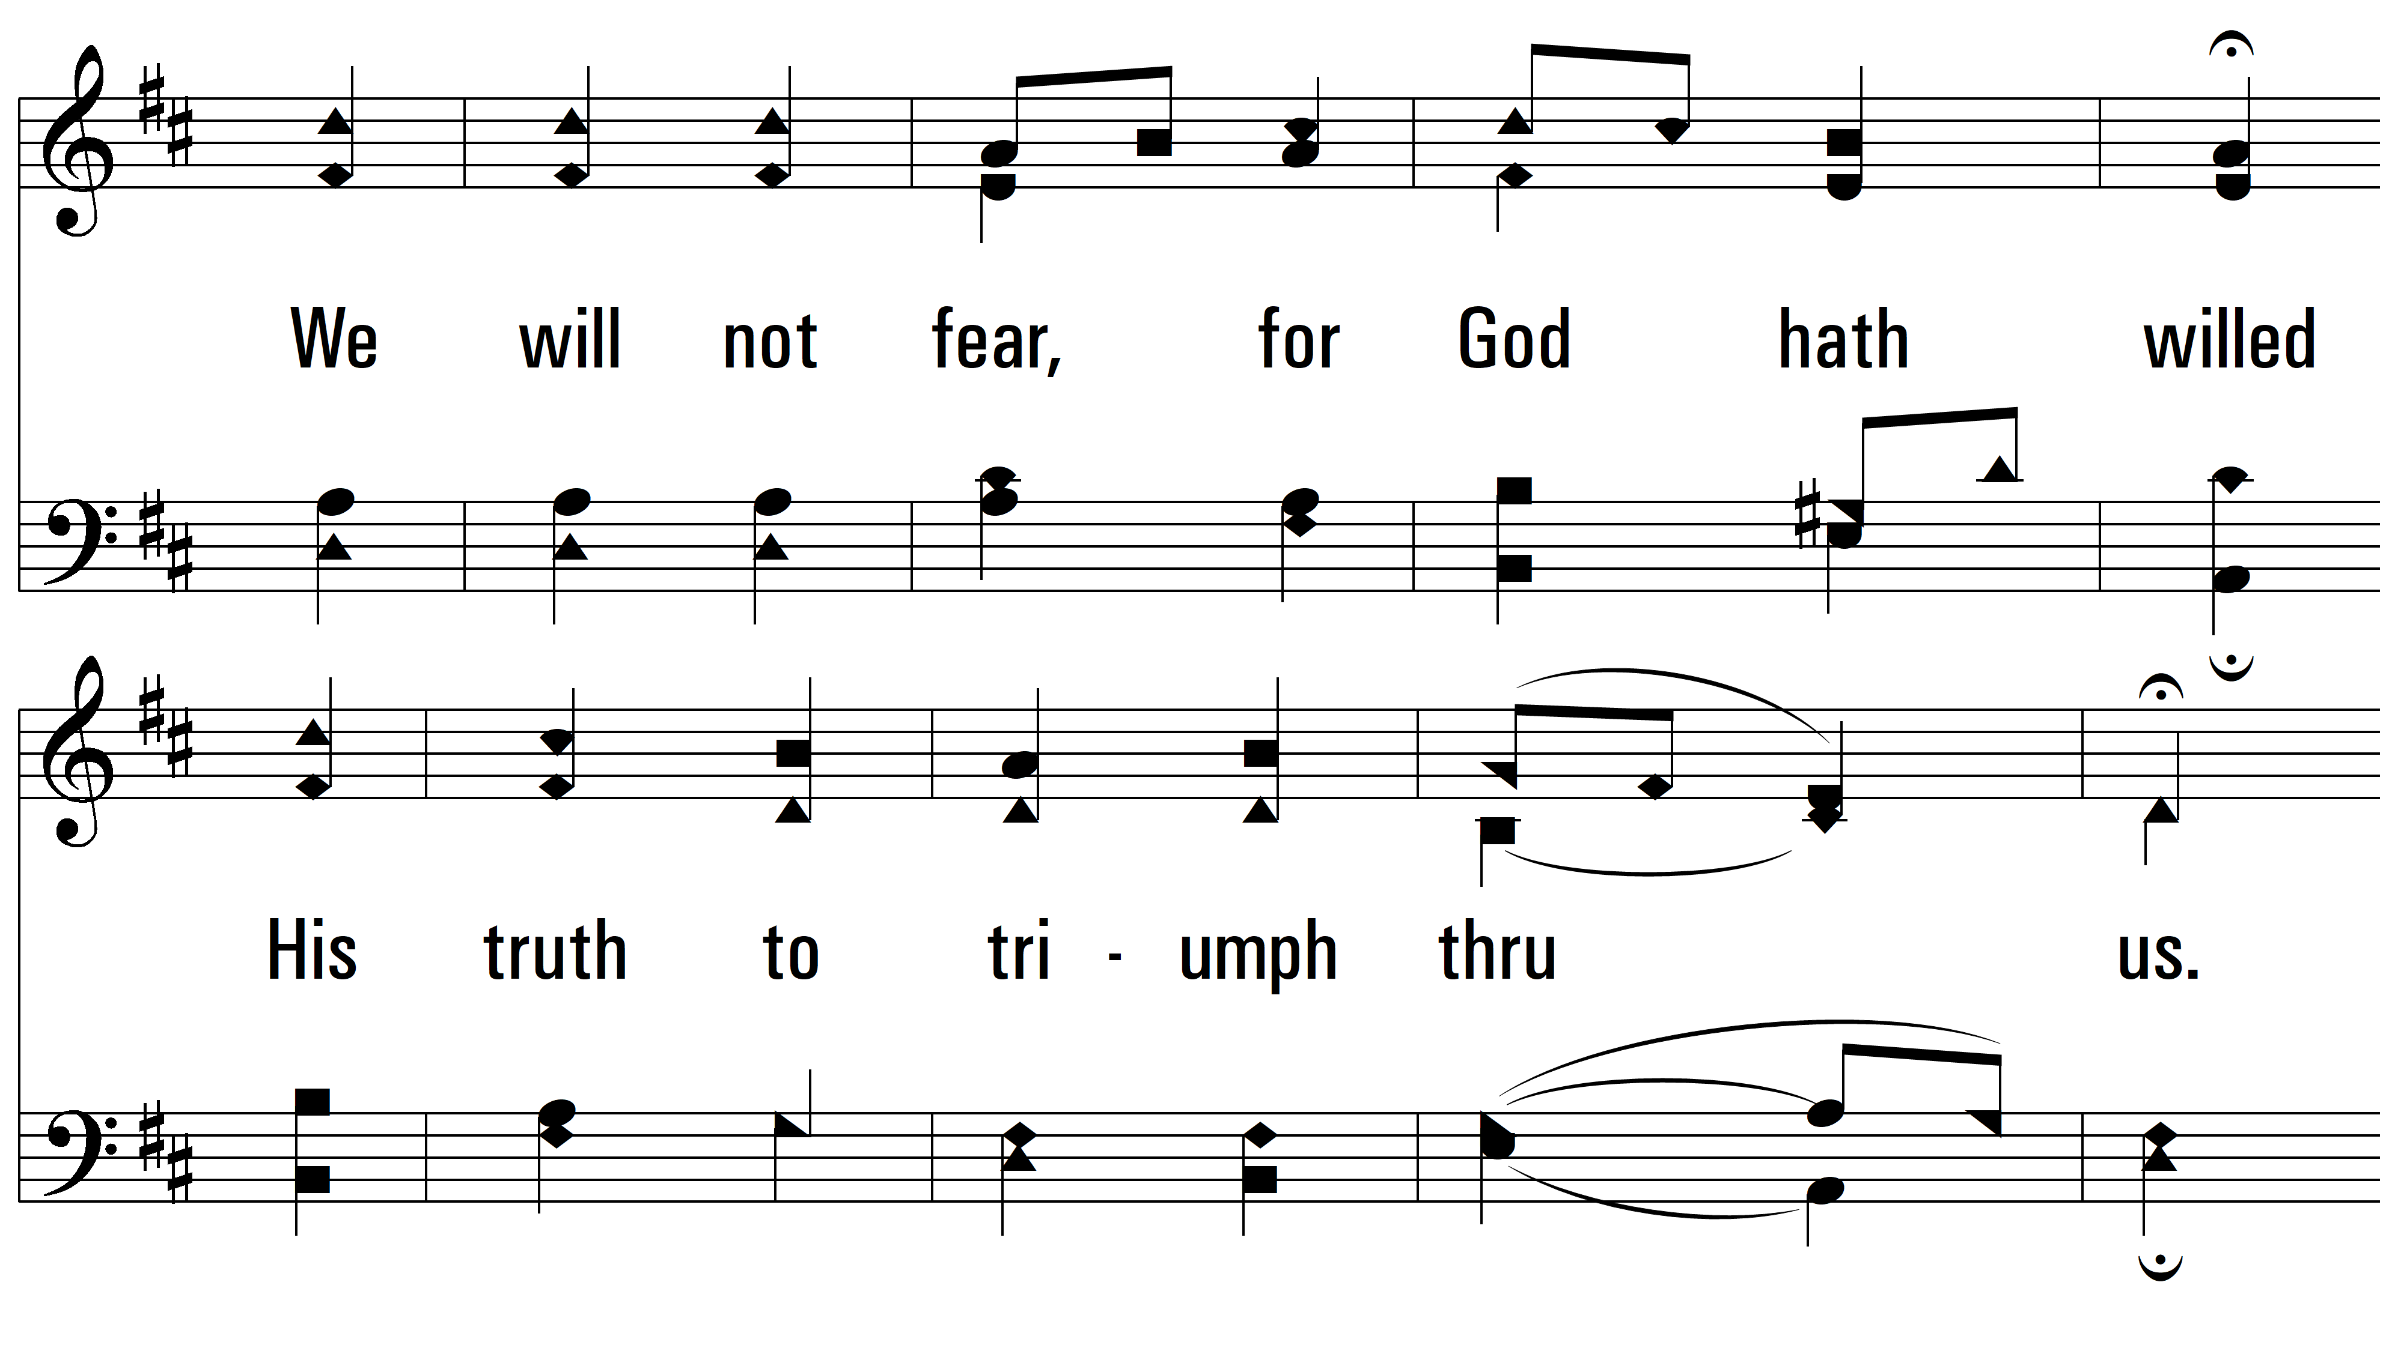
vs. 3

Slide 12
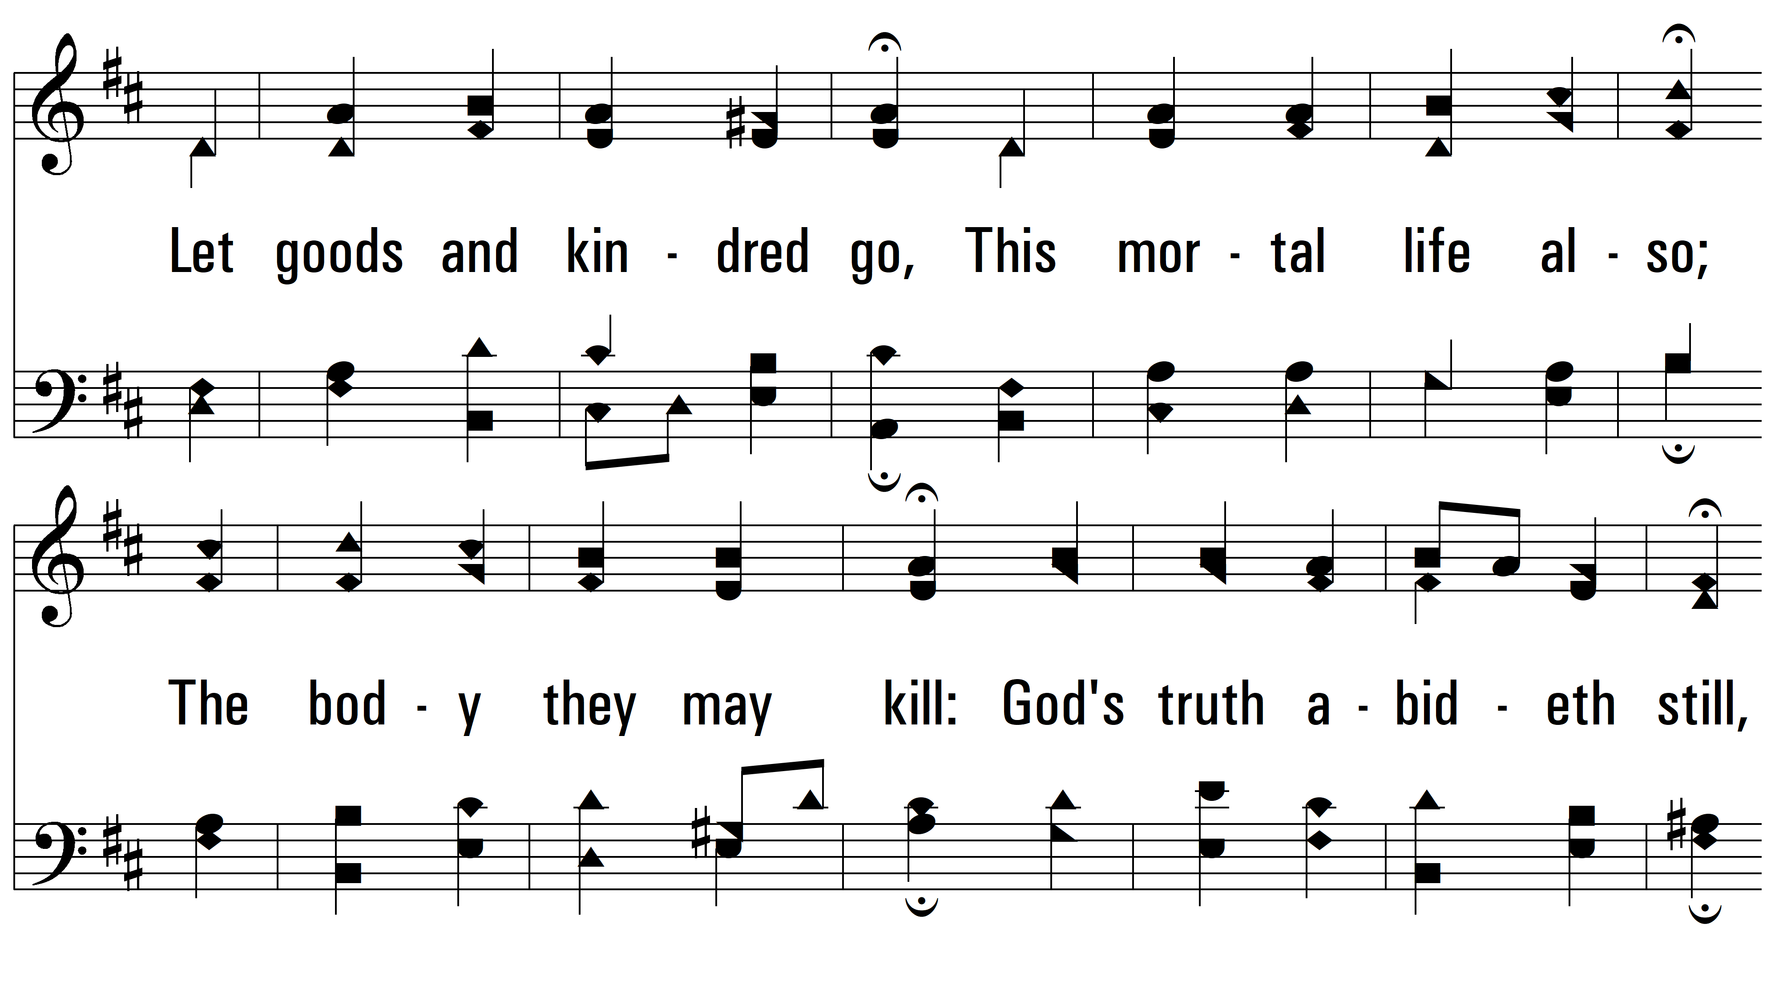
vs. 3

Slide 13
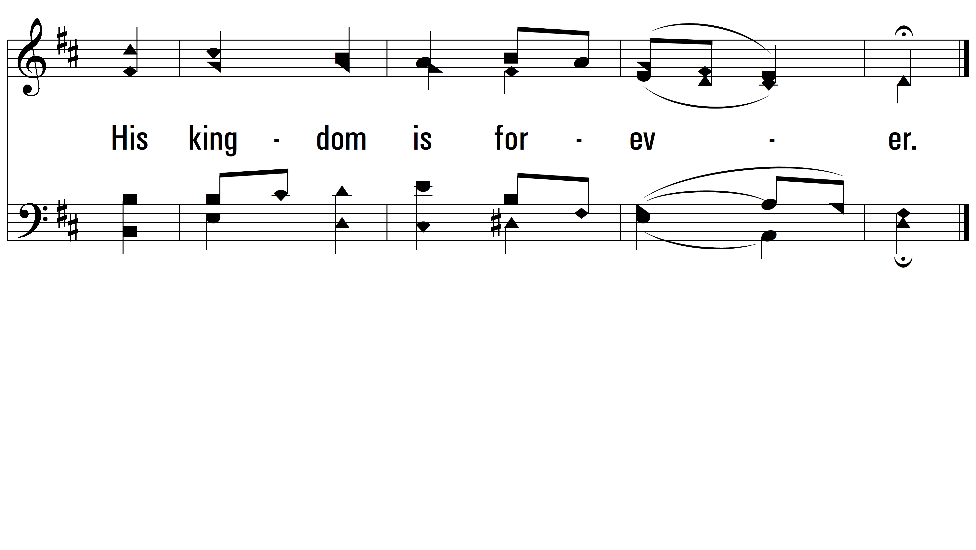
vs. 3

Slide 14
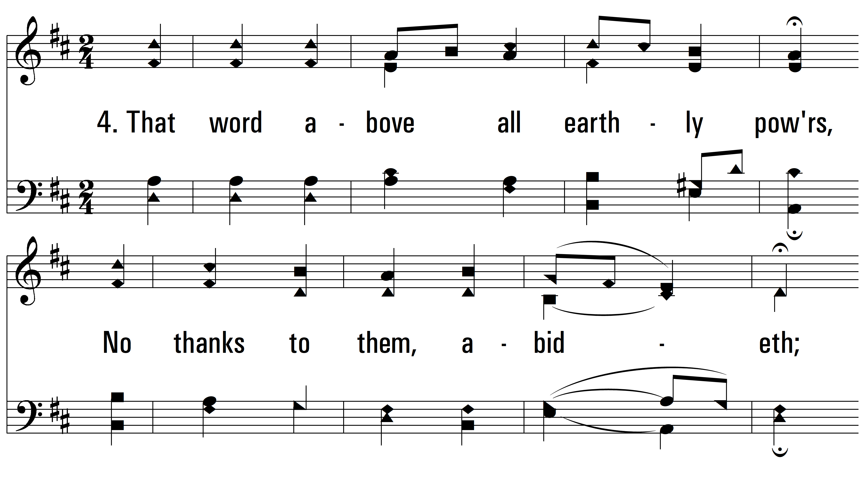
vs. 4 ~ A Mighty Fortress

Slide 15
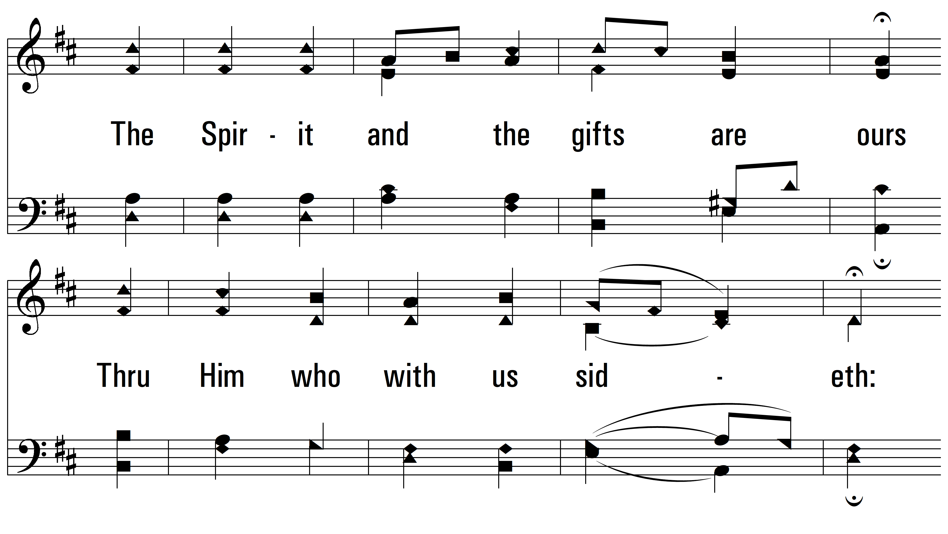
vs. 4

Slide 16
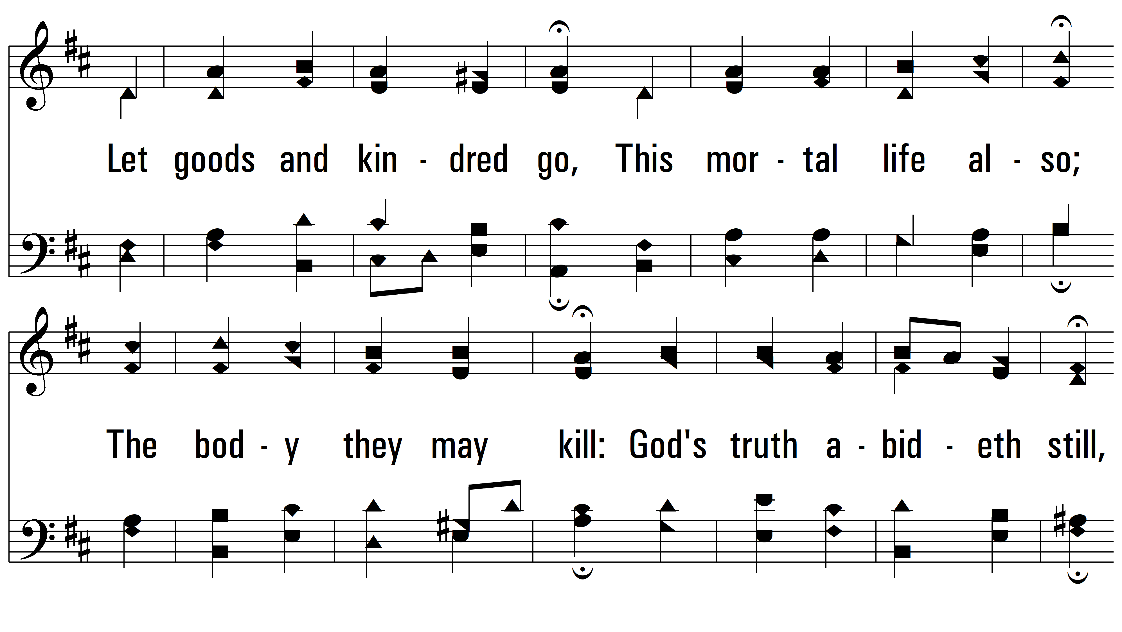
vs. 4

Slide 17

vs. 4
PDHymns.com
END

