Slide 1
A Charge To Keep I Have
BOYLSTON
SM
Words: | Charles Wesley (1762)
Music: | Lowell Mason (1832)
3/2
C/G - SOL
Verses: 4
Lead - | SOL
Alto - | MI
Tenor - | DO
Bass - | DO
PDHymns.com

Slide 2
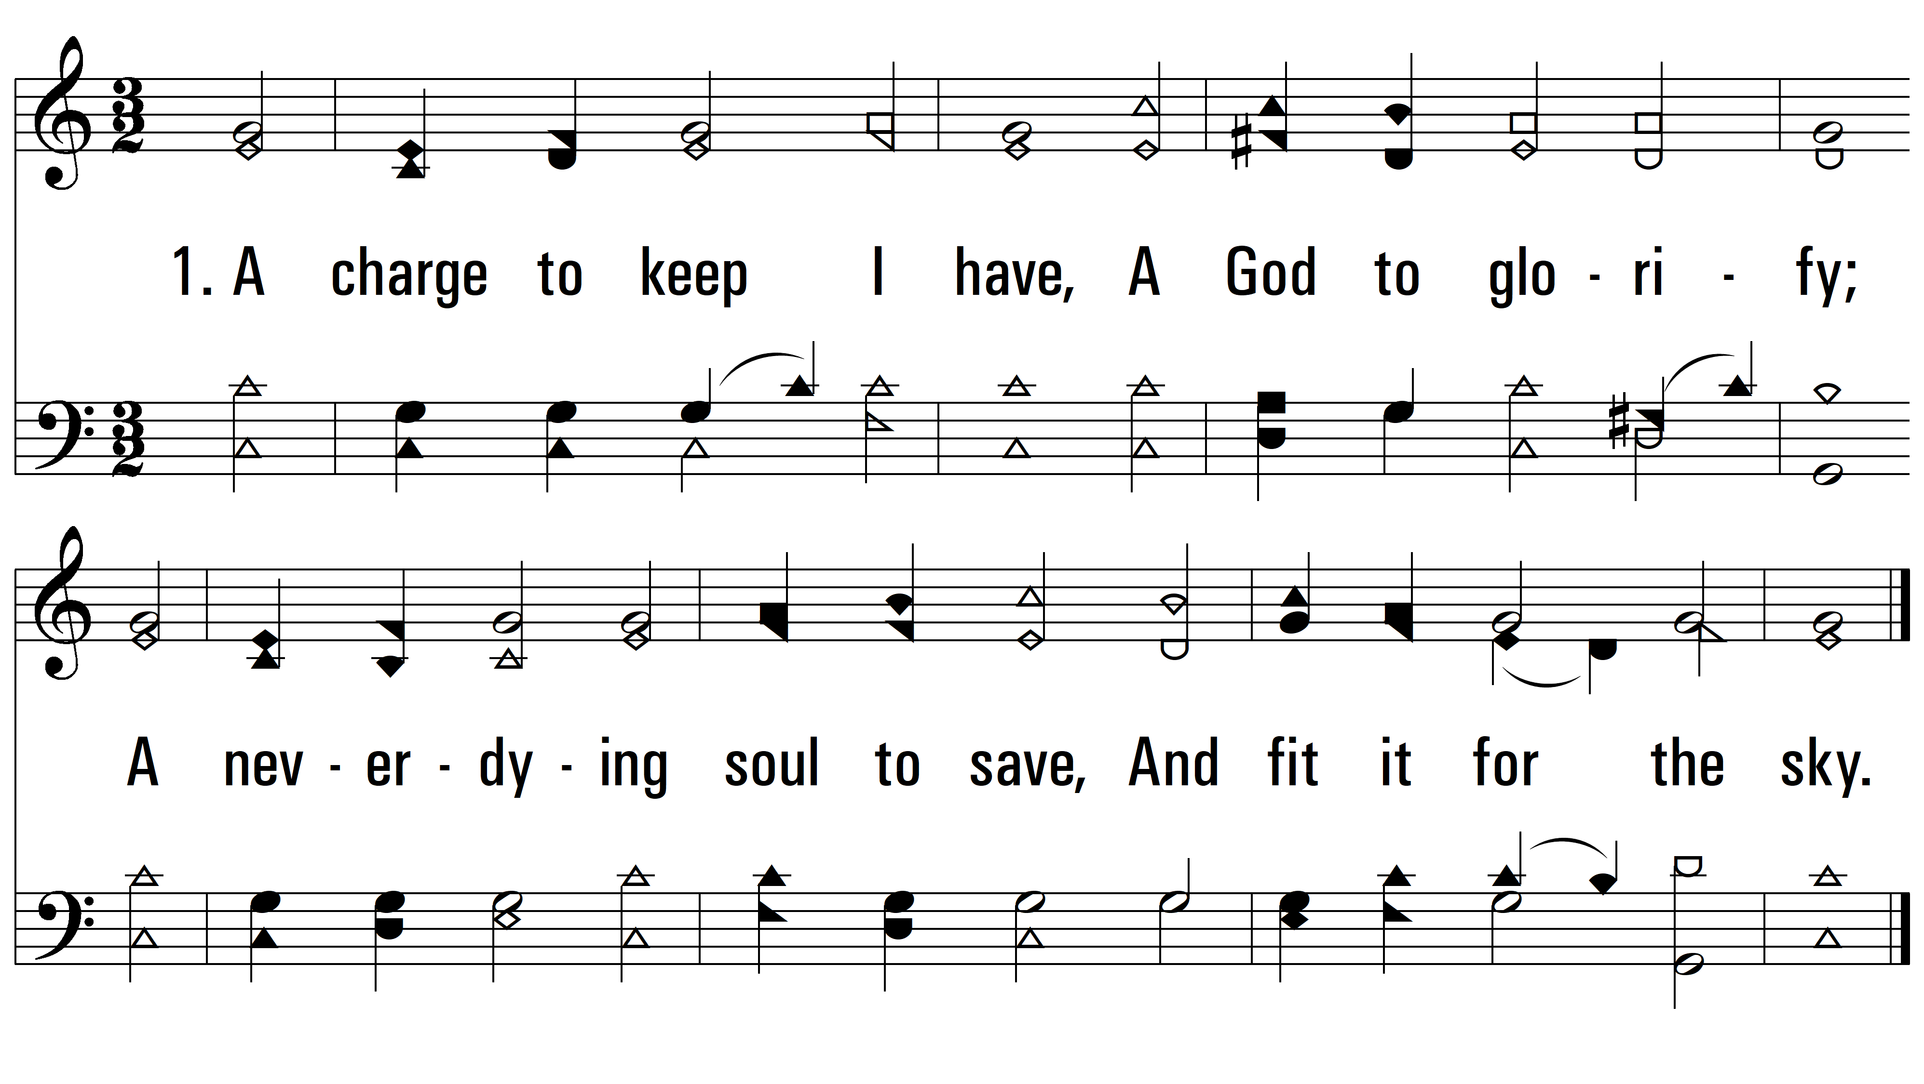
vs. 1 ~ A Charge To Keep I Have

Slide 3
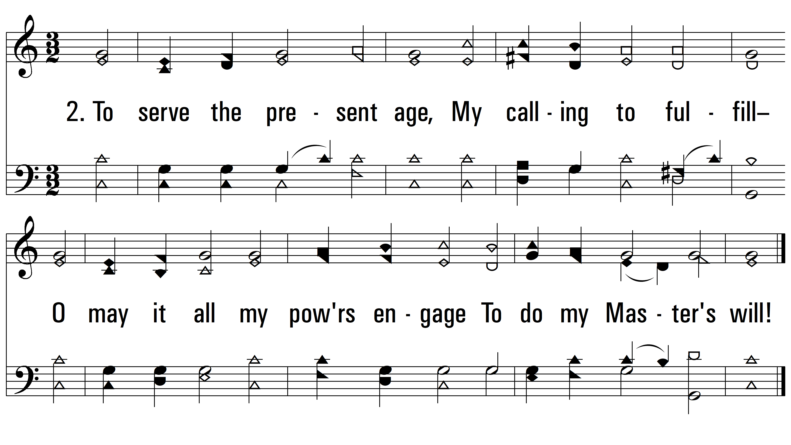
vs. 2 ~ A Charge To Keep I Have

Slide 4
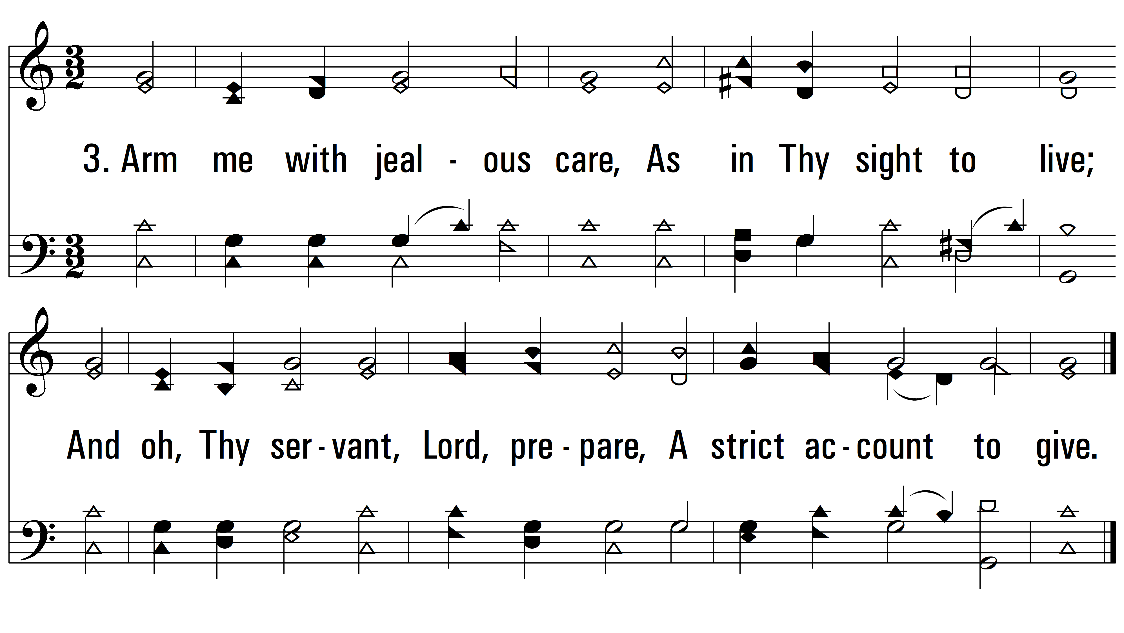
vs. 3 ~ A Charge To Keep I Have

Slide 5
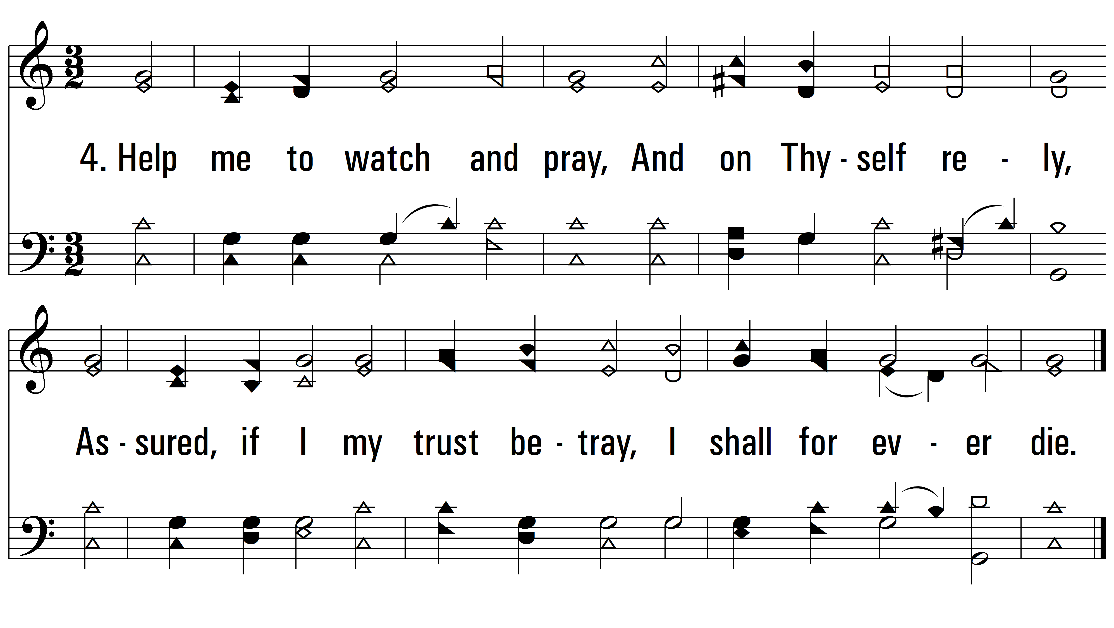
vs. 4 ~ A Charge To Keep I Have
PDHymns.com
END

