Slide 1
A Blessing In Prayer
(There Is Rest, Sweet Rest)
Words: | E. E. Hewitt (1887)
Music: | William J. Kirkpatrick (1887)
4/4
D/D - DO
Verses: 4/Chorus
Lead - | DO
Alto - | DO
Tenor - | MI
Bass - | DO
PDHymns.com

Slide 2
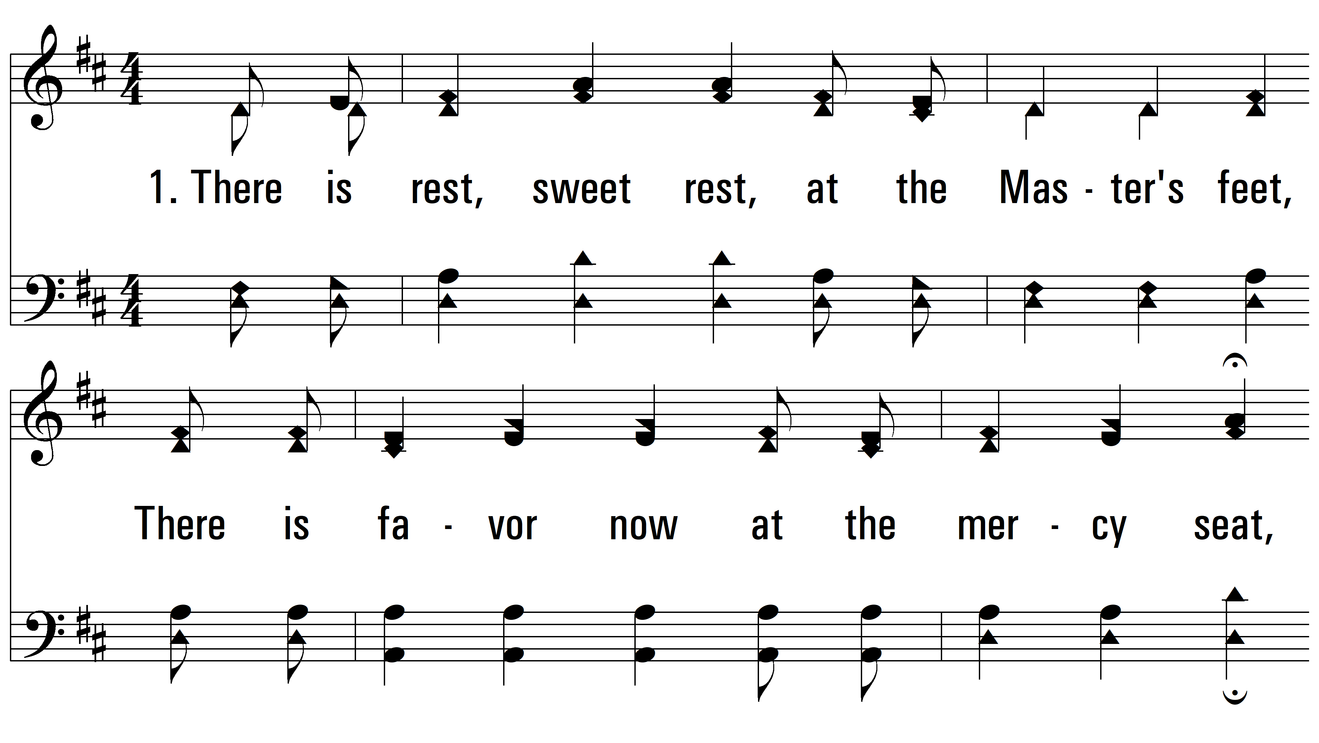
vs. 1 ~ A Blessing In Prayer

Slide 3
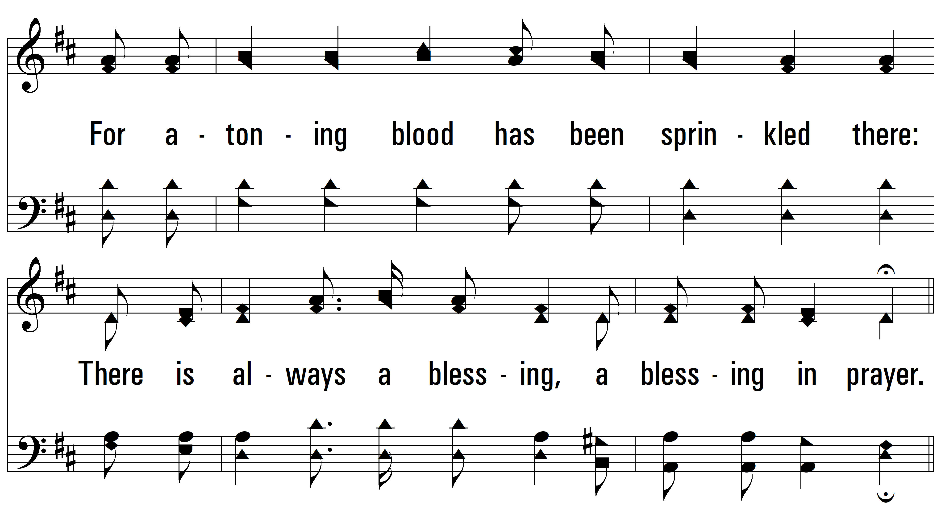
vs. 1

Slide 4
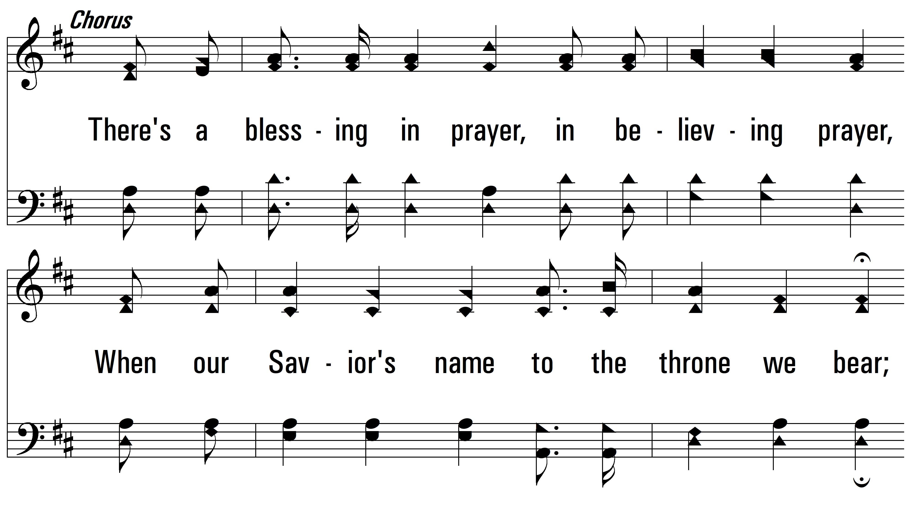
vs. 1

Slide 5
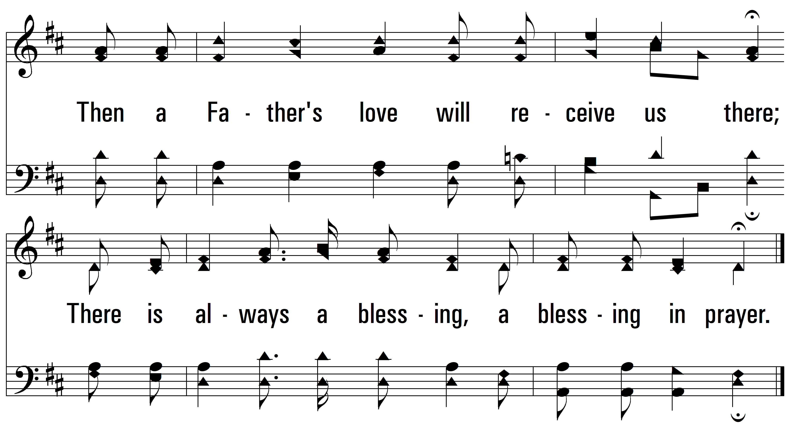
vs. 1

Slide 6
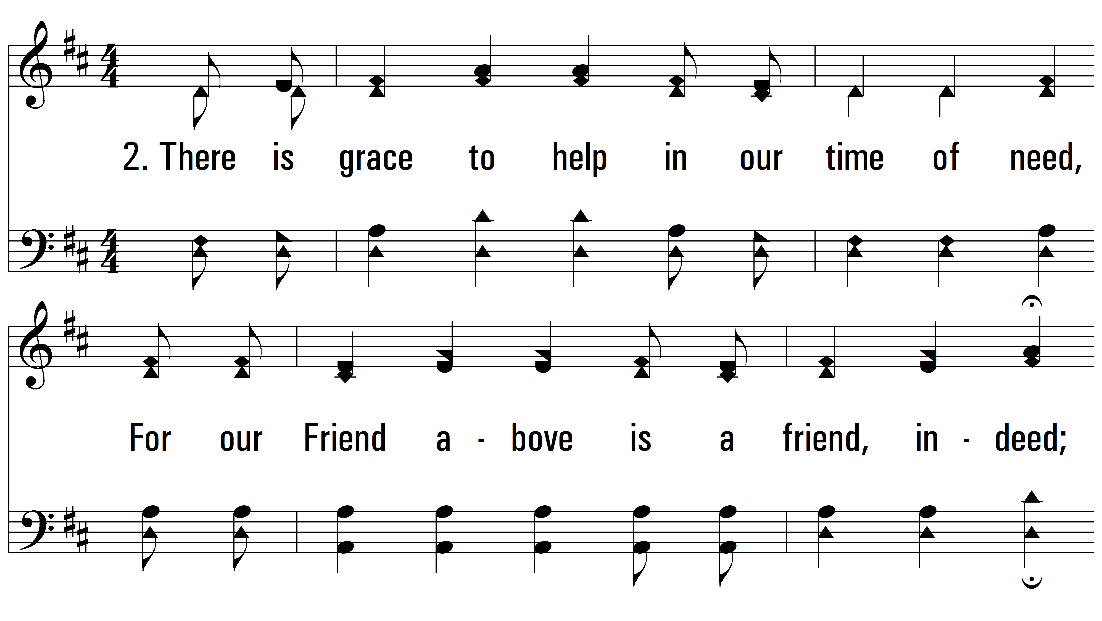
vs. 2 ~ A Blessing In Prayer

Slide 7
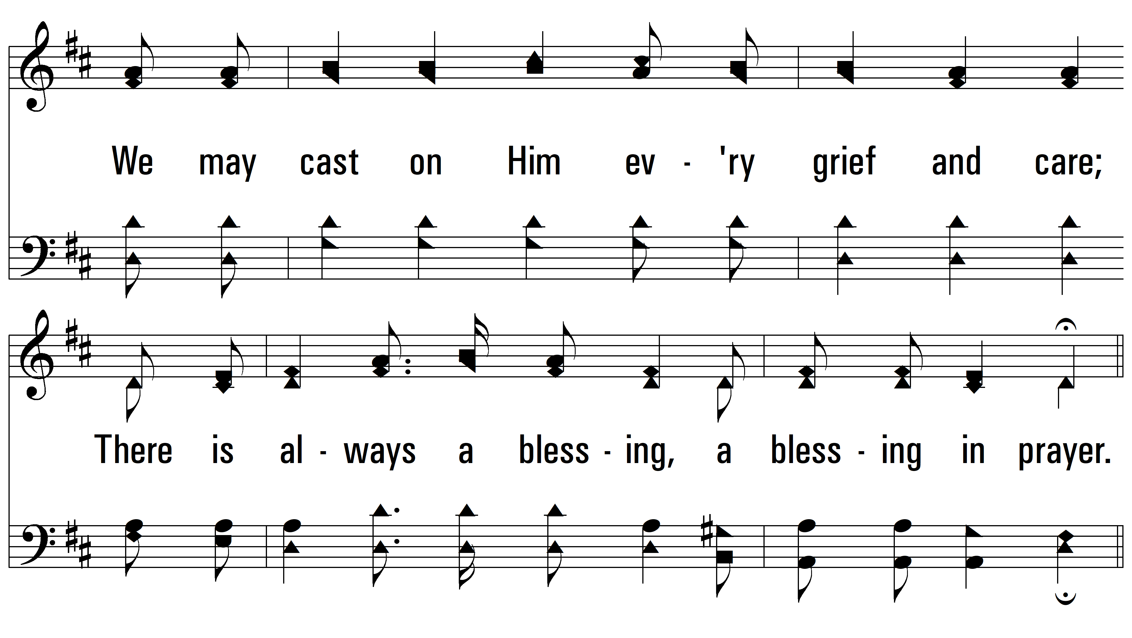
vs. 2

Slide 8
vs. 2

Slide 9
vs. 2

Slide 10
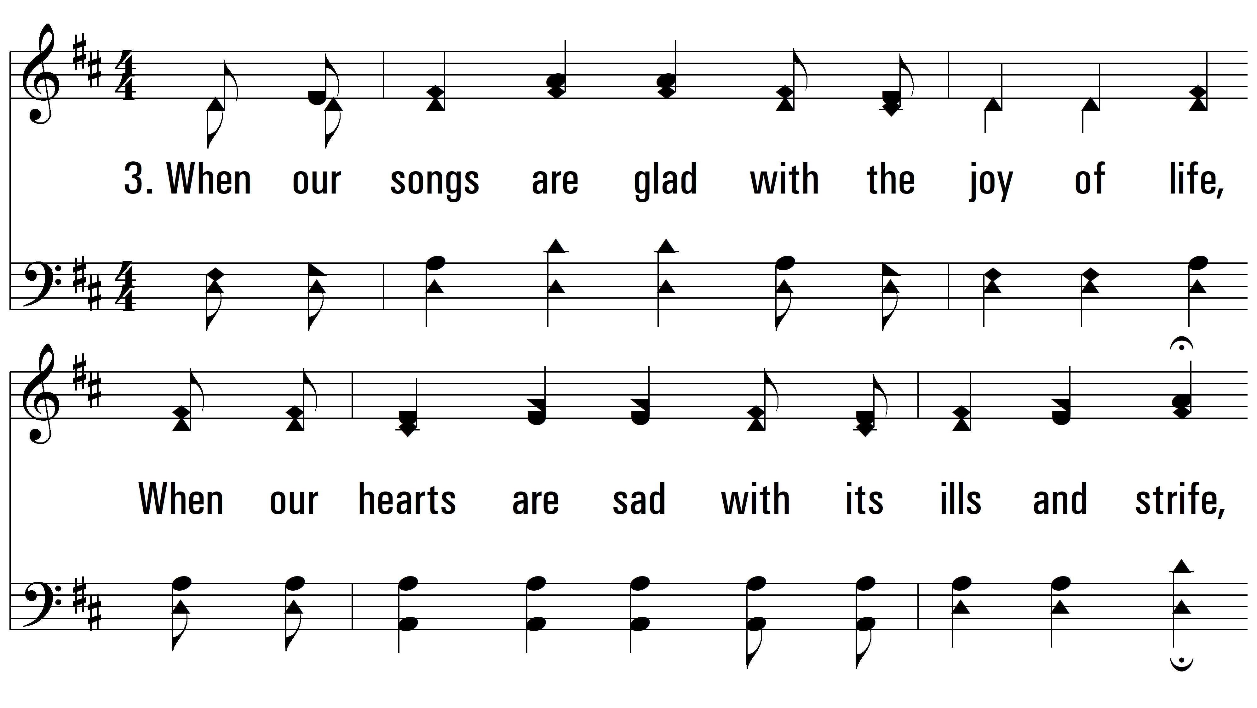
vs. 3 ~ A Blessing In Prayer

Slide 11
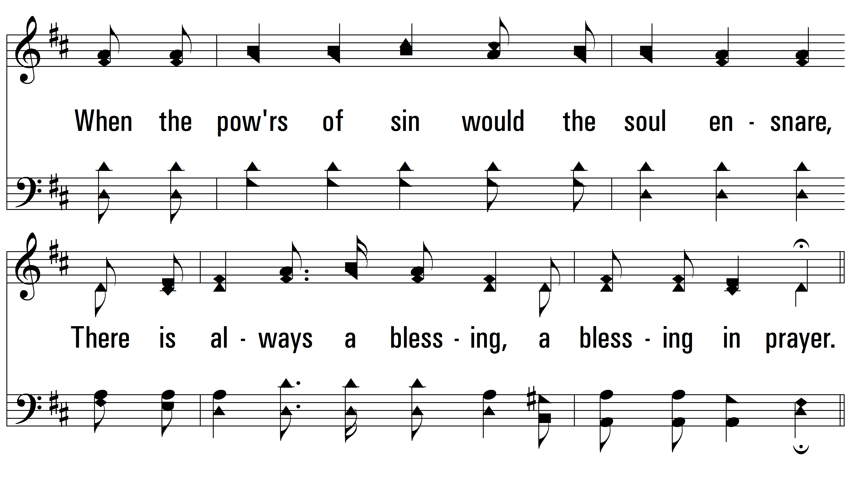
vs. 3

Slide 12
vs. 3

Slide 13
vs. 3

Slide 14
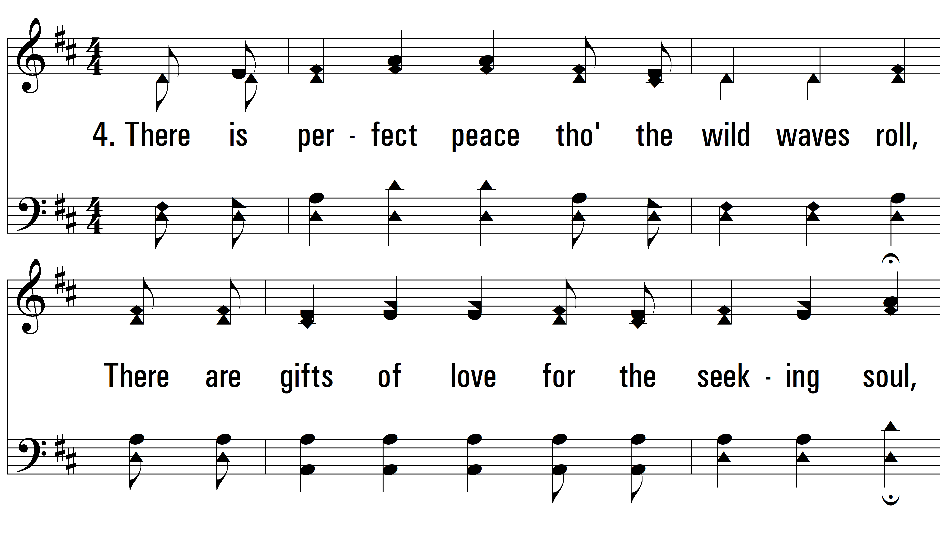
vs. 4 ~ A Blessing In Prayer

Slide 15
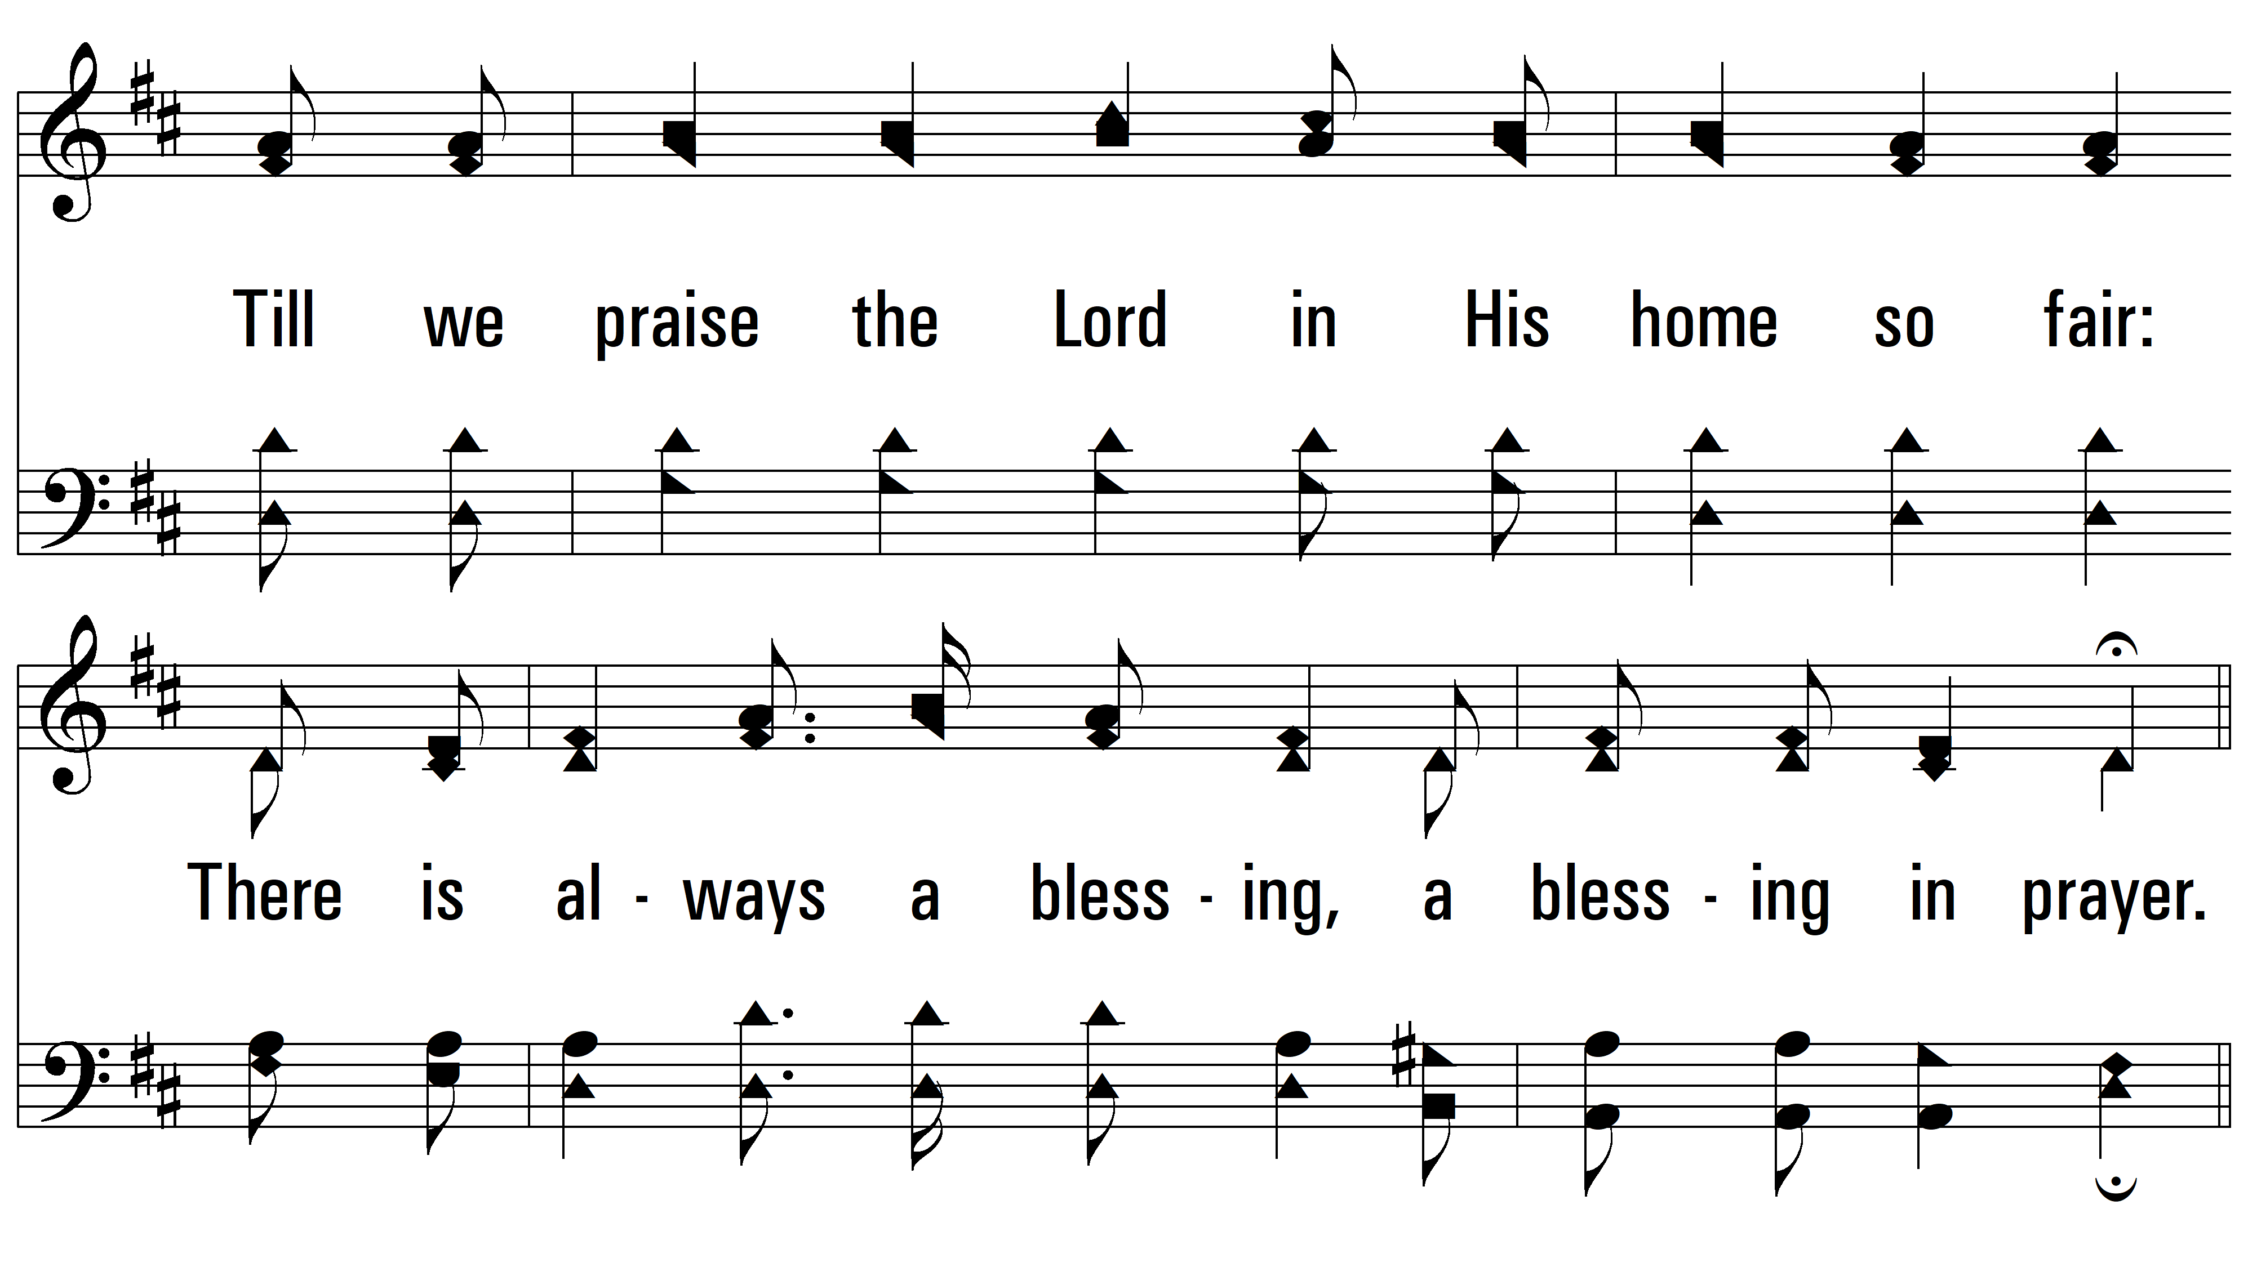
vs. 4

Slide 16
vs. 4

Slide 17
vs. 4
PDHymns.com
END

