Slide 1
A Beautiful Life
Words: | William M. Golden (1918)
Music: | William M. Golden (1918)
4/4
C/C - DO
Verses: 4/Chorus
Lead - | DO
Alto - | MI
Tenor - | SOL
Bass - | DO

Slide 2
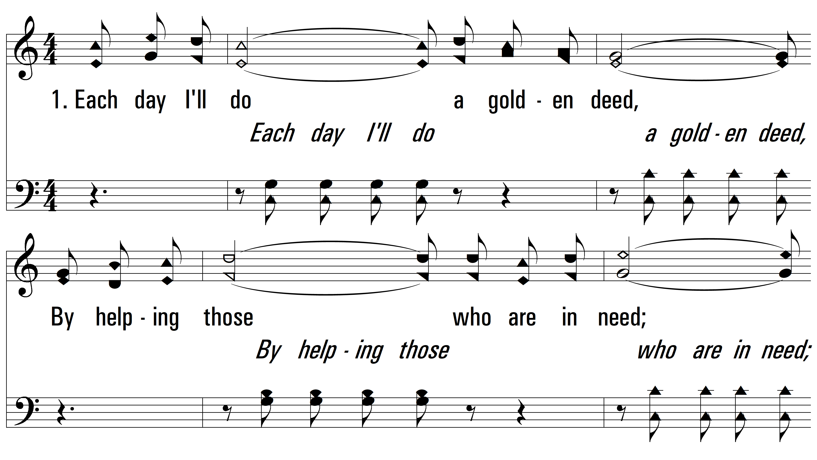
vs. 1 ~ A Beautiful Life

Slide 3
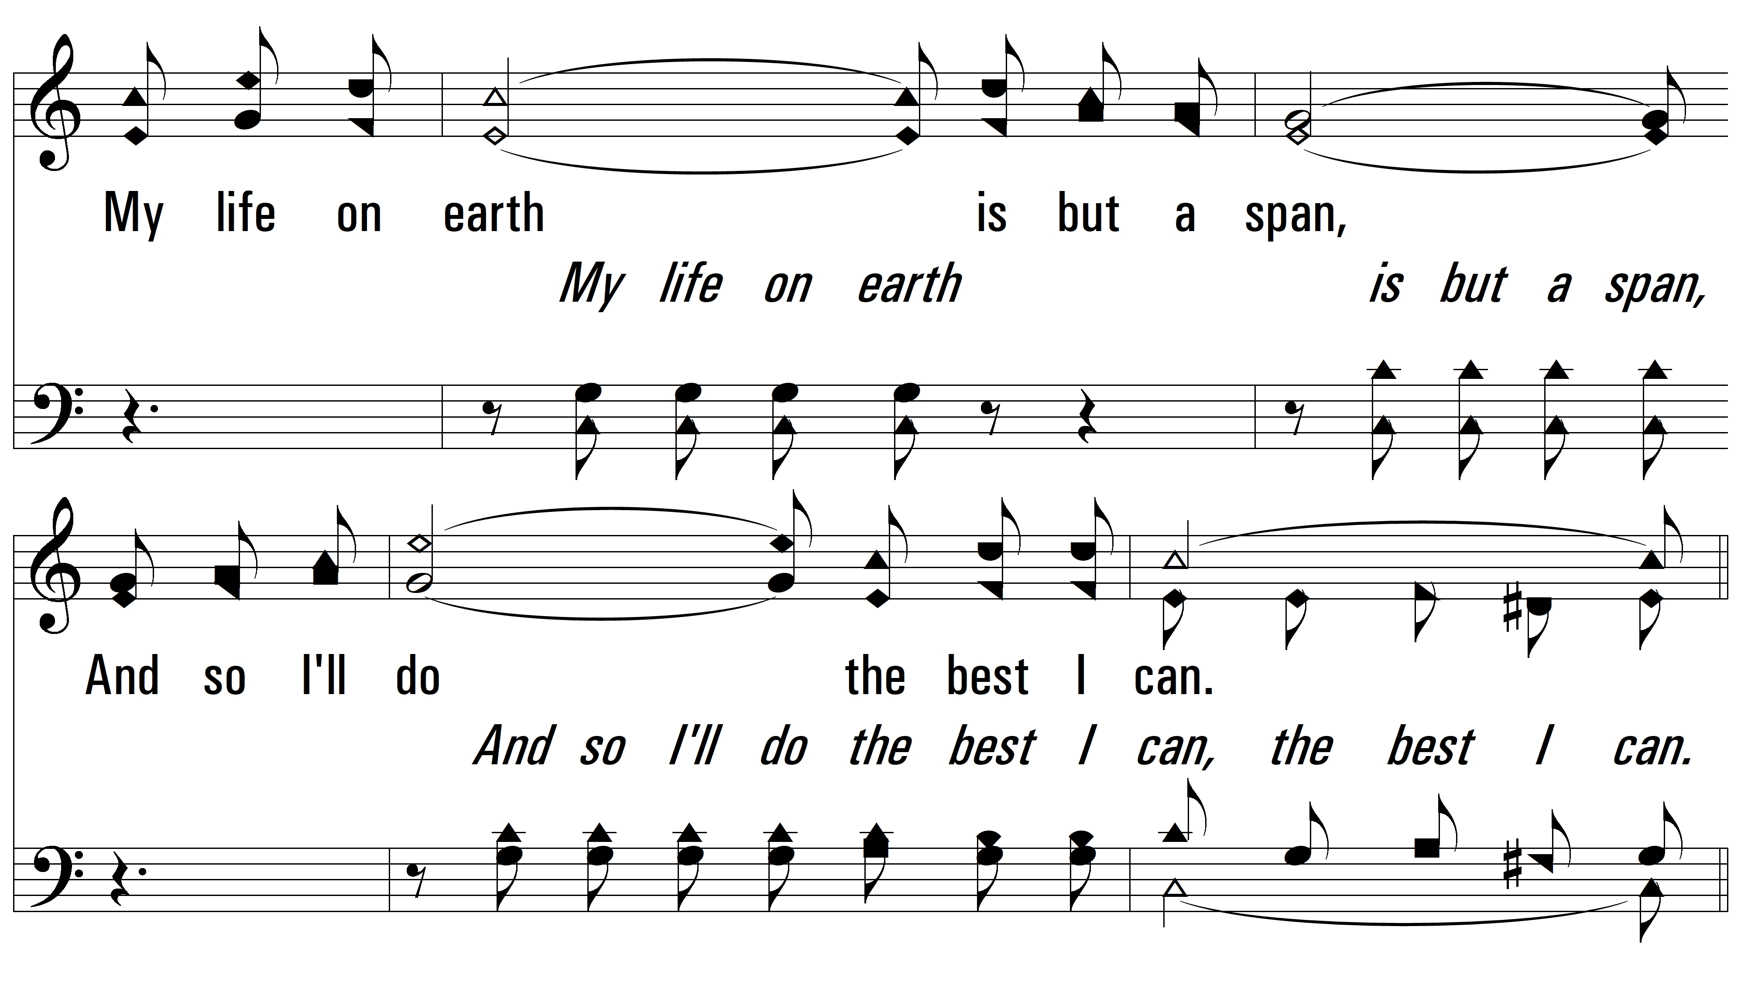
vs. 1

Slide 4
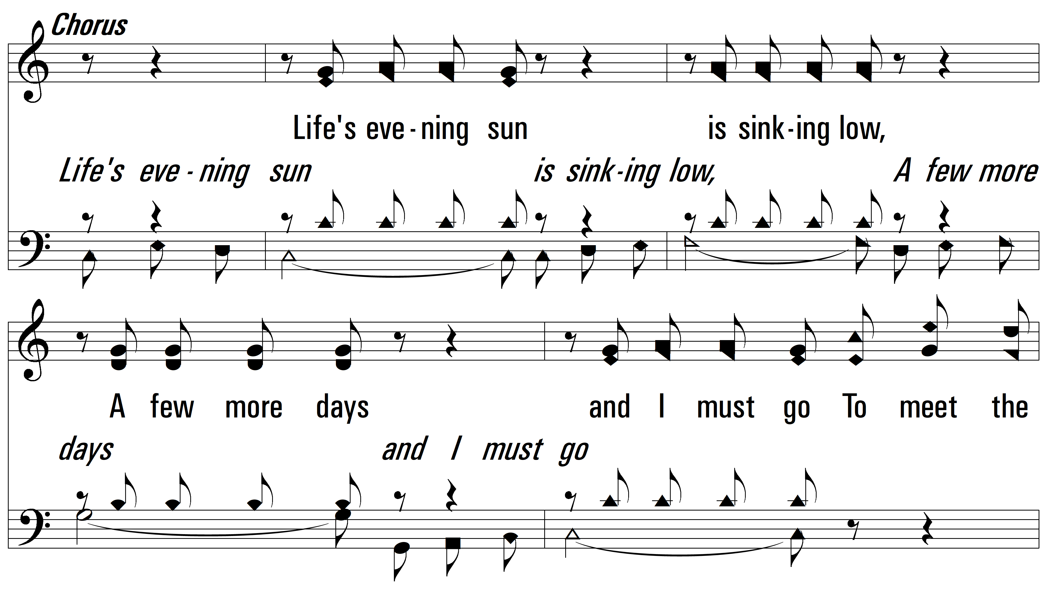
vs. 1

Slide 5
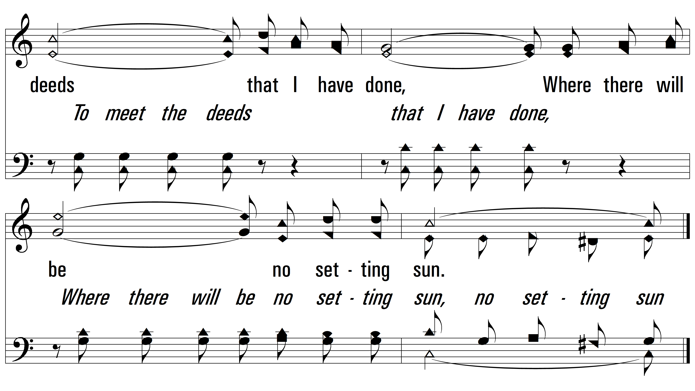
vs. 1

Slide 6
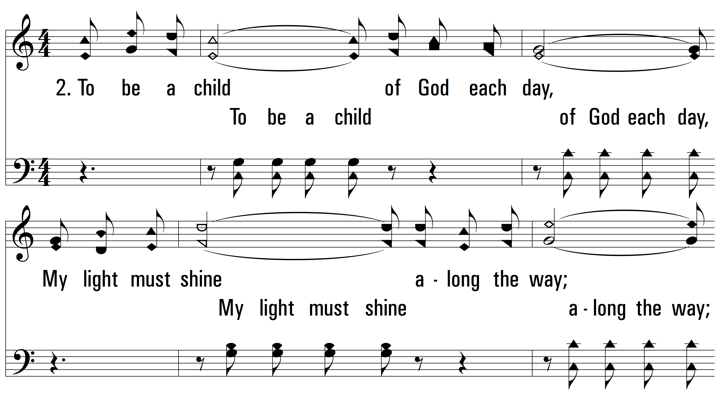
vs. 2 ~ A Beautiful Life

Slide 7
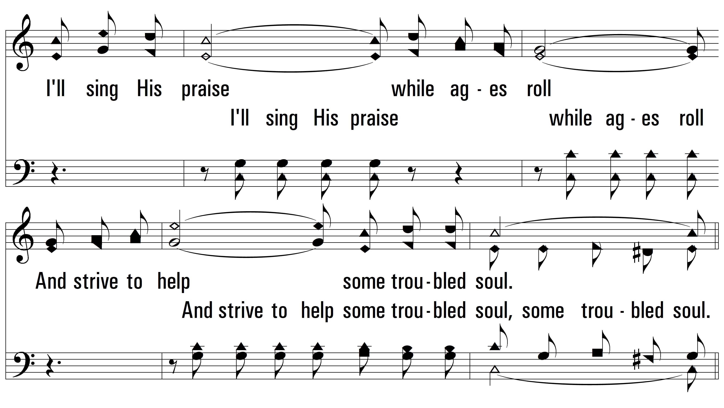
vs. 2

Slide 8
vs. 2

Slide 9
vs. 2

Slide 10
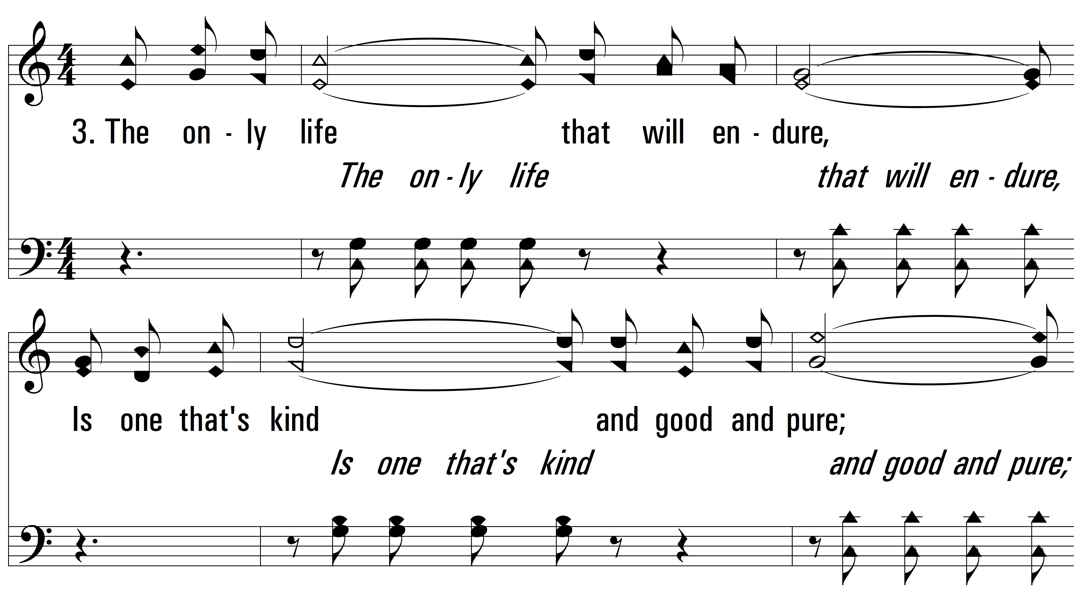
vs. 3 ~ A Beautiful Life

Slide 11
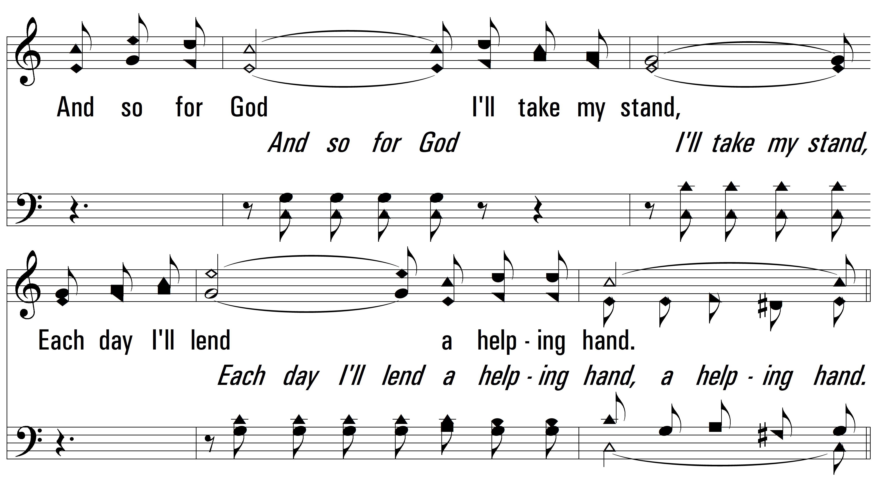
vs. 3

Slide 12
vs. 3

Slide 13
vs. 3

Slide 14
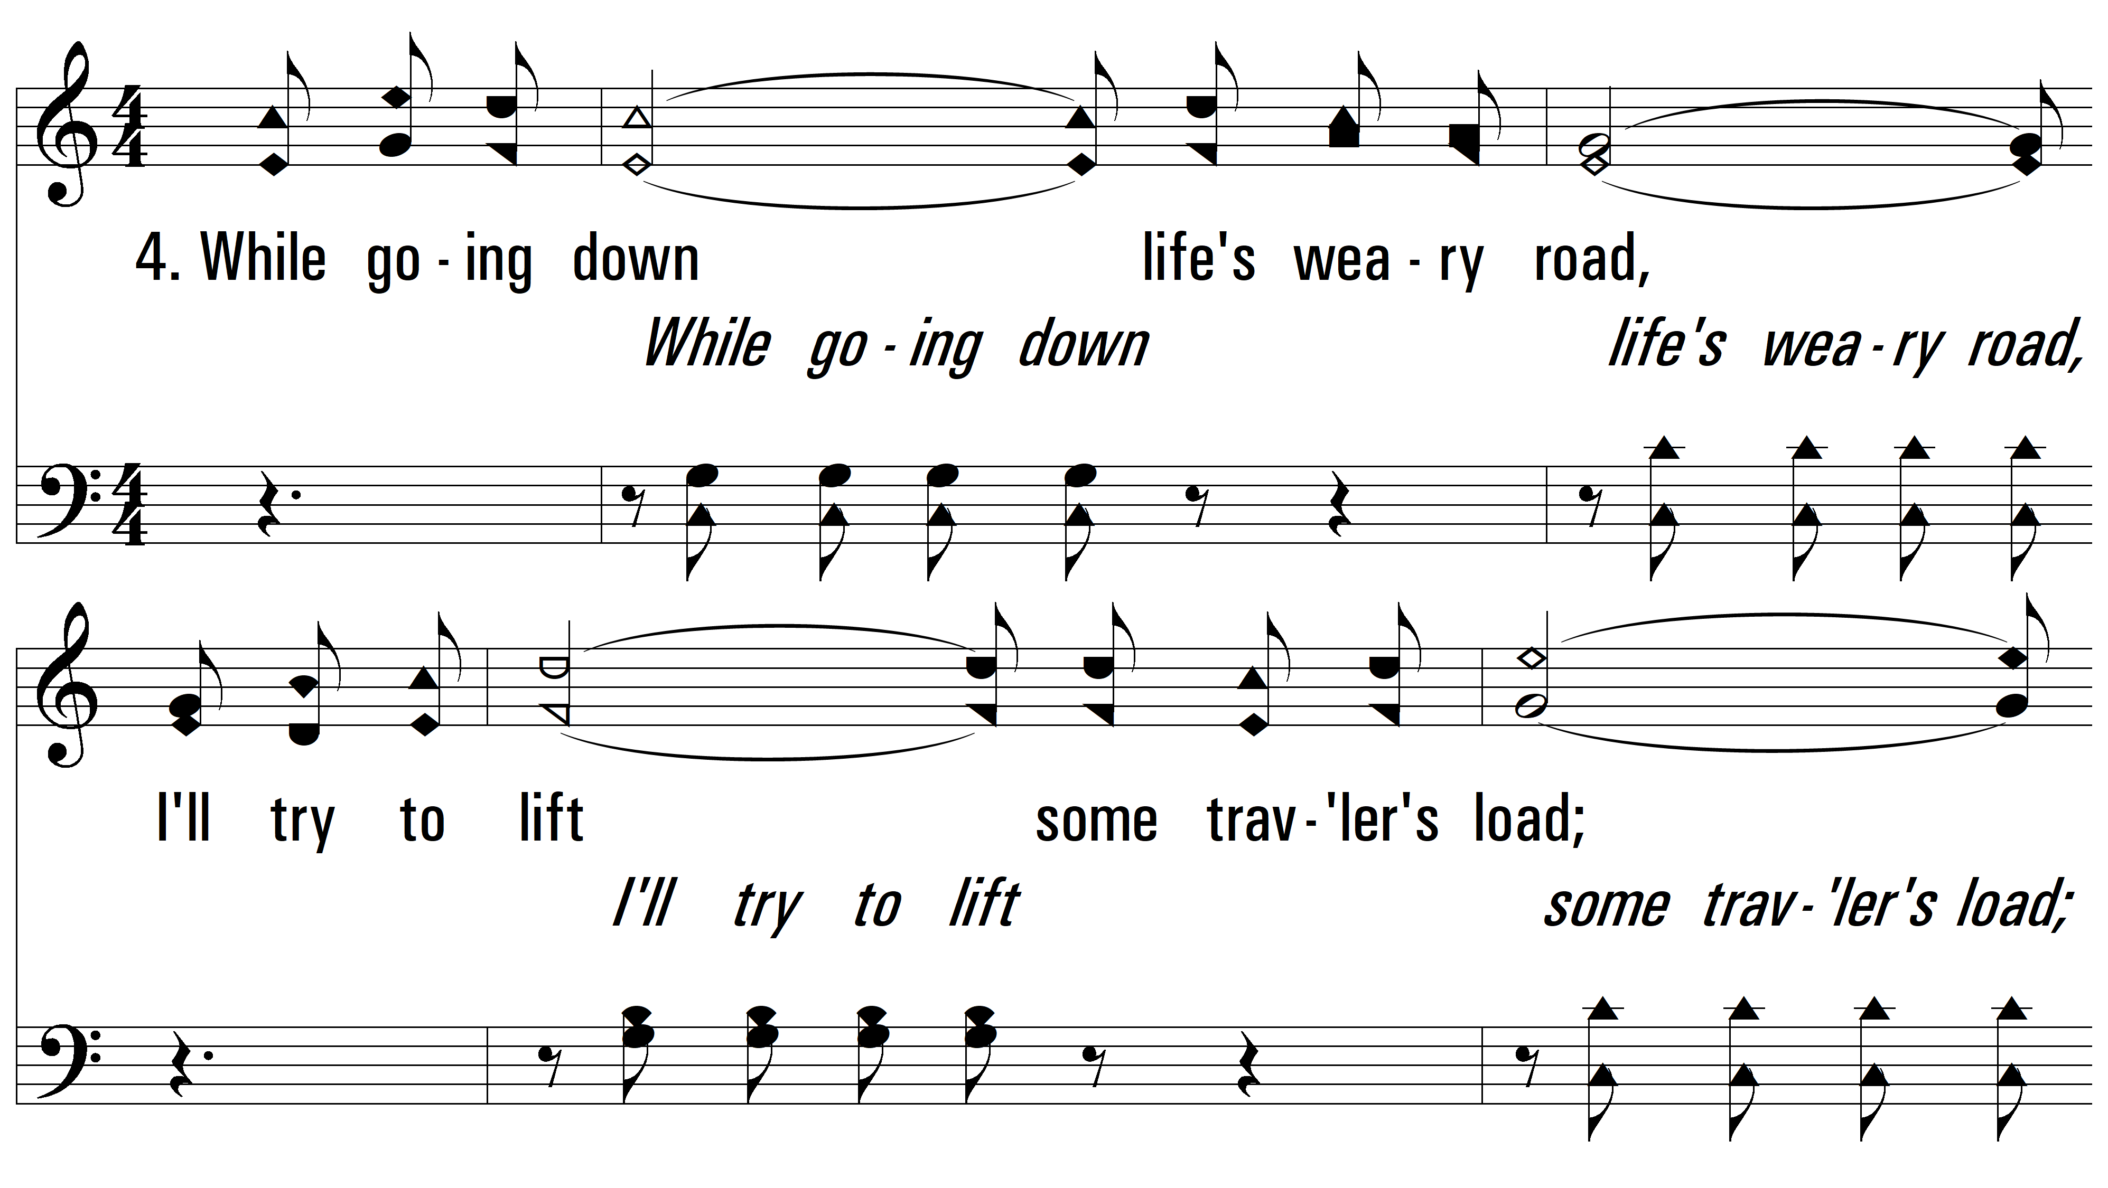
vs. 4 ~ A Beautiful Life

Slide 15
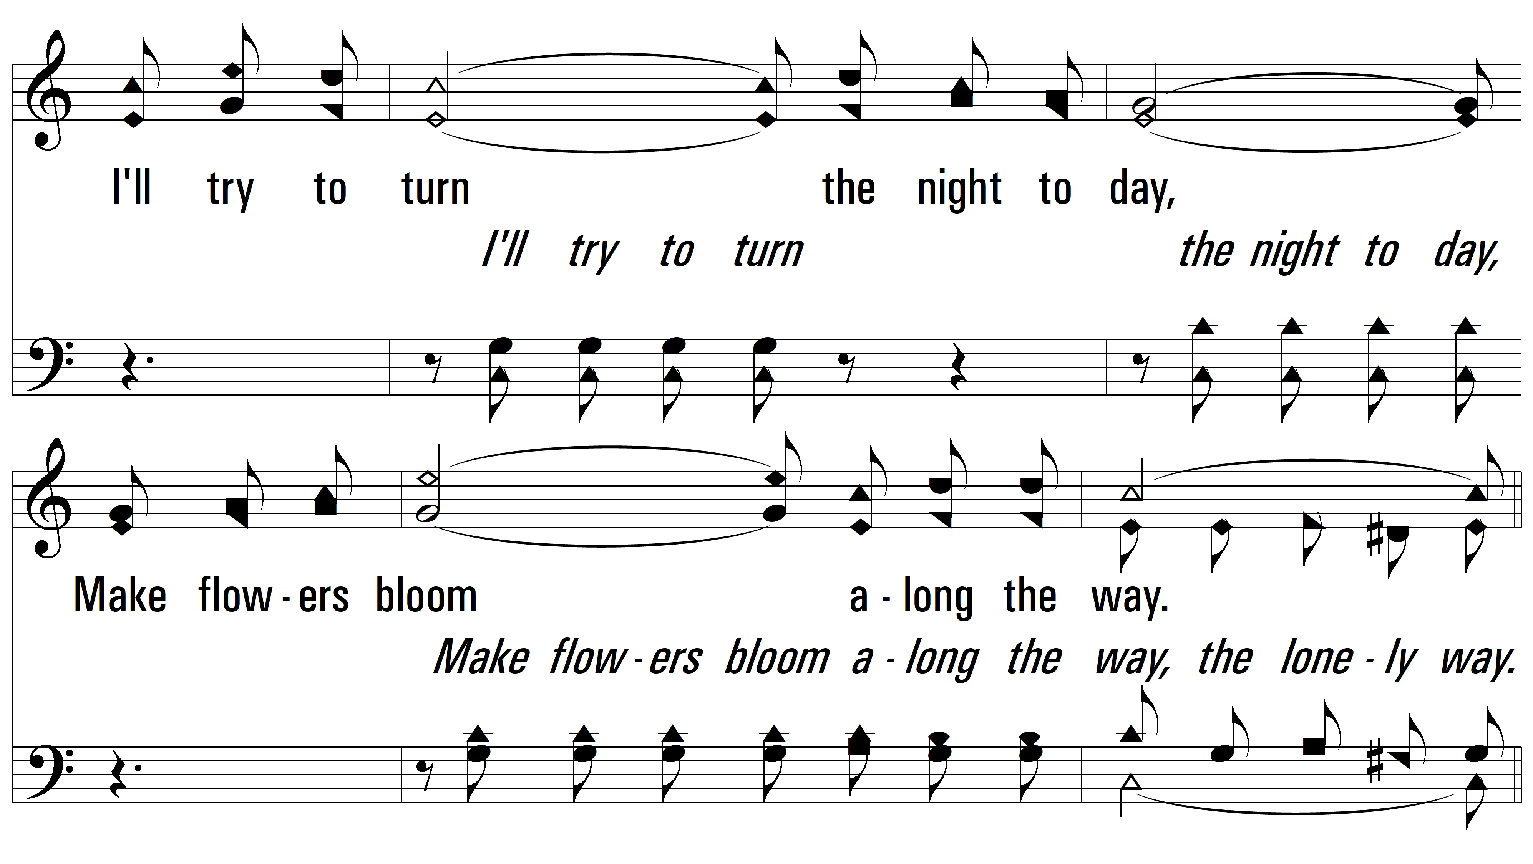
vs. 4

Slide 16
vs. 4

Slide 17
vs. 4
PDHymns.com
END

